Slide 1



Short overview of MCMC methods in phylogenetics
Bastien Boussau
Bastien.boussau@univ-lyon1.fr
@bastounette
With many slides stolen from
Brian R. Moore, UC Davis

Slide 2
Bayesian inference
Bayes theorem:
We are interested in the posterior probability of the parameter values: we want to find the most probable parameter values given the data.
Therefore we need to get the distribution for P(θ|D).
→ Smart sampling using Markov Chain Monte Carlo (MCMC)

Slide 3
Smart sampling: MCMC sampling of P(θ|D)
Aim: Sampling trees and parameter values with a frequency equal to their probability.
Idea: do a random sampling whose expectation is the target probability distribution. As a result, most samples should be in the high probability areas.
This is obtained by a Markov chain whose equilibrium value is the target distribution. Methods known as Markov Chain Monte Carlo (MCMC).

Slide 4
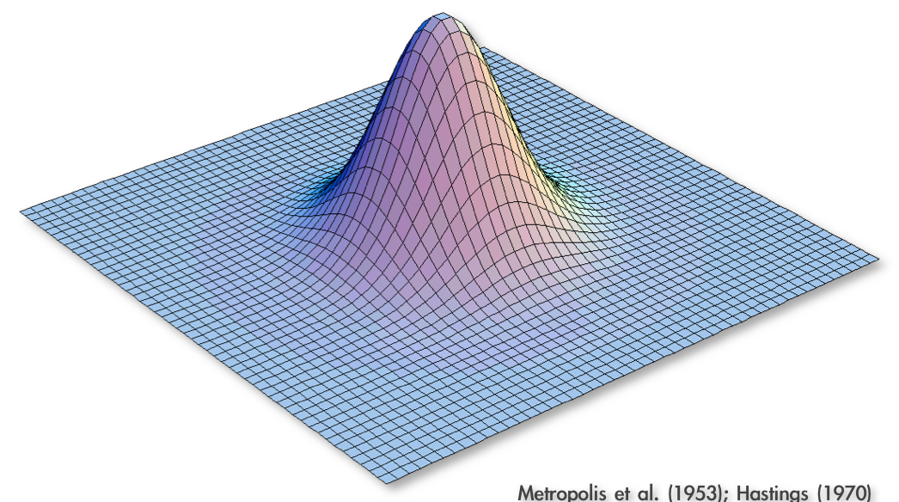
Approximating the Joint Posterior Probability Density using MCMC
Metropolis et al. (1953); Hastings (1970)

Slide 5
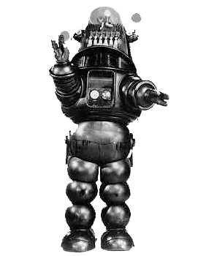
Approximating the Joint Posterior Probability Density using MCMC
Programming our MCMC robot...
Metropolis et al. (1953); Hastings (1970)

Slide 6
Approximating the Joint Posterior Probability Density using MCMC
Programming our MCMC robot...
Our robot parachutes into a random location in the joint posterior density and will explore parameter space by following these simple rules:
Metropolis et al. (1953); Hastings (1970)
Metropolis et al. (1953); Hastings (1970)

Slide 7
Approximating the Joint Posterior Probability Density using MCMC
Programming our MCMC robot...
Our robot parachutes into a random location in the joint posterior density and will explore parameter space by following these simple rules:
1. If the proposed step will take the robot uphill, it automatically takes the step
Metropolis et al. (1953); Hastings (1970)
Metropolis et al. (1953); Hastings (1970)

Slide 8
Approximating the Joint Posterior Probability Density using MCMC
Programming our MCMC robot...
Our robot parachutes into a random location in the joint posterior density and will explore parameter space by following these simple rules:
1. If the proposed step will take the robot uphill, it automatically takes the step
Pr(Accept) = 1
Metropolis et al. (1953); Hastings (1970)
Metropolis et al. (1953); Hastings (1970)

Slide 9
Approximating the Joint Posterior Probability Density using MCMC
Programming our MCMC robot...
Our robot parachutes into a random location in the joint posterior density and will explore parameter space by following these simple rules:
1. If the proposed step will take the robot uphill, it automatically takes the step
2. If the proposed step will take the robot downhill, it divides the elevation of
the proposed location by the current location, and it only takes the step if the
quotient is less than a uniform random variable, Uniform[0,1]
Metropolis et al. (1953); Hastings (1970)
Metropolis et al. (1953); Hastings (1970)

Slide 10
Approximating the Joint Posterior Probability Density using MCMC
Programming our MCMC robot...
Our robot parachutes into a random location in the joint posterior density and will explore parameter space by following these simple rules:
1. If the proposed step will take the robot uphill, it automatically takes the step
2. If the proposed step will take the robot downhill, it divides the elevation of
the proposed location by the current location, and it only takes the step if the
quotient is less than a uniform random variable, Uniform[0,1]
Pr(Accept) = new height/old height
Metropolis et al. (1953); Hastings (1970)
Metropolis et al. (1953); Hastings (1970)

Slide 11
Approximating the Joint Posterior Probability Density using MCMC
Programming our MCMC robot...
Our robot parachutes into a random location in the joint posterior density and will explore parameter space by following these simple rules:
1. If the proposed step will take the robot uphill, it automatically takes the step
2. If the proposed step will take the robot downhill, it divides the elevation of
the proposed location by the current location, and it only takes the step if the
quotient is less than a uniform random variable, Uniform[0,1]
3. The proposal distribution is symmetrical, so
Pr(Accept) = new height/old height
Metropolis et al. (1953); Hastings (1970)
Metropolis et al. (1953); Hastings (1970)

Slide 12
Approximating the Joint Posterior Probability Density using MCMC
Programming our MCMC robot...
Our robot parachutes into a random location in the joint posterior density and will explore parameter space by following these simple rules:
1. If the proposed step will take the robot uphill, it automatically takes the step
2. If the proposed step will take the robot downhill, it divides the elevation of
the proposed location by the current location, and it only takes the step if the
quotient is less than a uniform random variable, Uniform[0,1]
3. The proposal distribution is symmetrical, so
Metropolis et al. (1953); Hastings (1970)
Metropolis et al. (1953); Hastings (1970)

Slide 13
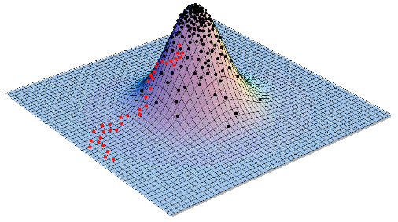
Approximating the Joint Posterior Probability Density using MCMC
Programming our MCMC robot...
Our robot parachutes into a random location in the joint posterior density and will explore parameter space by following these simple rules:
1. If the proposed step will take the robot uphill, it automatically takes the step
2. If the proposed step will take the robot downhill, it divides the elevation of
the proposed location by the current location, and it only takes the step if the
quotient is less than a uniform random variable, Uniform[0,1]
3. The proposal distribution is symmetrical, so
Metropolis et al. (1953); Hastings (1970)
Metropolis et al. (1953); Hastings (1970)

Slide 14
MCMCRobot
https://plewis.github.io/applets/mcmc-robot/

Slide 15
MCMC in phylogenetics
MCMC is an approach for sampling from a probability distribution
It is often used in the Bayesian setting, where one wants to sample from a Posterior probability distribution
In phylogenetics, one uses it to sample:
  Phylogenetic trees (when we don’t care about dates):
    topologies
    branch lengths
  Chronograms (when dates are of interest)
  Rates:
    Rates of exchangeability
    Site-wise rates of evolution
    Birth-death rates
    ...
  Frequencies:
      ACGT equilibrium frequencies
      Root frequencies
  Other parameters...

Slide 16
MCMC in phylogenetics
Parameter | Prior (example) | Move (example)
Topology | Uniform... | NNI, SPR, TBR...
Branch lengths | Exponential, Gamma+Dirichlet... | Scaling, Sliding...
Chronogram | Birth-Death, Coalescent... | SS, FNPR, NodeTimeSlide...
Rates of exchangeability | Dirichlet... | Dirichlet moves...
Site-wise rates of evolution | (Discretized) Gamma... | Scaling, Sliding...
Birth-death rates | Lognormal, Exponential... | Scaling, Sliding...
ACGT equilibrium frequencies | Dirichlet... | Dirichlet moves...
Root frequencies | Dirichlet... | Dirichlet moves...

Slide 17
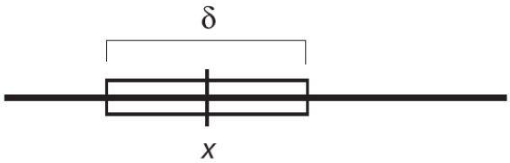
Sliding move
New values are picked uniformly in an interval of size δ centered on the current value
Increase δ: bolder moves
Decrease δ: more modest moves

Slide 18
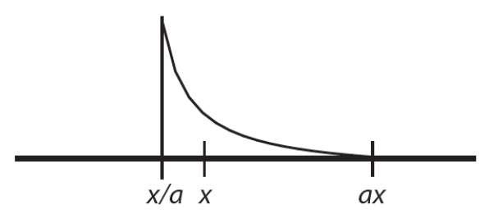
Scaling move
Like a sliding window, but on the log-transformed parameter
Tuning parameter: λ = 2 ln a
Increase λ: bolder moves
Decrease λ: more modest moves

Slide 19
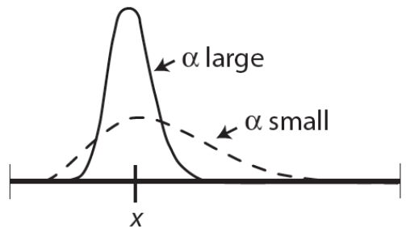
Dirichlet move
New values are picked from a Dirichlet (or Beta) distribution centered on x
Tuning parameter: α
Bolder proposals: decrease α
More modest proposals: increase α

Slide 20
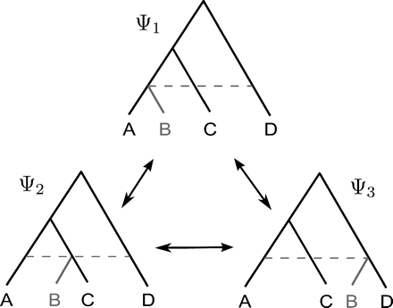
Chronogram moves
Fixed Node height Prune and Regraft (FNPR)
Höhna and Drummond 2012

Slide 21
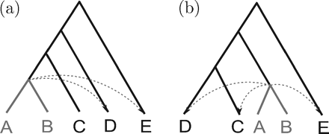
Chronogram moves (2)
Subtree swap
Höhna and Drummond 2012

Slide 22
Chronogram moves (2)
Subtree swap
Here the Hastings ratio needs to be computed to account for the bias in transition probabilities between (a) and (b)
Höhna and Drummond 2012

Slide 23
Conclusion
MCMC is an approach for sampling from a probability distribution
It is often used in the Bayesian setting, where one wants to sample from a Posterior probability distribution
In phylogenetics, one uses it to sample:
  Phylogenetic trees: topologies and branch lengths
  Divergence times
  Rates
  Other parameters…
Different moves have been designed for each of these parameters
Some joint moves operate on several parameters at the same time
Efficiency of the MCMC relies heavily on those moves
Other algorithms like Metropolis Coupled Markov Chain Monte Carlo (MC³) have been proposed and can help

