Slide 1


Introduction to RevBayes
Bastien Boussau and Mike May
With massive borrowings from
Sebastian Hoehna
Tracy Heath
Michael Landis

Slide 2
What is RevBayes?
Software for Bayesian statistical analyses
Strong focus on phylogenetic models
Strong focus on MCMC algorithms (Metropolis-Hastings, MCMCMC)
C++ core for efficiency
Interpreted R-like language for interactivity
Built with probabilistic graphical models in mind

Slide 3
Useful pointers
http://revbayes.github.io/
http://revbayes.github.io/tutorials/
https://revbayes.github.io/documentation/
http://revbayes.github.io/download
https://github.com/revbayes
https://groups.google.com/g/revbayes-users

Slide 4
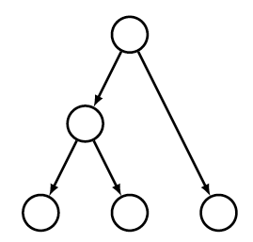
Graphical models in RevBayes
Graphical models provide a simple way to represent probabilistic models
They are also a powerful way to identify conditionally independent variables:
In RevBayes, objects are programmed in such a way that algorithms naturally benefit from conditional independence

Slide 5
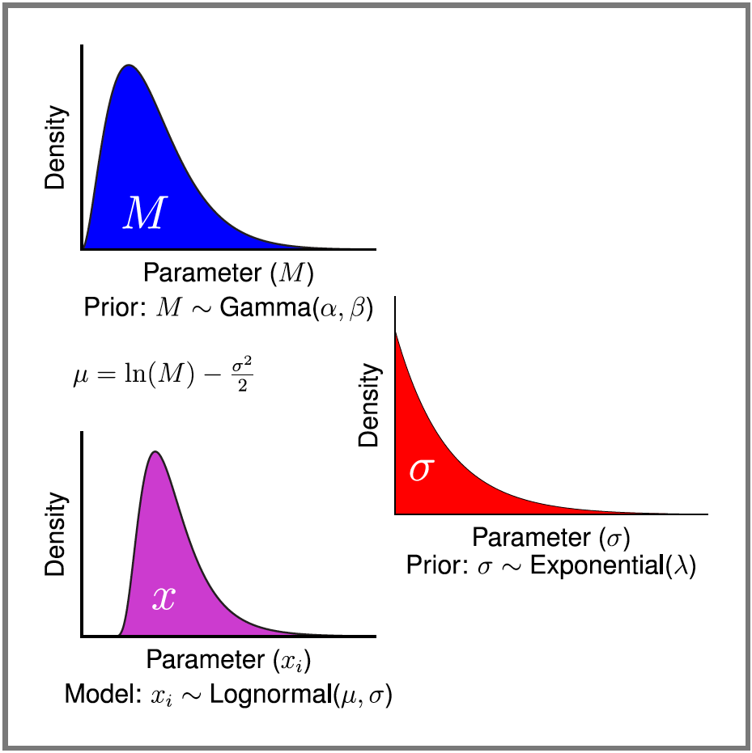
Distributions and functions

Slide 6
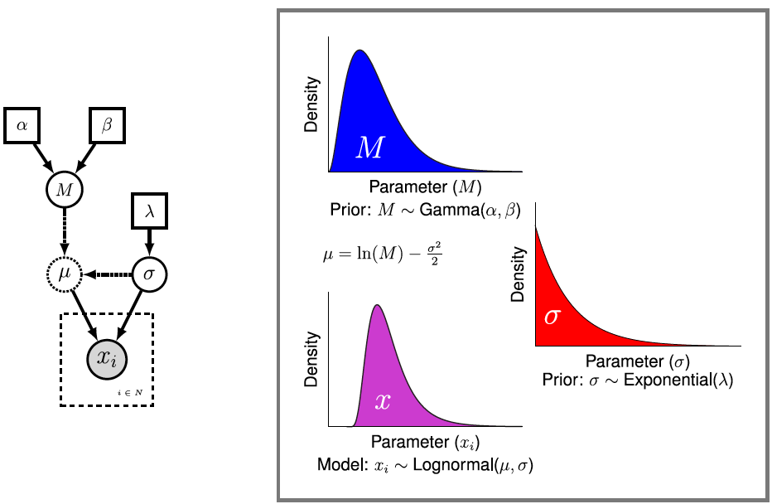
A probabilistic model is made of functions and distributions

Slide 7
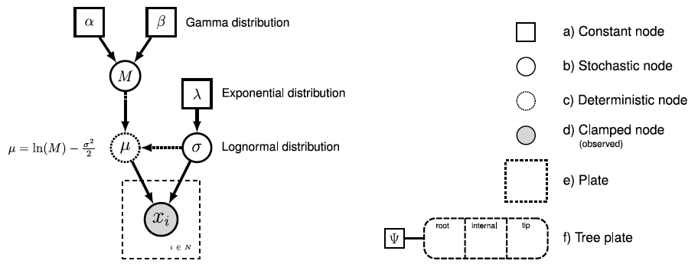
Graphical model conventions
Gamma distribution
Exponential distribution
Lognormal
distribution

Slide 8
Using the Rev language to build a model
Gamma distribution
Exponential distribution
Lognormal
distribution

Slide 9
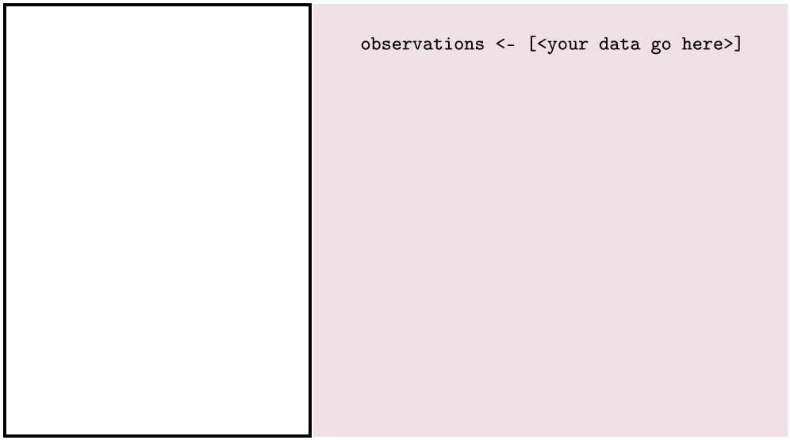
Using the Rev language to build a model

Slide 10
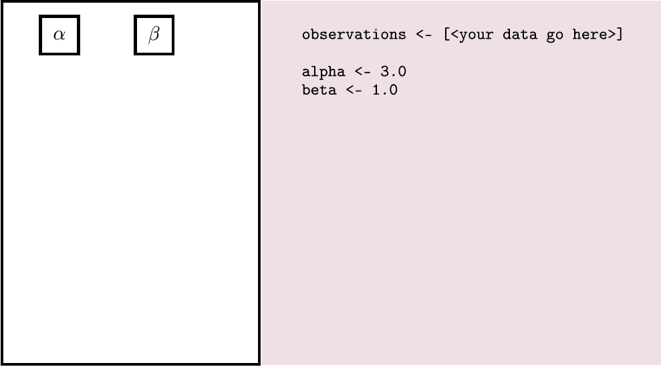
Using the Rev language to build a model

Slide 11
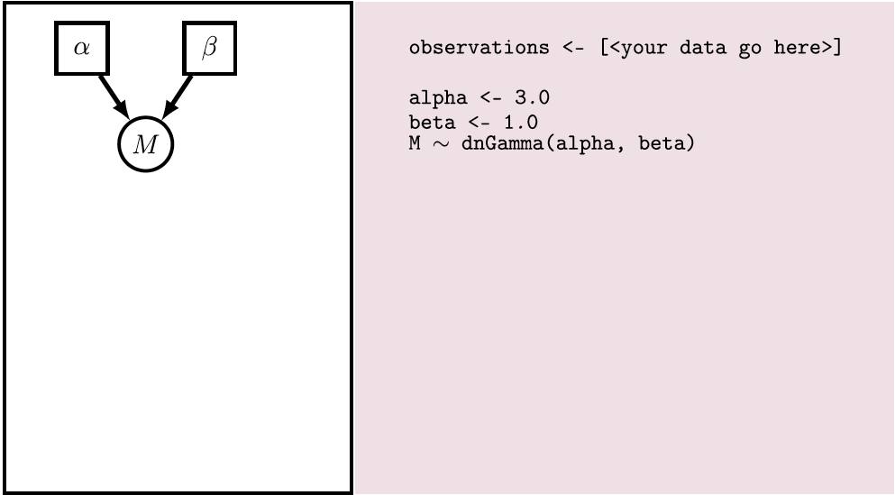
Using the Rev language to build a model

Slide 12
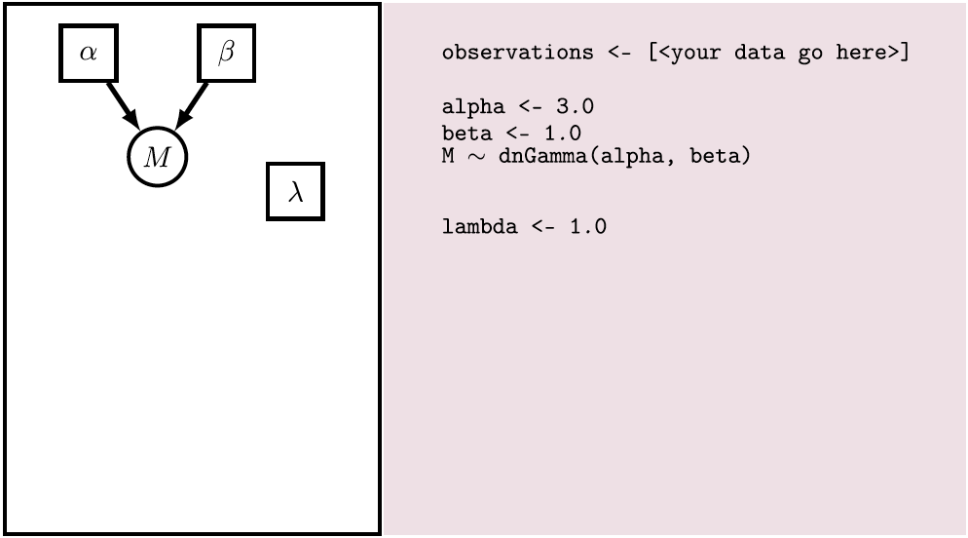
Using the Rev language to build a model

Slide 13
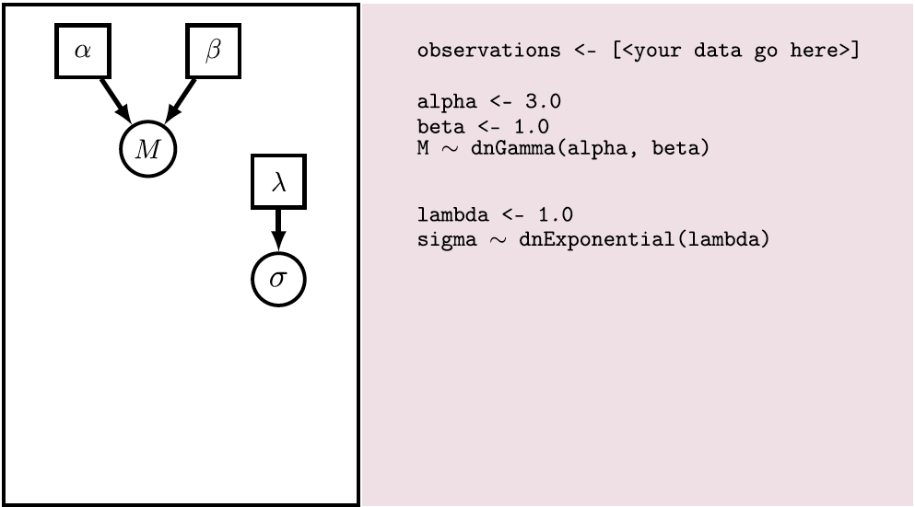
Using the Rev language to build a model

Slide 14
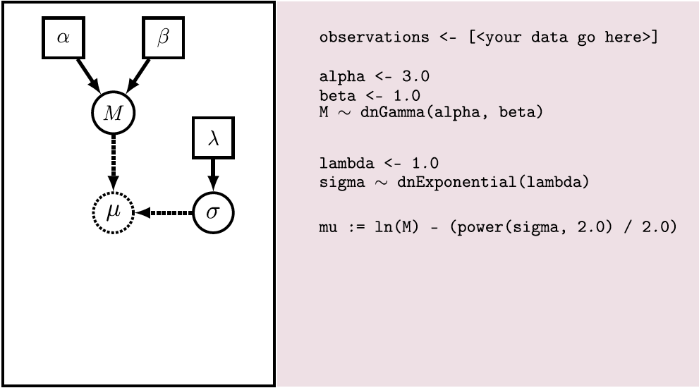
Using the Rev language to build a model

Slide 15
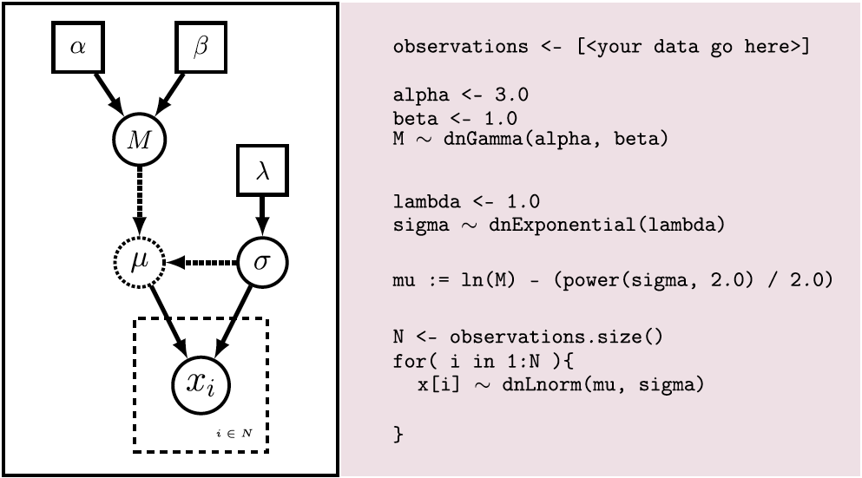
Using the Rev language to build a model

Slide 16
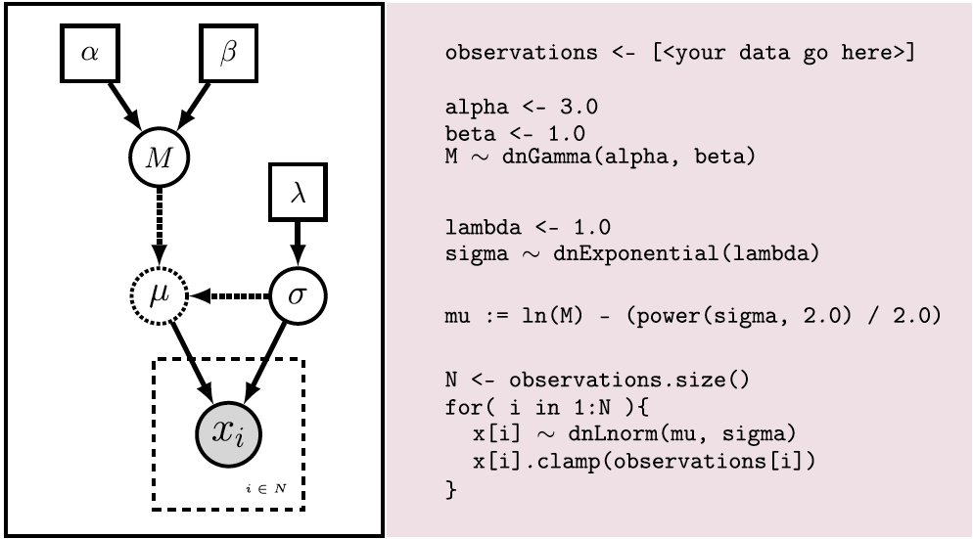
Using the Rev language to build a model

Slide 17
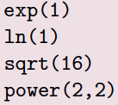
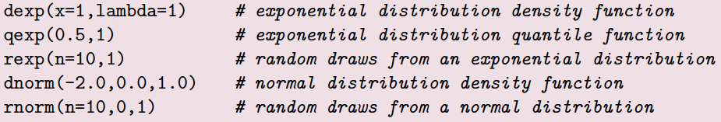
The Rev language
R-like
Type inference
Object-oriented
Completions
Case-sensitive
Math functions:
Distributions:

Slide 18
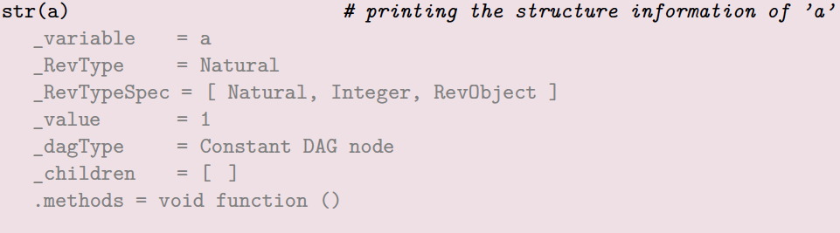

The Rev language: useful functions
Structure of a variable :
Type of a variable :
Help: ?mean
Working directory: getwd()
What’s in my environment: ls()
What commands are available? ls(all=TRUE)
Sourcing a file: source("file")
Setting the seed : seed(Natural x)

Slide 19

Variable declaration in Rev
2 main types of variables:
Environment variable: name = « MyAnalysis »
Model variables:
Constant variable: c <- 1
Deterministic variable: d := exp(c)
Stochastic variable: x ~ dnExponential(c)

Slide 20
A little practical exercise
Start revbayes
In the terminal :
rb

Slide 21
Let’s explore variable types
a<-1
b<-2
x~dnNormal(mean=a,sd=b)
print(x)
y:=x*x
z<-x*x
x.redraw();print("x: "+x);print("y: "+y);print("z: "+z)
x.redraw();print("x: "+x);print("y: "+y);print("z: "+z)
y.redraw()
z.redraw()

Slide 22
Let’s explore variable types
Constant node
a<-1
b<-2
x~dnNormal(mean=a,sd=b)
print(x)
y:=x*x
z<-x*x
x.redraw();print("x: "+x);print("y: "+y);print("z: "+z)
x.redraw();print("x: "+x);print("y: "+y);print("z: "+z)
y.redraw()
z.redraw()
Constant node
Stochastic node
Deterministic node
Constant node

Slide 23
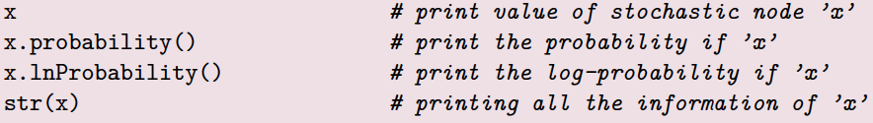
Variable declaration in Rev
2 main types of variables:
Environment variable: name = « MyAnalysis »
Model variables:
Constant variable: c <- 1
Deterministic variable: d := exp(c)
Stochastic variable: x ~ dnExponential(c)
More fun with stochastic variables:

Slide 24


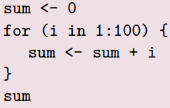
The Rev language: more details
Vectors: or: or:
Convenience functions:
Vectors are objects:
Control structures:
for loops
while loops

Slide 25
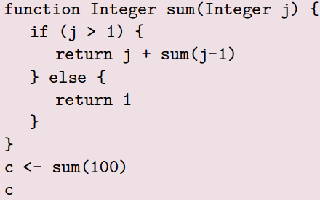
The Rev language: more details (2)
User-defined functions:
User-defined functions can be recursive:

Slide 26
Anatomy of a phylogenetic MCMC analysis
How do we set up inference with MCMC for a simple phylogenetic model in RevBayes ?

Slide 27
Anatomy of a phylogenetic MCMC analysis
########
# Data #
########
# We read the sequence alignment:
data = readDiscreteCharacterData("...")
n_branches = 2 * data.ntaxa() - 3

Slide 28
Anatomy of a phylogenetic MCMC analysis
########
# Data #
########
# We read the sequence alignment:
data = readDiscreteCharacterData("...")
n_branches = 2 * data.ntaxa() - 3
###############################
# Model of sequence evolution #
###############################
# Uniform prior on topologies
topology ~ dnUniformTopology(...)
# Exponential priors on branch lengths
for (i in 1:n_branches) {
bls[i] ~ dnExponential(10)
}
# Putting branch lengths and topology together
psi := treeAssembly(topology, bls)
# We define a JC rate matrix:
Q <- fnJC(4)
# The sequences are drawn from a CTMC running along the tree
seq ~ dnPhyloCTMC( tree=psi, Q=Q, type="DNA" )
# We condition the CTMC on the sequence alignment.
seq.clamp( data )
# We declare the model as one big object that we are going to use in the MCMC:
my_model = model(psi)

Slide 29
Anatomy of a phylogenetic MCMC analysis
########
# Data #
########
# We read the sequence alignment:
data = readDiscreteCharacterData("...")
n_branches = 2 * data.ntaxa() - 3
#########
# Moves #
#########
# We create a vector of moves to store them all:
moves = VectorMoves()
# Move on the topology
moves.append(mvNNI(topology, weight=10.0))
# We define moves on the branch lengths, one for each branch.
for (i in 1:n_branches) {
moves.append(mvScaleBactrian(bls[i], tune=TRUE))
}
###############################
# Model of sequence evolution #
###############################
# Uniform prior on topologies
topology ~ dnUniformTopology(...)
# Exponential priors on branch lengths
for (i in 1:n_branches) {
bls[i] ~ dnExponential(10)
}
# Putting branch lengths and topology together
psi := treeAssembly(topology, bls)
# We define a JC rate matrix:
Q <- fnJC(4)
# The sequences are drawn from a CTMC running along the tree
seq ~ dnPhyloCTMC( tree=psi, Q=Q, type="DNA" )
# We condition the CTMC on the sequence alignment.
seq.clamp( data )
# We declare the model as one big object that we are going to use in the MCMC:
my_model = model(psi)

Slide 30
Anatomy of a phylogenetic MCMC analysis
########
# Data #
########
# We read the sequence alignment:
data = readDiscreteCharacterData("...")
n_branches = 2 * data.ntaxa() - 3
#########
# Moves #
#########
# We create a vector of moves to store them all:
moves = VectorMoves()
# Move on the topology
moves.append(mvNNI(topology, weight=10.0))
# We define moves on the branch lengths, one for each branch.
for (i in 1:n_branches) {
moves.append(mvScaleBactrian(bls[i], tune=TRUE))
}
###############################
# Model of sequence evolution #
###############################
# Uniform prior on topologies
topology ~ dnUniformTopology(...)
# Exponential priors on branch lengths
for (i in 1:n_branches) {
bls[i] ~ dnExponential(10)
}
# Putting branch lengths and topology together
psi := treeAssembly(topology, bls)
# We define a JC rate matrix:
Q <- fnJC(4)
# The sequences are drawn from a CTMC running along the tree
seq ~ dnPhyloCTMC( tree=psi, Q=Q, type="DNA" )
# We condition the CTMC on the sequence alignment.
seq.clamp( data )
# We declare the model as one big object that we are going to use in the MCMC:
my_model = model(psi)
#################
# MCMC analysis #
#################
# Now we define monitors to keep track of what's happening during the MCMC.
# One monitor to store the parameter distributions into a file:
monitors[1] = mnModel(filename="...", printgen=10, separator = TAB)
# We create an MCMC object:
analysis = mcmc(my_model, monitors, moves, ...)
# We run the MCMC for 20,000 iterations:
analysis.run(20000)

Slide 31
Anatomy of a phylogenetic MCMC analysis
########
# Data #
########
# We read the sequence alignment:
data = readDiscreteCharacterData("...")
n_branches = 2 * data.ntaxa() - 3
#########
# Moves #
#########
# We create a vector of moves to store them all:
moves = VectorMoves()
# Move on the topology
moves.append(mvNNI(topology, weight=10.0))
# We define moves on the branch lengths, one for each branch.
for (i in 1:n_branches) {
moves.append(mvScaleBactrian(bls[i], tune=TRUE))
}
###############################
# Model of sequence evolution #
###############################
# Uniform prior on topologies
topology ~ dnUniformTopology(...)
# Exponential priors on branch lengths
for (i in 1:n_branches) {
bls[i] ~ dnExponential(10)
}
# Putting branch lengths and topology together
psi := treeAssembly(topology, bls)
# We define a JC rate matrix:
Q <- fnJC(4)
# The sequences are drawn from a CTMC running along the tree
seq ~ dnPhyloCTMC( tree=psi, Q=Q, type="DNA" )
# We condition the CTMC on the sequence alignment.
seq.clamp( data )
# We declare the model as one big object that we are going to use in the MCMC:
my_model = model(psi)
For comparison :
raxml-ng --msa test.fa --model GTR+G --prefix T3 --seed 2
#################
# MCMC analysis #
#################
# Now we define monitors to keep track of what's happening during the MCMC.
# One monitor to store the parameter distributions into a file:
monitors[1] = mnModel(filename="...", printgen=10, separator = TAB)
# We create an MCMC object:
analysis = mcmc(my_model, monitors, moves, ...)
# We run the MCMC for 20,000 iterations:
analysis.run(20000)

Slide 32
Why are we using RevBayes ?
1st year the practicals will be using RevBayes
We will need your feedback
Pros :
RevBayes forces you to make your hypotheses explicit
you have a lot of control over the moves you use
if you can understand the tutorials, you’ll be able to do lots of different types of analyses with your data
if you can set up an analysis in RevBayes, it’s likely you can set up an analysis in other Bayesian analysis software (mrBayes, Beast*, Exabayes, bpp ; JAGS, BUGS, Stan, pymcmc...)
Cons :
it can be tedious to not have default one-liners for standard phylogenetic analyses
you may find other cons as you try it

Slide 33
Anatomy of a phylogenetic MCMC analysis
########
# Data #
########
# We read the sequence alignment:
data = readDiscreteCharacterData("...")
n_branches = 2 * data.ntaxa() - 3
#########
# Moves #
#########
# We create a vector of moves to store them all:
moves = VectorMoves()
# Move on the topology
moves.append(mvNNI(topology, weight=10.0))
# We define moves on the branch lengths, one for each branch.
for (i in 1:n_branches) {
moves.append(mvScaleBactrian(bls[i], tune=TRUE))
}
###############################
# Model of sequence evolution #
###############################
# Uniform prior on topologies
topology ~ dnUniformTopology(...)
# Exponential priors on branch lengths
for (i in 1:n_branches) {
bls[i] ~ dnExponential(10)
}
# Putting branch lengths and topology together
psi := treeAssembly(topology, bls)
# We define a JC rate matrix:
Q <- fnJC(4)
# The sequences are drawn from a CTMC running along the tree
seq ~ dnPhyloCTMC( tree=psi, Q=Q, type="DNA" )
# We condition the CTMC on the sequence alignment.
seq.clamp( data )
# We declare the model as one big object that we are going to use in the MCMC:
my_model = model(psi)
#################
# MCMC analysis #
#################
# Now we define monitors to keep track of what's happening during the MCMC.
# One monitor to store the parameter distributions into a file:
monitors[1] = mnModel(filename="...", printgen=10, separator = TAB)
# We create an MCMC object:
analysis = mcmc(my_model, monitors, moves, ...)
# We run the MCMC for 20,000 iterations:
analysis.run(20000)

Slide 34
Anatomy of a phylogenetic MCMC analysis
########
# Data #
########
# We read the sequence alignment:
data = readDiscreteCharacterData("...")
n_branches = 2 * data.ntaxa() - 3
#########
# Moves #
#########
# We create a vector of moves to store them all:
moves = VectorMoves()
# Move on the topology
moves.append(mvNNI(topology, weight=10.0))
# We define moves on the branch lengths, one for each branch.
for (i in 1:n_branches) {
moves.append(mvScaleBactrian(bls[i], tune=TRUE))
}
DATA
MOVES
###############################
# Model of sequence evolution #
###############################
# Uniform prior on topologies
topology ~ dnUniformTopology(...)
# Exponential priors on branch lengths
for (i in 1:n_branches) {
bls[i] ~ dnExponential(10)
}
# Putting branch lengths and topology together
psi := treeAssembly(topology, bls)
# We define a JC rate matrix:
Q <- fnJC(4)
# The sequences are drawn from a CTMC running along the tree
seq ~ dnPhyloCTMC( tree=psi, Q=Q, type="DNA" )
# We condition the CTMC on the sequence alignment.
seq.clamp( data )
# We declare the model as one big object that we are going to use in the MCMC:
my_model = model(psi)
#################
# MCMC analysis #
#################
# Now we define monitors to keep track of what's happening during the MCMC.
# One monitor to store the parameter distributions into a file:
monitors[1] = mnModel(filename="...", printgen=10, separator = TAB)
# We create an MCMC object:
analysis = mcmc(my_model, monitors, moves, ...)
# We run the MCMC for 20,000 iterations:
analysis.run(20000)
MODEL
MCMC

Slide 35
Advice on organizing an analysis
create a folder for the analysis
put data in a folder « data »
put the scripts in a folder « scripts »
store the output files in « analyses » or « output »
to run an analysis from the terminal:
rb scripts/myscript.Rev
or, from within rb :
source("scripts/myscript.Rev")

Slide 36
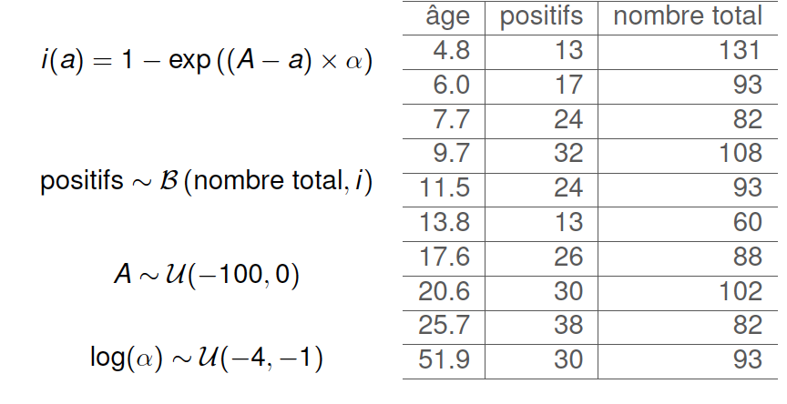
Example: toxoplasmosis in boars (from Guillaume Kon Kam King)
We model toxoplasmosis in boars as follows:
Age
Infected
Total number
Infected ~ B(Total number, i)

Slide 37
Entering the data and setting up the model
# Setting up the data
ages<-v(4.8, 6, 7.7, 9.7, 11.5, 13.8, 17.6, 20.6, 25.7, 51.9)
infected <-v(13, 17, 24, 32, 24, 13, 26, 30, 38, 30)
total <- v(131, 93, 82, 108, 93, 60, 88, 102, 82, 93)
# Setting up the model
A~dnUniform(0,100)
lalpha~dnUniform(-4, -1)
# The model is replicated across age categories
for (i in 1:ages.size()) {
intermediate[i] := Probability ( 1-exp( (-A -ages[i]) * (10^lalpha) ) )
infectedV[i] ~dnBinomial(p=intermediate[i], n=total[i])
infectedV[i].clamp(infected[i])
}
Need to convert from RealPos to Probability
… so that it works in there!

Slide 38
Preparing for inference
# Get a hang on the model (any node will do)
mymodel = model(A)
# Moves
moveIndex = 0
moves[moveIndex++] = mvSlice(A)
moves[moveIndex++] = mvSlice(lalpha)
moves[moveIndex++] = mvSlide(A)
moves[moveIndex++] = mvSlide(lalpha)
moves[moveIndex++] = mvScale(A)
# Some monitors to see how the MCMC is going
myOutputFile = "boars.log"
monitors[1] = mnModel(filename=myOutputFile, printgen=10, separator=" ")
monitors[2] = mnScreen(printgen=10, A, lalpha)
# Automatic stopping rules when convergence has occurred or when too much time has passed
stopping_rules[1] = srMaxIteration(200000)
stopping_rules[2] = srMaxTime(15,"hours")
stopping_rules[3] = srMinESS(50,myOutputFile,10000)
stopping_rules[4] = srGelmanRubin(1.01,myOutputFile,10000)
stopping_rules[5] = srGeweke(prob=0.001, file=myOutputFile,freq=10000)
stopping_rules[6] = srStationarity(prob=0.01, file=myOutputFile,freq=10000)

Slide 39
Performing inference
# Creating the MCMC object
mymcmc = mcmc(mymodel, monitors, moves, moveschedule="random", nruns=2)
# Alternatively we could create a MCMCMC object
#or mymcmc = mcmcmc(mymodel, monitors, moves, moveschedule="random", nchains=4, nruns=1)
# Running the analysis: first some burnin...
mymcmc.burnin(generations=10000,200)
# Then the real thing
mymcmc.run(stopping_rules)

Slide 40
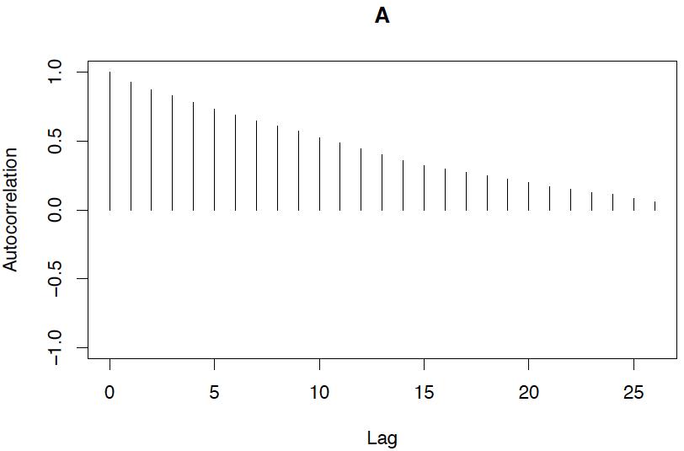
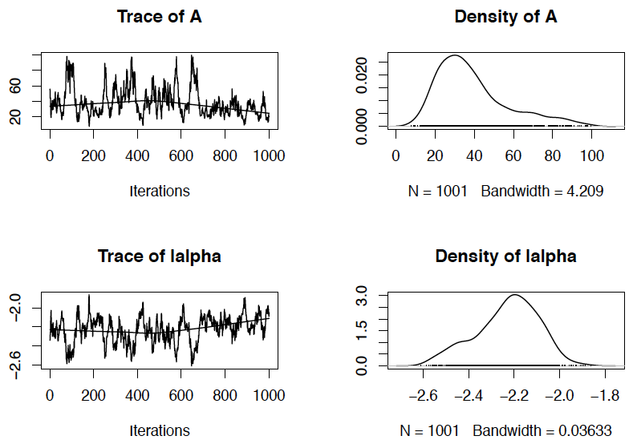
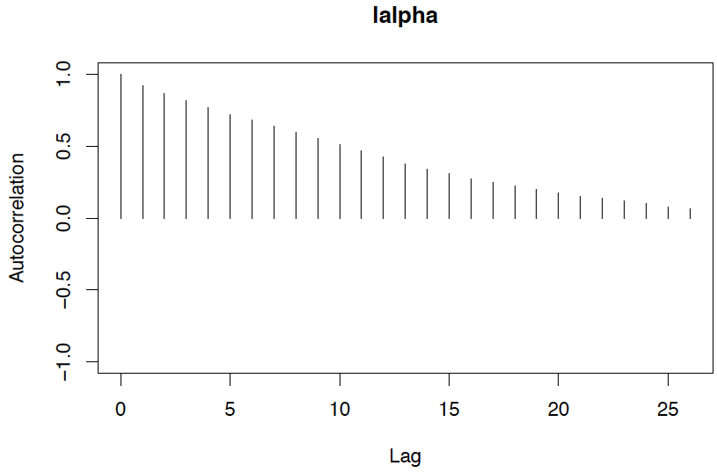
Convergence plots with coda

Slide 41
Changing the moves
moves[moveIndex++] = mvSlice(A)
moves[moveIndex++] = mvSlice(lalpha)

Slide 42
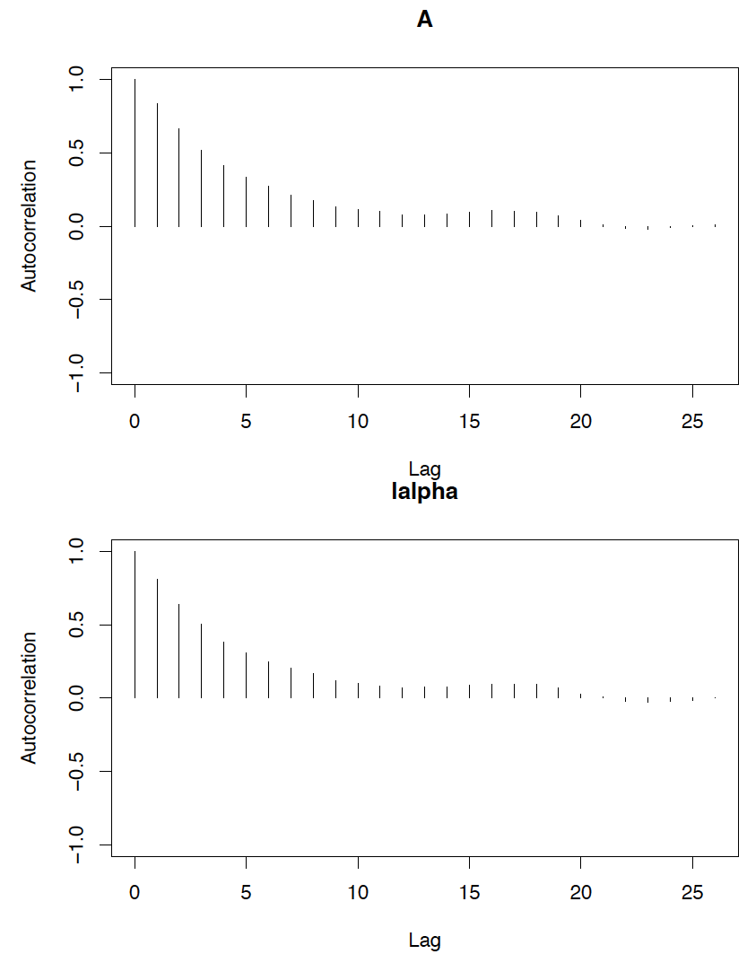
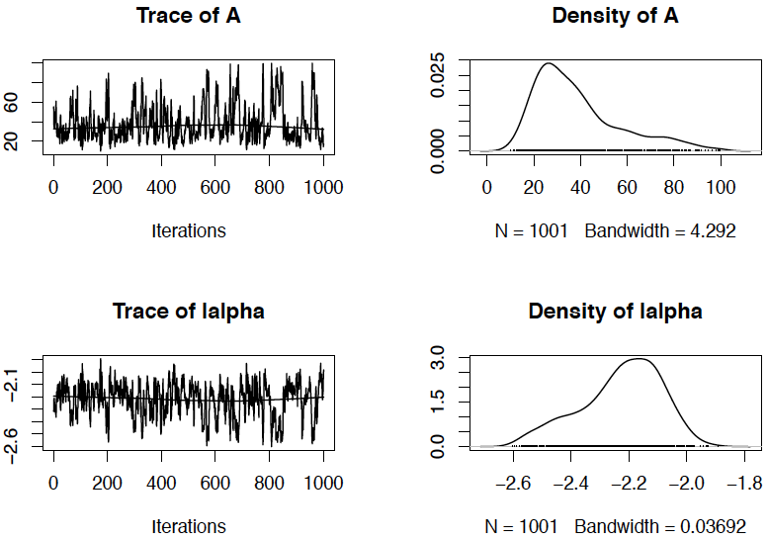
Convergence plots with coda

Slide 43
Combining moves
moveIndex = 0
moves[moveIndex++] = mvSlice(A)
moves[moveIndex++] = mvSlice(lalpha)
moves[moveIndex++] = mvSlide(A)
moves[moveIndex++] = mvSlide(lalpha)
moves[moveIndex++] = mvScale(A)

Slide 44
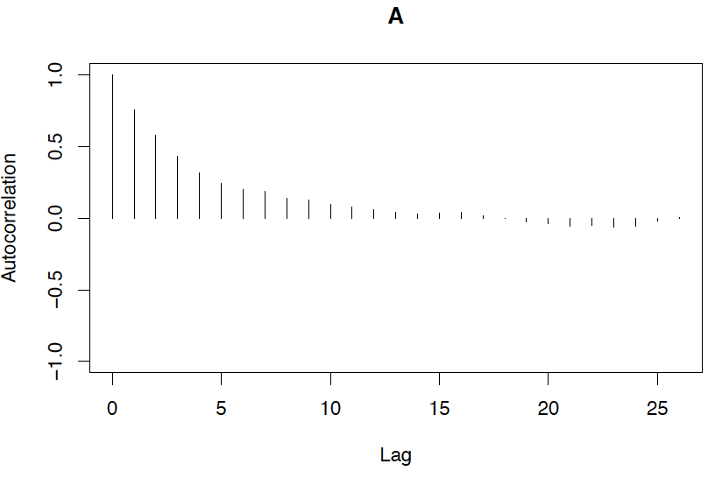
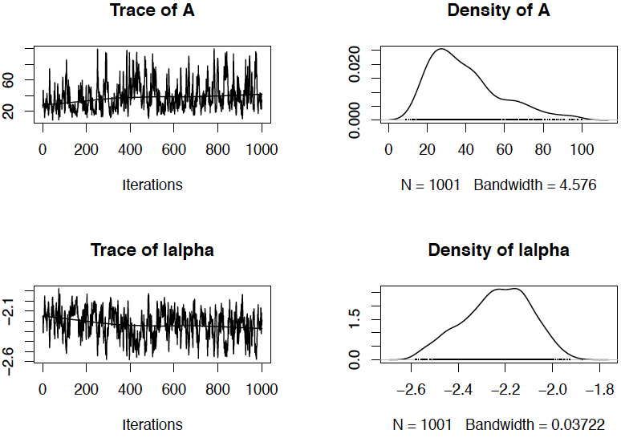
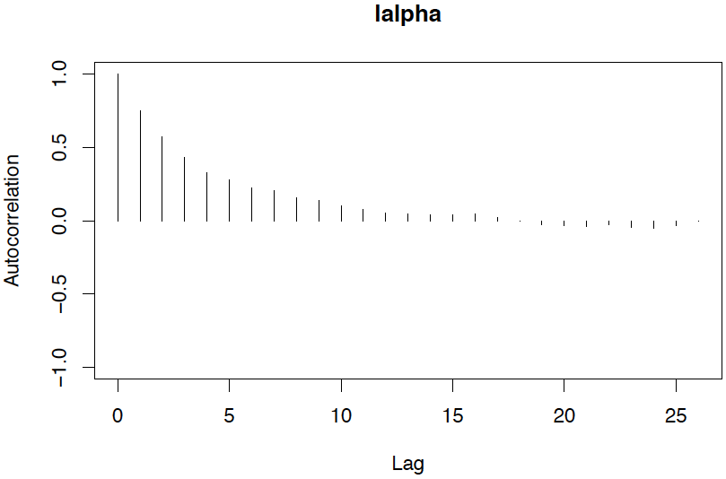
Convergence plots with coda

Slide 45
Combining moves and using MCMCMC
moveIndex = 0
moves[moveIndex++] = mvSlice(A)
moves[moveIndex++] = mvSlice(lalpha)
moves[moveIndex++] = mvSlide(A)
moves[moveIndex++] = mvSlide(lalpha)
moves[moveIndex++] = mvScale(A)
#...
mymcmc = mcmcmc(mymodel, monitors, moves, moveschedule="random", nchains=4, nruns=2)

Slide 46
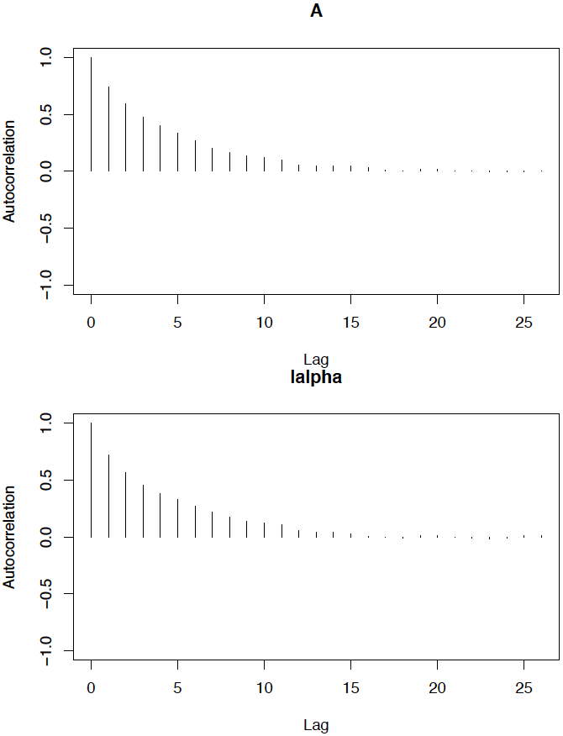
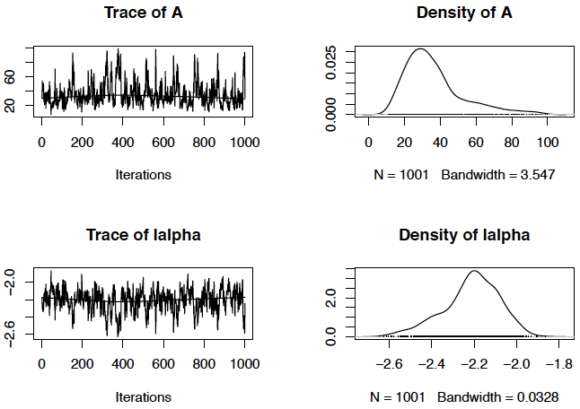
Convergence plots with coda

Slide 47
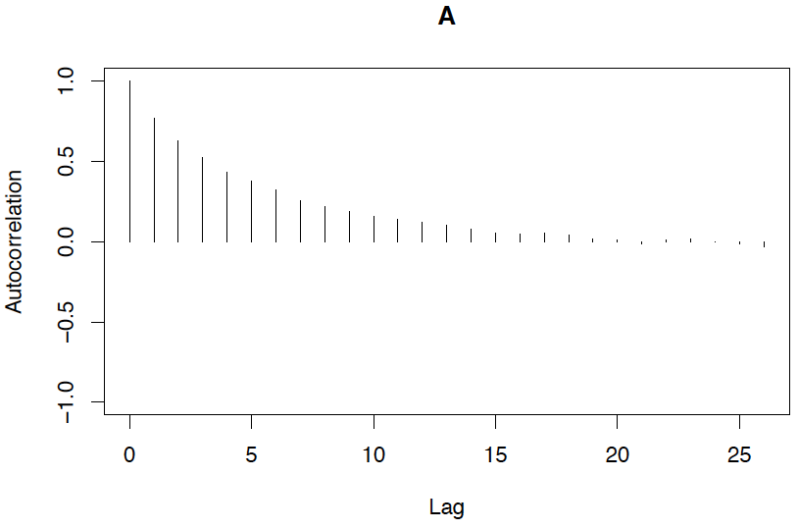
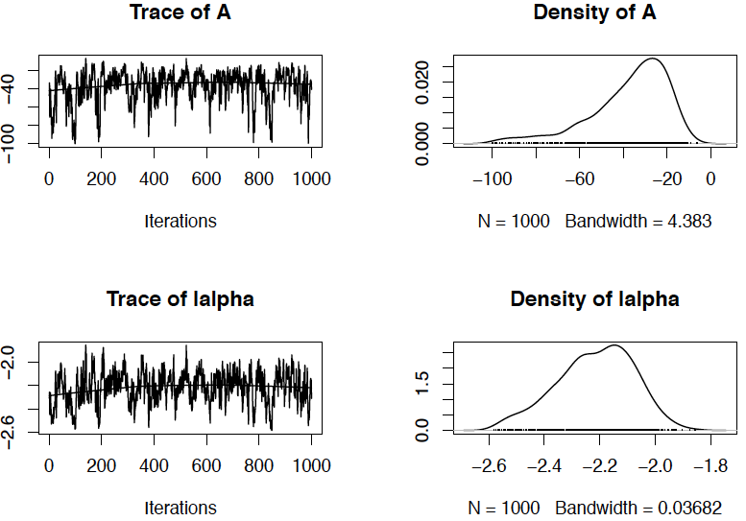
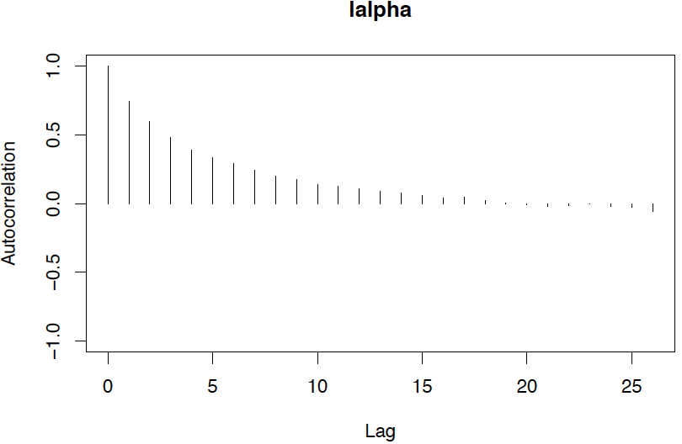
Comparison with Jags

Slide 48
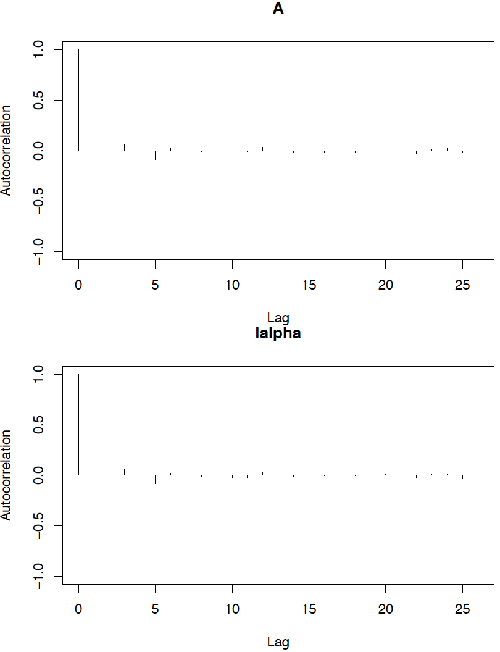
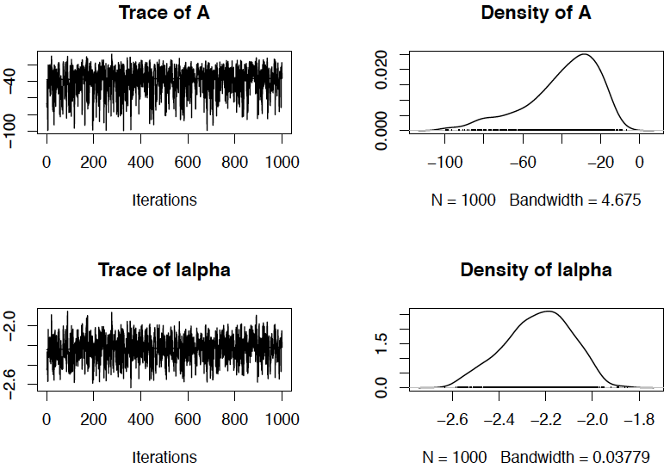
Comparison with Stan

Slide 49
Comparison of the lag for various moves and vs Jags and Stan
Slide moves
Slice moves
Slice+Slide+Scale moves
Slice+Slide+Scale moves + MC³
Jags
Stan

Slide 50
Things I did not talk about
RevBayes can compute marginal likelihoods for model comparison (stepping stone sampling, path sampling)
RevBayes can handle mixture models
RevBayes can handle infinite mixture models (Dirichlet process)
Of course, RevBayes is pretty good at phylogenetics and has the ability to sample tree topologies

