Slide 1



Phylogenetic reconstruction: criteria
Bastien Boussau
Bastien.boussau@univ-lyon1.fr
@bastounette

Slide 2
Phylogenetic inference
How to find the best tree given my data?
Need for a criterion/score
Need for an algorithm to find/construct the tree

Slide 3
Phylogenetic inference
How to find the best tree given my data?
Need for a criterion/score
  Maximum Parsimony
  Minimum Evolution or least squares (distance methods)
  Maximum Likelihood ~ P(D|M)
  Posterior Probability P(M|D)
Need for an algorithm to find/construct the tree

Slide 4
Phylogenetic inference
How to find the best tree given my data?
Need for a criterion/score
  Maximum Parsimony
  Minimum Evolution or least squares (distance methods)
  Maximum Likelihood ~ P(D|M)
  Posterior Probability P(M|D)
Need for an algorithm to find/construct the tree
M
M
M

Slide 5
Phylogenetic inference
How to find the best tree given my data?
Need for a criterion/score
  Maximum Parsimony
  Minimum Evolution or least squares (distance methods)
  Maximum Likelihood ~ P(D|M)
  Posterior Probability P(M|D)
Need for an algorithm to find/construct the tree
  e.g.: try several topologies, (choose some branch lengths,) score the topologies, choose the one that has the best score
M
M
M

Slide 6
Plan: Criteria for evaluating phylogenies
Criteria for evaluating phylogenetic trees:
  Parsimony
  Distance methods
  Maximum Likelihood
  Posterior probability (Bayesian approach)
Conventions:
  We’re dealing with aligned sequence data
  gaps are not taken into account

Slide 7
Parsimony
“The principle that the most acceptable explanation of an occurrence, phenomenon, or event is the simplest, involving the fewest entities, assumptions, or changes. In phylogenetics, for example, the preferred tree showing evolutionary relationships between species, molecules, or other entities is the one that requires the least amount of evolutionary change, that is, maximum parsimony.”
https://www.oxfordreference.com/view/10.1093/oi/authority.20110803100346221

Slide 8
Maximum parsimony
Criteria: Maximum Parsimony
Has been advocated strongly by some against model-based approaches: many controversies (see “The Troubled Growth of Statistical Phylogenetics”, Felsenstein 2001)
Edwards and Cavalli-Sforza (1963): the preferred evolutionary tree involves “the minimum net amount of evolution” = Maximum parsimony tree
→ For sequence data: find the phylogeny that involves the minimum number of substitutions
→ We need a way to count the minimum number of substitutions on a phylogeny = compute the parsimony score of a phylogenetic tree

Slide 9
Computing the parsimony score
Criteria: Maximum Parsimony
Sp1
Sp1 ATGCGCT...
Sp2 AGTCGCA...
Sp3 AGGTGCA...
Sp4 ATGCCCT...
Sp3
Sp2
Sp4
Parsimony score of a tree given an alignment: sum of the parsimony scores for each site
→ We assume that all sites are independent

Slide 10
Computing the parsimony score at one site
Criteria: Maximum Parsimony
Species tree S
Site i
Sp1
Sp3
A
C
X
Y
A
C
Sp2
Sp4
X and Y not observed

Slide 11
Computing the parsimony score at one site
Criteria: Maximum Parsimony
Species tree S
Site i
Sp1
Sp3
A
C
X
Y
A
C
Sp2
Sp4
X and Y not observed
Sp1
Sp3
Sp1
Sp3
Sp1
Sp3
A
C
A
C
A
C
A
C
A
A
T
G
A
C
A
C
A
C
Sp2
Sp4
Sp2
Sp4
Sp2
Sp4

Slide 12
Computing the parsimony score at one site
Criteria: Maximum Parsimony
Species tree S
Site i
Sp1
Sp3
A
C
X
Y
A
C
Sp2
Sp4
X and Y not observed
Sp1
Sp3
Sp1
Sp3
Sp1
Sp3
A
C
A
C
A
C
A
C
A
A
T
G
A
C
A
C
A
C
Sp2
Sp4
Sp2
Sp4
Sp2
Sp4
1 substitution
2 substitutions
5 substitutions

Slide 13
Computing the parsimony score at one site
Criteria: Maximum Parsimony
Species tree S
Site i
Sp1
Sp3
A
C
X
Y
A
C
Sp2
Sp4
X and Y not observed
Sp1
Sp3
Sp1
Sp3
Sp1
Sp3
A
C
A
C
A
C
A
C
A
A
T
G
A
C
A
C
A
C
Sp2
Sp4
Sp2
Sp4
Sp2
Sp4
1 substitution
2 substitutions
5 substitutions
Parsimony score of species tree S for site i: 1

Slide 14
Computing the parsimony score of a tree at one site
Criteria: Maximum Parsimony
Naive brute force approach: test all possible assignments on internal nodes
  N internal nodes, 4 possibilities {A,C,G,T} per node
  → 4^{N} possibilities to try
Fitch’s algorithm (1971):
  Arbitrarily root the tree
  Compute, from the tips up, two elements per node:
    P: The score of the underlying subtree
    X: The set of states possible at that node, given the score P
  Complexity: O(4N)

Slide 15
Computing the parsimony score of a tree at one site
Criteria: Maximum Parsimony
Naive brute force approach: test all possible assignments on internal nodes
  N internal nodes, 4 possibilities {A,C,G,T} per node
  → 4^{N} possibilities to try
Fitch’s algorithm (1971):
  Arbitrarily root the tree
  Compute, from the tips up, two elements per node:
    P: The score of the underlying subtree
    X: The set of states possible at that node, given the score P
  Complexity: O(4N)
For 2 internal nodes: 4² = 16

Slide 16
Computing the parsimony score of a tree at one site
Criteria: Maximum Parsimony
Naive brute force approach: test all possible assignments on internal nodes
  N internal nodes, 4 possibilities {A,C,G,T} per node
  → 4^{N} possibilities to try
Fitch’s algorithm (1971):
  Arbitrarily root the tree
  Compute, from the tips up, two elements per node:
    P: The score of the underlying subtree
    X: The set of states possible at that node, given the score P
  Complexity: O(4N)
For 2 internal nodes: 4² = 16
For 2 internal nodes: 4*2 =8

Slide 17
Fitch’s algorithm
Criteria: Maximum Parsimony
P: The score of the underlying subtree
X: The set of states possible at that node, given the score P
Climbing up the tree: computing P and X for a node given its children
1st case: X₁∩X₂ not empty
X₁,P₁
X₂,P₂
2nd case: X₁∩X₂ empty
X₁,P₁
X₂,P₂

Slide 18
Fitch’s algorithm
Criteria: Maximum Parsimony
P: The score of the underlying subtree
X: The set of states possible at that node, given the score P
Climbing up the tree: computing P and X for a node given its children
1st case: X₁∩X₂ not empty
X₁∩X₂,P₁+P₂
{A},3
X₁,P₁
X₂,P₂
{A,T},1
{A,C},2
2nd case: X₁∩X₂ empty
X₁,P₁
X₂,P₂

Slide 19
Fitch’s algorithm
Criteria: Maximum Parsimony
P: The score of the underlying subtree
X: The set of states possible at that node, given the score P
Climbing up the tree: computing P and X for a node given its children
1st case: X₁∩X₂ not empty
X₁∩X₂,P₁+P₂
{A},3
X₁,P₁
X₂,P₂
{A,T},1
{A,C},2
2nd case: X₁∩X₂ empty
X₁UX₂,P₁+P₂+1
X₁,P₁
X₂,P₂

Slide 20
Fitch’s algorithm
Criteria: Maximum Parsimony
P: The score of the underlying subtree
X: The set of states possible at that node, given the score P
Climbing up the tree: computing P and X for a node given its children
1st case: X₁∩X₂ not empty
X₁∩X₂,P₁+P₂
{A},3
X₁,P₁
X₂,P₂
{A,T},1
{A,C},2
2nd case: X₁∩X₂ empty
{A,C,G,T},4
X₁UX₂,P₁+P₂+1
{A,G},4
{C,T},4
X₁,P₁
X₂,P₂
{C,T},1
{A,G},2
{C,T},1
{A,G},2

Slide 21
Example
Criteria: Maximum Parsimony
C
T
G
T
A
A

Slide 22
Example
Criteria: Maximum Parsimony
{C},0
{T},0
{G},0
{T},0
{A},0
{A},0

Slide 23
Example
Criteria: Maximum Parsimony
{C,T},1
{C},0
{T},0
{G},0
{T},0
{A},0
{A},0

Slide 24
Example
Criteria: Maximum Parsimony
{C,T},1
{G,T},1
{C},0
{T},0
{G},0
{T},0
{A},0
{A},0

Slide 25
Example
Criteria: Maximum Parsimony
{A,G,T},2
{C,T},1
{G,T},1
{C},0
{T},0
{G},0
{T},0
{A},0
{A},0

Slide 26
Example
Criteria: Maximum Parsimony
{T},3
{A,G,T},2
{C,T},1
{G,T},1
{C},0
{T},0
{G},0
{T},0
{A},0
{A},0

Slide 27
Example
Criteria: Maximum Parsimony
{A,T},4
{T},3
{A,G,T},2
{C,T},1
{G,T},1
{C},0
{T},0
{G},0
{T},0
{A},0
{A},0

Slide 28
Example
Criteria: Maximum Parsimony
C
A
T
A
{A,T},4
T
A
T
A
{T},3
G
T
C
A
{A,G,T},2
{C,T},1
{G,T},1
T
T
T
T
G
T
A
{C},0
{T},0
{G},0
{T},0
{A},0
{A},0
T
Several possible scenarios

Slide 29
Plan: Criteria for evaluating phylogenies
Criteria for evaluating phylogenetic trees:
  Parsimony
  Distance methods
  Maximum Likelihood
  Posterior probability (Bayesian approach)
Conventions:
  We’re dealing with aligned sequence data
  gaps are not taken into account

Slide 30
Distance methods
Distance-based approaches:
  least squares methods,
  Minimum evolution method,
  Neighbor Joining.

Slide 31
Criteria for phylogenetic inference
Criteria/scores
  Maximum Parsimony
  Minimum Evolution or least squares (distance methods)
  Maximum Likelihood ~ P(D|M)
  Posterior Probability P(M|D)
M
M
M

Slide 32
Minimum Evolution or least squares: distance methods
Criteria: Minimum Evolution or least squares
Use a distance matrix:
Sp1 ATGCGCT...
Sp2 AGTCGCA...
Sp3 AGGTGCA...
Sp4 ATGCCCT...

Slide 33
Minimum Evolution or least squares: distance methods
Criteria: Minimum Evolution or least squares
Uses a distance matrix:
 | Sp1 | Sp2 | Sp3 | Sp4
Sp1 | 0 | 0.1 | 0.2 | 0.15
Sp2 | 0.1 | 0 | 0.3 | 0.01
Sp3 | 0.2 | 0.3 | 0 | 0.6
Sp4 | 0.15 | 0.01 | 0.6 | 0
Sp1 ATGCGCT...
Sp2 AGTCGCA...
Sp3 AGGTGCA...
Sp4 ATGCCCT...
1

Slide 34
Minimum Evolution or least squares: distance methods
Criteria: Minimum Evolution or least squares
Uses a distance matrix:
 | Sp1 | Sp2 | Sp3 | Sp4
Sp1 | 0 | 0.1 | 0.2 | 0.15
Sp2 | 0.1 | 0 | 0.3 | 0.01
Sp3 | 0.2 | 0.3 | 0 | 0.6
Sp4 | 0.15 | 0.01 | 0.6 | 0
Sp1 ATGCGCT...
Sp2 AGTCGCA...
Sp3 AGGTGCA...
Sp4 ATGCCCT...
1
2
Sp1
Sp1
Sp1
Sp3
Sp3
Sp3
Sp2
Sp4
Sp2
Sp4
Sp2
Sp4

Slide 35
Minimum Evolution or least squares: distance methods
Criteria: Minimum Evolution or least squares
Uses a distance matrix:
 | Sp1 | Sp2 | Sp3 | Sp4
Sp1 | 0 | 0.1 | 0.2 | 0.15
Sp2 | 0.1 | 0 | 0.3 | 0.01
Sp3 | 0.2 | 0.3 | 0 | 0.6
Sp4 | 0.15 | 0.01 | 0.6 | 0
Sp1 ATGCGCT...
Sp2 AGTCGCA...
Sp3 AGGTGCA...
Sp4 ATGCCCT...
1
How to compute the distance matrix?
2
Sp1
Sp1
Sp1
Sp3
Sp3
Sp3
Sp2
Sp4
Sp2
Sp4
Sp2
Sp4

Slide 36
Minimum Evolution or least squares: distance methods
Criteria: Minimum Evolution or least squares
Uses a distance matrix:
 | Sp1 | Sp2 | Sp3 | Sp4
Sp1 | 0 | 0.1 | 0.2 | 0.15
Sp2 | 0.1 | 0 | 0.3 | 0.01
Sp3 | 0.2 | 0.3 | 0 | 0.6
Sp4 | 0.15 | 0.01 | 0.6 | 0
Sp1 ATGCGCT...
Sp2 AGTCGCA...
Sp3 AGGTGCA...
Sp4 ATGCCCT...
1
How to compute the distance matrix?
Which tree fits the distance matrix best?
2
Sp1
Sp1
Sp1
Sp3
Sp3
Sp3
Sp2
Sp4
Sp2
Sp4
Sp2
Sp4

Slide 37
1: How to compute distances between sequences?
Criteria: Minimum Evolution or least squares
Simply count differences (observed divergence)
Sp1 ATGCGCT
Sp2 AGTCGCA
d(Sp1-Sp2) =

Slide 38
1: How to compute distances between sequences?
Criteria: Minimum Evolution or least squares
Simply count differences (observed divergence)
Sp1 ATGCGCT
Sp2 AGTCGCA
d(Sp1-Sp2) =

Slide 39
1: How to compute distances between sequences?
Criteria: Minimum Evolution or least squares
Simply count differences (observed divergence)
Sp1 ATGCGCT
Sp2 AGTCGCA
d(Sp1-Sp2) = 3/7~0.43

Slide 40
1: How to compute distances between sequences?
Criteria: Minimum Evolution or least squares
Simply count differences (observed divergence)
Use a model of sequence evolution
      → cf. talk on models
      Advantages:
        Hidden substitutions are taken into account
        Parameters of the model of substitution can be estimated in the Maximum Likelihood framework
Sp1 ATGCGCT
Sp2 AGTCGCA
d(Sp1-Sp2) = 3/7~0.43

Slide 41

Minimum Evolution or least squares: distance methods
Criteria: Minimum Evolution or least squares
Uses a distance matrix:
 | Sp1 | Sp2 | Sp3 | Sp4
Sp1 | 0 | 0.1 | 0.2 | 0.15
Sp2 | 0.1 | 0 | 0.3 | 0.01
Sp3 | 0.2 | 0.3 | 0 | 0.6
Sp4 | 0.15 | 0.01 | 0.6 | 0
Sp1 ATGCGCT...
Sp2 AGTCGCA...
Sp3 AGGTGCA...
Sp4 ATGCCCT...
1
How to compute the distance matrix?
Which tree fits the distance matrix best?
2
Sp1
Sp1
Sp1
Sp3
Sp3
Sp3
Sp2
Sp4
Sp2
Sp4
Sp2
Sp4

Slide 42
2: How to compute the fit between a distance matrix and a tree?
Criteria: Minimum Evolution or least squares
A tree implies distances between tips: compare those patristic distances to sequence-based distances
Sp1
Sp3
0.2
0.35
0.1
0.1
0.15
Sp2
Sp4

Slide 43
2: How to compute the fit between a distance matrix and a tree?
Criteria: Minimum Evolution or least squares
A tree implies distances between tips: compare those patristic distances to sequence-based distances
Sp1
 | Sp1 | Sp2 | Sp3 | Sp4
Sp1 | 0 | 0.3 | 0.65 | 0.7
Sp2 | 0.3 | 0 | 0.55 | 0.6
Sp3 | 0.65 | 0.55 | 0 | 0.25
Sp4 | 0.7 | 0.6 | 0.25 | 0
Sp3
0.2
0.35
0.1
0.1
0.15
Sp2
Sp4

Slide 44
2: How to compute the fit between a distance matrix and a tree?
Criteria: Minimum Evolution or least squares
A tree implies distances between tips: compare those patristic distances to sequence-based distances
Sp1
 | Sp1 | Sp2 | Sp3 | Sp4
Sp1 | 0 | 0.3 | 0.65 | 0.7
Sp2 | 0.3 | 0 | 0.55 | 0.6
Sp3 | 0.65 | 0.55 | 0 | 0.25
Sp4 | 0.7 | 0.6 | 0.25 | 0
Sp3
0.2
0.35
0.1
0.1
0.15
Sp2
Sp4
 | Sp1 | Sp2 | Sp3 | Sp4
Sp1 | 0 | 0.1 | 0.2 | 0.15
Sp2 | 0.1 | 0 | 0.3 | 0.01
Sp3 | 0.2 | 0.3 | 0 | 0.6
Sp4 | 0.15 | 0.01 | 0.6 | 0

Slide 45
2: How to compute the fit between a distance matrix and a tree?
Criteria: Minimum Evolution or least squares
A tree implies distances between tips: compare those patristic distances to sequence-based distances
Sp1
 | Sp1 | Sp2 | Sp3 | Sp4
Sp1 | 0 | 0.3 | 0.65 | 0.7
Sp2 | 0.3 | 0 | 0.55 | 0.6
Sp3 | 0.65 | 0.55 | 0 | 0.25
Sp4 | 0.7 | 0.6 | 0.25 | 0
Sp3
0.2
0.35
0.1
0.1
0.15
Sp2
Sp4
 | Sp1 | Sp2 | Sp3 | Sp4
Sp1 | 0 | 0.1 | 0.2 | 0.15
Sp2 | 0.1 | 0 | 0.3 | 0.01
Sp3 | 0.2 | 0.3 | 0 | 0.6
Sp4 | 0.15 | 0.01 | 0.6 | 0
score_{ULS} = (0-0)²+(0.3-0.1)²+(0.65-0.2)²+…
With ULS: Unweighted Least Squares
(other criteria have been proposed)

Slide 46
Computing the optimal distances on a given topology
Criteria: Minimum Evolution or least squares
Using the ULS criterion, we can compute the fit between a sequence-based distance matrix and any tree (topology + branch lengths), thanks to the patristic matrix trick.

Slide 47
Computing the optimal distances on a given topology
Criteria: Minimum Evolution or least squares
Using the ULS criterion, we can compute the fit between a sequence-based distance matrix and any tree (topology + branch lengths), thanks to the patristic matrix trick.
But how can we pick branch lengths on the topology?

Slide 48
Computing the optimal distances on a given topology
Criteria: Minimum Evolution or least squares
Using the ULS criterion, we can compute the fit between a sequence-based distance matrix and any tree (topology + branch lengths), thanks to the patristic matrix trick.
But how can we pick branch lengths on the topology?
ULS provides a mathematical way to find the optimal branch lengths on a given topology! This involves some simple matrix algebra (solving a set of linear equations).

Slide 49
Searching for the best tree using Unweighted Least Squares
Criteria: Minimum Evolution or least squares
We now know how to compute the ULS score of a tree topology. It involves:
  Matrix algebra to find the best branch lengths
  Computing the score_{ULS} for that tree
Given a set of tree topologies, we can compute the “best” tree topology according to the ULS criterion: it is the one with the lowest score_{ULS}
How to obtain a set of tree topologies to score is tackled later in the course (see Alexis’s talk)

Slide 50
Searching for the best tree using Unweighted Least Squares
Criteria: Minimum Evolution or least squares
We now know how to compute the ULS score of a tree topology. It involves:
  Matrix algebra to find the best branch lengths
  Computing the score_{ULS} for that tree
Given a set of tree topologies, we can compute the “best” tree topology according to the ULS criterion: it is the one with the lowest score_{ULS}
How to obtain a set of tree topologies to score is tackled later in the course (see Alexis’s talk)

Slide 51
Minimum evolution criterion
Motivation similar to parsimony
Hypothesis: the true tree should be the shortest tree
→ Idea:
  Given a matrix of pairwise distances and a set of tree topologies to evaluate
  Match pairwise distances onto each tree topology
  Sum the branch lengths on each tree
  Your best estimate is the tree with the smallest sum of branch lengths

Slide 52
Minimum evolution criterion
Motivation similar to parsimony
Hypothesis: the true tree should be the shortest tree
→ Idea:
  Given a matrix of pairwise distances and a set of tree topologies to evaluate
  Match pairwise distances onto each tree topology: Use least-squares fitting!
  Sum the branch lengths on each tree
  Your best estimate is the tree with the smallest sum of branch lengths

Slide 53
Minimum Evolution or least squares: distance methods
Criteria: Minimum Evolution or least squares
Uses a distance matrix:
 | Sp1 | Sp2 | Sp3 | Sp4
Sp1 | 0 | 0.1 | 0.2 | 0.15
Sp2 | 0.1 | 0 | 0.3 | 0.01
Sp3 | 0.2 | 0.3 | 0 | 0.6
Sp4 | 0.15 | 0.01 | 0.6 | 0
Sp1 ATGCGCT...
Sp2 AGTCGCA...
Sp3 AGGTGCA...
Sp4 ATGCCCT...
1
How to compute the distance matrix?
ME: involves the patristic
matrix, matrix algebra
and summing branch
lengths
2
Sp1
Sp1
Sp1
Sp3
Sp3
Sp3
Sp2
Sp4
Sp2
Sp4
Sp2
Sp4

Slide 54
Minimum evolution criterion
To obtain a Minimum Evolution tree, at some point we have to use Least Squares estimation to assign branch lengths to a tree topology
→ hybrid approach where two different criteria are mixed up
However, Minimum evolution works pretty well in practice
Neighbor-Joining (Saitou and Nei, 1987) is a famous heuristic algorithm for finding the Minimum Evolution tree (not seen in our course, but has been very widely used); see Gascuel and Steel, 2006 for a clear explanation

Slide 55
Summary on distance methods
Distance methods are the fastest phylogenetic methods available, notably thanks to Neighbor Joining and others (e.g. BioNJ, Weighbor, FastME…)
Can be based on models of sequence evolution to compute pairwise distances
Better than Maximum Parsimony when sequences are divergent, but less accurate than Maximum Likelihood or Bayesian Inference
The main reason is that distance methods do not use the entire data matrix together, but look at it pair of sequences by pair of sequences

Slide 56
Plan: Criteria for evaluating phylogenies
Criteria for evaluating phylogenetic trees:
  Parsimony
  Distance methods
  Maximum Likelihood
  Posterior probability (Bayesian approach)
Conventions:
  We’re dealing with aligned sequence data
  gaps are not taken into account

Slide 57
How to compute the likelihood of an alignment?
A
T
T
T
C
T
T
G
A
C
T
T

Slide 58
How to compute the likelihood of an alignment?
A
C
A

Slide 59
How to compute the likelihood of an alignment?
?
?
A
C
A

Slide 60
How to compute the likelihood of an alignment?
x
y
A
C
A
x ϵ {A,C,G,T}
y ϵ {A,C,G,T}

Slide 61
How to compute the likelihood of an alignment?
x
y
A
C
A
How can we compute P({A,C,A} | model) ?

Slide 62
End-conditioned simulation
Simulating along a branch that ends in state G:
G
t = 0
Temps t
x
G
A
G
How can we compute P(ending in G | model) ?

Slide 63
End-conditioned simulation
Simulating along a branch that ends in state G:
G
t = 0
Temps t
x
G
A
G
  Draw an initial state from a Multinomial distribution:
p=c(0.25, 0.25, 0.25, 0.25); state=rmultinom(n=1, p=p, size=1)
  t = t₀ ; N = 0 ; λ=0.1
  While t < T :
    Draw from an exponential distribution a waiting time Xi until the next event; t = t + Xi
      If t < T, change the state of the variable: state=rmultinom(n=1, p=p, size=1)
      (Else (t≥T): we stop)
  If EndState != G: Failure
  If EndState == G: Success
Can we use this to compute P(ending in G | model) ?

Slide 64
End-conditioned simulation
P(ending in G):
G
t = 0
Temps t
x
G
A
G
  Nsuccess=0
  For i in 1:10000:
    Draw an initial state from a Multinomial distribution:
p=c(0.25, 0.25, 0.25, 0.25); state=rmultinom(n=1, p=p, size=1)
    t = t₀ ; N = 0 ; λ=0.1
    While t < T :
      Draw from an exponential distribution a waiting time Xi until the next event; t = t + Xi
      If t < T, change the state of the variable: state=rmultinom(n=1, p=p, size=1)
      (Else (t≥T): we stop)
    If EndState == G: Nsuccess +=1

Slide 65
End-conditioned simulation
P(ending in G):
G
t = 0
Temps t
x
G
A
G
  Nsuccess=0
  For i in 1:10000:
    Draw an initial state from a Multinomial distribution:
p=c(0.25, 0.25, 0.25, 0.25); state=rmultinom(n=1, p=p, size=1)
    t = t₀ ; N = 0 ; λ=0.1
    While t < T :
      Draw from an exponential distribution a waiting time Xi until the next event; t = t + Xi
      If t < T, change the state of the variable: state=rmultinom(n=1, p=p, size=1)
      (Else (t≥T): we stop)
    If EndState == G: Nsuccess +=1
→ P(ending in G) = Nsuccess/10000

Slide 66
End-conditioned simulation on a tree
x
y
A
C
A
How can we compute P({A,C,A} | model) ?

Slide 67
Computing P({A,C,A}|model) by simulation
x
0.3
y
0.4
0.1
0.1
A
C
A
  Nsuccess = 0
  Repeat 10 000 times:
    Randomly pick x ϵ {A,C,G,T}
    Simulate along branch xy (length 0.3)
    Simulate along branch yA (length 0.1)
    Simulate along branch yC (length 0.1)
    Simulate along branch xA (length 0.4)
    If we have ACA at the tips: Nsuccess++
  P({A,C,A}|model) = Nsuccess/10000

Slide 68
Computing P({A,C,A}|model) by simulation
x
0.3
y
0.4
0.1
0.1
A
C
A
  Nsuccess = 0
  Repeat 10 000 times:
    Randomly pick x ϵ {A,C,G,T}
    Simulate along branch xy (length 0.3)
    Simulate along branch yA (length 0.1)
    Simulate along branch yC (length 0.1)
    Simulate along branch xA (length 0.4)
    If we have ACA at the tips: Nsuccess++
  P({A,C,A}|model) = Nsuccess/10000
Try and implement this in R!

Slide 69
Computing P({A,C,A}|model) by simulation
x
0.3
y
0.4
0.1
0.1
A
C
A
  Nsuccess = 0
  Repeat 10 000 times:
    Randomly pick x ϵ {A,C,G,T}
    Simulate along branch xy (length 0.3)
    Simulate along branch yA (length 0.1)
    Simulate along branch yC (length 0.1)
    Simulate along branch xA (length 0.4)
    If we have ACA at the tips: Nsuccess++
  P({A,C,A}|model) = Nsuccess/10000
http://rpubs.com/boussau/simuDNALikelihood

Slide 70
Interpretation
We generate a sample of substitution histories along the tree, given the model
Among those histories, we count those that are compatible with the data at the tips
This proportion is the probability of the data given the model, the likelihood:
P(site pattern|model)

Slide 71
An inefficient approach
This approach works well for 1 site and 3 tips
How can we scale to more tips?
→ Use an analytical approach to integrate efficiently over all substitution histories
2 elements:
Integrate over all substitution histories along a branch
Integrate over all states at internal nodes

Slide 72
An inefficient approach
This approach works well for 1 site and 3 tips
How can we scale to more tips?
→ Use an analytical approach to integrate efficiently over all substitution histories
2 elements:
Integrate over all substitution histories along a branch
Integrate over all states at internal nodes
Cf Alexis’s talk!

Slide 73
Integrating over substitution histories along a branch
Given a vector of initial frequencies F(0) = {A(0), C(0), G(0), T(0)}, how can we compute the vector of frequencies at time t F(t)?

Slide 74
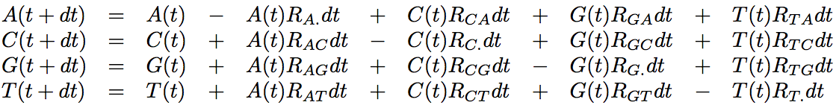
Integrating over substitution histories along a branch
Given a vector of initial frequencies F(0) = {A(0), C(0), G(0), T(0)}, how can we compute the vector of frequencies at time t F(t)?
For an infinitesimal dt:
where R_{XY} is the rate of instantaneous substitution from X to Y, and R_{X.} Is the instantaneous rate of substitution from X to all other states.

Slide 75
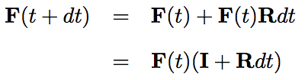

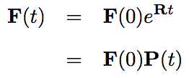
Integrating over substitution histories along a branch
Using matrix notation:
Thus:
Which can be solved as:

Slide 76
Discrete time interpretation
Let’s compute P_{n}(t) with n the number of substitutions: P_{n}(t) = F(0)*X

Slide 77
Discrete time interpretation
Let’s compute P_{n}(t) with n the number of substitutions: P_{n}(t) = F(0)*X
  If 0 substitution: P₀(t) = F(0) → X=Id

Slide 78
Discrete time interpretation
Let’s compute P_{n}(t) with n the number of substitutions: P_{n}(t) = F(0)*X
  If 0 substitution: P₀(t) = F(0) → X=Id
  If 1 substitution: P₁(t) = F(0) Rt → X=Rt

Slide 79
Discrete time interpretation
Let’s compute P_{n}(t) with n the number of substitutions: P_{n}(t) = F(0)*X
  If 0 substitution: P₀(t) = F(0) → X=Id
  If 1 substitution: P₁(t) = F(0) Rt → X=Rt
  If 2 substitutions: P₂(t) = F(0) R²*t² / 2! → X=R²*t² / 2!

Slide 80
Discrete time interpretation
Let’s compute P_{n}(t) with n the number of substitutions: P_{n}(t) = F(0)*X
  If 0 substitution: P₀(t) = F(0) → X=Id
  If 1 substitution: P₁(t) = F(0) Rt → X=Rt
  If 2 substitutions: P₂(t) = F(0) R²*t² / 2! → X=R²*t² / 2!
  If 3 substitutions: P₃(t) = F(0) R³*t³ / 3! → X=R³*t³ / 3!

Slide 81
Discrete time interpretation
Let’s compute P_{n}(t) with n the number of substitutions: P_{n}(t) = F(0)*X
  If 0 substitution: P₀(t) = F(0) → X=Id
  If 1 substitution: P₁(t) = F(0) Rt → X=Rt
  If 2 substitutions: P₂(t) = F(0) R²*t² / 2! → X=R²*t² / 2!
  If 3 substitutions: P₃(t) = F(0) R³*t³ / 3! → X=R³*t³ / 3!
  …

Slide 82
Discrete time interpretation
Let’s compute P_{n}(t) with n the number of substitutions: P_{n}(t) = F(0)*X
  If 0 substitution: P₀(t) = F(0) → X=Id
  If 1 substitution: P₁(t) = F(0) Rt → X=Rt
  If 2 substitutions: P₂(t) = F(0) R²*t² / 2! → X=R²*t² / 2!
  If 3 substitutions: P₃(t) = F(0) R³*t³ / 3! → X=R³*t³ / 3!
  …
→ Can you see the link with the exponential function?

Slide 83
Analytical computation of the likelihood: P({A,C,A} | model)
x
1
y
2
3
4
A
C
A
With π_{x} probability to find base x at the root (in our simple case, ¼)
and P₁(xy) = exp(rt₁)

Slide 84
Analytical computation of the likelihood: P({A,C,A} | model)
x
1
y
2
3
4
A
C
A
With π_{x} probability to find base x at the root (in our simple case, ¼)
and P₁(xy) = exp(rt₁)
No need to simulate substitution histories over each branch!

Slide 85
Analytical computation of the likelihood: P({A,C,A} | model)
Integrating over x and y: see Alexis’ talk!
x
1
y
2
3
4
A
C
A
With π_{x} probability to find base x at the root (in our simple case, ¼)
and P₁(xy) = exp(rt₁)
No need to simulate substitution histories over each branch!

Slide 86
Plan: Criteria for evaluating phylogenies
Criteria for evaluating phylogenetic trees:
  Parsimony
  Distance methods
  Maximum Likelihood
  Posterior probability (Bayesian approach)
Conventions:
  We’re dealing with aligned sequence data
  gaps are not taken into account

Slide 87
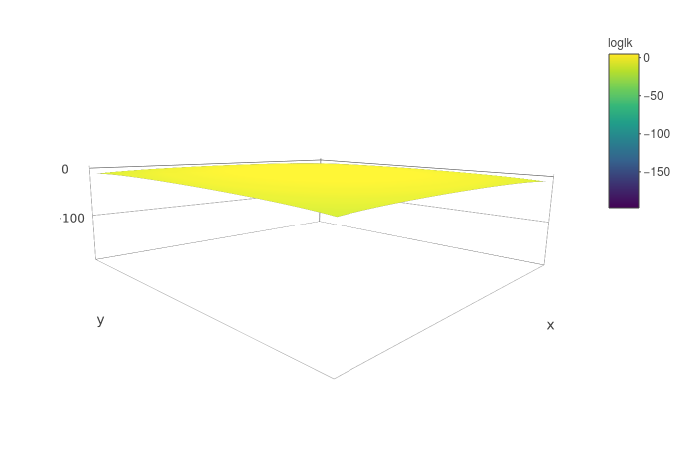
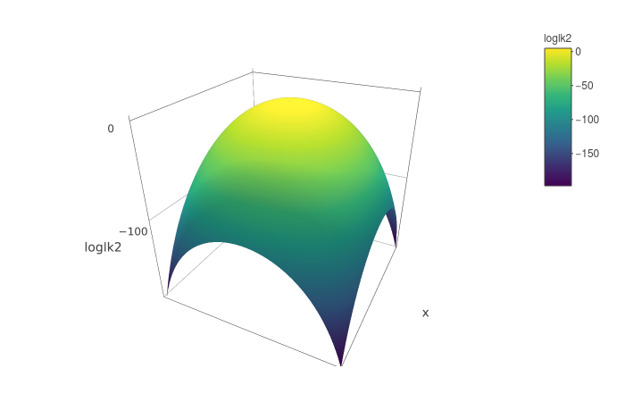
Problems when relying on the maximum
Ex. A: likelihood surface for a simple model with two parameters:
Log-likelihood
Log-likelihood

Slide 88
Problems when relying on the maximum
Ex. A: likelihood surface for a simple model with two parameters:
Maximum
Log-likelihood
Log-likelihood

Slide 89
Problems when relying on the maximum
Ex. B : Given an alignment, 9 trees have very similar likelihoods and are much more likely than all the other ones.
Taking the most likely tree only provides knowledge about 1 of those 9 almost equi-likely trees.
→ It would be better to take into account all 9 of them!

Slide 90
Integrating instead of maximizing
Maximizing: Looking for the topology and all other parameter values that are most likely
Integrating: integrating over all topologies and parameter values according to their probability
Pros :
  If we are interested only in the topology, we integrate over all “nuisance” parameters
  One gets confidence intervals for free

Slide 91
Likelihood vs Bayesian approach for sampling
Likelihood : P(D|M,θ)
We want to sample parameter values θ of model M.
How can we know that the 9 sets of parameter values θ we have sampled are much more likely than all other θ, without sampling everything?
→ NOT a probability distribution.
But :
→ True probability distribution.
If the added probabilities of 9 sets of parameter values θ reach 0.99, I know I have sampled all the most probable parameter values, without needing to sample more!

Slide 92
Likelihood vs Bayesian approach for sampling
Likelihood : P(D|M,θ)
We want to sample parameter values θ of model M.
How can we know that the 9 sets of parameter values θ we have sampled are much more likely than all other θ, without sampling everything?
→ NOT a probability distribution.
But :
→ True probability distribution.
If the added probabilities of 9 sets of parameter values θ reach 0.99, I know I have sampled all the most probable parameter values, without needing to sample more!

Slide 93
Likelihood vs Bayesian approach for sampling
Likelihood : P(D|M,θ)
We want to sample parameter values θ of model M.
How can we know that the 9 sets of parameter values θ we have sampled are much more likely than all other θ, without sampling everything?
→ NOT a probability distribution.
But :
→ True probability distribution.
If the added probabilities of 9 sets of parameter values θ reach 0.99, I know I have sampled all the most probable parameter values, without needing to sample more!
Posterior probability

Slide 94
Simplifying the notation
When we write P(θ|D,M), we mean that we are computing the probability of parameter values θ given model M and given data D.
Here M is used to represent the structure of the model.
For instance:
The fact that all sites are independent
The fact that they share a single value of the transition/transversion ratio
The fact that we have a Birth-death prior on a chronogram
Etc…
In some cases, we may want to integrate over different model structures M: e.g. a model with 1 value of the transition/transversion ratio, or 2, or 3…
In most cases, we use a single model M, so we will forget about it in most of the following:
P(θ|D,M) → P(θ|D)

Slide 95
Bayesian inference
Bayes theorem:

Slide 96
Bayesian inference
Bayes theorem:

Slide 97
Bayesian inference
Bayes theorem:
Posterior probability
Likelihood
Marginal likelihood
Prior probability

Slide 98
The importance of prior probabilities
The Bayesian approach amounts to considering that all parameters of a model are random variables in a probabilistic world.
Therefore, one needs to assign probability distributions to those parameters: the priors.
→ PROS: allows incorporating prior information coming from the analysis of other data: my conclusion relies on more than the tiny amount of data I have analyzed in a given experiment.
→ CONS: introduces prior information into the analysis: is my conclusion simply propagating my prior information?

Slide 99
Bayesian inference
Bayes theorem:
We are interested in the posterior probability of the parameter values: we want to sample parameter values according to their posterior probability given the data.
Therefore we need to get the distribution for P(θ|D).
We have two solutions:
Integrate over all parameter values
  Requires some maths
  Not always possible
Sample from this distribution in some (smart) way

Slide 100
Naive sampling of P(θ|D)
Random sampling
Can work for small problems.
Inference of the probability of getting heads from a coin
http://rpubs.com/boussau/384012

Slide 101
Naive sampling of P(θ|D)
Random sampling
Can work for small problems.
Inference of the probability of getting heads from a coin:
http://rpubs.com/boussau/384012
Problem : in phylogenetics, for 20 sequences, there are already 221. 10¹⁸ possible topologies… for which one would want to sample branch lengths and other parameter values.
→ We cannot reasonably hope to sample trees with a good probability using random sampling

Slide 102
Naive sampling of P(θ|D)
Random sampling
Can work for small problems.
Inference of the probability of getting heads from a coin:
http://rpubs.com/boussau/384012
Will not work for complex problems : in phylogenetics, for 20 sequences, there are already 221. 10¹⁸ possible topologies… for which one would want to sample branch lengths and other parameter values.
→ We cannot reasonably hope to sample trees with a good probability using random sampling
Tomorrow we will see smarter ways to sample from complex posterior distributions

Slide 103
Bayesian phylogenetics
Posterior probability
Likelihood
Marginal likelihood
Prior probability
In phylogenetics:
  D: aligned sequence data
  M: the model can be very complicated, but usually contains:
    Topology
    Branch lengths
    Rate matrix
    Etc…
  θ: the values of the parameters above

Slide 104
Bayesian phylogenetics
Posterior probability
Likelihood:
Cf Alexis’s talk!
Marginal likelihood
Prior probability
In phylogenetics:
  D: aligned sequence data
  M: the model can be very complicated, but usually contains:
    Topology
    Branch lengths
    Rate matrix
    Etc…
  θ: the values of the parameters above

Slide 105
Bayesian phylogenetics
Posterior probability
Likelihood:
Cf Alexis’s talk!
Marginal likelihood:
In lots of cases, it’s OK not to compute it
Prior probability
In phylogenetics:
  D: aligned sequence data
  M: the model can be very complicated, but usually contains:
    Topology
    Branch lengths
    Rate matrix
    Etc…
  θ: the values of the parameters above

Slide 106
Bayesian phylogenetics
Posterior probability
Likelihood:
Cf Alexis’s talk!
Marginal likelihood:
In lots of cases, it’s OK not to compute it
Prior probability:
We need prior distributions for all parameters
In phylogenetics:
  D: aligned sequence data
  M: the model can be very complicated, but usually contains:
    Topology
    Branch lengths
    Rate matrix
    Etc…
  θ: the values of the parameters above

Slide 107
Bayesian phylogenetics
In phylogenetics, one may want to sample:
  Phylogenetic trees (when we don’t care about dates):
    topologies
    branch lengths
  Chronograms (when dates are of interest)
  Rates:
    Rates of exchangeability
    Site-wise rates of evolution
    Birth-death rates
    ...
  Frequencies:
      ACGT equilibrium frequencies
      Root frequencies
  Other parameters...

Slide 108
MCMC in phylogenetics
Parameter | Prior (example)
Topology | Uniform...
Branch lengths | Exponential, Gamma+Dirichlet...
Chronogram | Birth-Death, Coalescent...
Rates of exchangeability | Dirichlet...
Site-wise rates of evolution | (Discretized) Gamma...
Birth-death rates | Lognormal, Exponential...
ACGT equilibrium frequencies | Dirichlet...
Root frequencies | Dirichlet...

Slide 109
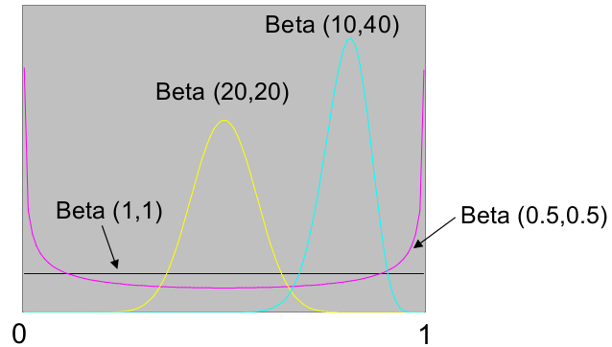
Prior for proportions
Beta prior

Slide 110
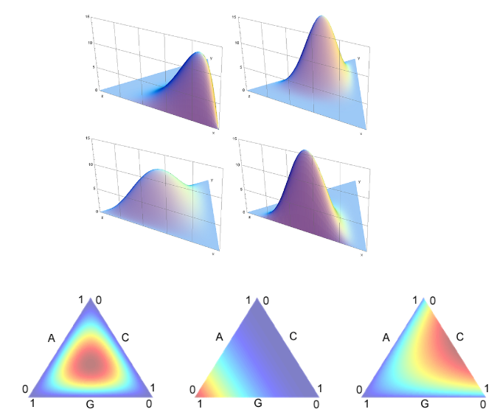
Prior for simplices (ACGT equilibrium frequencies, exchangeability rates...)
Dirichlet prior (i.e. Beta but in more dimensions)

Slide 111
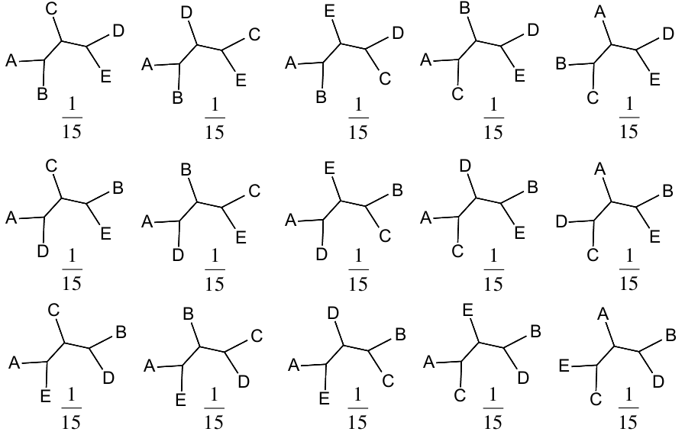
Unrooted topology prior
Discrete uniform prior

Slide 112
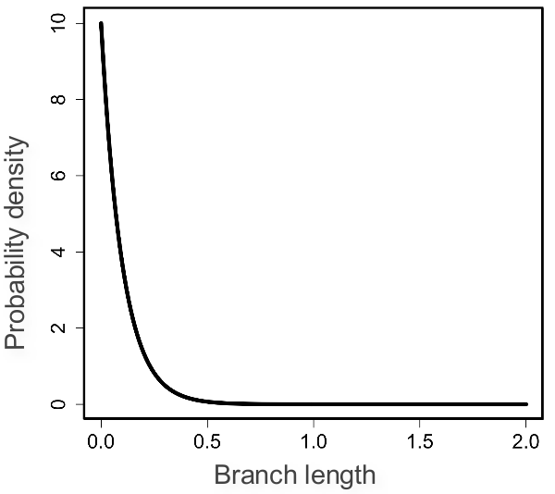
Prior for branch lengths
Exponential prior (λ=10, mean=0.1)
Alternative: Gamma for total tree length+Dirichlet

Slide 113
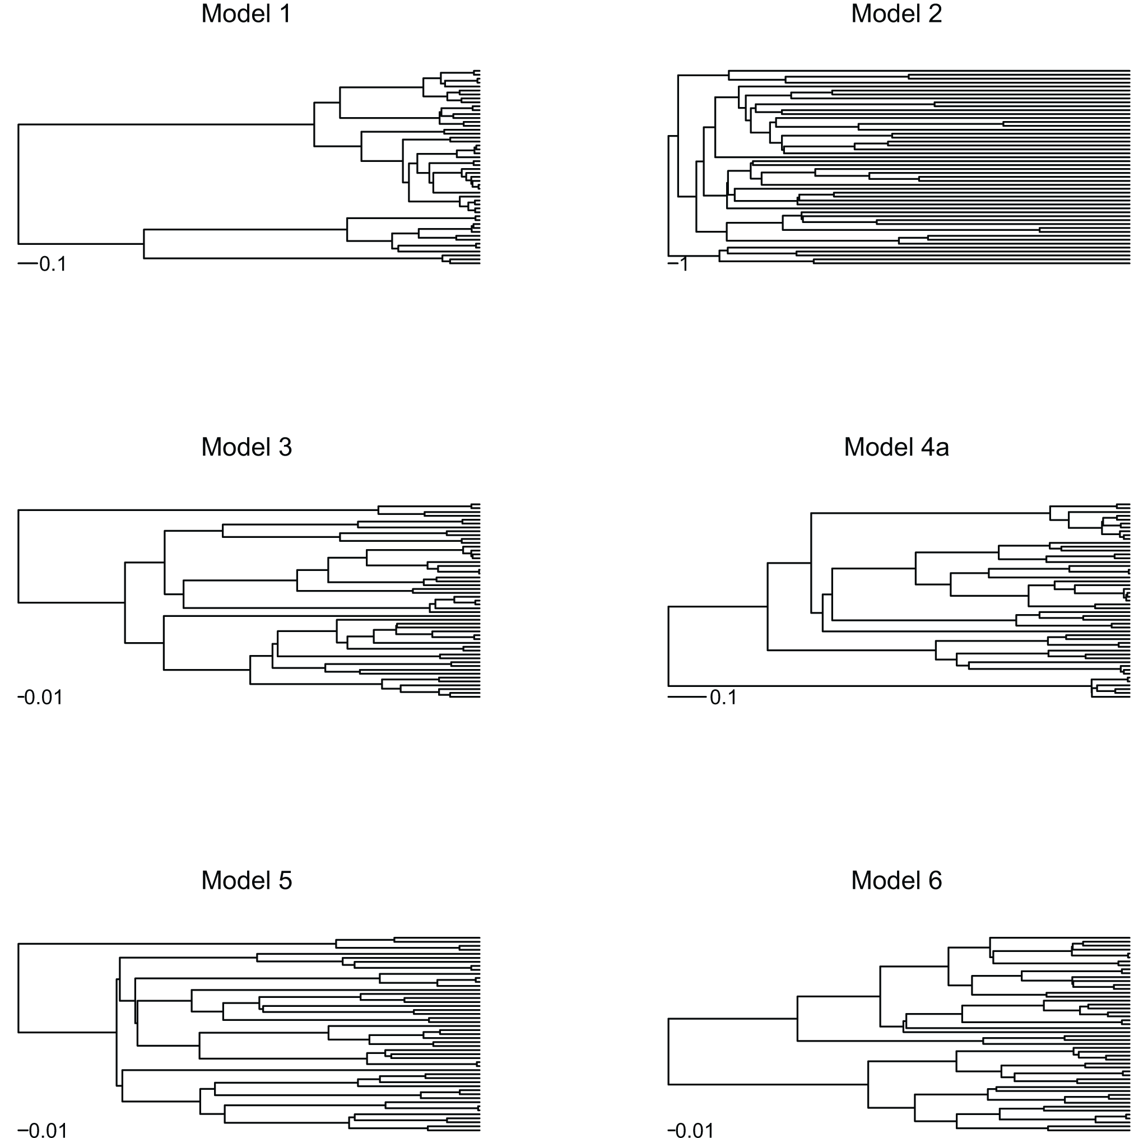
Chronogram prior: Birth-death process
Phylogenies simulated under a model with saturated diversity and a constant turnover rate (Model 1) have short terminal branches compared to phylogenies simulated under the pure-birth process (Yule model; Model 5). With saturated diversity but decaying turnover rates, terminal branches become longer (Model 2). Compared to the pure-birth process (Model 5), the presence of extinction pushes phylogenetic nodes towards the tips (Model 3), whereas a decay in speciation rate pushes them towards the root (Model 6). In the presence of both extinction and a decay in speciation rate (Model 4), however, these two effects counteract, producing a phylogeny that appears similar to the pure-birth model. All phylogenies were simulated with the same initial speciation rate (six speciation events per time unit). The extinction rate in Models 3 and 4a was identical (three speciation events per time unit). The exponential variation in speciation rate in Models 2, 4a, and 6 was identical (0.25 per time unit). Note the different time scales.
Morlon et al., 2010

Slide 114
Bayesian phylogenetics
Posterior probability
Likelihood:
Cf Alexis’s talk!
Marginal likelihood
Prior probability
In phylogenetics:
  D: aligned sequence data
  M: the model can be very complicated, but usually contains:
    Topology
    Branch lengths
    Rate matrix
    Etc…
  θ: the values of the parameters above

Slide 115
Bayesian phylogenetics
Posterior probability
Likelihood:
Cf Alexis’s talk!
Marginal likelihood
Prior probability
In phylogenetics:
  D: aligned sequence data
  M: the model can be very complicated, but usually contains:
    Topology
    Branch lengths
    Rate matrix
    Etc…
  θ: the values of the parameters above

Slide 116
Smart sampling of P(θ|D)
Smart sampling = no need to sample a huge number of points !
→ Ideally : Sample trees and parameter values with a frequency equal to their probability.
E.g.: we would sample one of our 9 trees 99% of the time!
Several approaches:
Importance sampling
Markov Chain Monte Carlo (MCMC)
Sequential Monte Carlo
...

Slide 117
Smart sampling of P(θ|D)
Smart sampling = no need to sample a huge number of points !
→ Ideally : Sample trees and parameter values with a frequency equal to their probability.
E.g.: we would sample one of our 9 trees 99% of the time!
Several approaches:
Importance sampling
Markov Chain Monte Carlo (MCMC)
Sequential Monte Carlo
...
Next time!

Slide 118
Conclusion
One can perform inference according to the posterior probability of a probabilistic model
That’s what Bayesian inference is about
It combines the likelihood with priors on parameter values
In phylogenetics, the likelihood is typically computed thanks to Felsenstein’s pruning algorithm (1981, cf Alexis)
Then priors need to be defined for:
  Topologies and branch lengths / chronograms
  Rates
  Other parameters…
When parameters are independent, to compute the prior of all parameter values, one only needs to compute the product over individual parameter priors

Slide 119
Plan: Criteria for evaluating phylogenies
Criteria for evaluating phylogenetic trees:
  Parsimony
  Distance methods
  Maximum Likelihood
  Posterior probability (Bayesian approach)
Conventions:
  We’re dealing with aligned sequence data
  gaps are not taken into account
Optimization algorithms
(Alexis, afternoon)
MCMC
(Mike, tomorrow)

