Slide 1



Introduction to modelling sequence evolution
Bastien Boussau
Bastien.boussau@univ-lyon1.fr
@bastounette

Slide 2
Aims
Understand the main ideas underlying models of sequence evolution
To do so, we will:
  Introduce important probability notions
  Simulate the evolution of a simple binary character through time
    In steps
    In continuous time
  Extend to more general alphabets
  Extend to longer sequences
  Extend to a tree
Briefly present some of the main models of nucleotide evolution

Slide 3
Why modelling sequence evolution?
Generic statistical paradigm
Question about some part of the world
Model of how this part of the world works
Collect data
Estimate parameters of the model that allow answering the question

Slide 4
Why modelling sequence evolution?
Generic statistical paradigm
Example
Question about some part of the world
Model of how this part of the world works
Collect data
Estimate parameters of the model that allow answering the question
Is my coin fair?
Repeated throws=independent identically distributed Bernoulli draws
Throw coin N times
Estimate probability of heads

Slide 5
Why modelling sequence evolution?
Generic statistical paradigm
Phylogeny example
Question about some part of the world
Model of how this part of the world works
Collect data
Estimate parameters of the model that allow answering the question
Are transitions as probable as transversions in rodents?
Sites of alignment=independent identically distributed Markov chains running along a phylogeny
Sequence rodents
Estimate transition/transversion ratio

Slide 6
Why modelling sequence evolution?
Generic statistical paradigm
Phylogeny example
Question about some part of the world
Model of how this part of the world works
Collect data
Estimate parameters of the model that allow answering the question
Are transitions as probable as transversions in rodents?
Sites of alignment=independent identically distributed Markov chains running along a phylogeny
Sequence rodents
Estimate transition/transversion ratio

Slide 7
Why are we interested in simulations?
Simulating data forces us to think in terms of a generating process
By comparing true to simulated data, we can get a sense of how realistic our model is
Simulations are also central to a lot of inferential problems:
  Validation of inference methods
  Posterior predictive tests
  Approximate Bayesian Computation (ABC)
  ...

Slide 8
Useful probability concepts
Conditional probabilities
Independence/intersection
Union
Bayes theorem
Common distributions that will be useful in this talk:
  Bernoulli
  Binomial
  Poisson
  Exponential

Slide 9
Crash course in probability
A tale of 3 events:
  It is raining in Marseille
  My laundry is dry
  Beyonce is performing somewhere
On average, over a year:
  80 rainy days per year: P(rain today)=80/365
Beyonce is singing the same proportion of time on rainy or sunny days:
Conditional probability

Slide 10




Crash course in probability
Record of various events during 10 days
Days
1
2
3
4
5
6
7
8
9
10
Weather in Lyon
Laundry dry
Beyonce singing

Slide 11
Crash course in probability
Record of various events during 10 days
Days
1
2
3
4
5
6
7
8
9
10
Weather in Lyon
Laundry dry
Beyonce singing

Slide 12
Crash course in probability
Record of various events during 10 days
Days
1
2
3
4
5
6
7
8
9
10
Weather in Lyon
Laundry dry
Beyonce singing

Slide 13
Crash course in probability
Record of various events during 10 days
Days
1
2
3
4
5
6
7
8
9
10
Weather in Lyon
Laundry dry
Beyonce singing

Slide 14
Crash course in probability
Record of various events during 10 days
Days
1
2
3
4
5
6
7
8
9
10
Weather in Lyon
Laundry dry
Beyonce singing

Slide 15
Crash course in probability
Record of various events during 10 days
Days
1
2
3
4
5
6
7
8
9
10
Weather in Lyon
Laundry dry
Beyonce singing
Conditional probability: P(A|B)

Slide 16
Crash course in probability
Record of various events during 10 days
Days
1
2
3
4
5
6
7
8
9
10
Weather in Lyon
Laundry dry
Beyonce singing

Slide 17
Crash course in probability
Record of various events during 10 days
Days
1
2
3
4
5
6
7
8
9
10
Weather in Lyon
Laundry dry
Beyonce singing

Slide 18
Crash course in probability
Record of various events during 10 days
Days
1
2
3
4
5
6
7
8
9
10
Weather in Lyon
Laundry dry
Beyonce singing
The events “Beyonce singing” and “sunny” are independent

Slide 19
Crash course in probability
Record of various events during 10 days
Days
1
2
3
4
5
6
7
8
9
10
Weather in Lyon
Laundry dry
Beyonce singing
The events “dry laundry” and “sunny” are NOT independent

Slide 20
Crash course in probability
Record of various events during 10 days
Days
1
2
3
4
5
6
7
8
9
10
Weather in Lyon
Laundry dry
Beyonce singing

Slide 21
Bayes formula
Days
1
2
3
4
5
6
7
8
9
10
Weather in Lyon
Laundry dry
Beyonce singing

Slide 22



Useful distributions
Discrete distributions (values in {0,1}, {0,1,2...}):
  Bernoulli: coin flip:
  Binomial: how many heads in several coin flips:
  Poisson: how many events of a type over a continuous time: how many meteorites with diameter > 1m in a year:
Continuous distributions (values in ℝ, [0,1]...):
  Exponential: Time between events in a Poisson process: how much time between two meteorites with diameter >1m:

Slide 23
Aims
Understand the main ideas underlying models of sequence evolution
To do so, we will:
  Introduce important probability notions
  Simulate the evolution of a simple binary character through time
    In steps
    In continuous time
  Extend to more general alphabets
  Extend to longer sequences
  Extend to a tree
Briefly present some of the main models of nucleotide evolution

Slide 24
How would we simulate the evolution of a binary character?
2 states: {0,1}

Slide 25
Evolution of a binary character
2 states: {0,1}
t = t₀
Time t

Slide 26
Evolution of a binary character
2 states: {0,1}
1
t = t₀
Time t

Slide 27
Evolution of a binary character
2 states: {0,1}
1
t = t₀
t = T
Time t
Number of substitutions at time t₀:
N(t₀) = 0

Slide 28
Evolution of a binary character
2 states: {0,1}
1
1→ 0
t = t₀
t = t₁
t = T
Time t
N(t₁) = 1

Slide 29
Evolution of a binary character
2 states: {0,1}
1
1→ 0
0→ 1
t = t₀
t = t₁
t = t₂
t = T
Time t
N(t₂) = 2

Slide 30
Evolution of a binary character
2 states: {0,1}
1
1→ 0
0→ 1
1→ 0
t = t₀
t = t₁
t = t₂
t = t₃
t = T
Time t
N(t₃) = 3

Slide 31
Evolution of a binary character
2 states: {0,1}
1
1→ 0
0→ 1
1→ 0
t = t₀
t = t₁
t = t₂
t = t₃
t = T
Time t
N(T) = 3

Slide 32
Evolution of a binary character
2 states: {0,1}
1
1→ 0
0→ 1
1→ 0
t = t₀
t = t₁
t = t₂
t = t₃
t = T
Time t
N(T) = 3
Could we simulate this process just with coin flips?

Slide 33
Evolution of a binary character
2 states: {0,1}
1
1→ 0
0→ 1
1→ 0
t = t₀
t = t₁
t = t₂
t = t₃
t = T
Time t
N(T) = 3
?
t = t₀
t = T
Time t

Slide 34
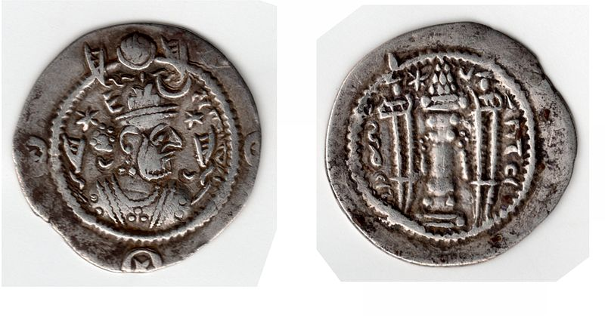
Evolution of a binary character
2 states: {0,1}
1
1→ 0
0→ 1
1→ 0
t = t₀
t = t₁
t = t₂
t = t₃
t = T
Time t
N(T) = 3
?
t = t₀
t = T
Time t

Slide 35
Evolution of a binary character
2 states: {0,1}
1
1→ 0
0→ 1
1→ 0
t = t₀
t = t₁
t = t₂
t = t₃
t = T
Time t
N(T) = 3
?
t = t₀
t = T
Time t
P(H) = ½

Slide 36
Evolution of a binary character
2 states: {0,1}
1
1→ 0
0→ 1
1→ 0
t = t₀
t = t₁
t = t₂
t = t₃
t = T
Time t
N(T) = 3
1
t = t₀
t = T
Time t
P(H) = ½

Slide 37
Evolution of a binary character
2 states: {0,1}
1
1→ 0
0→ 1
1→ 0
t = t₀
t = t₁
t = t₂
t = t₃
t = T
Time t
N(T) = 3
1
t = t₀
t = T
Time t
dt

Slide 38
Evolution of a binary character
2 states: {0,1}
1
1→ 0
0→ 1
1→ 0
t = t₀
t = t₁
t = t₂
t = t₃
t = T
Time t
N(T) = 3
1
t = t₀
t = T
Time t
dt

Slide 39
Evolution of a binary character
2 states: {0,1}
1
1→ 0
0→ 1
1→ 0
t = t₀
t = t₁
t = t₂
t = t₃
t = T
Time t
N(T) = 3
1
t = t₀
t = T
Time t
dt
P(H) = ½

Slide 40
Evolution of a binary character
2 states: {0,1}
1
1→ 0
0→ 1
1→ 0
t = t₀
t = t₁
t = t₂
t = t₃
t = T
Time t
t = T
N(T) = 3
1→ 0
0→ 1
0→ 1
1→ 0
1
1→ 0
0→ 1
1→ 0
1→ 0
0→ 1
1→ 0
0→ 1
T
T
H
T
T
H
T
H
H
H
T
H
T
T
T
H
T
T
T
T
H
T
H
T
T
H
H
t = t₀
t = T
Time t
dt
N(T) = 11
P(H) = ½

Slide 41
Evolution of a binary character
2 states: {0,1}
1
1→ 0
0→ 1
1→ 0
t = t₀
t = t₁
t = t₂
t = t₃
t = T
Time t
t = T
N(T) = 3
1→ 0
0→ 1
0→ 1
1→ 0
1
1→ 0
0→ 1
1→ 0
1→ 0
0→ 1
1→ 0
0→ 1
T
T
H
T
T
H
T
H
H
H
T
H
T
T
T
H
T
T
T
T
H
T
H
T
T
H
H
t = t₀
t = T
Time t
dt
N(T) = 11
P(H) = ½
Is our model realistic?

Slide 42
Evolution of a binary character
2 states: {0,1}
1
1→ 0
0→ 1
1→ 0
t = t₀
t = t₁
t = t₂
t = t₃
t = T
Time t
t = T
N(T) = 3
1→ 0
0→ 1
0→ 1
1→ 0
1
1→ 0
0→ 1
1→ 0
1→ 0
0→ 1
1→ 0
0→ 1
T
T
H
T
T
H
T
H
H
H
T
H
T
T
T
H
T
T
T
T
H
T
H
T
T
H
H
t = t₀
t = T
Time t
dt
N(T) = 11
P(H) = ½ p
Is our model realistic?

Slide 43
Our model so far
1→ 0
0→ 1
0→ 1
1→ 0
1
1→ 0
0→ 1
1→ 0
1→ 0
0→ 1
1→ 0
0→ 1
T
T
H
T
T
H
T
H
H
H
T
H
T
T
T
H
T
T
T
T
H
T
H
T
T
H
H
t = t₀
t = T
Time t
dt
N(T) = 11
P(H) = p
Discretization of time into n short intervals of length dt
Initial state: draw from a Bernoulli(p)
Substitutions: in each interval, draw from a Bernoulli(p)

Slide 44
Our model so far
1→ 0
0→ 1
0→ 1
1→ 0
1
1→ 0
0→ 1
1→ 0
1→ 0
0→ 1
1→ 0
0→ 1
T
T
H
T
T
H
T
H
H
H
T
H
T
T
T
H
T
T
T
T
H
T
H
T
T
H
H
t = t₀
t = T
Time t
dt
N(T) = 11
P(H) = p
Discretization of time into n short intervals of length dt
Initial state: draw from a Bernoulli(p)
Substitutions: in each interval, draw from a Bernoulli(p)
What is the distribution of N(T)?

Slide 45
Our model so far
1→ 0
0→ 1
0→ 1
1→ 0
1
1→ 0
0→ 1
1→ 0
1→ 0
0→ 1
1→ 0
0→ 1
T
T
H
T
T
H
T
H
H
H
T
H
T
T
T
H
T
T
T
T
H
T
H
T
T
H
H
t = t₀
t = T
Time t
dt
N(T) = 11
P(H) = p
Discretization of time into n short intervals of length dt
Initial state: draw from a Bernoulli(p)
Substitutions: in each interval, draw from a Bernoulli(p)
N(T)~Binomial(n, p)

Slide 46
From a discrete to a continuous model
t = t₀
t = T
dt
If dt → 0 or, equivalently, n→∞, towards what distribution tends N(t) ?

Slide 47
From a discrete to a continuous model
t = t₀
t = T
dt
If dt → 0 or, equivalently, n→∞, towards what distribution tends N(t) ?

Slide 48
From a discrete to a continuous model
t = t₀
t = T
dt
If dt → 0 or, equivalently, n→∞, towards what distribution tends N(t) ?

Slide 49
From a discrete to a continuous model
t = t₀
t = T
dt
If dt → 0 or, equivalently, n→∞, towards what distribution tends N(t) ?

Slide 50
The Poisson process
Let λ>0. The counting process {N(t),t∈[0,∞)} is a Poisson process of rate λ if all the following conditions apply:
  N(0)=0;
  N(t) has independent increments;
  The number of events in any interval τ>0 has distribution Poisson(λτ).

Slide 51
Waiting times in Poisson processes
X₁
X₂
X₃
t = t₀
t = t₁
t = t₂
t = t₃
t = T
t = T
Waiting time:
Time between the beginning of the process and the first event
Time between 2 events.
Let’s call a waiting time X.

Slide 52
Waiting times in Poisson processes
X₁
X₂
X₃
t = t₀
t = t₁
t = t₂
t = t₃
t = T
t = T

Slide 53
Waiting times in a Poisson process
X₁
X₂
X₃
t = t₀
t = t₁
t = t₂
t = t₃
t = T
t = T
The Xi variables are the waiting times between events. They are all independent and follow the same distribution :

Slide 54
Modelling the evolution of a binary trait: summary
  We can simulate its evolution by repeating n Bernoulli draws during time intervals dt
  N(t) follows a Binomial distribution
  When dt becomes very small, N(t) follows a Poisson distribution of parameter λ=n.dt
  Waiting times between events follow an exponential distribution of same rate parameter λ

Slide 55
Modelling the evolution of a binary trait: summary
  We can simulate its evolution by repeating n Bernoulli draws during time intervals dt
  N(t) follows a Binomial distribution
  When dt becomes very small, N(t) follows a Poisson distribution of parameter λ=n.dt
  Waiting times between events follow an exponential distribution of same rate parameter λ
Can you think of a way to simulate the evolution of a binary trait in continuous time?

Slide 56
Modelling the evolution of a binary trait in continuous time
X₁
X₂
X₃
t = t₀
t = t₁
t = t₂
t = t₃
t = T
t = T
  Draw an initial state from a Bernoulli distribution:
p=0.3; state=rbinom(1,1,p)
  t = t₀ ; N = 0 ; λ=0.1
  While t < T :
    Draw from an exponential distribution a waiting time Xi until the next event; t = t + Xi
      If t < T, change the state of the variable
      (Else (t≥T): we stop)

Slide 57
Our model of DNA evolution in continuous time is a Markov process
X₁
X₂
X₃
t = t₀
t = t₁
t = t₂
t = t₃
t = T
t = T
At any given time, the next state only depends on the current state, not on the previous states.
Therefore, we have defined a Markov chain.

Slide 58
R function to simulate the evolution of a binary trait
simulate <- function (T, p, lambda) {
N = 0
t = 0.0
state = rbinom(1,1,p)
states = c(state)
waitingTimes = c()
while (t < T) {
X = rexp(n=1, lambda)
t = t+X
if (t < T) {
N=N+1
if (state == 0) {
state = 1
}
else {
state = 0
}
states=c(states, state)
waitingTimes = c(waitingTimes, X)
}
}
return (list(N, states, waitingTimes))
}

Slide 59
Aims
Understand the main ideas underlying models of sequence evolution
To do so, we will:
  Introduce important probability notions
  Simulate the evolution of a simple binary character through time
    In steps
    In continuous time
  Extend to more general alphabets
  Extend to longer sequences
  Extend to a tree
Briefly present some of the main models of nucleotide evolution

Slide 60
Modelling the evolution of a DNA character in continuous time
A
C
A
G
t = t₀
t = t₁
t = t₂
t = t₃
t = T
t = T

Slide 61
Modelling the evolution of a DNA character in continuous time
A
X₁
C
X₂
A
X₃
G
t = t₀
t = t₁
t = t₂
t = t₃
t = T
t = T

Slide 62
Modelling the evolution of a DNA character in continuous time
A
X₁
C
X₂
A
X₃
G
t = t₀
t = t₁
t = t₂
t = t₃
t = T
t = T
  Draw an initial state from a Multinomial distribution:
p=c(0.25, 0.25, 0.25, 0.25); state=rmultinom(n=1, p=p, size=1)
  t = t₀ ; N = 0 ; λ=0.1
  While t < T :
    Draw from an exponential distribution a waiting time Xi until the next event; t = t + Xi
      If t < T, change the state of the variable: state=rmultinom(n=1, p=p, size=1)
      (Else (t≥T): we stop)

Slide 63
Aims
Understand the main ideas underlying models of sequence evolution
To do so, we will:
  Introduce important probability notions
  Simulate the evolution of a simple binary character through time
    In steps
    In continuous time
  Extend to more general alphabets
  Extend to a tree
  Extend to longer sequences
Briefly present some of the main models of nucleotide evolution

Slide 64
From one branch to two
A
X₁
C
X₂
A
X₃
G
t = t₀
t = t₀
t = t₁
t = t₁
t = t₂
t = t₂
t = t₃
t = t₃
t = T
t = T
t = T
t = T
t = t₀
t = T

Slide 65
From one branch to two
A
X₁
C
X₂
A
X₃
G
t = t₀
t = t₀
t = t₁
t = t₁
t = t₂
t = t₂
t = t₃
t = t₃
t = T
t = T
t = T
t = T
t = t₀
t = T

Slide 66
From one branch to two
A
X₁
C
X₂
A
X₃
G
t = t₀
t = t₀
t = t₁
t = t₁
t = t₂
t = t₂
t = t₃
t = t₃
t = T
t = T
t = T
t = T
t = t₀
t = T
Draw an initial state from a Multinomial distribution
  Left branch = simulate(state, T)
  Right branch = simulate(state, T)

Slide 67
From one branch to two
A
X₁
C
X₂
A
X₃
G
t = t₀
t = t₀
t = t₁
t = t₁
t = t₂
t = t₂
t = t₃
t = t₃
t = T
t = T
t = T
t = T
t = t₀
A
A
t = T
Draw an initial state from a Multinomial distribution
  Left branch = simulate(state, T)
  Right branch = simulate(state, T)

Slide 68
From one branch to two
A
X₁
C
X₂
A
X₃
G
t = t₀
t = t₀
t = t₁
t = t₁
t = t₂
t = t₂
t = t₃
t = t₃
t = T
t = T
t = T
t = T
t = t₀
A
A
t = T
Draw an initial state from a Multinomial distribution
  Left branch = simulate(state, T)
  Right branch = simulate(state, T)
We assume independence between the two branches

Slide 69
Simulating on a tree
t = t₀
A
b₂
t = t₁
b₁
b₃
b₄
t = T

Slide 70
Simulating on a tree
t = t₀
A
b₂
t = t₁
b₁
b₃
b₄
t = T
Draw an initial state from a Multinomial distribution
  Branch b₁ = simulate(state, T)
  Branch b₂ = simulate(state, t₁)
  Branch b₃ = simulate(state(end Branch b₂), T-t₁)
  Branch b₄ = simulate(state(end Branch b₂), T-t₁)

Slide 71
Aims
Understand the main ideas underlying models of sequence evolution
To do so, we will:
  Introduce important probability notions
  Simulate the evolution of a simple binary character through time
    In steps
    In continuous time
  Extend to more general alphabets
  Extend to a tree
  Extend to longer sequences
Briefly present some of the main models of nucleotide evolution

Slide 72
From one site to several
t = t₀
AACT
t = T
ATGT

Slide 73
From one site to several
t = t₀
AACT
t = T
ATGT
For i in {1..Number of sites}
  Draw an initial state state_{i} from a Multinomial distribution
  Site_{i} = simulate(state_{i}, T)

Slide 74
From one site to several, on a tree
t = t₀
AACT
b₂
t = t₁
b₁
b₃
b₄
t = T
For i in {1..Number of sites}
  Draw an initial state state_{i} from a Multinomial distribution
  Site_{i} = simulate_along_tree(state_{i})

Slide 75
Summary
We can simulate the evolution of a DNA character by drawing an initial state, then waiting times between substitutions
We can simulate on a tree by taking as initial state for child branches the terminal state of parent branches
We can simulate many independent sites, assuming they are all identically distributed.

Slide 76
Aims
Understand the main ideas underlying models of sequence evolution
To do so, we will:
  Introduce important probability notions
  Simulate the evolution of a simple binary character through time
    In steps
    In continuous time
  Extend to more general alphabets
  Extend to a tree
  Extend to longer sequences
Briefly present some of the main models of nucleotide evolution

Slide 77
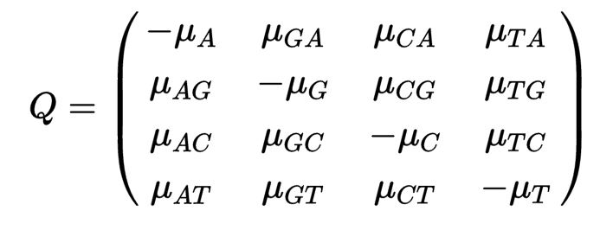
Substitution models
Rate matrix

Slide 78
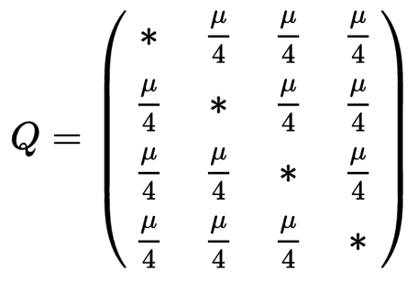
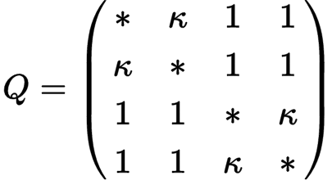
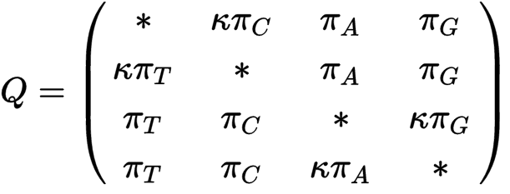
Substitution models
Rate matrix
Jukes and Cantor 1969
Hasegawa, Kishino, Yano 1985
Kimura 1980
1 free parameter (0 if we impose one substitution per unit time)
1 transition/transversion ratio : 1 free parameter
1 transition/transversion ratio
4 equilibrium frequencies:
4 free parameters

Slide 79
Substitution models
Rate matrix
Jukes and Cantor 1969
Hasegawa, Kishino, Yano 1985
Kimura 1980
1 free parameter (0 if we impose one substitution per unit time)
1 transition/transversion ratio : 1 free parameter
1 transition/transversion ratio
4 equilibrium frequencies:
4 free parameters
All those are particular cases of the GTR model

Slide 80
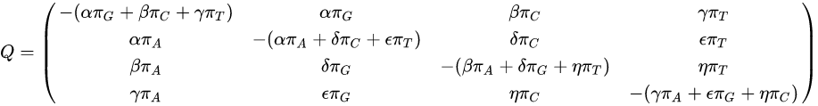
General Time Reversible model of substitution
Rate matrix
Lanave et al. 1984; Tavaré, 1986
4 equilibrium frequencies: 3 parameters
6 exchangeability parameters: 5 parameters (if we impose one substitution per unit time)
More general models do not assume reversibility (e.g. Barry-Hartigan model)

