Slide 1



Phylogenetic reconstruction: criteria
Bastien Boussau and Brian Moore
Bastien.boussau@univ-lyon1.fr
@bastounette

Slide 2
Phylogenetic inference
How to find the best tree given my data?
Need for a criterion/score
Need for an algorithm to find/construct the tree

Slide 3
Phylogenetic inference
How to find the best tree given my data?
Need for a criterion/score
  Maximum Parsimony
  Minimum Evolution or least squares (distance methods)
  Maximum Likelihood ~ P(D|M)
  Posterior Probability P(M|D)
Need for an algorithm to find/construct the tree

Slide 4
Phylogenetic inference
How to find the best tree given my data?
Need for a criterion/score
  Maximum Parsimony
  Minimum Evolution or least squares (distance methods)
  Maximum Likelihood ~ P(D|M)
  Posterior Probability P(M|D)
Need for an algorithm to find/construct the tree
M
M
M

Slide 5
Phylogenetic inference
How to find the best tree given my data?
Need for a criterion/score
  Maximum Parsimony
  Minimum Evolution or least squares (distance methods)
  Maximum Likelihood ~ P(D|M)
  Posterior Probability P(M|D)
Need for an algorithm to find/construct the tree
  e.g.: try several topologies, (choose some branch lengths,) score the topologies, choose the one that has the best score
M
M
M

Slide 6
Plan: Criteria for evaluating phylogenies
Criteria for evaluating phylogenetic trees:
  Parsimony
  Distance methods
  Maximum Likelihood
    Using a Monte Carlo simulation
    Using Felsenstein’s pruning algorithm
  Posterior probability (Bayesian approach)
Conventions:
  We’re dealing with aligned sequence data
  gaps are not taken into account

Slide 7
Parsimony
“The principle that the most acceptable explanation of an occurrence, phenomenon, or event is the simplest, involving the fewest entities, assumptions, or changes. In phylogenetics, for example, the preferred tree showing evolutionary relationships between species, molecules, or other entities is the one that requires the least amount of evolutionary change, that is, maximum parsimony.”
https://www.oxfordreference.com/view/10.1093/oi/authority.20110803100346221

Slide 8
Maximum parsimony
Criteria: Maximum Parsimony
Has been advocated strongly by some against model-based approaches: many controversies (see “The Troubled Growth of Statistical Phylogenetics”, Felsenstein 2001)
Edwards and Cavalli-Sforza (1963): the preferred evolutionary tree involves “the minimum net amount of evolution” = Maximum parsimony tree
→ For sequence data: find the phylogeny that involves the minimum number of substitutions
→ We need a way to count the minimum number of substitutions on a phylogeny = compute the parsimony score of a phylogenetic tree

Slide 9
How to compute the parsimony score?
Alexis!

Slide 10
Computing the parsimony score
Criteria: Maximum Parsimony
Sp1
Sp1 ATGCGCT...
Sp2 AGTCGCA...
Sp3 AGGTGCA...
Sp4 ATGCCCT...
Sp3
Sp2
Sp4
Parsimony score of a tree given an alignment: sum of the parsimony scores for each site
→ We assume that all sites are independent

Slide 11
Computing the parsimony score at one site
Criteria: Maximum Parsimony
Species tree S
Site i
Sp1
Sp3
A
C
X
Y
A
C
Sp2
Sp4
X and Y not observed

Slide 12
Computing the parsimony score at one site
Criteria: Maximum Parsimony
Species tree S
Site i
Sp1
Sp3
A
C
X
Y
A
C
Sp2
Sp4
X and Y not observed
Sp1
Sp3
Sp1
Sp3
Sp1
Sp3
A
C
A
C
A
C
A
C
A
A
T
G
A
C
A
C
A
C
Sp2
Sp4
Sp2
Sp4
Sp2
Sp4

Slide 13
Computing the parsimony score at one site
Criteria: Maximum Parsimony
Species tree S
Site i
Sp1
Sp3
A
C
X
Y
A
C
Sp2
Sp4
X and Y not observed
Sp1
Sp3
Sp1
Sp3
Sp1
Sp3
A
C
A
C
A
C
A
C
A
A
T
G
A
C
A
C
A
C
Sp2
Sp4
Sp2
Sp4
Sp2
Sp4
1 substitution
2 substitutions
5 substitutions

Slide 14
Computing the parsimony score at one site
Criteria: Maximum Parsimony
Species tree S
Site i
Sp1
Sp3
A
C
X
Y
A
C
Sp2
Sp4
X and Y not observed
Sp1
Sp3
Sp1
Sp3
Sp1
Sp3
A
C
A
C
A
C
A
C
A
A
T
G
A
C
A
C
A
C
Sp2
Sp4
Sp2
Sp4
Sp2
Sp4
1 substitution
2 substitutions
5 substitutions
Parsimony score of species tree S for site i: 1

Slide 15
Computing the parsimony score of a tree at one site
Criteria: Maximum Parsimony
Naive brute force approach: test all possible assignments on internal nodes
  N internal nodes, 4 possibilities {A,C,G,T} per node
  → 4^{N} possibilities to try
Fitch’s algorithm (1971):
  Arbitrarily root the tree
  Compute, from the tips up, two elements per node:
    P: The score of the underlying subtree
    X: The set of states possible at that node, given the score P
  Complexity: O(4N)

Slide 16
Computing the parsimony score of a tree at one site
Criteria: Maximum Parsimony
Naive brute force approach: test all possible assignments on internal nodes
  N internal nodes, 4 possibilities {A,C,G,T} per node
  → 4^{N} possibilities to try
Fitch’s algorithm (1971):
  Arbitrarily root the tree
  Compute, from the tips up, two elements per node:
    P: The score of the underlying subtree
    X: The set of states possible at that node, given the score P
  Complexity: O(4N)
For 2 internal nodes: 4² = 16

Slide 17
Computing the parsimony score of a tree at one site
Criteria: Maximum Parsimony
Naive brute force approach: test all possible assignments on internal nodes
  N internal nodes, 4 possibilities {A,C,G,T} per node
  → 4^{N} possibilities to try
Fitch’s algorithm (1971):
  Arbitrarily root the tree
  Compute, from the tips up, two elements per node:
    P: The score of the underlying subtree
    X: The set of states possible at that node, given the score P
  Complexity: O(4N)
For 2 internal nodes: 4² = 16
For 2 internal nodes: 4*2 =8

Slide 18
Fitch’s algorithm
Criteria: Maximum Parsimony
P: The score of the underlying subtree
X: The set of states possible at that node, given the score P
Climbing up the tree: computing P and X for a node given its children
1st case: X₁∩X₂ not empty
X₁,P₁
X₂,P₂
2nd case: X₁∩X₂ empty
X₁,P₁
X₂,P₂

Slide 19
Fitch’s algorithm
Criteria: Maximum Parsimony
P: The score of the underlying subtree
X: The set of states possible at that node, given the score P
Climbing up the tree: computing P and X for a node given its children
1st case: X₁∩X₂ not empty
X₁∩X₂,P₁+P₂
{A},3
X₁,P₁
X₂,P₂
{A,T},1
{A,C},2
2nd case: X₁∩X₂ empty
X₁,P₁
X₂,P₂

Slide 20
Fitch’s algorithm
Criteria: Maximum Parsimony
P: The score of the underlying subtree
X: The set of states possible at that node, given the score P
Climbing up the tree: computing P and X for a node given its children
1st case: X₁∩X₂ not empty
X₁∩X₂,P₁+P₂
{A},3
X₁,P₁
X₂,P₂
{A,T},1
{A,C},2
2nd case: X₁∩X₂ empty
X₁UX₂,P₁+P₂+1
X₁,P₁
X₂,P₂

Slide 21
Fitch’s algorithm
Criteria: Maximum Parsimony
P: The score of the underlying subtree
X: The set of states possible at that node, given the score P
Climbing up the tree: computing P and X for a node given its children
1st case: X₁∩X₂ not empty
X₁∩X₂,P₁+P₂
{A},3
X₁,P₁
X₂,P₂
{A,T},1
{A,C},2
2nd case: X₁∩X₂ empty
{A,C,G,T},4
X₁UX₂,P₁+P₂+1
{A,G},4
{C,T},4
X₁,P₁
X₂,P₂
{C,T},1
{A,G},2
{C,T},1
{A,G},2

Slide 22
Example
Criteria: Maximum Parsimony
C
T
G
T
A
A

Slide 23
Example
Criteria: Maximum Parsimony
{C},0
{T},0
{G},0
{T},0
{A},0
{A},0

Slide 24
Example
Criteria: Maximum Parsimony
{C,T},1
{C},0
{T},0
{G},0
{T},0
{A},0
{A},0

Slide 25
Example
Criteria: Maximum Parsimony
{C,T},1
{G,T},1
{C},0
{T},0
{G},0
{T},0
{A},0
{A},0

Slide 26
Example
Criteria: Maximum Parsimony
{A,G,T},2
{C,T},1
{G,T},1
{C},0
{T},0
{G},0
{T},0
{A},0
{A},0

Slide 27
Example
Criteria: Maximum Parsimony
{T},3
{A,G,T},2
{C,T},1
{G,T},1
{C},0
{T},0
{G},0
{T},0
{A},0
{A},0

Slide 28
Example
Criteria: Maximum Parsimony
{A,T},4
{T},3
{A,G,T},2
{C,T},1
{G,T},1
{C},0
{T},0
{G},0
{T},0
{A},0
{A},0

Slide 29
Example
Criteria: Maximum Parsimony
C
A
T
A
{A,T},4
T
A
T
A
{T},3
G
T
C
A
{A,G,T},2
{C,T},1
{G,T},1
T
T
T
T
G
T
A
{C},0
{T},0
{G},0
{T},0
{A},0
{A},0
T
Several possible scenarios

Slide 30
Conclusion on maximum parsimony
Involves looking for the tree with the least amount of change
Computing the parsimony score of a tree can be done with Fitch’s algorithm
Searching through topology space for the most parsimonious tree can be done with algorithms similar to those used for Maximum Likelihood reconstruction (see Alexis’s talk)

Slide 31
Plan: Criteria for evaluating phylogenies
Criteria for evaluating phylogenetic trees:
  Parsimony
  Distance methods
  Maximum Likelihood
    Using a Monte Carlo simulation
    Using Felsenstein’s pruning algorithm
  Posterior probability (Bayesian approach)
Conventions:
  We’re dealing with aligned sequence data
  gaps are not taken into account

Slide 32
Distance methods
Distance-based approaches:
  least squares methods,
  Minimum evolution method,
  Neighbor Joining.

Slide 33
Criteria for phylogenetic inference
Criteria/scores
  Maximum Parsimony
  Minimum Evolution or least squares (distance methods)
  Maximum Likelihood ~ P(D|M)
  Posterior Probability P(M|D)
M
M
M

Slide 34
Minimum Evolution or least squares: distance methods
Criteria: Minimum Evolution or least squares
Uses a distance matrix:
Sp1 ATGCGCT...
Sp2 AGTCGCA...
Sp3 AGGTGCA...
Sp4 ATGCCCT...

Slide 35
Minimum Evolution or least squares: distance methods
Criteria: Minimum Evolution or least squares
Uses a distance matrix:
 | Sp1 | Sp2 | Sp3 | Sp4
Sp1 | 0 | 0.1 | 0.2 | 0.15
Sp2 | 0.1 | 0 | 0.3 | 0.01
Sp3 | 0.2 | 0.3 | 0 | 0.6
Sp4 | 0.15 | 0.01 | 0.6 | 0
Sp1 ATGCGCT...
Sp2 AGTCGCA...
Sp3 AGGTGCA...
Sp4 ATGCCCT...
1

Slide 36
Minimum Evolution or least squares: distance methods
Criteria: Minimum Evolution or least squares
Uses a distance matrix:
 | Sp1 | Sp2 | Sp3 | Sp4
Sp1 | 0 | 0.1 | 0.2 | 0.15
Sp2 | 0.1 | 0 | 0.3 | 0.01
Sp3 | 0.2 | 0.3 | 0 | 0.6
Sp4 | 0.15 | 0.01 | 0.6 | 0
Sp1 ATGCGCT...
Sp2 AGTCGCA...
Sp3 AGGTGCA...
Sp4 ATGCCCT...
1
2
Sp1
Sp1
Sp1
Sp3
Sp3
Sp3
Sp2
Sp4
Sp2
Sp4
Sp2
Sp4

Slide 37
Minimum Evolution or least squares: distance methods
Criteria: Minimum Evolution or least squares
Uses a distance matrix:
 | Sp1 | Sp2 | Sp3 | Sp4
Sp1 | 0 | 0.1 | 0.2 | 0.15
Sp2 | 0.1 | 0 | 0.3 | 0.01
Sp3 | 0.2 | 0.3 | 0 | 0.6
Sp4 | 0.15 | 0.01 | 0.6 | 0
Sp1 ATGCGCT...
Sp2 AGTCGCA...
Sp3 AGGTGCA...
Sp4 ATGCCCT...
1
How to compute the distance matrix?
2
Sp1
Sp1
Sp1
Sp3
Sp3
Sp3
Sp2
Sp4
Sp2
Sp4
Sp2
Sp4

Slide 38
Minimum Evolution or least squares: distance methods
Criteria: Minimum Evolution or least squares
Uses a distance matrix:
 | Sp1 | Sp2 | Sp3 | Sp4
Sp1 | 0 | 0.1 | 0.2 | 0.15
Sp2 | 0.1 | 0 | 0.3 | 0.01
Sp3 | 0.2 | 0.3 | 0 | 0.6
Sp4 | 0.15 | 0.01 | 0.6 | 0
Sp1 ATGCGCT...
Sp2 AGTCGCA...
Sp3 AGGTGCA...
Sp4 ATGCCCT...
1
How to compute the distance matrix?
Which tree fits the distance matrix best?
2
Sp1
Sp1
Sp1
Sp3
Sp3
Sp3
Sp2
Sp4
Sp2
Sp4
Sp2
Sp4

Slide 39
1: How to compute distances between sequences?
Criteria: Minimum Evolution or least squares
Simply count differences (observed divergence)
Sp1 ATGCGCT
Sp2 AGTCGCA
d(Sp1-Sp2) =

Slide 40
1: How to compute distances between sequences?
Criteria: Minimum Evolution or least squares
Simply count differences (observed divergence)
Sp1 ATGCGCT
Sp2 AGTCGCA
d(Sp1-Sp2) =

Slide 41
1: How to compute distances between sequences?
Criteria: Minimum Evolution or least squares
Simply count differences (observed divergence)
Sp1 ATGCGCT
Sp2 AGTCGCA
d(Sp1-Sp2) = 3/7~0.43

Slide 42
1: How to compute distances between sequences?
Criteria: Minimum Evolution or least squares
Simply count differences (observed divergence)
Use a model of sequence evolution
      → cf. talk on models
      Advantages:
        Hidden substitutions are taken into account
        Parameters of the model of substitution can be estimated in the Maximum Likelihood framework
Sp1 ATGCGCT
Sp2 AGTCGCA
d(Sp1-Sp2) = 3/7~0.43

Slide 43

Minimum Evolution or least squares: distance methods
Criteria: Minimum Evolution or least squares
Uses a distance matrix:
 | Sp1 | Sp2 | Sp3 | Sp4
Sp1 | 0 | 0.1 | 0.2 | 0.15
Sp2 | 0.1 | 0 | 0.3 | 0.01
Sp3 | 0.2 | 0.3 | 0 | 0.6
Sp4 | 0.15 | 0.01 | 0.6 | 0
Sp1 ATGCGCT...
Sp2 AGTCGCA...
Sp3 AGGTGCA...
Sp4 ATGCCCT...
1
How to compute the distance matrix?
Which tree fits the distance matrix best?
2
Sp1
Sp1
Sp1
Sp3
Sp3
Sp3
Sp2
Sp4
Sp2
Sp4
Sp2
Sp4

Slide 44
2: How to compute the fit between a distance matrix and a tree?
Criteria: Minimum Evolution or least squares
A tree implies distances between tips: compare those patristic distances to sequence-based distances
Sp1
Sp3
0.2
0.35
0.1
0.1
0.15
Sp2
Sp4

Slide 45
2: How to compute the fit between a distance matrix and a tree?
Criteria: Minimum Evolution or least squares
A tree implies distances between tips: compare those patristic distances to sequence-based distances
Sp1
 | Sp1 | Sp2 | Sp3 | Sp4
Sp1 | 0 | 0.3 | 0.65 | 0.7
Sp2 | 0.3 | 0 | 0.55 | 0.6
Sp3 | 0.65 | 0.55 | 0 | 0.25
Sp4 | 0.7 | 0.6 | 0.25 | 0
Sp3
0.2
0.35
0.1
0.1
0.15
Sp2
Sp4

Slide 46
2: How to compute the fit between a distance matrix and a tree?
Criteria: Minimum Evolution or least squares
A tree implies distances between tips: compare those patristic distances to sequence-based distances
Sp1
 | Sp1 | Sp2 | Sp3 | Sp4
Sp1 | 0 | 0.3 | 0.65 | 0.7
Sp2 | 0.3 | 0 | 0.55 | 0.6
Sp3 | 0.65 | 0.55 | 0 | 0.25
Sp4 | 0.7 | 0.6 | 0.25 | 0
Sp3
0.2
0.35
0.1
0.1
0.15
Sp2
Sp4
 | Sp1 | Sp2 | Sp3 | Sp4
Sp1 | 0 | 0.1 | 0.2 | 0.15
Sp2 | 0.1 | 0 | 0.3 | 0.01
Sp3 | 0.2 | 0.3 | 0 | 0.6
Sp4 | 0.15 | 0.01 | 0.6 | 0

Slide 47
2: How to compute the fit between a distance matrix and a tree?
Criteria: Minimum Evolution or least squares
A tree implies distances between tips: compare those patristic distances to sequence-based distances
Sp1
 | Sp1 | Sp2 | Sp3 | Sp4
Sp1 | 0 | 0.3 | 0.65 | 0.7
Sp2 | 0.3 | 0 | 0.55 | 0.6
Sp3 | 0.65 | 0.55 | 0 | 0.25
Sp4 | 0.7 | 0.6 | 0.25 | 0
Sp3
0.2
0.35
0.1
0.1
0.15
Sp2
Sp4
 | Sp1 | Sp2 | Sp3 | Sp4
Sp1 | 0 | 0.1 | 0.2 | 0.15
Sp2 | 0.1 | 0 | 0.3 | 0.01
Sp3 | 0.2 | 0.3 | 0 | 0.6
Sp4 | 0.15 | 0.01 | 0.6 | 0
score_{ULS} = (0-0)²+(0.3-0.1)²+(0.65-0.2)²+…
With ULS: Unweighted Least Squares
(other criteria have been proposed)

Slide 48
Computing the optimal distances on a given topology
Criteria: Minimum Evolution or least squares
Using the ULS criterion, we can compute the fit between a sequence-based distance matrix and any tree (topology + branch lengths), thanks to the patristic matrix trick.

Slide 49
Computing the optimal distances on a given topology
Criteria: Minimum Evolution or least squares
Using the ULS criterion, we can compute the fit between a sequence-based distance matrix and any tree (topology + branch lengths), thanks to the patristic matrix trick.
But how can we pick branch lengths on the topology?

Slide 50
Computing the optimal distances on a given topology
Criteria: Minimum Evolution or least squares
Using the ULS criterion, we can compute the fit between a sequence-based distance matrix and any tree (topology + branch lengths), thanks to the patristic matrix trick.
But how can we pick branch lengths on the topology?
ULS provides a mathematical way to find the optimal branch lengths on a given topology! This involves some simple matrix algebra (solving a set of linear equations).

Slide 51
Searching for the best tree using Unweighted Least Squares
Criteria: Minimum Evolution or least squares
We now know how to compute the ULS score of a tree topology. It involves:
  Matrix algebra to find the best branch lengths
  Computing the score_{ULS} for that tree
Given a set of tree topologies, we can compute the “best” tree topology according to the ULS criterion: it is the one with the lowest score_{ULS}
How to obtain a set of tree topologies to score is tackled later in the course (see Alexis’s talk)

Slide 52
Searching for the best tree using Unweighted Least Squares
Criteria: Minimum Evolution or least squares
We now know how to compute the ULS score of a tree topology. It involves:
  Matrix algebra to find the best branch lengths
  Computing the score_{ULS} for that tree
Given a set of tree topologies, we can compute the “best” tree topology according to the ULS criterion: it is the one with the lowest score_{ULS}
How to obtain a set of tree topologies to score is tackled later in the course (see Alexis’s talk)

Slide 53
Minimum evolution criterion
Motivation similar to parsimony
Hypothesis: the true tree should be the shortest tree
→ Idea:
  Given a matrix of pairwise distances and a set of tree topologies to evaluate
  Match pairwise distances onto each tree topology
  Sum the branch lengths on each tree
  Your best estimate is the tree with the smallest sum of branch lengths

Slide 54
Minimum evolution criterion
Motivation similar to parsimony
Hypothesis: the true tree should be the shortest tree
→ Idea:
  Given a matrix of pairwise distances and a set of tree topologies to evaluate
  Match pairwise distances onto each tree topology: Use least-squares fitting!
  Sum the branch lengths on each tree
  Your best estimate is the tree with the smallest sum of branch lengths

Slide 55
Minimum Evolution or least squares: distance methods
Criteria: Minimum Evolution or least squares
Uses a distance matrix:
 | Sp1 | Sp2 | Sp3 | Sp4
Sp1 | 0 | 0.1 | 0.2 | 0.15
Sp2 | 0.1 | 0 | 0.3 | 0.01
Sp3 | 0.2 | 0.3 | 0 | 0.6
Sp4 | 0.15 | 0.01 | 0.6 | 0
Sp1 ATGCGCT...
Sp2 AGTCGCA...
Sp3 AGGTGCA...
Sp4 ATGCCCT...
1
How to compute the distance matrix?
ME: involves the patristic
matrix, matrix algebra
and summing branch
lengths
2
Sp1
Sp1
Sp1
Sp3
Sp3
Sp3
Sp2
Sp4
Sp2
Sp4
Sp2
Sp4

Slide 56
Minimum evolution criterion
To obtain a Minimum Evolution tree, at some point we have to use Least Squares estimation to assign branch lengths to a tree topology
→ hybrid approach where two different criteria are mixed up
However, Minimum evolution works pretty well in practice
Neighbor-Joining (Saitou and Nei, 1987) is a famous heuristic algorithm for finding the Minimum Evolution tree (not seen in our course, but has been very widely used); see Gascuel and Steel, 2006 for a clear explanation

Slide 57
Summary on distance methods
Distance methods are the fastest phylogenetic methods available, notably thanks to Neighbor Joining and other algorithms to build a tree given a distance matrix (e.g. BioNJ, Weighbor, FastME…)
Can be based on models of sequence evolution to compute pairwise distances
Better than Maximum Parsimony when sequences are divergent, but less accurate than Maximum Likelihood or Bayesian Inference
The main reason is that distance methods do not use the entire data matrix together, but look at it pair of sequences by pair of sequences

Slide 58
Plan: Criteria for evaluating phylogenies
Criteria for evaluating phylogenetic trees:
  Parsimony
  Distance methods
  Maximum Likelihood
    Using a Monte Carlo simulation
    Using Felsenstein’s pruning algorithm
  Posterior probability (Bayesian approach)
Conventions:
  We’re dealing with aligned sequence data
  gaps are not taken into account

Slide 59
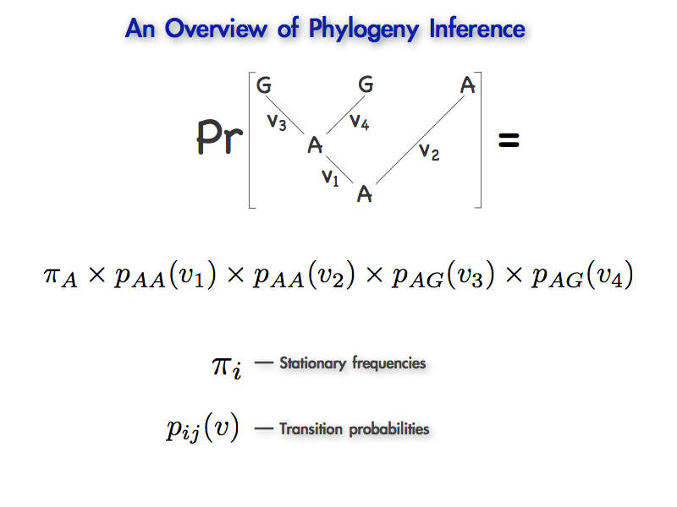
An Introduction to the Likelihood Function
?
?
Stationary frequencies
Transition probabilities

Slide 60
An Introduction to the Likelihood Function
What is likelihood?
The likelihood is a quantity that is proportional to the probability of
observing/realizing the data under a fully specified model/hypothesis.

Slide 61
An Introduction to the Likelihood Function
What is likelihood?
The likelihood is a quantity that is proportional to the probability of
observing/realizing the data under a fully specified model/hypothesis.

Slide 62
An Introduction to the Likelihood Function
What is likelihood?
The likelihood is a quantity that is proportional to the probability of
observing/realizing the data under a fully specified model/hypothesis.

Slide 63
An Introduction to the Likelihood Function
What is likelihood?
The likelihood is a quantity that is proportional to the probability of
observing/realizing the data, X, under a fully specified model/hypothesis.

Slide 64
An Introduction to the Likelihood Function
What is likelihood?
The likelihood is a quantity that is proportional to the probability of
observing/realizing the data, X, under a fully specified model/hypothesis, .

Slide 65

An Introduction to the Likelihood Function
What is likelihood?
The likelihood is a quantity that is proportional to the probability of
observing/realizing the data, X, under a fully specified model/hypothesis, .

Slide 66
An Introduction to the Likelihood Function
What is likelihood?
The likelihood is a quantity that is proportional to the probability of
observing/realizing the data, X, under a fully specified model/hypothesis, .
For phylogenetic problems, the likelihood is proportional to the probability of
observing the sequence alignment, X, under a fully specified phylogenetic model.

Slide 67
An Introduction to the Likelihood Function
What is likelihood?
The likelihood is a quantity that is proportional to the probability of
observing/realizing the data, X, under a fully specified model/hypothesis, .
For phylogenetic problems, the likelihood is proportional to the probability of
observing the sequence alignment, X, under a fully specified phylogenetic model.
tree topology

Slide 68
An Introduction to the Likelihood Function
What is likelihood?
The likelihood is a quantity that is proportional to the probability of
observing/realizing the data, X, under a fully specified model/hypothesis, .
For phylogenetic problems, the likelihood is proportional to the probability of
observing the sequence alignment, X, under a fully specified phylogenetic model.
tree topology
branch lengths

Slide 69
An Introduction to the Likelihood Function
What is likelihood?
The likelihood is a quantity that is proportional to the probability of
observing/realizing the data, X, under a fully specified model/hypothesis, .
For phylogenetic problems, the likelihood is proportional to the probability of
observing the sequence alignment, X, under a fully specified phylogenetic model.
tree topology
branch lengths
substitution-model parameters

Slide 70
An Introduction to the Likelihood Function
What is likelihood?
The likelihood is a quantity that is proportional to the probability of
observing/realizing the data, X, under a fully specified model/hypothesis, .
For phylogenetic problems, the likelihood is proportional to the probability of
observing the sequence alignment, X, under a fully specified phylogenetic model.
A model that has a high likelihood score on a data set is a model that has a high probability of simulating this data set.
tree topology
branch lengths
substitution-model parameters
The likelihood is a score that measures the fit of the model to the data, providing a
basis for comparing different hypotheses/parameter values on the same data

Slide 71
An Introduction to the Likelihood Function
OK, so what does likelihood really mean?
Consider a simple simulation experiment to develop our intuition

Slide 72

An Introduction to the Likelihood Function
OK, so what does likelihood really mean?
Consider a simple simulation experiment to develop our intuition
Imagine we have a fully specified phylogenetic model for four species:
I
II
III
IV

Slide 73
An Introduction to the Likelihood Function
OK, so what does likelihood really mean?
The four species have the following observed site pattern: TTGT
T
T
G
T
I
II
III
IV

Slide 74
An Introduction to the Likelihood Function
OK, so what does likelihood really mean?
The four species have the following observed site pattern: TTGT
What is the likelihood of observing the site pattern under this model?
T
T
G
T
I
II
III
IV

Slide 75
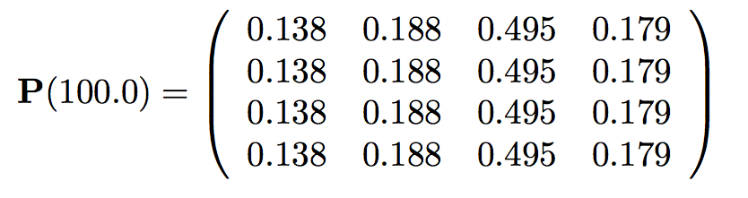
An Introduction to the Likelihood Function
OK, so what does likelihood really mean?
The four species have the following observed site pattern: TTGT
What is the likelihood of observing the site pattern under this model?
T
T
G
T
I
II
III
IV
The stationary frequencies have been estimated from the rate matrix:

Slide 76
An Introduction to the Likelihood Function
OK, so what does likelihood really mean?
The four species have the following observed site pattern: TTGT
What is the likelihood of observing the site pattern under this model?
T
T
G
T
I
II
III
IV
The stationary frequencies have been estimated from the rate matrix:
A = 0.138
C = 0.188
G = 0.495
T = 0.179

Slide 77
An Introduction to the Likelihood Function
OK, so what does likelihood really mean?
The four species have the following observed site pattern: TTGT
What is the likelihood of observing the site pattern under this model?
T
T
G
T
I
II
III
IV
The stationary frequencies have been estimated from the rate matrix:
A = 0.138
0-0.138 = A
C = 0.188
0.138-0.326 = C
G = 0.495
0.326-0.821 = G
T = 0.179
0.821-1 = T

Slide 78
An Introduction to the Likelihood Function
OK, so what does likelihood really mean?
The four species have the following observed site pattern: TTGT
What is the likelihood of observing the site pattern under this model?
T
T
G
T
I
II
III
IV
The stationary frequencies have been estimated from the rate matrix:
A = 0.138
0-0.138 = A
C = 0.188
0.138-0.326 = C
G = 0.495
0.326-0.821 = G
T = 0.179
0.821-1 = T
Pick a starting state at the root using x~dnUniform(0,1)

Slide 79
An Introduction to the Likelihood Function
OK, so what does likelihood really mean?
The four species have the following observed site pattern: TTGT
What is the likelihood of observing the site pattern under this model?
T
T
G
T
I
II
III
IV
The stationary frequencies have been estimated from the rate matrix:
A = 0.138
0-0.138 = A
C = 0.188
0.138-0.326 = C
G = 0.495
0.326-0.821 = G
T = 0.179
0.821-1 = T
x=0.246
Pick a starting state at the root using x~dnUniform(0,1)

Slide 80
An Introduction to the Likelihood Function
OK, so what does likelihood really mean?
The four species have the following observed site pattern: TTGT
What is the likelihood of observing the site pattern under this model?
T
T
G
T
I
II
III
IV
C
The stationary frequencies have been estimated from the rate matrix:
A = 0.138
0-0.138 = A
C = 0.188
0.138-0.326 = C
G = 0.495
0.326-0.821 = G
T = 0.179
0.821-1 = T
We randomly selected state C

Slide 81
An Introduction to the Likelihood Function
OK, so what does likelihood really mean?
The four species have the following observed site pattern: TTGT
What is the likelihood of observing the site pattern under this model?
T
T
G
T
I
II
III
IV
C
The stationary frequencies have been estimated from the rate matrix:
A = 0.138
0-0.138 = A
C = 0.188
0.138-0.326 = C
G = 0.495
0.326-0.821 = G
T = 0.179
0.821-1 = T
Simulate histories along each branch in a pre-order traversal

Slide 82
An Introduction to the Likelihood Function
OK, so what does likelihood really mean?
The four species have the following observed site pattern: TTGT
What is the likelihood of observing the site pattern under this model?
What is the likelihood of observing the site pattern under this model?
T
T
G
T
I
II
III
IV
C
The stationary frequencies have been estimated from the rate matrix:
A = 0.138
0-0.138 = A
C = 0.188
0.138-0.326 = C
G = 0.495
0.326-0.821 = G
T = 0.179
0.821-1 = T
Simulate histories along each branch in a pre-order traversal

Slide 83
An Introduction to the Likelihood Function
OK, so what does likelihood really mean?
The four species have the following observed site pattern: TTGT
What is the likelihood of observing the site pattern under this model?
T
T
G
T
I
II
III
IV
C
The stationary frequencies have been estimated from the rate matrix:
A = 0.138
0-0.138 = A
C = 0.188
0.138-0.326 = C
G = 0.495
0.326-0.821 = G
T = 0.179
0.821-1 = T
Simulate histories along each branch in a pre-order traversal : u~dnExponential(1.069)

Slide 84
An Introduction to the Likelihood Function
OK, so what does likelihood really mean?
The four species have the following observed site pattern: TTGT
What is the likelihood of observing the site pattern under this model?
T
T
G
T
I
II
III
IV
C
The stationary frequencies have been estimated from the rate matrix:
A = 0.138
0-0.138 = A
C = 0.188
0.138-0.326 = C
G = 0.495
0.326-0.821 = G
T = 0.179
0.821-1 = T
Simulate histories along each branch in a pre-order traversal : u~dnExponential(1.069)

Slide 85
An Introduction to the Likelihood Function
OK, so what does likelihood really mean?
The four species have the following observed site pattern: TTGT
What is the likelihood of observing the site pattern under this model?
T
T
G
T
I
II
III
IV
C
The stationary frequencies have been estimated from the rate matrix:
A = 0.138
0-0.138 = A
C = 0.188
0.138-0.326 = C
G = 0.495
0.326-0.821 = G
T = 0.179
0.821-1 = T
Simulate histories along each branch in a pre-order traversal : u~dnExponential(1.069)

Slide 86
An Introduction to the Likelihood Function
OK, so what does likelihood really mean?
The four species have the following observed site pattern: TTGT
What is the likelihood of observing the site pattern under this model?
T
T
G
T
I
II
III
IV
C
The stationary frequencies have been estimated from the rate matrix:
A = 0.138
0-0.138 = A
C = 0.188
0.138-0.326 = C
G = 0.495
0.326-0.821 = G
T = 0.179
0.821-1 = T
Simulate histories along each branch in a pre-order traversal
Simulate histories along each branch in a pre-order traversal : u~dnExponential(1.069)

Slide 87
An Introduction to the Likelihood Function
OK, so what does likelihood really mean?
The four species have the following observed site pattern: TTGT
What is the likelihood of observing the site pattern under this model?
T
T
G
T
I
II
III
IV
C
The stationary frequencies have been estimated from the rate matrix:
A = 0.138
0-0.138 = A
C = 0.188
0.138-0.326 = C
G = 0.495
0.326-0.821 = G
T = 0.179
0.821-1 = T
Simulate histories along each branch in a pre-order traversal : u~dnExponential(1.069)

Slide 88
An Introduction to the Likelihood Function
OK, so what does likelihood really mean?
The four species have the following observed site pattern: TTGT
What is the likelihood of observing the site pattern under this model?
T
T
G
T
I
II
III
IV
C
The stationary frequencies have been estimated from the rate matrix:
A = 0.138
0-0.138 = A
C = 0.188
0.138-0.326 = C
G = 0.495
0.326-0.821 = G
T = 0.179
0.821-1 = T
Simulate histories along each branch in a pre-order traversal : u~dnExponential(1.069)

Slide 89
An Introduction to the Likelihood Function
OK, so what does likelihood really mean?
The four species have the following observed site pattern: TTGT
What is the likelihood of observing the site pattern under this model?
T
T
G
T
I
II
III
IV
C C C C ≠ T T G T
C
The stationary frequencies have been estimated from the rate matrix:
A = 0.138
0-0.138 = A
C = 0.188
0.138-0.326 = C
G = 0.495
0.326-0.821 = G
T = 0.179
0.821-1 = T
Simulate histories along each branch in a pre-order traversal : u~dnExponential(1.069)

Slide 90
An Introduction to the Likelihood Function
OK, so what does likelihood really mean?
The four species have the following observed site pattern: TTGT
What is the likelihood of observing the site pattern under this model?
T
T
G
T
I
II
III
IV
We repeat the simulation 100,000,000 times and record the frequency of outcomes
that match the observed tip states.

Slide 91
An Introduction to the Likelihood Function
OK, so what does likelihood really mean?
The four species have the following observed site pattern: TTGT
What is the likelihood of observing the site pattern under this model?
T
T
G
T
I
II
III
IV
We repeat the simulation 100,000,000 times and record the frequency of outcomes
that match the observed tip states.
The observed site pattern, TTGT, is one of 4⁴ = 256 possible site patterns.

Slide 92
An Introduction to the Likelihood Function
OK, so what does likelihood really mean?
The four species have the following observed site pattern: TTGT
What is the likelihood of observing the site pattern under this model?
T
T
G
T
I
II
III
IV
Of the 100,000,000 simulations, 850,358 realize the observed data (TTGT);
the estimated probability of the observed data is therefore 0.00850358.

Slide 93
An Introduction to the Likelihood Function
OK, so what does likelihood really mean?
The four species have the following observed site pattern: TTGT
What is the likelihood of observing the site pattern under this model?
T
T
G
T
I
II
III
IV
Of the 100,000,000 simulations, 850,358 realize the observed data (TTGT);
the estimated probability of the observed data is therefore 0.00850358.
The probability includes all of the possible histories that can give rise to the data.
Number of Changes

Slide 94
An Introduction to the Likelihood Function
OK, so what does likelihood really mean?
The four species have the following observed site pattern: TTGT
What is the likelihood of observing the site pattern under this model?
T
T
G
T
I
II
III
IV
Using Monte Carlo simulation to estimate site likelihood is pedagogical,
but too inefficient for the analysis of real data.

Slide 95
An Introduction to the Likelihood Function
OK, so what does likelihood really mean?
The four species have the following observed site pattern: TTGT
What is the likelihood of observing the site pattern under this model?
T
T
G
T
I
II
III
IV
Using Monte Carlo simulation to estimate site likelihood is pedagogical,
but too inefficient for the analysis of real data.
e.g., there are >1,000,000 possible site patterns for a tree with 10 species.

Slide 96
Plan: Criteria for evaluating phylogenies
Criteria for evaluating phylogenetic trees:
  Parsimony
  Distance methods
  Maximum Likelihood
    Using a Monte Carlo simulation
    Using Felsenstein’s pruning algorithm
  Posterior probability (Bayesian approach)
Conventions:
  We’re dealing with aligned sequence data
  gaps are not taken into account

Slide 97
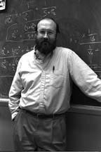
How Do We Calculate Site Likelihoods?
The Felsenstein Pruning Algorithm
Make the math mirror the tree to avoid redundant calculations.
T
T
T
G
T
I
II
III
IV
0.05
0.05
j
0.15
0.15
0.15
k
0.05
i
Joe Felsenstein (c.1981)

Slide 98
How Do We Calculate Site Likelihoods?
The Felsenstein Pruning Algorithm
Make the math mirror the tree to avoid redundant calculations.
Multiple summations over ancestral-state configurations
at internal nodes are moved as far to the right as
possible.
T
T
T
G
T
I
II
III
IV
0.05
0.05
j
0.15
0.15
0.15
k
0.05
i

Slide 99
How Do We Calculate Site Likelihoods?
The Felsenstein Pruning Algorithm
Make the math mirror the tree to avoid redundant calculations.
Multiple summations over ancestral-state configurations
at internal nodes are moved as far to the right as
possible.
T
T
T
G
T
I
II
III
IV
0.05
0.05
j
0.15
0.15
0.15
k
The pruning algorithm reduces this (64 evaluations):
0.05
i

Slide 100
How Do We Calculate Site Likelihoods?
The Felsenstein Pruning Algorithm
Make the math mirror the tree to avoid redundant calculations.
Multiple summations over ancestral-state configurations
at internal nodes are moved as far to the right as
possible.
T
T
T
G
T
I
II
III
IV
0.05
0.05
j
0.15
0.15
0.15
k
The pruning algorithm reduces this (64 evaluations):
0.05
i
to this (12 evaluations):

Slide 101



How Do We Calculate Site Likelihoods?
The Felsenstein Pruning Algorithm
T
T
T
G
T
I
II
III
IV
0.05
0.05
j
0.15
0.15
0.15
k
0.05
i

Slide 102
How Do We Calculate Site Likelihoods?
The Felsenstein Pruning Algorithm
T
T
T
G
T
I
II
III
IV
0.05
0.05
j
0.15
0.15
0.15
k
0.05
i

Slide 103
How Do We Calculate Site Likelihoods?
The Felsenstein Pruning Algorithm
T
T
T
G
T
I
II
III
IV
0.05
0.05
j
0.15
0.15
0.15
k
0.05
i

Slide 104
How Do We Calculate Site Likelihoods?
The Felsenstein Pruning Algorithm
Evaluating the likelihood of a site involves the
recursive calculation of conditional likelihoods
from the tips of the tree to the root.

Slide 105
How Do We Calculate Site Likelihoods?
The Felsenstein Pruning Algorithm
Evaluating the likelihood of a site involves the
recursive calculation of conditional likelihoods
from the tips of the tree to the root.
The conditional likelihoods are the probabilities of the observations above some point in the tree (a local ancestral node, Anc), conditional on state i at that node.

Slide 106
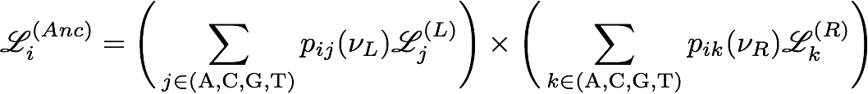

How Do We Calculate Site Likelihoods?
The Felsenstein Pruning Algorithm
Evaluating the likelihood of a site involves the
recursive calculation of conditional likelihoods from the tips of the tree to the root.
The conditional likelihoods are the probabilities of the observations above some point in the tree (a local ancestral node, Anc), conditional on state i at that node.
where

Slide 107
How Do We Calculate Site Likelihoods?
The Felsenstein Pruning Algorithm
These conditional likelihoods are the likelihoods of
the observations above the end of each branch...

Slide 108
How Do We Calculate Site Likelihoods?
The Felsenstein Pruning Algorithm
These conditional likelihoods are either known (if tip)
or have already been computed (in a previous step).

Slide 109
How Do We Calculate Site Likelihoods?
The Felsenstein Pruning Algorithm
1
0
0
0
0
1
0
0
These conditional likelihoods are either known (if tip)
or have already been computed (in a previous step).
If the branch is a tip, the probability of the observed state is 1,
otherwise it is 0.

Slide 110
How Do We Calculate Site Likelihoods?
The Felsenstein Pruning Algorithm
1
0
0
0
0
1
0
0
These conditional likelihoods are either known (if tip)
or have already been computed (in a previous step).
If the branch is a tip, the probability of the observed state is 1,
otherwise it is 0 (e.g., depicted for states A and C in L and R).

Slide 111
How Do We Calculate Site Likelihoods?
The Felsenstein Pruning Algorithm
These conditional likelihoods are either known (if tip)
or have already been computed (in a previous step).
If the branch is a tip, the probability of the observed state is 1,
otherwise it is 0 (e.g., depicted for states A and C in L and R).
If the branch is not a tip, the probability of each possible state
has previously been evaluated in a prior step.

Slide 112
How Do We Calculate Site Likelihoods?
The Felsenstein Pruning Algorithm
#
#
#
#
#
#
#
#
These conditional likelihoods are either known (if tip)
or have already been computed (in a previous step).
If the branch is a tip, the probability of the observed state is 1,
otherwise it is 0 (e.g., depicted for states A and C in L and R).
If the branch is not a tip, the probability of each possible state
has previously been evaluated in a prior step.

Slide 113
How Do We Calculate Site Likelihoods?
The Felsenstein Pruning Algorithm
So, how do we calculate the conditional likelihoods?

Slide 114
How Do We Calculate Site Likelihoods?
The Felsenstein Pruning Algorithm
So, how do we calculate the conditional likelihoods?
Let’s first focus on the left descendant branch.

Slide 115
How Do We Calculate Site Likelihoods?
The Felsenstein Pruning Algorithm
So, how do we calculate the conditional likelihoods?
for each possible
end state sum…
…the product of the
transition probabilities
of changes from i to j
over branch L…
…and the conditional
likelihood of each end state, j.

Slide 116
How Do We Calculate Site Likelihoods?
The Felsenstein Pruning Algorithm
So, how do we calculate the conditional likelihoods?
Recall that the transition probabilities, P (v ), of histories ending in state j that were initiated from state i and run over branch L are either approximated (by Monte Carlo simulation) or solved by exponentiating the product of the instantaneous-rate matrix, Q, and branch length, v
ij
L
L

Slide 117
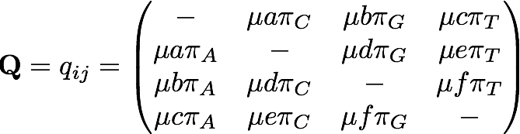

How Do We Calculate Site Likelihoods?
The Felsenstein Pruning Algorithm
So, how do we calculate the conditional likelihoods?
Recall that the transition probabilities, P (v ), of histories ending in state j that were initiated from state i and run over branch L are either approximated (by Monte Carlo simulation) or solved by exponentiating the product of the instantaneous-rate matrix, Q, and branch length, v
ij
L
L

Slide 118
How Do We Calculate Site Likelihoods?
The Felsenstein Pruning Algorithm
So, how do we calculate the conditional likelihoods?
The probability that the process is in state j at the end of the branch, times…

Slide 119
How Do We Calculate Site Likelihoods?
The Felsenstein Pruning Algorithm
#
#
#
#
So, how do we calculate the conditional likelihoods?
The probability that the process is in state j at the end of the branch, times…
…the probability of everything ‘above’ the end of
the branch, conditional on state j.

Slide 120
How Do We Calculate Site Likelihoods?
The Felsenstein Pruning Algorithm
#
#
#
#
So, how do we calculate the conditional likelihoods?
We iteratively compute this product for each of the four j end states, A,C,G,T…

Slide 121
How Do We Calculate Site Likelihoods?
The Felsenstein Pruning Algorithm
So, how do we calculate the conditional likelihoods?
We iteratively compute this product for each of the four j end states, A,C,G,T…
…and then we sum these four terms because they are mutually exclusive.

Slide 122


How Do We Calculate Site Likelihoods?
The Felsenstein Pruning Algorithm
First, set the start state, i, to i = A
v
L
The transition probabilities p ( ) over branch
are calculated by exponentiating the product of the instantaneous rate matrix, Q, and branch length .
v
v
AA
L
L
v
L

Slide 123
How Do We Calculate Site Likelihoods?
The Felsenstein Pruning Algorithm
First, set the start state, i, to i = A
and set the end state, j, to j = A
v
L
The transition probabilities p ( ) over branch
are calculated by exponentiating the product of the instantaneous rate matrix, Q, and branch length .
v
v
AA
L
L
v
L

Slide 124

How Do We Calculate Site Likelihoods?
The Felsenstein Pruning Algorithm
First, set the start state, i, to i = A
and set the end state, j, to j = A
next set the end state, j, to j = C…
v
L
Then we do the same thing for end state j = C…

Slide 125

How Do We Calculate Site Likelihoods?
The Felsenstein Pruning Algorithm
First, set the start state, i, to i = A
and set the end state, j, to j = A
next set the end state, j, to j = C
then set the end state, j, to j = G…
v
L
Then we do the same thing for end state j = G…

Slide 126

How Do We Calculate Site Likelihoods?
The Felsenstein Pruning Algorithm
First, set the start state, i, to i = A
and set the end state, j, to j = A
next set the end state, j, to j = C
then set the end state, j, to j = G
then set the end state, j, to j = T
v
L
Finally, we do the same thing for end state j = T

Slide 127
How Do We Calculate Site Likelihoods?
The Felsenstein Pruning Algorithm
Next, we sum the fractional likelihoods for each
of the four end states j = {A, C, G, T}...
Then we sum the fractional likelihoods for each of the four end states j = {A, C, G, T}...

Slide 128
How Do We Calculate Site Likelihoods?
The Felsenstein Pruning Algorithm
v
Next, we repeat the process for the right branch, .
R

Slide 129
How Do We Calculate Site Likelihoods?
The Felsenstein Pruning Algorithm
v
Next, we repeat the process for the right branch, .
R

Slide 130
How Do We Calculate Site Likelihoods?
The Felsenstein Pruning Algorithm
v
Next, we repeat the process for the right branch, .
R

Slide 131
How Do We Calculate Site Likelihoods?
The Felsenstein Pruning Algorithm
v
Next, we repeat the process for the right branch, .
R

Slide 132
How Do We Calculate Site Likelihoods?
The Felsenstein Pruning Algorithm
v
Next, we repeat the process for the right branch, .
R

Slide 133
How Do We Calculate Site Likelihoods?
The Felsenstein Pruning Algorithm
Finally, we calculate as the product of the
conditional likelihoods of the two descendant branches,
which makes explicit the assumption that substitutions
along these two lineages are independent.
A

Slide 134
How Do We Calculate Site Likelihoods?
The Felsenstein Pruning Algorithm
Now we have computed …
A

Slide 135
How Do We Calculate Site Likelihoods?
The Felsenstein Pruning Algorithm
So, now we need to repeat the entire process
for i = C to compute …
C

Slide 136
How Do We Calculate Site Likelihoods?
The Felsenstein Pruning Algorithm
So, now we need to repeat the entire process
for i = C to compute …
C

Slide 137
How Do We Calculate Site Likelihoods?
The Felsenstein Pruning Algorithm
So, now we need to repeat the entire process
for i = C to compute …
C

Slide 138
How Do We Calculate Site Likelihoods?
The Felsenstein Pruning Algorithm
So, now we need to repeat the entire process
for i = C to compute …
C

Slide 139
How Do We Calculate Site Likelihoods?
The Felsenstein Pruning Algorithm
So, now we need to repeat the entire process
for i = C to compute …
C

Slide 140
How Do We Calculate Site Likelihoods?
The Felsenstein Pruning Algorithm
So, now we need to repeat the entire process
for i = C to compute
for i = G to compute …
C
G

Slide 141
How Do We Calculate Site Likelihoods?
The Felsenstein Pruning Algorithm
So, now we need to repeat the entire process
for i = C to compute
for i = G to compute …
C
G

Slide 142
How Do We Calculate Site Likelihoods?
The Felsenstein Pruning Algorithm
So, now we need to repeat the entire process
for i = C to compute
for i = G to compute …
C
G

Slide 143
How Do We Calculate Site Likelihoods?
The Felsenstein Pruning Algorithm
So, now we need to repeat the entire process
for i = C to compute
for i = G to compute …
C
G

Slide 144
How Do We Calculate Site Likelihoods?
The Felsenstein Pruning Algorithm
So, now we need to repeat the entire process
for i = C to compute
for i = G to compute
and finally for i = T to compute …
C
G
T

Slide 145
How Do We Calculate Site Likelihoods?
The Felsenstein Pruning Algorithm
So, now we need to repeat the entire process
for i = C to compute
for i = G to compute
and finally for i = T to compute …
C
G
T

Slide 146
How Do We Calculate Site Likelihoods?
The Felsenstein Pruning Algorithm
So, now we need to repeat the entire process
for i = C to compute
for i = G to compute
and finally for i = T to compute …
C
G
T

Slide 147
How Do We Calculate Site Likelihoods?
The Felsenstein Pruning Algorithm
So, now we need to repeat the entire process
for i = C to compute
for i = G to compute
and finally for i = T to compute …
C
G
T

Slide 148
How Do We Calculate Site Likelihoods?
The Felsenstein Pruning Algorithm
Then we need to repeat the entire process for
each of the more inclusive nodes toward the root,
where the conditional likelihoods of the tips are first
recorded...

Slide 149
How Do We Calculate Site Likelihoods?
The Felsenstein Pruning Algorithm
Then we need to repeat the entire process for
each of the more inclusive nodes toward the root,
where the conditional likelihoods of the tips are first
recorded...

Slide 150
How Do We Calculate Site Likelihoods?
The Felsenstein Pruning Algorithm
Then we need to repeat the entire process for
each of the more inclusive nodes toward the root,
where the conditional likelihoods of the tips are first
recorded...

Slide 151
How Do We Calculate Site Likelihoods?
The Felsenstein Pruning Algorithm
Then we need to repeat the entire process for
each of the more inclusive nodes toward the root,
where the conditional likelihoods of the tips are first
recorded...

Slide 152
How Do We Calculate Site Likelihoods?
The Felsenstein Pruning Algorithm
Then we need to repeat the entire process for
each of the more inclusive nodes toward the root,
where the conditional likelihoods of the tips are first
recorded...

Slide 153
How Do We Calculate Site Likelihoods?
The Felsenstein Pruning Algorithm
Then we need to repeat the entire process for
each of the more inclusive nodes toward the root,
where the conditional likelihoods of the tips are first
recorded...

Slide 154
How Do We Calculate Site Likelihoods?
The Felsenstein Pruning Algorithm
Then we need to repeat the entire process for
each of the more inclusive nodes toward the root,
where the conditional likelihoods of the tips are first
recorded, then we loop over the internal nodes
in a post-order traversal…

Slide 155
How Do We Calculate Site Likelihoods?
The Felsenstein Pruning Algorithm
Then we need to repeat the entire process for
each of the more inclusive nodes toward the root,
where the conditional likelihoods of the tips are first
recorded, then we loop over the internal nodes
in a post-order traversal…

Slide 156
How Do We Calculate Site Likelihoods?
The Felsenstein Pruning Algorithm
Then we need to repeat the entire process for
each of the more inclusive nodes toward the root,
where the conditional likelihoods of the tips are first
recorded, then we loop over the internal nodes
in a post-order traversal…

Slide 157
How Do We Calculate Site Likelihoods?
The Felsenstein Pruning Algorithm
Then we need to repeat the entire process for
each of the more inclusive nodes toward the root,
where the conditional likelihoods of the tips are first
recorded, then we loop over the internal nodes
in a post-order traversal…

Slide 158
How Do We Calculate Site Likelihoods?
The Felsenstein Pruning Algorithm
Then we need to repeat the entire process for
each of the more inclusive nodes toward the root,
where the conditional likelihoods of the tips are first
recorded, then we loop over the internal nodes
in a post-order traversal…

Slide 159
How Do We Calculate Site Likelihoods?
The Felsenstein Pruning Algorithm
Then we need to repeat the entire process for
each of the more inclusive nodes toward the root,
where the conditional likelihoods of the tips are first
recorded, then we loop over the internal nodes
in a post-order traversal…

Slide 160
How Do We Calculate Site Likelihoods?
The Felsenstein Pruning Algorithm
Then we need to repeat the entire process for
each of the more inclusive nodes toward the root,
where the conditional likelihoods of the tips are first
recorded, then we loop over the internal nodes
in a post-order traversal…

Slide 161
How Do We Calculate Site Likelihoods?
The Felsenstein Pruning Algorithm
Then we need to repeat the entire process for
each of the more inclusive nodes toward the root,
where the conditional likelihoods of the tips are first
recorded, then we loop over the internal nodes
in a post-order traversal…

Slide 162
How Do We Calculate Site Likelihoods?
The Felsenstein Pruning Algorithm
Then we need to repeat the entire process for
each of the more inclusive nodes toward the root,
where the conditional likelihoods of the tips are first
recorded, then we loop over the internal nodes
in a post-order traversal…

Slide 163
How Do We Calculate Site Likelihoods?
The Felsenstein Pruning Algorithm
Then we need to repeat the entire process for
each of the more inclusive nodes toward the root,
where the conditional likelihoods of the tips are first
recorded, then we loop over the internal nodes
in a post-order traversal…

Slide 164
How Do We Calculate Site Likelihoods?
The Felsenstein Pruning Algorithm
Then we need to repeat the entire process for
each of the more inclusive nodes toward the root,
where the conditional likelihoods of the tips are first
recorded, then we loop over the internal nodes
in a post-order traversal…

Slide 165
How Do We Calculate Site Likelihoods?
The Felsenstein Pruning Algorithm
Then we need to repeat the entire process for
each of the more inclusive nodes toward the root,
where the conditional likelihoods of the tips are first
recorded, then we loop over the internal nodes
in a post-order traversal…

Slide 166
How Do We Calculate Site Likelihoods?
The Felsenstein Pruning Algorithm
Then we need to repeat the entire process for
each of the more inclusive nodes toward the root,
where the conditional likelihoods of the tips are first
recorded, then we loop over the internal nodes
in a post-order traversal…

Slide 167
How Do We Calculate Site Likelihoods?
The Felsenstein Pruning Algorithm
Then we need to repeat the entire process for
each of the more inclusive nodes toward the root,
where the conditional likelihoods of the tips are first
recorded, then we loop over the internal nodes
in a post-order traversal…

Slide 168
How Do We Calculate Site Likelihoods?
The Felsenstein Pruning Algorithm
Then we need to repeat the entire process for
each of the more inclusive nodes toward the root,
where the conditional likelihoods of the tips are first
recorded, then we loop over the internal nodes
in a post-order traversal…

Slide 169
How Do We Calculate Site Likelihoods?
The Felsenstein Pruning Algorithm
Then we need to repeat the entire process for
each of the more inclusive nodes toward the root,
where the conditional likelihoods of the tips are first
recorded, then we loop over the internal nodes
in a post-order traversal…

Slide 170
How Do We Calculate Site Likelihoods?
The Felsenstein Pruning Algorithm
Then we need to repeat the entire process for
each of the more inclusive nodes toward the root,
where the conditional likelihoods of the tips are first
recorded, then we loop over the internal nodes
in a post-order traversal…

Slide 171
How Do We Calculate Site Likelihoods?
The Felsenstein Pruning Algorithm
Then we need to repeat the entire process for
each of the more inclusive nodes toward the root,
where the conditional likelihoods of the tips are first
recorded, then we loop over the internal nodes
in a post-order traversal…

Slide 172
How Do We Calculate Site Likelihoods?
The Felsenstein Pruning Algorithm
Then we need to repeat the entire process for
each of the more inclusive nodes toward the root,
where the conditional likelihoods of the tips are first
recorded, then we loop over the internal nodes
in a post-order traversal…

Slide 173
How Do We Calculate Site Likelihoods?
The Felsenstein Pruning Algorithm
Then we need to repeat the entire process for
each of the more inclusive nodes toward the root,
where the conditional likelihoods of the tips are first
recorded, then we loop over the internal nodes
in a post-order traversal…

Slide 174
How Do We Calculate Site Likelihoods?
The Felsenstein Pruning Algorithm
Then we need to repeat the entire process for
each of the more inclusive nodes toward the root,
where the conditional likelihoods of the tips are first
recorded, then we loop over the internal nodes
in a post-order traversal…

Slide 175
How Do We Calculate Site Likelihoods?
The Felsenstein Pruning Algorithm
Then we need to repeat the entire process for
each of the more inclusive nodes toward the root,
where the conditional likelihoods of the tips are first
recorded, then we loop over the internal nodes
in a post-order traversal…

Slide 176
How Do We Calculate Site Likelihoods?
The Felsenstein Pruning Algorithm
Then we need to repeat the entire process for
each of the more inclusive nodes toward the root,
where the conditional likelihoods of the tips are first
recorded, then we loop over the internal nodes
in a post-order traversal…

Slide 177
How Do We Calculate Site Likelihoods?
The Felsenstein Pruning Algorithm
Then we need to repeat the entire process for
each of the more inclusive nodes toward the root,
where the conditional likelihoods of the tips are first
recorded, then we loop over the internal nodes
in a post-order traversal…

Slide 178
How Do We Calculate Site Likelihoods?
The Felsenstein Pruning Algorithm
Then we need to repeat the entire process for
each of the more inclusive nodes toward the root,
where the conditional likelihoods of the tips are first
recorded, then we loop over the internal nodes
in a post-order traversal…

Slide 179
How Do We Calculate Site Likelihoods?
The Felsenstein Pruning Algorithm
Then we need to repeat the entire process for
each of the more inclusive nodes toward the root,
where the conditional likelihoods of the tips are first
recorded, then we loop over the internal nodes
in a post-order traversal…

Slide 180
How Do We Calculate Site Likelihoods?
The Felsenstein Pruning Algorithm
Then we need to repeat the entire process for
each of the more inclusive nodes toward the root,
where the conditional likelihoods of the tips are first
recorded, then we loop over the internal nodes
in a post-order traversal…

Slide 181
How Do We Calculate Site Likelihoods?
The Felsenstein Pruning Algorithm
Then we need to repeat the entire process for
each of the more inclusive nodes toward the root,
where the conditional likelihoods of the tips are first
recorded, then we loop over the internal nodes
in a post-order traversal…

Slide 182
How Do We Calculate Site Likelihoods?
The Felsenstein Pruning Algorithm
Then we need to repeat the entire process for
each of the more inclusive nodes toward the root,
where the conditional likelihoods of the tips are first
recorded, then we loop over the internal nodes
in a post-order traversal…

Slide 183
How Do We Calculate Site Likelihoods?
The Felsenstein Pruning Algorithm
Then we need to repeat the entire process for
each of the more inclusive nodes toward the root,
where the conditional likelihoods of the tips are first
recorded, then we loop over the internal nodes
in a post-order traversal…

Slide 184
How Do We Calculate Site Likelihoods?
The Felsenstein Pruning Algorithm
Then we need to repeat the entire process for
each of the more inclusive nodes toward the root,
where the conditional likelihoods of the tips are first
recorded, then we loop over the internal nodes
in a post-order traversal…

Slide 185
How Do We Calculate Site Likelihoods?
The Felsenstein Pruning Algorithm
Then we need to repeat the entire process for
each of the more inclusive nodes toward the root,
where the conditional likelihoods of the tips are first
recorded, then we loop over the internal nodes
in a post-order traversal…

Slide 186
How Do We Calculate Site Likelihoods?
The Felsenstein Pruning Algorithm
Then we need to repeat the entire process for
each of the more inclusive nodes toward the root,
where the conditional likelihoods of the tips are first
recorded, then we loop over the internal nodes
in a post-order traversal…

Slide 187
How Do We Calculate Site Likelihoods?
The Felsenstein Pruning Algorithm
Then we need to repeat the entire process for
each of the more inclusive nodes toward the root,
where the conditional likelihoods of the tips are first
recorded, then we loop over the internal nodes
in a post-order traversal…

Slide 188
How Do We Calculate Site Likelihoods?
The Felsenstein Pruning Algorithm
Then we need to repeat the entire process for
each of the more inclusive nodes toward the root,
where the conditional likelihoods of the tips are first
recorded, then we loop over the internal nodes
in a post-order traversal…

Slide 189
How Do We Calculate Site Likelihoods?
The Felsenstein Pruning Algorithm
Then we need to repeat the entire process for
each of the more inclusive nodes toward the root,
where the conditional likelihoods of the tips are first
recorded, then we loop over the internal nodes
in a post-order traversal…

Slide 190
How Do We Calculate Site Likelihoods?
The Felsenstein Pruning Algorithm
Then we need to repeat the entire process for
each of the more inclusive nodes toward the root,
where the conditional likelihoods of the tips are first
recorded, then we loop over the internal nodes
in a post-order traversal…

Slide 191
How Do We Calculate Site Likelihoods?
The Felsenstein Pruning Algorithm
Then we need to repeat the entire process for
each of the more inclusive nodes toward the root,
where the conditional likelihoods of the tips are first
recorded, then we loop over the internal nodes
in a post-order traversal…

Slide 192
How Do We Calculate Site Likelihoods?
The Felsenstein Pruning Algorithm
Then we need to repeat the entire process for
each of the more inclusive nodes toward the root,
where the conditional likelihoods of the tips are first
recorded, then we loop over the internal nodes
in a post-order traversal…

Slide 193
How Do We Calculate Site Likelihoods?
The Felsenstein Pruning Algorithm
Then we need to repeat the entire process for
each of the more inclusive nodes toward the root,
where the conditional likelihoods of the tips are first
recorded, then we loop over the internal nodes
in a post-order traversal…

Slide 194
How Do We Calculate Site Likelihoods?
The Felsenstein Pruning Algorithm
Then we need to repeat the entire process for
each of the more inclusive nodes toward the root,
where the conditional likelihoods of the tips are first
recorded, then we loop over the internal nodes
in a post-order traversal…

Slide 195
How Do We Calculate Site Likelihoods?
The Felsenstein Pruning Algorithm
Then we need to repeat the entire process for
each of the more inclusive nodes toward the root,
where the conditional likelihoods of the tips are first
recorded, then we loop over the internal nodes
in a post-order traversal…

Slide 196
How Do We Calculate Site Likelihoods?
The Felsenstein Pruning Algorithm
Then we need to repeat the entire process for
each of the more inclusive nodes toward the root,
where the conditional likelihoods of the tips are first
recorded, then we loop over the internal nodes
in a post-order traversal…

Slide 197
How Do We Calculate Site Likelihoods?
The Felsenstein Pruning Algorithm
Then we need to repeat the entire process for
each of the more inclusive nodes toward the root,
where the conditional likelihoods of the tips are first
recorded, then we loop over the internal nodes
in a post-order traversal…

Slide 198
How Do We Calculate Site Likelihoods?
The Felsenstein Pruning Algorithm
Then we need to repeat the entire process for
each of the more inclusive nodes toward the root,
where the conditional likelihoods of the tips are first
recorded, then we loop over the internal nodes
in a post-order traversal…

Slide 199
How Do We Calculate Site Likelihoods?
The Felsenstein Pruning Algorithm
Then we need to repeat the entire process for
each of the more inclusive nodes toward the root,
where the conditional likelihoods of the tips are first
recorded, then we loop over the internal nodes
in a post-order traversal…

Slide 200
How Do We Calculate Site Likelihoods?
The Felsenstein Pruning Algorithm
Then we need to repeat the entire process for
each of the more inclusive nodes toward the root,
where the conditional likelihoods of the tips are first
recorded, then we loop over the internal nodes
in a post-order traversal…

Slide 201
How Do We Calculate Site Likelihoods?
The Felsenstein Pruning Algorithm
Then we need to repeat the entire process for
each of the more inclusive nodes toward the root,
where the conditional likelihoods of the tips are first
recorded, then we loop over the internal nodes
in a post-order traversal…

Slide 202

How Do We Calculate Site Likelihoods?
The Felsenstein Pruning Algorithm
Upon reaching the root of the tree, the
conditional likelihood of each state is
‘weighted’ by the prior probability (stationary
frequency) of the corresponding state, , to
give the unconditional probability of the j^{th} site, .
The probability of everything in the tree above the root, given that the process is in state A…

Slide 203
How Do We Calculate Site Likelihoods?
The Felsenstein Pruning Algorithm
Upon reaching the root of the tree, the
conditional likelihood of each state is
‘weighted’ by the prior probability (stationary
frequency) of the corresponding state, , to
give the unconditional probability of the j^{th} site, .
The probability of everything in the tree above the root, given that the process is in state A,…
…times the probability that the process was in state A at the root.

Slide 204
How Do We Calculate Site Likelihoods?
The Felsenstein Pruning Algorithm
Upon reaching the root of the tree, the
conditional likelihood of each state is
‘weighted’ by the prior probability (stationary
frequency) of the corresponding state, , to
give the unconditional probability of the j^{th} site, .
We compete a similar product for the other three states, C…

Slide 205
How Do We Calculate Site Likelihoods?
The Felsenstein Pruning Algorithm
Upon reaching the root of the tree, the
conditional likelihood of each state is
‘weighted’ by the prior probability (stationary
frequency) of the corresponding state, , to
give the unconditional probability of the j^{th} site, .
We compete a similar product for the other three states, C, G…

Slide 206
How Do We Calculate Site Likelihoods?
The Felsenstein Pruning Algorithm
Upon reaching the root of the tree, the
conditional likelihood of each state is
‘weighted’ by the prior probability (stationary
frequency) of the corresponding state, , to
give the unconditional probability of the j^{th} site, .
We compete a similar product for the other three states, C, G, and T…

Slide 207
How Do We Calculate Site Likelihoods?
The Felsenstein Pruning Algorithm
Upon reaching the root of the tree, the
conditional likelihood of each state is
‘weighted’ by the prior probability (stationary
frequency) of the corresponding state, , to
give the unconditional probability of the j^{th} site, .
…and then sum the four terms because these root states are mutually exclusive.

Slide 208
How Do We Calculate Site Likelihoods?
The Felsenstein Pruning Algorithm
Upon reaching the root of the tree, the
conditional likelihood of each state is
‘weighted’ by the prior probability (stationary
frequency) of the corresponding state, , to
give the unconditional probability of the data, .
π
π
i
i
x
x
i
i
→ We have computed the likelihood of site pattern TTGT using Felsenstein’s pruning algorithm!

Slide 209
Calculating the Likelihood of several sites
Calculating the likelihood of an alignment assumes independence of sites
We generally assume that the substitution process is independent across sites,
which allows us to combine their probabilities as the product of the N site likelihoods.

Slide 210
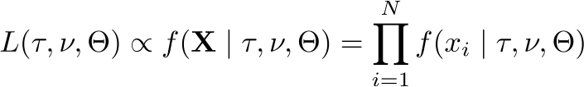
Calculating the Likelihood of several sites
Calculating the likelihood of an alignment assumes independence of sites
We generally assume that the substitution process is independent across sites,
which allows us to combine their probabilities as the product of the N site likelihoods.

Slide 211
Calculating the Likelihood of several sites
Calculating the likelihood of an alignment assumes independence of sites
We generally assume that the substitution process is independent across sites,
which allows us to combine their probabilities as the product of the N site likelihoods.
That is, we compute the likelihood for each site in the alignment (one site at a
time) and then combine them as a product

Slide 212
Calculating the Likelihood of several sites
Calculating the likelihood of an alignment assumes independence of sites
We generally assume that the substitution process is independent across sites,
which allows us to combine their probabilities as the product of the N site likelihoods.
That is, we compute the likelihood for each site in the alignment (one site at a
time) and then combine them as a product
Although this is a convenient assumption, it is not very biologically realistic.
More complex models can relax it, cf Jeff Thorne’s talk.

Slide 213
Plan: Criteria for evaluating phylogenies
Criteria for evaluating phylogenetic trees:
  Parsimony
  Distance methods
  Maximum Likelihood
    Using a Monte Carlo simulation
    Using Felsenstein’s pruning algorithm
  Posterior probability (Bayesian approach)
Conventions:
  We’re dealing with aligned sequence data
  gaps are not taken into account

Slide 214
Outline
I. A quick review of where we’ve been
Components of the phylogenetic model and properties of CTMCs
II. A brief introduction to the likelihood function
What, exactly, is likelihood anyway?
III. Calculating the likelihood of the data
How to calculate the likelihood of a single site:
Using Monte Carlo simulation
Using brute force
Using the Felsenstein pruning algorithm
How to calculate the likelihood of an entire alignment:
Site compression
Log likelihoods

Slide 215
Outline
I. A quick review of where we’ve been
Components of the phylogenetic model and properties of CTMCs
II. A brief introduction to the likelihood function
What, exactly, is likelihood anyway?
III. Calculating the likelihood of the data
How to calculate the likelihood of a single site:
Using Monte Carlo simulation
Using brute force
Using the Felsenstein pruning algorithm
How to calculate the likelihood of an entire alignment:
Site compression
Log likelihoods

Slide 216
Calculating the Likelihood of an Alignment
Compressing the alignment using unique site patterns
Because we assume that sites are independent, sites with the same site pattern
(e.g., TTGT) will have the same likelihood

Slide 217
Calculating the Likelihood of an Alignment
Compressing the alignment using unique site patterns
Because we assume that sites are independent, sites with the same site pattern
(e.g., TTGT) will have the same likelihood
Therefore, we can avoid redundant calculations (and increase computational
efficiency) by identifying the set of N' unique site patterns.

Slide 218
Calculating the Likelihood of an Alignment
Compressing the alignment using unique site patterns
Because we assume that sites are independent, sites with the same site pattern
(e.g., TTGT) will have the same likelihood
Therefore, we can avoid redundant calculations (and increase computational
efficiency) by identifying the set of N' unique site patterns.
species I TCGCACCGGCGTA...
species II TCGTTCAGGCGTT...
species III GCGTTCACCGGGG...
species IV TCGTTCACCCGTT...

Slide 219
Calculating the Likelihood of an Alignment
Compressing the alignment using unique site patterns
Because we assume that sites are independent, sites with the same site pattern
(e.g., TTGT) will have the same likelihood
Therefore, we can avoid redundant calculations (and increase computational
efficiency) by identifying the set of N' unique site patterns.
species I TCGCACCGGCGTA...
species II TCGTTCAGGCGTT...
species III GCGTTCACCGGGG...
species IV TCGTTCACCCGTT...

Slide 220
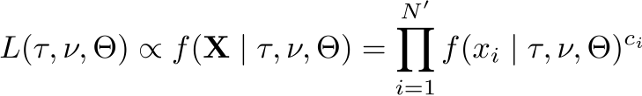
Calculating the Likelihood of an Alignment
Compressing the alignment using unique site patterns
Because we assume that sites are independent, sites with the same site pattern
(e.g., TTGT) will have the same likelihood
Therefore, we can avoid redundant calculations (and increase computational
efficiency) by identifying the set of N' unique site patterns.
species I TCGCACCGGCGTA...
species II TCGTTCAGGCGTT...
species III GCGTTCACCGGGG...
species IV TCGTTCACCCGTT...

Slide 221
Calculating the Likelihood of an Alignment
Compressing the alignment using unique site patterns
Because we assume that sites are independent, sites with the same site pattern
(e.g., TTGT) will have the same likelihood
Therefore, we can avoid redundant calculations (and increase computational
efficiency) by identifying the set of N' unique site patterns.
species I TCGCACCGGCGTA...
species II TCGTTCAGGCGTT...
species III GCGTTCACCGGGG...
species IV TCGTTCACCCGTT...
where c_{i} is the number of instances of the unique site pattern i.

Slide 222
Outline
I. A brief introduction to the likelihood function
What, exactly, is likelihood anyway?
II. Calculating the likelihood of the data
How to calculate the likelihood of a single site:
Using Monte Carlo simulation
Using brute force
Using the Felsenstein pruning algorithm
How to calculate the likelihood of an entire alignment:
Site compression
Log likelihoods

Slide 223
Outline
I. A brief introduction to the likelihood function
What, exactly, is likelihood anyway?
II. Calculating the likelihood of the data
How to calculate the likelihood of a single site:
Using Monte Carlo simulation
Using brute force
Using the Felsenstein pruning algorithm
How to calculate the likelihood of an entire alignment:
Site compression
Log likelihoods

Slide 224
Calculating the Likelihood of an Alignment
Why do we calculate log likelihoods?
Conditional likelihoods for a given site are real numbers with values < 1.

Slide 225
Calculating the Likelihood of an Alignment
Why do we calculate log likelihoods?
Conditional likelihoods for a given site are real numbers with values < 1.
Because an alignment typically has thousands of sites, the product of
these numbers can quickly become too small to be held correctly
in computer memory (a problem called 'underflow').

Slide 226
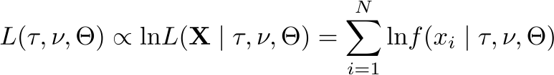
Calculating the Likelihood of an Alignment
Why do we calculate log likelihoods?
Conditional likelihoods for a given site are real numbers with values < 1.
Because an alignment typically has thousands of sites, the product of
these numbers can quickly become too small to be held correctly
in computer memory (a problem called 'underflow').
To avoid underflow, we sum the logs of the site likelihoods:

Slide 227
Calculating the Likelihood of an Alignment
Why do we calculate log likelihoods?
Conditional likelihoods for a given site are real numbers with values < 1.
Because an alignment typically has thousands of sites, the product of
these numbers can quickly become too small to be held correctly
in computer memory (a problem called 'underflow').
To avoid underflow, we sum the logs of the site likelihoods:
Using the log likelihood does not alter the estimates of parameters.

Slide 228
Calculating the Likelihood of an Alignment
We scale the conditional log likelihoods for the same reason
Underflow can also become a problem as the number of species increases

Slide 229
Calculating the Likelihood of an Alignment
We scale the conditional log likelihoods for the same reason
Underflow can also become a problem as the number of species increases
Conditional likelihoods tend to get smaller as we visit progressively deeper nodes

Slide 230
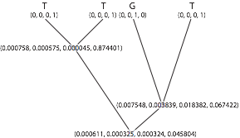
Calculating the Likelihood of an Alignment
We scale the conditional log likelihoods for the same reason
Underflow can also become a problem as the number of species increases
Conditional likelihoods tend to get smaller as we visit progressively deeper nodes

Slide 231
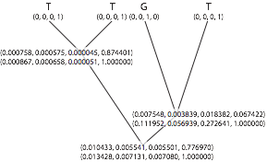
Calculating the Likelihood of an Alignment
We scale the conditional log likelihoods for the same reason
Underflow can also become a problem as the number of species increases
Conditional likelihoods tend to get smaller as we visit progressively deeper nodes
At each node, we scale the conditional likelihoods by pulling out the largest value.

Slide 232
Calculating the Likelihood of an Alignment
We scale the conditional log likelihoods for the same reason
Underflow can also become a problem as the number of species increases
Conditional likelihoods tend to get smaller as we visit progressively deeper nodes
At each node, we scale the conditional likelihoods by pulling out the largest value.
The scaling factors are logged, summed, and added to the unconditional probability for
each site at the root.

Slide 233
Calculating the Likelihood of an Alignment
We scale the conditional log likelihoods for the same reason
Underflow can also become a problem as the number of species increases
Conditional likelihoods tend to get smaller as we visit progressively deeper nodes
At each node, we scale the conditional likelihoods by pulling out the largest value.
The scaling factors are logged, summed, and added to the unconditional probability for
each site at the root.
Scaling conditional likelihoods adds to the compute time, but is often necessary for
accurate computation (and beware of methods that take shortcuts; e.g., BEAGLE)

Slide 234
How to compute the likelihood of an alignment?
A
T
T
T
C
T
T
G
A
C
T
T

Slide 235
How to compute the likelihood of an alignment?
A
C
A

Slide 236
How to compute the likelihood of an alignment?
?
?
A
C
A

Slide 237
How to compute the likelihood of an alignment?
x
y
A
C
A
x ϵ {A,C,G,T}
y ϵ {A,C,G,T}

Slide 238
How to compute the likelihood of an alignment?
x
y
A
C
A
How can we compute P({A,C,A} | model) ?

Slide 239
End-conditioned simulation
Simulating along a branch that ends in state G:
G
t = 0
Temps t
x
G
A
G
How can we compute P(ending in G | model) ?

Slide 240
End-conditioned simulation
Simulating along a branch that ends in state G:
G
t = 0
Temps t
x
G
A
G
  Draw an initial state from a Multinomial distribution:
p=c(0.25, 0.25, 0.25, 0.25); state=rmultinom(n=1, p=p, size=1)
  t = t₀ ; N = 0 ; λ=0.1
  While t < T :
    Draw from an exponential distribution a waiting time Xi until the next event; t = t + Xi
      If t < T, change the state of the variable: state=rmultinom(n=1, p=p, size=1)
      (Else (t≥T): we stop)
  If EndState != G: Failure
  If EndState == G: Success
Can we use this to compute P(ending in G | model) ?

Slide 241
End-conditioned simulation
P(ending in G):
G
t = 0
Temps t
x
G
A
G
  Nsuccess=0
  For i in 1:10000:
    Draw an initial state from a Multinomial distribution:
p=c(0.25, 0.25, 0.25, 0.25); state=rmultinom(n=1, p=p, size=1)
    t = t₀ ; N = 0 ; λ=0.1
    While t < T :
      Draw from an exponential distribution a waiting time Xi until the next event; t = t + Xi
      If t < T, change the state of the variable: state=rmultinom(n=1, p=p, size=1)
      (Else (t≥T): we stop)
    If EndState == G: Nsuccess +=1

Slide 242
End-conditioned simulation
P(ending in G):
G
t = 0
Temps t
x
G
A
G
  Nsuccess=0
  For i in 1:10000:
    Draw an initial state from a Multinomial distribution:
p=c(0.25, 0.25, 0.25, 0.25); state=rmultinom(n=1, p=p, size=1)
    t = t₀ ; N = 0 ; λ=0.1
    While t < T :
      Draw from an exponential distribution a waiting time Xi until the next event; t = t + Xi
      If t < T, change the state of the variable: state=rmultinom(n=1, p=p, size=1)
      (Else (t≥T): we stop)
    If EndState == G: Nsuccess +=1
→ P(ending in G) = Nsuccess/10000

Slide 243
End-conditioned simulation on a tree
x
y
A
C
A
How can we compute P({A,C,A} | model) ?

Slide 244
Computing P({A,C,A}|model) by simulation
x
0.3
y
0.4
0.1
0.1
A
C
A
  Nsuccess = 0
  Repeat 10 000 times:
    Randomly pick x ϵ {A,C,G,T}
    Simulate along branch xy (length 0.3)
    Simulate along branch yA (length 0.1)
    Simulate along branch yC (length 0.1)
    Simulate along branch xA (length 0.4)
    If we have ACA at the tips: Nsuccess++
  P({A,C,A}|model) = Nsuccess/10000

Slide 245
Computing P({A,C,A}|model) by simulation
x
0.3
y
0.4
0.1
0.1
A
C
A
  Nsuccess = 0
  Repeat 10 000 times:
    Randomly pick x ϵ {A,C,G,T}
    Simulate along branch xy (length 0.3)
    Simulate along branch yA (length 0.1)
    Simulate along branch yC (length 0.1)
    Simulate along branch xA (length 0.4)
    If we have ACA at the tips: Nsuccess++
  P({A,C,A}|model) = Nsuccess/10000
Try and implement this in R!

Slide 246
Computing P({A,C,A}|model) by simulation
x
0.3
y
0.4
0.1
0.1
A
C
A
  Nsuccess = 0
  Repeat 10 000 times:
    Randomly pick x ϵ {A,C,G,T}
    Simulate along branch xy (length 0.3)
    Simulate along branch yA (length 0.1)
    Simulate along branch yC (length 0.1)
    Simulate along branch xA (length 0.4)
    If we have ACA at the tips: Nsuccess++
  P({A,C,A}|model) = Nsuccess/10000
http://rpubs.com/boussau/simuDNALikelihood

Slide 247
Interpretation
We generate a sample of substitution histories along the tree, given the model
Among those histories, we count those that are compatible with the data at the tips
This proportion is the probability of the data given the model, the likelihood:
P(site pattern|model)

Slide 248
An inefficient approach
This approach works well for 1 site and 3 tips
How can we scale to more tips?
→ Use an analytical approach to integrate efficiently over all substitution histories
2 elements:
Integrate over all substitution histories along a branch
Integrate over all states at internal nodes

Slide 249
An inefficient approach
This approach works well for 1 site and 3 tips
How can we scale to more tips?
→ Use an analytical approach to integrate efficiently over all substitution histories
2 elements:
Integrate over all substitution histories along a branch
Integrate over all states at internal nodes
Cf Alexis’s talk!

Slide 250
Integrating over substitution histories along a branch
Given a vector of initial frequencies F(0) = {A(0), C(0), G(0), T(0)}, how can we compute the vector of frequencies at time t F(t)?

Slide 251
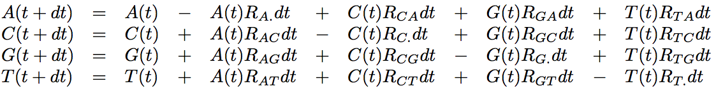
Integrating over substitution histories along a branch
Given a vector of initial frequencies F(0) = {A(0), C(0), G(0), T(0)}, how can we compute the vector of frequencies at time t F(t)?
For an infinitesimal dt:
where R_{XY} is the rate of instantaneous substitution from X to Y, and R_{X.} Is the instantaneous rate of substitution from X to all other states.

Slide 252
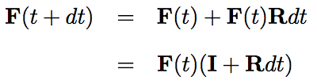

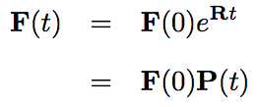
Integrating over substitution histories along a branch
Using matrix notation:
Thus:
Which can be solved as:

Slide 253
Discrete time interpretation
Let’s compute P_{n}(t) with n the number of substitutions: P_{n}(t) = F(0)*X

Slide 254
Discrete time interpretation
Let’s compute P_{n}(t) with n the number of substitutions: P_{n}(t) = F(0)*X
  If 0 substitution: P₀(t) = F(0) → X=Id

Slide 255
Discrete time interpretation
Let’s compute P_{n}(t) with n the number of substitutions: P_{n}(t) = F(0)*X
  If 0 substitution: P₀(t) = F(0) → X=Id
  If 1 substitution: P₁(t) = F(0) Rt → X=Rt

Slide 256
Discrete time interpretation
Let’s compute P_{n}(t) with n the number of substitutions: P_{n}(t) = F(0)*X
  If 0 substitution: P₀(t) = F(0) → X=Id
  If 1 substitution: P₁(t) = F(0) Rt → X=Rt
  If 2 substitutions: P₂(t) = F(0) R²*t² / 2! → X=R²*t² / 2!

Slide 257
Discrete time interpretation
Let’s compute P_{n}(t) with n the number of substitutions: P_{n}(t) = F(0)*X
  If 0 substitution: P₀(t) = F(0) → X=Id
  If 1 substitution: P₁(t) = F(0) Rt → X=Rt
  If 2 substitutions: P₂(t) = F(0) R²*t² / 2! → X=R²*t² / 2!
  If 3 substitutions: P₃(t) = F(0) R³*t³ / 3! → X=R³*t³ / 3!

Slide 258
Discrete time interpretation
Let’s compute P_{n}(t) with n the number of substitutions: P_{n}(t) = F(0)*X
  If 0 substitution: P₀(t) = F(0) → X=Id
  If 1 substitution: P₁(t) = F(0) Rt → X=Rt
  If 2 substitutions: P₂(t) = F(0) R²*t² / 2! → X=R²*t² / 2!
  If 3 substitutions: P₃(t) = F(0) R³*t³ / 3! → X=R³*t³ / 3!
  …

Slide 259
Discrete time interpretation
Let’s compute P_{n}(t) with n the number of substitutions: P_{n}(t) = F(0)*X
  If 0 substitution: P₀(t) = F(0) → X=Id
  If 1 substitution: P₁(t) = F(0) Rt → X=Rt
  If 2 substitutions: P₂(t) = F(0) R²*t² / 2! → X=R²*t² / 2!
  If 3 substitutions: P₃(t) = F(0) R³*t³ / 3! → X=R³*t³ / 3!
  …
→ Can you see the link with the exponential function?

Slide 260
Analytical computation of the likelihood: P({A,C,A} | model)
x
1
y
2
3
4
A
C
A
With π_{x} probability to find base x at the root (in our simple case, ¼)
and P₁(xy) = exp(rt₁)

Slide 261
Analytical computation of the likelihood: P({A,C,A} | model)
x
1
y
2
3
4
A
C
A
With π_{x} probability to find base x at the root (in our simple case, ¼)
and P₁(xy) = exp(rt₁)
No need to simulate substitution histories over each branch!

Slide 262
Analytical computation of the likelihood: P({A,C,A} | model)
Integrating over x and y: see Alexis’ talk!
x
1
y
2
3
4
A
C
A
With π_{x} probability to find base x at the root (in our simple case, ¼)
and P₁(xy) = exp(rt₁)
No need to simulate substitution histories over each branch!

Slide 263
Problems when relying on the maximum
So far, we have presented all methods for phylogenetic reconstruction as attempting to find the best tree according to some criterion.
This optimization approach has some drawbacks.
Let’s see two examples.

Slide 264
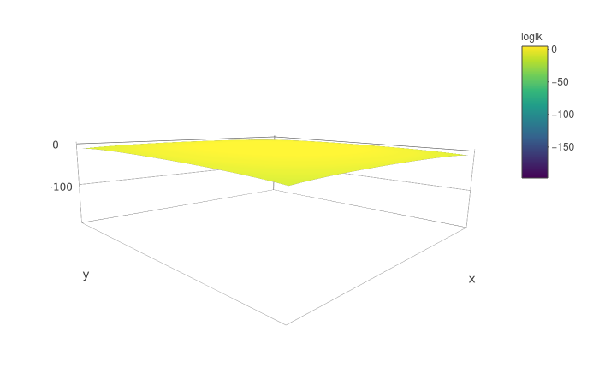
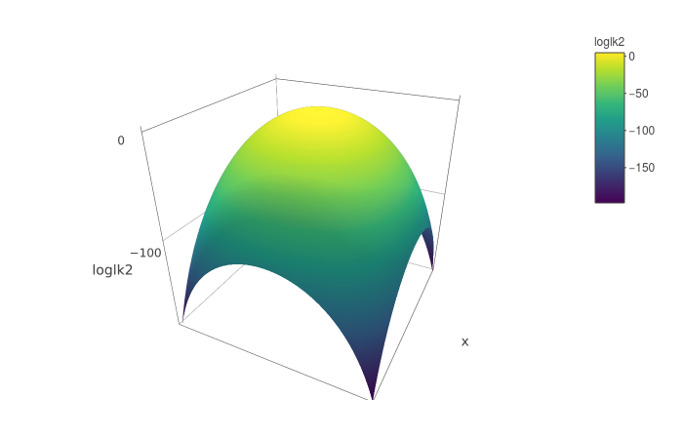
Problems when relying on the maximum
Ex. A: likelihood surface for a simple model with two parameters:
Log-likelihood
Log-likelihood

Slide 265
Problems when relying on the maximum
Ex. A: likelihood surface for a simple model with two parameters:
Maximum
Log-likelihood
Log-likelihood

Slide 266
Problems when relying on the maximum
Ex. B : Given an alignment, 9 trees have very similar likelihoods and are much more likely than all the other ones.
Taking the most likely tree only provides knowledge about 1 of those 9 almost equi-likely trees.
→ It would be better to take into account all 9 of them!

Slide 267
Optimizing, integrating, sampling
Optimizing: Looking for the topology and all other parameter values that are most likely
Integrating: visiting all topologies and parameter values according to their probability
Pros :
  If we are interested only in the topology, we integrate over all “nuisance” parameters
  One gets confidence intervals for free
Sampling: like integrating, but we do not attempt to be exhaustive in our exploration of parameter values

Slide 268
Likelihood vs Bayesian approach for sampling
Likelihood : P(D|M,θ)
We want to sample parameter values θ of model M.
How can we know that the 9 sets of parameter values θ we have sampled are much more likely than all other θ, without sampling everything?
→ NOT a probability distribution.
But :
→ True probability distribution.
If the added probabilities of 9 sets of parameter values θ reach 0.99, I know I have sampled all the most probable parameter values, without needing to sample more!

Slide 269
Likelihood vs Bayesian approach for sampling
Likelihood : P(D|M,θ)
We want to sample parameter values θ of model M.
How can we know that the 9 sets of parameter values θ we have sampled are much more likely than all other θ, without sampling everything?
→ NOT a probability distribution.
But :
→ True probability distribution.
If the added probabilities of 9 sets of parameter values θ reach 0.99, I know I have sampled all the most probable parameter values, without needing to sample more!

Slide 270
Likelihood vs Bayesian approach for sampling
Likelihood : P(D|M,θ)
We want to sample parameter values θ of model M.
How can we know that the 9 sets of parameter values θ we have sampled are much more likely than all other θ, without sampling everything?
→ NOT a probability distribution.
But :
→ True probability distribution.
If the added probabilities of 9 sets of parameter values θ reach 0.99, I know I have sampled all the most probable parameter values, without needing to sample more!

Slide 271
Likelihood vs Bayesian approach for sampling
Likelihood : P(D|M,θ)
We want to sample parameter values θ of model M.
How can we know that the 9 sets of parameter values θ we have sampled are much more likely than all other θ, without sampling everything?
→ NOT a probability distribution.
But :
→ True probability distribution.
If the added probabilities of 9 sets of parameter values θ reach 0.99, I know I have sampled all the most probable parameter values, without needing to sample more!
Posterior probability

Slide 272
Simplifying the notation
When we write P(θ|D,M), we mean that we are computing the probability of parameter values θ given model M and given data D.
Here M is used to represent the structure of the model.
For instance:
The fact that all sites are independent
The fact that they share a single value of the transition/transversion ratio
The fact that we have a Birth-death prior on a chronogram
Etc…
In some cases, we may want to integrate over different model structures M: e.g. a model with 1 value of the transition/transversion ratio, or 2, or 3…
In most cases, we use a single model M, so we will forget about it in most of the following:
P(θ|D,M) → P(θ|D)

Slide 273
Bayesian inference
Bayes theorem:

Slide 274
Bayesian inference
Bayes theorem:

Slide 275
Bayesian inference
Bayes theorem:
Hard to compute.
In practice, we can often ignore it.

Slide 276
Bayesian inference
Bayes theorem:
Posterior probability
Likelihood
Marginal likelihood
Prior probability

Slide 277
The importance of prior probabilities
The Bayesian approach amounts to considering that all parameters of a model are random variables in a probabilistic world.
Therefore, one needs to assign probability distributions to those parameters: the priors.
→ PROS: allows incorporating prior information coming from the analysis of other data: my conclusion relies on more than the tiny amount of data I have analyzed in a given experiment.
→ CONS: introduces prior information into the analysis: is my conclusion simply propagating my prior information?

Slide 278
Bayesian inference
Bayes theorem:
We are interested in the posterior probability of the parameter values: we want to sample parameter values according to their posterior probability given the data.
Therefore we need to get the distribution for P(θ|D).
We have two solutions:
Integrate over all parameter values
  Requires some maths
  Not always possible
Sample from this distribution in some (smart) way

Slide 279
Naive sampling of P(θ|D)
Random sampling
Can work for small problems.
Inference of the probability of getting heads from a coin
http://rpubs.com/boussau/384012

Slide 280
Naive sampling of P(θ|D)
Random sampling
Can work for small problems.
Inference of the probability of getting heads from a coin:
http://rpubs.com/boussau/384012
Will not work for complex problems : in phylogenetics, for 20 sequences, there are already 221. 10¹⁸ possible topologies… for which one would want to sample branch lengths and other parameter values.
→ We cannot reasonably hope to sample trees with a good probability using random sampling

Slide 281
Naive sampling of P(θ|D)
Random sampling
Can work for small problems.
Inference of the probability of getting heads from a coin:
http://rpubs.com/boussau/384012
Will not work for complex problems : in phylogenetics, for 20 sequences, there are already 221. 10¹⁸ possible topologies… for which one would want to sample branch lengths and other parameter values.
→ We cannot reasonably hope to sample trees with a good probability using random sampling
Later we will see smarter ways to sample from complex posterior distributions

Slide 282
Bayesian phylogenetics
Posterior probability
Likelihood
Marginal likelihood
Prior probability
In phylogenetics:
  D: aligned sequence data
  M: the model can be very complicated, but usually contains:
    Topology
    Branch lengths
    Rate matrix
    Etc…
  θ: the values of the parameters above

Slide 283
Bayesian phylogenetics
Posterior probability
Likelihood:
Felsenstein pruning algorithm
Marginal likelihood
Prior probability
In phylogenetics:
  D: aligned sequence data
  M: the model can be very complicated, but usually contains:
    Topology
    Branch lengths
    Rate matrix
    Etc…
  θ: the values of the parameters above

Slide 284
Bayesian phylogenetics
Posterior probability
Likelihood:
Felsenstein pruning algorithm
Marginal likelihood:
In lots of cases, it’s OK not to compute it, except for model comparison
Prior probability
In phylogenetics:
  D: aligned sequence data
  M: the model can be very complicated, but usually contains:
    Topology
    Branch lengths
    Rate matrix
    Etc…
  θ: the values of the parameters above

Slide 285
Bayesian phylogenetics
Posterior probability
Likelihood:
Felsenstein pruning algorithm
Marginal likelihood:
In lots of cases, it’s OK not to compute it, except for model comparison
Prior probability:
We need prior distributions for all parameters, see Mike’s talk!
In phylogenetics:
  D: aligned sequence data
  M: the model can be very complicated, but usually contains:
    Topology
    Branch lengths
    Rate matrix
    Etc…
  θ: the values of the parameters above

Slide 286
Bayesian phylogenetics
In phylogenetics, one may want to sample:
  Phylogenetic trees (when we don’t care about dates):
    topologies
    branch lengths
  Chronograms (when dates are of interest)
  Rates:
    Rates of exchangeability
    Site-wise rates of evolution
    Birth-death rates
    ...
  Frequencies:
      ACGT equilibrium frequencies
      Root frequencies
  Other parameters...

Slide 287
MCMC in phylogenetics
Parameter | Prior (example)
Topology | Uniform...
Branch lengths | Exponential, Gamma+Dirichlet...
Chronogram | Birth-Death, Coalescent...
Rates of exchangeability | Dirichlet...
Site-wise rates of evolution | (Discretized) Gamma...
Birth-death rates | Lognormal, Exponential...
ACGT equilibrium frequencies | Dirichlet...
Root frequencies | Dirichlet...

Slide 288
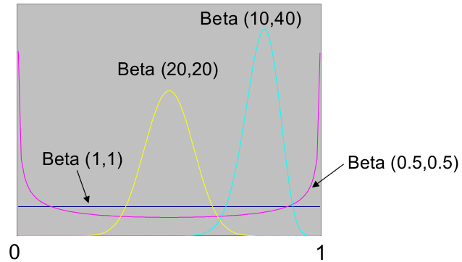
Prior for proportions
Beta prior

Slide 289
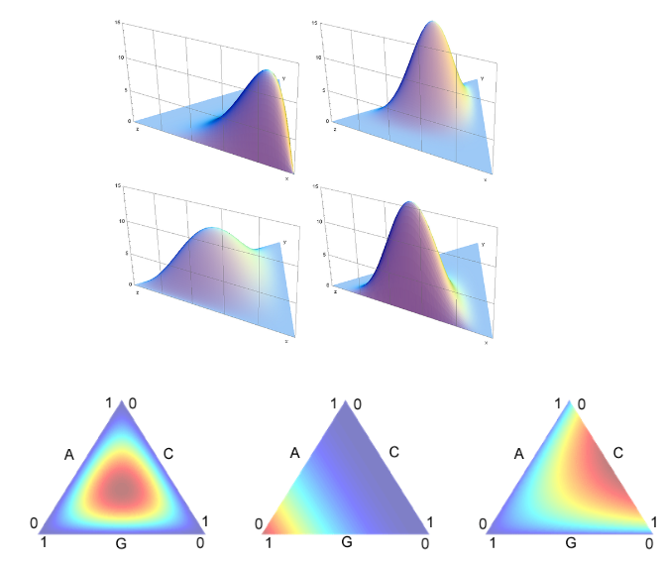
Prior for simplices (ACGT equilibrium frequencies, exchangeability rates...)
Dirichlet prior (i.e. Beta but in more dimensions)

Slide 290
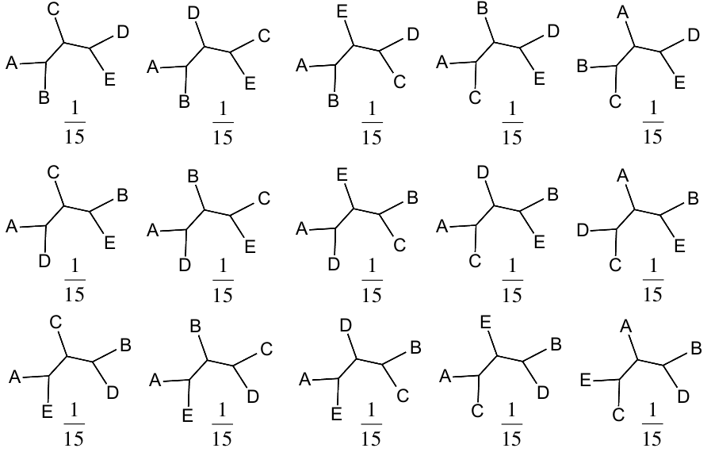
Unrooted topology prior
Discrete uniform prior

Slide 291
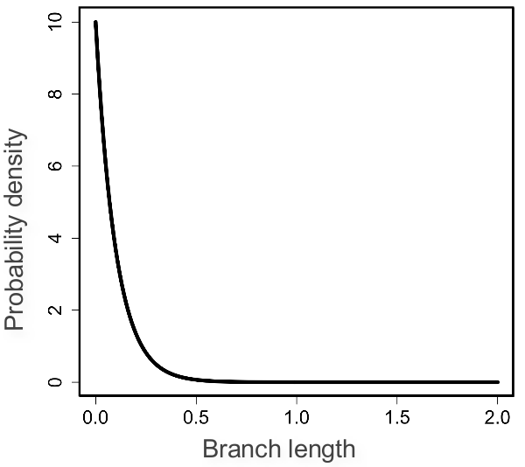
Prior for branch lengths
Exponential prior (λ=10, mean=0.1)
Alternative: Gamma for total tree length+Dirichlet

Slide 292
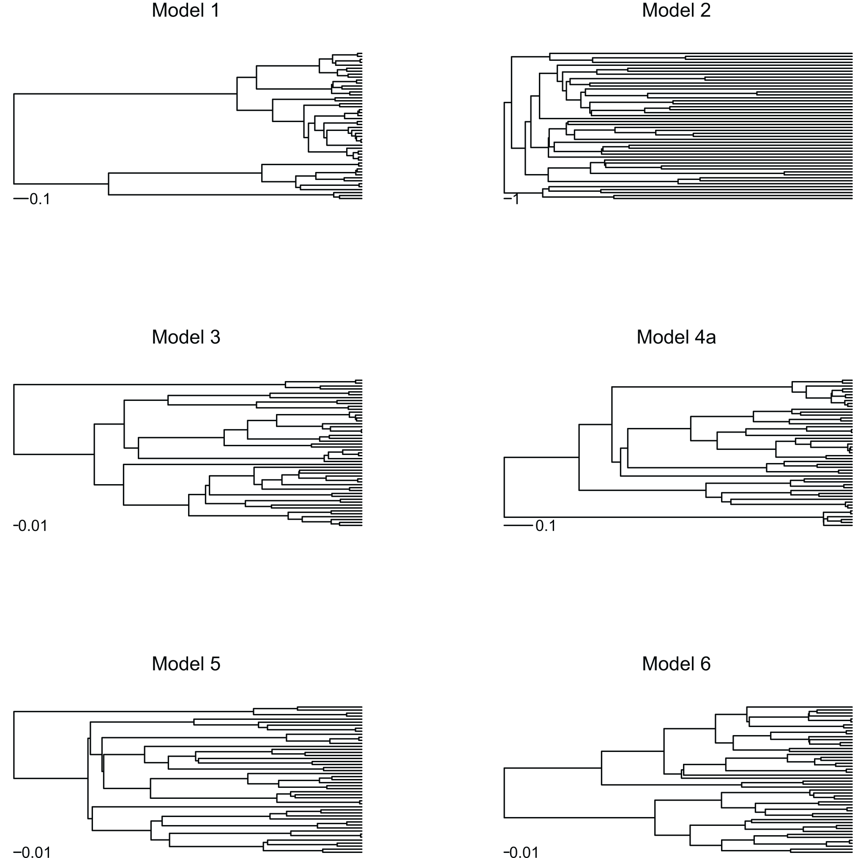
Chronogram prior: Birth-death process
Phylogenies simulated under a model with saturated diversity and a constant turnover rate (Model 1) have short terminal branches compared to phylogenies simulated under the pure-birth process (Yule model; Model 5). With saturated diversity but decaying turnover rates, terminal branches become longer (Model 2). Compared to the pure-birth process (Model 5), the presence of extinction pushes phylogenetic nodes towards the tips (Model 3), whereas a decay in speciation rate pushes them towards the root (Model 6). In the presence of both extinction and a decay in speciation rate (Model 4), however, these two effects counteract, producing a phylogeny that appears similar to the pure-birth model. All phylogenies were simulated with the same initial speciation rate (six speciation events per time unit). The extinction rate in Models 3 and 4a was identical (three speciation events per time unit). The exponential variation in speciation rate in Models 2, 4a, and 6 was identical (0.25 per time unit). Note the different time scales.
Morlon et al., 2010

Slide 293
Bayesian phylogenetics
Posterior probability
Likelihood:
Cf Alexis’s talk!
Marginal likelihood
Prior probability
In phylogenetics:
  D: aligned sequence data
  M: the model can be very complicated, but usually contains:
    Topology
    Branch lengths
    Rate matrix
    Etc…
  θ: the values of the parameters above

Slide 294
Bayesian phylogenetics
Posterior probability
Likelihood:
Cf Alexis’s talk!
Marginal likelihood
Prior probability
In phylogenetics:
  D: aligned sequence data
  M: the model can be very complicated, but usually contains:
    Topology
    Branch lengths
    Rate matrix
    Etc…
  θ: the values of the parameters above

Slide 295
Smart sampling of P(θ|D)
Smart sampling = no need to sample a huge number of points !
→ Ideally : Sample trees and parameter values with a frequency equal to their probability.
E.g.: we would sample one of our 9 trees 99% of the time!
Several approaches:
Importance sampling
Markov Chain Monte Carlo (MCMC)
Sequential Monte Carlo
...

Slide 296
Smart sampling of P(θ|D)
Smart sampling = no need to sample a huge number of points !
→ Ideally : Sample trees and parameter values with a frequency equal to their probability.
E.g.: we would sample one of our 9 trees 99% of the time!
Several approaches:
Importance sampling
Markov Chain Monte Carlo (MCMC)
Sequential Monte Carlo
...
Next time!

Slide 297
Conclusion
One can perform inference according to the posterior probability of a probabilistic model
That’s what Bayesian inference is about
It combines the likelihood with priors on parameter values
In phylogenetics, the likelihood is typically computed thanks to Felsenstein’s pruning algorithm (1981)
Then priors need to be defined for:
  Topologies and branch lengths / chronograms
  Rates
  Other parameters… (cf Mike)
When parameters are independent, to compute the prior of all parameter values, one only needs to compute the product over individual parameter priors

Slide 298
Plan: Criteria for evaluating phylogenies
Criteria for evaluating phylogenetic trees:
  Parsimony
  Distance methods
  Maximum Likelihood
    Using a Monte Carlo simulation
    Using Felsenstein’s pruning algorithm
  Posterior probability (Bayesian approach)
Conventions:
  We’re dealing with aligned sequence data
  gaps are not taken into account
Optimization algorithms
(Alexis)
Bayesian inference and MCMC
(Mike)

