Slide 1
MR.GENIUS / CHALLENGE PROTOTYPE
Context Bridge
FIWARE
Search public service records, inspect their linked sources and verify local review updates through a real NGSI-LD broker.
REAL PUBLIC DATA BENCHMARK
Working Python application over a local Antares NGSI-LD broker.
Mohammed Bouzyani / Mr.Genius Morocco Since AI 2026 prototype
01
Notes:
City of Helsinki Service Map, https://servicemap.hel.fi . CC BY 4.0. No endorsement. Antares v0.2.0 by joinedcontext, EUPL 1.2.
https://www.hel.fi/palvelukarttaws/rest/v4/unit/?search=kirjasto
Public registry snapshot, not current operating status. Some units match library-related services rather than a standalone library. Source fields may be incomplete. Review decisions are local prototype annotations, not municipality or business-owner approval. Antares runs in memory. Review projections reset on restart. No full ETSI conformance certification or production authentication is claimed.
Source fingerprint: e4d4b597a9bbc67c106c5e00516e74715d2654d1c29b3fa8a8d5b1328eaf5f5f

Slide 2
MR.GENIUS / FIWARE
Public service records need interoperable evidence
Put attributed records into an NGSI-LD Context Broker. Preserve organisation relationships and verify local reviews through the same API.
Decision design
Evidence stays visible. A human reviewer controls the next action.
Mohammed Bouzyani / Mr.Genius Morocco Since AI 2026 prototype
02
Notes:
City of Helsinki Service Map, https://servicemap.hel.fi . CC BY 4.0. No endorsement. Antares v0.2.0 by joinedcontext, EUPL 1.2.
https://www.hel.fi/palvelukarttaws/rest/v4/unit/?search=kirjasto
Public registry snapshot, not current operating status. Some units match library-related services rather than a standalone library. Source fields may be incomplete. Review decisions are local prototype annotations, not municipality or business-owner approval. Antares runs in memory. Review projections reset on restart. No full ETSI conformance certification or production authentication is claimed.
Source fingerprint: e4d4b597a9bbc67c106c5e00516e74715d2654d1c29b3fa8a8d5b1328eaf5f5f

Slide 3
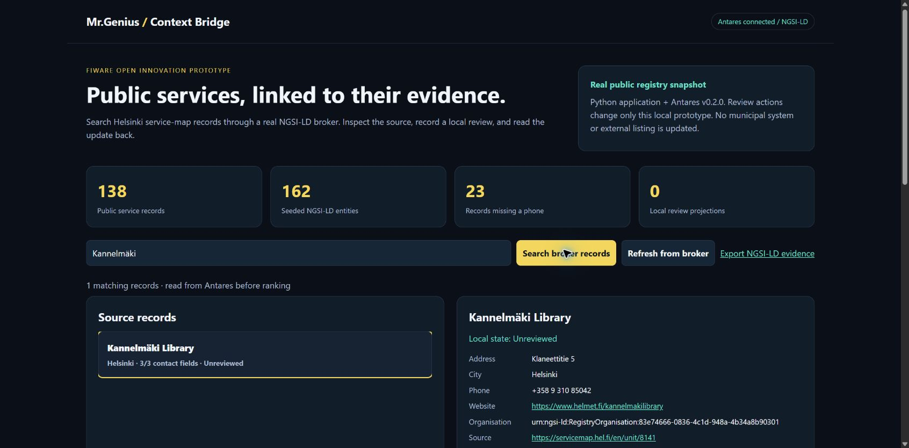
MR.GENIUS / FIWARE
Working application over Antares
Python produces NGSI-LD entities and organisation relationships. Antares v0.2.0 stores and queries context. TF-IDF ranks returned records. Review events link to a target, PATCH updates its local state, and GET verifies the result.
Mohammed Bouzyani / Mr.Genius Morocco Since AI 2026 prototype
03
Notes:
City of Helsinki Service Map, https://servicemap.hel.fi . CC BY 4.0. No endorsement. Antares v0.2.0 by joinedcontext, EUPL 1.2.
https://www.hel.fi/palvelukarttaws/rest/v4/unit/?search=kirjasto
Public registry snapshot, not current operating status. Some units match library-related services rather than a standalone library. Source fields may be incomplete. Review decisions are local prototype annotations, not municipality or business-owner approval. Antares runs in memory. Review projections reset on restart. No full ETSI conformance certification or production authentication is claimed.
Source fingerprint: e4d4b597a9bbc67c106c5e00516e74715d2654d1c29b3fa8a8d5b1328eaf5f5f

Slide 4
MR.GENIUS / FIWARE
Measured public benchmark
138
162
10
Public service records
Seeded context entities
Integration tests passed
Antares stores 138 public service records and 24 organisation entities. End-to-end verification creates a review event, updates the target state and reads it back.
Public benchmark only. No company records or deployment results.
Mohammed Bouzyani / Mr.Genius Morocco Since AI 2026 prototype
04
Notes:
City of Helsinki Service Map, https://servicemap.hel.fi . CC BY 4.0. No endorsement. Antares v0.2.0 by joinedcontext, EUPL 1.2.
https://www.hel.fi/palvelukarttaws/rest/v4/unit/?search=kirjasto
Public registry snapshot, not current operating status. Some units match library-related services rather than a standalone library. Source fields may be incomplete. Review decisions are local prototype annotations, not municipality or business-owner approval. Antares runs in memory. Review projections reset on restart. No full ETSI conformance certification or production authentication is claimed.
Source fingerprint: e4d4b597a9bbc67c106c5e00516e74715d2654d1c29b3fa8a8d5b1328eaf5f5f

Slide 5
MR.GENIUS / FIWARE
Computed evidence: Registry contact completeness
Records by available address, phone and website fields
Mohammed Bouzyani / Mr.Genius Morocco Since AI 2026 prototype
05
Notes:
City of Helsinki Service Map, https://servicemap.hel.fi . CC BY 4.0. No endorsement. Antares v0.2.0 by joinedcontext, EUPL 1.2.
https://www.hel.fi/palvelukarttaws/rest/v4/unit/?search=kirjasto
Public registry snapshot, not current operating status. Some units match library-related services rather than a standalone library. Source fields may be incomplete. Review decisions are local prototype annotations, not municipality or business-owner approval. Antares runs in memory. Review projections reset on restart. No full ETSI conformance certification or production authentication is claimed.
Source fingerprint: e4d4b597a9bbc67c106c5e00516e74715d2654d1c29b3fa8a8d5b1328eaf5f5f

Slide 6
MR.GENIUS / FIWARE
Data provenance and practical limits
City of Helsinki Service Map, https://servicemap.hel.fi . CC BY 4.0. No endorsement. Antares v0.2.0 by joinedcontext, EUPL 1.2.
https://www.hel.fi/palvelukarttaws/rest/v4/unit/?search=kirjasto
Public registry snapshot, not current operating status. Some units match library-related services rather than a standalone library. Source fields may be incomplete. Review decisions are local prototype annotations, not municipality or business-owner approval. Antares runs in memory. Review projections reset on restart. No full ETSI conformance certification or production authentication is claimed.
Mohammed Bouzyani / Mr.Genius Morocco Since AI 2026 prototype
06
Notes:
City of Helsinki Service Map, https://servicemap.hel.fi . CC BY 4.0. No endorsement. Antares v0.2.0 by joinedcontext, EUPL 1.2.
https://www.hel.fi/palvelukarttaws/rest/v4/unit/?search=kirjasto
Public registry snapshot, not current operating status. Some units match library-related services rather than a standalone library. Source fields may be incomplete. Review decisions are local prototype annotations, not municipality or business-owner approval. Antares runs in memory. Review projections reset on restart. No full ETSI conformance certification or production authentication is claimed.
Source fingerprint: e4d4b597a9bbc67c106c5e00516e74715d2654d1c29b3fa8a8d5b1328eaf5f5f

Slide 7
MR.GENIUS / FIWARE
Company pilot and next decision
Demonstrate Context Bridge live for the independent FIWARE award. Next, agree on an approved municipal workflow, add authentication and validate source freshness before production integration.
Pilot success criteria are proposed, not measured outcomes.
Independent FIWARE award route. A working live demonstration is required. Company challenge assignment is separate and remains pending.
Mohammed Bouzyani / Mr.Genius Morocco Since AI 2026 prototype
07
Notes:
City of Helsinki Service Map, https://servicemap.hel.fi . CC BY 4.0. No endorsement. Antares v0.2.0 by joinedcontext, EUPL 1.2.
https://www.hel.fi/palvelukarttaws/rest/v4/unit/?search=kirjasto
Public registry snapshot, not current operating status. Some units match library-related services rather than a standalone library. Source fields may be incomplete. Review decisions are local prototype annotations, not municipality or business-owner approval. Antares runs in memory. Review projections reset on restart. No full ETSI conformance certification or production authentication is claimed.
Source fingerprint: e4d4b597a9bbc67c106c5e00516e74715d2654d1c29b3fa8a8d5b1328eaf5f5f

