Slide 1
Student Lifestyle on the Basis of Their GPA
Bovas Benson
DeVos Graduate School, Northwood University
MTH 650: Introduction to Data Analytics
Dr. Itauma Itauma

Slide 2
Introduction
Lifestyle choices significantly affect academic performance.
Study hours, sleep, social interactions, and extracurricular activities impact GPA.
The study aims to analyze these factors using statistical techniques.

Slide 3
Problem Statement
How do study hours, sleep, extracurricular activities, and socializing affect GPA?
What trade-offs do students make between academics and other activities?
How do students distribute their time across different activities?

Slide 4
Dataset Description
The dataset includes variables like study hours, sleep hours, social hours, extracurricular activities, and physical activity.
The dependent variable is GPA.
Data helps understand how lifestyle impacts academic performance.

Slide 5
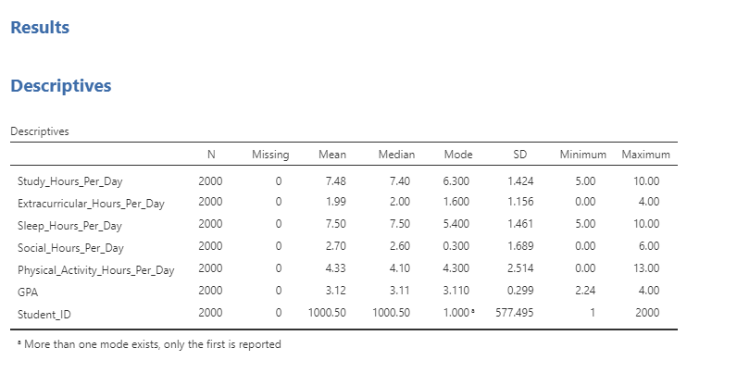

Slide 6
Descriptive Analysis
Average study hours: 7.48 hours/day.
Sleep hours: 7.5 hours/night.
Socializing: 2.7 hours/day.
Extracurricular activities: 1.99 hours/day.
Physical activity: 4.33 hours/day.
Average GPA: 3.12.

Slide 7
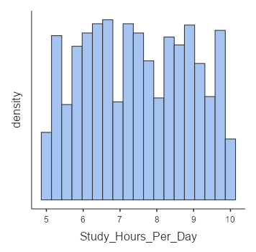
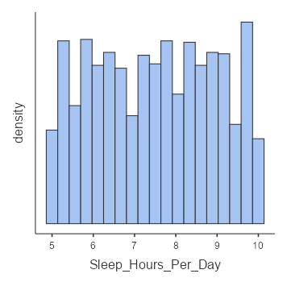
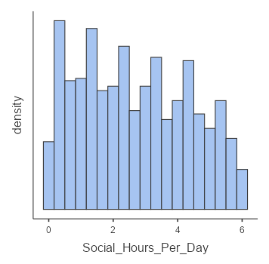
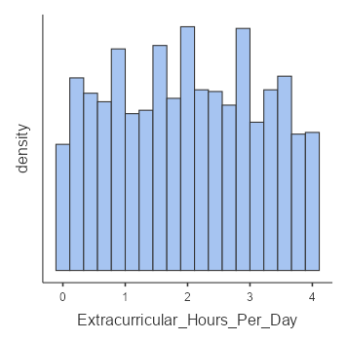
Histogram

Slide 8
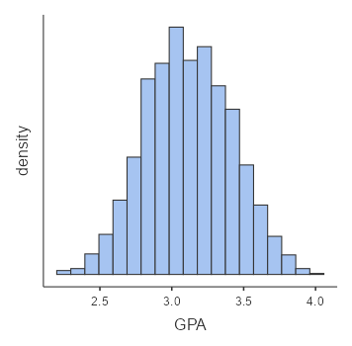
Study Habits: Most students dedicate 7 to 8 hours per day to studying, indicating a common focus on academics.
Lifestyle Variations: Sleep patterns range from 5 to 10 hours, while socializing, extracurricular involvement, and physical activity levels vary greatly — from none to very high engagement.
Academic Performance: GPAs follow a normal distribution, with most students' scores concentrated near the average.

Slide 9
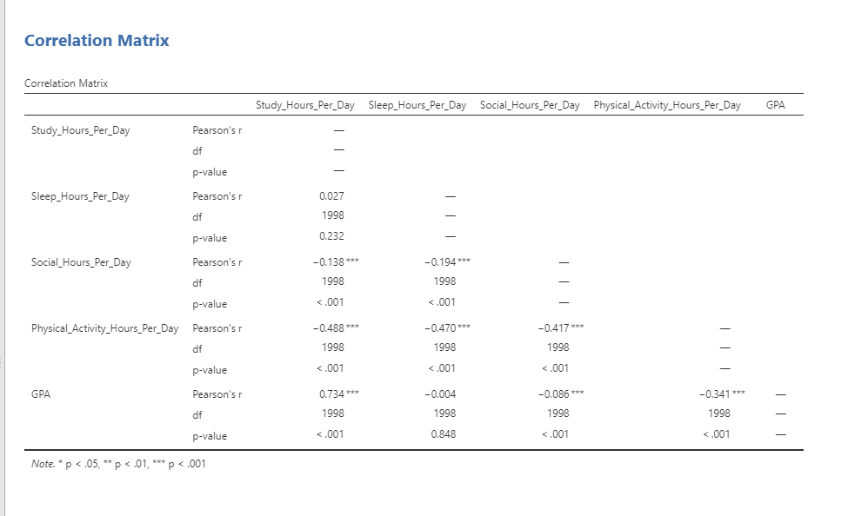

Slide 10
Correlation Matrix Analysis
Strong positive correlation (r = 0.734) between study hours and GPA.
Negative correlation between study hours and social hours (r = -0.138).
Negative correlation between physical activity and GPA (r = -0.341).
Sleep time negatively correlated with social time (r = -0.194).

Slide 11
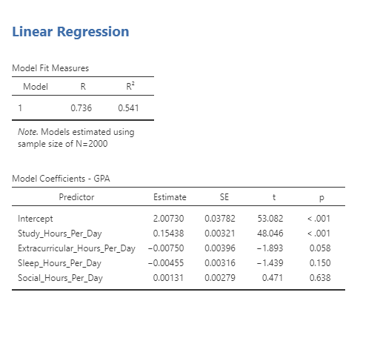

Slide 12
Linear Regression Analysis
Every extra hour of study increases GPA by 0.154.
Extracurricular activities and sleep have minimal impact on GPA.
Social hours have a negligible positive effect on GPA.
R² = 0.541, meaning 54.1% of GPA variation is explained by the independent variables.

Slide 13
Key Takeaways
Study time is crucial for higher GPA.
Extracurricular activities and socializing do not harm academic performance.
Time management is essential for balancing academics and personal well-being.
Exercise is linked to lower GPA, indicating a possible trade-off with study time.

Slide 14
Reference
. Hershner, S. D., & Chervin, R. D. (2014). Causes and consequences of sleepiness among college students. Nature and Science of Sleep, 6, 73-84. https://doi.org/10.2147/NSS.S62907
. Topping, K. J. (1996). The effectiveness of peer tutoring in further and higher education: A typology and review of the literature. Higher Education, 32(3), 321-345. https://doi.org/10.1007/BF00138870
. Singh, A., Uijtdewilligen, L., Twisk, J. W., Van Mechelen, W., & Chinapaw, M. J. (2012). Physical activity and performance at school. Archives of Pediatrics & Adolescent Medicine, 166(1), 49-55. https://doi.org/10.1001/archpediatrics.2011.716

Slide 15
Conclusion
Study hours are the most significant factor in GPA improvement.
Sleep, social life, and extracurricular activities have minimal impact.
Exercise negatively correlates with GPA, suggesting students may study less when engaging in physical activities.
In Future I want to analysis extra factors like Stress, Students like and dislike of the subject, Technology in there performances.

Slide 16


Slide 17


