Slide 1
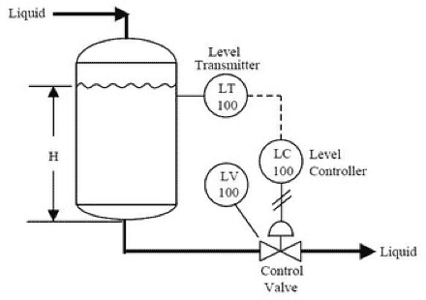
Process Dynamic And Control-Bioreactor Project
<number>

Slide 2
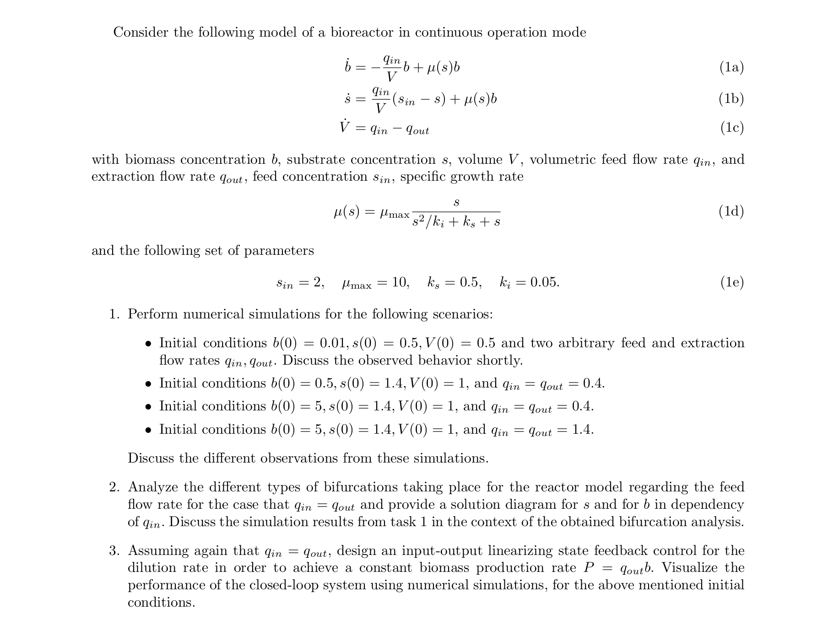
Project
<number>

Slide 3
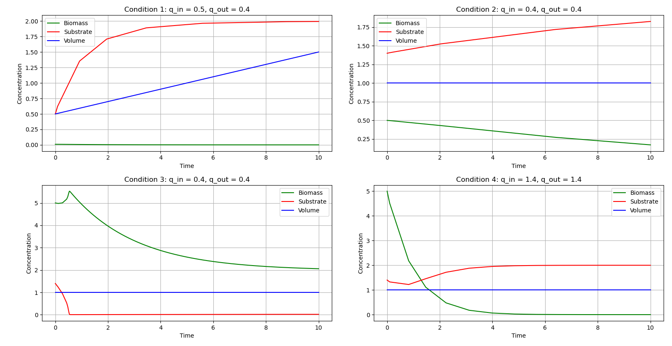
Numerical Simulation Result(s)
Summary
Condition 1: Substrate buildup and negligible biomass growth .
Condition 2: Biomass decreases as substrate increases.
Condition 3: High starting biomass quickly consumes substrate, resulting in a decline in both
Condition 4 : High initial biomass and substrate dynamics stabilize after the initial rapid shift.
3

Slide 4
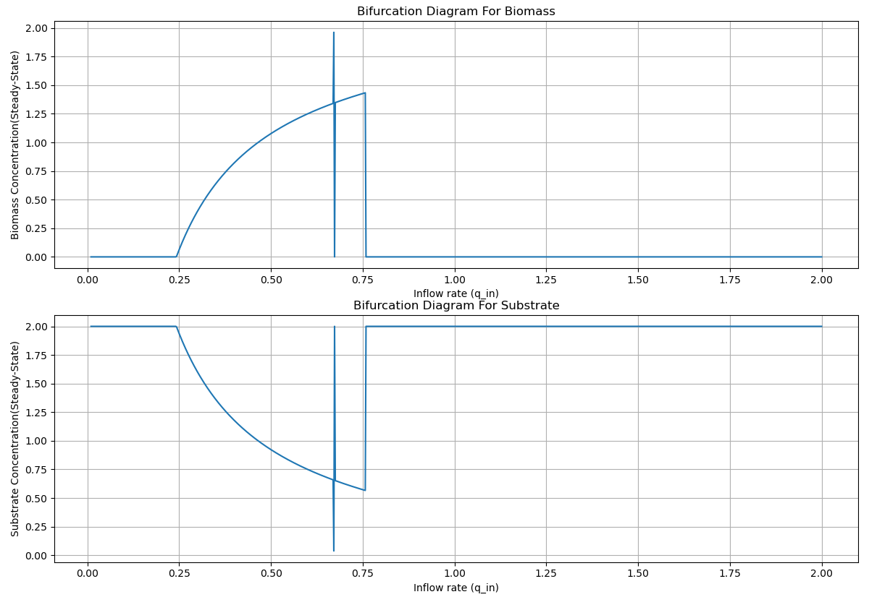
Bifurcation Analysis Result(s)
Summary
Biomass concentration si zero when q_in < 0.2, showing condition for biomass. When 0.2 < q_in <0.75, biomass concentration show steady increase
Substrate concentration is high at very low and high inflow rates, and between q_in 0.2 and q_in 0.75, the substrate concentration slowly decreases
4

Slide 5
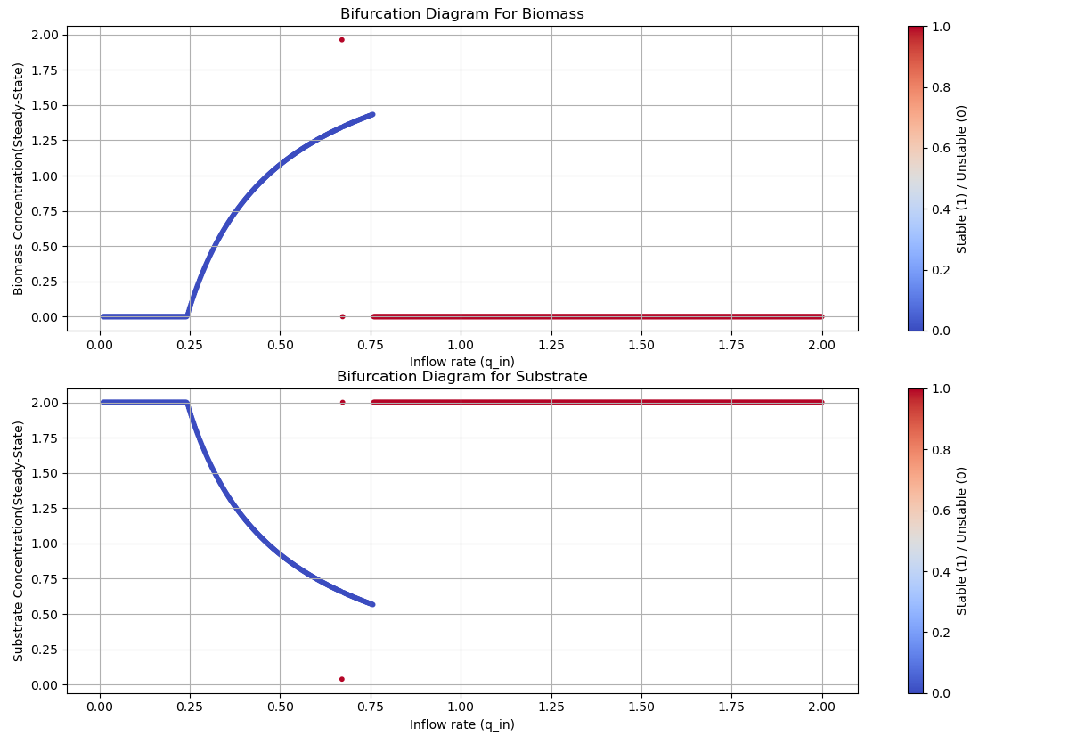
Bifurcation Analysis Result(s)
Summary
Biomass concentration increase predictably in the stable(blue) region for q-in < 0.75 while a sudden decline in biomass concentration occurs in the unstable(red) region for q_in ≈ 0.75 and beyond
Substrate concentration decreases predictably in the stable(blue) region for q-in < 0.75 while a sudden spike in substrate concentration occurs in the unstable(red) region for q_in ≈ 0.75 and beyond
The system exhibit a saddle-node bifurcation, it occurs around q-in = 0.75
5

Slide 6
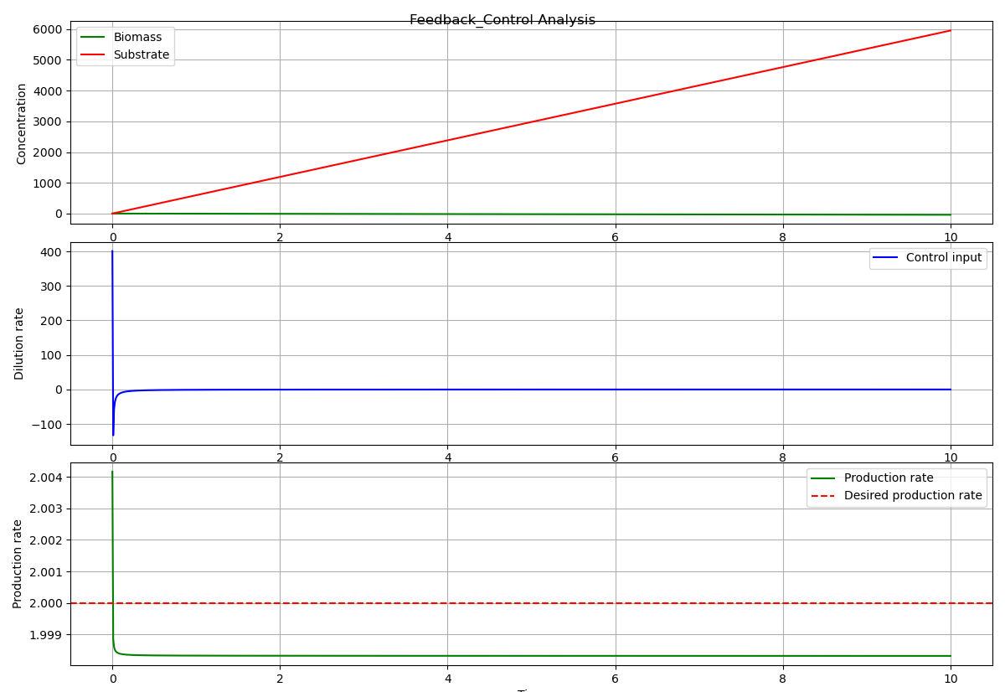
Feedback-Control Simulation Result
5

Slide 7
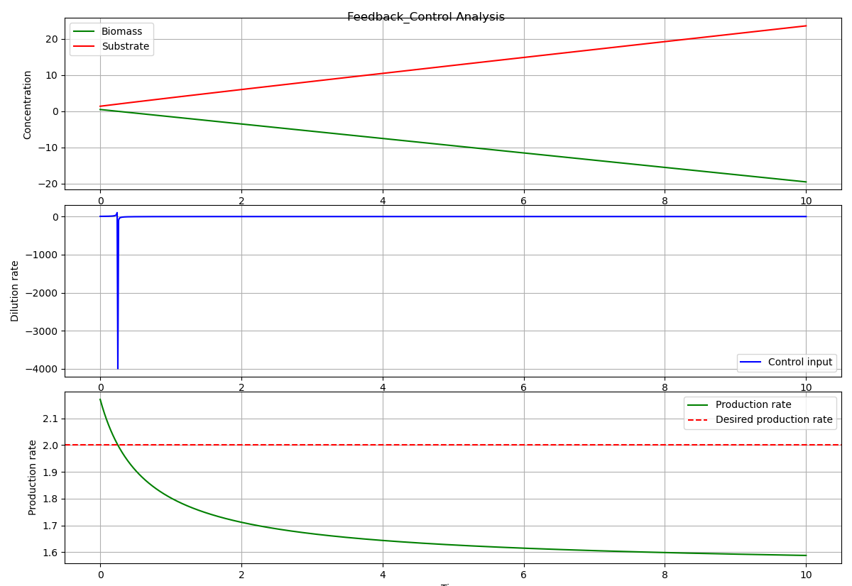
Feedback-Control Simulation Result
5

Slide 8
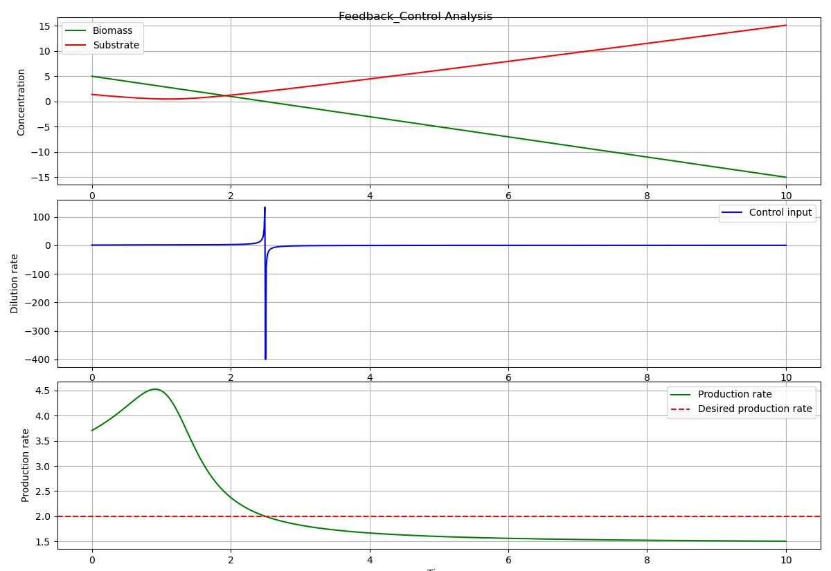
Feedback-Control Simulation Result
<number>

Slide 9
Feedback-Control Simulation Result
Biomass and Substrate Dynamic
First feedback control analysis: Biomass continues at zero, indicating no substrate utilization
Second analysis: Biomass and substrate concentrations move in opposing directions, indicating that biomass consumes substrate at a constant rate
The third analysis shows that both biomass and substrate stabilize after an initial spike, demonstrating dynamic equilibrium.
Dilution rate
High Initial Value: The dilution rate begins high and then stabilize at zero, indicating the control system's adjustment processes
Large Spikes: Aggressive control inputs at the beginning, particularly in the second and third simulations.
Production rate
In the first feedback control analysis, the production rate is close to the targeted level
Second and third analyses: The production rate first exceeds the target rate but then falls and stabilize below it, showing that the control system is unable to sustain the required rate over time
9

Slide 10
TAKE-HOME MESSAGE
This bioreactor model's analysis underscores the importance of understanding non-linear dynamics in bioprocess systems, revealing that integrating numerical simulations, bifurcation analysis, and advanced control strategies provides deep insights into system behaviour and aids in developing reliable operating strategies
Thank you for listening!

