Slide 1
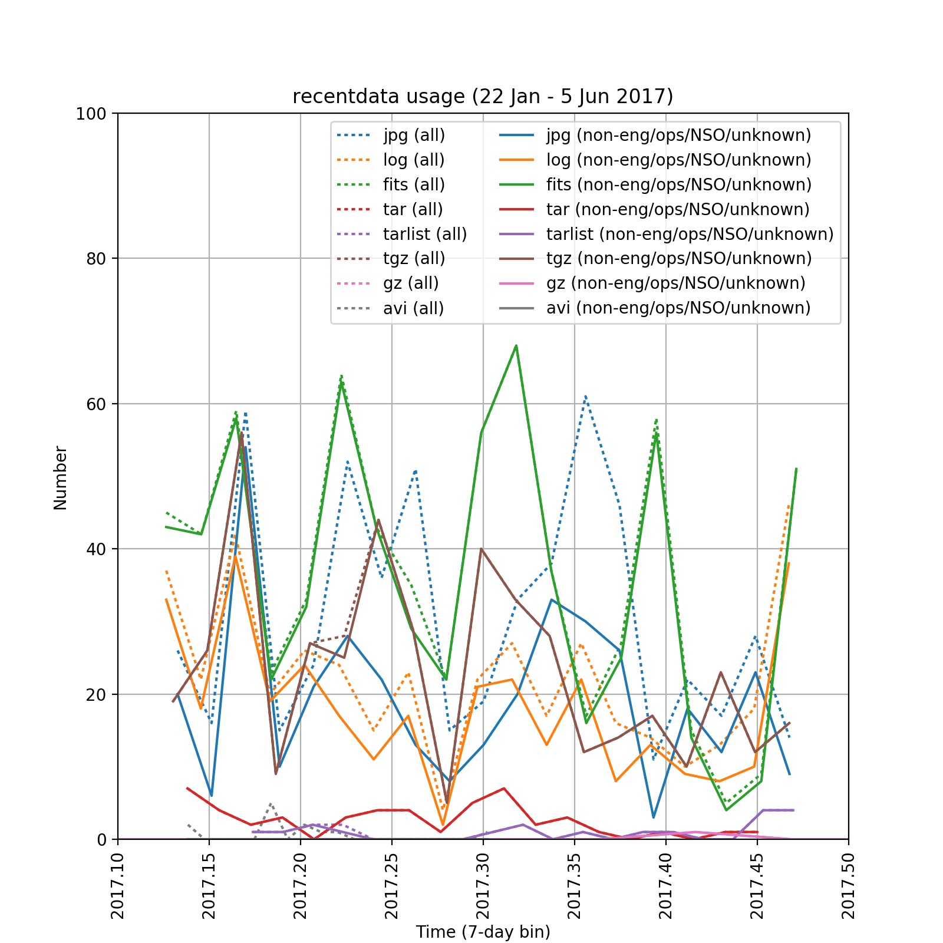

Slide 2
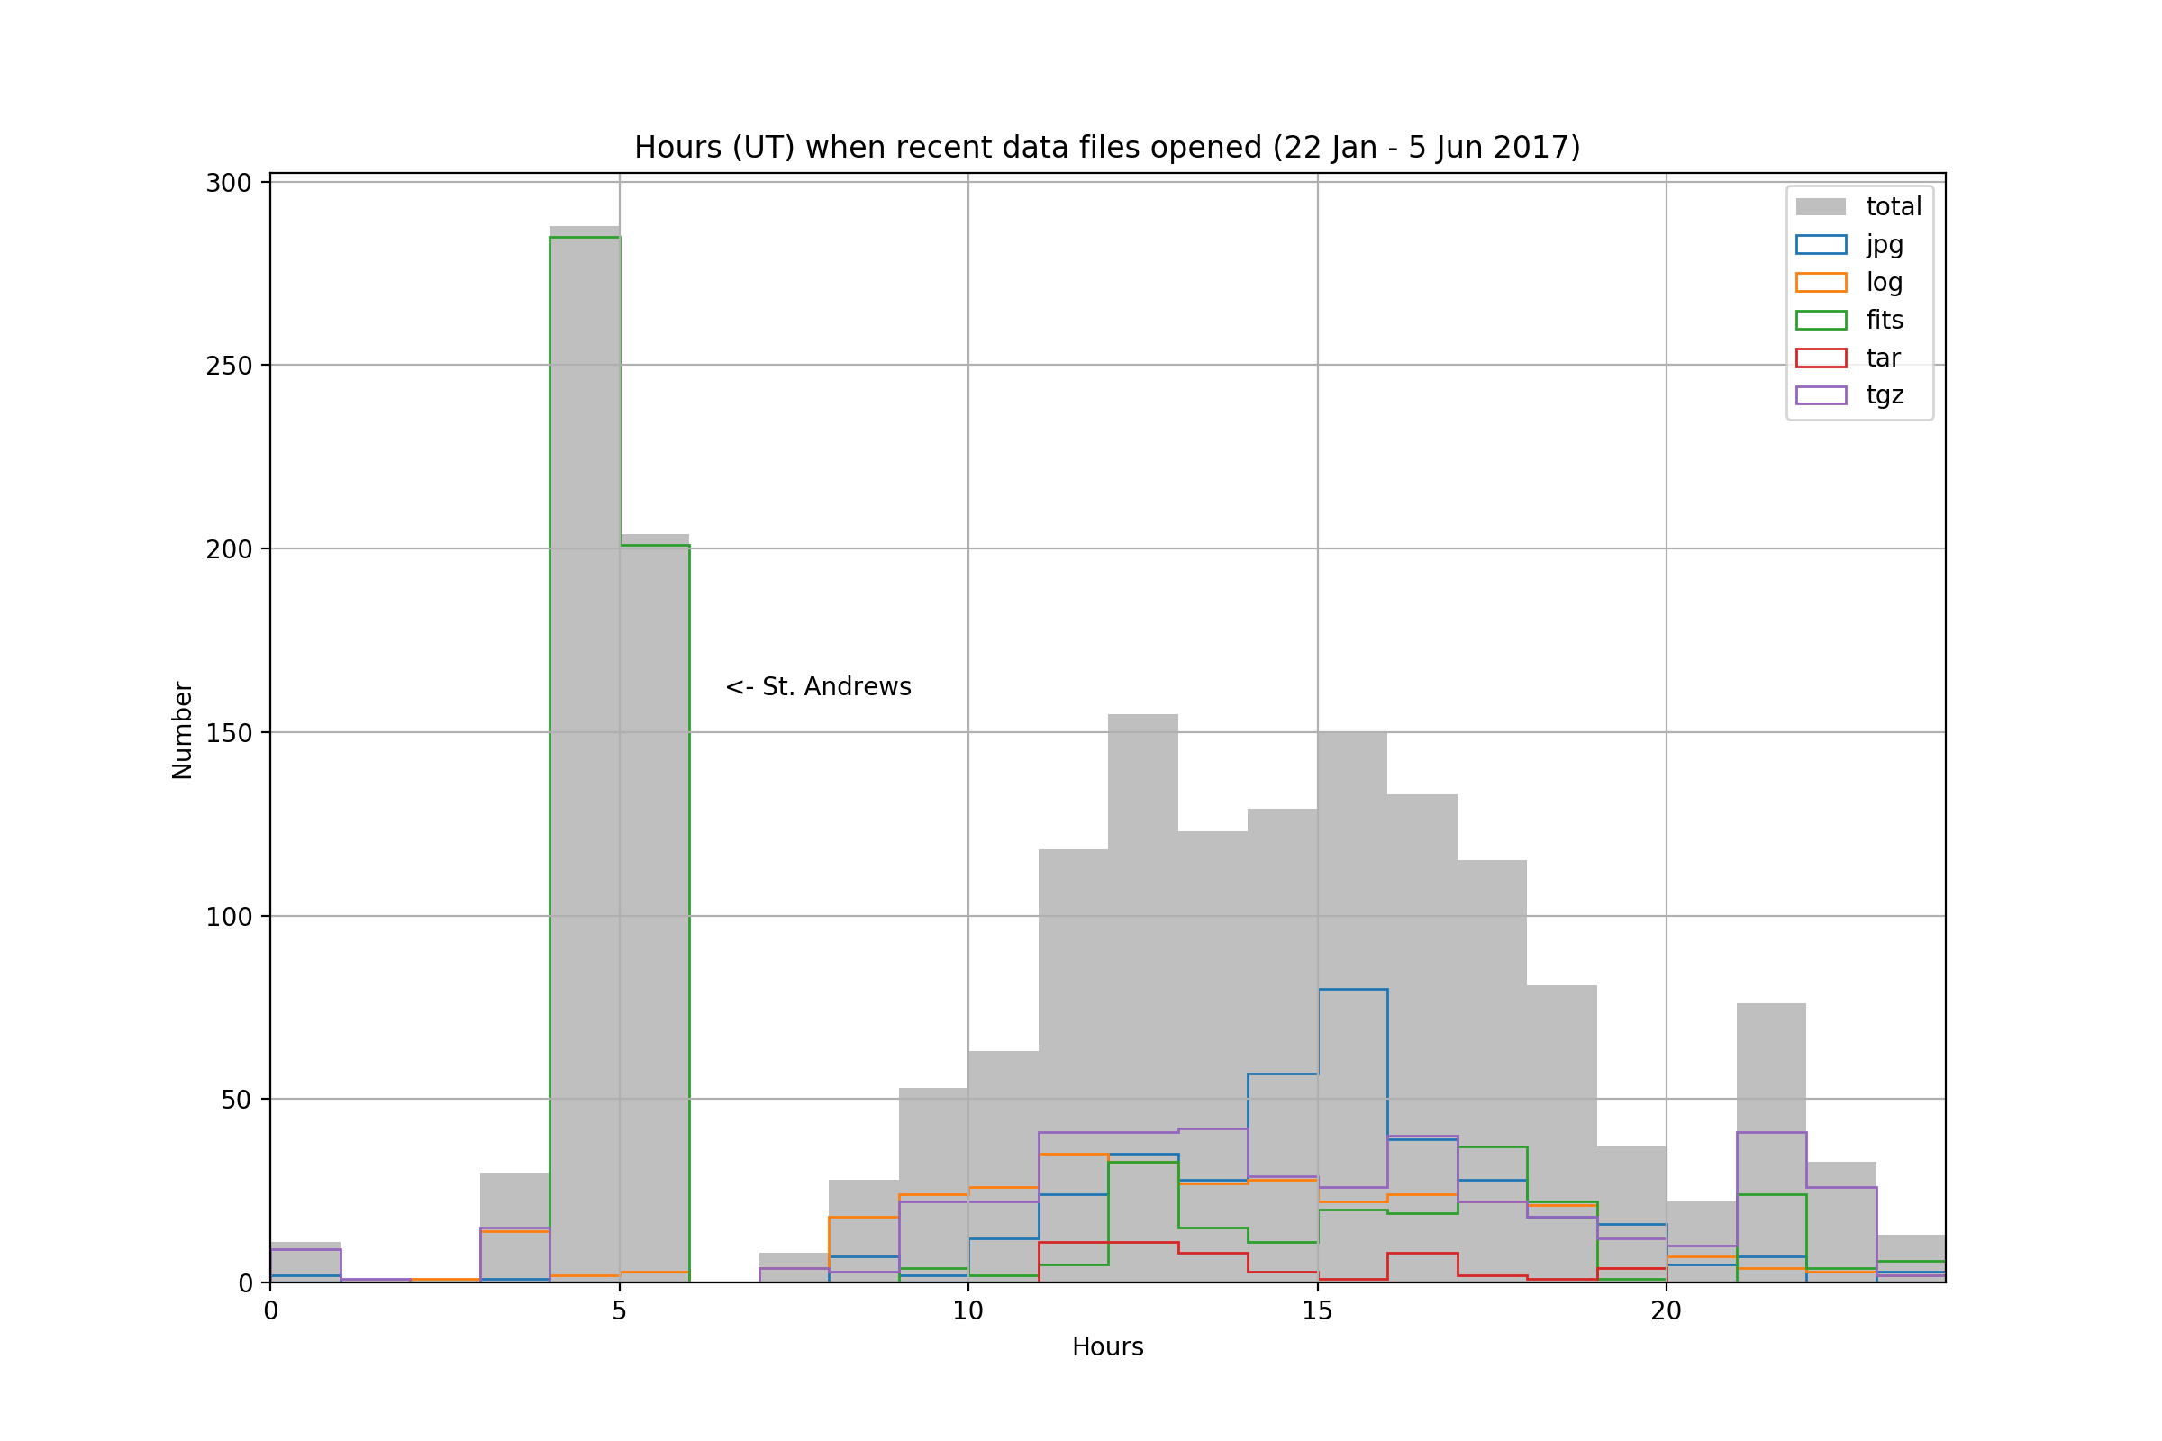

Slide 3
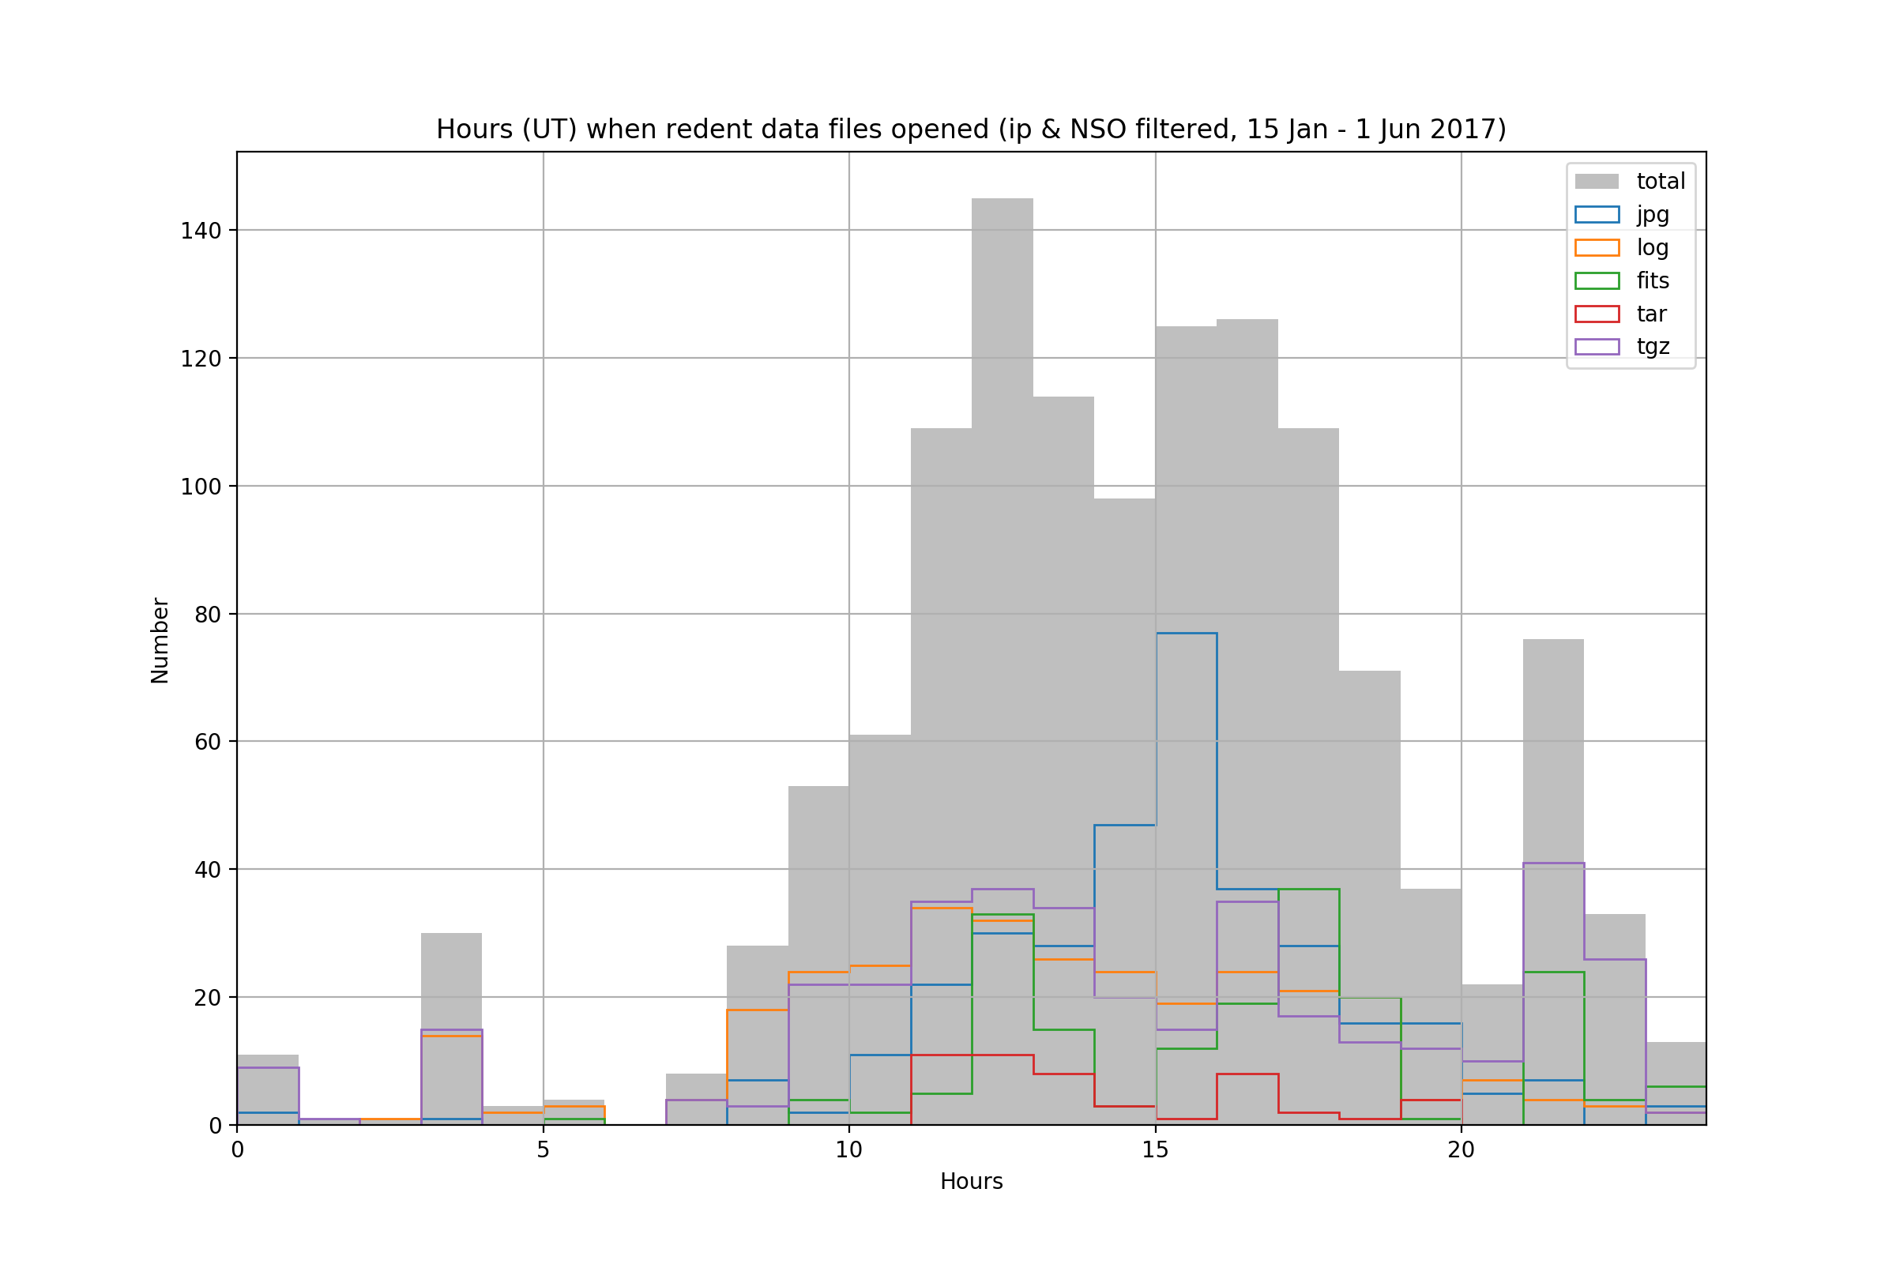
Cleaned from
Eng
Ops
Unknown
ARI
St. Andrews

