Slide 1
Chained Matrix Multiplication
Prof. Shin-Hung Chang

Slide 2
Matrix Multiplication
Problem:A_{2x4}×B_{4x3}×C_{3x5}×D_{5x1}
What is the minimum “×” cost order to do this matrix multiplication?

Slide 3
35
(A×B×C×D)_{2x5}
(A×B×C)2x5
(B×C×D)4x1
54
27
(A×B)_{2x3}
(B×C)_{4x5}
(C×D)_{3x1}
24
60
15
A_{2x4}
B_{4x3}
C_{3x5}
D_{5x1}

Slide 4

Chained Matrix Multiplication
Suppose we want to multiply a 2 × 3 matrix times a 3 × 4 matrix as follows:
The resultant matrix is a 2 × 4 matrix
If we use the standard method of multiplying matrices, it takes three elementary multiplications to compute each item in the product
Because there are 2 × 4 = 8 entries in the product, the total number of elementary multiplication is
ixj
jxk
ixk
2×3×4

Slide 5



Consider the multiplication of the following four matrices:
There are five different orders in which we can multiply four matrices, each possibly resulting in a different number of elementary multiplications
The third order is the optimal order for multiplying the four matrices

Slide 6
A_{i}, A_{i+1}, …, A_{j} 在某組合方式所需的純量積乘法次數為最小 (最佳)，則必存在一個k，使得A_{i}, A_{i+1}, …, A_{k} 和A_{k+1}, A_{k+2}, …, A_{j}皆為最佳。
((d_{i-1} A_{i} d_{i} A_{i+1} … A_{k}d_{k})(A_{k+1}d_{k+1} A_{k+2}d_{k+2} …, A_{j}d_{j}))
Chained Matrix Multiplication Recurrence
Optimal
Sub Optimal
Sub optimal

Slide 7
Chained Matrix Multiplication
Example: A¹_{3×3}, A²_{3×7}, A³_{7×2}, A⁴_{2×9}, A⁵_{9×4}
Sol:
Two matrix: M[1…5, 1…5] and P[1…4, 2…5]
★紀錄誰是 k
★紀錄最少的乘法個數
M | 1 | 2 | 3 | 4 | 5
1
2
3
4
5
P | 2 | 3 | 4 | 5
1
2
3
4

Slide 8
Chained Matrix Multiplication
Example: A¹_{3×3}, A²_{3×7}, A³_{7×2}, A⁴_{2×9}, A⁵_{9×4}
K=1
M[1,1]+M[2,3]
M[1,2]+M[3,3]
兩種可能
M[1,3]有
K=2
M | 1 | 2 | 3 | 4 | 5
1
2
3
4
5
P | 2 | 3 | 4 | 5
1
2
3
4

Slide 9
Chained Matrix Multiplication
Example: A¹_{3×3}, A²_{3×7}, A³_{7×2}, A⁴_{2×9}, A⁵_{9×4}
Sol:
Two matrix: M[1…5, 1…5] and P[1…4, 2…5]
diagonal 1
M | 1 | 2 | 3 | 4 | 5
1 | 0
2 |  | 0
3 |  |  | 0
4 |  |  |  | 0
5 |  |  |  |  | 0
P | 2 | 3 | 4 | 5
1
2
3
4

Slide 10
Chained Matrix Multiplication
Example: A¹_{3×3}, A²_{3×7}, A³_{7×2}, A⁴_{2×9}, A⁵_{9×4}
Sol:
Two matrix: M[1…5, 1…5] and P[1…4, 2…5]
M | 1 | 2 | 3 | 4 | 5
1 | 0 | 63
2 |  | 0 | 42
3 |  |  | 0 | 126
4 |  |  |  | 0 | 72
5 |  |  |  |  | 0
P | 2 | 3 | 4 | 5
1 | 1
2 |  | 2
3 |  |  | 3
4 |  |  |  | 4

Slide 11
Chained Matrix Multiplication
Example: A¹_{3×3}, A²_{3×7}, A³_{7×2}, A⁴_{2×9}, A⁵_{9×4}
Sol:
Two matrix: M[1…5, 1…5] and P[1…4, 2…5]
M | 1 | 2 | 3 | 4 | 5
1 | 0 | 63 | 60
2 |  | 0 | 42
3 |  |  | 0 | 126
4 |  |  |  | 0 | 72
5 |  |  |  |  | 0
P | 2 | 3 | 4 | 5
1 | 1 | 1
2 |  | 2
3 |  |  | 3
4 |  |  |  | 4
105
60

Slide 12
Chained Matrix Multiplication
Example: A¹_{3×3}, A²_{3×7}, A³_{7×2}, A⁴_{2×9}, A⁵_{9×4}
Sol:
Two matrix: M[1…5, 1…5] and P[1…4, 2…5]
M | 1 | 2 | 3 | 4 | 5
1 | 0 | 63 | 60
2 |  | 0 | 42 | 96
3 |  |  | 0 | 126
4 |  |  |  | 0 | 72
5 |  |  |  |  | 0
P | 2 | 3 | 4 | 5
1 | 1 | 1
2 |  | 2 | 3
3 |  |  | 3
4 |  |  |  | 4
96
315

Slide 13
Chained Matrix Multiplication
Example: A¹_{3×3}, A²_{3×7}, A³_{7×2}, A⁴_{2×9}, A⁵_{9×4}
Sol:
Two matrix: M[1…5, 1…5] and P[1…4, 2…5]
M | 1 | 2 | 3 | 4 | 5
1 | 0 | 63 | 60
2 |  | 0 | 42 | 96
3 |  |  | 0 | 126 | 128
4 |  |  |  | 0 | 72
5 |  |  |  |  | 0
P | 2 | 3 | 4 | 5
1 | 1 | 1
2 |  | 2 | 3
3 |  |  | 3 | 3
4 |  |  |  | 4
378
128

Slide 14
Chained Matrix Multiplication
Example: A¹_{3×3}, A²_{3×7}, A³_{7×2}, A⁴_{2×9}, A⁵_{9×4}
Sol:
Two matrix: M[1…5, 1…5] and P[1…4, 2…5]
M | 1 | 2 | 3 | 4 | 5
1 | 0 | 63 | 60 | 114
2 |  | 0 | 42 | 96
3 |  |  | 0 | 126 | 128
4 |  |  |  | 0 | 72
5 |  |  |  |  | 0
P | 2 | 3 | 4 | 5
1 | 1 | 1 | 3
2 |  | 2 | 3
3 |  |  | 3 | 3
4 |  |  |  | 4
114
368
177

Slide 15
Chained Matrix Multiplication
Example: A¹_{3×3}, A²_{3×7}, A³_{7×2}, A⁴_{2×9}, A⁵_{9×4}
Sol:
Two matrix: M[1…5, 1…5] and P[1…4, 2…5]
M | 1 | 2 | 3 | 4 | 5
1 | 0 | 63 | 60 | 114
2 |  | 0 | 42 | 96 | 138
3 |  |  | 0 | 126 | 128
4 |  |  |  | 0 | 72
5 |  |  |  |  | 0
P | 2 | 3 | 4 | 5
1 | 1 | 1 | 3
2 |  | 2 | 3 | 3
3 |  |  | 3 | 3
4 |  |  |  | 4
180
138
212

Slide 16
Chained Matrix Multiplication
Example: A¹_{3×3}, A²_{3×7}, A³_{7×2}, A⁴_{2×9}, A⁵_{9×4}
Sol:
Two matrix: M[1…5, 1…5] and P[1…4, 2…5]
M | 1 | 2 | 3 | 4 | 5
1 | 0 | 63 | 60 | 114 | 156
2 |  | 0 | 42 | 96 | 138
3 |  |  | 0 | 126 | 128
4 |  |  |  | 0 | 72
5 |  |  |  |  | 0
P | 2 | 3 | 4 | 5
1 | 1 | 1 | 3 | 3
2 |  | 2 | 3 | 3
3 |  |  | 3 | 3
4 |  |  |  | 4

Slide 17
A¹, A², A³, A⁴, A⁵
A¹ A², A²A³, A³A⁴, A⁴A⁵
A¹ A²A³, A²A³A⁴, A³A⁴A⁵
A¹ A²A³A⁴, A²A³A⁴A⁵
A¹ A²A³A⁴A⁵
diagonal = 1
diagonal = 2
diagonal = 3
diagonal = 4
diagonal = 5

Slide 18
Optimal Binary Search Tree (OBST)
Prof. Shin-Hung Chang

Slide 19
Lots of different BSTs
Consider a set of three keys
<4, 6, 7>
There are 5 different BSTs possible

Slide 20
Problem Definition
Binary Search Tree with Given Access Probabilities
5(p=0.3)
2(p=0.1)
12(p=0.01)
4(p=0.59)
★Balanced BST is optimal only in case that all the access probabilities are equal: 1/n

Slide 21
Is there a best BST?
If all keys are equally probable, then a well balanced tree is best
Red-Black Trees or AVL Trees work well
If some keys are needed frequently, put them close to the root
If some keys are accessed very infrequently, put them far down in the tree

Slide 22
Examples
A dictionary has many words. Many are very uncommon
My personal phonebook has many numbers. Some are very frequently used, others very infrequently

Slide 23
Tabulate Probabilities
i | 0 | 1 | 2 | 3 | 4 | 5
p_{i} |  | 0.15 | 0.10 | 0.05 | 0.10 | 0.20
q_{i} | 0.05 | 0.10 | 0.05 | 0.05 | 0.05 | 0.10
k₁ k₂ k₃ k₄ k₅
d₀ d₁ d₂ d₃ d₄ d₅
★p_{i} is the probability of searching for ki
(有找到)
★q_{i} is the probability of searching for
something between k_{i} and k_{i+1}
(沒找到)

Slide 24
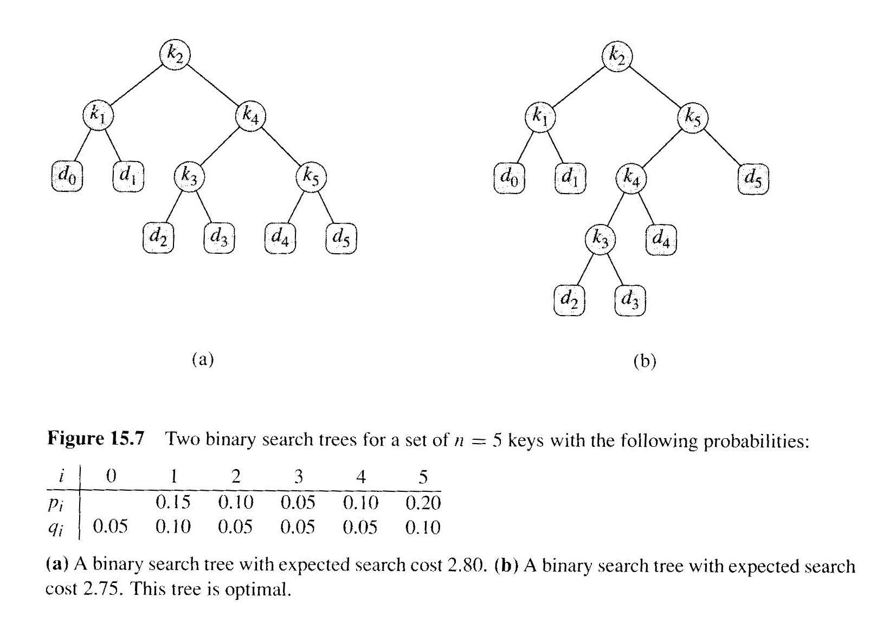
NULL

Slide 25
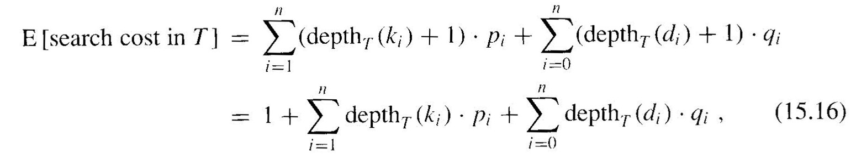
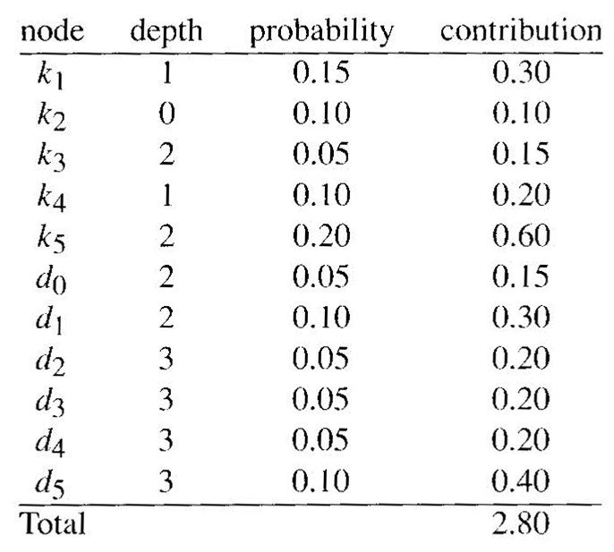
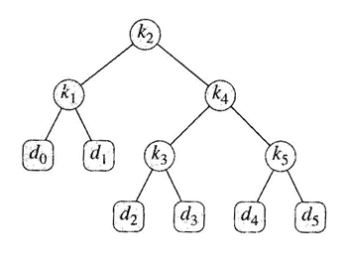
How to Calculate Avg. Search Time
0.1
0
0.15
0.1
1
0.05
0.2
2
0.05
0.1
3
0.05
0.05
0.05
0.1
0.1+0.5+1.2+1=2.8

Slide 26
Final Recursive Formulation

Slide 27
Optimal BST is one with smallest E (search cost in T)
Note that our subproblems are also optimal
k_{i} at the root
The left subtree contains k₁..k_{i-1} in an optimal configuration
Also true for the right subtree, nodes k_{i+1}..k_{n}

Slide 28
A Recursive Formula
Define E[i, j] = expected cost of searching optimal BST containing the keys k_{i}..k_{j}
E[i,i-1]=q_{i-1} (Empty tree)
Define
w(1,3)

Slide 29
Dynamic Programming Solution
Use 3 arrays
E[1..n+1, 0..n] contains the subtree values
w[1..n+1, 0..n] contains the node sums
root[1..n, 1..n] contains the root value for each subtree

Slide 30
Finding the Optimal BST
i | 0 | 1 | 2 | 3 | 4 | 5
p_{i} |  | 0.15 | 0.10 | 0.05 | 0.10 | 0.20
q_{i} | 0.05 | 0.10 | 0.05 | 0.05 | 0.05 | 0.10
w(1,1)
w(2,3)
★We need to calculate w(i,j) first
0 1 2 3 4 5
1
2
3
4
5
6
0.05 | 0.3 | 0.45 | 0.55 | 0.7 | 1
 | 0.1 | 0.25 | 0.35 | 0.5 | 0.8
 |  | 0.05 | 0.15 | 0.3 | 0.6
 |  |  | 0.05 | 0.2 | 0.5
 |  |  |  | 0.05 | 0.35
 |  |  |  |  | 0.1
w(i,j)=

Slide 31
0 1 2 3 4 5
1
2
3
4
5
6
0.05 | 0.3 | 0.45 | 0.55 | 0.7 | 1
 | 0.1 | 0.25 | 0.35 | 0.5 | 0.8
 |  | 0.05 | 0.15 | 0.3 | 0.6
 |  |  | 0.05 | 0.2 | 0.5
 |  |  |  | 0.05 | 0.35
 |  |  |  |  | 0.1
w(i,j)=
★Then we calculate E(i,j)
0 1 2 3 4 5
E[1,1]=w(1,1)+E[1,0]+E[2,1]
1
2
3
4
5
6
0.05 | 0.45
 | 0.1 | 0.4
 |  | 0.05 | 0.25
 |  |  | 0.05 | 0.3
 |  |  |  | 0.05 | 0.5
 |  |  |  |  | 0.1
k₁
E(i,j)=
d₀
d₁

Slide 32
0 1 2 3 4 5
1
2
3
4
5
6
0.05 | 0.3 | 0.45 | 0.55 | 0.7 | 1
 | 0.1 | 0.25 | 0.35 | 0.5 | 0.8
 |  | 0.05 | 0.15 | 0.3 | 0.6
 |  |  | 0.05 | 0.2 | 0.5
 |  |  |  | 0.05 | 0.35
 |  |  |  |  | 0.1
w(i,j)=
★Then we calculate E(i,j)
0 1 2 3 4 5
1
2
3
4
5
6
0.05 | 0.45 | 0.9
 | 0.1 | 0.4 | 0.7
 |  | 0.05 | 0.25 | 0.6
 |  |  | 0.05 | 0.3 | 0.9
 |  |  |  | 0.05 | 0.5
 |  |  |  |  | 0.1
root: 1
E(i,j)=
E[1,2]=w(1,2)+ E[1,0]+E[2,2]
E[1,1]+E[3,2]
root: 2

Slide 33
0 1 2 3 4 5
1
2
3
4
5
6
0.05 | 0.3 | 0.45 | 0.55 | 0.7 | 1
 | 0.1 | 0.25 | 0.35 | 0.5 | 0.8
 |  | 0.05 | 0.15 | 0.3 | 0.6
 |  |  | 0.05 | 0.2 | 0.5
 |  |  |  | 0.05 | 0.35
 |  |  |  |  | 0.1
w(i,j)=
★Then we calculate E(i,j)
0 1 2 3 4 5
4
1
2
3
4
5
6
0.05 | 0.45 | 0.9 | 1.25
 | 0.1 | 0.4 | 0.7 | 1.2
 |  | 0.05 | 0.25 | 0.6 | 1.3
 |  |  | 0.05 | 0.3 | 0.9
 |  |  |  | 0.05 | 0.5
 |  |  |  |  | 0.1
2
5
E(i,j)=
1
3

Slide 34
0 1 2 3 4 5
1
2
3
4
5
6
0.05 | 0.3 | 0.45 | 0.55 | 0.7 | 1
 | 0.1 | 0.25 | 0.35 | 0.5 | 0.8
 |  | 0.05 | 0.15 | 0.3 | 0.6
 |  |  | 0.05 | 0.2 | 0.5
 |  |  |  | 0.05 | 0.35
 |  |  |  |  | 0.1
w(i,j)=
★Then we calculate E(i,j)
0 1 2 3 4 5
1
2
3
4
5
6
0.05 | 0.45 | 0.9 | 1.25 | 1.75
 | 0.1 | 0.4 | 0.7 | 1.2 | 2.0
 |  | 0.05 | 0.25 | 0.6 | 1.3
 |  |  | 0.05 | 0.3 | 0.9
 |  |  |  | 0.05 | 0.5
 |  |  |  |  | 0.1
E(i,j)=

Slide 35
0 1 2 3 4 5
1
2
3
4
5
6
0.05 | 0.3 | 0.45 | 0.55 | 0.7 | 1
 | 0.1 | 0.25 | 0.35 | 0.5 | 0.8
 |  | 0.05 | 0.15 | 0.3 | 0.6
 |  |  | 0.05 | 0.2 | 0.5
 |  |  |  | 0.05 | 0.35
 |  |  |  |  | 0.1
w(i,j)=
★Then we calculate E(i,j)
4
0 1 2 3 4 5
1
2
3
4
5
6
0.05 | 0.45 | 0.9 | 1.25 | 1.75 | 2.75
 | 0.1 | 0.4 | 0.7 | 1.2 | 2.0
 |  | 0.05 | 0.25 | 0.6 | 1.3
 |  |  | 0.05 | 0.3 | 0.9
 |  |  |  | 0.05 | 0.5
 |  |  |  |  | 0.1
1,2,3
5
E(i,j)=

Slide 36
Maximum Subarray (Dynamic Programming)

Slide 37
Summary
OPT(n): indicates optimal sum of a subarray in array A[n]
OPT*(n): indicates max sum of a subarray with ending at A[n]
OPT(n) = max{OPT(n-1), OPT*(n) }
沒包含A[n]的 Optimal
有包含A[n]的 Optimal

Slide 38
Maximum Subarray (1)
Given array A[n]
OPT(n): indicates optimal sum of a subarray in array A[n]
Now, consider whether element A[n] is in the optimal solution:
If No, then OPT(n) = OPT(n-1)
If Yes, then the optimal solution is A[i~n] for some i , OPT*(n)
But A[i ~n-1] may not be OPT(n-1)
n
i
n

Slide 39
Maximum Subarray (2)
OPT*(n): indicates max sum of a subarray with ending at A[n]
Now, consider whether element A[n] is in the max solution:
if Yes, then OPT*(n) = OPT*(n-1) + A[n]
if No, then OPT*(n) = 0
Thus, we have the relation
OPT* (n) = max{OPT* (n-1) + A[n], 0}
n
n

Slide 40
Algorithm
Max-Subarray-Sum(A[n])
{ opt=0; opt*=0;
for i=1 to n
{ opt*=max{0, opt*+A[i]}
opt=max{opt, opt*} }
return opt
}

Slide 41
i
opt*(0)=0
opt (0)=0
1
2
3
4
5
Max-Subarray-Sum(A[n])
{ opt=0; opt*=0;
for i=1 to n
{ opt*=max{0, opt*+A[i]}
opt=max{opt,opt*} }
return opt
}
A[ ]=
-23
18
20
-7
12
opt*(1)=0
opt (1)=0
i
1
2
3
4
5
A[ ]=
-23
18
20
-7
12
opt*(2)=18
opt (2)=18

Slide 42
i
opt*(2)=18
opt (2)=18
1
2
3
4
5
Max-Subarray-Sum(A[n])
{ opt=0; opt*=0;
for i=1 to n
{ opt*=max{0, opt*+A[i]}
opt=max{opt,opt*} }
return opt
}
A[ ]=
-23
18
20
-7
12
opt*(3)=38
opt (3)=38
i
1
2
3
4
5
A[ ]=
-23
18
20
-7
12
opt*(4)=31
opt (4)=38

Slide 43
i
opt*(4)=31
opt (4)=38
1
2
3
4
5
Max-Subarray-Sum(A[n])
{ opt=0; opt*=0;
for i=1 to n
{ opt*=max{0, opt*+A[i]}
opt=max{opt,opt*} }
return opt
}
A[ ]=
-23
18
20
-7
12
opt*(5)=43
opt (5)=43

Slide 44
Time Complexity
O(n)

