Slide 1
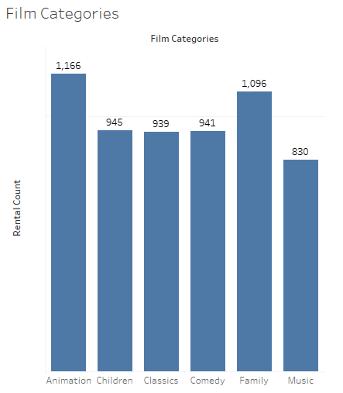
What is the most rented film Category?
<visualization>
From the chart we could see that for the family-friendly categories, Animation films are the most rented out films followed by Family films.

Slide 2
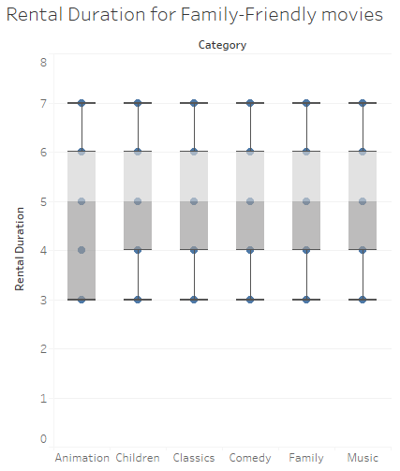
Length of rental duration for Family-Friendly films
This plot shows the length of rental duration of the family-friendly films. The length of rental duration is between 4 to 6 days.
<visualization>

Slide 3
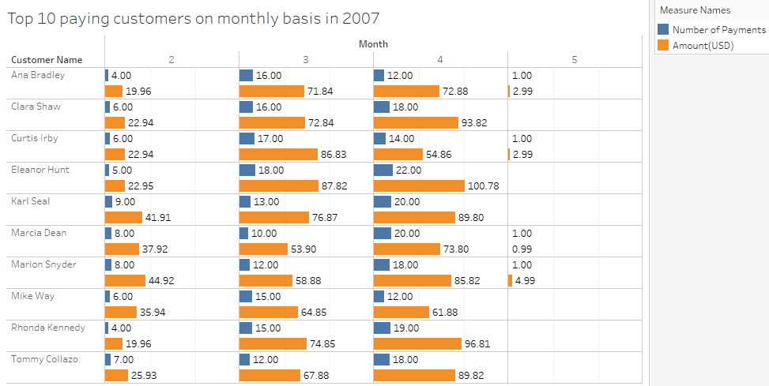
Top 10 paying Customers in 2007
Here is a chart showing number of payments and amount paid by the top 10 custiomers in 2007.
<visualization>

Slide 4
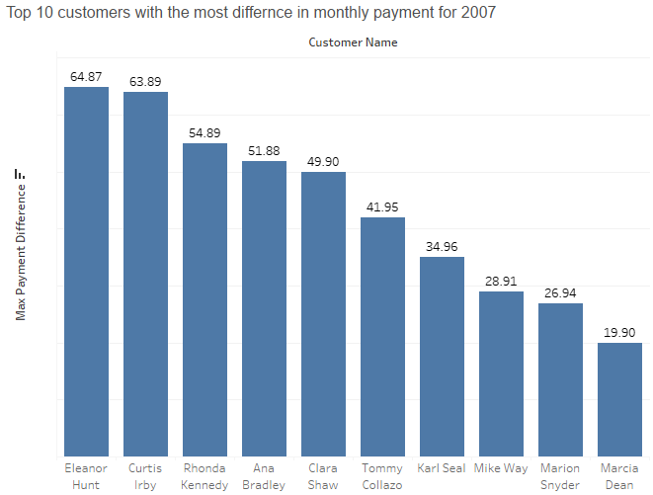
Customer that paid the most differnce in terms of payments
Eleanor Hunt paid the most difference in terms of payments monthly ($64.89) as indicated by the bar chart.
<visualization>
Notes:
m

