Slide 1




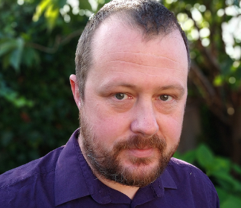
Meet the Team:
Grant Johnstone | Jason Hewitt | Lewis Brogan | Calum Macintosh

Slide 2

Call for Code 2020
Why focus on climate change?
Simply put, climate change has the potential to impact every human, every industry and every living organism on the planet. It sounds extreme because it is. Exhaustive research has confirmed changing weather patterns, rapidly rising sea levels, and extreme weather events proliferating around the world.

Slide 3

First year students on the BSc Hons Applied Software Development degree at the University of Highlands Islands looking to make a change using the Disaster Resiliency starter kit supplied by IBM.

Slide 4

Did you know that..

Slide 5
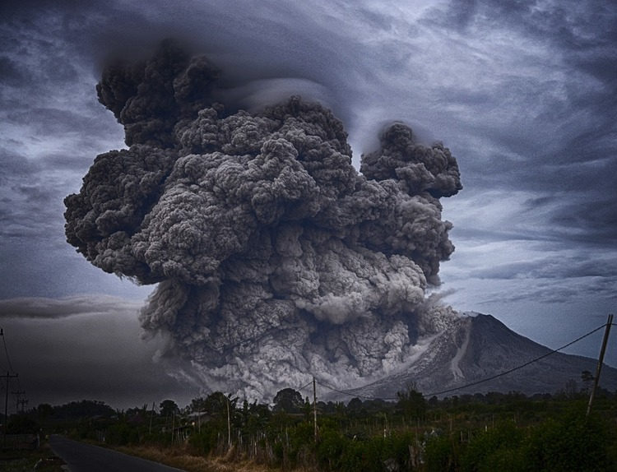
Climate change affects the social and environmental determinants of health – clean air, safe drinking water, sufficient food and secure shelter. Between 2030 and 2050, climate change is expected to cause approximately 250 000 additional deaths per year, from malnutrition, malaria, diarrhea and heat stress.
Climate change affects global temperature and precipitation patterns. These effects, in turn, influence the intensity and, in some cases, the frequency of extreme environmental events, such as forest fires, hurricanes, heat waves, floods, droughts, and storms

Slide 6
Moving onto Natural Disasters..
Did you know that there was 409 natural disasters across the world last year? Every year natural disasters kill around 90 000 people and affect close to 160 million people worldwide. We can’t tell you when every disaster will strike but we can help you prepare..

Slide 7

Our solution?
An app that will allow communities to pool their resources in times of emergency, so that they can help find and provide aid to the people who need it most.

Slide 8
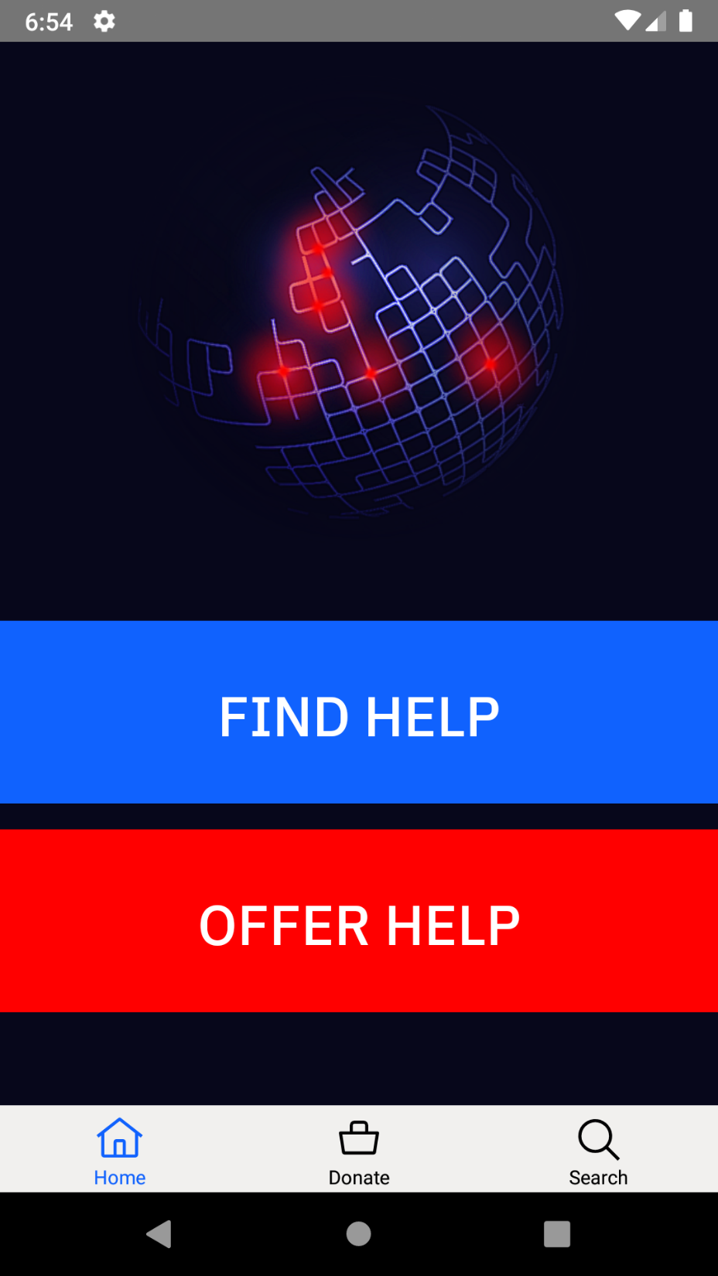
We wanted to keep it simple, in an emergency you don’t want to be navigating through a complicated App.

Slide 9
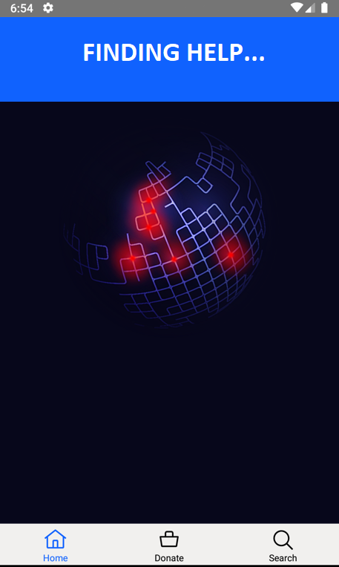
Will connect you with someone to help you, and display your GPS incase location services are not available.
DISPLAY GPS

Slide 10

IBM Watson Questions and Replies.
What is IBM Watson?
IBM Watson is a supercomputer that provides answers to your questions. It uses machine learning to answer your questions and will let you learn more with fewer data.
Knowing this information, we can use IBM Watson to help in the event of a natural disaster by connecting you with people who can help by just tapping one button on your phone.

Slide 11
IBM Watson Questions and Replies:
How bad was the current disaster at my Location?
Where is the nearest Hospital?
How far away is my support?

Slide 12
End of presentation.
We hope you enjoyed our presentation and hope to be apart of the call of code in the upcoming years.

