Slide 1


Volatility Analysis of AMZN: Implied vs. Historical
FRE-GY 6083 Final Project
Name
Department Course Number Section Time Location
DATE

Slide 2
Introduction
Name
Department Course Number Section Time Location
DATE
Main Objectives
Why this project matters
Calculate implied volatility from option prices using the Black-Scholes model, for AMZN
Compare implied volatility with historical volatility.
Explore trading opportunities based on the difference between implied and historical volatility
Market Sentiment and Expectations
Pricing and Risk Management
Potential for Trading Opportunities
Implied Volatility
Historical Volatility
Value of the volatility of the underlying instrument which, when input in an option pricing model (usually Black–Scholes), will return a theoretical value equal to the price of the option.
Reflects the market’s expectation of future price movement.
A statistical measure of the dispersion of returns for a given security or market index over a given period of time.
Measures past volatility by calculating standard deviation of returns.

Slide 3
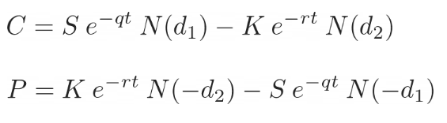
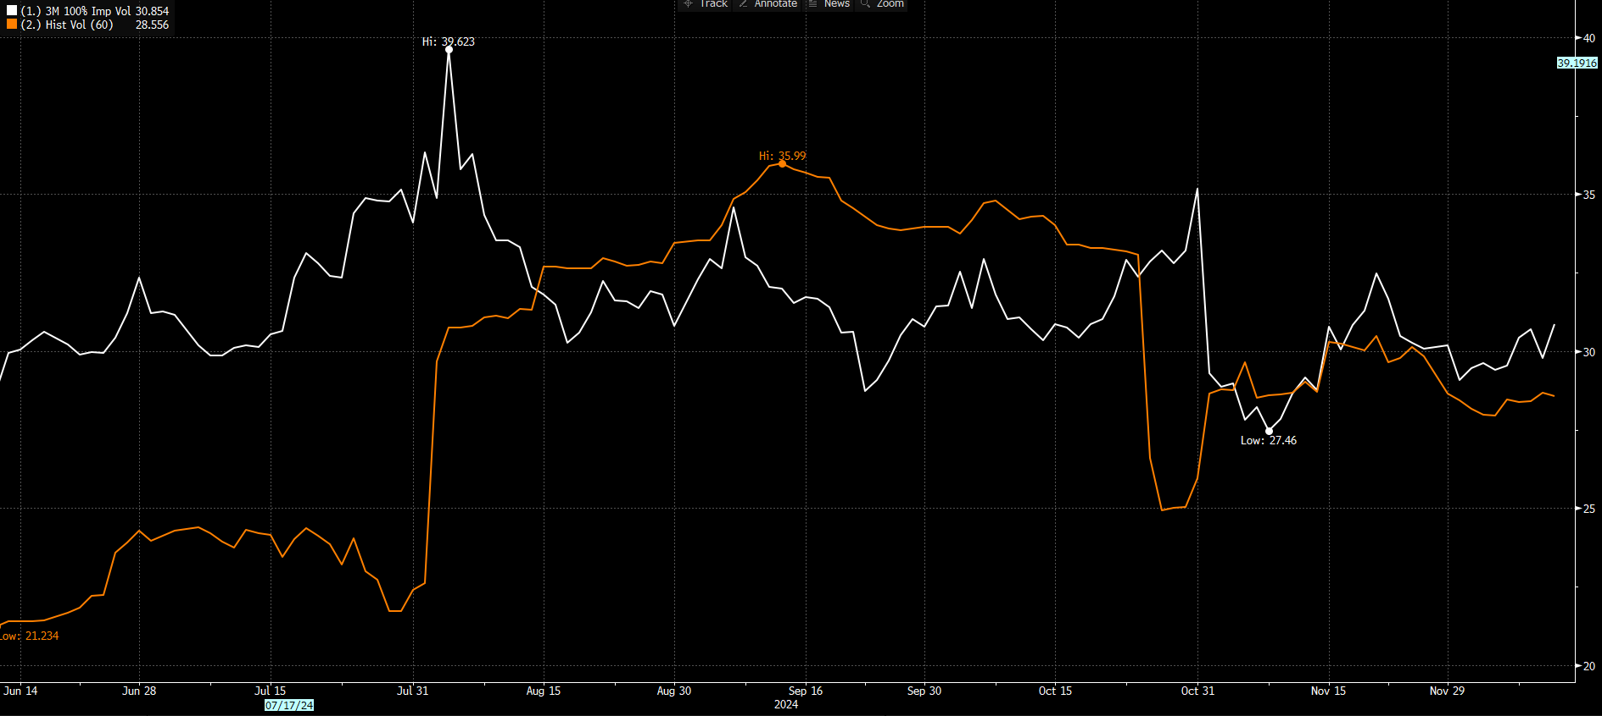
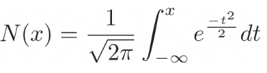
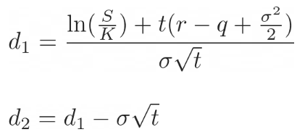
Implied Volatility Implementation
Name
Department Course Number Section Time Location
DATE
Black-Scholes Model:

Slide 4
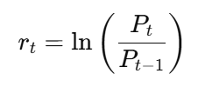
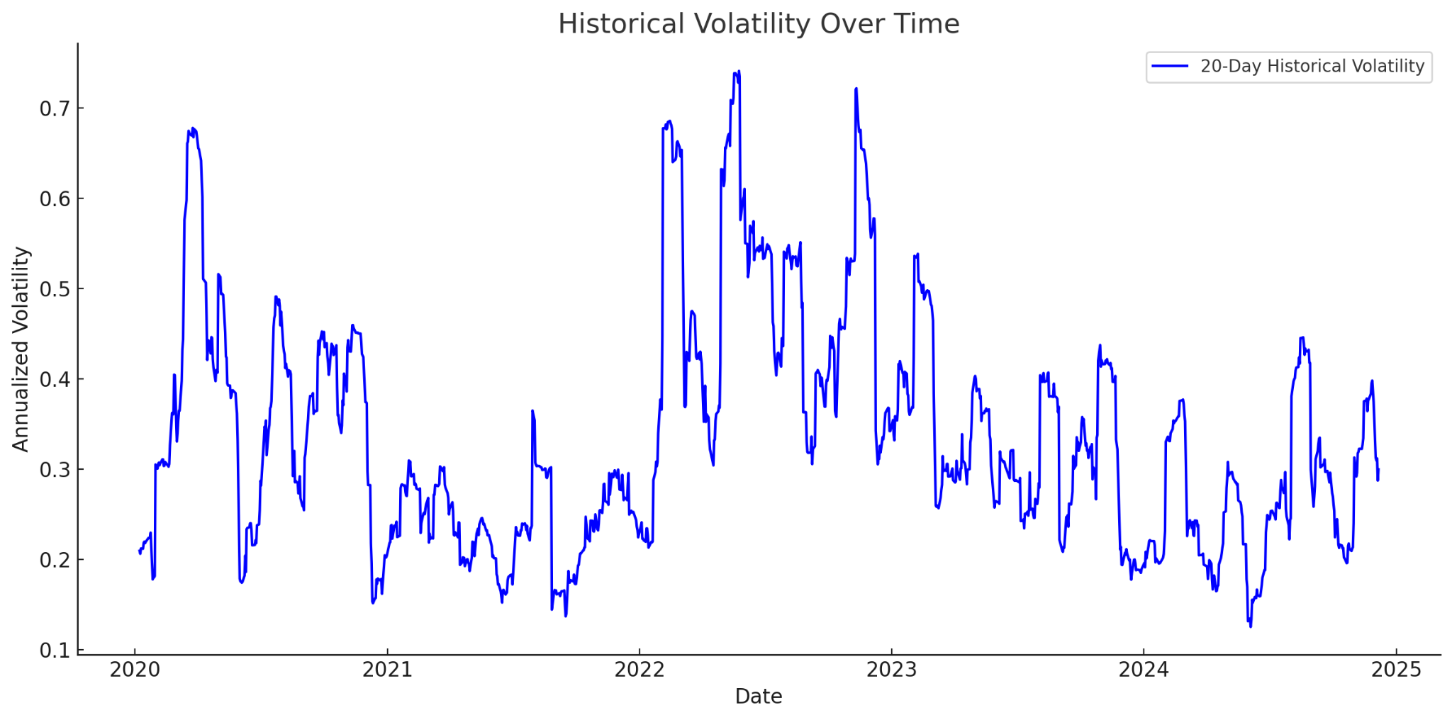
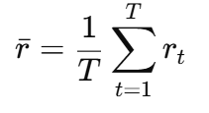
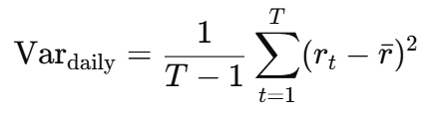


Historical Volatility Implementation
Name
Department Course Number Section Time Location
DATE
Collect Daily Returns
Calculate the Standard Deviation of Daily Returns
Average daily return:
Variance of daily returns:
Standard deviation:
Annualize the Daily Standard Deviation

Slide 5
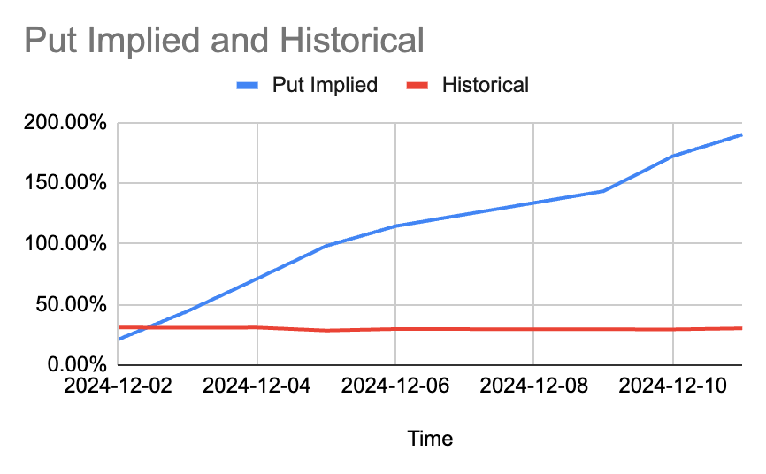
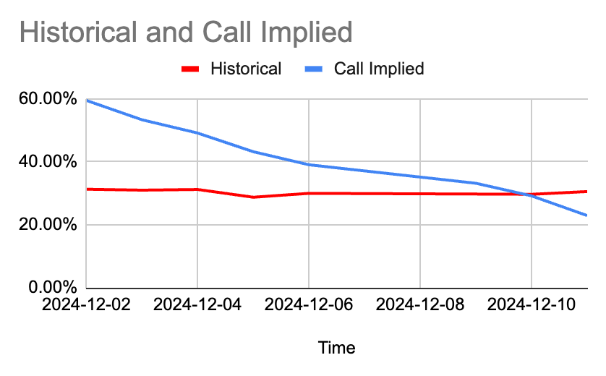
Implied Volatility VS. Historical Volatility Comparison
Name
Department Course Number Section Time Location

Slide 6
Trading Strategies
Name
Department Course Number Section Time Location
DATE
When IV > HV (Option overvaluation)
Selling options
Writing Strangles/Straddles
Volatility Arbitrage
Covered Calls: price of the underlying asset not rise much above the strike price / remain relatively stable.
Naked Calls: benefits by collecting a high premium, betting that the price of the underlying will stay below the strike price.
-premium for both the call and put options is inflated.
-the underlying asset (AMZN) will remain between the strike prices of the call and put.
-profit from this by betting that the implied volatility will revert to more normal (historical) levels.
Profit from higher option prices relative to realized volatility.
When IV < HV (Option undervaluation)
Buying options
Long Volatility Strategies
Synthetic Long Position (Call + Put)
Straddles: underlying asset will make a significant move in either direction, an increase in volatility, higher option premiums.
Strangles: more room for underlying asset to move, potential for significant profits from a large price movement.
-as volatility increases, option premiums rise, leading to potential profits from long volatility positions.
-allows the trader to capture large price movements in either direction, with the expectation that volatility will increase and the options will appreciate in value.
Profit from potential future volatility increase.

Slide 7
Thank you!
Name
Department Course Number Section Time Location
DATE

