Slide 1
WDD
ASP, JSP and PHP
Notes:
WDD-M05-ASP-JSP-PHP

Slide 2

In this module …
Intro to ASP, JSP and PHP
We will continue talking about dynamic web-page content and generation using server-side technologies:
  Server-Side in General
  ASP – Active Server Pages
  JSP – Java Server Pages
  PHP – Hypertext Preprocessor

Slide 3
Server Side Programming
Intro to ASP, JSP and PHP
Why do you think we want to be able to do programming on the web-server?
  Some of the big reasons might be …
    To be able to create and generate dynamic content
    To be able to process and provide responses to request from client (i.e. form-based requests)
    To be able to access server-side data store(s)
    To have the control and ability to implement security
    And of course the possibility of improved processing performance

Slide 4
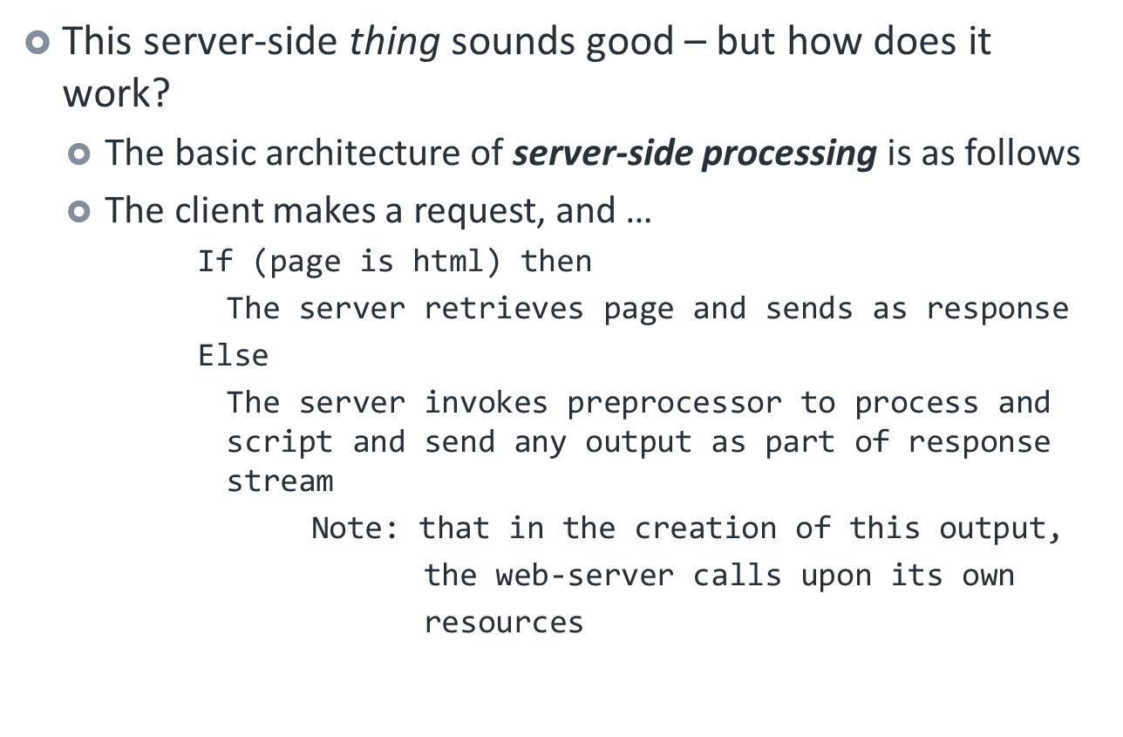
Server Side Programming (cont’d)
Intro to ASP, JSP and PHP

Slide 5
Setting up the Server(s)
Intro to ASP, JSP and PHP
This module makes reference to:
  Microsoft Internet Information Services (IIS)
    If you are running the Windows O/S – IIS may or may not come bundled automatically– you’ll need to check your own O/S Documentation
    If not, there are often downloaded packages from Microsoft to enable and install IIS on your version of Windows
  Apache Tomcat Open-Source Web-Server
    Offering up implementation of Java Servlet and JavaServer Page technologies
    This can be downloaded from Apache Tomcat - there are also Windows 32 and 64 bit Installers
  Please note that Microsoft IIS and Apache Tomcat can co-exist on the same machine!
  We also discuss PHP in this module – this scripting language can be installed on either an IIS or Apache Tomcat server
    Visit the Official PHP site for download / installer information

Slide 6
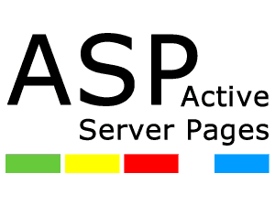
ASP
Intro to ASP, JSP and PHP
ASP stands for Active Server Pages
  This is a Microsoft proprietary technology
  Which unfortunately means that it only runs on IIS
The acceptable file extension on ASP source code is .asp
Natively supported scripting languages are VBScript or JScript (a Microsoft variant of JavaScript)
  Note that you can also enable support for JavaScript on IIS and can therefore use this scripting language in ASP
You can visit W3 Schools for more on ASP

Slide 7
ASP Installation / Activation
Intro to ASP, JSP and PHP
Since ASP is a Microsoft-only type of thing – this only applies to IIS
  Use the Turn Windows features on and off option in the Control Panel’s Programs and Features
    There you would see the Internet Information Services (IIS)
      When activating and configuring IIS you would find an ASP checkbox in the Application Development Features of the World Wide Web Services
    IIS is not available on Basic and some Home editions – check your documentation to be sure

Slide 8
ASP Syntax
Intro to ASP, JSP and PHP
ASP Pages can be a mixture of HTML source and also server-side scripting
  Server-Side directives (scripting) are placed inside <%...%> delimiters
  These Script tags can be used embedded within HTML, as long as the document hierarchy is maintained
  ASP is not case sensitive
  When commenting your ASP pages, you can use REM or single quote (')
    This makes ASP coding very VB-like (Visual Basic)

Slide 9
ASP Variable Declarations
Intro to ASP, JSP and PHP
In ASP, variables really do not need to be declared …
  By default - on first use, a variable is declared
  Again, at the risk of making ASP even more VB-like, you can use the DIM directive to explicitly declare variables
    You would specify <% option explicit %> in first line of the ASP page to require variable declaration using DIM

Slide 10
ASP Objects
Intro to ASP, JSP and PHP
ASP has the Request Object – which gives interface to
  The Form Collection Object
    Used to gain access to data from a <form> which was submitted with the POST method
  The QueryString Collection Object
    Used to gain access to data from a <form> which was submitted with the GET method
  The ServerVariables Collection Object
    Used to gain access to the server’s variables
  Many other collections …
ASP also has the Response Object
  Which itself contains many methods such as write() and redirect() – all used for creating and controlling the output from ASP

Slide 11
ASP Objects (cont’d)
Intro to ASP, JSP and PHP
As well ASP offers many more programmable objects
  The Application Object
    Used to tie multiple ASP pages together into an application
  The Server Object
    Used to gain access / modify attributes of the web-server
  The Session Object
    Used to hold/store temporary information about a user’s session (visit) to the server
  The Error Object
    Used to hold and display detailed error information that occurs in ASP pages
  And more … see W3 Schools

Slide 12

JSP
Intro to ASP, JSP and PHP
JSP stands for JavaServer Pages
  And it is proprietary to Sun Microsystems (now Oracle)
It is however truly based on Java
  As opposed to JavaScript – which as we know is Java-like
The acceptable file extension on JSP source code is .jsp
  When we code JSP pages - the blocks of code are known as Scriplets

Slide 13
JSP Installation / Activation
Intro to ASP, JSP and PHP
Requires two components
  Tomcat
    Usually installs with Apache
    Download both Apache and Tomcat as a single package
      It is recommended that you get the Windows Service Installer
    Read RUNNING.txt for configuration information
  Java Runtime (JRE)
    This is a separate installation available from Oracle
As per RUNNING.txt, two environment variables required:
  CATALINA_HOME (or CATALINA_BASE)
  JAVA_HOME (or JRE_HOME)
    If you download the Windows Installer – these variables are taken care of for you …

Slide 14
JSP Syntax
Intro to ASP, JSP and PHP
JSP Pages can be a mixture of HTML source and also server-side scripting
  Server-Side directives (Scriptlet) are placed inside <%...%> delimiters
  These Script tags can be used embedded within HTML, as long as the document hierarchy is maintained
  JSP is case sensitive
  When commenting your JSP pages, you use
    <%-- to begin the comment block and --%> to end it
  The syntax of the Scriptlets is Java (which is similar to C#)

Slide 15
JSP Variable Declarations
Intro to ASP, JSP and PHP
Scriptlets being Java based make for strongly typed variables – i.e. the data-type is crucial and enforced!
When a variable is declared:
  Its scope is local to the Scriptlet that it is defined within
  To achieve global scope, we use the JSP Declaration
  tag <%! … %>
    For example : <%! String str; %> would define a variable called str that could be used throughout the JSP page and any Scriptlet

Slide 16
JSP Objects
Intro to ASP, JSP and PHP
We’ll turn our attention to another tutorial site to learn about and play with JSP
  JSP has the Request Object used to get data from the client request. This object exposes methods like:
    getParameter() returns a page’s parameter value as a string
    getQueryString() returns the entire query string from the URL
  JSP has the Response Object which is used to send HTTP header information back from the server. This object exposes methods like:
    sendRedirect() which redirects the client browser to another URL
    sendError() use to populate and send HTTP error information

Slide 17
JSP Objects (cont’d)
Intro to ASP, JSP and PHP
  JSP has the Out Object which is used to send actual content back from the server through the HTML stream. This object exposes methods like:
    print() which prints the argument to the returning stream
    println() which also prints the argument to the returning stream – but also appends a line break
  And again like ASP, JSP exposes other objects
    The Application Object
      Used to tie various JSP pages within your application together through attributes
    The Session Object
      Used to hold/store temporary information about a user’s session (visit) to the server
    The Exception Object
      Used to allow exception data to be accessed by the JSP

Slide 18

PHP
Intro to ASP, JSP and PHP
PHP stands for “PHP: Hypertext Preprocessor”
It is an open source technology and is arguably the most popular server-side technology
  If you’re interested in the history and background of PHP – you can read about it here

Slide 19
PHP Installation / Activation
Intro to ASP, JSP and PHP
This technology may be installed for IIS and/or Apache
You can download the PHP installation from php.net site
  If installing for IIS, easier to use the Installer, and provide appropriate options
  Here are some instructions for installing PHP on IIS v7.0 or higher

Slide 20
PHP Syntax
Intro to ASP, JSP and PHP
PHP Pages can be a mixture of HTML source and also server-side scripting
  PHP scripts are placed inside <?php ... ?> delimiters
  These Script tags can be used embedded within HTML, as long as the document hierarchy is maintained
  PHP is case sensitive
  Commenting your PHP pages is like C and C++
    Use // for single line comments
    And /* … */ for block comments
  Overall, the syntax of PHP scripts is similar to C and C++

Slide 21
PHP Variable Declarations
Intro to ASP, JSP and PHP
In PHP, variable names begin with a dollar sign ($) followed by the actual name starting with letter or underscore
  e.g. $_myVar or $myVar
  Variables do not need to be explicitly declared as they are not strongly typed

Slide 22
PHP Objects and Programming
Intro to ASP, JSP and PHP
I will refer you to W3 Schools for PHP tutoring as well as PHP.NET itself
PHP comes equipped with some pre-defined variables to accessing the Request Object
  $_GET[key] references data when GET is used in the requesting form
  $_POST[key] references data when POST is used in the requesting form
  $_REQUEST[key] references data from either the GET or POST method

Slide 23
PHP Objects and Programming (cont’d)
Intro to ASP, JSP and PHP
When it comes to generating content for Response to the client, PHP:
  The echo statement is used to print information to the response stream
  Unlike other programming languages you are use to, PHP uses the dot “.” as the concatenation operator
    $myName = “Sean ” . “Clarke” or
    $functionRetVal = “The function returned:” . fn_call()
And as with the other server-side scripting technologies, you have access to :
  The Session Object
  Environment Variables
  And a number of others …
  When it comes to handling errors in PHP, it is recommended that you use Exceptions

Slide 24
For more information …
Intro to ASP, JSP and PHP
You can visit the following links for more information about the technology (or you can search the web yourself ☺
  ASP
    Microsoft ASP Tutorial
    W3 School’s ASP Tutorial
  JSP
    Generic JSP Tutorial
    Zentut’s JSP Tutorial
    Oracle’s JSP Information
  PHP
    PHP.NET’s Language Reference Manual
    W3 School’s PHP Tutorial
    Excellent site filled with PHP Examples (and source) **
  Tomcat
    http://tomcat.apache.org/

