Slide 1
Hospital Appointment System
4 x 4 Challenge
Kungfu Panda
February 19, 2015

Slide 2

Do you know the average wait time in the hospital ?

Slide 3

In 2012 – 2013, more than 40 per cent of the 161 hospitals have a three-hour wait time for patients to get assessed by an emergency room physician.
Some hospitals — three in Winnipeg and one in Ontario — saw double or even triple the suggested three-hour wait.

Slide 4
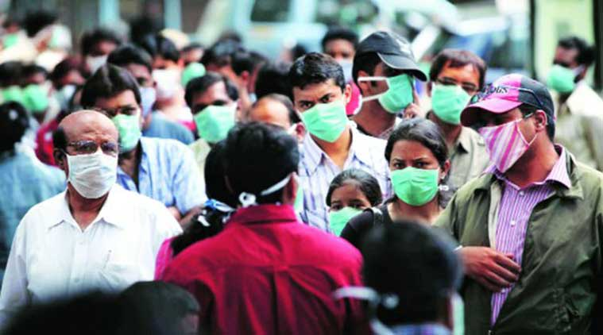
“
An estimated 650,000 patients per year in the U.S. develop an infection while in the hospital, and almost 75,000 die as a result
”

Slide 5
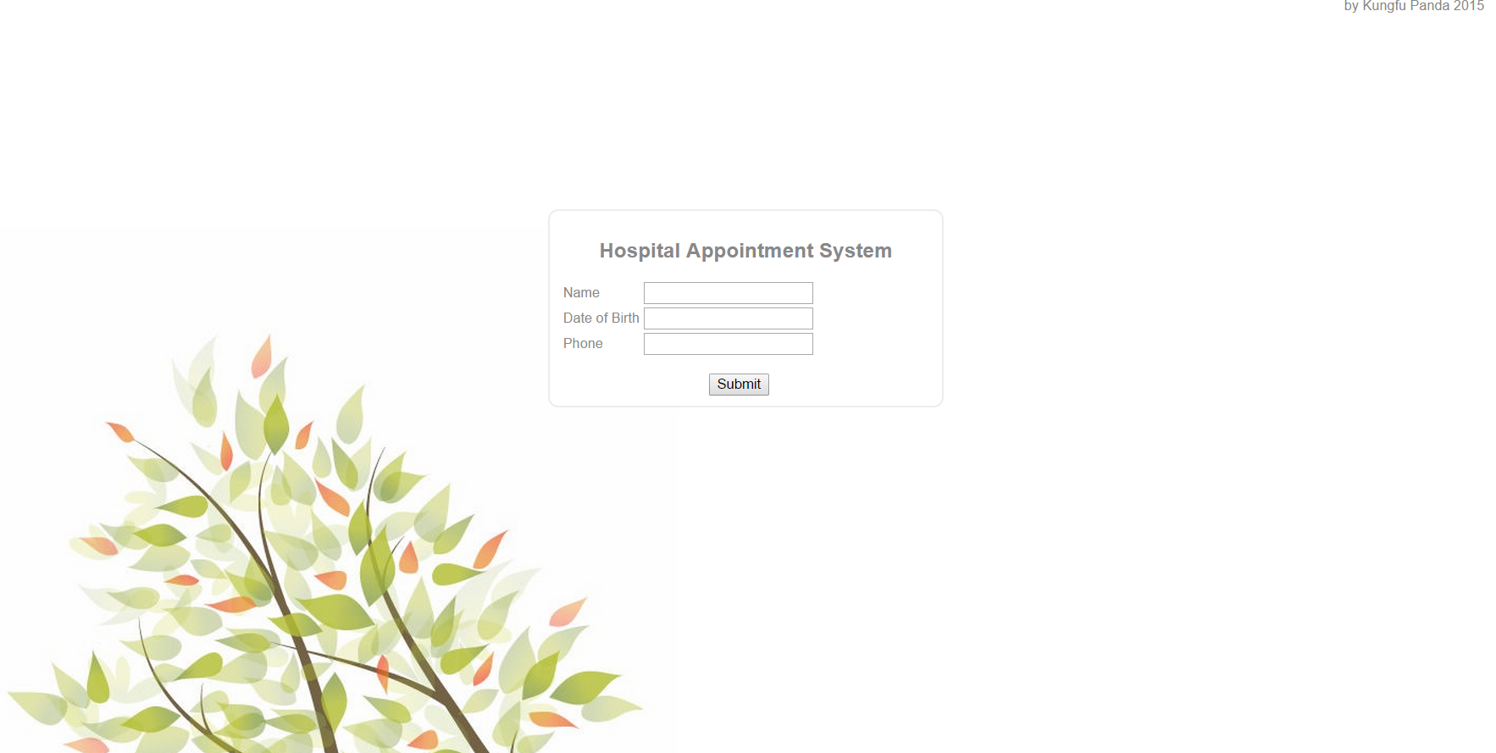
Clinic Appointment System

Slide 6

What is Clinic Appointment System
A software system that saves patients’ time of waiting, by sending patients SMS notifications.
Consist of
Frontend Web application
Android application
MySQL Database

Slide 7
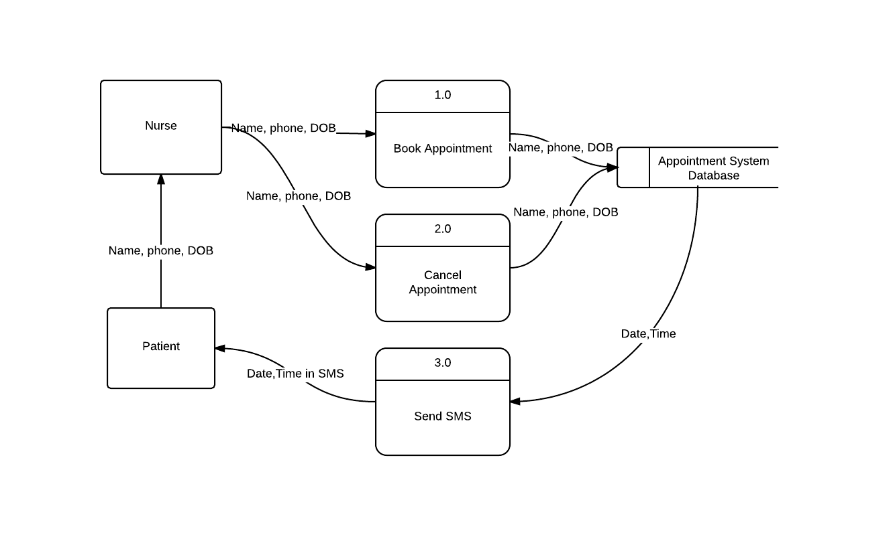
How does it work?

Slide 8

Why Choosing Clinic Appointment System
Easy to maintain
Easy to install and setup
Low Pricing

Slide 9

Data is highly secured
Very limited amount of data is required
All private data is purged at 12 am every night
Data are stored locally, no un-authorized access is permitted

Slide 10
Reference
http://www.cbc.ca/news/health/hospital-er-times-reveal-some-disturbing-waits-1.2767867
http://www.consumerreports.org/cro/news/2015/02/consumer-reports-gave-california-hospital-with-deadly-infection-a-low-score/index.htm

