Slide 1
Modeling with R and the Tidyverse
Matt McDonald
University of Connecticut
FNCE 5352

Slide 2
Materials
Materials are available on github
LINK: https://github.com/mattmcd71/fnce5352_spring18

Slide 3
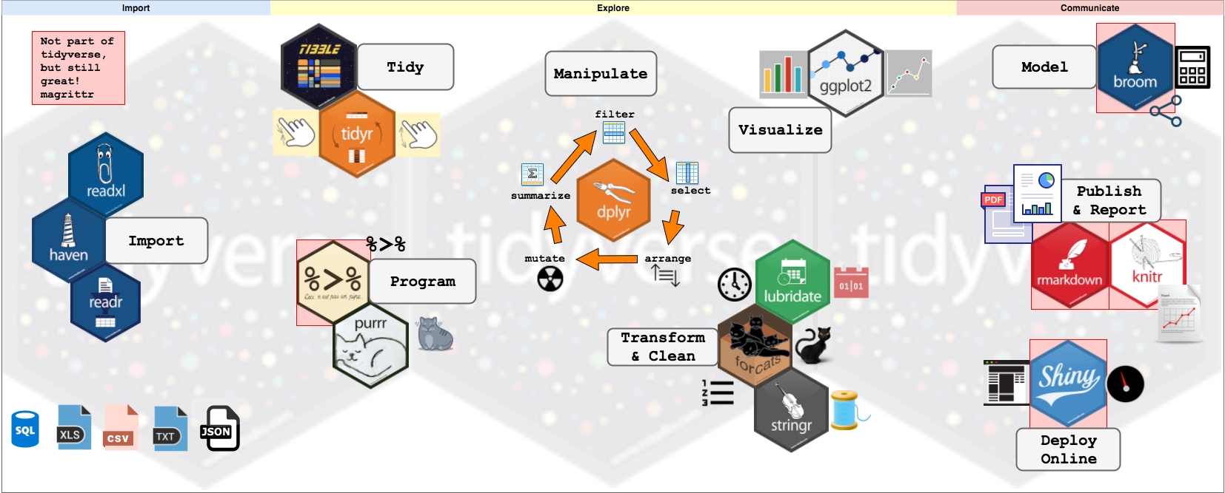
Tidyverse

Slide 4
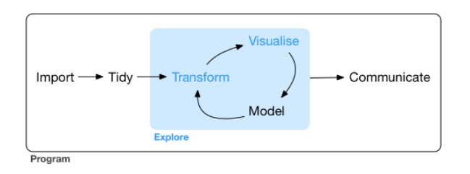
“The Pit of Success”

Slide 5
Help on the Tidyverse
Rstudio Cheat Sheets!
https://www.rstudio.com/resources/cheatsheets/
R for Data Science
http://r4ds.had.co.nz/

Slide 6
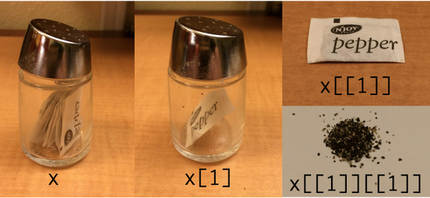
Lists in R

