Slide 1
Secure Coding in C and C++
Integer Security
Lecture 7
Acknowledgement: These slides are based on author Seacord’s original presentation

Slide 2
Integer Security
Integers represent a growing and underestimated source of vulnerabilities in C and C++ programs.
Integer range checking has not been systematically applied in the development of most C and C++ software.
  security flaws involving integers exist
  a portion of these are likely to be vulnerabilities
A software vulnerability may result when a program evaluates an integer to an unexpected value.

Slide 3
Integer Representation
Signed-magnitude
One’s complement
Two’s complement
These integer representations vary in how they represent negative numbers

Slide 4
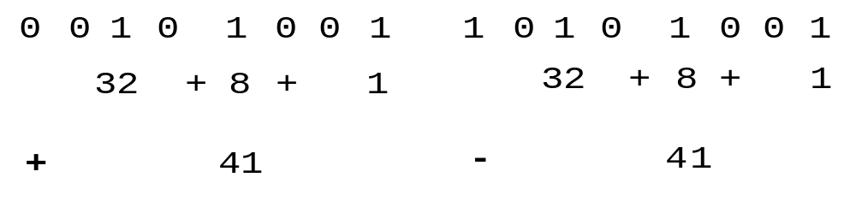
Signed-magnitude Representation
Uses the high-order bit to indicate the sign
  0 for positive
  1 for negative
  remaining low-order bits indicate the magnitude of the value
Signed magnitude representation of +41 and -41

Slide 5
One’s Complement
One’s complement replaced signed magnitude because the circuitry was too complicated.
Negative numbers are represented in one’s complement form by complementing each bit
0 0 1 0 1 0 0 1
each 1 is replaced with a 0
even the sign bit is reversed
1 1 0 1 0 1 1 0
each 0 is replaced with a 1

Slide 6
Two’s Complement
The two’s complement form of a negative integer is created by adding one to the one’s complement representation.
Two’s complement representation has a single (positive) value for zero.
The sign is represented by the most significant bit.
The notation for positive integers is identical to their signed-magnitude representations.
0 0 1 0 1 0 0 1
0 0 1 0 1 0 0 1
1 1 0 1 0 1 1 0
+ 1 =
1 1 0 1 0 1 1 1

Slide 7
Signed and Unsigned Types
Integers in C and C++ are either signed or unsigned.
Signed integers
  represent positive and negative values.
  In two’s complement arithmetic, a signed integer ranges from -2^{n-1} through 2^{n-1}-1.
Unsigned integers
  range from zero to a maximum that depends on the size of the type
  This maximum value can be calculated as
  2^{n}-1, where n is the number of bits used to represent the unsigned type.
Notes:
-128=10000000

Slide 8
Signed integers (8 bits)
01111111 = +127
01111110 = +126
01111101 = +125
...
00000001 = +1
00000000 = 0
11111111 = -1
...
10000010 = -126
10000001 = -127
10000000 = -128
Notes:
-128=10000000

Slide 9
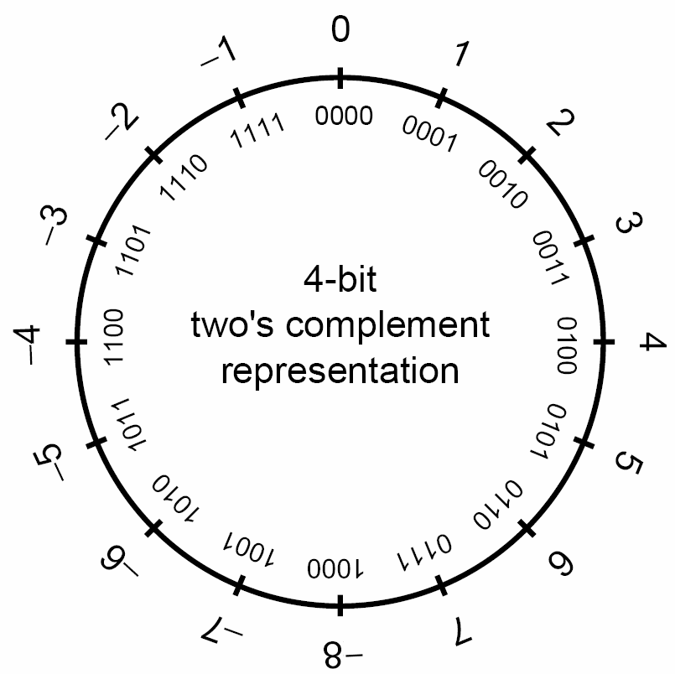
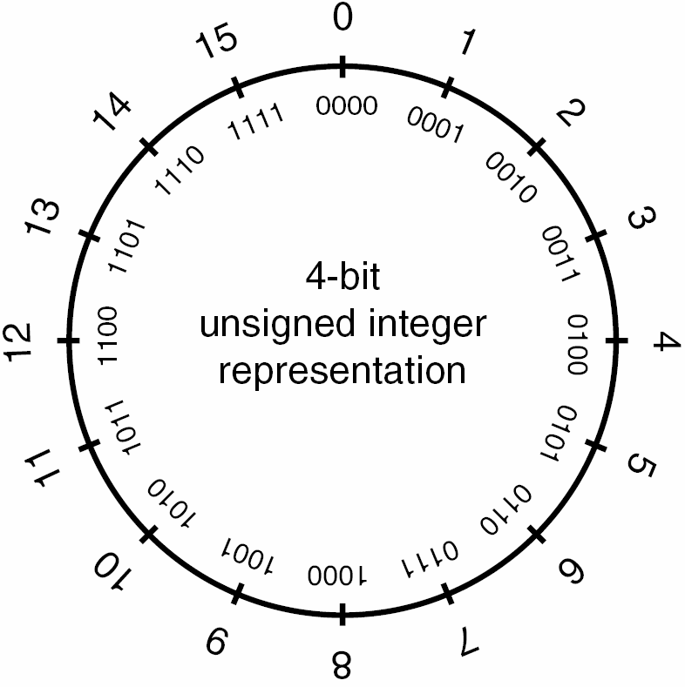
Representation
4-bit
two’s complement
representation
Signed Integer
Unsigned Integer

Slide 10
Standard Integer Types
Standard integers include the following types, in non-decreasing length order
  signed char (8 bits)
  short int (16 bits)
  int (16 bits)
  long int (32 bits)
  long long int (64 bits)

Slide 11
Platform-Specific Integer Types
Vendors often define platform-specific integer types.
The Microsoft Windows API defines a large number of integer types
  __int8, __int16, __int32, __int64
  ATOM
  BOOLEAN, BOOL
  BYTE
  CHAR
  DWORD, DWORDLONG, DWORD32, DWORD64
  WORD
  INT, INT32, INT64
  LONG, LONGLONG, LONG32, LONG64
  Etc.

Slide 12
Integer Ranges
Minimum and maximum values for an integer type depend on
  the type’s representation
  signedness
  number of allocated bits
The C99 standard sets minimum requirements for these ranges.
Notes:
Integer ranges are compiler dependent but greatly influenced by the target machine architecture.
Compiler- and platform-specific integral limits are documented in the limits.h header.

Slide 13
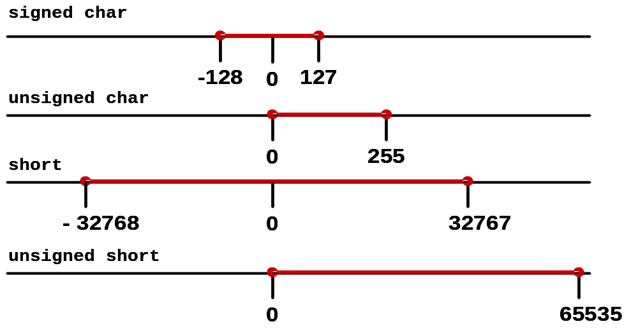
Example Integer Ranges

Slide 14
Quiz
8 Bits unsigned
  0 - 1 = ?
  255 + 1 = ?
8 Bits signed
  -128 - 1 = ?
  127 + 1 = ?

Slide 15
Quiz
8 Bits unsigned
    0 - 1 = 255 (0000 0000 - 0000 0001 = 1111 1111)
    255 + 1 = 0 (1111 1111 + 0000 0001 = 0000 0000)
8 Bits signed
  -128 - 1 = 127 (1000 0000 - 0000 0001 = 0111 1111)
  127 + 1 = -128 (0111 1111 + 0000 0001 = 1000 0000)

Slide 16
Integer Conversions
Type conversions
  occur explicitly in C and C++ as the result of a cast or
  implicitly as required by an operation.
Conversions can lead to lost or misinterpreted data.
  Implicit conversions are a consequence of the C language ability to perform operations on mixed types.
C99 rules define how C compilers handle conversions
  integer promotions
  integer conversion rank
  usual arithmetic conversions

Slide 17
Integer Promotions
Integer types smaller than int are promoted when an operation is performed on them.
If all values of the original type can be represented as an int
    the value of the smaller type is converted to int
    otherwise, it is converted to unsigned int.
Integer promotions are applied as part of the usual arithmetic conversions

Slide 18
Integer Promotion Example
Integer promotions require the promotion of each variable (c1 and c2) to int size
      char c1, c2;
      c1 = c1 + c2;
    The two ints are added and the sum truncated to fit into the char type.
    Integer promotions avoid arithmetic errors from the overflow of intermediate values.

Slide 19
Implicit Conversions
The sum of c1 and c2 exceeds the maximum size of signed char
1. char cresult, c1, c2, c3;
2. c1 = 100;
3. c2 = 90;
4. c3 = -120;
5. cresult = c1 + c2 + c3;
However, c1, c1, and c3 are each converted to integers and the overall expression is successfully evaluated.
The sum is truncated and stored in cresult without a loss of data
The value of c1 is added to the value of c2.
Notes:
F=70

Slide 20
Integer Conversion Rank & Rules
Every integer type has an integer conversion rank that determines how conversions are performed.
  No two signed integer types have the same rank, even if they have the same representation.
  The rank of a signed integer type is > the rank of any signed integer type with less precision.
    rank of [long long int > long int> int > short int > signed char].
  The rank of any unsigned integer type is equal to the rank of the corresponding signed integer type.
Notes:
Every integer type has an integer conversion rank defined as follows:
— No two signed integer types shall have the same rank, even if they hav e the same
representation.
— The rank of a signed integer type shall be greater than the rank of any signed integer
type with less precision.
— The rank of long long int shall be greater than the rank of long int, which
shall be greater than the rank of int, which shall be greater than the rank of short
int, which shall be greater than the rank of signed char.
— The rank of any unsigned integer type shall equal the rank of the corresponding
signed integer type, if any.
— The rank of any standard integer type shall be greater than the rank of any extended
integer type with the same width.
— The rank of char shall equal the rank of signed char and unsigned char.
— The rank of _Bool shall be less than the rank of all other standard integer types.
— The rank of any enumerated type shall equal the rank of the compatible integer type
(see 6.7.2.2).
— The rank of any extended signed integer type relative to another extended signed
integer type with the same precision is implementation-defined, but still subject to the
other rules for determining the integer conversion rank.
— For all integer types T1, T2, and T3, if T1 has greater rank than T2 and T2 has
greater rank than T3, then T1 has greater rank than T3.

Slide 21
Unsigned Integer Conversions 1
Conversions of smaller unsigned integer types to larger unsigned integer types is
    always safe
    typically accomplished by zero-extending the value
When a larger unsigned integer is converted to a smaller unsigned integer type the
    larger value is truncated
    low-order bits are preserved

Slide 22
Unsigned Integer Conversions 2
When unsigned integer types are converted to the corresponding signed integer type
    the bit pattern is preserved so no data is lost
    the high-order bit becomes the sign bit
    If the sign bit is set, both the sign and magnitude of the value changes.

Slide 23
From unsigned | To | Method
char | char | Preserve bit pattern; high-order bit becomes sign bit
char | short | Zero-extend
char | long | Zero-extend
char | unsigned short | Zero-extend
char | unsigned long | Zero-extend
short | char | Preserve low-order byte
short | short | Preserve bit pattern; high-order bit becomes sign bit
short | long | Zero-extend
short | unsigned char | Preserve low-order byte
long | char | Preserve low-order byte
long | short | Preserve low-order word
long | long | Preserve bit pattern; high-order bit becomes sign bit
long | unsigned char | Preserve low-order byte
long | unsigned short | Preserve low-order word
Key:
Lost data
Misinterpreted data

Slide 24
Signed Integer Conversions 1
When a signed integer is converted to an unsigned integer of equal or greater size and the value of the signed integer is not negative
    the value is unchanged
    the signed integer is sign-extended
A signed integer is converted to a shorter signed integer by truncating the high-order bits.

Slide 25
Signed Integer Conversions 2
When signed integers are converted to unsigned integers
    bit pattern is preserved—no lost data
    high-order bit loses its function as a sign bit
    If the value of the signed integer is not negative, the value is unchanged.
    If the value is negative, the resulting unsigned value is evaluated as a large, signed integer.

Slide 26
From | To | Method
char | short | Sign-extend
char | long | Sign-extend
char | unsigned char | Preserve pattern; high-order bit loses function as sign bit
char | unsigned short | Sign-extend to short; convert short to unsigned short
char | unsigned long | Sign-extend to long; convert long to unsigned long
short | char | Preserve low-order byte
short | long | Sign-extend
short | unsigned char | Preserve low-order byte
short | unsigned short | Preserve bit pattern; high-order bit loses function as sign bit
short | unsigned long | Sign-extend to long; convert long to unsigned long
long | char | Preserve low-order byte
long | short | Preserve low-order word
long | unsigned char | Preserve low-order byte
long | unsigned short | Preserve low-order word
long | unsigned long | Preserve pattern; high-order bit loses function as sign bit
Key:
Lost data
Misinterpreted data

Slide 27
Signed Integer Conversion Example
1. unsigned int m = ULONG_MAX;
2. char c = -1;
3. if (c == m) {
4. printf("-1 = 4,294,967,295?\n");
5. }
#include <climits>
The value of c is compared to the value of m.
Because of integer promotions, c is converted to an unsigned integer with a value of 0xFFFFFFFF or 4,294,967,295

Slide 28
Signed/Unsigned Characters
The type char can be signed or unsigned.
When a signed char with its high bit set is saved in an integer, the result is a negative number.
Use unsigned char for buffers, pointers, and casts when dealing with character data that may have values greater than 127 (0x7f).

Slide 29
Usual Arithmetic Conversions
If both operands have the same type no conversion is needed.
If both operands are of the same integer type (signed or unsigned), the operand with the type of lesser integer conversion rank is converted to the type of the operand with greater rank.
If the operand that has unsigned integer type has rank >= to the rank of the type of the other operand, the operand with signed integer type is converted to the type of the operand with unsigned integer type.
If the type of the operand with signed integer type can represent all of the values of the type of the operand with unsigned integer type, the operand with unsigned integer type is converted to the type of the operand with signed integer type.
Otherwise, both operands are converted to the unsigned integer type corresponding to the type of the operand with signed integer type.

Slide 30
Integer Error Conditions
Integer operations can resolve to unexpected values as a result of an
  overflow
  sign error
  truncation

Slide 31
Overflow
An integer overflow occurs when an integer is increased beyond its maximum value or decreased beyond its minimum value.
Overflows can be signed or unsigned
A signed overflow occurs when a value is carried over to the sign bit
An unsigned overflow occurs when the underlying representation can no longer represent a value

Slide 32
Overflow Examples 1
1. int i;//32 bit signed
2. unsigned int j;
3. i = INT_MAX; // 2,147,483,647 or 2^31-1
4. i++;
5. printf("i = %d\n", i);
6. j = UINT_MAX; // 4,294,967,295;
7. j++;
8. printf("j = %u\n", j);
i=-2,147,483,648
j = 0

Slide 33
Overflow Examples 2
9. i = INT_MIN; // -2,147,483,648;
10. i--;
11. printf("i = %d\n", i);
12. j = 0;
13. j--;
14. printf("j = %u\n", j);
i=2,147,483,647
j = 4,294,967,295

Slide 34
Truncation Errors
Truncation errors occur when
  an integer is converted to a smaller integer type and
  the value of the original integer is outside the range of the smaller type
Low-order bits of the original value are preserved and the high-order bits are lost.

Slide 35
Truncation Error Example
1. char cresult, c1, c2, c3;
2. c1 = 100;
3. c2 = 90;
4. cresult = c1 + c2;
Adding c1 and c2 exceeds the max size of signed char (+127)
Truncation occurs when the value is assigned to a type that is too small to represent the resulting value
Integers smaller than int are promoted to int or unsigned int before being operated on
Notes:
Integers smaller than int are promoted to int or unsigned int before being operated on.
Integers smaller than int are unlikely to overflow because the actual operations are performed on the promoted values.
These operations may result in a truncation error if the value is assigned to a variable of the size of the original operands.
3E (note some IED won’t display, e.g., Eclipse)

Slide 36
Sign Errors:
Converting to Signed Integer
Converting an unsigned integer to a signed integer of
  Equal size - preserve bit pattern; high-order bit becomes sign bit
  Greater size - the value is zero-extended then converted
  Lesser size - preserve low-order bits
If the high-order bit of the unsigned integer is
  Not set - the value is unchanged
  Set - results in a negative value

Slide 37
Converting to Unsigned Integer
Converting a signed integer to an unsigned integer of
    Equal size - bit pattern of the original integer is preserved
    Greater size - the value is sign-extended then converted
    Lesser size - preserve low-order bits
If the value of the signed integer is
    Not negative - the value is unchanged
    Negative - a (typically large) positive value

Slide 38
Sign Error Example
1. int i = -3;
2. unsigned short u;
3. u = i;
4. printf("u = %hu\n", u);
Implicit conversion to smaller unsigned integer
There are sufficient bits to represent the value so no truncation occurs. The two’s complement representation is interpreted as a large signed value, however, so u = 65533

Slide 39
Integer Operations
Integer operations can result in errors and unexpected value.
Unexpected integer values can cause
  unexpected program behavior
  security vulnerabilities
Most integer operations can result in exceptional conditions.

Slide 40
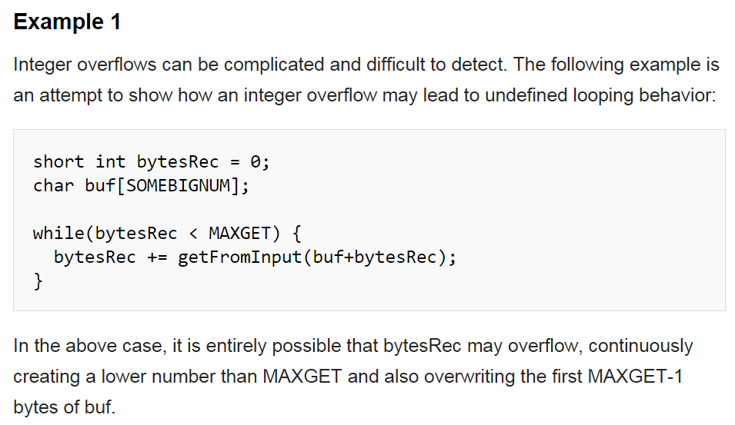
Add a big number into buf
Notes:
The purpose of the program: Read from buf, the max size is MAXGET

Slide 41
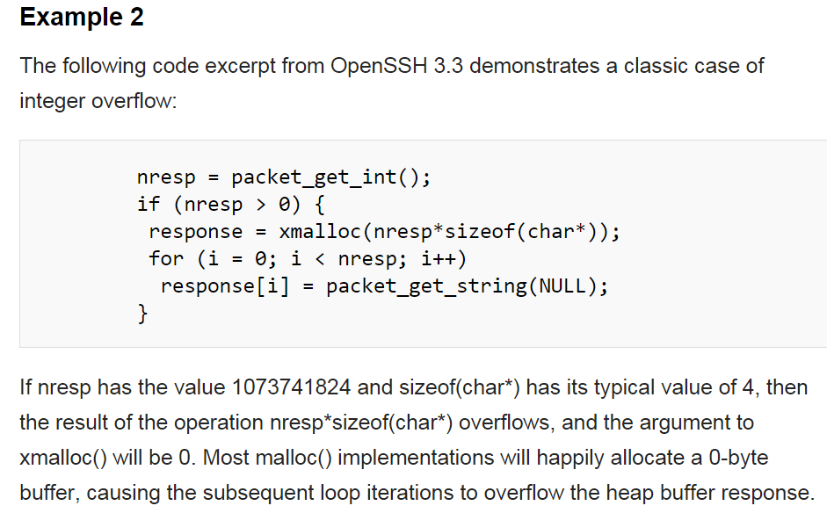
Notes:
30 bits
2^32=2^30*4=1073741824*4
The max is 2^32-1

Slide 42
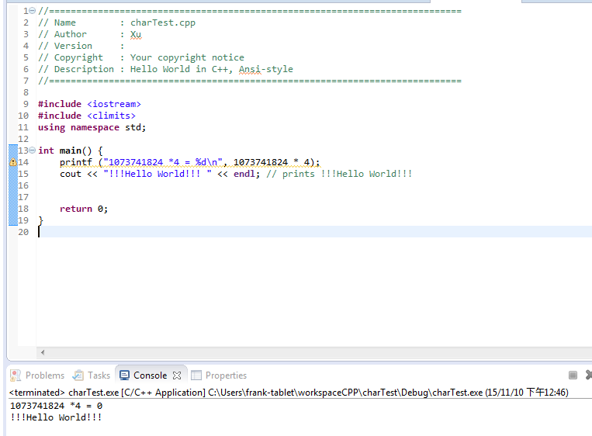

Slide 43
Integer Addition
Addition can be used to add two arithmetic operands or a pointer and an integer.
If both operands are of arithmetic type, the usual arithmetic conversions are performed on them.
Integer addition can result in an overflow if the sum cannot be represented in the number allocated bits

Slide 44
Add Instruction
IA-32 instruction set includes an add instruction that takes the form
  add destination, source
Adds the 1st (destination) op to the 2nd (source) op
  Stores the result in the destination operand
  Destination operand can be a register or memory location
  Source operand can be an immediate, register, or memory location
Signed and unsigned overflow conditions are detected and reported.

Slide 45
Add Instruction Example
The instruction:
    add ax, bx
  adds the 16-bit bx register to the 16-bit ax register
  leaves the sum in the ax register
The add instruction sets flags in the flags register
  overflow flag indicates signed arithmetic overflow
  carry flag indicates unsigned arithmetic overflow

Slide 46
Layout of the Flags Register
15
0
Overflow
Direction
Interrupt
Sign
Zero
Auxiliary Carry
Parity
Carry

Slide 47
Interpreting Flags
There are no distinctions between the addition of signed and unsigned integers at the machine level.
Overflow and carry flags must be interpreted in context

Slide 48
Adding signed and unsigned int
Both signed int and unsigned int values are added as follows:
  ui1 + ui2
  7. mov eax, dword ptr [ui1]
  8. add eax, dword ptr [ui2]

Slide 49
Adding signed long long int
The add instruction adds the low-order 32 bits
sll1 + sll2
9. mov eax, dword ptr [sll1]
10. add eax, dword ptr [sll2]
11. mov ecx, dword ptr [ebp-98h]
12. adc ecx, dword ptr [ebp-0A8h]
The adc instruction adds the high-order 32 bits and the value of the carry bit

Slide 50
Unsigned Overflow Detection
The carry flag denotes an unsigned arithmetic overflow
Unsigned overflows can be detected using the
  jc instruction (jump if carry)
  jnc instruction (jump if not carry)
Conditional jump instructions are placed after the
  add instruction in the 32-bit case
  adc instruction in the 64-bit case

Slide 51
Signed Overflow Detection
The overflow flag denotes a signed arithmetic overflow
Signed overflows can be detected using the
  jo instruction (jump if overflow)
  jno instruction (jump if not overflow)
Conditional jump instructions are placed after the
  add instruction in the 32-bit case
  adc instruction in the 64-bit case

Slide 52
Integer Subtraction
The IA-32 instruction set includes
  sub (subtract)
  sbb (subtract with borrow).
The sub and sbb instructions set the overflow and carry flags to indicate an overflow in the signed or unsigned result.

Slide 53
sub Instruction
Subtracts the 2nd (source) operand from the 1st (destination) operand
Stores the result in the destination operand
The destination operand can be a
  register
  memory location
The source operand can be a(n)
  immediate
  register
  memory location

Slide 54
sbb Instruction
The sbb instruction is executed as part of a multi-byte or multi-word subtraction.
The sbb instruction adds the 2nd (source) operand and the carry flag and subtracts the result from the 1st (destination) operand
The result of the subtraction is stored in the destination operand.
The carry flag represents a borrow from a previous subtraction.

Slide 55
signed long long int Sub
The sub instruction subtracts the low-order 32 bits
sll1 - sll2
1. mov eax, dword ptr [sll1]
2. sub eax, dword ptr [sll2]
3. mov ecx, dword ptr [ebp-0E0h]
4. sbb ecx, dword ptr [ebp-0F0h]
The sbb instruction subtracts the high-order 32 bits
NOTE: Assembly Code Generated by Visual C++ for Windows 2000

Slide 56
Integer Multiplication
Multiplication is prone to overflow errors because relatively small operands can overflow
One solution is to allocate storage for the product that is twice the size of the larger of the two operands.

Slide 57
Signed/Unsigned Examples
The max value for an unsigned integer is 2^{n}-1
  2^{n}-1 x 2^{n}-1 = 2^{2n} – 2^{n+1} + 1 < 2^{2n}
The minimum value for a signed integer is -2^{n-1}
  -2^{n-1} x -2^{n-1} = 2^{2n-2} 2 < 2^{2n}
Notes:
Unsigned:
For n = 8, 255 x 255 = 65,025
For n = 8, 2^{2n} – 2^{n+1} + 1 = 65,536 – 512 + 1 = 65,025
Signed:
For n = 8, -128 x -128 = 16,384
For n = 8, 2^{2n-2} = 16,384

Slide 58
Multiplication Instructions
The IA-32 instruction set includes a
  mul (unsigned multiply) instruction
  imul (signed multiply) instruction
The mul instruction
  performs an unsigned multiplication of the 1st (destination) operand and the 2nd (source) operand
  stores the result in the destination operand.

Slide 59
Unsigned Multiplication
Product of 8-bit operands are stored in 16-bit destination registers
1. if (OperandSize == 8) {
2. AX = AL * SRC;
3. else {
4. if (OperandSize == 16) {
5. DX:AX = AX * SRC;
6. }
7. else { // OperandSize == 32
8. EDX:EAX = EAX * SRC;
9. }
10. }
Product of 16-bit operands are stored in 32-bit destination registers
Product of 32-bit operands are stored in 64-bit destination registers

Slide 60
Signed/Unsigned int Multiplication
si_product = si1 * si2;
ui_product = ui1 * ui2;
9. mov eax, dword ptr [ui1]
10. imul eax, dword ptr [ui2]
11. mov dword ptr [ui_product], eax

Slide 61
Upcasting
Cast both operands to the next larger size and then multiply.
For unsigned integers
  check high-order bits in the next larger integer
  if any are set, throw an error.
For signed integers all zeros or all ones in the high-order bits and the sign bit on the low-order bit indicate no overflow.

Slide 62
Upcast Example
void* AllocBlocks(size_t cBlocks) {
// allocating no blocks is an error
if (cBlocks == 0) return NULL;
// Allocate enough memory
// Upcast the result to a 64-bit integer
// and check against 32-bit UINT_MAX
// to makes sure there's no overflow
unsigned long long alloc = cBlocks * 16;
return (alloc < UINT_MAX)
? malloc(cBlocks * 16)
: NULL;
}
Multiplication results in a 32-bit value. The result is assigned to a unsigned long long but the calculation may have already overflowed.

Slide 63
Standard Compliance
To be compliant with C99, multiplying two
32-bit numbers in this context must yield a
32-bit result.
The language was not modified because the result would be burdensome on architectures that do not have widening multiply instructions.
The correct result could be achieved by casting one of the operands.

Slide 64
Corrected Upcast Example
void* AllocBlocks(size_t cBlocks) {
// allocating no blocks is an error
if (cBlocks == 0) return NULL;
// Allocate enough memory
// Upcast the result to a 64-bit integer
// and check against 32-bit UINT_MAX
// to makes sure there's no overflow
unsigned long long alloc =
(unsigned long long)cBlocks*16;
return (alloc < UINT_MAX)
? malloc(cBlocks * 16)
: NULL;
}

Slide 65
Integer Division
An integer overflow condition occurs when the minimum integer value for 32-bit or 64-bit integers are divided by -1.
  In the 32-bit case, –2,147,483,648/-1 should be equal to 2,147,483,648
  Because 2,147,483,648 cannot be represented as a signed 32-bit integer the resulting value is incorrect
- 2,147,483,648 /-1 = - 2,147,483,648
Notes:
Integer division overflows can be prevented by for 32-bit and 64-bit division by checking to see whether the numerator is the minimum value for the integer type and the denominator is -1.
Division by zero can be prevented by ensuring that the divisor is non-zero.

Slide 66
Error Detection
The IA-32 instruction set includes the div and idiv instructions
The div instruction
  divides the (unsigned) integer value in the ax, dx:ax, or edx:eax registers (dividend) by the source operand (divisor)
  stores the result in the ax (ah:al), dx:ax, or edx:eax registers
The idiv instruction performs the same operations on (signed) values.

Slide 67
Signed Integer Division
si_quotient = si_dividend / si_divisor;
1. mov eax, dword ptr [si_dividend]
2. cdq
3. idiv eax, dword ptr [si_divisor]
4. mov dword ptr [si_quotient], eax
The cdq instruction copies the sign (bit 31) of the value in the eax
register into every bit position in the edx register.
NOTE: Assembly code generated by Visual C++

Slide 68
Unsigned Integer Division
ui_quotient = ui1_dividend / ui_divisor;
5. mov eax, dword ptr [ui_dividend]
6. xor edx, edx
7. div eax, dword ptr [ui_divisor]
8. mov dword ptr [ui_quotient], eax
NOTE: Assembly code generated by Visual C++

Slide 69
Error Detection
The Intel division instructions div and idiv do not set the overflow flag.
A division error is generated if
  the source operand (divisor) is zero
  if the quotient is too large for the designated register
A divide error results in a fault on interrupt vector 0.
When a fault is reported, the processor restores the machine state to the state before the beginning of execution of the faulting instruction.

Slide 70
Vulnerabilities
A vulnerability is a set of conditions that allows violation of an explicit or implicit security policy.
Security flaws can result from hardware-level integer error conditions or from faulty logic involving integers.
These security flaws can, when combined with other conditions, contribute to a vulnerability.

Slide 71
Vulnerabilities Section Agenda
Integer overflow
Sign error
Truncation
Non-exceptional
Integer overflow
Sign error
Truncation
Non-exceptional

Slide 72
JPEG Example: load the comments to *comment for future process
Based on a real-world vulnerability in the handling of the comment field in JPEG files
Comment field includes a two-byte length field indicating the length of the comment, including the two-byte length field.
To determine the length of the comment string (for memory allocation), the function reads the value in the length field and subtracts two.
The function then allocates the length of the comment plus one byte for the terminating null byte.
0 | D | m | y |  | c | o | m | m | e | n | t | \0
2 bytes |  | Comment information
Size=13 (0x0D)

Slide 73
Integer Overflow Example
1. void getComment(unsigned int len, char *src) {
2. unsigned int size;
3. size = len - 2;
4. char *comment = (char *)malloc(size + 1);
5. memcpy(comment, src, size);
6. return;
7. }
8. int _tmain(int argc, _TCHAR* argv[]) {
9. getComment(1, "Comment ");
10. return 0;
11. }
0 byte malloc() succeeds
Size is interpreted as a large positive value of 0xffffffff
Possible to cause an overflow by creating
an image with a comment length field of 1
Notes:
Try to save the comments to *comment for future process
0001
- 1
-----------
0000
- 1
--------
1111

Slide 74
Memory Allocation Example
Integer overflow can occur in calloc() and other memory allocation functions when computing the size of a memory region.
A buffer smaller than the requested size is returned, possibly resulting in a subsequent buffer overflow.
The following code fragments may lead to vulnerabilities:
  C: p = calloc(sizeof(element_t), count);
  C++: p = new ElementType[count];

Slide 75
Memory Allocation
The calloc() library call accepts two arguments
  the storage size of the element type
  the number of elements
The element type size is not specified explicitly in the case of new operator in C++.
To compute the size of the memory required, the storage size is multiplied by the number of elements.

Slide 76
Overflow Condition
If the result cannot be represented in a signed integer, the allocation routine can appear to succeed but allocate an area that is too small.
The application can write beyond the end of the allocated buffer resulting in a heap-based buffer overflow.

Slide 77
Sign Error Example 1
Program accepts two arguments (the length of data to copy and the actual data)
1. #define BUFF_SIZE 10
2. int main(int argc, char* argv[]){
3. int len;
4. char buf[BUFF_SIZE];
5. len = atoi(argv[1]);
6. if (len < BUFF_SIZE){
7. memcpy(buf, argv[2], len);
8. }
9. }
len declared as a signed integer
argv[1] can be a negative value
A negative value bypasses the check
Value is interpreted as an unsigned value of type size_t
void * memcpy ( void * destination, const void * source, size_t num );

Slide 78
Sign Errors Example 2
The negative length is interpreted as a large, positive integer with the resulting buffer overflow
This vulnerability can be prevented by restricting the integer len to a valid value
  more effective range check that guarantees len is greater than 0 but less than BUFF_SIZE
  declare as an unsigned integer
    eliminates the conversion from a signed to unsigned type in the call to memcpy()
    prevents the sign error from occurring

Slide 79
Truncation:
Vulnerable Implementation
32 bits
1. bool func(char *name, long cbBuf) {
2. unsigned short bufSize = cbBuf;
3. char *buf = (char *)malloc(bufSize);
4. if (buf) {
5. memcpy(buf, name, cbBuf);
6. if (buf) free(buf);
7. return true;
8. }
9. return false;
10. }
16 bits
cbBuf is used to initialize bufSize which is used to allocate memory for buf
cbBuf is declared as a long and used as the size in the memcpy() operation
void* malloc (size_t size); size_t is an unsigned integral type.

Slide 80
Vulnerability 1
cbBuf is temporarily stored in the unsigned short bufSize.
The maximum size of an unsigned short for both GCC and the Visual C++ compiler on IA-32 is 65,535.
The maximum value for a signed long on the same platform is 2,147,483,647.
A truncation error will occur on line 2 for any values of cbBuf between 65,535 and 2,147,483,647.

Slide 81
Vulnerability 2
This would only be an error and not a vulnerability if bufSize were used for both the calls to malloc() and memcpy()
Because bufSize is used to allocate the size of the buffer and cbBuf is used as the size on the call to memcpy() it is possible to overflow buf by anywhere from 1 to 2,147,418,112 (2,147,483,647 - 65,535) bytes.

Slide 82
Non-Exceptional Integer Errors
Integer related errors can occur without an exceptional condition (such as an overflow) occurring

Slide 83
Negative Indices
1. int *table = NULL;\
2. int insert_in_table(int pos, int value){
3. if (!table) {
4. table = (int *)malloc(sizeof(int) * 100);
5. }
6. if (pos > 99) {
7. return -1;
8. }
9. table[pos] = value;
10. return 0;
11. }
Storage for the array is allocated on the heap
pos is not > 99
value is inserted into the array at the specified position

Slide 84
Vulnerability
There is a vulnerability resulting from incorrect range checking of pos
  Because pos is declared as a signed integer, both positive and negative values can be passed to the function.
  An out-of-range positive value would be caught but a negative value would not.

Slide 85
Mitigation
Type range checking
Strong typing
Compiler checks
Safe integer operations
Testing and reviews

Slide 86
Type Range Checking
Type range checking can eliminate integer vulnerabilities.
Languages such as Pascal and Ada allow range restrictions to be applied to any scalar type to form subtypes.
Ada allows range restrictions to be declared on derived types using the range keyword:
type day is new INTEGER range 1..31;
Range restrictions are enforced by the language runtime.
C and C++ are not nearly as good at enforcing type safety.

Slide 87
Type Range Checking Example
1. #define BUFF_SIZE 10
2. int main(int argc, char* argv[]){
3. unsigned int len;
4. char buf[BUFF_SIZE];
5. len = atoi(argv[1]);
6. if ((0<len) && (len<BUFF_SIZE) ){
7. memcpy(buf, argv[2], len);
8. }
9. else
10. printf("Too much data\n");
11. }
.
Implicit type check from the declaration as an unsigned integer
Explicit check for both upper and lower bounds

Slide 88
Range Checking
External inputs should be evaluated to determine whether there are identifiable upper and lower bounds.
  these limits should be enforced by the interface
  easier to find and correct input problems than it is to trace internal errors back to faulty inputs
Limit input of excessively large or small integers
Typographic conventions can be used in code to
  distinguish constants from variables
  distinguish externally influenced variables from locally used variables with well-defined ranges

Slide 89
Strong Typing
One way to provide better type checking is to provide better types.
Using an unsigned type can guarantee that a variable does not contain a negative value.
This solution does not prevent overflow.
Strong typing should be used so that the compiler can be more effective in identifying range problems.

Slide 90
Strong Typing Example
Declare an integer to store the temperature of water using the Fahrenheit scale
  unsigned char waterTemperature;
waterTemperature is an unsigned 8-bit value in the range 1-255
unsigned char
  sufficient to represent liquid water temperatures which range from 32 degrees Fahrenheit (freezing) to 212 degrees Fahrenheit (the boiling point).
  does not prevent overflow
  allows invalid values (e.g., 1-31 and 213-255).

Slide 91
Abstract Data Type
One solution is to create an abstract data type in which waterTemperature is private and cannot be directly accessed by the user.
A user of this data abstraction can only access, update, or operate on this value through public method calls.
These methods must provide type safety by ensuring that the value of the waterTemperature does not leave the valid range.
If implemented properly, there is no possibility of an integer type range error occurring.

Slide 92
Visual C++ Compiler Checks
Visual C++ .NET 2003 generates a warning (C4244) when an integer value is assigned to a smaller integer type.
  At level 1 a warning is issued if __int64 is assigned to unsigned int.
  At level 3 and 4, a “possible loss of data” warning is issued if an integer is converted to a smaller type.
For example, the following assignment is flagged at warning level 4
int main() {
int b = 0, c = 0;
short a = b + c; // C4244
}

Slide 93
Visual C++ Runtime Checks
Visual C++ .NET 2003 includes runtime checks that catch truncation errors as integers are assigned to shorter variables that result in lost data.
The /RTCc compiler flag catches those errors and creates a report.
Visual C++ includes a runtime_checks pragma that disables or restores the /RTC settings, but does not include flags for catching other runtime errors such as overflows.
Runtime error checks are not valid in a release (optimized) build for performance reasons.

Slide 94
GCC Runtime Checks
GCC compilers provide an -ftrapv option
  provides limited support for detecting integer exceptions at runtime.
  generates traps for signed overflow for addition, subtraction, and multiplication
  generates calls to existing library functions
GCC runtime checks are based on post-conditions—the operation is performed and the results are checked for validity

Slide 95
Postcondition
For unsigned integers if the sum is smaller than either operand, an overflow has occurred
For signed integers, let sum = lhs + rhs
  If lhs is non-negative and sum < rhs, an overflow has occurred.
  If lhs is negative and sum > rhs, an overflow has occurred.
  In all other cases, the addition operation succeeds

Slide 96
Adding Signed Integers
Function from the gcc runtime system used to detect errors resulting from the addition of signed 16-bit integers
1. Wtype __addvsi3 (Wtype a, Wtype b) {
2. const Wtype w = a + b;
3. if (b >= 0 ? w < a : w > a)
4. abort ();
5. return w;
6. }
The addition is performed and the sum is compared to the operands to determine if an error occurred
abort() is called if
b is non-negative and w < a
b is negative and w > a

Slide 97
Safe Integer Operations 1
Integer operations can result in error conditions and possible lost data.
The first line of defense against integer vulnerabilities should be range checking
  Explicitly
  Implicitly - through strong typing
It is difficult to guarantee that multiple input variables cannot be manipulated to cause an error to occur in some operation somewhere in a program.

Slide 98
Safe Integer Operations 2
An alternative or ancillary approach is to protect each operation.
This approach can be labor intensive and expensive to perform.
Use a safe integer library for all operations on integers where one or more of the inputs could be influenced by an untrusted source.

Slide 99
Safe Integer Solutions
C language compatible library
  Written by Michael Howard at Microsoft
  Detects integer overflow conditions using IA-32 specific mechanisms

Slide 100
Unsigned Add Function
1. in bool UAdd(size_t a, size_t b, size_t *r) {
2. __asm {
3. mov eax, dword ptr [a]
4. add eax, dword ptr [b]
5. mov ecx, dword ptr [r]
6. mov dword ptr [ecx], eax
7. jc short j1
8. mov al, 1 // 1 is success
9. jmp short j2
10. j1:
11. xor al, al // 0 is failure
12. j2:
13. };
14. }

Slide 101
Unsigned Add Function Example
1. int main(int argc, char *const *argv) {
2. unsigned int total;
3. if (UAdd(strlen(argv[1]), 1, &total) &&
UAdd(total, strlen(argv[2]), &total)) {
4. char *buff = (char *)malloc(total);
5. strcpy(buff, argv[1]);
6. strcat(buff, argv[2]);
7. else {
8. abort();
9. }
10. }
The length of the combined strings is calculated using UAdd() with appropriate checks for error conditions.

Slide 102
SafeInt Class
SafeInt is a C++ template class written by David LeBlanc.
Implements a precondition approach that tests the values of operands before performing an operation to determine if an error will occur.
The class is declared as a template, so it can be used with any integer type.
Every operator has been overridden except for the subscript operator[]

Slide 103
SafeInt Example
The variables s1 and s2 are declared as SafeInt types
1. int main(int argc, char *const *argv) {
2. try{
3. SafeInt<unsigned long> s1(strlen(argv[1]));
4. SafeInt<unsigned long> s2(strlen(argv[2]));
5. char *buff = (char *) malloc(s1 + s2 + 1);
6. strcpy(buff, argv[1]);
7. strcat(buff, argv[2]);
8. }
9. catch(SafeIntException err) {
10. abort();
11. }
12. }
When the + operator is invoked it uses the safe version of the operator implemented as part of the SafeInt class.

Slide 104
Addition
Addition of unsigned integers can result in an integer overflow if the sum of the left-hand side (LHS) and right-hand side (RHS) of an addition operation is greater than
  UINT_MAX for addition of unsigned int type
  ULLONG_MAX for addition of unsigned long long type

Slide 105
Safe Integer Solutions Compared
SafeInt library has several advantages
  more portable than safe arithmetic operations that depend on assembly language instructions.
  more usable
    operators can be used inline in expressions
    SafeInt uses C++ exception handling
  better performance (with optimized code)
Fails to provide correct integer promotion behavior

Slide 106
When to Use Safe Integers
Use safe integers when integer values can be manipulated by untrusted sources, for example
  the size of a structure
  the number of structures to allocate
void* CreateStructs(int StructSize, int HowMany) {
SafeInt<unsigned long> s(StructSize);
s *= HowMany;
return malloc(s.Value());
}
Structure size multiplied by # required to determine size of memory to allocate.
The multiplication can overflow the integer and create a buffer overflow vulnerability

Slide 107
When Not to Use Safe Integers
Don’t use safe integers when no overflow possible
  tight loop
  variables are not externally influenced
void foo() {
char a[INT_MAX];
int i;
for (i = 0; i < INT_MAX; i++)
a[i] = '\0';
}

Slide 108
Testing 1
Input validation does not guarantee that subsequent operations on integers will not result in an overflow or other error condition.
Testing does not provide any guarantees either
  It is impossible to cover all ranges of possible inputs on anything but the most trivial programs.
  If applied correctly, testing can increase confidence that the code is secure.

Slide 109
Testing 2
Integer vulnerability tests should include boundary conditions for all integer variables.
  If type range checks are inserted in the code, test that they function correctly for upper and lower bounds.
  If boundary tests have not been included, test for minimum and maximum integer values for the various integer sizes used.
Use white box testing to determine the types of integer variables.
If source code is not available, run tests with the various maximum and minimum values for each type.

Slide 110
Source Code Audit
Source code should be audited or inspected for possible integer range errors
When auditing, check for the following:
  Integer type ranges are properly checked.
  Input values are restricted to a valid range based on their intended use.
Integers that do not require negative values are declared as unsigned and properly range-checked for upper and lower bounds.
Operations on integers originating from untrusted sources are performed using a safe integer library.

Slide 111
Notable Vulnerabilities
Integer Overflow In XDR Library
  SunRPC xdr_array buffer overflow
  http://www.iss.net/security_center/static/9170.php
Windows DirectX MIDI Library
  eEye Digital Security advisory AD20030723
  http://www.eeye.com/html/Research/Advisories/AD20030723.html
Bash
  CERT Advisory CA-1996-22
  http://www.cert.org/advisories/CA-1996-22.html

