Slide 1
Outline
User authentication
  Password authentication, salt
  Challenge-response authentication protocols
  Biometrics
  Token-based authentication
Authentication in distributed systems (multi service providers/domains)
  Single sign-on, Microsoft Passport
  Trusted Intermediaries (KPC and CA)
Notes:
Authentication: reliably verifying the identity

Slide 2
Objectives
Understand the four major individual authentication mechanisms and their comparison
Understand the basic mechanisms of trusted intermediaries for distributed authentication using different crypto methods
  Symmetric key: KDC (the key concept of ticket)
  Asymmetric key: CA
Know the practical protocols of distributed authentication
  Symmetric key: Kerberos
  Asymmetric key: X.509

Slide 3
Password authentication
Basic idea
  User has a secret password
  System checks password to authenticate user
Issues
  How is password stored?
  How does system check password?
  How easy is it to guess a password?
    Difficult to keep password file secret, so best if it is hard to guess password even if you have the password file

Slide 4
Basic password scheme
User
Password file
kiwifruit
exrygbzyf
kgnosfix
ggjoklbsz
…
…
hash function

Slide 5
Basic password scheme
Hash function h : strings → strings
  Given h(password), hard to find password
  No known algorithm better than trial and error
User password stored as h(password)
When user enters password
  System computes h(password)
  Compares with entry in password file
No passwords stored on disk

Slide 6
Unix password system
Hash function is 25xDES
  25 rounds of DES-variant encryptions
Any user can try “dictionary attack”
R.H. Morris and K. Thompson, Password security: a case history, Communications of the ACM, November 1979

Slide 7
UNIX Password System
Password line
  walt:fURfuu4.4hY0U:129:129:Belgers:/home/walt:/bin/csh
Compare
Salt
Input
Constant,
A 64-bit block of 0
Key
25x DES
Ciphertext
Plaintext
Notes:
account:coded password data:uid:gid:GCOS-field:homedir:shell
Salt: 12 bits encoded in 2 bytes
Ciphertext: 11 bytes
It is much harder to infer the key than to infer the clear text.
When password is set, salt is chosen randomly 12-bit salt slows dictionary attack by factor of 2¹²

Slide 8
Dictionary Attack – some numbers
Typical password dictionary
  1,000,000 entries of common passwords
    people's names, common pet names, and ordinary words.
  Suppose you generate and analyze 10 guesses per second
    This may be reasonable for a web site; offline is much faster
  Dictionary attack in at most 100,000 seconds = 28 hours, or 14 hours on average
If passwords were random
  Assume six-character password
    Upper- and lowercase letters, digits, 32 punctuation characters
    689,869,781,056 password combinations.
    Exhaustive search requires 1,093 years on average

Slide 9
Outline
User authentication
  Password authentication, salt
  Challenge-response authentication protocols
  Biometrics
  Token-based authentication
Authentication in distributed systems (multi service providers/domains)
  Single sign-on, Microsoft Passport
  Trusted Intermediaries
Notes:
Authentication: reliably verifying the identity

Slide 10



Challenge-response Authentication
Goal: Bob wants Alice to “prove” her identity to him
Protocol ap1.0: Alice says “I am Alice”
“I am Alice”
Failure scenario??

Slide 11
Authentication
Goal: Bob wants Alice to “prove” her identity to him
Protocol ap1.0: Alice says “I am Alice”
in a network,
Bob can not “see” Alice, so Trudy simply declares
herself to be Alice
“I am Alice”

Slide 12
Authentication: another try
Protocol ap2.0: Alice says “I am Alice” in an IP packet
containing her source IP address
Alice’s
IP address
“I am Alice”
Failure scenario??

Slide 13
Authentication: another try
Protocol ap2.0: Alice says “I am Alice” in an IP packet
containing her source IP address
Trudy can create
a packet “spoofing”
Alice’s address
Alice’s
IP address
“I am Alice”

Slide 14
Authentication: another try
Protocol ap3.0: Alice says “I am Alice” and sends her
secret password to “prove” it.
Alice’s
IP addr
Alice’s
password
“I’m Alice”
Failure scenario??
Alice’s
IP addr
OK

Slide 15

Authentication: another try
Protocol ap3.0: Alice says “I am Alice” and sends her
secret password to “prove” it.
Alice’s
IP addr
Alice’s
password
“I’m Alice”
playback attack: Trudy records Alice’s packet
and later
plays it back to Bob
Alice’s
IP addr
OK
Alice’s
IP addr
Alice’s
password
“I’m Alice”

Slide 16
Authentication: yet another try
Protocol ap3.1: Alice says “I am Alice” and sends her
encrypted secret password to “prove” it.
Alice’s
IP addr
encrypted
password
“I’m Alice”
Failure scenario??
Alice’s
IP addr
OK

Slide 17
Authentication: another try
Protocol ap3.1: Alice says “I am Alice” and sends her
encrypted secret password to “prove” it.
Alice’s
IP addr
encryppted
password
“I’m Alice”
record
and
playback
still works!
Alice’s
IP addr
OK
Alice’s
IP addr
encrypted
password
“I’m Alice”

Slide 18
Authentication: yet another try
Goal: avoid playback attack
Nonce: number (R) used only once –in-a-lifetime
ap4.0: to prove Alice “live”, Bob sends Alice nonce, R. Alice
must return R, encrypted with shared secret key
“I am Alice”
R
K (R)
Alice is live, and only Alice knows key to encrypt nonce, so it must be Alice!
A-B
Failures, drawbacks?
Notes:
Masquerade attack? No, unless A and B want to communicate simulatenously.

Slide 19
Authentication: ap5.0
ap4.0 doesn’t protect against server database reading
can we authenticate using public key techniques?
ap5.0: use nonce, public key cryptography
“I am Alice”
Bob computes
R
+
-
-
K
(K (R)) = R
K (R)
A
A
A
and knows only Alice could have the private key, that encrypted R such that
+
-
K
(K (R)) = R
A
A

Slide 20
Outline
User authentication
  Password authentication, salt
  Challenge-response authentication protocols
  Biometrics
  Token-based authentication
Authentication in distributed systems (multi service providers/domains)
  Single sign-on, Microsoft Passport
  Trusted Intermediaries
Notes:
Authentication: reliably verifying the identity

Slide 21
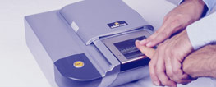

Biometrics
Use a person’s physical characteristics
  fingerprint, voice, face, keyboard timing, …
Advantages
  Cannot be disclosed, lost, forgotten
Disadvantages
  Cost, installation, maintenance
  Reliability of comparison algorithms
    False positive: Allow access to unauthorized person
    False negative: Disallow access to authorized person
  Privacy?
  If forged, how do you revoke?

Slide 22

Biometrics
Common uses
  Specialized situations, physical security
  Combine
    Multiple biometrics
    Biometric and PIN
    Biometric and token

Slide 23
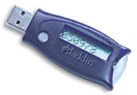
Token-based Authentication
Smart Card
With embedded CPU and memory
  Carries conversation w/ a small card reader
Various forms
  PIN protected memory card
    Enter PIN to get the password
  PIN and smart phone based token
    Google authentication
  Cryptographic challenge/response cards
    Computer create a random challenge
    Enter PIN to encrypt/decrypt the challenge w/ the card
Notes:
PIN protected: usually the password is much harder to memorize. Also, you need both PIN and smart card for authentication.
Sometimes, no random challenge for cryptographic challenge/response cards, eg, the crypto calculator.

Slide 24
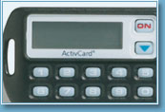
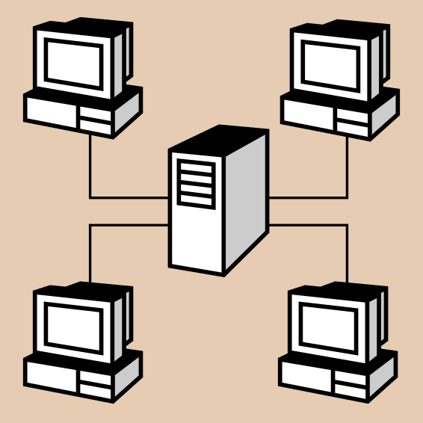
Smart Card Example
Initial data (PIN)
Time
Challenge
Time
function
Some complications
  Initial data (PIN) shared with server
    Need to set this up securely
    Shared database for many sites
  Clock skew

Slide 25
Group Quiz
Suppose Bob is a stateless server which does not require him to remember the challenge he sends to Alice. Is the following protocol secure?
“I am Alice”
R
R, K (R)
A-B

Slide 26
Outline
User authentication
  Password authentication, salt
  Challenge-Response
  Biometrics
  Token-based authentication
Authentication in distributed systems
  Single sign-on, Microsoft Passport
  Trusted Intermediaries

Slide 27
Single sign-on systems
LAN
Rules
Database
user name,
password,
other auth
Authentication
Application
Server
Advantages
  User signs on once
  No need for authentication at multiple sites, applications
  Can set central authorization policy for the enterprise
Notes:
Netegrity purchased by CA, for identity and access management product
http://www.internetnews.com/bus-news/article.php/3418101

Slide 28
Microsoft Passport
Launched 1999
  Claim > 200 million accounts in 2002
  Over 3.5 billion authentications each month
Log in to many websites using one account
  Used by MS services Hotmail, MSN Messenger or MSN subscriptions; also Radio Shack, etc.
  Hotmail or MSN users automatically have Microsoft Passport accounts set up
Notes:
www.networkmagazine.com/article/NMG20020304S0003

Slide 29
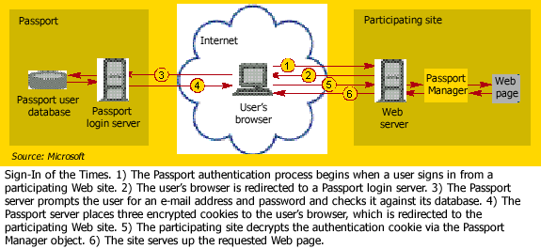
Passport log-in
Notes:
Use both symmetric and asymmetric cipher.
The Passport server encrypts the first two cookies with the unique key it shares with BuyStuff.com. Passport's own key encrypts the third cookie, which participating sites can't read.

Slide 30
Trusted Intermediaries
Symmetric key problem:
How do two entities establish shared secret key over network?
Solution:
trusted key distribution center (KDC) acting as intermediary between entities
Public key problem:
When Alice obtains Bob’s public key (from web site, e-mail, diskette), how does she know it is Bob’s public key, not Trudy’s?
Solution:
trusted certification authority (CA)

Slide 31



Key Distribution Center (KDC)
Alice, Bob need shared symmetric key.
KDC: server shares different secret key with each registered user (many users)
Alice, Bob know own symmetric keys, K_{A-KDC} K_{B-KDC} , for communicating with KDC.
KDC
K_{A-KDC}
K_{P-KDC}
K_{X-KDC}
K_{P-KDC}
K_{B-KDC}
K_{Y-KDC}
K_{Z-KDC}
K_{A-KDC}
K_{B-KDC}

Slide 32

Key Distribution Center (KDC)
Q: How does KDC allow Bob, Alice to determine shared symmetric secret key to communicate with each other?
Alice and Bob communicate: using R1 as
session key for shared symmetric encryption
Notes:
Why not have KDC send KB-KDC(A,R1) directly to B?
KDC will have extra overhead. Easier for applications like A as well. Doesn’t have to wait for B’s reply.
Knows for sure that the key is from KDC.

Slide 33
Ticket and Standard Using KDC
Ticket
  In K_{A-KDC}(R1, K_{B-KDC}(A,R1) ), the K_{B-KDC}(A,R1) is also known as a ticket
  Comes with expiration time
KDC used in Kerberos: standard for shared key based authentication
  Users register passwords
  Shared key derived from the password

Slide 34
Kerberos
Trusted key server system from MIT
  one of the best known and most widely implemented trusted third party key distribution systems.
Provides centralised private-key third-party authentication in a distributed network
  allows users access to services distributed through network
  without needing to trust all workstations
  rather all trust a central authentication server
Two versions in use: 4 & 5
Widely used
  Red Hat 7.2 and Windows Server 2003 or higher
Notes:
Kerberos is an authentication service developed as part of Project Athena at MIT, and is one of the best known and most widely implemented trusted third party key distribution systems.
Kerberos provides a centralized authentication server whose function is to authenticate users to servers and servers to users. Unlike most other authentication schemes, Kerberos relies exclusively on symmetric encryption, making no use of public-key encryption. Two versions of Kerberos are in common use: v4 & v5.

Slide 35
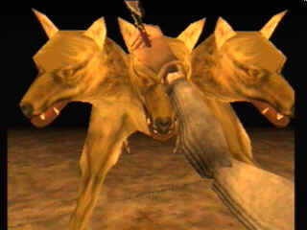




Two-Step Authentication
Prove identity once to obtain special TGS ticket
Use TGS to get tickets for any network service
USER=Joe; service=TGS
Joe the User
Encrypted TGS ticket
Key distribution
center (KDC)
TGS ticket
Ticket granting
service (TGS)
Encrypted
service ticket
Encrypted
service ticket
File server, printer,
other network services
slide <number>

Slide 36
Still Not Good Enough
Ticket hijacking
  Malicious user may steal the service ticket of another user on the same workstation and use it
    IP address verification does not help
  Servers must verify that the user who is presenting the ticket is the same user to whom the ticket was issued
slide <number>
Notes:
No server authentication
Attacker may misconfigure the network so that he receives messages addressed to a legitimate server
Capture private information from users and/or deny service
Servers must prove their identity to users

Slide 37
Symmetric Keys in Kerberos
K_{c} is long-term key of client C
  Derived from user’s password
  Known to client and key distribution center (KDC)
K_{TGS} is long-term key of TGS
  Known to KDC and ticket granting service (TGS)
K_{v} is long-term key of network service V
  Known to V and TGS; separate key for each service
K_{c,TGS} is short-term key between C and TGS
  Created by KDC, known to C and TGS
K_{c,v} is short-term key betwen C and V
  Created by TGS, known to C and V
slide <number>

Slide 38
“Single Logon” Authentication
kinit program (client)
Key Distribution
Center (KDC)
password
ID_{c} , ID_{TGS} , time_{c}
Convert into
client master key
User
K_{c}
Encrypt_{Kc}(K_{c,TGS} , ID_{TGS} , time_{KDC} ,
lifetime , ticket_{TGS})
Decrypts with
K_{c} and obtains
K_{c,TGS} and
ticket_{TGS}
Fresh key to be used
between client and TGS
TGS
Key = K_{TGS}
Encrypt_{KTGS}(K_{c,TGS} , ID_{c} , Addr_{c} ,
ID_{TGS} , time_{KDC} , lifetime)
Client will use this unforgeable ticket to
get other tickets without re-authenticating
Key = K_{c}
…
All users must
pre-register their
passwords with KDC
Client only needs to obtain TGS ticket once (say, every morning)
  Ticket is encrypted; client cannot forge it or tamper with it
slide <number>

Slide 39
Obtaining a Service Ticket
Client
Encrypt_{Kc,TGS}(ID_{c} , Addr_{c} , time_{c})
Proves that client knows key K_{c,TGS}
contained in encrypted TGS ticket
Ticket Granting
Service (TGS)
usually lives inside KDC
Knows K_{c,TGS}
and ticket_{TGS}
System command,
e.g. “lpr –Pprint”
ID_{v} , ticket_{TGS} , auth_{C}
User
Encrypt_{Kc,TGS}(K_{c,v} , ID_{v} , time_{TGS} ,
ticket_{v})
Fresh key to be used
between client and service
Knows key K_{v} for
each service
Encrypt_{Kv}(K_{c,v} , ID_{c} , Addr_{c} , ID_{v} ,
time_{TGS} , lifetime)
Client will use this unforgeable
ticket to get access to service V
Client uses TGS ticket to obtain a service ticket and a short-term key for each network service
  One encrypted, unforgeable ticket per service (printer, email, etc.)
slide <number>

Slide 40

Obtaining Service
Client
Encrypt_{Kc,v}(ID_{c} , Addr_{c} , time_{c})
Proves that client knows key K_{c,v}
contained in encrypted ticket
Knows K_{c,v}
and ticket_{v}
Server V
System command,
e.g. “lpr –Pprint”
ticket_{v} , auth_{C}
User
Encrypt_{Kc,v}(time_{c}+1)
Authenticates server to client
Reasoning:
Server can produce this message only if he knows key K_{c,v}.
Server can learn key K_{c,v} only if he can decrypt service ticket.
Server can decrypt service ticket only if he knows correct key K_{v}.
If server knows correct key K_{v}, then he is the right server.
For each service request, client uses the short-term key for that service and the ticket he received from TGS
slide <number>

Slide 41
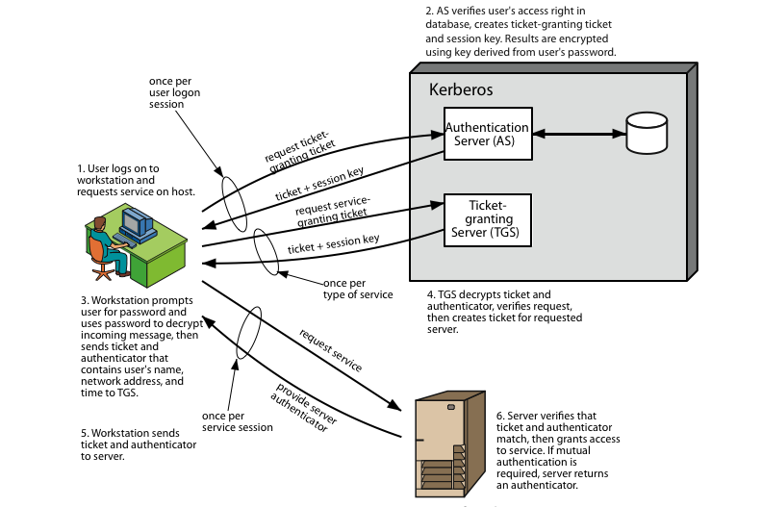
Kerberos 4 Overview
Notes:
Stallings Figure 14.1 diagrammatically summarizes the Kerberos v4 authentication dialogue, with 3 pairs of messages, for each phase listed previously.

Slide 42
Important Ideas in Kerberos
Short-term session keys
  Long-term secrets used only to derive short-term keys
  Separate session key for each user-server pair
    … but multiple user-server sessions re-use the same key
Proofs of identity are based on authenticators
  Client encrypts his identity, address and current time using a short-term session key
    Also prevents replays (if clocks are globally synchronized)
  Server learns this key separately (via encrypted ticket that client can’t decrypt) and verifies user’s identity
Symmetric cryptography only
slide <number>

Slide 43
Practical Uses of Kerberos
Email, FTP, network file systems and many other applications have been kerberized
  Use of Kerberos is transparent for the end user
  Transparency is important for usability!
Local authentication
  login and su in OpenBSD
Authentication for network protocols
  rlogin, rsh, telnet

Slide 44
Trusted Intermediaries
Symmetric key problem:
How do two entities establish shared secret key over network?
Solution:
trusted key distribution center (KDC) acting as intermediary between entities
Public key problem:
When Alice obtains Bob’s public key (from web site, e-mail, diskette), how does she know it is Bob’s public key, not Trudy’s?
Solution:
trusted certification authority (CA)

Slide 45

Certification Authorities
Certification authority (CA): binds public key to particular entity, E.
E (person, router) registers its public key with CA.
  E provides “proof of identity” to CA.
  CA creates certificate binding E to its public key.
  Certificate containing E’s public key digitally signed by CA – CA says “this is E’s public key”
Bob’s
public
key
digital
signature
(encrypt)
+
K
+
B
K
B
CA
private
key
certificate for Bob’s public key, signed by CA
Bob’s
identifying information
-
K
CA
Notes:
CA is heart of the X.509 standard which has been used extensively in SSL (Secure Socket Layer), S/MIME (Secure/Multiple Purpose Internet Mail Extension), and IP Sec

Slide 46
Certification Authorities
When Alice wants Bob’s public key:
  gets Bob’s certificate (Bob or elsewhere).
  apply CA’s public key to Bob’s certificate, get Bob’s public key
CA is heart of the X.509 standard used extensively in
  SSL (Secure Socket Layer)/TLS: deployed in every Web browser
  S/MIME (Secure/Multiple Purpose Internet Mail Extension), and IP Sec, etc.
+
digital
signature
(decrypt)
Bob’s
public
key
K
B
+
K
B
CA
public
key
+
K
CA

Slide 47
General Process of SSL
Version, Crypto choice, nonce
C
S
Version, Choice, nonce,
signed certificate
containing server’s
public key Ks
Secret key K
encrypted with
server’s key Ks
switch to negotiated cipher
hash of sequence of messages
hash of sequence of messages

Slide 48
Authentication in SSL/HTTPS
Company asks CA (e.g., Verisign) for a certificate
CA creates certificates and signs it
Certificate installed in server (e.g., web server)
Browser issued with root certificates
  Windows Root Certificates List
    http://social.technet.microsoft.com/wiki/contents/articles/2592.aspx
Browser verify certificates and trust correctly signed ones

Slide 49
Single KDC/CA
Problems
  Single administration trusted by all principals
  Single point of failure
  Scalability
Solutions: break into multiple domains
  Each domain has a trusted administration

Slide 50
Multiple KDC/CA Domains
Secret keys:
KDCs share pairwise key
topology of KDC: tree with shortcuts
Public keys:
cross-certification of CAs
example: Alice with CA_{A}, Boris with CA_{B}
  Alice gets CA_{B}’s certificate (public key p₁), signed by CA_{A}
  Alice gets Boris’ certificate (its public key p₂), signed by CA_{B} (p₁)

Slide 51
Key Distribution Center (KDC)
Q: How does KDC allow Bob, Alice to determine shared symmetric secret key to communicate with each other?
KDC generates R1
K_{A-KDC}(A,B)
Alice
knows R1
K_{A-KDC}(R1, K_{B-KDC}(A,R1) )
Bob knows to use R1 to communicate with Alice
K_{B-KDC}(A,R1)
Alice and Bob communicate: using R1 as
session key for shared symmetric encryption
Notes:
Why not have KDC send KB-KDC(A,R1) directly to B?
KDC will have extra overhead. Easier for applications like A as well. Doesn’t have to wait for B’s reply.
Knows for sure that the key is from KDC.

Slide 52
Group Quiz
Consider the KDC and CA servers. Suppose a KDC goes down. What is the impact on the ability of parties to communicate securely; that is, who can and cannot communicate? Justify your answer. Suppose now a CA goes down. What is the impact of this failure?

Slide 53
Backup Slides

Slide 54
Advantages of salt
Without salt
  Same hash functions on all machines
    Compute hash of all common strings once
    Compare hash file with all known password files
With salt
  One password hashed 2¹² different ways
    Precompute hash file?
      Need much larger file to cover all common strings
    Dictionary attack on known password file
      For each salt found in file, try all common strings

Slide 55
Four parts of Passport account
Passport Unique Identifier (PUID)
  Assigned to the user when he or she sets up the account
User profile, required to set up account
  Phone number or Hotmail or MSN.com e-mail address
  Also name, ZIP code, state, or country, …
Credential information
  Minimum six-character password or PIN
  Four-digit security key, used for a second level of authentication on sites requiring stronger sign-in credentials
Wallet
  Passport-based application at passport.com domain
  E-commerce sites with Express Purchase function use wallet information rather than prompt the user to type in data

Slide 56
Kerberos in Large Networks
One KDC isn’t enough for large networks (why?)
Network is divided into realms
  KDCs in different realms have different key databases
To access a service in another realm, users must…
  Get ticket for home-realm TGS from home-realm KDC
  Get ticket for remote-realm TGS from home-realm TGS
    As if remote-realm TGS were just another network service
  Get ticket for remote service from that realm’s TGS
  Use remote-realm ticket to access service
  N(N-1)/2 key exchanges for full N-realm interoperation
slide <number>

Slide 57
When NOT Use Kerberos
No quick solution exists for migrating user passwords from a standard UNIX password database to a Kerberos password database
  such as /etc/passwd or /etc/shadow
For an application to use Kerberos, its source must be modified to make the appropriate calls into the Kerberos libraries
All-or-nothing proposition
  If any services that transmit plaintext passwords remain in use, passwords can still be compromised

