Slide 1

Data Structures Using C++ 2E
Chapter 5
Linked Lists

Slide 2
Objectives
Learn about linked lists
Become aware of the basic properties of linked lists
Explore the insertion and deletion operations on linked lists
Discover how to build and manipulate a linked list
Data Structures Using C++ 2E

Slide 3
Objectives (cont’d.)
Learn how to construct a doubly linked list
Discover how to use the STL container list
Learn about linked lists with header and trailer nodes
Become aware of circular linked lists
Data Structures Using C++ 2E

Slide 4

Linked Lists
Collection of components (nodes)
  Every node (except last)
    Contains address of the next node
Node components
  Data: stores relevant information
  Link: stores address
FIGURE 5-1 Structure of a node
Data Structures Using C++ 2E

Slide 5

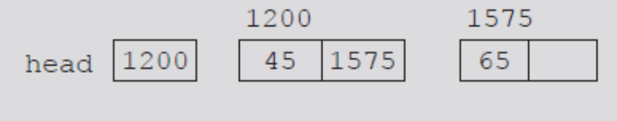
Linked Lists (cont’d.)
Head (first)
  Address of the first node in the list
Arrow points to node address
  Stored in node
Down arrow in last node indicates NULL link field
FIGURE 5-2 Linked list
FIGURE 5-3 Linked list and values of the links
Data Structures Using C++ 2E

Slide 6
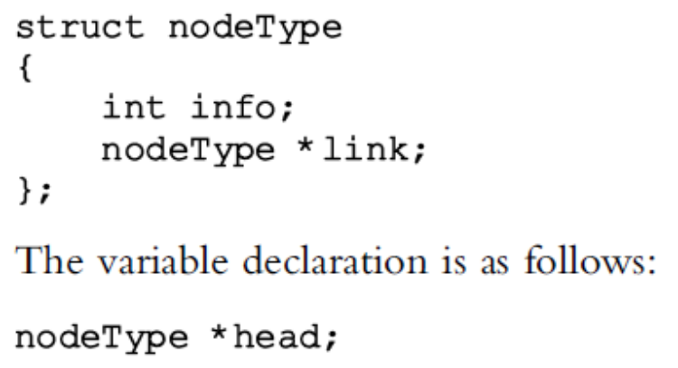
Linked Lists (cont’d.)
Two node components
  Declared as a class or struct
    Data type depends on specific application
  Link component: pointer
    Data type of pointer variable: node type itself
Data Structures Using C++ 2E

Slide 7
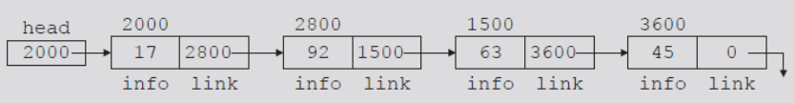
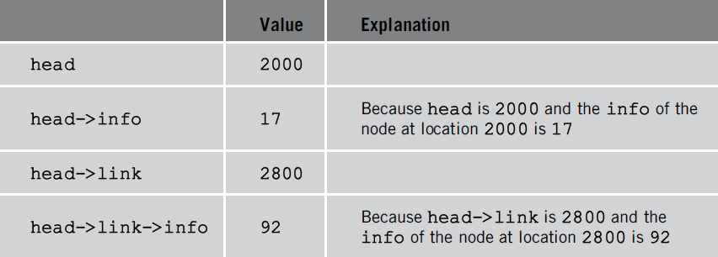
Linked Lists: Some Properties
Head stores address of first node
Info stores information
Link stores address of next node
  Assume info type int
TABLE 5-1 Values of head and some of
the nodes of the linked list in Figure 5-4
FIGURE 5-4 Linked list with four nodes
Data Structures Using C++ 2E

Slide 8
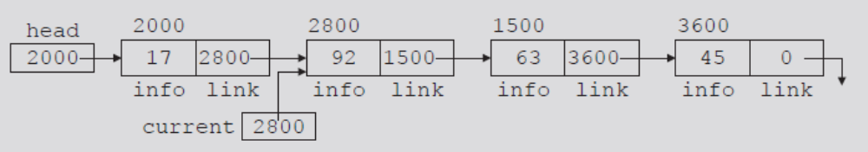
Linked Lists: Some Properties (cont’d.)
Pointer current: same type as pointer head
  current = head;
    Copies value of head into current
  current = current->link;
    Copies value of current->link (2800) into current
FIGURE 5-5 List after the statement
current = current->link; executes
Data Structures Using C++ 2E

Slide 9
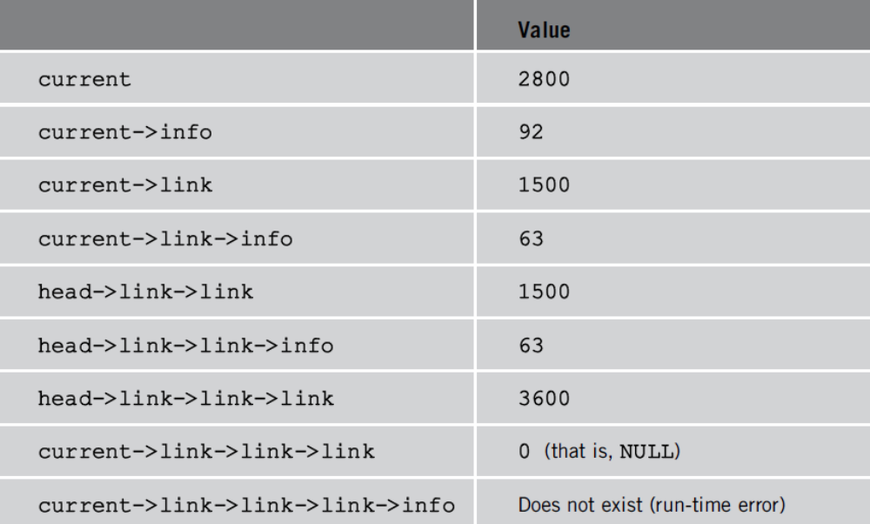
Linked Lists: Some Properties (cont’d.)
TABLE 5-2 Values of current, head, and some of the nodes of the linked list in Figure 5-5
Data Structures Using C++ 2E

Slide 10
Traversing a Linked List
Basic linked list operations
  Search list to determine if particular item is in the list
  Insert item in list
  Delete item from list
These operations require list traversal
  Given pointer to list first node, we must step through list nodes
Data Structures Using C++ 2E

Slide 11
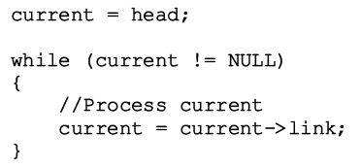
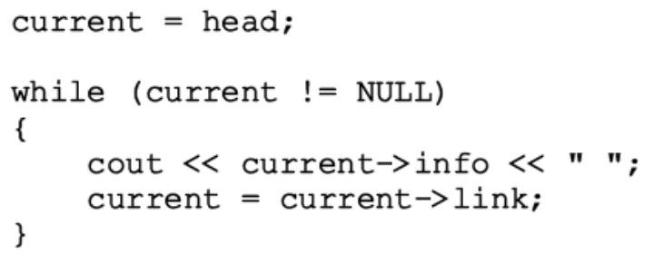
Traversing a Linked List (cont’d.)
Suppose head points to a linked list of numbers
  Code outputting data stored in each node
Data Structures Using C++ 2E

Slide 12
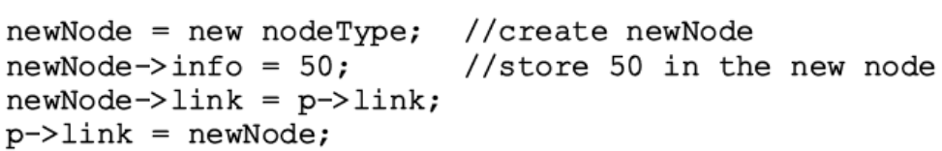
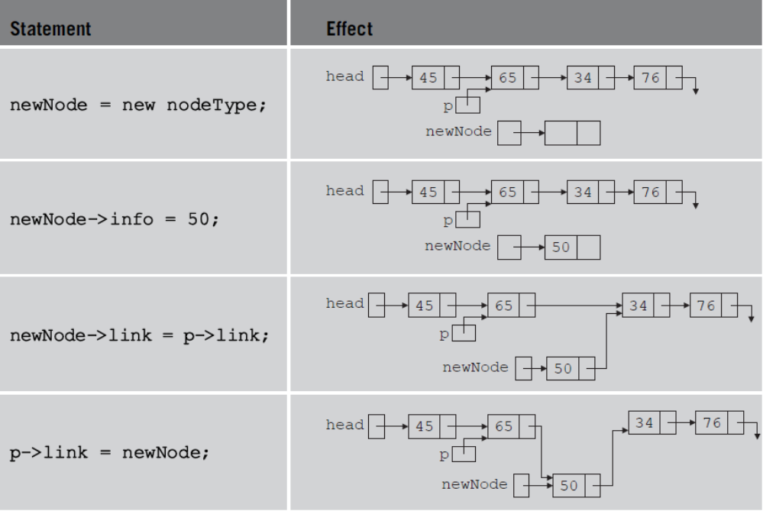
Item Insertion and Deletion
Generic definition of a node on page 270
TABLE 5-3 Inserting a node in a linked list
Data Structures Using C++ 2E

Slide 13
Item Insertion and Deletion (cont’d.)
Sequence of statements to insert node
  Very important
    Use only one pointer (p) to adjust links of the nodes
Using two pointers
  Can simplify insertion code somewhat
Data Structures Using C++ 2E

Slide 14
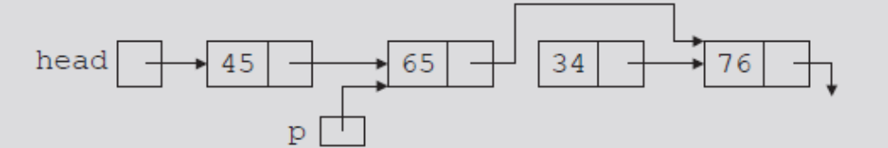
Item Insertion and Deletion (cont’d.)
Memory still occupied by node after deletion
  Memory is inaccessible
  Deallocate memory using a pointer to this node
FIGURE 5-10 List after the statement
p->link = p->link->link; executes
Data Structures Using C++ 2E

Slide 15
Building a Linked List
If linked list data unsorted
  Linked list unsorted
Ways to build linked list
  Forward
    New node always inserted at end of the linked list
    See example on page 274
    See function buildListForward on page 277
  Backward
    New node always inserted at the beginning of the list
    See example on page 277
    See function buildListBackward on page 278
Data Structures Using C++ 2E

Slide 16
Linked List as an ADT
11 basic operations
Two types of linked lists: sorted, unsorted
class linkedListType
  Implements basic linked list operations as an ADT
  Derive two classes using inheritance
    unorderedLinkedList and orderedLinkedList
Unordered linked list functions
  buildListForward and buildListBackward
  Two more functions accommodate both operations
    insertFirst and insertLast
Data Structures Using C++ 2E

Slide 17
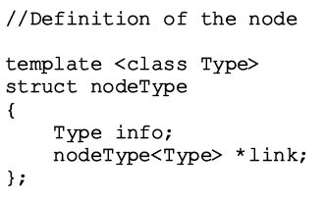
Structure of Linked List Nodes
Node has two instance variables
  Simplify operations (insert, delete)
    Define class to implement linked list node as a struct
Definition of the struct nodeType
Data Structures Using C++ 2E

Slide 18
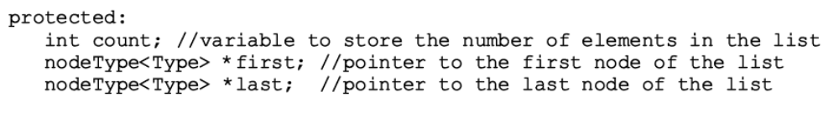
Member Variables of the class linkedListType
class linkedListType
  Three instance variables
Data Structures Using C++ 2E

Slide 19
Linked List Iterators
To process each node
  Must traverse list starting at first node
Iterator
  Object producing each element of a container
  One element at a time
Operations on iterators: ++ and *
See code on pages 280-281
  class linkedListType
  Functions of class linkedListIterator
Data Structures Using C++ 2E

Slide 20
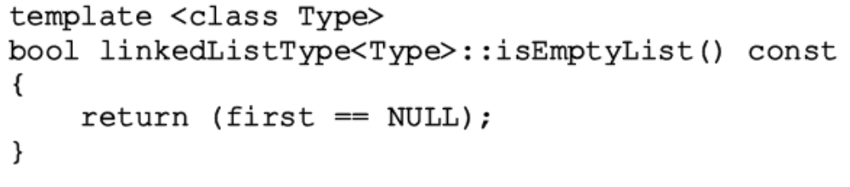
Linked List Iterators (cont’d.)
Abstract class linkedListType
  Defines basic properties of a linked list as an ADT
  See code on page 282
  Empty list: first is NULL
    Definition of function isEmptyList
Data Structures Using C++ 2E

Slide 21
Linked List as an ADT (cont’d.)
Default constructor
  Initializes list to an empty state
Destroy the list
  Deallocates memory occupied by each node
Initialize the list
  Reinitializes list to an empty state
    Must delete the nodes (if any) from the list
  Default constructor, copy constructor
    Initialized list when list object declared
Data Structures Using C++ 2E

Slide 22
Linked List as an ADT (cont’d.)
Print the list
  Must traverse the list starting at first node
Length of a list
  Number of nodes stored in the variable count
  Function length
    Returns value of variable count
Retrieve the data of the first node
  Function front
    Returns the info contained in the first node
    If list is empty, assert statement terminates program
Data Structures Using C++ 2E

Slide 23
Linked List as an ADT (cont’d.)
Retrieve the data of the last node
  Function back
    Returns info contained in the last node
    If list is empty, assert statement terminates program
Begin and end
  Function begin returns an iterator to the first node in the linked list
  Function end returns an iterator to the last node in the linked list
Data Structures Using C++ 2E

Slide 24
Linked List as an ADT (cont’d.)
Copy the list
  Makes an identical copy of a linked list
    Create node called newNode
    Copy node info (original list) into newNode
    Insert newNode at the end of list being created
  See function copyList on page 289
Data Structures Using C++ 2E

Slide 25
Linked List as an ADT (cont’d.)
Destructor
  When class object goes out of scope
    Deallocates memory occupied by list nodes
  Memory allocated dynamically
    Resetting pointers first and last
      Does not deallocate memory
  Must traverse list starting at first node
    Delete each node in the list
  Calling destroyList destroys list
Data Structures Using C++ 2E

Slide 26
Linked List as an ADT (cont’d.)
Copy constructor
  Makes identical copy of the linked list
  Function copyListc checks whether original list empty
    Checks value of first
  Must initialize first to NULL
    Before calling the function copyList
Overloading the assignment operator
  Similar to copy constructor definition
Data Structures Using C++ 2E

Slide 27
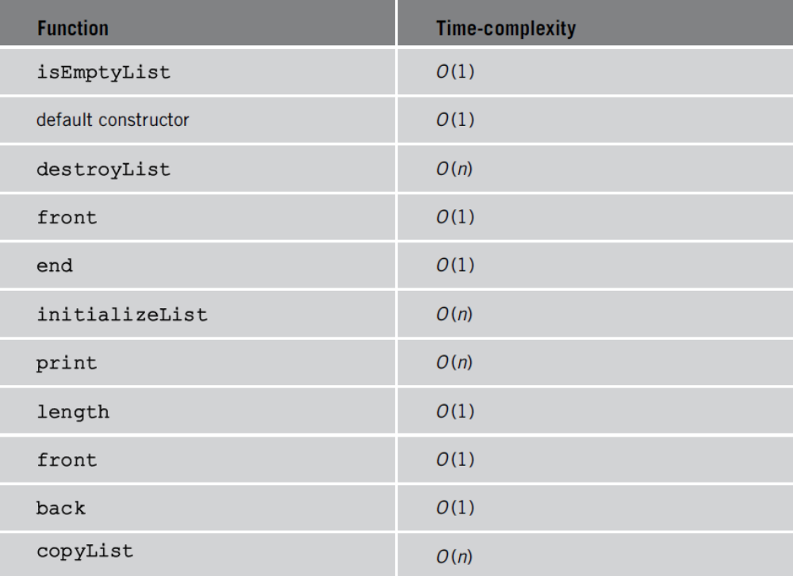

TABLE 5-6 Time-complexity of the operations of the
class linkedListType
Data Structures Using C++ 2E

Slide 28
Unordered Linked Lists
Derive class unorderedLinkedList from the abstract class linkedListType
  Implement the operations search, insertFirst, insertLast, deleteNode
See code on page 292
  Defines an unordered linked list as an ADT
  class unorderedLinkedList
Data Structures Using C++ 2E

Slide 29
Unordered Linked Lists (cont’d.)
Search the list
  Steps
    Step one: Compare the search item with the current node in the list. If the info of the current node is the same as the search item, stop the search; otherwise, make the next node the current node
    Step two: Repeat Step one until either the item is found or no more data is left in the list to compare with the search item
  See function search on page 293
Data Structures Using C++ 2E

Slide 30
Unordered Linked Lists (cont’d.)
Insert the first node
  Steps
    Create a new node
    If unable to create the node, terminate the program
    Store the new item in the new node
    Insert the node before first
    Increment count by one
  See function insertFirst on page 294
Data Structures Using C++ 2E

Slide 31
Unordered Linked Lists (cont’d.)
Insert the last node
  Similar to definition of member function insertFirst
  Insert new node after last
  See function insertLast on page 294
Data Structures Using C++ 2E

Slide 32
Unordered Linked Lists (cont’d.)
Delete a node
  Consider the following cases:
    The list is empty
    The node is nonempty and the node to be deleted is the first node
    The node is nonempty and the node to be deleted is not the first node, it is somewhere in the list
    The node to be deleted is not in the list
  See pseudocode on page 295
  See definition of function deleteNode on page 297
Data Structures Using C++ 2E

Slide 33
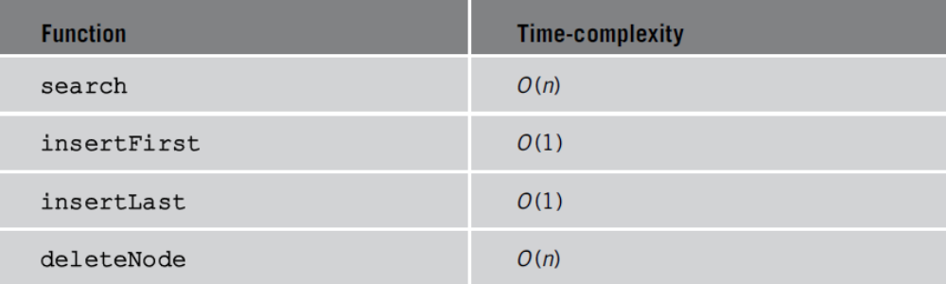
Unordered Linked Lists (cont’d.)
TABLE 5-7 Time-complexity of the operations of the
class unorderedLinkedList
Data Structures Using C++ 2E

Slide 34
Header File of the Unordered Linked List
Create header file defining class unorderedListType
  See class unorderedListType code on page 299
    Specifies members to implement basic properties of an unordered linked list
    Derived from class linkedListType
Data Structures Using C++ 2E

Slide 35
Ordered Linked Lists
Derive class orderedLinkedList from class linkedListType
  Provide definitions of the abstract functions:
    insertFirst, insertLast, search, deleteNode
  Ordered linked list elements are arranged using some ordering criteria
    Assume elements of an ordered linked list arranged in ascending order
See class orderedLinkedList on pages 300-301
Data Structures Using C++ 2E

Slide 36
Ordered Linked Lists (cont’d.)
Search the list
  Steps describing algorithm
    Step one: Compare the search item with the current node in the list. If the info of the current node is greater than or equal to the search item, stop the search; otherwise, make the next node the current node
    Step two: Repeat Step one until either an item in the list that is greater than or equal to the search item is found, or no more data is left in the list to compare with the search item
Data Structures Using C++ 2E

Slide 37
Ordered Linked Lists (cont’d.)
Insert a node
  Find place where new item goes
    Insert item in the list
  See code on page 304
    Definition of the function insert
Data Structures Using C++ 2E

Slide 38
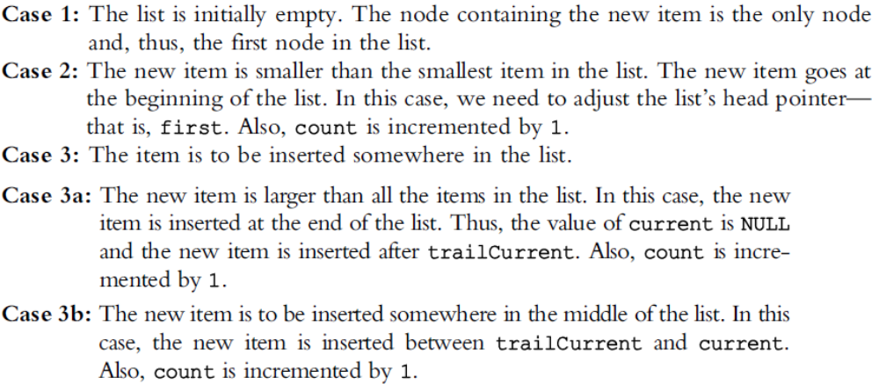
Ordered Linked Lists (cont’d.)
Insert a node (cont’d.)
  Consider the following cases
Data Structures Using C++ 2E

Slide 39
Ordered Linked Lists (cont’d.)
Insert first and insert last
  Function insertFirst
    Inserts new item at beginning of the list
    Must be inserted at the proper place
  Function insertLast
    Inserts new item at the proper place
Data Structures Using C++ 2E

Slide 40
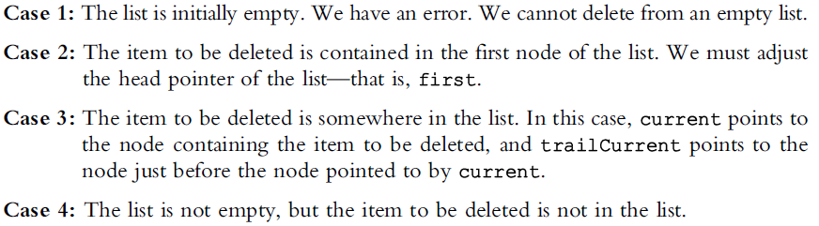
Ordered Linked Lists (cont’d.)
Delete a node
  Several cases to consider
  See function deleteNode code on page 306
Data Structures Using C++ 2E

Slide 41
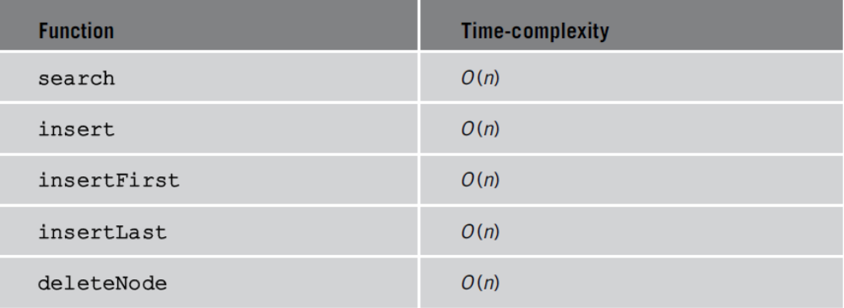
Ordered Linked Lists (cont’d.)
TABLE 5-8 Time-complexity of the operations of
the class orderedLinkedList
Data Structures Using C++ 2E

Slide 42
Header File of the Ordered Linked List
See code on page 308
  Specifies members to implement the basic properties of an ordered linked list
  Derived from class linkedListType
See test program on page 309
  Tests various operations on an ordered linked list
Data Structures Using C++ 2E

Slide 43
Doubly Linked Lists
Traversed in either direction
Typical operations
  Initialize the list
  Destroy the list
  Determine if list empty
  Search list for a given item
  Insert an item
  Delete an item, and so on
See code on page 311
  Class specifying members to implement properties of an ordered doubly linked list
Data Structures Using C++ 2E

Slide 44
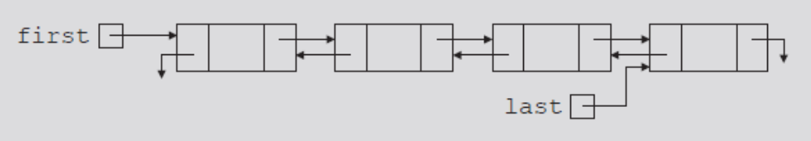
Doubly Linked Lists (cont’d.)
Linked list in which every node has a next pointer and a back pointer
  Every node contains address of next node
    Except last node
  Every node contains address of previous node
    Except the first node
FIGURE 5-27 Doubly linked list
Data Structures Using C++ 2E

Slide 45
Doubly Linked Lists (cont’d.)
Default constructor
  Initializes the doubly linked list to an empty state
isEmptyList
  Returns true if the list empty
    Otherwise returns false
  List empty if pointer first is NULL
Data Structures Using C++ 2E

Slide 46
Doubly Linked Lists (cont’d.)
Destroy the list
  Deletes all nodes in the list
    Leaves list in an empty state
    Traverse list starting at the first node; delete each node
    count set to zero
Initialize the list
  Reinitializes doubly linked list to an empty state
    Can be done using the operation destroy
Length of the list
  Length of a linked list stored in variable count
    Returns value of this variable
Data Structures Using C++ 2E

Slide 47
Doubly Linked Lists (cont’d.)
Print the list
  Outputs info contained in each node
    Traverse list starting from the first node
Reverse print the list
  Outputs info contained in each node in reverse order
    Traverse list starting from the last node
Search the list
  Function search returns true if searchItem found
    Otherwise, it returns false
  Same as ordered linked list search algorithm
Data Structures Using C++ 2E

Slide 48
Doubly Linked Lists (cont’d.)
First and last elements
  Function front returns first list element
  Function back returns last list element
  If list empty
    Functions terminate the program
Data Structures Using C++ 2E

Slide 49
Doubly Linked Lists (cont’d.)
Insert a node
  Four cases
    Case 1: Insertion in an empty list
    Case 2: Insertion at the beginning of a nonempty list
    Case 3: Insertion at the end of a nonempty list
    Case 4: Insertion somewhere in a nonempty list
    Cases 1 and 2 requirement: Change value of the pointer first
    Cases 3 and 4: After inserting an item, count incremented by one
Data Structures Using C++ 2E

Slide 50
Doubly Linked Lists (cont’d.)
Insert a node (cont’d.)
  Figures 5-28 and 5-29 illustrate case 4
  See code on page 317
    Definition of the function insert
Data Structures Using C++ 2E

Slide 51
Doubly Linked Lists (cont’d.)
Delete a node
  Four cases
    Case 1: The list is empty
    Case 2: The item to be deleted is in the first node of the list, which would require us to change the value of the pointer first
    Case 3: The item to be deleted is somewhere in the list
    Case 4: The item to be deleted is not in the list
  See code on page 319
    Definition of function deleteNode
Data Structures Using C++ 2E

Slide 52
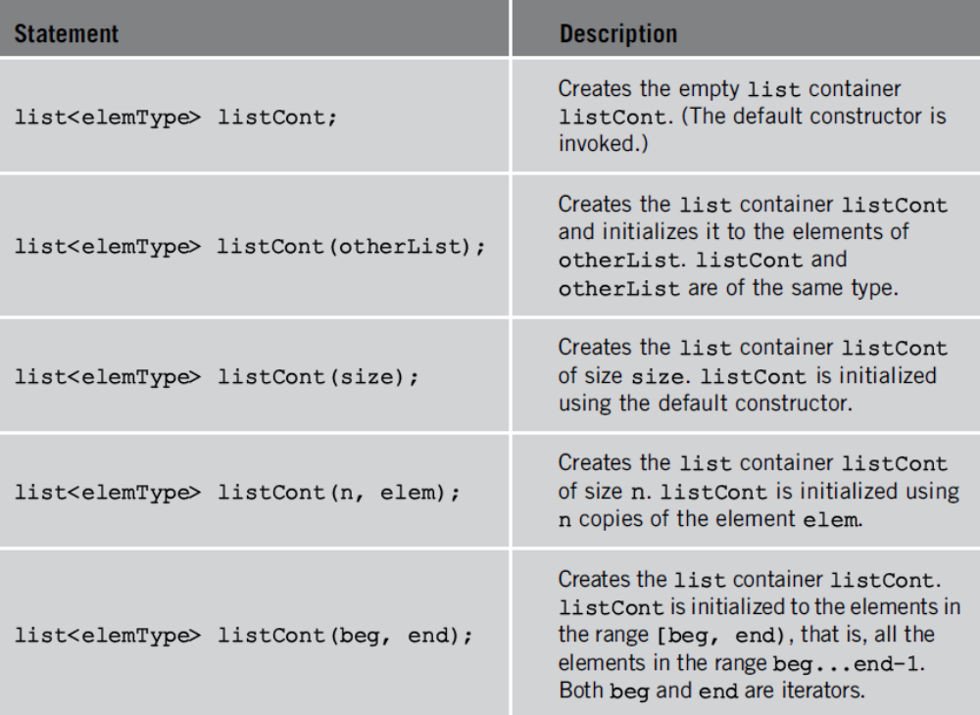
STL Sequence Container: list
TABLE 5-9 Various ways to declare a list object
Data Structures Using C++ 2E

Slide 53
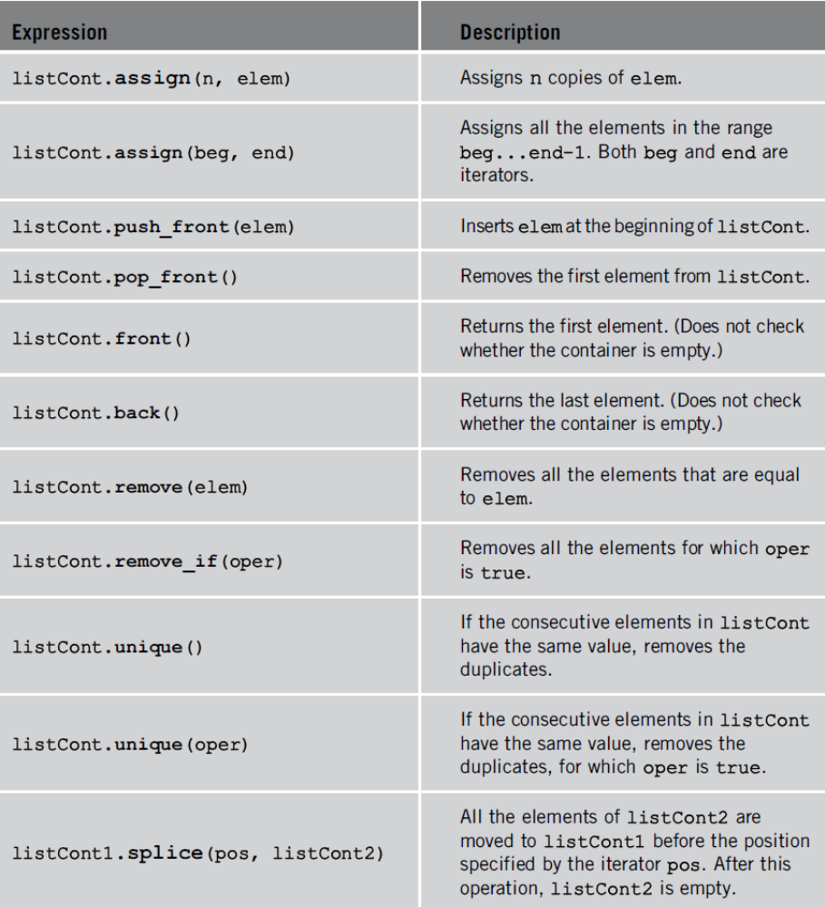
TABLE 5-10 Operations specific to a list container
Data Structures Using C++ 2E

Slide 54
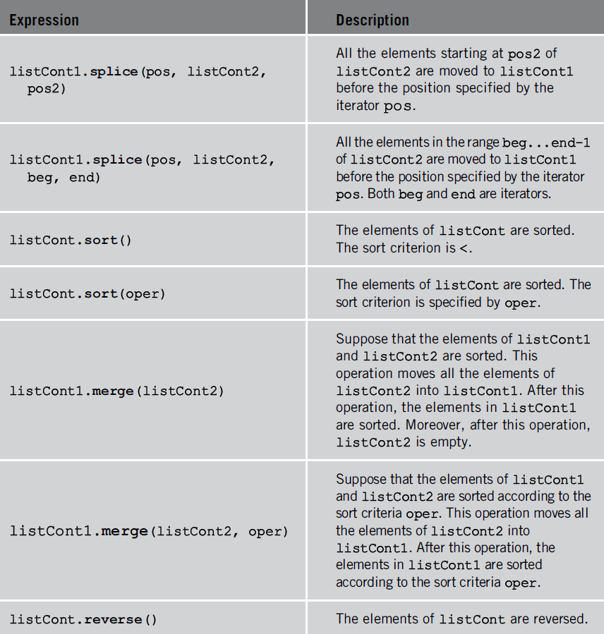
TABLE 5-10 Operations specific to a list container (cont’d.)
Data Structures Using C++ 2E

Slide 55
Linked Lists with Header and Trailer Nodes
Simplify insertion and deletion
  Never insert item before the first or after the last item
  Never delete the first node
Set header node at beginning of the list
  Containing a value smaller than the smallest value in the data set
Set trailer node at end of the list
  Containing value larger than the largest value in the data set
Data Structures Using C++ 2E

Slide 56
Linked Lists with Header and Trailer Nodes (cont’d.)
Header and trailer nodes
  Serve to simplify insertion and deletion algorithms
  Not part of the actual list
Actual list located between these two nodes
Data Structures Using C++ 2E

Slide 57
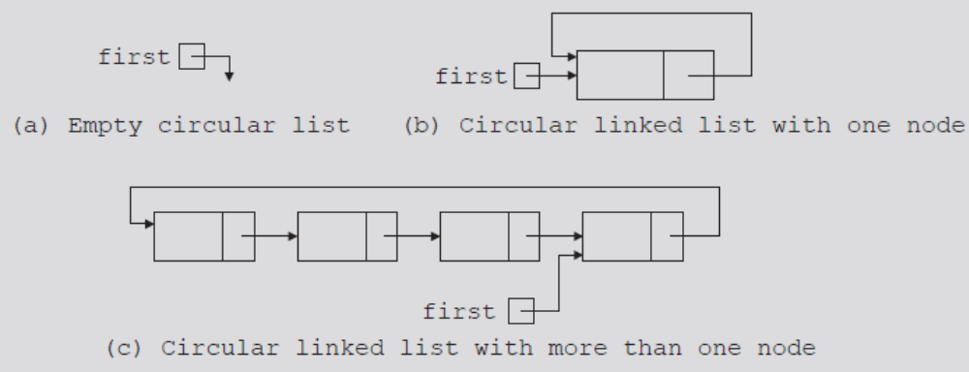
Circular Linked Lists
Last node points to the first node
Basic operations
  Initialize list (to an empty state), determine if list is empty, destroy list, print list, find the list length, search for a given item, insert item, delete item, copy the list
FIGURE 5-34 Circular linked lists
Data Structures Using C++ 2E

Slide 58
Summary
Linked list topics
  Traversal, searching, inserting, deleting
Building a linked list
  Forward, backward
Linked list as an ADT
Ordered linked lists
Doubly linked lists
STL sequence container list
Linked lists with header and trailer nodes
Circular linked lists
Data Structures Using C++ 2E

