Slide 1

Data Structures Using C++ 2E
Chapter 9
Searching and Hashing Algorithms

Slide 2
Objectives
Learn the various search algorithms
Explore how to implement the sequential and binary search algorithms
Discover how the sequential and binary search algorithms perform
Become aware of the lower bound on comparison-based search algorithms
Learn about hashing
Data Structures Using C++ 2E

Slide 3
Search Algorithms
Item key
  Unique member of the item
  Used in searching, sorting, insertion, deletion
Number of key comparisons
  Comparing the key of the search item with the key of an item in the list
Can use class arrayListType (Chapter 3)
  Implements a list and basic operations in an array
Data Structures Using C++ 2E

Slide 4
Sequential Search
Array-based lists
  Covered in Chapter 3
Linked lists
  Covered in Chapter 5
Works the same for array-based lists and linked lists
See code on page 499
Data Structures Using C++ 2E

Slide 5
Sequential Search Analysis
Examine effect of for loop in code on page 499
Different programmers might implement same algorithm differently
Computer speed affects performance
Data Structures Using C++ 2E

Slide 6
Sequential Search Analysis (cont’d.)
Sequential search algorithm performance
  Examine worst case and average case
  Count number of key comparisons
Unsuccessful search
  Search item not in list
  Make n comparisons
Conducting algorithm performance analysis
  Best case: make one key comparison
  Worst case: algorithm makes n comparisons
Data Structures Using C++ 2E

Slide 7
Sequential Search Analysis (cont’d.)
Determining the average number of comparisons
  Consider all possible cases
  Find number of comparisons for each case
  Add number of comparisons, divide by number of cases
Data Structures Using C++ 2E

Slide 8
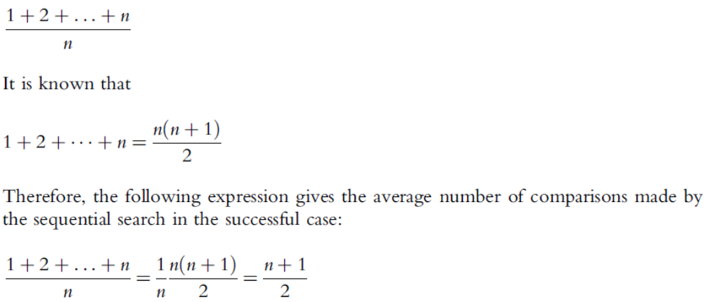
Sequential Search Analysis (cont’d.)
Determining the average number of comparisons (cont’d.)
Data Structures Using C++ 2E

Slide 9
Ordered Lists
Elements ordered according to some criteria
  Usually ascending order
Operations
  Same as those on an unordered list
    Determining if list is empty or full, determining list length, printing the list, clearing the list
Defining ordered list as an abstract data type (ADT)
  Use inheritance to derive the class to implement the ordered lists from class arrayListType
  Define two classes
Data Structures Using C++ 2E

Slide 10
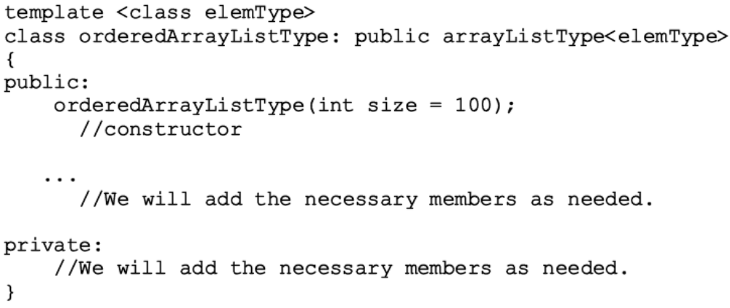
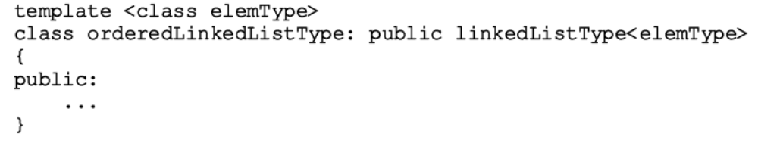
Ordered Lists (cont’d.)
Data Structures Using C++ 2E

Slide 11
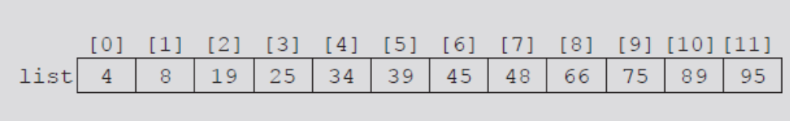
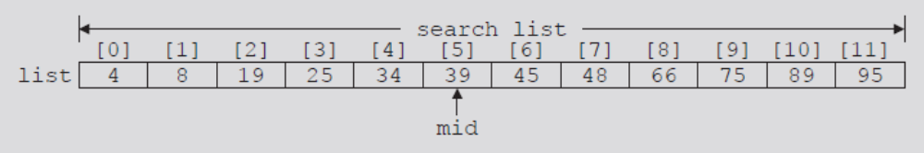
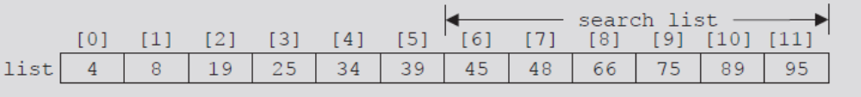
Binary Search
Performed only on ordered lists
Uses divide-and-conquer technique
FIGURE 9-1 List of length 12
FIGURE 9-2 Search list, list[0]...list[11]
FIGURE 9-3 Search list, list[6]...list[11]
Data Structures Using C++ 2E

Slide 12
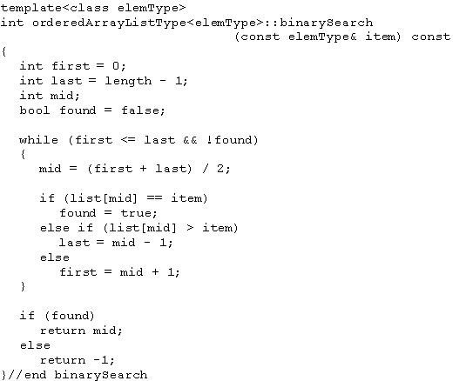
Binary Search (cont’d.)
C++ function implementing binary search algorithm
Data Structures Using C++ 2E

Slide 13

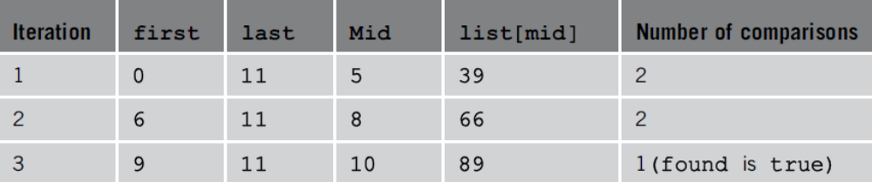
Binary Search (cont’d.)
Example 9-1
FIGURE 9-4 Sorted list for a binary search
TABLE 9-1 Values of first, last, and mid and the number of comparisons for search item 89
Data Structures Using C++ 2E

Slide 14
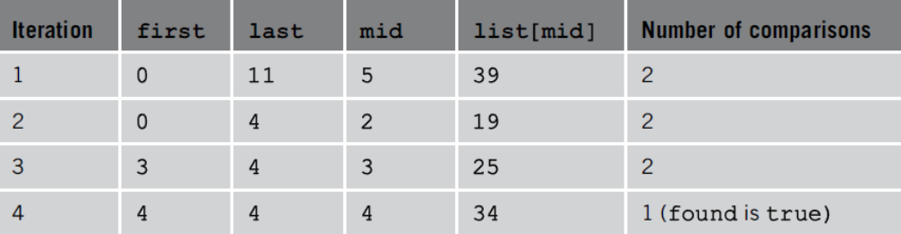
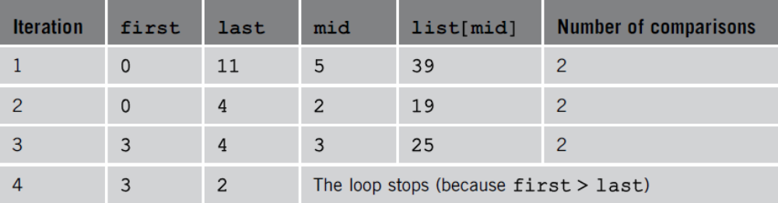
Binary Search (cont’d.)
TABLE 9-2 Values of first, last, and mid and the
number of comparisons for search item 34
TABLE 9-3 Values of first, last, and mid and the number of comparisons for search item 22
Data Structures Using C++ 2E

Slide 15
Insertion into an Ordered List
After insertion: resulting list must be ordered
  Find place in the list to insert item
    Use algorithm similar to binary search algorithm
  Slide list elements one array position down to make room for the item to be inserted
  Insert the item
    Use function insertAt (class arrayListType)
Data Structures Using C++ 2E

Slide 16
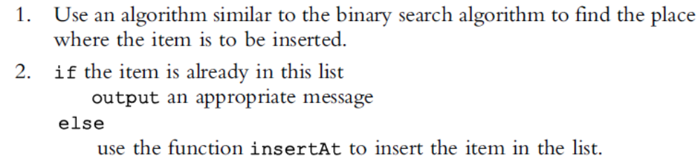
Insertion into an Ordered List (cont’d.)
Algorithm to insert the item
Function insertOrd implements algorithm
Data Structures Using C++ 2E

Slide 17
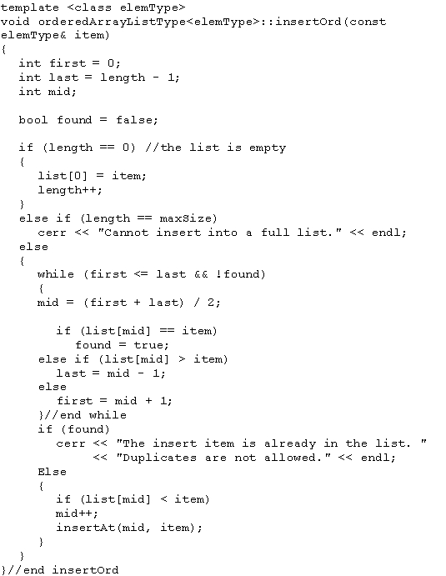
Data Structures Using C++ 2E

Slide 18
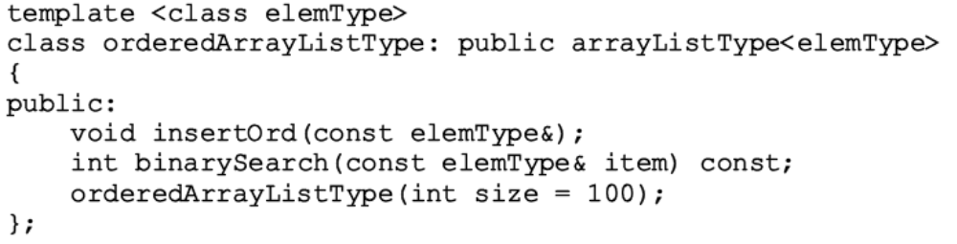
Insertion into an Ordered List (cont’d.)
Add binary search algorithm and the insertOrd algorithm to the class orderedArrayListType
Data Structures Using C++ 2E

Slide 19
Insertion into an Ordered List (cont’d.)
class orderedArrayListType
  Derived from class arrayListType
  List elements of orderedArrayListType
    Ordered
Must override functions insertAt and insertEnd of class arrayListType in class orderedArrayListType
  If these functions are used by an object of type orderedArrayListType, list elements will remain in order
Data Structures Using C++ 2E

Slide 20
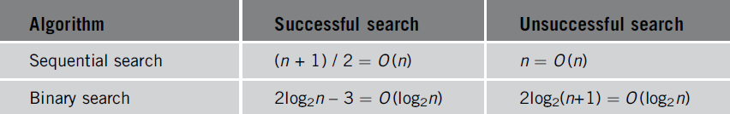
Insertion into an Ordered List (cont’d.)
Can also override function seqSearch
  Perform sequential search on an ordered list
    Takes into account that elements are ordered
TABLE 9-4 Number of comparisons for a list of length n
Data Structures Using C++ 2E

Slide 21
Lower Bound on Comparison-Based Search Algorithms
Comparison-based search algorithms
  Search list by comparing target element with list elements
Sequential search: order n
Binary search: order log₂n
Data Structures Using C++ 2E

Slide 22
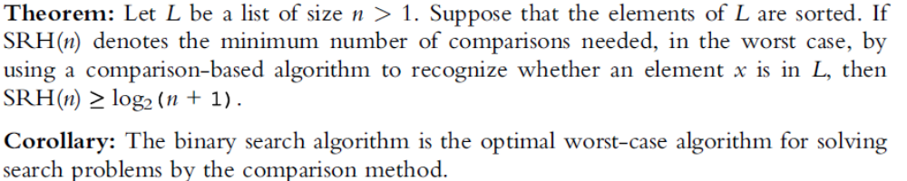
Lower Bound on Comparison-Based Search Algorithms (cont’d.)
Devising a search algorithm with order less than log₂n
  Obtain lower bound on number of comparisons
Cannot be comparison based
Data Structures Using C++ 2E

Slide 23
Hashing
Algorithm of order one (on average)
Requires data to be specially organized
  Hash table
    Helps organize data
    Stored in an array
    Denoted by HT
  Hash function
    Arithmetic function denoted by h
    Applied to key X
    Compute h(X): read as h of X
    h(X) gives address of the item
Data Structures Using C++ 2E

Slide 24
Hashing (cont’d.)
Organizing data in the hash table
  Store data within the hash table (array)
  Store data in linked lists
Hash table HT divided into b buckets
  HT[0], HT[1], . . ., HT[b – 1]
  Each bucket capable of holding r items
  Follows that br = m, where m is the size of HT
  Generally r = 1
    Each bucket can hold one item
The hash function h maps key X onto an integer t
  h(X) = t, such that 0 <= h(X) <= b – 1
Data Structures Using C++ 2E

Slide 25
Hashing (cont’d.)
See Examples 9-2 and 9-3
Synonym
  Occurs if h(X₁) = h(X₂)
    Given two keys X₁ and X₂, such that X₁ ≠ X₂
Overflow
  Occurs if bucket t full
Collision
  Occurs if h(X₁) = h(X₂)
    Given X₁ and X₂ nonidentical keys
Data Structures Using C++ 2E

Slide 26
Hashing (cont’d.)
Overflow and collision occur at same time
  If r = 1 (bucket size = one)
Choosing a hash function
  Main objectives
    Choose an easy to compute hash function
    Minimize number of collisions
If HTSize denotes the size of hash table (array size holding the hash table)
  Assume bucket size = one
    Each bucket can hold one item
    Overflow and collision occur simultaneously
Data Structures Using C++ 2E

Slide 27
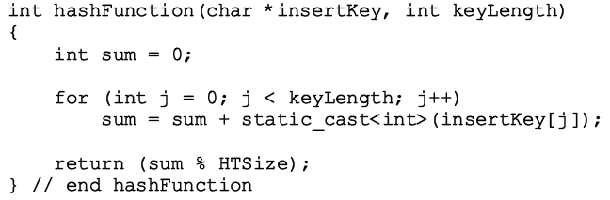
Hash Functions: Some Examples
Mid-square
Folding
Division (modular arithmetic)
  In C++
    h(X) = i_{X} % HTSize;
  C++ function
Data Structures Using C++ 2E

Slide 28
Collision Resolution
Desirable to minimize number of collisions
  Collisions unavoidable in reality
    Hash function always maps a larger domain onto a smaller range
Collision resolution technique categories
  Open addressing (closed hashing)
    Data stored within the hash table
  Chaining (open hashing)
    Data organized in linked lists
    Hash table: array of pointers to the linked lists
Data Structures Using C++ 2E

Slide 29
Collision Resolution: Open Addressing
Data stored within the hash table
  For each key X, h(X) gives index in the array
    Where item with key X likely to be stored
Data Structures Using C++ 2E

Slide 30
Linear Probing
Starting at location t
  Search array sequentially to find next available slot
Assume circular array
  If lower portion of array full
    Can continue search in top portion of array using mod operator
  Starting at t, check array locations using probe sequence
    t, (t + 1) % HTSize, (t + 2) % HTSize, . . ., (t + j) % HTSize
Data Structures Using C++ 2E

Slide 31
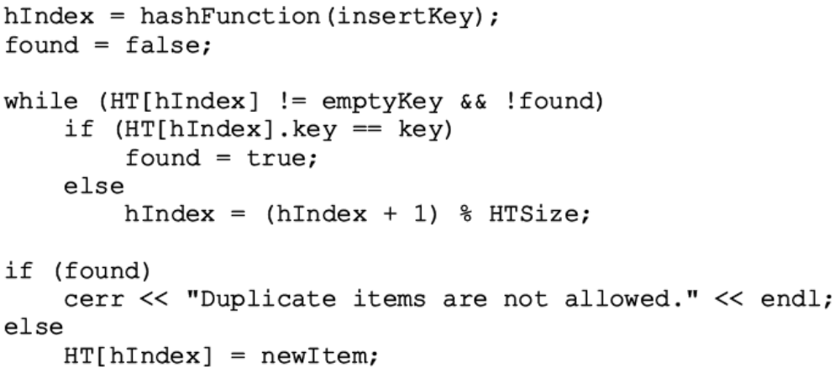
Linear Probing (cont’d.)
The next array slot is given by
  (h(X) + j) % HTSize where j is the j^{th} probe
See Example 9-4
C++ code implementing linear programming
Data Structures Using C++ 2E

Slide 32

Linear Probing (cont’d.)
Causes clustering
  More and more new keys would likely be hashed to the array slots already occupied
FIGURE 9-5 Hash table of size 20
FIGURE 9-6 Hash table of size 20 with certain positions occupied
FIGURE 9-7 Hash table of size 20 with certain positions occupied
Data Structures Using C++ 2E

Slide 33

Linear Probing (cont’d.)
Improving linear probing
  Skip array positions by fixed constant (c) instead of one
  New hash address:
    If c = 2 and h(X) = 2k (h(X) even)
      Only even-numbered array positions visited
    If c = 2 and h(X) = 2k + 1, ( h(X) odd)
      Only odd-numbered array positions visited
    To visit all the array positions
      Constant c must be relatively prime to HTSize
Data Structures Using C++ 2E

Slide 34
Random Probing
Uses random number generator to find next available slot
  i^{th} slot in probe sequence: (h(X) + r_{i}) % HTSize
    Where r_{i} is the i^{th} value in a random permutation of the numbers 1 to HTSize – 1
  All insertions, searches use same random numbers sequence
See Example 9-5
Data Structures Using C++ 2E

Slide 35
Rehashing
If collision occurs with hash function h
  Use a series of hash functions: h₁, h₂, . . ., h_{s}
  If collision occurs at h(X)
    Array slots h_{i}(X), 1 <= h_{i}(X) <= s examined
Data Structures Using C++ 2E

Slide 36
Quadratic Probing
Suppose
  Item with key X hashed at t (h(X) = t and 0 <= t <= HTSize – 1)
  Position t already occupied
Starting at position t
  Linearly search array at locations (t + 1)% HTSize, (t + 2² ) % HTSize = (t + 4) %HTSize, (t + 3²) % HTSize = (t + 9) % HTSize, . . ., (t + i²) % HTSize
Probe sequence: t, (t + 1) % HTSize (t + 2² ) % HTSize, (t + 3²) % HTSize, . . ., (t + i²) % HTSize
Data Structures Using C++ 2E

Slide 37
Quadratic Probing (cont’d.)
See Example 9-6
Reduces primary clustering
Does not probe all positions in the table
  Probes about half the table before repeating probe sequence
    When HTSize is a prime
  Considerable number of probes
    Assume full table
    Stop insertion (and search)
Data Structures Using C++ 2E

Slide 38
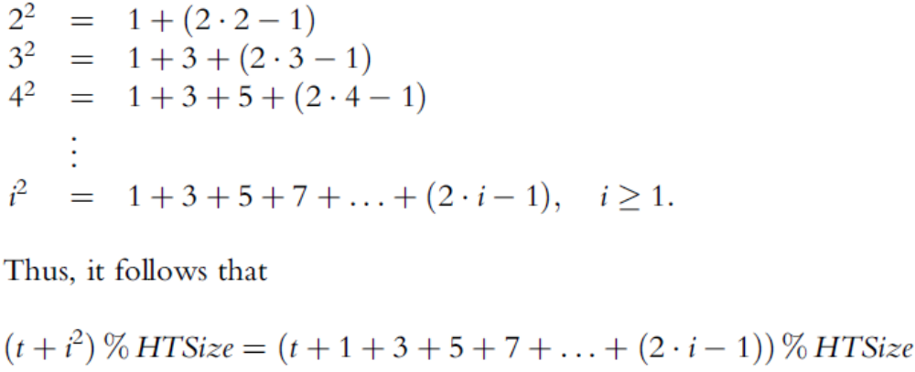
Quadratic Probing (cont’d.)
Generating the probe sequence
Data Structures Using C++ 2E

Slide 39
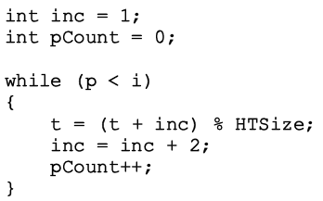
Quadratic Probing (cont’d.)
Consider probe sequence
  t, t +1, t + 2², t + 3², . . . , (t + i²) % HTSize
  C++ code computes i^{th} probe
    (t + i²) % HTSize
Data Structures Using C++ 2E

Slide 40
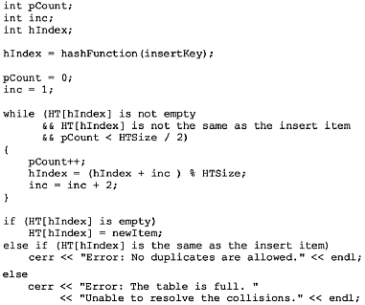
Quadratic Probing (cont’d.)
Pseudocode implementing quadratic probing
Data Structures Using C++ 2E

Slide 41
Quadratic Probing (cont’d.)
Random, quadratic probings eliminate primary clustering
Secondary clustering
  Random, quadratic probing functions of home positions
    Not original key
Data Structures Using C++ 2E

Slide 42
Quadratic Probing (cont’d.)
Secondary clustering (cont’d.)
  If two nonidentical keys (X₁ and X₂) hashed to same home position (h(X₁) = h(X₂))
    Same probe sequence followed for both keys
  If hash function causes a cluster at a particular home position
    Cluster remains under these probings
Data Structures Using C++ 2E

Slide 43
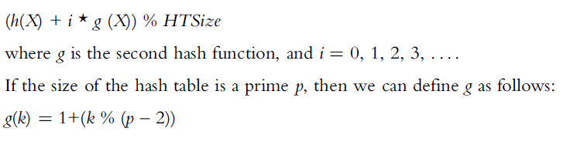
Quadratic Probing (cont’d.)
Solve secondary clustering with double hashing
  Use linear probing
    Increment value: function of key
  If collision occurs at h(X)
    Probe sequence generation
See Examples 9-7 and 9-8
Data Structures Using C++ 2E

Slide 44
Deletion: Open Addressing
Designing a class as an ADT
  Implement hashing using quadratic probing
Use two arrays
  One stores the data
  One uses indexStatusList as described in the previous section
    Indicates whether a position in hash table free, occupied, used previously
See code on pages 521 and 522
  Class template implementing hashing as an ADT
  Definition of function insert
Data Structures Using C++ 2E

Slide 45
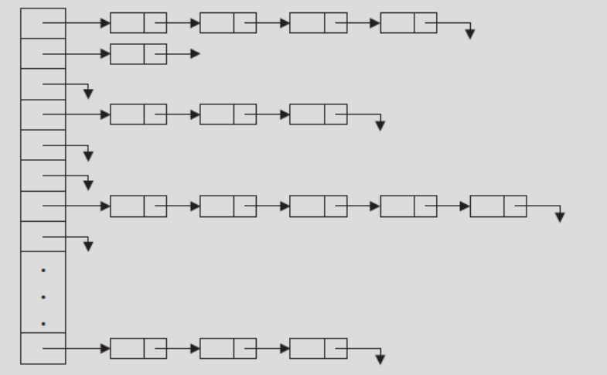
Collision Resolution: Chaining (Open Hashing)
Hash table HT: array of pointers
  For each j, where 0 <= j <= HTsize -1
    HT[j] is a pointer to a linked list
    Hash table size (HTSize): less than or equal to the number of items
FIGURE 9-10 Linked hash table
Data Structures Using C++ 2E

Slide 46
Collision Resolution: Chaining (cont’d.)
Item insertion and collision
  For each key X (in the item)
    First find h(X) – t, where 0 <= t <= HTSize – 1
    Item with this key inserted in linked list pointed to by HT[t]
  For nonidentical keys X₁ and X₂
    If h(X₁) = h(X₂)
      Items with keys X₁ and X₂ inserted in same linked list
    Collision handled quickly, effectively
Data Structures Using C++ 2E

Slide 47
Collision Resolution: Chaining (cont’d.)
Search
  Determine whether item R with key X is in the hash table
    First calculate h(X)
  Example: h(X) = T
    Linked list pointed to by HT[t] searched sequentially
Deletion
  Delete item R from the hash table
    Search hash table to find where in a linked list R exists
    Adjust pointers at appropriate locations
    Deallocate memory occupied by R
Data Structures Using C++ 2E

Slide 48
Collision Resolution: Chaining (cont’d.)
Overflow
  No longer a concern
    Data stored in linked lists
    Memory space to store data allocated dynamically
  Hash table size
    No longer needs to be greater than number of items
  Hash table less than the number of items
    Some linked lists contain more than one item
    Good hash function has average linked list length still small (search is efficient)
Data Structures Using C++ 2E

Slide 49
Collision Resolution: Chaining (cont’d.)
Advantages of chaining
  Item insertion and deletion: straightforward
  Efficient hash function
    Few keys hashed to same home position
    Short linked list (on average)
      Shorter search length
    If item size is large
      Saves a considerable amount of space
Data Structures Using C++ 2E

Slide 50
Collision Resolution: Chaining (cont’d.)
Disadvantage of chaining
  Small item size wastes space
Example: 1000 items each requires one word of storage
  Chaining
    Requires 3000 words of storage
  Quadratic probing
    If hash table size twice number of items: 2000 words
    If table size three times number of items
      Keys reasonably spread out
      Results in fewer collisions
Data Structures Using C++ 2E

Slide 51
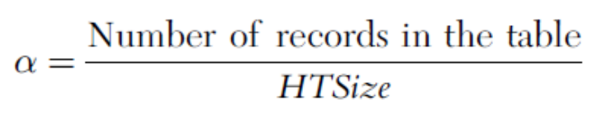
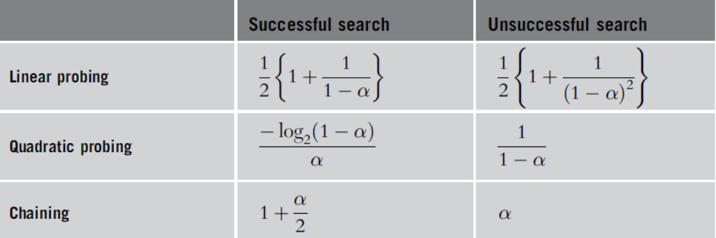
Hashing Analysis
Load factor
  Parameter α
TABLE 9-5 Number of comparisons in hashing
Data Structures Using C++ 2E

Slide 52
Summary
Sequential search
  Order n
Ordered lists
  Elements ordered according to some criteria
Binary search
  Order log₂n
Hashing
  Data organized using a hash table
  Apply hash function to determine if item with a key is in the table
  Two ways to organize data
Data Structures Using C++ 2E

Slide 53
Summary (cont’d.)
Hash functions
  Mid-square
  Folding
  Division (modular arithmetic)
Collision resolution technique categories
  Open addressing (closed hashing)
  Chaining (open hashing)
Search analysis
  Review number of key comparisons
  Worst case, best case, average case
Data Structures Using C++ 2E

