Slide 1

Data Structures Using C++ 2E
Chapter 10
Sorting Algorithms

Slide 2
Objectives
Learn the various sorting algorithms
Explore how to implement selection sort, insertion sort, Shellsort, quicksort, mergesort, and heapsort
Discover how the sorting algorithms discussed in this chapter perform
Learn how priority queues are implemented
Data Structures Using C++ 2E

Slide 3
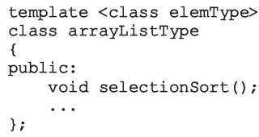
Sorting Algorithms
Several types in the literature
  Discussion includes most common algorithms
Analysis
  Provides a comparison of algorithm performance
Functions implementing sorting algorithms
  Included as public members of related class
Data Structures Using C++ 2E

Slide 4
Selection Sort: Array-Based Lists
List sorted by selecting elements in the list
  Select elements one at a time
  Move elements to their proper positions
Selection sort operation
  Find location of the smallest element in unsorted list portion
    Move it to top of unsorted portion of the list
  First time: locate smallest item in the entire list
  Second time: locate smallest item in the list starting from the second element in the list, and so on
Data Structures Using C++ 2E

Slide 5
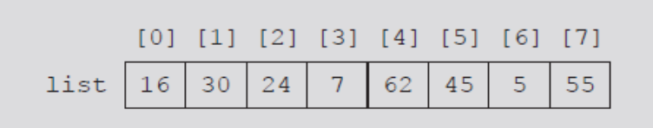
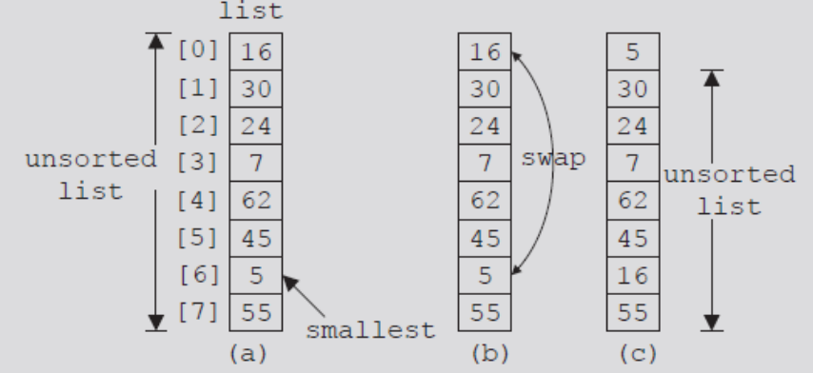
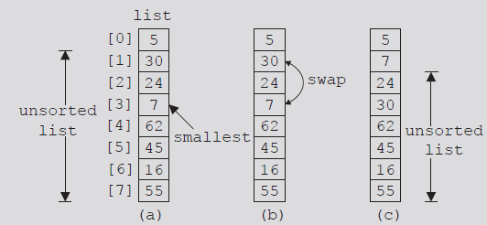
FIGURE 10-1 List of 8 elements
FIGURE 10-2 Elements of list during the first iteration
FIGURE 10-3 Elements of list during the second iteration
Data Structures Using C++ 2E

Slide 6
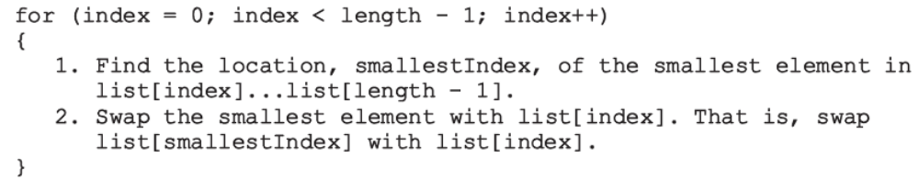
Selection Sort: Array-Based Lists (cont’d.)
Selection sort steps
  In the unsorted portion of the list
    Find location of smallest element
    Move smallest element to beginning of the unsorted list
Keep track of unsorted list portion with a for loop
Data Structures Using C++ 2E

Slide 7
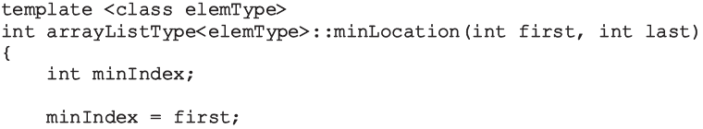
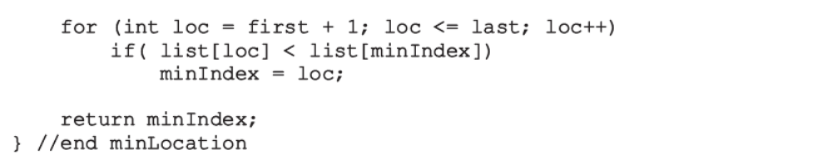
Selection Sort: Array-Based Lists (cont’d.)
Given: starting index, first, ending index, last
  C++ function returns index of the smallest element in list[first]...list[last]
Data Structures Using C++ 2E

Slide 8
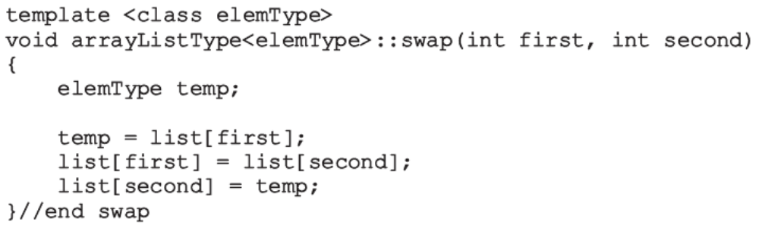
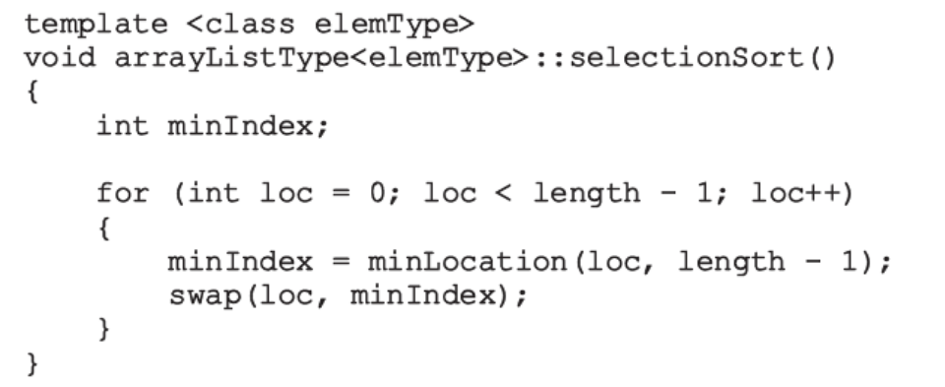
Selection Sort: Array-Based Lists (cont’d.)
Function swap
Definition of function selectionSort
Data Structures Using C++ 2E

Slide 9
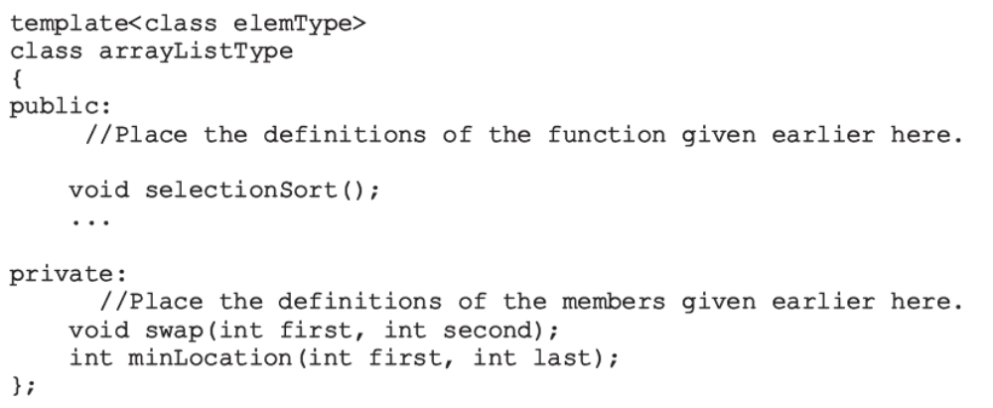
Selection Sort: Array-Based Lists (cont’d.)
Add functions to implement selection sort in the definition of class arrayListType
Data Structures Using C++ 2E

Slide 10
Analysis: Selection Sort
Search algorithms
  Concerned with number of key (item) comparisons
Sorting algorithms
  Concerned with number of key comparisons and number of data movements
Analysis of selection sort
  Function swap
    Number of item assignments: 3(n-1)
  Function minLocation
    Number of key comparisons of O(n²)
Data Structures Using C++ 2E

Slide 11
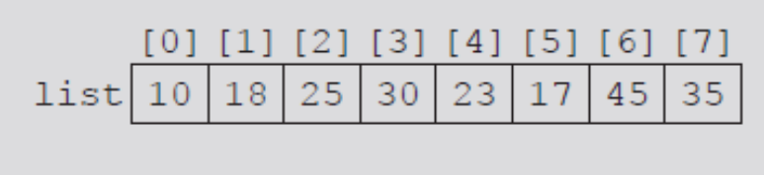
Insertion Sort: Array-Based Lists
Attempts to improve high selection sort key comparisons
Sorts list by moving each element to its proper place
Given list of length eight
FIGURE 10-4 list
Data Structures Using C++ 2E

Slide 12
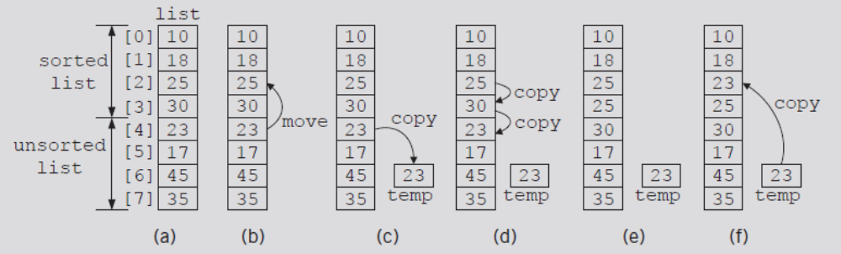
Insertion Sort: Array-Based Lists (cont’d.)
Elements list[0], list[1], list[2], list[3] in order
Consider element list[4]
  First element of unsorted list
FIGURE 10-5 list elements while moving list[4] to its proper place
Data Structures Using C++ 2E
Notes:
Best case: ordered o(n)
Worst case: reverse ordered(n2)

Slide 13
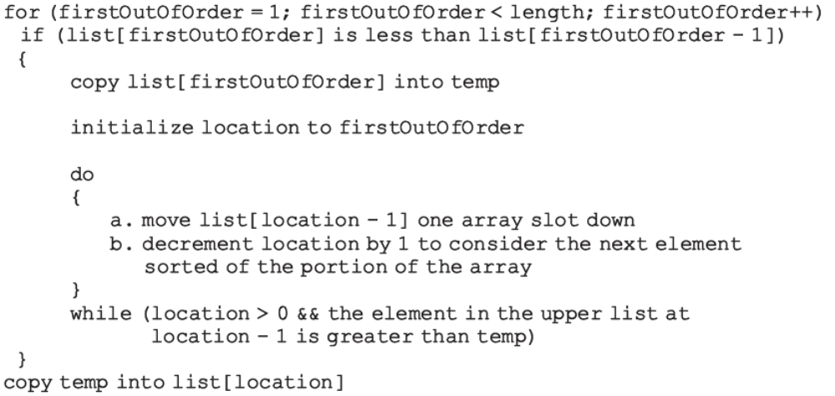
Insertion Sort: Array-Based Lists (cont’d.)
Array containing list divided into two sublists
  Upper and lower
Index firstOutOfOrder
  Points to first element in the lower sublist
Data Structures Using C++ 2E

Slide 14
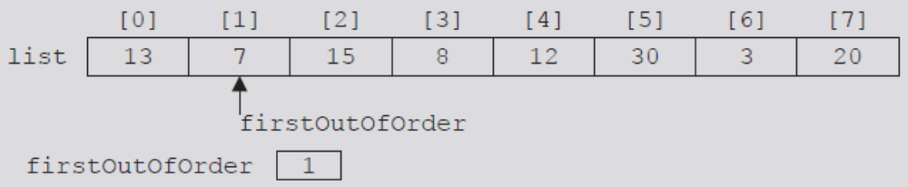
Insertion Sort: Array-Based Lists (cont’d.)
length = 8
Initialize firstOutOfOrder to one
FIGURE 10-6 firstOutOfOrder = 1
Data Structures Using C++ 2E

Slide 15
Insertion Sort: Array-Based Lists (cont’d.)
list[firstOutOfOrder] = 7
list[firstOutOfOrder - 1] = 13
  7 < 13
Expression in if statement evaluates to true
  Execute body of if statement
    temp = list[firstOutOfOrder] = 7
    location = firstOutOfOrder = 1
  Execute the do...while loop
    list[1] = list[0] = 13
    location = 0
Data Structures Using C++ 2E

Slide 16
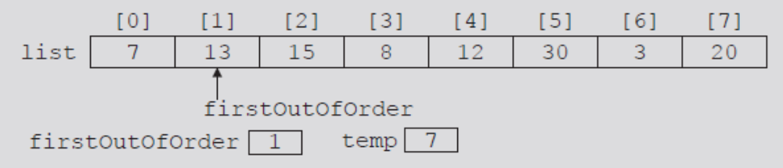
Insertion Sort: Array-Based Lists (cont’d.)
do...while loop terminates
  Because location = 0
    Copy temp into list[location] (list[0])
FIGURE 10-7 list after the first iteration of insertion sort
Data Structures Using C++ 2E

Slide 17
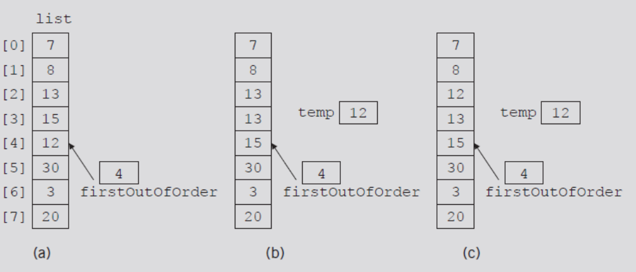
Insertion Sort: Array-Based Lists (cont’d.)
Suppose list given in Figure 10-8(a)
  Walk through code
FIGURE 10-8 list elements while moving list[4] to its proper place
Data Structures Using C++ 2E

Slide 18
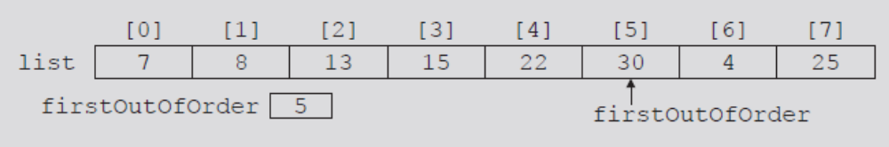
Insertion Sort: Array-Based Lists (cont’d.)
Suppose list given in Figure 10-9
  Walk through code
FIGURE 10-9 First out-of-order element is at position 5
Data Structures Using C++ 2E

Slide 19
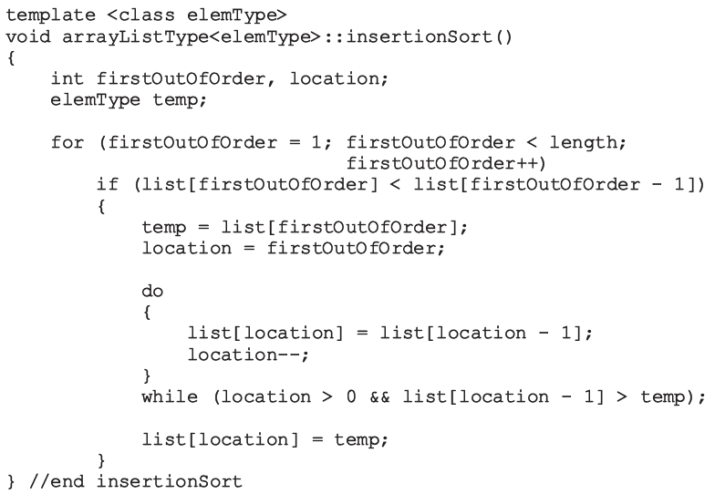
Insertion Sort: Array-Based Lists (cont’d.)
C++ function implementing previous algorithm
Data Structures Using C++ 2E

Slide 20
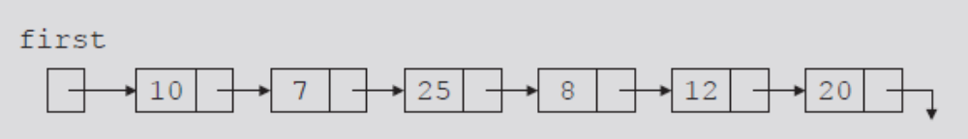
Insertion Sort: Linked List-Based Lists
If list stored in an array
  Traverse list in either direction using index variable
If list stored in a linked list
  Traverse list in only one direction
    Starting at first node: links only in one direction
FIGURE 10-10 Linked list
Data Structures Using C++ 2E

Slide 21
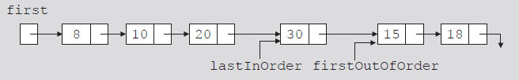
Insertion Sort: Linked List-Based Lists (cont’d.)
firstOutOfOrder
  Pointer to node to be moved to its proper location
lastInOrder
  Pointer to last node of the sorted portion of the list
FIGURE 10-11 Linked list and pointers lastInOrder
and firstOutOfOrder
Data Structures Using C++ 2E

Slide 22
Insertion Sort: Linked List-Based Lists (cont’d.)
Compare firstOutOfOrder info with first node info
  If firstOutOfOrder info smaller than first node info
    firstOutOfOrder moved before first node
  Otherwise, search list starting at second node to find location where to move firstOutOfOrder
Search list using two pointers
  current
  trailCurrent: points to node just before current
Handle any special cases
Data Structures Using C++ 2E

Slide 23
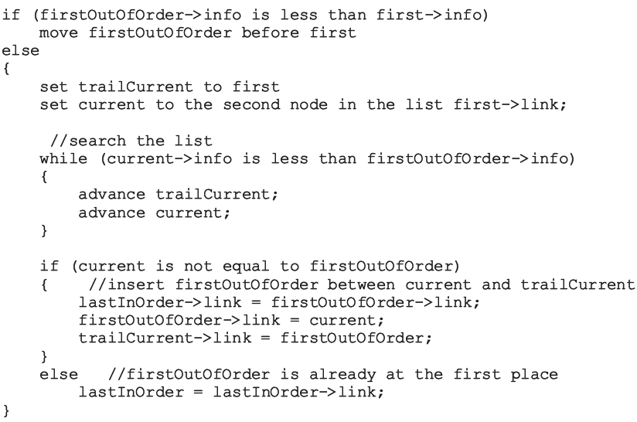
Insertion Sort: Linked List-Based Lists (cont’d.)
Data Structures Using C++ 2E

Slide 24
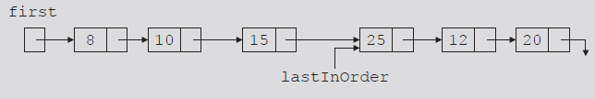
Insertion Sort: Linked List-Based Lists (cont’d.)
Case 1
  firstOutOfOrder->info less than first->info
    Node firstOutOfOrder moved before first
    Adjust necessary links
FIGURE 10-13 Linked list after moving the node with info 8 to the beginning
Data Structures Using C++ 2E

Slide 25
Insertion Sort: Linked List-Based Lists (cont’d.)
Review Case 2 on page 546
Review Case 3 on page 546
Review function linkedInsertionSort on page 547
  Implements previous algorithm
Data Structures Using C++ 2E

Slide 26
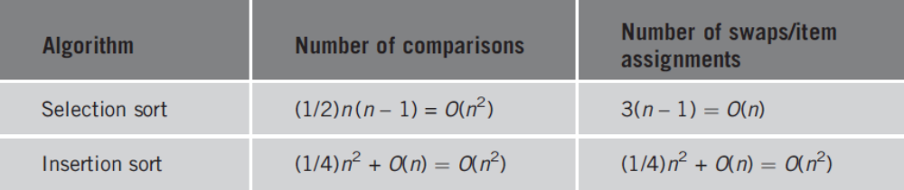
Analysis: Insertion Sort
TABLE 10-1 Average-case behavior of the selection sort and insertion sort for a list of length n
Data Structures Using C++ 2E

Slide 27
Shellsort
Reduces number of item movements in insertion sort by modifying it
  Introduced in 1959 by D.E. Shell
  Also known as diminishing-increment sort
List elements viewed as sublists at a particular distance
  Each sublist sorted
    Elements far apart move closer to their final position
Data Structures Using C++ 2E

Slide 28
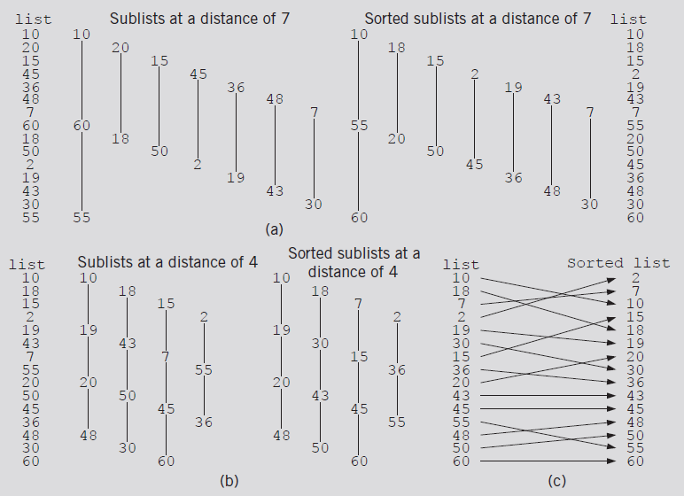
Shellsort (cont’d.)
FIGURE 10-19 Lists during Shellsort
Data Structures Using C++ 2E

Slide 29
Shellsort (cont’d.)
Figure 10-19
  Sort elements at a distance of 7, 4, 1
    Called increment sequence
Desirable to use as few increments as possible
D.E. Knuth recommended increment sequence
  1, 4, 13, 40, 121, 364, 1093, 3280. . . .
    Ratio between successive increments: about one-third
    i^{th} increment = 3 • (i – 1)th increment + 1
Certain increment sequences must be avoided
  1, 2, 4, 8, 16, 32, 64, 128, 256. . . .
    Bad performance
Data Structures Using C++ 2E

Slide 30
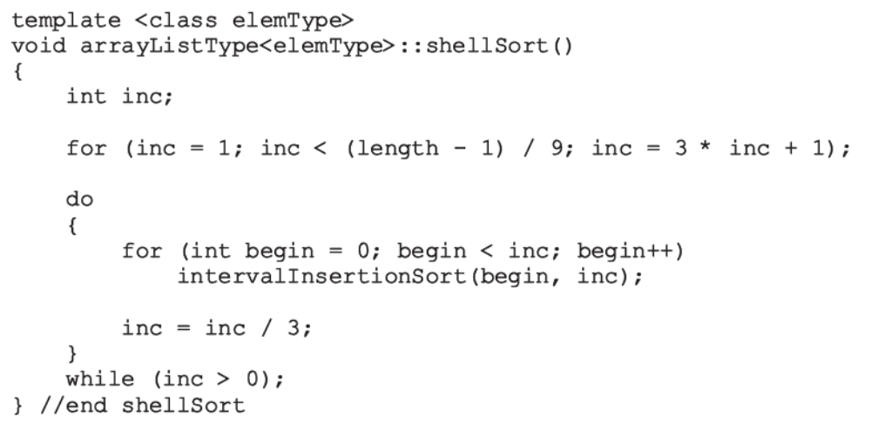
Shellsort (cont’d.)
Function implementing Shellsort algorithm
Data Structures Using C++ 2E

Slide 31
Shellsort (cont’d.)
Function shellSort
  Uses function intervalInsertionSort
    Modified version of insertion sort for array-based lists
intervalInsertionSort
  Sublist starts at variable begin
  Increment between successive elements given by variable inc instead of one
Analysis of Shellsort
  Difficult to obtain
Data Structures Using C++ 2E

Slide 32
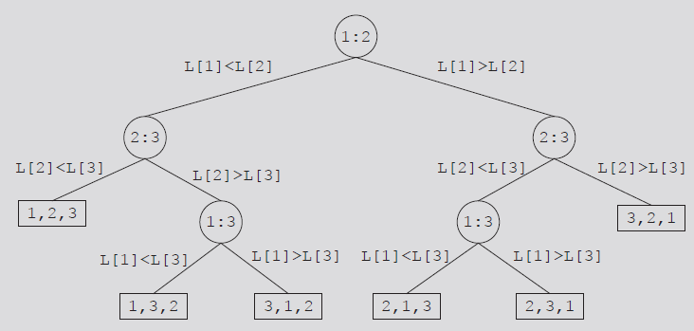
Lower Bound on Comparison-Based
Sort Algorithms
Comparison tree
  Graph tracing comparison-based algorithm execution
    Node: comparison drawn as a circle
    Leaf: rectangle representing final node ordering
    Root node: top node in the figure
    Branch: straight line connecting two nodes
    Path: sequence of branches between nodes
FIGURE 10-20 Comparison tree for sorting three items
Data Structures Using C++ 2E

Slide 33
Lower Bound on Comparison-Based
Sort Algorithms (cont’d.)
Unique permutation of the elements
  Associated with each path from the root to a leaf
Theorem
  Let L be a list of n distinct elements. Any sorting algorithm that sorts L by comparison of the keys only, in its worst case, makes at least O(nlog₂n) key comparisons
Data Structures Using C++ 2E

Slide 34
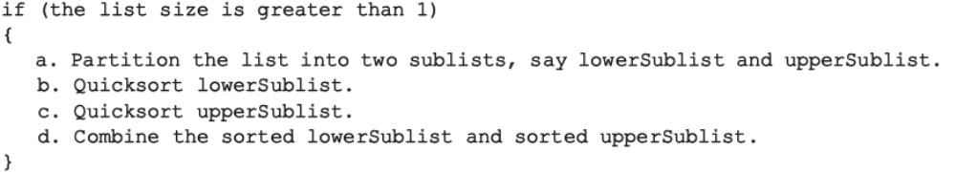
Quicksort: Array-Based Lists
Uses the divide-and-conquer technique to sort a list
  List partitioned into two sublists
    Two sublists sorted and combined into one list
    Combined list then sorted using quicksort (recursion)
Trivial to combine sorted lowerSublist and upperSublist
All sorting work done in partitioning the list
Data Structures Using C++ 2E

Slide 35
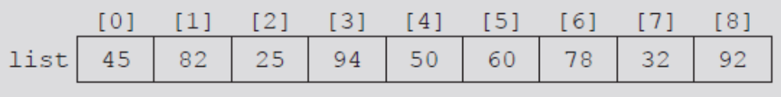

Quicksort: Array-Based Lists (cont’d.)
Pivot divides list into two sublists
  lowerSublist: elements smaller than pivot
  upperSublist: elements greater than pivot
Choosing the pivot
  lowerSublist and upperSublist nearly equal
FIGURE 10-21 List before the partition
FIGURE 10-22 List after the partition
Data Structures Using C++ 2E

Slide 36
First sd | index |  |  |  |  |  |  | last | Sd=Pointer to the last element smaller than pivot
0 | 1 | 2 | 3 | 4 | 5 | 6 | 7 | 8 | index
45 | 82 | 25 | 94 | 50 | 60 | 78 | 32 | 92 | Pivot (middle index) =50
50 | 82 | 25 | 94 | 45 | 60 | 78 | 32 | 92 | Swap(first and pivot)
sd |  | index
50 | 82 | 25 | 94 | 45 | 60 | 78 | 32 | 92
 | sd |  |  | index
50 | 25 | 82 | 94 | 45 | 60 | 78 | 32 | 92
 |  | sd |  | index
50 | 25 | 45 | 94 | 82 | 60 | 78 | 32 | 92
 |  |  | sd |  |  |  | index
50 | 25 | 45 | 32 | 82 | 60 | 78 | 94 | 92
32 | 25 | 45 | 50 | 82 | 60 | 78 | 94 | 92 | Last swap
Data Structures Using C++ 2E

Slide 37
Quicksort: Array-Based Lists (cont’d.)
Partition algorithm
  Determine pivot; swap pivot with first list element
    Suppose index smallIndex points to last element smaller than pivot. smallIndex initialized to first list element
  For the remaining list elements (starting at second element): If current element smaller than pivot
    Increment smallIndex
    Swap current element with array element pointed to by smallIndex
  Swap first element (pivot) with array element pointed to by smallIndex
Data Structures Using C++ 2E

Slide 38
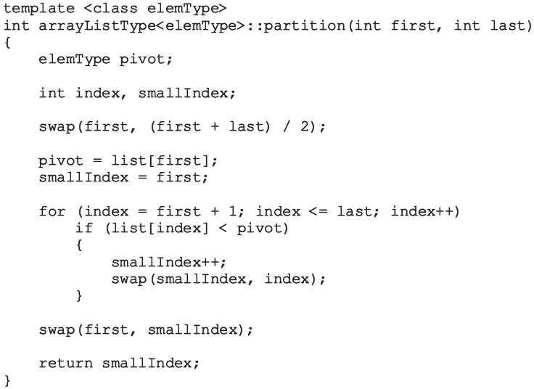
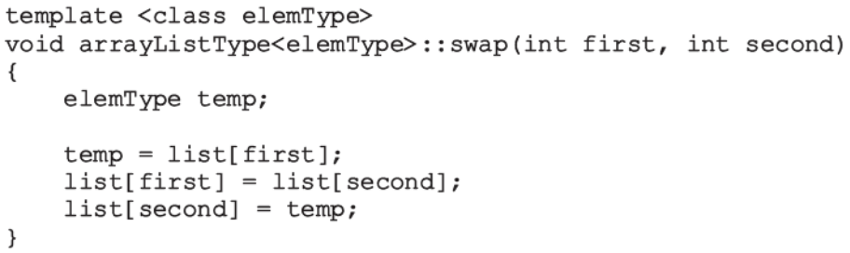
Quicksort: Array-Based Lists (cont’d.)
Function partition
  Passes starting and ending list indices
  Swaps certain elements of the list
Data Structures Using C++ 2E

Slide 39
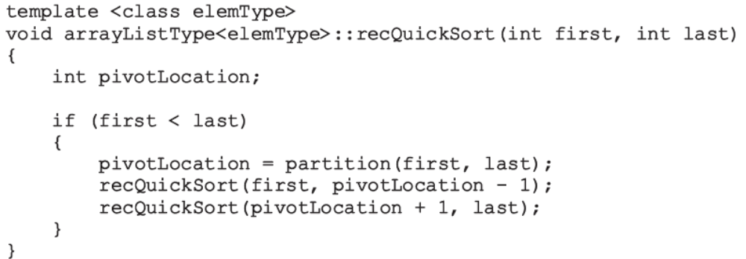
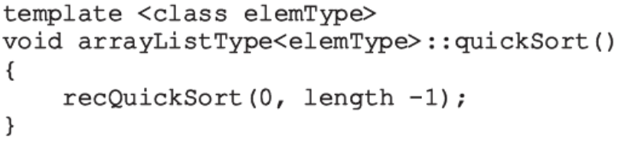
Quicksort: Array-Based Lists (cont’d.)
Given starting and ending list indices
  Function recQuickSort implements the recursive version of quicksort
Function quickSort calls recQuickSort
Data Structures Using C++ 2E

Slide 40
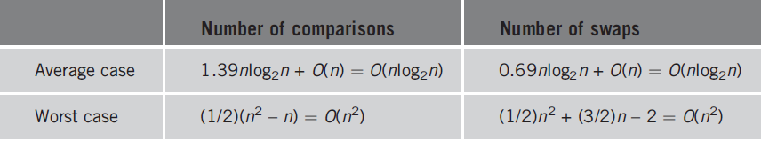
Analysis: Quicksort
TABLE 10-2 Analysis of quicksort for a list of length n
Data Structures Using C++ 2E

Slide 41
Mergesort: Linked List-Based Lists
Quicksort
  Average-case behavior: O(nlog₂n)
  Worst-case behavior: O(n²)
Mergesort behavior: always O(nlog₂n)
  Uses divide-and-conquer technique to sort a list
  Partitions list into two sublists
    Sorts sublists
    Combines sorted sublists into one sorted list
Difference between mergesort and quicksort
  How list is partitioned
Data Structures Using C++ 2E

Slide 42
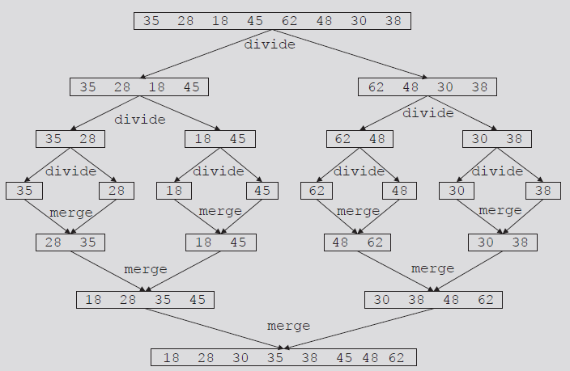
Mergesort: Linked List-Based Lists (cont’d.)
FIGURE 10-32 Mergesort algorithm
Data Structures Using C++ 2E

Slide 43
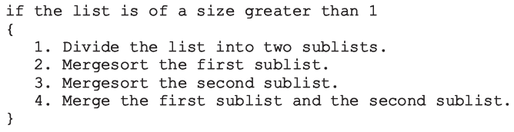
Mergesort: Linked List-Based Lists (cont’d.)
Most sorting work done in merging sorted sublists
General algorithm for mergesort
Data Structures Using C++ 2E

Slide 44
Divide
To divide list into two sublists
  Need to find middle node
  Use two pointers: middle and current
    Advance middle by one node, advance current by one node
    current becomes NULL; middle points to last node
  Divide list into two sublists
    Using the link of middle: assign pointer to node following middle
    Set link of middle to NULL
See function divideList on page 561
Data Structures Using C++ 2E

Slide 45
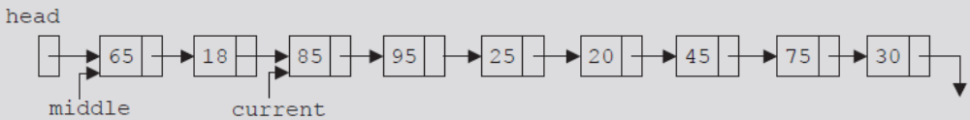
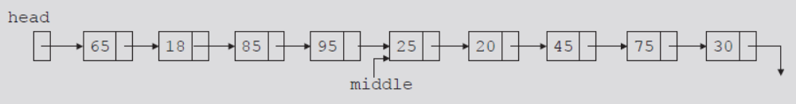
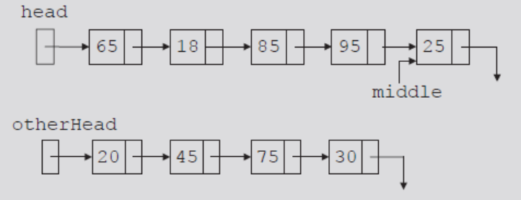
FIGURE 10-33 Unsorted linked list
FIGURE 10-34 middle and current before traversing the list
FIGURE 10-35 middle after traversing the list
FIGURE 10-36 List after dividing it into two lists
Data Structures Using C++ 2E

Slide 46
Merge
Once sublists sorted
  Next step: merge the sorted sublists
Merge process
  Compare elements of the sublists
  Adjust references of nodes with smaller info
See code on page 564 and 565
Data Structures Using C++ 2E

Slide 47
Analysis: Mergesort
Maximum number of comparisons made by mergesort: O(n log₂n)
If W(n) denotes number of key comparisons
  Worst case to sort L: W(n) = O(n log₂n)
Let A(n) denote number of key comparisons in the average case
  Average number of comparisons for mergesort
  If n is a power of 2
    A(n) = n log₂n - 1.25n = O(n log₂n)
Data Structures Using C++ 2E

Slide 48
Heapsort: Array-Based Lists
Overcomes quicksort worst case
Heap: list in which each element contains a key
  Key in the element at position k in the list
    At least as large as the key in the element at position 2k + 1 (if it exists) and 2k + 2 (if it exists)
C++ array index starts at zero
  Element at position k
    k + 1th element of the list
FIGURE 10-41 A heap
Data Structures Using C++ 2E

Slide 49
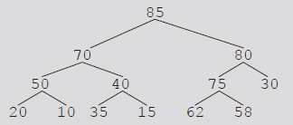
Heapsort: Array-Based Lists (cont’d.)
Data given in Figure 10-41
  Can be viewed in a complete binary tree
Heapsort
  First step: convert list into a heap
    Called buildHeap
  After converting the array into a heap
    Sorting phase begins
FIGURE 10-42 Complete binary tree
corresponding to the list in Figure 10-41
Data Structures Using C++ 2E

Slide 50
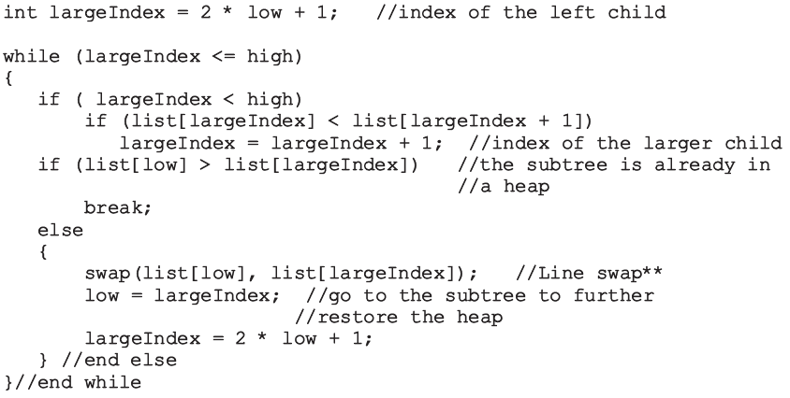
Build Heap
Data Structures Using C++ 2E

Slide 51
Build Heap (cont’d.)
Function heapify
  Restores the heap in a subtree
  Implements the buildHeap function
    Converts list into a heap
Data Structures Using C++ 2E

Slide 52
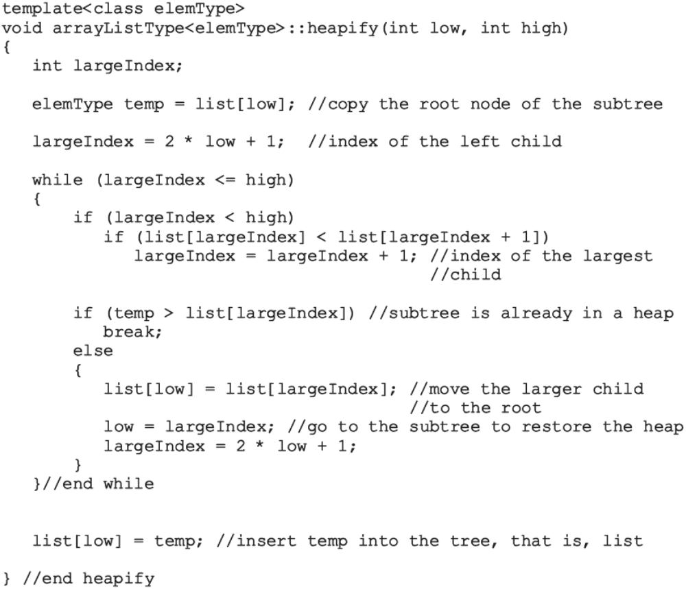
Data Structures Using C++ 2E

Slide 53
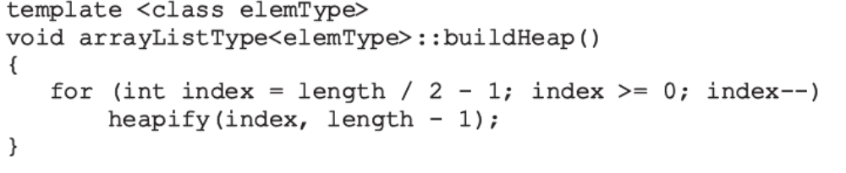
Build Heap (cont’d.)
Data Structures Using C++ 2E

Slide 54
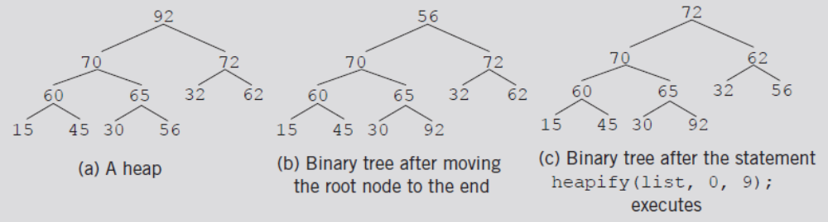
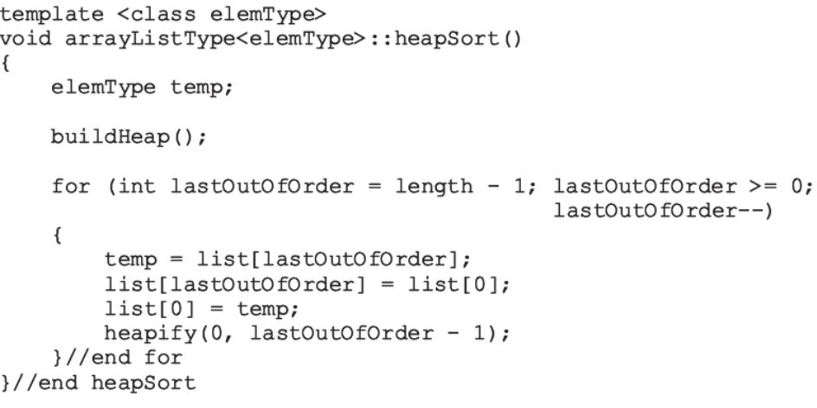
Build Heap (cont’d.)
The heapsort algorithm
FIGURE 10-48 Heapsort
Data Structures Using C++ 2E

Slide 55
Analysis: Heapsort
Given L a list of n elements where n > 0
Worst case
  Number of key comparisons to sort L
    2nlog₂n + O(n)
  Number of item assignments to sort L
    nlog₂n + O(n)
Average number of comparisons to sort L
  O(nlog₂n)
Heapsort takes twice as long as quicksort
  Avoids the slight possibility of poor performance
Data Structures Using C++ 2E

Slide 56
Priority Queues (Revisited)
Customers or jobs with higher priorities
  Pushed to front of the queue
Assume priority of the queue elements is assigned using the relational operators
  In a heap, largest list element is always the first element of the list
  After removing largest list element
    Function heapify restores the heap in the list
  Implement priority queues as heaps
    To ensure largest element of the priority queue is always the first element of the queue
Data Structures Using C++ 2E

Slide 57
Priority Queues (Revisited) (cont’d.)
Insert an element in the priority queue
  Insert new element in first available list position
    Ensures array holding the list is a complete binary tree
  After inserting new element in the heap, the list might no longer be a heap
    Restore the heap (might result in moving the new entry to the root node)
Data Structures Using C++ 2E

Slide 58
Priority Queues (Revisited) (cont’d.)
Remove an element from the priority queue
  Assume priority queue implemented as a heap
    Copy last element of the list into first array position
    Reduce list length by one
    Restore heap in the list
  Other operations for priority queues
    Can be implemented in the same way as implemented for queues
Data Structures Using C++ 2E

Slide 59
Summary
Search algorithms may require sorted data
Several sorting algorithms available
  Selection sort, insertion sort, Shellsort, quicksort, mergesort, and heapsort
    Can be applied to either array-based lists or linked lists
Compare algorithm performance through analysis
  Number of key comparisons
  Number of data movements
Functions implementing sorting algorithms
  Included as public members of the related class
Data Structures Using C++ 2E

