Slide 1

Data Structures Using C++ 2E
Chapter 13
Standard Template Library (STL) II

Slide 2
Objectives
Learn more about the Standard Template Library (STL)
Become familiar with associative containers
Explore how associative containers are used to manipulate data in a program
Learn about various generic algorithms
Data Structures Using C++ 2E

Slide 3
Class pair
Allows two values to be combined into a single unit
  Treated as one unit
  Functions using class pair
    Return two values
Using the class pair in a program
  class pair definition contained in header file utility
  Include statement: #include <utility>
Data Structures Using C++ 2E

Slide 4

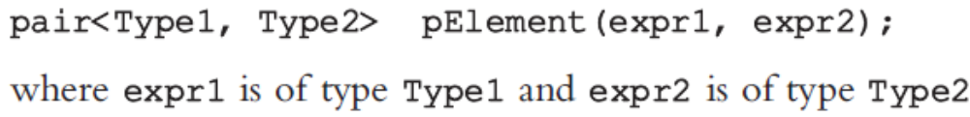
Class pair (cont’d.)
class pair constructors
  Default constructor
  Constructor with two parameters
Type pair object
  Two public data members: first, second
See Example 13-1
Data Structures Using C++ 2E

Slide 5
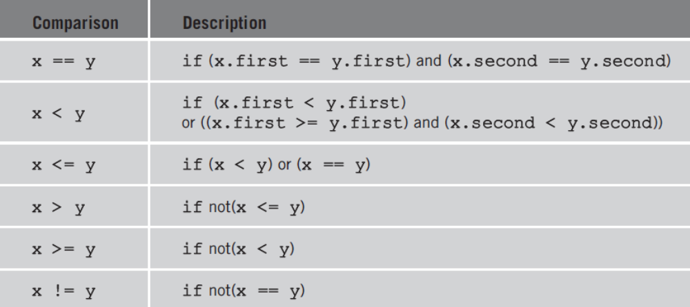
Comparing Objects of Type pair
Relational operators
  Overloaded for class pair
TABLE 13-1 Relational operators for the class pair
Data Structures Using C++ 2E

Slide 6
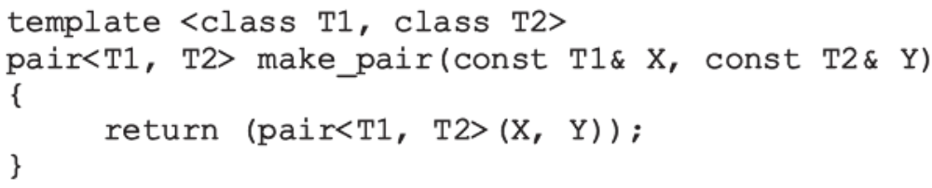
Type pair and Function make_pair
Header file utility
  Contains definition of function template make_pair
Create pairs without explicitly specifying type pair
  With function make_pair
Function template make_pair
  Value returning function
    Returns a value of type pair
Data Structures Using C++ 2E

Slide 7
Associative Containers
Elements automatically sorted
  According to some ordering criteria
  Default ordering criterion
    Relational operator < (less than)
    Users can specify own ordering criterion
New element inserted at the proper place
Binary search tree
  Convenient and fast way to implement data structure
Four predefined associative containers
Data Structures Using C++ 2E

Slide 8
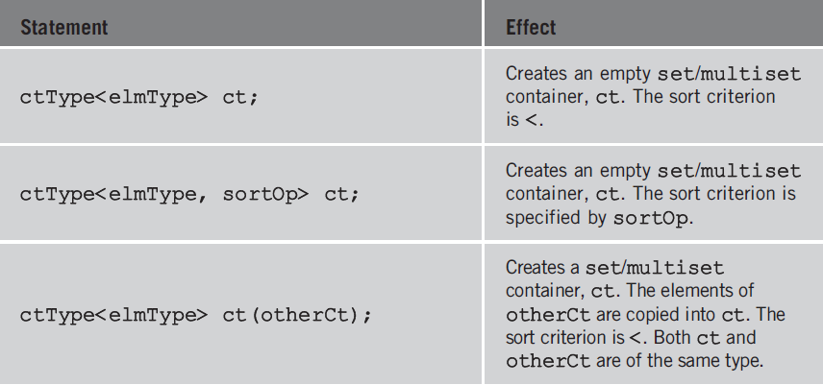
Associative Containers: set and multiset
TABLE 13-2 Various ways to declare a set/multiset container
Data Structures Using C++ 2E

Slide 9
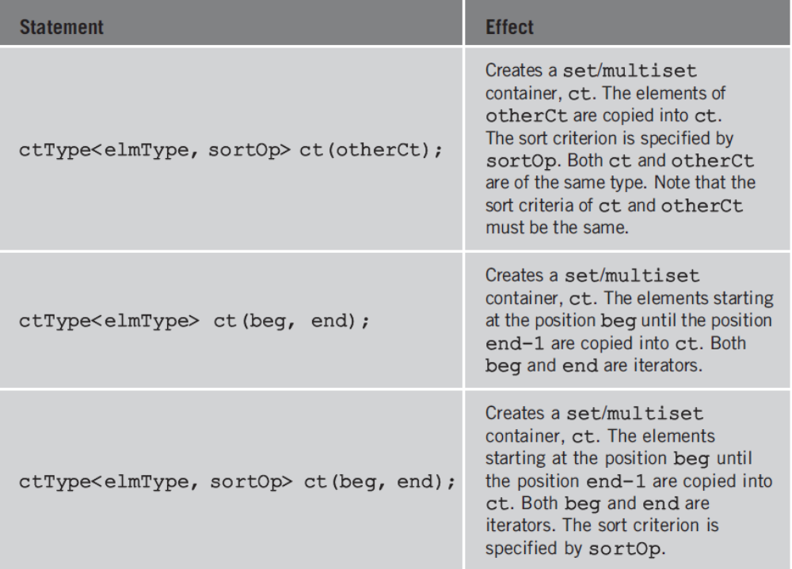
Associative Containers: set and multiset (cont’d.)
TABLE 13-2 Various ways to declare a set/multiset
container (continued)
Data Structures Using C++ 2E

Slide 10
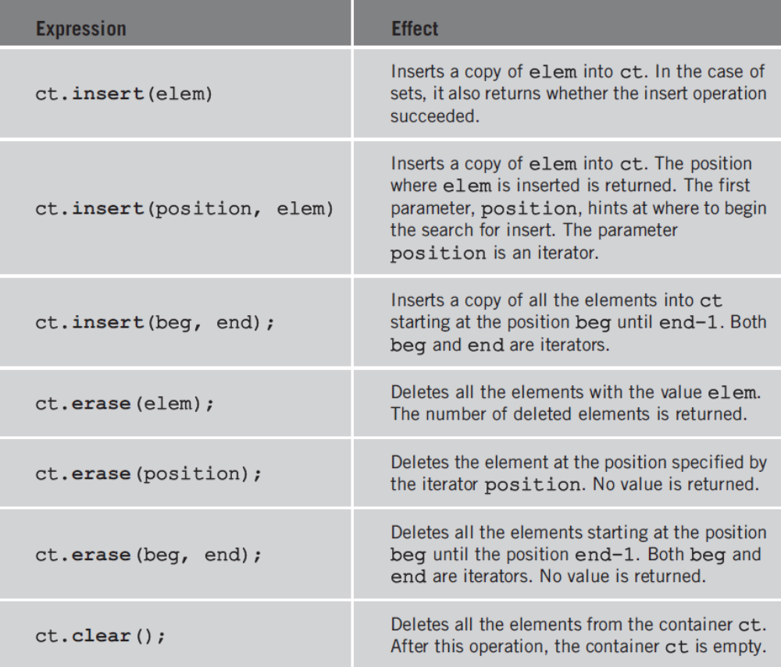
Associative Containers: set and multiset (cont’d.)
TABLE 13-3 Operations to insert or delete elements from a set
Data Structures Using C++ 2E

Slide 11
Associative Containers: map and multimap
Manage elements in the form key/value
Sorting elements
  Automatically according to sort criteria applied on key
    Default sorting criterion: relational operator < (less than)
  User can specify sorting criteria
User-defined data types and relational operators
  Must be properly overloaded
Data Structures Using C++ 2E

Slide 12
Associative Containers: map and multimap (cont’d.)
Difference between map and multimap
  Container multimap allows duplicates
  Container map does not
Class name defining container map: map
Class name defining container multimap: multimap
Use include statement: #include <map>
Data Structures Using C++ 2E

Slide 13
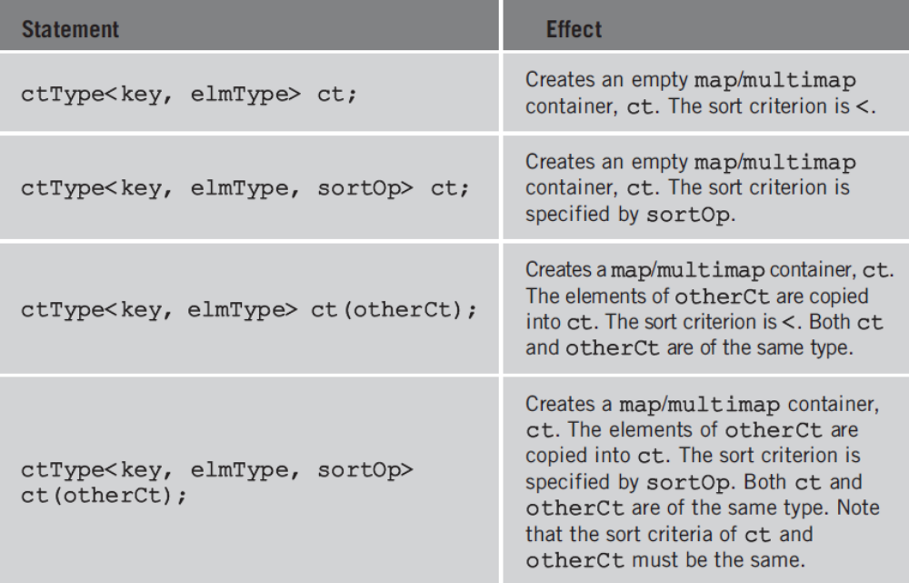
Associative Containers: map and multimap (cont’d.)
TABLE 13-4 Various ways to declare a map/multimap container
Data Structures Using C++ 2E

Slide 14
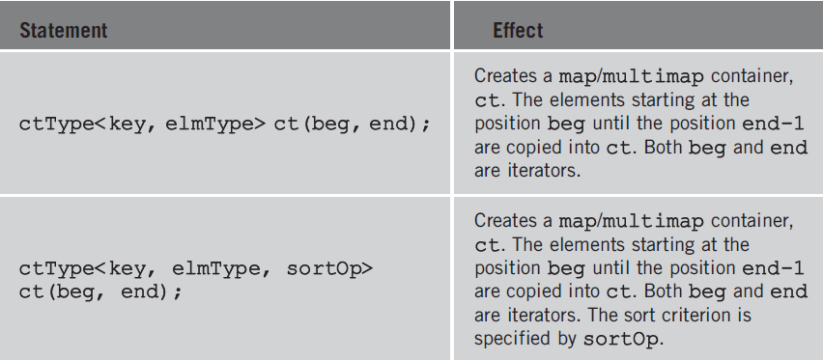
Associative Containers: map and multimap (cont’d.)
TABLE 13-4 Various ways to declare a map/multimap container (continued)
Data Structures Using C++ 2E

Slide 15

Associative Containers: map and multimap (cont’d.)
TABLE 13-5 Operations to insert or delete
elements from a map or multimap
Data Structures Using C++ 2E

Slide 16
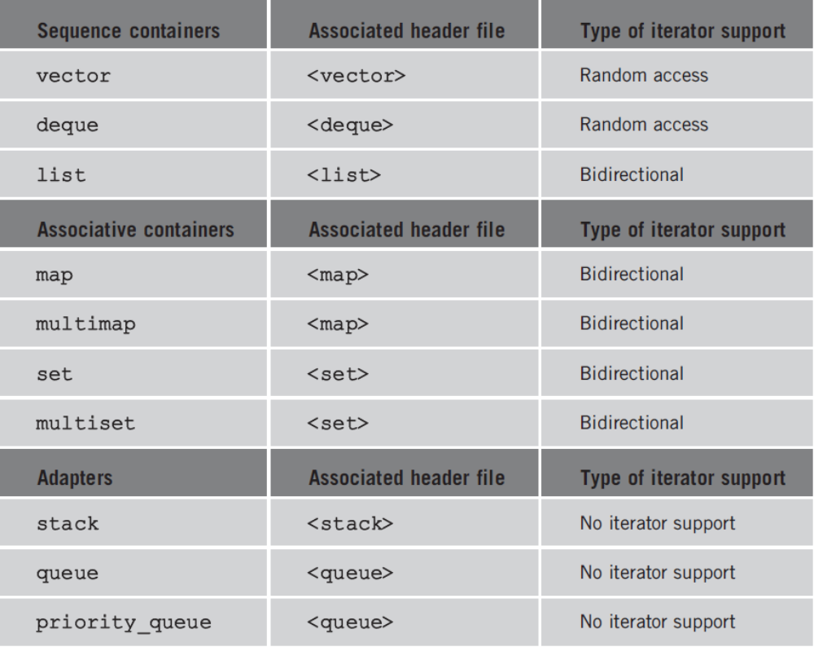
Containers, Associated Header Files, and Iterator Support
TABLE 13-6 Containers, their associated header files, and the type of iterator supported by each container
Data Structures Using C++ 2E

Slide 17
Algorithms
Some operations specific to a container
  Provided as part of container definition
Generic algorithms
  Common to all containers
    Contained in header file algorithm
  Examples
    Find
    Sort
    Merge
Data Structures Using C++ 2E

Slide 18
STL Algorithm Classification
Algorithms may be tied to a specific container
  Members of a specific class
  Examples: clear, sort, merge
Generic algorithms
  Applied in a variety of situations
STL generic algorithm classifications
  Nonmodifying algorithms
  Modifying algorithms
  Numeric algorithms
  Heap algorithms
Data Structures Using C++ 2E

Slide 19
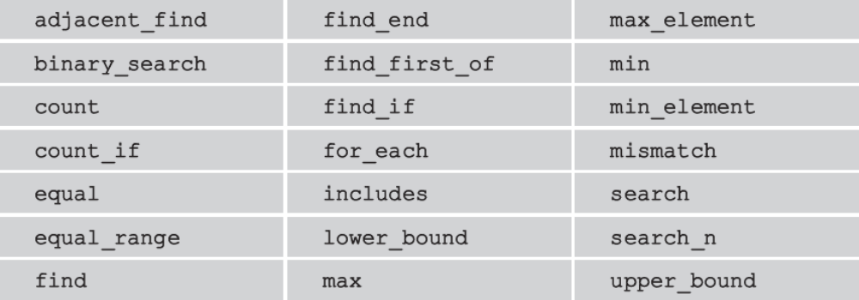
Nonmodifying Algorithms
Do not modify container elements
Investigate the elements
TABLE 13-7 Nonmodifying algorithms
Data Structures Using C++ 2E

Slide 20
Modifying Algorithms
Modify container elements by
  Rearranging, removing, changing element values
Mutating algorithms
  Modifying algorithms that change element order
    Not element values
  Examples
    next_permutation, partition, prev_permutation, random_shuffle, reverse, reverse_copy, rotate, rotate_copy, stable_partition
Data Structures Using C++ 2E

Slide 21
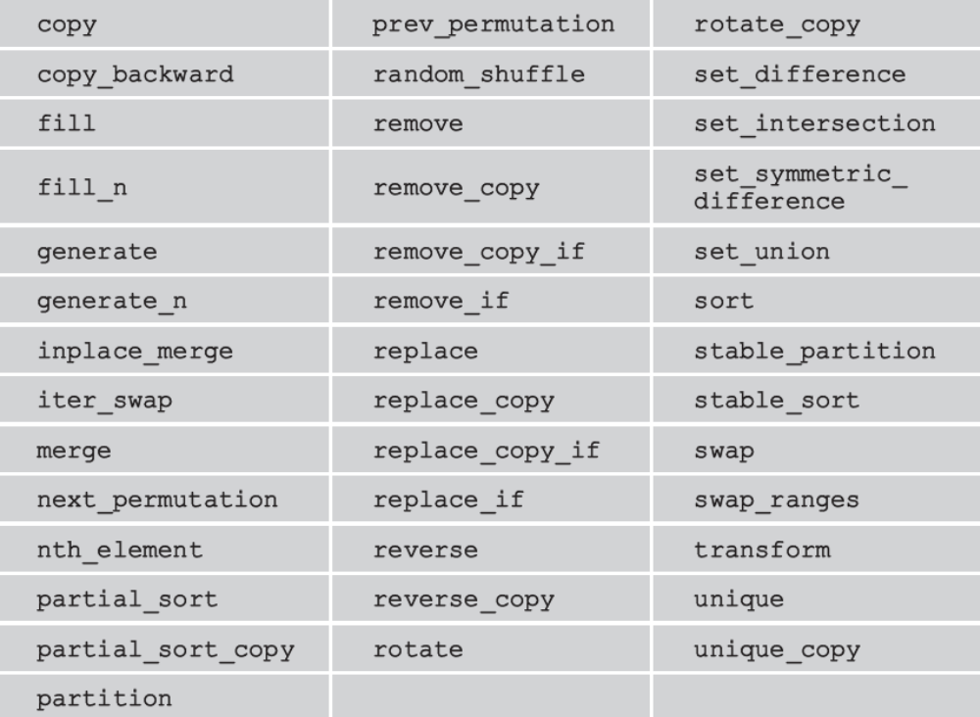
Modifying Algorithms (cont’d.)
TABLE 13-8 Modifying algorithms
Data Structures Using C++ 2E

Slide 22

Numeric Algorithms
Designed to perform numeric calculations container elements
TABLE 13-9 Numeric algorithms
Data Structures Using C++ 2E

Slide 23
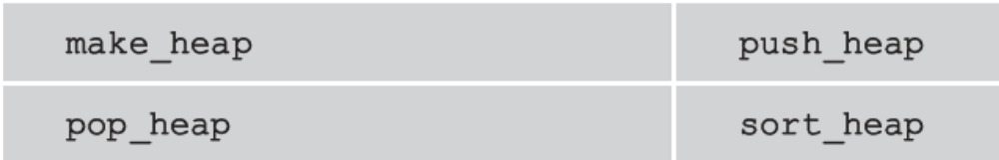
Heap Algorithms
Based on heapsort algorithm operation
TABLE 13-10 Heap algorithms
Data Structures Using C++ 2E

Slide 24
Function Objects
Generic algorithm flexibility
  STL provides two forms of an algorithm
    Using function overloading
First algorithm form
  Uses natural operation to accomplish goal
Second algorithm form
  User specifies criteria
Data Structures Using C++ 2E

Slide 25
Function Objects (cont’d.)
Function object
  Contains a function
    Treated as a function using function call operator, ()
  Class template
    Overloads the function call operator, ()
  STL allows creation of own function objects
    STL provides arithmetic, relational, logical function objects
STL’s function objects
  Contained in header file functional
Data Structures Using C++ 2E

Slide 26
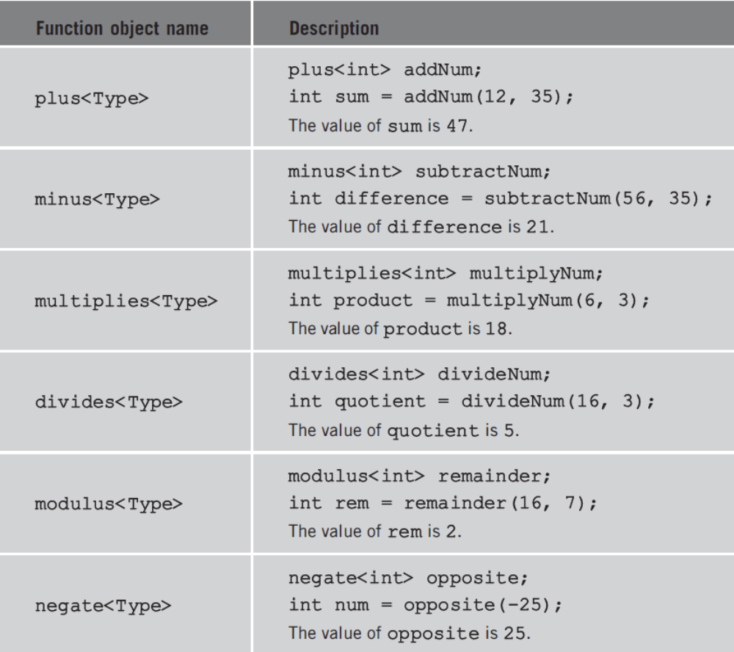
Function Objects (cont’d.)
TABLE 13-11 Arithmetic STL function objects
Data Structures Using C++ 2E

Slide 27
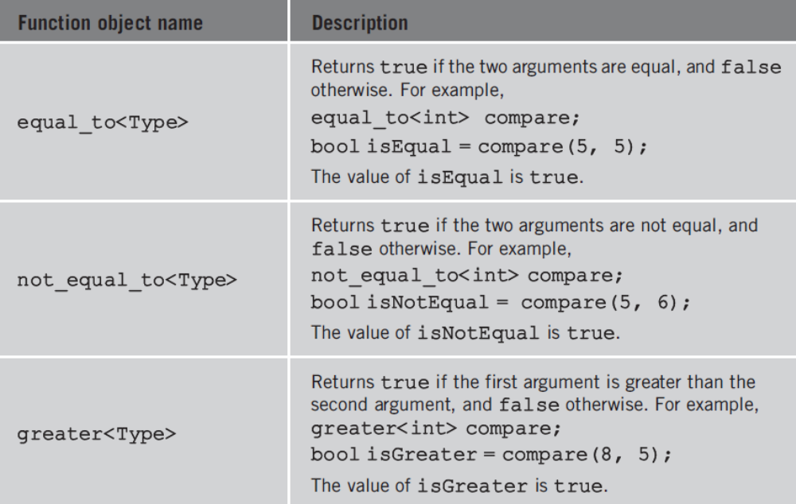
Function Objects (cont’d.)
TABLE 13-12 Relational STL function objects
Data Structures Using C++ 2E

Slide 28
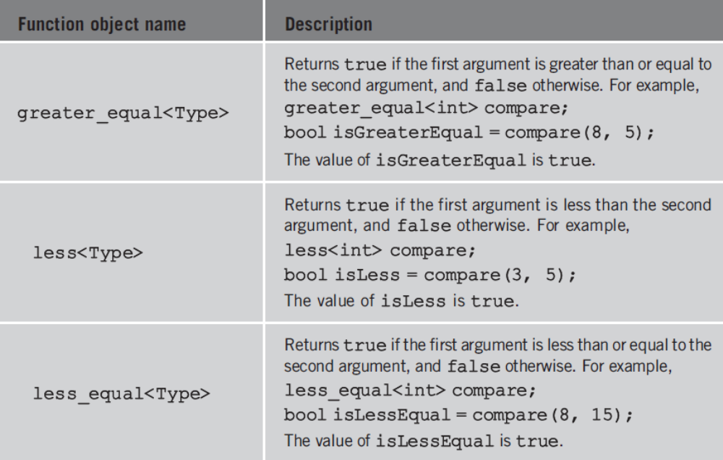
Function Objects (cont’d.)
TABLE 13-12 Relational STL function objects (continued)
Data Structures Using C++ 2E

Slide 29
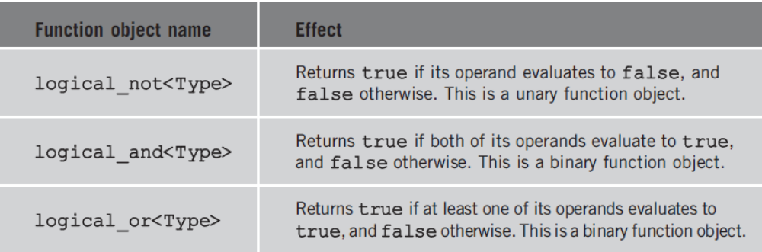
Function Objects (cont’d.)
TABLE 13-13 Logical STL function objects
Data Structures Using C++ 2E

Slide 30
Predicates
Special types of function objects
  Return Boolean values
Unary predicates
  Check a specific property for a single argument
Binary predicates
  Check a specific property for a pair of (two) arguments
Data Structures Using C++ 2E

Slide 31
Predicates (cont’d.)
Typical use
  Specifying searching, sorting criterion
In STL
  Always return same result for same value
Functions modifying their internal states
  Cannot be considered predicates
Data Structures Using C++ 2E

Slide 32
Predicates (cont’d.)
Insert iterator
  STL provides three insert iterators
    To insert elements at destination
Class vector
  Does not support the push_front operation
    Cannot be used for a vector container
Data Structures Using C++ 2E

Slide 33
Predicates (cont’d.)
back_inserter
  Uses the push_back operation of the container in place of the assignment operator
front_inserter
  Uses the push_front operation of the container in place of the assignment operator
inserter
  Uses the container’s insert operation in place of the assignment operator
Data Structures Using C++ 2E

Slide 34
STL Algorithms
Many STL algorithms available
Section coverage
  Function prototypes
  Brief description of what the algorithm does
  Program showing how to use algorithm
Section conventions
  In the function prototypes
    Parameter types indicate for which type of container the algorithm is applicable
  Abbreviations used
Data Structures Using C++ 2E

Slide 35
STL Algorithms (cont’d.)
Functions fill and fill_n
  Function fill
    Fills a container with elements
  Function fill_n
    Fills in the next n elements
Functions generate and generate_n
  Both generate elements and fill a sequence
Functions find, find_if, find_end, and find_first_of
  All are used to find the elements in a given range
Data Structures Using C++ 2E

Slide 36
STL Algorithms (cont’d.)
Functions remove, remove_if, remove_copy, and remove_copy_if
  Function remove
    Removes certain elements from a sequence
  Function remove_if
    Removes elements from a sequence
    Using some criterion
Data Structures Using C++ 2E

Slide 37
STL Algorithms (cont’d.)
Functions remove, remove_if, remove_copy, and remove_copy_if (cont’d.)
  Function remove_copy
    Copies the elements in a sequence into another sequence
    By excluding certain elements from the first sequence
  Function remove_copy_if
    Copies elements in a sequence into another sequence
    By excluding certain elements, using some criterion, from the first sequence
Data Structures Using C++ 2E

Slide 38
STL Algorithms (cont’d.)
Functions replace, replace_if, replace_copy, and replace_copy_if
  Function replace
    Replaces all the occurrences, within a given range, of a given element with a new value
  Function replace_if
    Replaces the values of the elements, within a given range, satisfying certain criteria with a new value
Data Structures Using C++ 2E

Slide 39
STL Algorithms (cont’d.)
Functions replace, replace_if, replace_copy, and replace_copy_if (cont’d.)
  Function replace_copy
    Combination of replace and copy
  Function replace_copy_if
    Combination of replace_if and copy
Data Structures Using C++ 2E

Slide 40
STL Algorithms (cont’d.)
Functions swap, iter_swap, and swap_ranges
  Used to swap elements
Functions search, search_n, sort, and binary_search
  Used to search elements
Data Structures Using C++ 2E

Slide 41
STL Algorithms (cont’d.)
Functions adjacent_find, merge, and inplace_merge
  Function adjacent_find
    Finds the first occurrence of consecutive elements satisfying a certain criterion
  Algorithm merge
    Merges two sorted lists
  Algorithm inplace_merge
    Combines two sorted, consecutive sequences
Data Structures Using C++ 2E

Slide 42
STL Algorithms (cont’d.)
Functions reverse, reverse_copy, rotate, and rotate_copy
  Algorithm reverse
    Reverses the order of the elements in a given range
  Algorithm reverse_copy
    Reverses the elements in a given range while copying into a destination range
    Source not modified
Data Structures Using C++ 2E

Slide 43
STL Algorithms (cont’d.)
Functions reverse, reverse_copy, rotate, and rotate_copy (cont’d.)
  Algorithm rotate
    Rotates the elements in a given range
  Algorithm rotate_copy
    Copies the elements of the source at the destination in a rotated order
Data Structures Using C++ 2E

Slide 44
STL Algorithms (cont’d.)
Functions count, count_if, max_element, min_element, and random_shuffle
  Algorithm count
    Counts occurrences of a given value in a given range
  Algorithm count_if
    Counts occurrences of a given value in a given range satisfying a certain criterion
  Algorithm max_element
    Determines the largest element in a given range
Data Structures Using C++ 2E

Slide 45
STL Algorithms (cont’d.)
Functions count, count_if, max_element, min_element, and random_shuffle (cont’d.)
  Algorithm min_element
    Determines the smallest element in a given range
  Algorithm random_shuffle
    Used to randomly order the elements in a given range
Data Structures Using C++ 2E

Slide 46
STL Algorithms (cont’d.)
Functions for_each and transform
  Algorithm for_each
    Used to access and process each element in a given range by applying a function, which is passed as a parameter
  Function transform
    Creates a sequence of elements by applying certain operations to each element in a given range
Data Structures Using C++ 2E

Slide 47
STL Algorithms (cont’d.)
Functions includes, set_intersection, set_union, set_difference, and set_symmetric_difference
  Algorithm includes
    Determines whether the elements of one range appear in another range
  Algorithm set_intersection
    Finds the elements that are common to two ranges of elements
  Algorithm set_union
    Finds the elements that are contained in two ranges of elements
Data Structures Using C++ 2E

Slide 48
STL Algorithms (cont’d.)
Functions includes, set_intersection, set_union, set_difference, and set_symmetric_difference (cont’d.)
  Algorithm set_difference
    Finds the elements in one range of elements that do not appear in another range of elements
  Given two ranges of elements, the algorithm set_symmetric_difference
    Determines the elements that are in the first range but not the second range, or the elements that are in the second range but not the first range
Data Structures Using C++ 2E

Slide 49
STL Algorithms (cont’d.)
Functions accumulate, adjacent_difference,
inner_product, and partial_sum
  All are numerical functions
    Manipulate numeric data
Data Structures Using C++ 2E

Slide 50
Summary
This chapter discussed
  The Standard Template Library (STL)
  Associative containers
  Operations on associative containers
  Function and algorithms on associative containers
  Examples of the use of function and algorithms
Data Structures Using C++ 2E

