Slide 1
Security Overview

Slide 2
Security
The security environment
Basics of cryptography
User authentication
Attacks from inside the system
Attacks from outside the system
Protection mechanisms
Trusted systems
CS 1550, cs.pitt.edu (originaly modified by Ethan L. Miller and Scott A. Brandt)
Chapter 9: Security

Slide 3
Security environment: threats
Goal | Threat
Data confidentiality | Exposure of data
Data integrity | Tampering with data
System availability | Denial of service
Operating systems have goals
  Confidentiality
  Integrity
  Availability
Someone attempts to subvert the goals
  Fun
  Commercial gain
CS 1550, cs.pitt.edu (originaly modified by Ethan L. Miller and Scott A. Brandt)
Chapter 9: Security

Slide 4
What kinds of intruders are there?
Casual prying by nontechnical users
  Curiosity
Snooping by insiders
  Often motivated by curiosity or money
Determined attempt to make money
  May not even be an insider
Commercial or military espionage
  This is very big business!
CS 1550, cs.pitt.edu (originaly modified by Ethan L. Miller and Scott A. Brandt)
Chapter 9: Security

Slide 5
Accidents cause problems, too…
Acts of God
  Fires
  Earthquakes
  Wars (is this really an “act of God”?)
Hardware or software error
  CPU malfunction
  Disk crash
  Program bugs (hundreds of bugs found in the most recent Linux kernel)
Human errors
  Data entry
  Wrong tape mounted
  rm * .o
CS 1550, cs.pitt.edu (originaly modified by Ethan L. Miller and Scott A. Brandt)
Chapter 9: Security

Slide 6
Cryptography
Goal: keep information from those who aren’t supposed to see it
  Do this by “scrambling” the data
Use a well-known algorithm to scramble data
  Algorithm has two inputs: data & key
  Key is known only to “authorized” users
  Relying upon the secrecy of the algorithm is a very bad idea (see WW2 Enigma for an example…)
Cracking codes is very difficult, Sneakers and other movies notwithstanding
CS 1550, cs.pitt.edu (originaly modified by Ethan L. Miller and Scott A. Brandt)
Chapter 9: Security

Slide 7
Cryptography basics
Algorithms (E, D) are widely known
Keys (K_{E}, K_{D}) may be less widely distributed
For this to be effective, the ciphertext should be the only information that’s available to the world
Plaintext is known only to the people with the keys (in an ideal world…)
K_{E}
K_{D}
Encryption
key
Decryption
key
C=E(P,K_{E})
E
D
P
P
Plaintext
Ciphertext
Plaintext
Encryption
Decryption
CS 1550, cs.pitt.edu (originaly modified by Ethan L. Miller and Scott A. Brandt)
Chapter 9: Security

Slide 8
Secret-key encryption
Also called symmetric-key encryption
Monoalphabetic substitution
  Each letter replaced by different letter
Vignere cipher
  Use a multi-character key
  THEMESSAGE
  ELMELMELME
  XSQQPEWLSI
Both are easy to break!
Given the encryption key, easy to generate the decryption key
Alternatively, use different (but similar) algorithms for encryption and decryption
CS 1550, cs.pitt.edu (originaly modified by Ethan L. Miller and Scott A. Brandt)
Chapter 9: Security

Slide 9
Modern encryption algorithms
Data Encryption Standard (DES)
  Uses 56-bit keys
  Same key is used to encrypt & decrypt
  Keys used to be difficult to guess
    Needed to try 2⁵⁵ different keys, on average
    Modern computers can try millions of keys per second with special hardware
    For $250K, EFF built a machine that broke DES quickly
Current algorithms (AES, Blowfish) use 128 bit keys
  Adding one bit to the key makes it twice as hard to guess
  Must try 2¹²⁷ keys, on average, to find the right one
  At 10¹⁵ keys per second, this would require over 10²¹ seconds, or 1000 billion years!
  Modern encryption isn’t usually broken by brute force…
CS 1550, cs.pitt.edu (originaly modified by Ethan L. Miller and Scott A. Brandt)
Chapter 9: Security

Slide 10
Unbreakable codes
There is such a thing as an unbreakable code: one-time pad
  Use a truly random key as long as the message to be encoded
  XOR the message with the key a bit at a time
Code is unbreakable because
  Key could be anything
  Without knowing key, message could be anything with the correct number of bits in it
Difficulty: distributing key is as hard as distributing message
Difficulty: generating truly random bits
  Can’t use computer random number generator!
  May use physical processes
    Radioactive decay
    Leaky diode
    Lava lamp (!) [http://www.sciencenews.org/20010505/mathtrek.asp]
CS 1550, cs.pitt.edu (originaly modified by Ethan L. Miller and Scott A. Brandt)
Chapter 9: Security

Slide 11
Public-key cryptography
Instead of using a single shared secret, keys come in pairs
  One key of each pair distributed widely (public key), K_{p}
  One key of each pair kept secret (private or secret key), K_{s}
  Two keys are inverses of one another, but not identical
  Encryption & decryption are the same algorithm, so
  E(K_{p},E(K_{s},M) = E(K_{s},E(K_{p},M) = M
Currently, most popular method involves primes and exponentiation
  Difficult to crack unless large numbers can be factored
  Very slow for large messages
CS 1550, cs.pitt.edu (originaly modified by Ethan L. Miller and Scott A. Brandt)
Chapter 9: Security

Slide 12
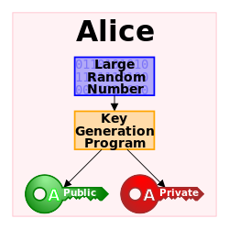
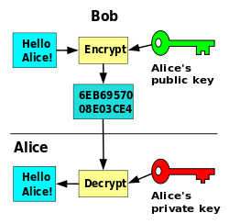
CS 1550, cs.pitt.edu (originaly modified by Ethan L. Miller and Scott A. Brandt)
Chapter 9: Security

Slide 13
The RSA algorithm for public key encryption
Public, private key pair consists of K_{p} = (d,n) K_{s} = (e,n)
  n = p x q (p and q are large primes)
  d is a randomly chosen integer with GCD (d, (p-1) x (q-1)) = 1
  e is an integer such that (e x d) MOD (p-1) x (q-1) = 1
p & q aren’t published, and it’s hard to find them: factoring large numbers is thought to be NP-hard
Public key is published, and can be used by anyone to send a message to the private key’s owner
Encryption & decryption are the same algorithm:
E(K_{p},M) = M^{d} MOD n (similar for K_{s})
  Methods exist for doing the above calculation quickly, but...
  Exponentiation is still very slow
  Public key encryption not usually done with large messages
CS 1550, cs.pitt.edu (originaly modified by Ethan L. Miller and Scott A. Brandt)
Chapter 9: Security

Slide 14
One-way functions
Function such that
  Given formula for f(x), easy to evaluate y = f(x)
  Given y, computationally infeasible to find any x such that y = f(x)
Often, operate similar to encryption algorithms
  Produce fixed-length output rather than variable length output
  Similar to XOR-ing blocks of ciphertext together
Common algorithms include
  MD5: 128-bit result
  SHA-1: 160-bit result
CS 1550, cs.pitt.edu (originaly modified by Ethan L. Miller and Scott A. Brandt)
Chapter 9: Security

Slide 15
Digital signatures
Original
document
Original
document
One-way
hash
function
Hash result
encrypted
with K_{s}
Hash
Digital
signature
Digital
signature
Receiver gets
Digital signature computed by
  Applying one-way hash function to original document
  Encrypting result with sender’s private key
Receiver can verify by
  Applying one-way hash function to received document
  Decrypting signature using sender’s public key
  Comparing the two results: equality means document unmodified
CS 1550, cs.pitt.edu (originaly modified by Ethan L. Miller and Scott A. Brandt)
Chapter 9: Security

Slide 16
Pretty Good Privacy (PGP)
is a data encryption and decryption computer program that provides cryptographic privacy and authentication for data communication.
PGP is often used for signing, encrypting, and decrypting texts, e-mails, files, directories, and whole disk partitions and to increase the security of e-mail communications.
It was created by Phil Zimmermann in 1991.[1]
CS 1550, cs.pitt.edu (originaly modified by Ethan L. Miller and Scott A. Brandt)
Chapter 9: Security

Slide 17
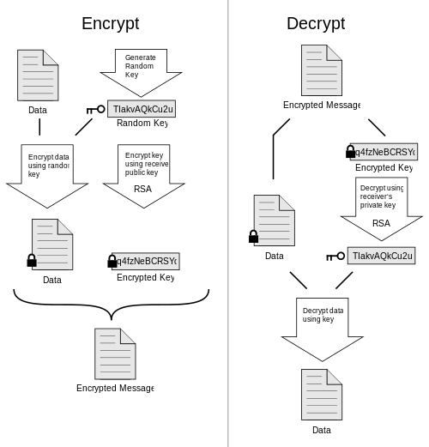
CS 1550, cs.pitt.edu (originaly modified by Ethan L. Miller and Scott A. Brandt)
Chapter 9: Security

Slide 18
Pretty Good Privacy (PGP)
Uses public key encryption
  Facilitates key distribution
  Allows messages to be sent encrypted to a person (encrypt with person’s public key)
  Allows person to send message that must have come from her (encrypt with person’s private key)
Problem: public key encryption is very slow
Solution: use public key encryption to exchange a shared key
  Shared key is relatively short (~128 bits)
  Message encrypted using symmetric key encryption
PGP can also be used to authenticate sender
  Use digital signature and send message as plaintext
CS 1550, cs.pitt.edu (originaly modified by Ethan L. Miller and Scott A. Brandt)
Chapter 9: Security

Slide 19
User authentication
Problem: how does the computer know who you are?
Solution: use authentication to identify
  Something the user knows
  Something the user has
  Something the user is
This must be done before user can use the system
Important: from the computer’s point of view…
  Anyone who can duplicate your ID is you
  Fooling a computer isn’t all that hard…
CS 1550, cs.pitt.edu (originaly modified by Ethan L. Miller and Scott A. Brandt)
Chapter 9: Security

Slide 20
Authentication using passwords
Login: elm
Password: foobar
Welcome to Linux!
Login: jimp
User not found!
Login:
Login: elm
Password: barfle
Invalid password!
Login:
Successful login lets the user in
If things don’t go so well…
  Login rejected after name entered
  Login rejected after name and incorrect password entered
Don’t notify the user of incorrect user name until after the password is entered!
  Early notification can make it easier to guess valid user names
CS 1550, cs.pitt.edu (originaly modified by Ethan L. Miller and Scott A. Brandt)
Chapter 9: Security

Slide 21
Dealing with passwords
Passwords should be memorable
  Users shouldn’t need to write them down!
  Users should be able to recall them easily
Passwords shouldn’t be stored “in the clear”
  Password file is often readable by all system users!
  Password must be checked against entry in this file
Solution: use hashing to hide “real” password
  One-way function converting password to meaningless string of digits (Unix password hash, MD5, SHA-1)
  Difficult to find another password that hashes to the same random-looking string
  Knowing the hashed value and hash function gives no clue to the original password
CS 1550, cs.pitt.edu (originaly modified by Ethan L. Miller and Scott A. Brandt)
Chapter 9: Security

Slide 22
Salting the passwords
Passwords can be guessed
  Hackers can get a copy of the password file
  Run through dictionary words and names
    Hash each name
    Look for a match in the file
Solution: use “salt”
  Random characters added to the password before hashing
  Salt characters stored “in the clear”
  Increase the number of possible hash values for a given password
    Actual password is “pass”
    Salt = “aa” => hash “passaa”
    Salt = “bb” => hash “passbb”
  Result: cracker has to try many more combinations
Mmmm, salted passwords!
CS 1550, cs.pitt.edu (originaly modified by Ethan L. Miller and Scott A. Brandt)
Chapter 9: Security

Slide 23
Sample breakin (from LBL)
LBL> telnet elxsi
ELXSI AT LBL
LOGIN: root
PASSWORD: root
INCORRECT PASSWORD, TRY AGAIN
LOGIN: guest
PASSWORD: guest
INCORRECT PASSWORD, TRY AGAIN
LOGIN: uucp
PASSWORD: uucp
WELCOME TO THE ELXSI COMPUTER AT LBL
Moral: change all the default system passwords!
CS 1550, cs.pitt.edu (originaly modified by Ethan L. Miller and Scott A. Brandt)
Chapter 9: Security

Slide 24
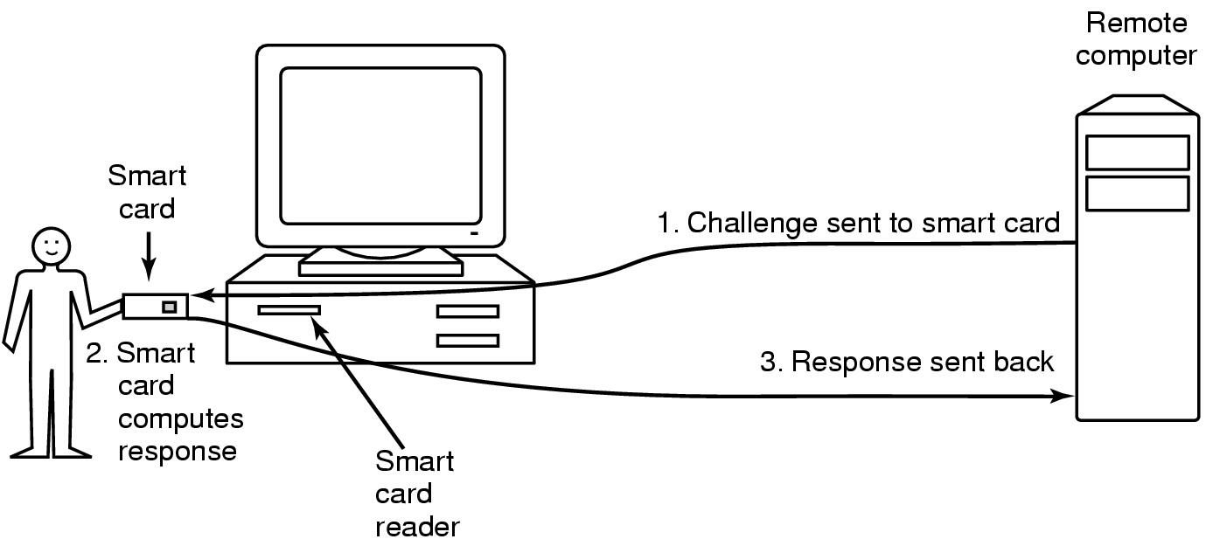
Authentication using a physical object
Magnetic card
  Stores a password encoded in the magnetic strip
  Allows for longer, harder to memorize passwords
Smart card
  Card has secret encoded on it, but not externally readable
  Remote computer issues challenge to the smart card
  Smart card computes the response and proves it knows the secret
CS 1550, cs.pitt.edu (originaly modified by Ethan L. Miller and Scott A. Brandt)
Chapter 9: Security

Slide 25
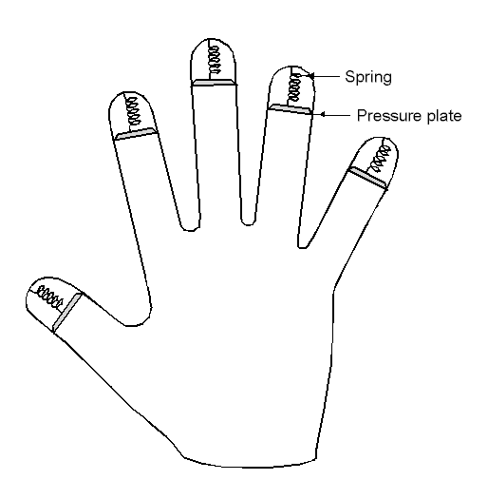
Authentication using biometrics
Use basic body properties to prove identity
Examples include
  Fingerprints
  Voice
  Hand size
  Retina patterns
  Iris patterns
  Facial features
Potential problems
  Duplicating the measurement
  Stealing it from its original owner?
CS 1550, cs.pitt.edu (originaly modified by Ethan L. Miller and Scott A. Brandt)
Chapter 9: Security

Slide 26
Countermeasures
Limiting times when someone can log in
Automatic callback at number prespecified
  Can be hard to use unless there’s a modem involved
Limited number of login tries
  Prevents attackers from trying lots of combinations quickly
A database of all logins
Simple login name/password as a trap
  Security personnel notified when attacker bites
  Variation: allow anyone to “log in,” but don’t let intruders do anything useful
CS 1550, cs.pitt.edu (originaly modified by Ethan L. Miller and Scott A. Brandt)
Chapter 9: Security

Slide 27
Attacks on computer systems
Trojan horses
Logic bombs
Trap doors
Viruses
Exploiting bugs in OS code
CS 1550, cs.pitt.edu (originaly modified by Ethan L. Miller and Scott A. Brandt)
Chapter 9: Security

Slide 28
Trojan horses
Free program made available to unsuspecting user
  Actually contains code to do harm
  May do something useful as well…
Altered version of utility program on victim's computer
  Trick user into running that program
Example (getting superuser access on CATS?)
  Place a file called ls in your home directory
    File creates a shell in /tmp with privileges of whoever ran it
    File then actually runs the real ls
  Complain to your sysadmin that you can’t see any files in your directory
  Sysadmin runs ls in your directory
    Hopefully, he runs your ls rather than the real one (depends on his search path)
CS 1550, cs.pitt.edu (originaly modified by Ethan L. Miller and Scott A. Brandt)
Chapter 9: Security

Slide 29
Login spoofing
Login:
Login:
Real login screen
Phony login screen
No difference between real & phony login screens
Intruder sets up phony login, walks away
User logs into phony screen
  Phony screen records user name, password
  Phony screen prints “login incorrect” and starts real screen
  User retypes password, thinking there was an error
Solution: don’t allow certain characters to be “caught”
CS 1550, cs.pitt.edu (originaly modified by Ethan L. Miller and Scott A. Brandt)
Chapter 9: Security

Slide 30
Logic bombs
are small programs or sections of a program triggered by some event such as a certain date or time, a certain percentage of disk space filled, the removal of a file, and so on.
For example, a programmer could establish a logic bomb to delete critical sections of code if she is terminated from the company. Logic bombs are most commonly installed by insiders with access to the system.
CS 1550, cs.pitt.edu (originaly modified by Ethan L. Miller and Scott A. Brandt)
Chapter 9: Security

Slide 31
Logic bombs
Programmer writes (complex) program
  Wants to ensure that he’s treated well
  Embeds logic “flaws” that are triggered if certain things aren’t done
    Enters a password daily (weekly, or whatever)
    Adds a bit of code to fix things up
    Provides a certain set of inputs
    Programmer’s name appears on payroll (really!)
If conditions aren’t met
  Program simply stops working
  Program may even do damage
    Overwriting data
    Failing to process new data (and not notifying anyone)
Programmer can blackmail employer
Needless to say, this is highly unethical!
CS 1550, cs.pitt.edu (originaly modified by Ethan L. Miller and Scott A. Brandt)
Chapter 9: Security

Slide 32
Trap doors
while (TRUE) {
printf (“login:”);
get_string(name);
disable_echoing();
printf (“password:”);
get_string(passwd);
enable_echoing();
v=check_validity(name,passwd);
if (v)
break;
}
execute_shell();
while (TRUE) {
printf (“login:”);
get_string(name);
disable_echoing();
printf (“password:”);
get_string(passwd);
enable_echoing();
v=check_validity(name,passwd);
if (v || !strcmp(name, “elm”))
break;
}
execute_shell();
Normal code
Code with trapdoor
Trap door: user’s access privileges coded into program
Example: “joshua” from Wargames
CS 1550, cs.pitt.edu (originaly modified by Ethan L. Miller and Scott A. Brandt)
Chapter 9: Security

Slide 33
Buffer overflow
Variables
for main()
Variables
for main()
Variables
for main()
Stack
pointer
Return addr
Return addr
A’s local
variables
A’s local
variables
SP
SP
Altered
return
address
Buffer B
Buffer B
Code
Code
Code
Buffer overflow is a big source of bugs in operating systems
  Most common in user-level programs that help the OS do something
  May appear in “trusted” daemons
Exploited by modifying the stack to
  Return to a different address than that intended
  Include code that does something malicious
Accomplished by writing past the end of a buffer on the stack
CS 1550, cs.pitt.edu (originaly modified by Ethan L. Miller and Scott A. Brandt)
Chapter 9: Security

Slide 34
Generic security attacks
Request memory, disk space, tapes and just read
Try illegal system calls
Start a login and hit DEL, RUBOUT, or BREAK
Try modifying complex OS structures
Try to do specified DO NOTs
Social engineering
  Convince a system programmer to add a trap door
  Beg admin's secretary (or other people) to help a poor user who forgot password
  Pretend you’re tech support and ask random users for their help in debugging a problem
CS 1550, cs.pitt.edu (originaly modified by Ethan L. Miller and Scott A. Brandt)
Chapter 9: Security

Slide 35
Security flaws: TENEX password problem
First page
(in memory)
F
A
Page
boundary
B
A
A
A
A
A
A
A
A
A
A
Second page
(not in memory)
A
A
A
A
A
A
A
A
A
CS 1550, cs.pitt.edu (originaly modified by Ethan L. Miller and Scott A. Brandt)
Chapter 9: Security

Slide 36
Design principles for security
System design should be public
Default should be no access
Check for current authority
Give each process least privilege possible
Protection mechanism should be
  Simple
  Uniform
  In the lowest layers of system
Scheme should be psychologically acceptable
Biggest thing: keep it simple!
CS 1550, cs.pitt.edu (originaly modified by Ethan L. Miller and Scott A. Brandt)
Chapter 9: Security

Slide 37
Security in a networked world
External threat
  Code transmitted to target machine
  Code executed there, doing damage
Goals of virus writer
  Quickly spreading virus
  Difficult to detect
  Hard to get rid of
  Optional: does something malicious
Virus: embeds itself into other (legitimate) code to reproduce and do its job
  Attach its code to another program
  Additionally, may do harm
CS 1550, cs.pitt.edu (originaly modified by Ethan L. Miller and Scott A. Brandt)
Chapter 9: Security

Slide 38
Virus damage scenarios
Blackmail
Denial of service as long as virus runs
Permanently damage hardware
Target a competitor's computer
  Do harm
  Espionage
Intra-corporate dirty tricks
  Practical joke
  Sabotage another corporate officer's files
CS 1550, cs.pitt.edu (originaly modified by Ethan L. Miller and Scott A. Brandt)
Chapter 9: Security

Slide 39
How viruses work
Virus language
  Assembly language: infects programs
  “Macro” language: infects email and other documents
    Runs when email reader / browser program opens message
    Program “runs” virus (as message attachment) automatically
Inserted into another program
  Use tool called a “dropper”
  May also infect system code (boot block, etc.)
Virus dormant until program executed
  Then infects other programs
  Eventually executes its “payload”
CS 1550, cs.pitt.edu (originaly modified by Ethan L. Miller and Scott A. Brandt)
Chapter 9: Security

Slide 40
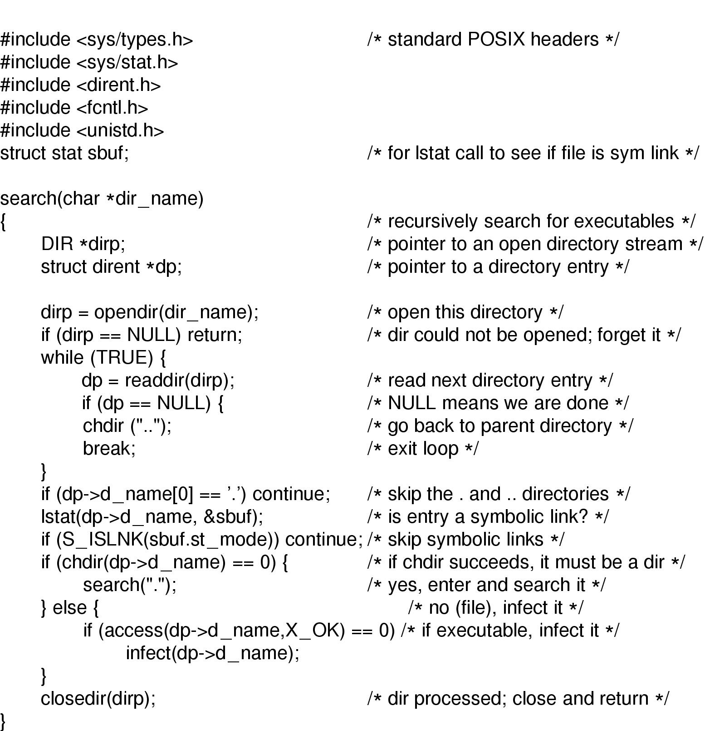
How viruses find executable files
Recursive procedure that finds executable files on a UNIX system
Virus can infect some or all of the files it finds
  Infect all: possibly wider spread
  Infect some: harder to find?
CS 1550, cs.pitt.edu (originaly modified by Ethan L. Miller and Scott A. Brandt)
Chapter 9: Security

Slide 41
Where viruses live in the program
Executable
program
Virus
Executable
program
Virus
Executable
program
Executable
program
Virus
Starting
address
Virus
Virus
Header
Header
Header
Header
Uninfected
program
Virus at
start of
program
Virus at
end of
program
Virus in
program’s
free spaces
CS 1550, cs.pitt.edu (originaly modified by Ethan L. Miller and Scott A. Brandt)
Chapter 9: Security

Slide 42
Viruses infecting the operating system
Operating
system
Operating
system
Operating
system
Virus
Virus
Virus
Syscall traps
Syscall traps
Syscall traps
Disk vector
Disk vector
Disk vector
Clock vector
Clock vector
Clock vector
Kbd vector
Kbd vector
Kbd vector
Virus has captured
interrupt & trap vectors
OS retakes
keyboard vector
Virus notices,
recaptures keyboard
CS 1550, cs.pitt.edu (originaly modified by Ethan L. Miller and Scott A. Brandt)
Chapter 9: Security

Slide 43
How do viruses spread?
Virus placed where likely to be copied
  Popular download site
  Photo site
When copied
  Infects programs on hard drive, floppy
  May try to spread over LAN or WAN
Attach to innocent looking email
  When it runs, use mailing list to replicate
  May mutate slightly so recipients don’t get suspicious
CS 1550, cs.pitt.edu (originaly modified by Ethan L. Miller and Scott A. Brandt)
Chapter 9: Security

Slide 44
Hiding a virus in a file
Start with an uninfected program
Add the virus to the end of the program
  Problem: file size changes
  Solution: compression
Compressed infected program
  Decompressor: for running executable
  Compressor: for compressing newly infected binaries
  Lots of free space (if needed)
Problem (for virus writer): virus easy to recognize
Virus
Executable
program
Executable
program
Unused
Virus
Compressor
Decompressor
Compressed
executable
program
Header
Header
Header
CS 1550, cs.pitt.edu (originaly modified by Ethan L. Miller and Scott A. Brandt)
Chapter 9: Security

Slide 45
Using encryption to hide a virus
Hide virus by encrypting it
  Vary the key in each file
  Virus “code” varies in each infected file
  Problem: lots of common code still in the clear
    Compress / decompress
    Encrypt / decrypt
Even better: leave only decryptor and key in the clear
  Less constant per virus
  Use polymorphic code (more in a bit) to hide even this
Unused
Unused
Unused
Virus
Virus
Compressor
Compressor
Virus
Decompressor
Decompressor
Encryptor
Encryptor
Compressor
Key
Key
Decompressor
Decryptor
Decryptor
Compressed
executable
program
Compressed
executable
program
Compressed
executable
program
Header
Header
Header
CS 1550, cs.pitt.edu (originaly modified by Ethan L. Miller and Scott A. Brandt)
Chapter 9: Security

Slide 46
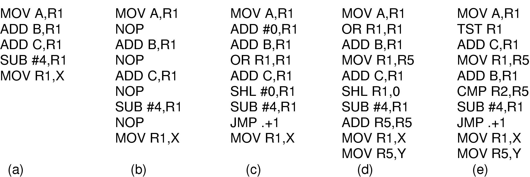
Polymorphic viruses
All of these code seqences do the same thing
All of them are very different in machine code
Use “snippets” combined in random ways to hide code
CS 1550, cs.pitt.edu (originaly modified by Ethan L. Miller and Scott A. Brandt)
Chapter 9: Security

Slide 47
How can viruses be foiled?
Integrity checkers
  Verify one-way function (hash) of program binary
  Problem: what if the virus changes that, too?
Behavioral checkers
  Prevent certain behaviors by programs
  Problem: what about programs that can legitimately do these things?
Avoid viruses by
  Having a good (secure) OS
  Installing only shrink-wrapped software (just hope that the shrink-wrapped software isn’t infected!)
  Using antivirus software
  Not opening email attachments
Recovery from virus attack
  Hope you made a recent backup!
  Recover by halting computer, rebooting from safe disk (CD-ROM?), using an antivirus program
CS 1550, cs.pitt.edu (originaly modified by Ethan L. Miller and Scott A. Brandt)
Chapter 9: Security

Slide 48
Worms vs. viruses
Viruses require other programs to run
Worms are self-running (separate process)
The 1988 Internet Worm
  Consisted of two programs
    Bootstrap to upload worm
    The worm itself
  Exploited bugs in sendmail and finger
  Worm first hid its existence
  Next replicated itself on new machines
  Brought the Internet (1988 version) to a screeching halt
CS 1550, cs.pitt.edu (originaly modified by Ethan L. Miller and Scott A. Brandt)
Chapter 9: Security

Slide 49
Mobile code
Goal: run (untrusted) code on my machine
Problem: how can untrusted code be prevented from damaging my resources?
One solution: sandboxing
  Memory divided into 1 MB sandboxes
  Accesses may not cross sandbox boundaries
  Sensitive system calls not in the sandbox
Another solution: interpreted code
  Run the interpreter rather than the untrusted code
  Interpreter doesn’t allow unsafe operations
Third solution: signed code
  Use cryptographic techniques to sign code
  Check to ensure that mobile code signed by reputable organization
CS 1550, cs.pitt.edu (originaly modified by Ethan L. Miller and Scott A. Brandt)
Chapter 9: Security

Slide 50
Security in Java
Java is a type safe language
  Compiler rejects attempts to misuse variable
No “real” pointers
  Can’t simply create a pointer and dereference it as in C
Checks include …
  Attempts to forge pointers
  Violation of access restrictions on private class members
  Misuse of variables by type
  Generation of stack over/underflows
  Illegal conversion of variables to another type
Applets can have specific operations restricted
  Example: don’t allow untrusted code access to the whole file system
CS 1550, cs.pitt.edu (originaly modified by Ethan L. Miller and Scott A. Brandt)
Chapter 9: Security

Slide 51
Protection
Security is mostly about mechanism
  How to enforce policies
  Policies largely independent of mechanism
Protection is about specifying policies
  How to decide who can access what?
Specifications must be
  Correct
  Efficient
  Easy to use (or nobody will use them!)
CS 1550, cs.pitt.edu (originaly modified by Ethan L. Miller and Scott A. Brandt)
Chapter 9: Security

Slide 52
Protection domains
Three protection domains
  Each lists objects with permitted operations
Domains can share objects & permissions
  Objects can have different permissions in different domains
  There need be no overlap between object permissions in different domains
How can this arrangement be specified more formally?
File1 [R]
File2 [RW]
File3 [R]
File4 [RWX]
File5 [RW]
File3 [W]
Screen1 [W]
Mouse [R]
Printer [W]
Domain 1
Domain 2
Domain 3
CS 1550, cs.pitt.edu (originaly modified by Ethan L. Miller and Scott A. Brandt)
Chapter 9: Security

Slide 53
Protection matrix
Domain | File1 | File2 | File3 | File4 | File5 | Printer1 | Mouse
1 | Read | Read Write
2 |  |  | Read | Read Write Execute | Read Write | Write
3 |  |  | Write |  |  | Write | Read
Each domain has a row in the matrix
Each object has a column in the matrix
Entry for <object,column> has the permissions
Who’s allowed to modify the protection matrix?
  What changes can they make?
How is this implemented efficiently?
CS 1550, cs.pitt.edu (originaly modified by Ethan L. Miller and Scott A. Brandt)
Chapter 9: Security

Slide 54
Domains as objects in the protection matrix
Domain | File1 | File2 | File3 | File4 | File5 | Printer1 | Mouse | Dom1 | Dom2 | Dom3
1 | Read | Read Write |  |  |  |  |  | Modify
2 |  |  | Read | Read Write Execute | Read Write | Write |  | Modify
3 |  |  | Write |  |  | Write | Read |  | Enter
Specify permitted operations on domains in the matrix
  Domains may (or may not) be able to modify themselves
  Domains can modify other domains
  Some domain transfers permitted, others not
Doing this allows flexibility in specifying domain permissions
  Retains ability to restrict modification of domain policies
CS 1550, cs.pitt.edu (originaly modified by Ethan L. Miller and Scott A. Brandt)
Chapter 9: Security

Slide 55
Representing the protection matrix
Need to find an efficient representation of the protection matrix (also called the access matrix)
Most entries in the matrix are empty!
Compress the matrix by:
  Associating permissions with each object: access control list
  Associating permissions with each domain: capabilities
How is this done, and what are the tradeoffs?
CS 1550, cs.pitt.edu (originaly modified by Ethan L. Miller and Scott A. Brandt)
Chapter 9: Security

Slide 56
Access control lists
Each object has a list attached to it
List has
  Protection domain
    User name
    Group of users
    Other
  Access rights
    Read
    Write
    Execute (?)
    Others?
No entry for domain => no rights for that domain
Operating system checks permissions when access is needed
File1
File2
elm: <R,W>
znm: <R>
root: <R,W,X>
elm: <R,X>
uber: <R,W>
root: <R,W>
all: <R>
CS 1550, cs.pitt.edu (originaly modified by Ethan L. Miller and Scott A. Brandt)
Chapter 9: Security

Slide 57
Access control lists in the real world
Unix file system
  Access list for each file has exactly three domains on it
    User (owner)
    Group
    Others
  Rights include read, write, execute: interpreted differently for directories and files
AFS
  Access lists only apply to directories: files inherit rights from the directory they’re in
  Access list may have many entries on it with possible rights:
    read, write, lock (for files in the directory)
    lookup, insert, delete (for the directories themselves),
    administer (ability to add or remove rights from the ACL)
CS 1550, cs.pitt.edu (originaly modified by Ethan L. Miller and Scott A. Brandt)
Chapter 9: Security

Slide 58
Capabilities
Each process has a capability list
List has one entry per object the process can access
  Object name
  Object permissions
Objects not listed are not accessible
How are these secured?
  Kept in kernel
  Cryptographically secured
Process
A
Process
B
File1: <R,W>
File2: <R>
File3: <R,W,X>
File2: <R,W>
File4: <R,W,X>
File7: <W>
File9: <R,W>
CS 1550, cs.pitt.edu (originaly modified by Ethan L. Miller and Scott A. Brandt)
Chapter 9: Security

Slide 59
Cryptographically protected capability
Server
Object
Rights
F(Objects,Rights,Check)
Rights include generic rights (read, write, execute) and
  Copy capability
  Copy object
  Remove capability
  Destroy object
Server has a secret (Check) and uses it to verify capabilities presented to it
  Alternatively, use public-key signature techniques
CS 1550, cs.pitt.edu (originaly modified by Ethan L. Miller and Scott A. Brandt)
Chapter 9: Security

Slide 60
Protecting the access matrix: summary
OS must ensure that the access matrix isn’t modified (or even accessed) in an unauthorized way
Access control lists
  Reading or modifying the ACL is a system call
  OS makes sure the desired operation is allowed
Capability lists
  Can be handled the same way as ACLs: reading and modification done by OS
  Can be handed to processes and verified cryptographically later on
  May be better for widely distributed systems where capabilities can’t be centrally checked
CS 1550, cs.pitt.edu (originaly modified by Ethan L. Miller and Scott A. Brandt)
Chapter 9: Security

Slide 61
Reference monitor
Process
A
All system calls go through the reference monitor for security checking
User
space
Operating system kernel
Trusted computing base
Reference monitor
Kernel
space
CS 1550, cs.pitt.edu (originaly modified by Ethan L. Miller and Scott A. Brandt)
Chapter 9: Security

Slide 62
Formal models of secure systems
Limited set of primitive operations on access matrix
  Create/delete object
  Create/delete domain
  Insert/remove right
Primitives can be combined into protection commands
  May not be combined arbitrarily!
OS can enforce policies, but can’t decide what policies are appropriate
Question: is it possible to go from an “authorized” matrix to an “unauthorized” one?
  In general, undecidable
  May be provable for limited cases
CS 1550, cs.pitt.edu (originaly modified by Ethan L. Miller and Scott A. Brandt)
Chapter 9: Security

Slide 63
Bell-La Padula multilevel security model
Processes, objects have security level
Simple security property
  Process at level k can only read objects at levels k or lower
* property
  Process at level k can only write objects at levels k or higher
These prevent information from leaking from higher levels to lower levels
4
5
E
6
3
3
C
4
D
A writes 4
2
B
2
1
1
A
CS 1550, cs.pitt.edu (originaly modified by Ethan L. Miller and Scott A. Brandt)
Chapter 9: Security

Slide 64
Biba multilevel integrity model
Principles to guarantee integrity of data
Simple integrity principle
  A process can write only objects at its security level or lower
  No way to plant fake information at a higher level
The integrity * property
  A process can read only objects at its security level or higher
  Prevent someone from getting information from above and planting it at their level
Biba is in direct conflict with Bell-La Padula
  Difficult to implement both at the same time!
CS 1550, cs.pitt.edu (originaly modified by Ethan L. Miller and Scott A. Brandt)
Chapter 9: Security

Slide 65
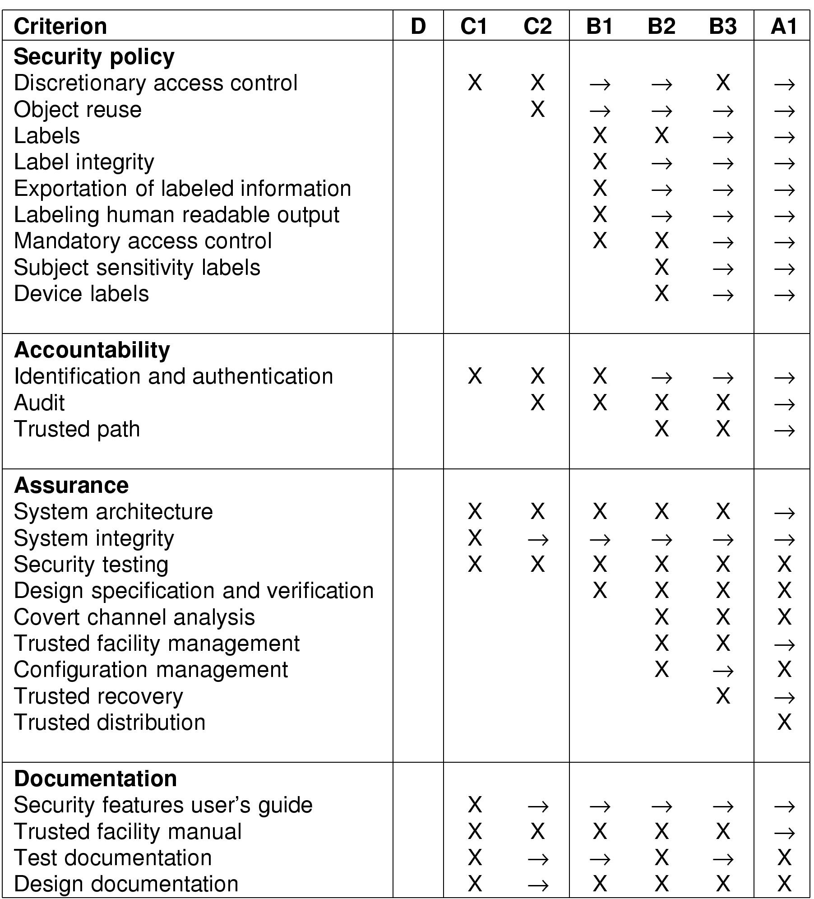
Orange Book security requirements
CS 1550, cs.pitt.edu (originaly modified by Ethan L. Miller and Scott A. Brandt)
Chapter 9: Security

Slide 66
Orange Book security requirements, cont’d
CS 1550, cs.pitt.edu (originaly modified by Ethan L. Miller and Scott A. Brandt)
Chapter 9: Security

Slide 67
Covert channels
Circumvent security model by using more subtle ways of passing information
Can’t directly send data against system’s wishes
Send data using “side effects”
  Allocating resources
  Using the CPU
  Locking a file
  Making small changes in legal data exchange
Very difficult to plug leaks in covert channels!
CS 1550, cs.pitt.edu (originaly modified by Ethan L. Miller and Scott A. Brandt)
Chapter 9: Security

Slide 68
Covert channel using file locking
Exchange information using file locking
Assume n+1 files accessible to both A and B
A sends information by
  Locking files 0..n-1 according to an n-bit quantity to be conveyed to B
  Locking file n to indicate that information is available
B gets information by
  Reading the lock state of files 0..n+1
  Unlocking file n to show that the information was received
May not even need access to the files (on some systems) to detect lock status!
CS 1550, cs.pitt.edu (originaly modified by Ethan L. Miller and Scott A. Brandt)
Chapter 9: Security

Slide 69
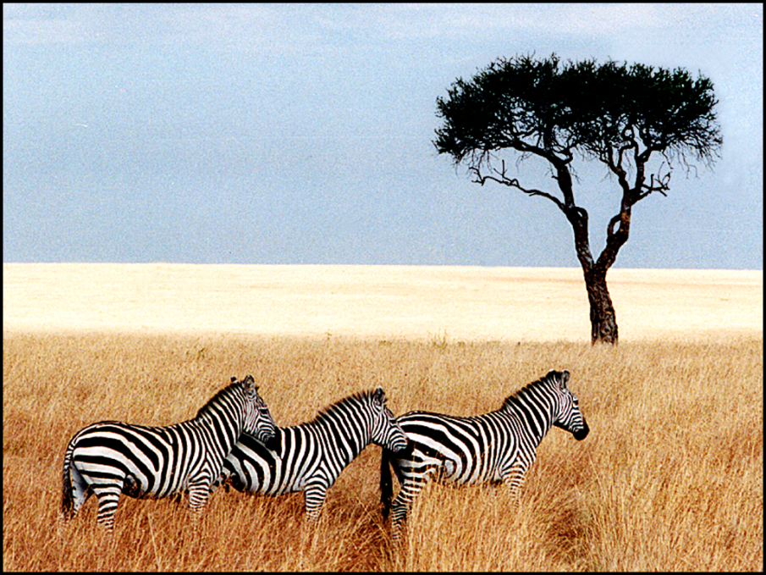
Steganography
Hide information in other data
Picture on right has text of 5 Shakespeare plays
  Encrypted, inserted into low order bits of color values
Zebras
Hamlet, Macbeth, Julius Caesar
Merchant of Venice, King Lear
CS 1550, cs.pitt.edu (originaly modified by Ethan L. Miller and Scott A. Brandt)
Chapter 9: Security

