Slide 1
SWE 681 / ISA 681
Secure Software Design & Programming
Lecture 1: Introduction
Dr. David A. Wheeler
2015-01-22

Slide 2
Outline
Why is most software insecure?
Must consider security throughout lifecycle
Information security principles/terminology
Risk management/assurance cases
Weakness groupings
Overview of Unix/Linux/POSIX

Slide 3
Insecure software
Insecure software may:
  Release private/secret information
  Corrupt information
  Lose service
Costing:
  money
  time
  trust
  lives

Slide 4
Why is most software insecure?
Few developers know how to develop secure sw
  Most schools don’t have it in their curricula
    If it is, it’s optional graduate level, not required undergrad
  Programming books/courses don’t teach it
  Some common operations intrinsically dangerous (esp. C)
  Most developers don’t think like an attacker
    “How could this be attacked?” – be slightly paranoid
  Developers don’t learn from others’ security mistakes
    Most vulnerabilities caused by same mistakes over 40+ years
    Focus on learning common errors… so you won’t make them
Customers can’t easily evaluate software security
Managers don’t always resource/train adequately
There are many other reasons, too.

Slide 5
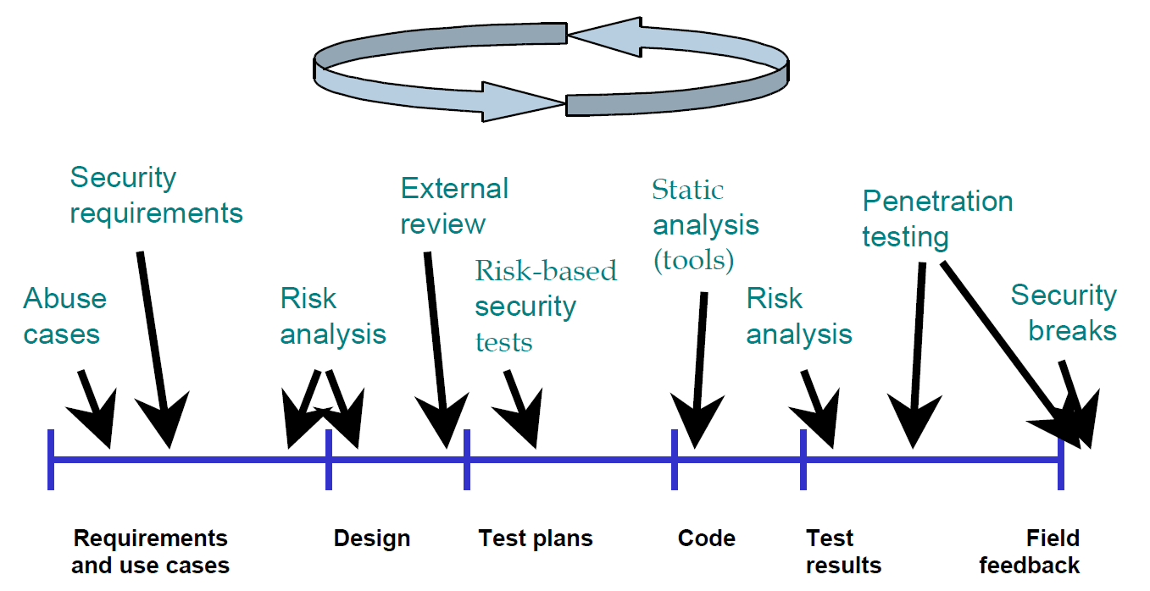
Must consider security throughout lifecycle
Developing secure software requires actions throughout lifecycle
  “Defense-in-breadth”
This class focuses on design & implementation (code)
Source: “Improving Security Across the Software Development Lifecycle – Task Force Report”, April 1, 2004. http://www.cyberpartnership.org/init.html; based on Gary McGraw 2004, IEEE Security and Privacy. Fair use asserted.

Slide 6
Information Security Principles and Terminology

Slide 7
Attacker, Cracker, Hacker
Attack: “Any kind of malicious activity that attempts to collect, disrupt, deny, degrade, or destroy information system resources or the information itself.” [National Information Assurance (IA) Glossary, CNSS 4009]
Attacker: Someone who attacks a system (without authorization)
Cracker: “an individual who attempts to access computer systems without authorization” (type of attacker) [RFC 1392]
Hacker: “A person who delights in having an intimate understanding of the internal workings of a system, computers and computer networks in particular” [RFC 1392]
  NOTE: Hacker ≠ attacker
  Most hackers don’t attack systems
  Many attackers aren’t hackers (might not be clever or knowledgeable)
  Common journalist mistake

Slide 8
Many types of attackers
Criminals (for money)
Terrorists
Governments
Crackers (often for pleasure)
…
We want to prevent their attacks from succeeding!
It is harder to defend vs. well-resourced adversary:
  What are their resources?
  What are they trying to do (so we can counter)?

Slide 9
Security objectives
Typical security objectives (CIA):
  Confidentiality: “No unauthorized read”
  Integrity: “No unauthorized modification (write/delete)”
  Availability: “Keeps working in presence of attack”
    vs. “Denial of Service” (DoS) attack
    “Distributed Denial of Service (DDoS)” attack is resource vs. resource
      Make harder to take down, recover quickly when stop(ped)
Sometimes separately-listed objectives:
  Non-repudiation (of sender and/or receiver)
  Privacy (e.g., protecting user identity)
  Auditing/accountability/logging
  Identity & [identity] authentication (I&A), authorization
    Last two abbreviated as AuthN and AuthZ

Slide 10
[User] Authentication
Proving the identity of a user (might be a program!)
Authentication is basis of an authorization decision
  All objectives depend on if you’re authorized
  So authentication is fundamental
Authentication approaches (first 3 traditional):
  Something you know (passwords)
  Something you have (key, token)
  Something you are (biometrics)
  Somebody you know (vouching) – often forgotten
Strong authentication uses more than one approach
Most common: Passwords (“something you know”) to prove username (identity)
Notes:
“Fourth-Factor Authentication: Somebody You Know” by
John Brainard, Ari Juels, Ronald L. Rivest, Michael Szydlo, Moti Yung
CCS’06, October 30–November 3, 2006, Alexandria,Virginia, USA.
Copyright 2006 ACM1-59593-518-5/06/0010

Slide 11
Password Problems
User-created passwords often easily guessed
  Often based on user name, personal traits, etc.
  Often based on dictionaries with trivial substitutions
  Often too short
Yet system-generated passwords often too hard to remember
How many passwords do you have to remember?
  If browser stores them, what if browser is subverted?
  If reuse, breaking into one breaks into many
Often passwords can be captured or discovered

Slide 12
Attackers vs. passwords
Capture password
  Keyloggers, network eavesdropping, shoulder surfing
  Break into server, capture passwords, reuse elsewhere
Brute force attack
  Try all combinations
Dictionary attacks
  Guess passwords using a password dictionary + permutations
  Password dictionaries widely available
    Include multiple human languages, terms from wide interests (e.g., Shakespeare and Star Trek), etc.

Slide 13
Defending passwords
Encrypt connection carrying passwords
Require “good” passwords when user tries to set one
  Long enough, different symbol types, etc.
  Check against dictionaries
On server, don’t store passwords as clear text
  Store as “salted hashes” so attacker cannot use directly
  We’ll discuss salted hashes later in course
Require occasional password changes
Make it hard for attacker to exploit “lost my password”
Alert user when the password is changed
  E.G., via email

Slide 14
Alternatives to passwords
Algorithms
  One-time passwords
  Shared secret
  Public key cryptography
Hardware

Slide 15
One-time passwords
Password list – must use in order, can’t reuse
  Give user a list, cross off each one as used
Pros:
  Counters network eavesdropping, shoulder surfing
  Cheap to implement; tiny state to store at server
Cons:
  Harder to distribute list
  Compromise of list allows impersonation
  Users hate them (when implemented by hand)

Slide 16
Shared secret
User & server have shared secret
Authentication process:
  Server generates nonce (random number), sends to client
  Client encrypts nonce with secret, sends back
  Server also encrypts, compares with client value
  If same, user must know the secret – ok!
Pros:
  Prevents network eavesdropping
Cons:
  If secret compromised, user can be impersonated

Slide 17
Public key cryptography
Use “public key cryptography”
  User has two numbers, “public key” & “private key”
  Server knows public key of users
Authentication process:
  Server generates/sends random nonce to client
  Client encrypts nonce with private key, sends back
  Server decrypts with public key, if match, ok!
Pros: Provides non-repudiation of client key
Cons: If user’s private key compromised, user can be impersonated

Slide 18
Hardware devices
Challenge-response: Server sends number (nonce), devices receives and generates response, response sent back to server
    Could implement shared-secret or public key
Time-based challenge-response: Uses current time to determine what to send to server
    Server and token have to have time synchronized
Smartcards: Contains user credentials
    Better ones never yield credentials outside card

Slide 19
Example: YubiKey
YubiKey: Physical device, plugs into USB port, pretends to be (an additional) keyboard
User moves cursor to “password” position and presses button on Yubikey
On Button press, generates and “types in” a one-time password + ENTER
Server verifies; if verifies, that password can’t be reused
Internally works on shared-secret key with AES
Shared secret used to encrypt a “serial number” that‘s incremented
Sources: http://lwn.net/Articles/409031/ http://yubico.com/products/yubikey/

Slide 20
Authorization
Once you have user identity and authentication, you can determine what they’re authorized to do
Discretionary Access Control
  Data has owner, owner decides who can do what
Mandatory Access Control
  Data has certain properties, some access rights cannot be granted even by owner (e.g., classification)
Role Based Access Control (RBAC)
  Assigns users into roles (static or dynamic)
  Access granted to the role, not directly to the user
  Sometimes membership restrictions (receiving clerk must not be purchasing agent)

Slide 21
Auditing/Accountability/Logging
Record system actions, esp. security-relevant ones (e.g., log in)
Detect unusual activity that might signal attack or exploitation
  So you can take action: Disconnect that connection, take down system, prosecute, …
  May help recovery or preventing future exploitation (by knowing what happened)
  Operational systems often send logs elsewhere
    If system subverted, older log entries can’t be changed

Slide 22
Defense-in-depth/breadth
Defense in depth: Having multiple defense mechanisms (“layers”) in place, so that an attacker has to defeat multiple mechanisms to perform a successful attack
Defense in breadth: Applying approaches to develop secure software throughout the lifecycle

Slide 23
Weaknesses & Vulnerabilities
Weakness: A type of defect/flaw that might lead to a failure to meet security objectives
Vulnerability: “Weakness in an information system, system security procedures, internal controls, or implementation that could be exploited by a threat source” [CNSS 4009]

Slide 24
Weakness classifications
Software is vulnerable because of some weakness that is exploitable
  Typically vulnerability is unintentional
  Usually the weakness (type/kind of flaw) has occurred thousands of times before
We’ll spend lots of time learning about weaknesses – so you won’t make the same mistakes
Many weakness classification systems exist
  Common Weakness Enumeration (CWE) – merged
  “Seven pernicious kingdoms”, etc.
  Key is to learn what these weaknesses are

Slide 25
Common Weakness Enumeration (CWE)
Common Weakness Enumeration (CWE) = list of software weaknesses
Weakness = Type of vulnerabilities
CWE-120 = Buffer Copy without Checking Size of Input (“Classic Buffer Overflow”)
Common naming system
  Useful as “common name” (e.g., tool coordination)
  Does have some structuring/organization (slices, graphs, parents/children)… but that’s not its strength
More info: http://cwe.mitre.org

Slide 26
Seven Pernicious Kingdoms
Input Validation and Representation
API Abuse
Security Features
Time and State
Error Handling
Code Quality
Encapsulation
Source: Tsipenyuk, Chess, and McGraw,
“Seven Pernicious Kingdoms: A Taxonomy of Software Security Errors”,
Proceedings SSATTM, 2005

Slide 27
Abstract view of a program
Program
Process Data
(Structured Program Internals)
Input
Output
Call-out to
other programs
(also consider
input & output issues)

Slide 28
Risk Management &
Assurance Cases

Slide 29
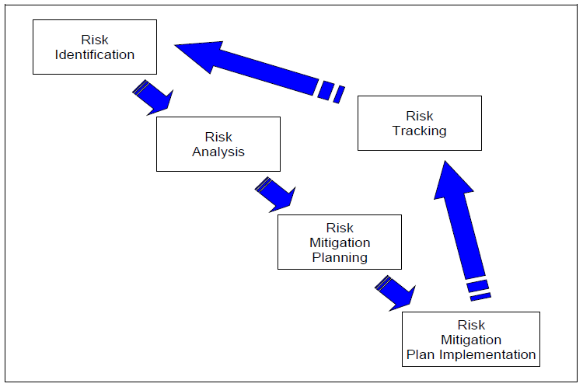
Risk Management should be part of entire system lifecycle
Risk management process:
Communication and consultation
Establishing the context
Risk assessment
  Risk identification
  Risk analysis
  Risk evaluation
Risk Treatment
Source: ISO 31000:2009
Source: Risk Management Guide for DoD Acquisition, DoD, August 2006
Potential impacts of security vulnerabilities are a risk
  Manage that risk as part of risk management
  If complex to communicate, assurance case can help

Slide 30
Possible risk responses
(with some of their names)
Avoid / eliminate
  Ensure risk can’t happen. Best, not always practical
Control / reduce / mitigate
  Limit system privileges so if attacker “takes over” a program, that program cannot do everything
  Limit data available on potentially-attacked system
  Detect/recover (quickly)
    Recover quickly when network denial-of-service ends
    Maintain protected backups, easy restore mechanism
Transfer / share (e.g., outsourcing, insurance)
Assume / accept / retain (budget for it!)
Notes:
Sources:
Risk Management Guide for DoD Acquisition, Sixth Edition (Version 1.0), 2006.
Dorfman, Mark S. (2007). Introduction to Risk Management and Insurance (9 ed.). Englewood Cliffs, N.J: Prentice Hall. ISBN 0-13-224227-3.

Slide 31
The key point about risks
You cannot eliminate all risks!
  Good goal, not always (affordably) achievable
You can manage them

Slide 32
Assurance case
(ISO/IEC 15026)
Assurance = Grounds for justified confidence that a claim has been/will be achieved (but how communicate that?)
ISO/IEC 15026-2:2011 specifies defines structure & contents of an assurance case
  Facilitates stakeholder communications, engineering decisions
  Typically for claims such as safety & security
An assurance case includes:
  Claim(s): Top-level claim(s) for a property of a system or product
  Arguments: Systematic argumentation justifying this claim
  Evidence/assumptions: evidence & explicit assumptions underlying argument

Slide 33
Structure of an assurance case
Claim
(Conclusions, uncertainty)
Argument
Justification of
Argument
Sub-claim
Evidence
Assumption
  “Arguing through multiple levels of subordinate claims, this structured argumentation connects the top-level claim to the evidence and assumptions.”

Slide 34
Security-specific example of an assurance case (moderate threat)
System is adequately secure against moderate threats
Off-the-shelf (OTS)/platform includes
OS, libraries, & services (e.g., RDBMS);
Discuss reputation, evaluation(s),
supply chain used, config hardening,
patch process, …
Claim:
System design counters or reduces impact of most vulnerabilities
Most vulnerabilities are due to likely/ common weaknesses (defect types), & custom sw is unlikely to have them
OTS/ platform is secure
System security verification found no issues
All un-trusted inputs id’d and checked by strict white-lists
Compo-nents given limited privilege, so break-ins less likely to have significant harm
Passwords stored as salted hashes, not clear text, so attacker cannot easily reuse them if acquired
Static analysis results ok
Dynamic analysis results ok
Identified list of likely weak-nesses
All developers trained in likely weaknesses & how to avoid them
All likely weak-nesses have specific counter-measures
…
All SQL statements prepared
Buffer overflows not possible in selected programming language

Slide 35
Discussion
What changes might you make to the sample assurance case on the previous slide?
  Given what you know now; obviously you’ll learn more as we go through the class!

Slide 36
ISO/IEC 15026 is intentionally limited
Does not place requirements on the quality of the contents of an assurance case
  Assurance case provides structure to record claims, arguments, & evidence
  Stakeholders decide if it’s enough
    Powerful terms: “All” / “highest priority” / “most important”
Does not require the use of a particular terminology or graphical representation. Notations in use include:
  Claims, Arguments and Evidence (CAE) notation
  Goal Structuring Notation (GSN)
Does not specify where or how data stored/managed
Does not require that all information be in 1 place
  Point to info elsewhere (URLs/filenames)

Slide 37
Unix/Linux/POSIX

Slide 38
Basics of Unix/Linux/POSIX
Our focus on secure apps/server software
  Not on creating secure operating systems (same principles)
Must understand security model of supporting components (e.g., OS and DBMS)
Focus on Unix/Linux/POSIX model, used in:
  Linux-based (Red Hat Enterprise, Fedora, Ubuntu, Debian, Android, …)
  Unix (*BSDs, Solaris, AIX, …)
  MacOS & iOS
We will call these “Unix-like” systems
MS Windows’ model is different in detail, though in many cases very similar (many analogies)

Slide 39
Kernel vs. User space
Usually implemented as:
  Kernel: Low-level software that connects to hardware & implements basic constructs
  User space: Processes that run programs
    Some processes have special privileges
    Some long-running processes provide services (daemons)
User space
Kernel
Kernel

Slide 40
Users & Groups
Each user is assigned user id (UID) – an integer
  UID 0 (“root user”) can override security controls
  File /etc/passwd lists username and its UID
Users belong to at least one group
  Each group has a name and group id (GID) – integer
  In practice, GID 0 also has special privileges
  Modern systems allow users to belong to many groups
  File /etc/group lists groupname, GID, membership
  Often a special group exists for just that user
Separate different users in a multi-user system
Android: Applications have different UID/GID

Slide 41
Processes
A process = a running program
  Same program may be run by >1 process
  Process may have multiple threads of control
Processes inherit most attributes & rights from creating process, often all the way back to the creating user
See running processes with command line:
  ps -ef
Processes have various attributes

Slide 42
Process Attributes
RUID, RGID: Real UID, GID of process’ user
EUID, EGID: Effective UID, GID – what is actually used for security tests (not always RUID, RGID).
SUID, SGID: Saved UID, GID – a UID, GID that can be switched to (so you can enable/disable privileges)
FSUID, FSGID: (Linux only) UID and GID used for filesystem checks UID, GID
Supplemental groups: List of groups process is a member of
Umask: Used to set default permissions of created files
File system root (where it thinks “/” is; not the same as user root)
Pointer to current directory (used with relative pathnames)

Slide 43
Files
Files, aka filesystem objects (FSOs), can be read from or written to. Files may be:
  Regular (ordinary) file, character special file, block special file, FIFO special file, symbolic link, socket, and directory
Pathname: A sequence of bytes to identify a file
  Absolute pathnames start with “/” (the “root directory”)
  Regular pathnames don’t –begin at current directory
  Sequence of pathname components (filenames) and “/” (directory separator)
  What many call “filenames” are officially “pathname components”
  Different pathnames may refer to the same file
    You can create multiple alias names to the same underlying file
    If you “remove” a file, it may still be there via another path
  Filenames & pathnames not necessarily character string
    Byte sequences may be illegal/meaningless in current (or other) locale

Slide 44
Files have attributes
Owner UID and GID: Who owns this file?
  Only owner can change file’s UID and GID
Permission bits: What rights are granted?
  User: read (r), write (w), execute (x)
  Group: read (r), write (w), execute (x)
  Other: read (r), write (w), execute (x)
  Sticky (t) for directory: Remove/rename of its files may only be done by owner of directory or that file
Attributes that grant rights when run:
  Setuid: When run, set EUID to owner UID
  Setgid: When run, set EGID to owner GID

Slide 45
Applying permission bits
The most specific permission set is used
  If process UID is file UID, the file “user” permissions are used to determine if can r,w,x.
  If a process GID (including supplemental groups) is a file GID, the file “group” permissions are used
  Otherwise, the “other” set is used
For files, this is straightforward
  E.G., process P tries to write to file F. If process P has UID u, and file owner is also u, then the “user” permission “write” is checked

Slide 46
Permission bits of directories
Directories are implemented as ordinary files with special capabilities
  This may help you understand permission meaning
Directory permissions are:
  Read (r): can see the filenames in it
  Write (w): Can add/remove/rename its filenames
  Execute (x): Can look up (use) a filename in it

Slide 47
Seeing file permissions
The “ls -l” command lists files + other info
-rw-rw-r--. 1 dwheeler dwheeler 21 Aug 22 2012 junk.txt
Left-hand side:
  Type of file (-=ordinary, d=directory, …)
  User permissions (rwx); s for x if executable & setuid
  Group permissions (rwx); s for x if executable & setgid
  Other permissions (rwx); t for x if executable & sticky
  “-” for permission not granted
- | r | w | x | r | w | x | r | w | x
Type
User
Group
Other

Slide 48
Setting file permissions
Command-line utility to set permissions:
  chmod new-permissions list-of-files
New-permissions can be:
  Set permissions: [ugo]=[rwx]
  Remove permissions: [ugo]-[rwx]
  Add permissions: [ugo]+[rwx]
For example:
  chmod go-wx somefile

Slide 49
Setting file permissions (2)
To set or see permissions, faster in octal (!!)
  Add up read=4, write=2, execute=1
  Write each digit down
For example:
  User read+write… 4+2=6
  Group read… 4=4
  Others none.. 0
For final command, just write user/group/other digit:
  chmod 640 my-secret-sauce
Other examples:
  777=rwxrwxrwx (everyone has all permissions – avoid this)
  755=rwxr-xr-x (user can do all; group/other can read & execute)

Slide 50
When are permission values used?
File permissions on checked on file open
  Not on every read/write
Permissions are checked on system calls from user process to the kernel, e.g.:
  open – open file
  creat – create new file
  rename – rename the file
  link – create a new name (hard link) for a file
  unlink – remove the link (if this is the last one, it’s deleted)
  symlink – create a symbolic link (a name that points elsewhere)
  socket – create an endpoint for communication
  mknod – make a special file (e.g., a named pipe)

Slide 51
Additional permission systems
Some systems have additional permission systems layered on top
Security-Enhanced Linux (SELinux)
  Originally developed by NSA
  Deployed by default in RHEL, CentOS, Fedora
  Variant (SEAndroid) deployed in Android 4.3 & enforcing 4.4+
  Every file system object (per metadata) & process has a type label
  Every kernel request checks if that interaction ok
  Amusing introduction available in “The SELinux coloring book”
AppArmor
  Deployed by default in Ubuntu & SuSE Linux
  Rights granted using file system path name, not inode metadata
    Hard links to same contents are different to AppArmor (& same in SELinux)
  Emphasis on simplicity & not fine-grained control
    E.g., originally only controlled read, write, append, execute, lock, and link
Notes:
“The SELinux coloring” is available via http://blog.linuxgrrl.com/2014/04/16/the-selinux-coloring-book/

Slide 52
Unix-like documentation
Historically in “man pages” in sections:
  1 Executable programs or shell commands
  2 System calls (functions provided by the kernel)
  3 Library calls (functions within program libraries)
  8 System administration commands
E.G., “ls(1)” is the page about the program “ls”
Sometimes the same name reused, so often used to distinguish
  chmod(1) is the user program
  chmod(2) is the system call that chmod(1) uses

Slide 53
Quotas & Limits
Useful for preventing denial of service attacks
Beware: Terms “soft limit” and “hard limit”
File system quotas on each “mountpoint” (where disk is added)
  Hard limit (actual maximum)
  Soft limit (can be temporarily exceeded)
  Can limit the total blocks and the total number of files
  Per user and/or per group
  See quota(1), quotactl(2), quotaon(8)
Process resource limits (rlimit/setrlimit)
  Hard limit: Cannot be exceeded by normal user
  Soft limit: Cannot be exceeded, but can be raised/lowered up to hard limit
  RLIMIT_CPU: Maximum CPU time
  RLIMIT_DATA: Maximum data size
  Also: File size, number of child processes, number of open files, etc.
  See getrlimit(2), setrlimit(2), and getrusage(2), sysconf(3), and ulimit(1)

Slide 54
Sockets (for TCP/IP)
Server
Client
Sockets represent network communication endpoints
Today, network == Internet protocol (IP), and usually TCP (creates illusion of data flow)
If you want to encrypt it, typically build encryption on top
socket()
socket()
bind()
listen()
connect()
Establish
connection
accept()
read()/
write()
read()/
write()
close()/
shutdown()
close()/
shutdown()

Slide 55
Pluggable Authentication Modules (PAM)
Implemented in many Unix-like systems
Separates modules for system authentication from application
  Typical: Directory “/etc/pam.d” has a config file for each application that needs authentication
File identifies modules to use for 4 operations:
  account: Determines whether the user is allowed to access the service, whether their passwords has expired, etc.
  auth: Authentication (is user is who they claim to be?)
  password: Change authentication (e.g., password)
  session: What to do before and/or after user is authenticated
Key application call:
  pam_authenticate: Authenticate user given “password”

Slide 56
Auditing/Logging: Syslog/rsyslog/…
Unix/Linux/POSIX systems often record system logs by appending to a text file
  E.G., /var/log/messages
Stored Simple Format
  Date Time Machine-name service: report
    Aug 28 14:23:20 dwheeler3-pc dbus[923]: [system] Successfully activated service 'net.reactivated.Fprint'
Logger can be configured (what to log & where)
Programs call syslog(3) to report something that might be logged

Slide 57
Syslog priority levels
Programs assign a priority level to each message [POSIX 2008]:
  LOG_EMERG - A panic condition, reported to all processes
  LOG_ALERT - A condition that should be corrected immediately
  LOG_CRIT - A critical condition
  LOG_ERR - An error message
  LOG_WARNING - A warning message
  LOG_NOTICE - A condition requiring special handling
  LOG_INFO - A general information message
  LOG_DEBUG - A message useful for debugging programs
Administrators can configure what’s done with them

Slide 58
What we’ll cover in the course
We’ll be covering key guidelines
  What to do…
  … and what not to do
Designing & implementing secure software is more than just knowing common mistakes
  But vast majority of vulnerabilities are caused by common mistakes (“weaknesses”)
  We’ll spend significant time understanding them & learning how to prevent them

Slide 59
Any questions?

Slide 60
Released under CC BY-SA 3.0
This presentation is released under the Creative Commons Attribution-ShareAlike 3.0 Unported (CC BY-SA 3.0) license
You are free:
  to Share — to copy, distribute and transmit the work
  to Remix — to adapt the work
  to make commercial use of the work
Under the following conditions:
  Attribution — You must attribute the work in the manner specified by the author or licensor (but not in any way that suggests that they endorse you or your use of the work)
  Share Alike — If you alter, transform, or build upon this work, you may distribute the resulting work only under the same or similar license to this one
These conditions can be waived by permission from the copyright holder
  dwheeler at dwheeler dot com
Details at: http://creativecommons.org/licenses/by-sa/3.0/
Attribute me as “David A. Wheeler”

