Slide 1
Mobile OS Security
Rashad Maqbool Jillani
rjillani@fau.edu

Slide 2
Background
1.5 billion mobile phone users (ITU)
Mobile device capabilities are significantly advanced than those in the past
PDA + Cell Phone = Smartphone
Key question
  Are we going to face the same level of threat to security of mobile devices as that of in desktop environment?

Slide 3
Background
Operating System (OS)
  Process Management
  Memory Management
  File Management
  I/O Management
  Networking
  Protection System
  User Interface
Real Time Operating System (RTOS)
  Characterized by timing constraints
Mobile Operating System (Mobile OS)
  RTOS running on a mobile device

Slide 4
Introduction
Mobile Malware
  Security research on mobile networks has focused largely on routing
  issues, and more recently on protocol security.
Information Theft
  Transient information, Static information
  Blue Snarfing, Blue Bugging
Unsolicited Information
Theft of Service Attacks
Denial of Service Attacks
  Flood the device
  Drain Power Attacks (Battery Exhaustion or Sleep Deprivation Torture)

Slide 5
Introduction
Evolution of Symbian OS
  1997 - 32 bit EPOC Platform (Psion Software Inc) – Psion Series 5 PDA
  1998 – Symbian – A spin-off from Psion Software Inc.
  Co-owned by Psion, Nokia, Eriksson, Motorola
  The motive behind this spin-off was to develop an advanced software platform for a new combination of consumer products called smartphones which would combine telephony and computing capability
  1999 – EPOC named as Symbian OS
  Co-owned by Psion, Nokia, Sony-Eriksson, Motorola, Matsushita (Panasonic), Samsung and Siemens.
Symbian OS
  Hard RTOS based on layered/micro-kernel architecture
  StrongARM architecture (ARM9 running over 100 MHZ)
  Program storage (flash memory) ; OS storage flash ROM

Slide 6
Symbian OS
Micro-kernel uses client/server session based IPC
Servers mediate access to shared resources and services
Kernel deals with memory allocation and IPCs
Proactive defense mechanism
  Platform Security Architecture
  OS Services
  Data Caging

Slide 7
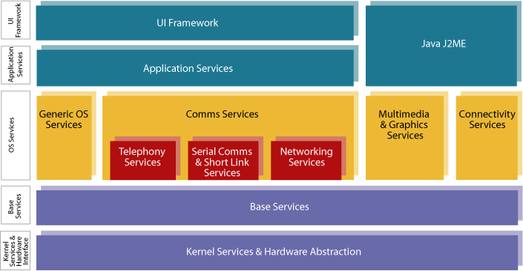
Symbian OS Architecture

Slide 8
Architectural Overview
Core
  Kernel, file server, memory management and device drivers
System Layer
  Communication and computing services e.g. TCP/IP, IMAP4, SMS and database management
Application Engines
User Interface Software
Applications
All layers communicate with each other using Client/Server Mechanism

Slide 9
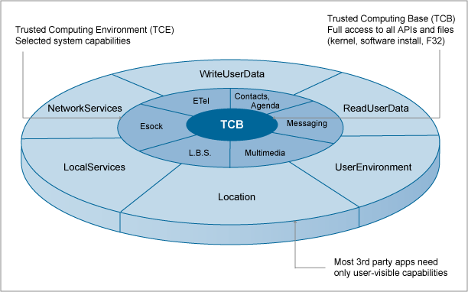
Platform Security
Categories of trust

Slide 10
Capability Model
A capability is an access token that corresponds to permission to access sensitive system resources. (Entity of protection)
Capability Rules
Rule 1: Every process has a set of capabilities and its capabilities never change during its lifetime.
Rule 2: A process cannot load a DLL with a smaller set of capabilities than itself.
…………..
…………..

Slide 11
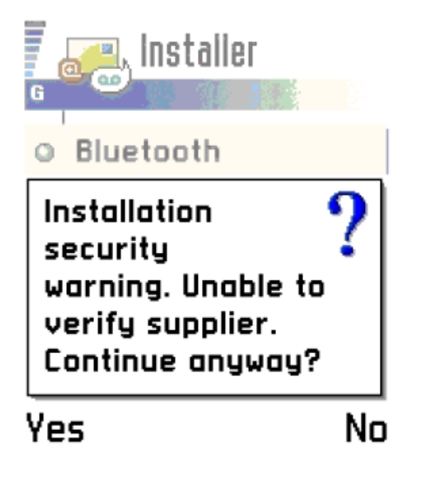
Certification
PlatSec uses certification to grant access to
capabilities.
EXE
Requested capabilities
capabilities required
Compared and checked
at install time
DLL
Requested capabilities
capabilities that can be granted
Certificate
capabilities that can be granted
Created during
validation
procedure.
Validity confirmed
SIS

Slide 12
The kernel’s role
EKA2 kernel is the key component of TCB
Multi-threaded and pre-emptive multitasking RTOS kernel
IPC mechanism – Client/Server Sessions
Special accessor and copy functions
Thread stacks and heaps are private chunks
When the kernel allocates memory to a process, it overwrites it with zeroes to prevent any private data from the previous owner being accessible to the new process.
DBMS
Window
Server
File
Server
Kernel
Server
Kernel mediated sessions
Application

Slide 13
The kernel…
Parameter passing in IPC request – the length is checked, even in the case of a pointer, to ensure that the server will not read or write more than the client expected to disclose : any attempt to read before the pointer’s address or after its length will fail.
EKA2 also takes advantage of the ARMv6 never-execute bit in the page permissions when supported by the hardware. This is used to deny execution of code from stacks, heaps and static data.

Slide 14
Data Caging
Data caging allows applications on a Symbian OS device to have private data which is not accessible by other applications.
It is about file access control. Opposite to traditional “Access Control List”, it is “Fixed Access Control Policy”.
‘‘The access rules of a file are entirely determined by its directory path, regardless of the drive.’’
Four different sets of rules have been identified which are represented by four directory hierarchies under the root ‘\’:
\sys ; Only TCB processes can read and write
\resource ; All processes can read but only TCB processes can write
\private ; All program are provided a private sub directory regardless of their level of trust. Only process owner and TCB processes can read and write
All other root files and directories ; Public space

Slide 15
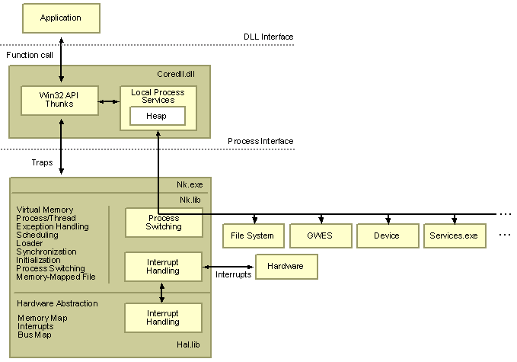
Windows CE OS
Win CE 5.0 is a hard RTOS
Base OS functionality is provided by kernel which includes process, thread, memory and file management
Kernel acts as a conduit for the rest of the core OS
Windows CE kernel uses a paged virtual-memory system to manage and allocate program memory.
The kernel also allocates memory to the stack for each new process or thread.

Slide 16
Memory Architecture
ROM stores the entire operating system (OS), as well as the applications that come with the OS design.
The OS loads all read/write data into RAM.
When OS executes programs directly from ROM, it saves program on RAM and reduces the time needed to start an application, because the OS does not have to copy the program into RAM before launching it.
The maximum size for the RAM file system is 256 MB, with a maximum size of 32 MB for a single file.
The maximum size for the RAM file system is 256 MB, with a maximum size of 32 MB for a single file. However, a database-volume file has a 16-MB limit. The maximum number of objects in the object store is 4,000,000.
The boundary between the object store and the program RAM is movable.

Slide 17
Memory Architecture (cont)
Windows Mobile 5.0
RAM is used exclusively for running programs.
Flash memory is used for storage of programs and data.
Result: extended battery life but slower performance

Slide 18
OS Security
Componentization: OS loads only required components
Module Certification: Windows CE exposes a function called OEMCertifyModule, if implemented; this function gives OEM the ability to verify the trust level of a process or a DLL within the OS.
The file system can be either a RAM and ROM file system or a ROM only file system.
The system registry stores the data about applications, user configuration settings and preferences, passwords.
System registry is readable.

Slide 19
Mobile Malware
Cabir: June 20, 2004, Symbian OS, Bluetooth worm
DUTS: July 17, 2004, Win CE, File sharing and email virus
BRADOR: August 5, 2004, Win CE, requires manual installation, first know backdoor
Qdial: August 12, 2004, Symbian OS, replicates through Mosquitoes game, sends SMS to premium rate numbers
Skulls: November 21, 2004, Symbian OS, trojan that replicates through file sharing networks
Velasco: December 29, 2004, Symbian OS, Bluetooth worm
Locknut (Gavno): February 1, 2005, Symbian OS, replicates via download from Symbian patch sites
CommonWarrior: March 7, 2005, Symbian OS, spreads over Bluetooth/MMS
Dampig: March 8, 2005, Symbian OS, malicious file dropper
Cardtrap: September 20, 2005, Symbian OS, Trojan that spreads to users’ PC through phone’s memory card

Slide 20
Comparative Review
OS Design and Architecture
  Symbian: ARM processors running 100-200 MHz
  Win CE: ARM and Intel processors running 200-400 MHz
Memory Management
  Symbian: OS kernel runs in privileged mode, with each app has its own address space
  Win CE: Shared RAM and flash ROM, use eXecute In Place (XIP) scheme
File System
  Symbian: TCB contains file system
  Win CE: Hierarchical file system accessible through kernel functions
Development
  Symbian: Symbian specific frameworks/libraries
  Win CE: Windows API
Security
  Symbian: Fairly well designed
  Win CE: Lack of process’s address space protection
Audit Trail

Slide 21
Conclusion
As the user base of these devices grows over time, the possibility of serious threats will be imminent.
Openness facilitates to both third party developers and malware writers
Control the software distribution channel
Biggest concern is the hijacking of radio facilities of mobile device
Mobile worms and viruses will be a greater challenge in future unless safeguards become a standard provision on the new devices.
Solution: Antivirus software for mobile devices

