Slide 1
Operating Systems Security Basics & Unix Access Control
https://www.cs.purdue.edu/homes/ninghui/courses/526_Fall14/lectures.html

Slide 2
Readings for This Lecture
Wikipedia
  CPU modes
  System call
  Filesystem Permissions
Other readings
  UNIX File and Directory Permissions and Modes
    http://www.hccfl.edu/pollock/AUnix1/FilePermissions.htm
  Unix file permissions
    http://www.unix.com/tips-tutorials/19060-unix-file-permissions.html
Topic 8: Operating System Security Basics

Slide 3
Announcements and Outline
Outline of this topic
  Brief overview of the goals of OS security
  Memory protection, CPU modes, and system calls
  Access control basic concepts
  UNIX File System permissions
  UNIX processes
CS526
Topic 8: Operating System Security Basics

Slide 4
What Security Goals Does Operating System Provide?
Originally: time-sharing computers: enabling multiple users to securely share a computer
  Separation and sharing of processes, memory, files, devices, etc.
What is the threat model?
  Users may be malicious, users have terminal access to computers, software may be malicious/buggy, and so on
Security mechanisms
  Memory protection
  Processor modes
  User authentication
  File access control
CS526
Topic 8: Operating System Security Basics
Notes:
Threat model: users may be malicious, users have terminal access to computers, software may be malicious/buggy.

Slide 5
What Security Goals Does Operating System Provide?
More recent past and present: Networked desktop computers: ensure secure operation in networked environment
New threat?
  Attackers coming from the network. Network-facing programs on computers may be buggy. Users may be hurt via online communication.
Security mechanisms
  Authentication; Access Control
  Secure Communication (using cryptography)
  Logging & Auditing
  Intrusion Prevention and Detection
  Recovery
CS526
Topic 8: Operating System Security Basics
Notes:
Threat model: adversaries control the network; can communicate with computers;
Security Goal: Confidentiality, Integrity, Availability

Slide 6
What Security Goals Does Operating System Provide?
Present and near future: mobile computing devices:
New threat?
  Apps (programs) may be malicious.
  More tightly connected with personal life of the owner.
Security mechanisms?
  Isolation of each app.
  Help users assess risks of apps.
  Risk communication.
CS526
Topic 8: Operating System Security Basics

Slide 7
Security is About Reconciling Separation and Sharing
Ensure separation
  Physical: users are restricted to separate devices
  Temporal: processes are executed one at a time
  Logical: each process can have its ownsandbox
    Sandboxing prevents code executing from doing something harmful. Access to resources outside the sandbox is strictly limited.
  Cryptographical: lets pages in the memory being encrypted by cryptographic keys.
    Although other processors may be able to read this information, they may not be able to decrypt the information without the key.
OS also need to ensure sharing
CS526
Topic 8: Operating System Security Basics

Slide 8
Computer System Components
Hardware
  Provides basic computing resources (CPU, memory, I/O devices).
Operating system
  Controls and coordinates the use of the hardware among the various application programs.
Applications programs
  Define the ways in which the system resources are used to solve the computing problems of the users.
Users
  E.g., people, machines, other computers.
CS526
Topic 8: Operating System Security Basics

Slide 9

Abstract View of System Components
CS526
Topic 8: Operating System Security Basics

Slide 10
Memory Protection: Access Control to Memory
Ensures that one user’s process cannot access other’s memory
  fence
  relocation
  base/bounds register
  segmentation
  paging
  …
Operating system and user processes need to have different privileges
CS526
Topic 8: Operating System Security Basics
Notes:
Kernel needs to maintain separation among user processes.
OS kernel needs to access all memory, and user processes cannot
Kernel needs to have more power than user processes.
Earliest PC are not like this. In MS DOS, all processes have the same power.

Slide 11
CPU Modes (a.k.a. processor modes or privilege
System mode (privileged mode, master mode, supervisor mode, kernel mode)
  Can execute any instruction
  Can access any memory locations, e.g., accessing hardware devices,
  Can enable and disable interrupts,
  Can change privileged processor state,
  Can access memory management units,
  Can modify registers for various descriptor tables .
Reading: http://en.wikipedia.org/wiki/CPU_modes
CS526
Topic 8: Operating System Security Basics
Notes:
The separation from different modes are like walls, protecting the kernel from the other processes.

Slide 12
User Mode
User mode
  Access to memory is limited,
  Cannot execute some instructions
  Cannot disable interrupts,
  Cannot change arbitrary processor state,
  Cannot access memory management units
Transition from user mode to system mode can only happen via well defined entry points, i.e., through system calls
Reading: http://en.wikipedia.org/wiki/CPU_modes
CS526
Topic 8: Operating System Security Basics
Notes:
A wall separates the user mode with the system mode.
The wall need gates; and system call are the gates.

Slide 13
System Calls
Guarded gates from user mode (space, land) into kernel mode (space, land)
  use a special CPU instruction (often an interruption), transfers control to predefined entry point in more privileged code; allows the more privileged code to specify where it will be entered as well as important processor state at the time of entry.
  the higher privileged code, by examining processor state set by the less privileged code and/or its stack, determines what is being requested and whether to allow it.
http://en.wikipedia.org/wiki/System_call
CS526
Topic 8: Operating System Security Basics

Slide 14
Kernel space vs User space
Part of the OS runs in the kernel model
  known as the OS kernel
Other parts of the OS run in the user mode, including service programs (daemon programs), user applications, etc.
  they run as processes
  they form the user space (or the user land)
What is the difference between kernel mode and processes running as root (or superuser, administrator)?
CS526
Topic 8: Operating System Security Basics
Notes:
Analogy. Bank.

Slide 15
High-level View of Kernel Space vs. User Space
……
Process 1
Process 2
Process n
The Kernel
Hardware (disks, network interfaces, etc.)
CS526
Topic 8: Operating System Security Basics

Slide 16
Access control
A reference monitor mediates all access to resources
  Principle: Complete mediation: control all accesses to resources
Reference
monitor
?
Resource
User process
access request
policy
CS526
Topic 8: Operating System Security Basics
Notes:
System call gates actually performs access control.

Slide 17
Subject, Principal, User
Subject - In a security context, a subject is any entity that requests access to an object. These are generic terms used to denote the thing requesting access and the thing the request is made against. When you log onto an application you are the subject and the application is the object. When someone knocks on your door the visitor is the subject requesting access and your home is the object access is requested of.
Principal - A subset of subject that is represented by an account, role or other unique identifier. When we get to the level of implementation details, principals are the unique keys we use in access control lists. They may represent human users, automation, applications, connections, etc.
User - A subset of principal usually referring to a human operator. The distinction is blurring over time because the words "user" or "user ID" are commonly interchanged with "account". However, when you need to make the distinction between the broad class of things that are principals and the subset of these that are interactive operators driving transactions in a non-deterministic fashion, "user" is the right word.
CS526
Topic 8: Operating System Security Basics

Slide 18
ACCESS MATRIX MODEL
Objects (and Subjects)
F
G
S
u
b
j
e
c
t
s
r w
own
r
U
r w
own
V
rights
CS526
Topic 8: Operating System Security Basics

Slide 19
ACCESS MATRIX MODEL
Basic Abstractions
  Subjects
  Objects
  Rights
The rights in a cell specify the access of the subject (row) to the object (column)
CS526
Topic 8: Operating System Security Basics

Slide 20
PRINCIPALS AND SUBJECTS
A subject is a program (application) executing on behalf of some principal(s)
A principal may at any time be idle, or have one or more subjects executing on its behalf
What are subjects in UNIX?
What are principals in UNIX?
CS526
Topic 8: Operating System Security Basics

Slide 21
OBJECTS
An object is anything on which a subject can perform operations (mediated by rights)
Usually objects are passive, for example:
  File
  Directory (or Folder)
  Memory segment
But, subjects (i.e. processes) can also be objects, with operations performed on them
  kill, suspend, resume, send interprocess communication, etc.
CS526
Topic 8: Operating System Security Basics

Slide 22
Basic Concepts of UNIX Access Control: Users, Groups, Files, Processes
Each user account has a unique UID
  The UID 0 means the super user (system admin)
A user account belongs to multiple groups
Subjects are processes
  associated with uid/gid pairs, e.g., (euid, egid), (ruid, rgid), (suid, sgid)
Objects are files
CS526
Topic 8: Operating System Security Basics

Slide 23
USERS AND PRINCIPALS
USERS
PRINCIPALS
Unit of Access Control
and Authorization
Real World User
the system authenticates the human user to a particular principal
CS526
Topic 8: Operating System Security Basics

Slide 24
USERS AND PRINCIPALS
There should be a one-to-many mapping from users to principals
  a user may have many principals, but
  each principal is associated with an unique user
This ensures accountability of a user's actions
What does the above imply in UNIX?
CS526
Topic 8: Operating System Security Basics

Slide 25
Organization of Objects
In UNIX, almost all objects are modeled as files
  Files are arranged in a hierarchy
  Files exist in directories
  Directories are also one kind of files
Each object has
  owner
  group
  12 permission bits
    rwx for owner, rwx for group, and rwx for others
    suid, sgid, sticky
CS526
Topic 8: Operating System Security Basics

Slide 26
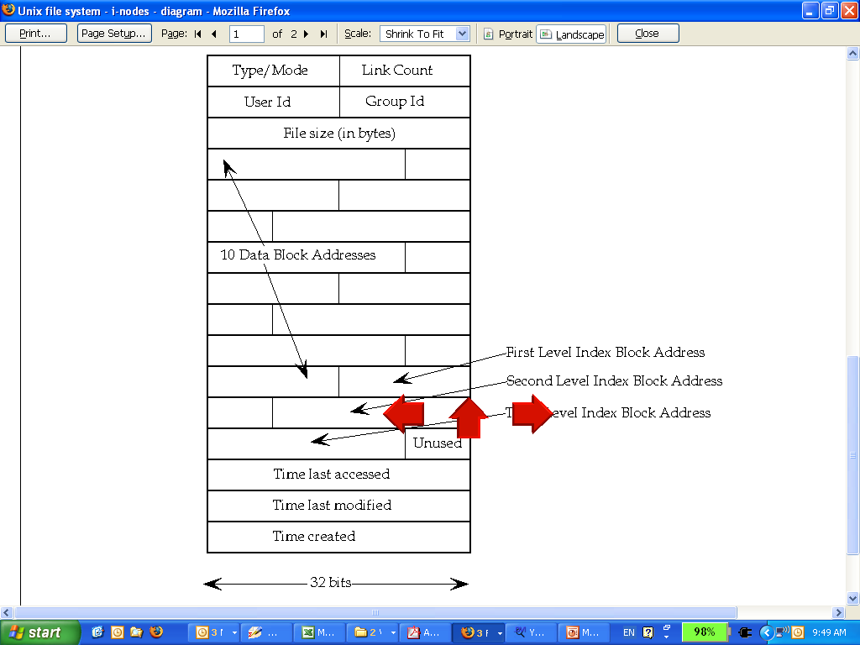
UNIX inodes:
Each file corresponds to an inode
CS526
Topic 8: Operating System Security Basics

Slide 27
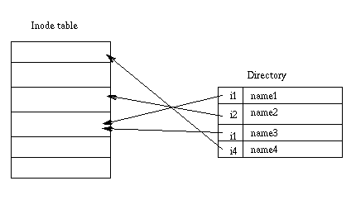
UNIX Directories
CS526
Topic 8: Operating System Security Basics

Slide 28
Basic Permissions Bits on Files (Non-directories)
Read controls reading the content of a file
  i.e., the read system call
Write controls changing the content of a file
  i.e., the write system call
Execute controls loading the file in memory and execute
  i.e., the execve system call
CS526
Topic 8: Operating System Security Basics

Slide 29
Execution of a file
Binary file vs. script file
Having execute but not read, can one run a binary file?
Having execute but not read, can one run a script file?
Having read but not execute, can one run a script file?
CS526
Topic 8: Operating System Security Basics
Notes:
Having execute but not read, can one run a binary file? Yes.
Having execute but not read, can one run a script file? No.
Having read but not execute, can one run a script file? Yes, by invoking the interpreter

Slide 30
Permission Bits on Directories
Read bit allows one to show file names in a directory
The execution bit controls traversing a directory
  does a lookup, allows one to find inode # from file name
  chdir to a directory requires execution
Write + execution control creating/deleting files in the directory
  Deleting a file under a directory requires no permission on the file
Accessing a file identified by a path name requires execution to all directories along the path
CS526
Topic 8: Operating System Security Basics

Slide 31
Read bit = If set, you can read this list. So, for example, if you have a directory named poems:
You can ls poems and you'll get a list of items living within (-l won't reveal any details!).
You can use command-line completion i.e. touch poems/so <TAB> poems/somefile.
You cannot make poems your working directory (i.e. cd into it).
Write bit = If set, you can modify this list i.e. you can {add,rename,delete} names on it. But! You can actually do it only if the execute bit is set too.
Execute bit = Make this directory your working directory i.e. cd into it. You need this permission if you want to:
access (read, write, execute) items living within.
modify the list itself i.e. add, rename, delete names on it (of course the write bit must be set on the directory).
Interesting case 1: If you have write + execute permissions on a directory, you can {delete,rename} items living within even if you don't have write perimission on those items. (use sticky bit to prevent this)
Interesting case 2: If you have execute (but not write) permission on a directory AND you have write permission on a file living within, you cannot delete the file (because it involves removing it from the list). However, you can erase its contents e.g. if it's a text file you can use vi to open it and delete everything. The file will still be there, but it will be empty.
Summary:
Read bit = You can read the names on the list.
Write bit = You can {add,rename,delete} names on the list IF the execute bit is set too.
Execute bit = You can make this directory your working directory.
CS526
Topic 8: Operating System Security Basics

Slide 32
The suid, sgid, sticky bits
 | suid | sgid | sticky bit
non-executable files | no effect | affect locking (unimportant for us) | not used anymore
executable files | change euid when executing the file | change egid when executing the file | not used anymore
directories | no effect | new files inherit group of the directory | only the owner of a file can delete
CS526
Topic 8: Operating System Security Basics

Slide 33
Some Examples
What permissions are needed to access a file/directory?
  read a file: /d1/d2/f3
  write a file: /d1/d2/f3
  delete a file: /d1/d2/f3
  rename a file: from /d1/d2/f3 to /d1/d2/f4
  …
File/Directory Access Control is by System Calls
  e.g., open(2), stat(2), read(2), write(2), chmod(2), opendir(2), readdir(2), readlink(2), chdir(2), …
CS526
Topic 8: Operating System Security Basics

Slide 34
The Three Sets of Permission Bits
Intuition:
  if the user is the owner of a file, then the r/w/x bits for owner apply
  otherwise, if the user belongs to the group the file belongs to, then the r/w/x bits for group apply
  otherwise, the r/w/x bits for others apply
CS526
Topic 8: Operating System Security Basics
Notes:
Can one implement negative authorization, i.e., only members of a particular group are not allowed to access a file?

Slide 35
Other Issues On Objects in UNIX
Accesses other than read/write/execute
  Who can change the permission bits?
    The owner can
  Who can change the owner?
    Only the superuser
Rights not related to a file
  Affecting another process
  Operations such as shutting down the system, mounting a new file system, listening on a low port
    traditionally reserved for the root user
CS526
Topic 8: Operating System Security Basics

Slide 36
Security Principles Related to Access Control
Psychological acceptability is related to configuring access control policies.
Fail-safe defaults
Least privilege
Complete mediation
CS526
Topic 8: Operating System Security Basics

Slide 37
Principle of Fail-safe defaults
Base access decisions on permission rather than exclusion.
  In a large system some objects will be inadequately considered, so a default of lack of permission is safer.
This principle[…] means that the default situation is lack of access, and the protection scheme identifies conditions under which access is permitted.
The alternative, in which mechanisms attempt to identify conditions under which access should be refused, presents the wrong psychological base for secure system design.
A conservative design must be based on arguments why objects should be accessible, rather than why they should not.
E.g., whitelisting instead of black listing.
CS526
Topic 8: Operating System Security Basics
Notes:
In a large system some objects will be inadequately considered, so a default of lack of permission is safer. A design or implementation mistake in a mechanism that gives explicit permission tends to fail by refusing permission, a safe situation, since it will be quickly detected. On the other hand, a design or implementation mistake in a mechanism that explicitly excludes access tends to fail by allowing access, a failure which may go unnoticed in normal use. This principle applies both to the outward appearance of the protection mechanism and to its underlying implementation.

Slide 38
Principle of Least Privilege
Every program and every user of the system should operate using the least set of privileges necessary to complete the job.
Primarily, this principle limits the damage that can result from an accident or error.
It also reduces the number of potential interactions among privileged programs to the minimum for correct operation, so that unintentional, unwanted, or improper uses of privilege are less likely to occur. [……]
The military security rule of "need-to-know" is an example of this principle.
CS526
Topic 8: Operating System Security Basics

Slide 39
Principle of Complete mediation
Every access to every object must be checked for authority.
This principle, when systematically applied, is the primary underpinning of the protection system.
It forces a system-wide view of access control, which in addition to normal operation includes initialization, recovery, shutdown, and maintenance.
It implies that a foolproof method of identifying the source of every request must be devised.
It also requires that proposals to gain performance by remembering the result of an authority check be examined skeptically.
If a change in authority occurs, such remembered results must be systematically updated.
CS526
Topic 8: Operating System Security Basics
Notes:
Examples:

Slide 40
Subjects vs. Principals
Access rights are specified for user accounts (principals).
Accesses are performed by processes (subjects)
The OS needs to know on which user accounts’ behalf a process is executing
How is this done in Unix?
CS526
Topic 8: Operating System Security Basics

Slide 41
Process User ID Model in Modern UNIX Systems
Each process has three user IDs
  real user ID (ruid) owner of the process
  effective user ID (euid) used in most access control decisions
  saved user ID (suid)
and three group IDs
  real group ID
  effective group ID
  saved group ID
when a program running with elevated privileges needs to temporarily do some unprivileged work
CS526
Topic 8: Operating System Security Basics

Slide 42
Process User ID Model in Modern UNIX Systems
When a process is created by fork
  it inherits all three users IDs from its parent process
When a process executes a file by exec
  it keeps its three user IDs unless the set-user-ID bit of the file is set, in which case the effective uid and saved uid are assigned the user ID of the owner of the file
A process may change the user ids via system calls
CS526
Topic 8: Operating System Security Basics

Slide 43
The Need for suid/sgid Bits
Some operations are not modeled as files and require user id = 0
  halting the system
  bind/listen on “privileged ports” (TCP/UDP ports below 1024)
  non-root users need these privileges
File level access control is not fine-grained enough
System integrity requires more than controlling who can write, but also how it is written
CS526
Topic 8: Operating System Security Basics

Slide 44
Security Problems of Programs with suid/sgid
These programs are typically setuid root
Violates the least privilege principle
  every program and every user should operate using the least privilege necessary to complete the job
Why violating least privilege is bad?
How would an attacker exploit this problem?
How to solve this problem?
CS526
Topic 8: Operating System Security Basics

Slide 45
Problem description
Your program runs setuid or setgid, thus providing your program with extra privileges when it is executed.
After the work requiring the extra privileges is done, those privileges need to be dropped so that an attacker cannot leverage your program during an attack that results in privilege elevation.
CS526
Topic 8: Operating System Security Basics

Slide 46
Changing effective user IDs
A process that executes a set-uid program can drop its privilege; it can
  drop privilege permanently
    removes the privileged user id from all three user IDs
  drop privilege temporarily
    removes the privileged user ID from its effective uid but stores it in its saved uid, later the process may restore privilege by restoring privileged user ID in its effective uid
CS526
Topic 8: Operating System Security Basics

Slide 47
What Happens during Logging in
login
pid | 2235
euid | 500
ruid | 500
suid | 500
bash
pid | 2235
euid | 500
ruid | 500
suid | 500
login
pid | 2235
euid | 0
ruid | 0
suid | 0
setuid(500)
exec(“bash”)
fork()
After the login process verifies that the entered password is correct, it issues a setuid system call.
The login process then loads the shell, giving the user a login shell.
The user types in the passwd command to change his password.
CS526
Topic 8: Operating System Security Basics

Slide 48
bash
pid | 2235
euid | 500
ruid | 500
suid | 500
passwd
pid | 2297
euid | 500
ruid | 500
suid | 500
Drop privilege permanently
bash
pid | 2297
euid | 500
ruid | 500
suid | 500
passwd
pid | 2297
euid | 0
ruid | 500
suid | 0
exec(“passwd”)
passwd
pid | 2297
euid | 500
ruid | 500
suid | 0
The fork call creates a new process, which loads “passwd”, which is owned by root user, and has setuid bit set.
Drop privilege temporarily
CS526
Topic 8: Operating System Security Basics

Slide 49
Mechanism versus Policy
“Separation of mechanism and policy” as a design principle
  Roughly, implements a mechanism that is flexible and can be configured to support different policies, instead of hardcoding the policy in the implementation.
  Delay decisions as much as possible, leave decisions to users
Examples:
  “Mechanism, not policy” made explicit initially by the designers of X windowing system
    X provide primitives, and Interface and look-and-feel up to application level
  UNIX’s philosophy in general, simple flexible tools
  Linux security module as another example
CS526
Topic 8: Operating System Security Basics

Slide 50
Case Against “Mechanism, no Policy”
Eric Steven Raymond in The Art of Unix Programming, the “What Unix Gets Wrong” section
  “But the cost of the mechanism-not-policy approach is that when the user can set policy, the user must set policy. Nontechnical end-users frequently find Unix's profusion of options and interface styles overwhelming and retreat to systems that at least pretend to offer them simplicity.”
  “In the short term, Unix's laissez-faire approach may lose it a good many nontechnical users. In the long term, however, it may turn out that this ‘mistake’ confers a critical advantage — because policy tends to have a short lifetime, mechanism a long one. So the flip side of the flip side is that the “mechanism, not policy” philosophy may enable Unix to renew its relevance long after competitors more tied to one set of policy or interface choices have faded from view.”
CS526
Topic 8: Operating System Security Basics
Notes:
So the flip side of the flip side is that the “mechanism, not policy” philosophy may enable Unix to renew its relevance long after competitors more tied to one set of policy or interface choices have faded from view

Slide 51
Case Against “Mechanism, no Policy”, My View
Especially problematic for security.
  “A security mechanism that is very flexible and can be extensively configured is not just overwhelming for end users, it is also highly error-prone. While there are right ways to configure the mechanism to enforce some desirable security policies, there are often many more incorrect ways to configure a system. And the complexity often overwhelms users so that the mechanism is simply not enabled. […] While a mechanism is absolutely necessary for implementing a protection system, having only a low-level mechanism is not enough.”
  In Li et al. “Usable Mandatory Integrity Protection for Operating Systems”, IEEE SSP 2007.
For security, needs to provide right tradeoff of flexibility versus rigitity.
CS526
Topic 8: Operating System Security Basics

Slide 52
A Case Study of “Mechanism vs. Policy” in UNIX Access Control
The policy: a process that executes a set-uid program can drop its privilege; it can
  drop privilege permanently
  drop privilege temporarily
The mechanism: setuid system calls
“Setuid Demystified”, In USENIX Security ‘ 02
CS526
Topic 8: Operating System Security Basics

Slide 53
Access Control in Early UNIX
A process has two user IDs: real uid and effective uid and one system call setuid
The system call setuid(id)
  when euid is 0, setuid set both the ruid and the euid to the parameter
  otherwise, the setuid could only set effective uid to real uid
    Permanently drops privileges
A process cannot temporarily drop privilege
CS526
Topic 8: Operating System Security Basics
Notes:
Why need setuid program?

Slide 54
System V
To enable temporarily drop privilege, added saved uid & a new system call
The system call seteuid
  if euid is 0, seteuid could set euid to any user ID
  otherwise, could set euid to ruid or suid
    Setting euid to ruid temp. drops privilege
The system call setuid is also changed
  if euid is 0, setuid functions as seteuid
  otherwise, setuid sets all three user IDs to real uid
CS526
Topic 8: Operating System Security Basics

Slide 55
BSD
Uses ruid & euid, change the system call from setuid to setreuid
  if euid is 0, then the ruid and euid could be set to any user ID
  otherwise, either the ruid or the euid could be set to value of the other one
    enables a process to swap ruid & euid
CS526
Topic 8: Operating System Security Basics

Slide 56
Modern UNIX
System V & BSD affect each other, both implemented setuid, seteuid, setreuid, with different semantics
  some modern UNIX introduced setresuid
Things get messy, complicated, inconsistent, and buggy
  POSIX standard, Solaris, FreeBSD, Linux
CS526
Topic 8: Operating System Security Basics

Slide 57
Suggested Improved API
Three method calls
  drop_priv_temp
  drop_priv_perm
  restore_priv
Lessons from this?
  “Mechanism, not policy” not necessarily a good idea for security (flexibility not always a good thing)
  Psychological acceptability principle
    “human interface should be designed for ease of use”
    the user’s mental image of his protection goals should match the mechanism
CS526
Topic 8: Operating System Security Basics

Slide 58

Coming Attractions …
Software Vulnerabilities
CS526
Topic 8: Operating System Security Basics

