Slide 1
Chapter 3:
Input/Output

Slide 2
Objectives
In this chapter, you will:
  Learn what a stream is and examine input and output streams
  Explore how to read data from the standard input device
  Learn how to use predefined functions in a program
  Explore how to use the input stream functions get, ignore, putback, and peek
C++ Programming: From Problem Analysis to Program Design, Seventh Edition

Slide 3
Objectives (cont’d.)
  Become familiar with input failure
  Learn how to write data to the standard output device
  Discover how to use manipulators in a program to format output
  Learn how to perform input and output operations with the string data type
  Learn how to debug logic errors
  Become familiar with file input and output
C++ Programming: From Problem Analysis to Program Design, Seventh Edition

Slide 4
I/O Streams and Standard I/O Devices
I/O: sequence of bytes (stream of bytes) from source to destination
  Bytes are usually characters, unless program requires other types of information
  Stream: sequence of characters from source to destination
  Input stream: sequence of characters from an input device to the computer
  Output stream: sequence of characters from the computer to an output device
C++ Programming: From Problem Analysis to Program Design, Seventh Edition

Slide 5
I/O Streams and Standard I/O Devices (cont’d.)
Use iostream header file to receive data from keyboard and send output to the screen
  Contains definitions of two data types:
    istream: input stream
    ostream: output stream
  Has two variables:
    cin: stands for common input
    cout: stands for common output
C++ Programming: From Problem Analysis to Program Design, Seventh Edition

Slide 6
I/O Streams and Standard I/O Devices (cont’d.)
Variable declaration is similar to:
  istream cin;
  ostream cout;
To use cin and cout, the preprocessor directive #include <iostream> must be used
Input stream variables: type istream
Output stream variables: type ostream
C++ Programming: From Problem Analysis to Program Design, Seventh Edition

Slide 7

cin and the Extraction Operator >>
The syntax of an input statement using cin and the extraction operator >> is:
The extraction operator >> is binary
  Left-side operand is an input stream variable
    Example: cin
  Right-side operand is a variable
C++ Programming: From Problem Analysis to Program Design, Seventh Edition

Slide 8
cin and the Extraction Operator >> (cont’d.)
No difference between a single cin with multiple variables and multiple cin statements with one variable
When scanning, >> skips all whitespace
  Blanks and certain nonprintable characters
>> distinguishes between character 2 and number 2 by the right-side operand of >>
  If type char or int (or double), the 2 is treated as a character or as a number 2
C++ Programming: From Problem Analysis to Program Design, Seventh Edition

Slide 9
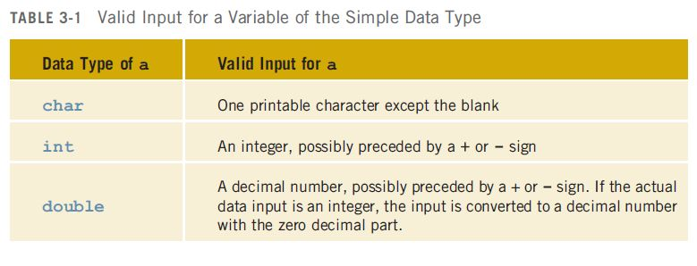
cin and the Extraction Operator >> (cont’d.)
Entering a char value into an int or double variable causes serious errors, called input failure
C++ Programming: From Problem Analysis to Program Design, Seventh Edition

Slide 10
cin and the Extraction Operator >> (cont’d.)
When reading data into a char variable
  >> skips leading whitespace, finds and stores only the next character
  Reading stops after a single character
To read data into an int or double variable
  >> skips leading whitespace, reads + or - sign (if any), reads the digits (including decimal)
  Reading stops on whitespace non-digit character
C++ Programming: From Problem Analysis to Program Design, Seventh Edition

Slide 11
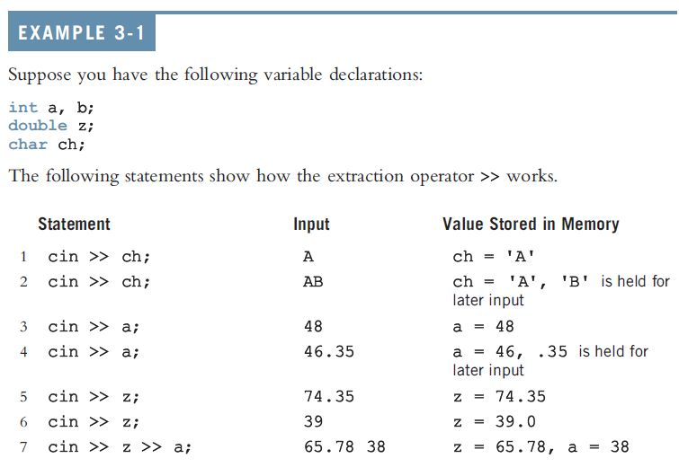

cin and the Extraction Operator >> (cont’d.)
C++ Programming: From Problem Analysis to Program Design, Seventh Edition

Slide 12
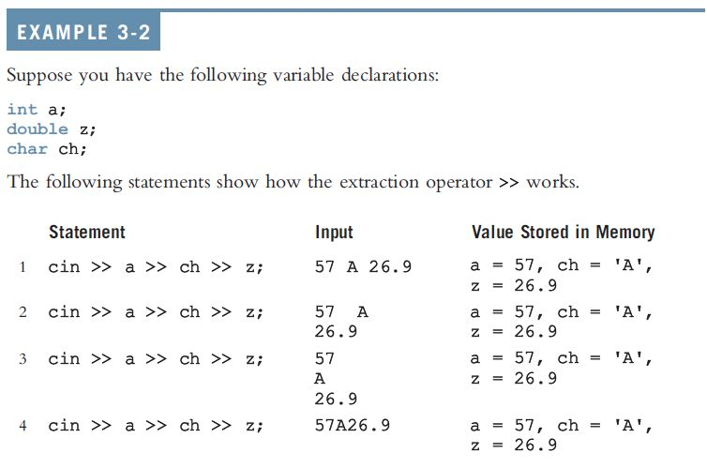
cin and the Extraction Operator >> (cont’d.)
C++ Programming: From Problem Analysis to Program Design, Seventh Edition

Slide 13
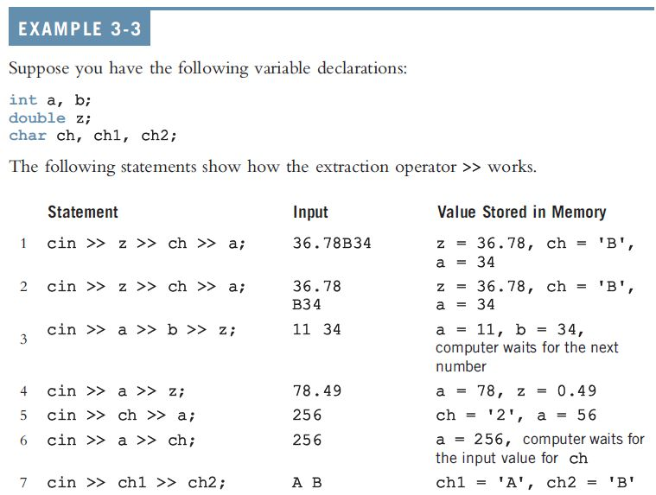
cin and the Extraction Operator >> (cont’d.)
C++ Programming: From Problem Analysis to Program Design, Seventh Edition

Slide 14
Using Predefined Functions in a Program
Function (subprogram): set of instructions
  When activated, it accomplishes a task
main executes when a program is run
Other functions execute only when called
C++ includes a wealth of functions
  Predefined functions are organized as a collection of libraries called header files
C++ Programming: From Problem Analysis to Program Design, Seventh Edition

Slide 15
Using Predefined Functions in a Program (cont’d.)
Header file may contain several functions
To use a predefined function, you need the name of the appropriate header file
  You also need to know:
    Function name
    Number of parameters required
    Type of each parameter
    What the function is going to do
C++ Programming: From Problem Analysis to Program Design, Seventh Edition

Slide 16
Using Predefined Functions in a Program (cont’d.)
To use pow (power), include cmath
  Two numeric parameters
  Syntax: pow(x,y) = x^{y}
    x and y are the arguments or parameters
  In pow(2,3), the parameters are 2 and 3
C++ Programming: From Problem Analysis to Program Design, Seventh Edition

Slide 17

cin and the get Function
The get function
  Inputs next character (including whitespace)
  Stores in memory location indicated by its argument
The syntax of cin and the get function:
varChar
  Is a char variable
  Is the argument (or parameter) of the function
C++ Programming: From Problem Analysis to Program Design, Seventh Edition

Slide 18

cin and the ignore Function
ignore function
  Discards a portion of the input
The syntax to use the function ignore is:
  intExp is an integer expression
  chExp is a char expression
If intExp is a value m, the statement says to ignore the next m characters or all characters until the character specified by chExp
C++ Programming: From Problem Analysis to Program Design, Seventh Edition

Slide 19
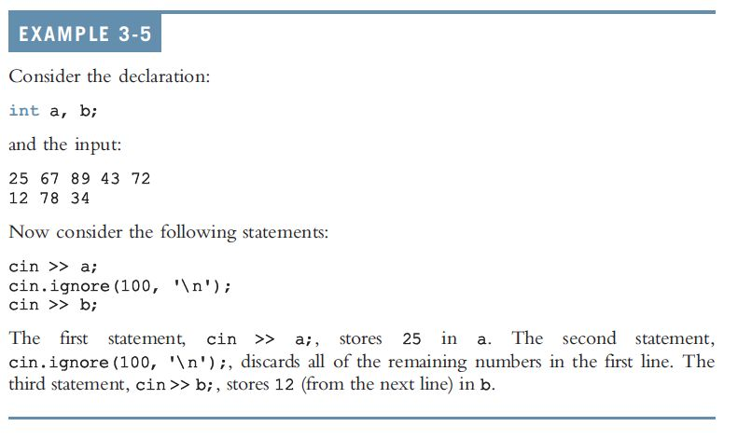
cin and the ignore Function (cont’d.)
C++ Programming: From Problem Analysis to Program Design, Seventh Edition

Slide 20
putback and peek Functions
putback function
  Places previous character extracted by the get function from an input stream back to that stream
peek function
  Returns next character from the input stream
  Does not remove the character from that stream
C++ Programming: From Problem Analysis to Program Design, Seventh Edition

Slide 21


putback and peek Functions (cont’d.)
The syntax for putback:
  istreamVar: an input stream variable (cin)
  ch is a char variable
The syntax for peek:
  istreamVar: an input stream variable (cin)
  ch is a char variable
C++ Programming: From Problem Analysis to Program Design, Seventh Edition

Slide 22
The Dot Notation Between I/O Stream Variables and I/O Functions
A precaution
  In the statement
  cin.get(ch);
  cin and get are two separate identifiers separated by a dot
  Dot separates the input stream variable name from the member, or function, name
  In C++, dot is the member access operator
C++ Programming: From Problem Analysis to Program Design, Seventh Edition

Slide 23
Input Failure
Things can go wrong during execution
If input data does not match corresponding variables, program may run into problems
Trying to read a letter into an int or double variable will result in an input failure
If an error occurs when reading data
  Input stream enters the fail state
C++ Programming: From Problem Analysis to Program Design, Seventh Edition

Slide 24

The clear Function
Once in a fail state, all further I/O statements using that stream are ignored
The program continues to execute with whatever values are stored in variables
  This causes incorrect results
The clear function restores input stream to a working state
C++ Programming: From Problem Analysis to Program Design, Seventh Edition

Slide 25
Output and Formatting Output
Syntax of cout when used with <<
expression is evaluated
value is printed
manipulator is used to format the output
  Example: endl
C++ Programming: From Problem Analysis to Program Design, Seventh Edition

Slide 26

setprecision Manipulator
Syntax:
Outputs decimal numbers with up to n decimal places
Must include the header file iomanip:
  #include <iomanip>
C++ Programming: From Problem Analysis to Program Design, Seventh Edition

Slide 27
fixed Manipulator
fixed outputs floating-point numbers in a fixed decimal format
  Example: cout << fixed;
  Disable by using the stream member function unsetf
    Example: cout.unsetf(ios::fixed);
scientific manipulator: outputs floating-point numbers in scientific format
C++ Programming: From Problem Analysis to Program Design, Seventh Edition

Slide 28
showpoint Manipulator
showpoint forces output to show the decimal point and trailing zeros
Examples:
  cout << showpoint;
  cout << fixed << showpoint;
C++ Programming: From Problem Analysis to Program Design, Seventh Edition

Slide 29
setw
Outputs the value of an expression in a specified number of columns
  cout << setw(5) << x << endl;
If number of columns exceeds the number of columns required by the expression
  Output of the expression is right-justified
  Unused columns to the left are filled with spaces
Must include the header file iomanip
C++ Programming: From Problem Analysis to Program Design, Seventh Edition

Slide 30
Additional Output Formatting Tools
Additional formatting tools that give you more control over your output:
  setfill manipulator
  left and right manipulators
  unsetf manipulator
C++ Programming: From Problem Analysis to Program Design, Seventh Edition

Slide 31

setfill Manipulator
Output stream variables can use setfill to fill unused columns with a character
Example:
  cout << setfill('#');
C++ Programming: From Problem Analysis to Program Design, Seventh Edition

Slide 32



left and right Manipulators
left: left-justifies the output
Disable left by using unsetf
right: right-justifies the output
C++ Programming: From Problem Analysis to Program Design, Seventh Edition

Slide 33
Types of Manipulators
Two types of manipulators:
  With parameters
  Without parameters
Parameterized: require iomanip header
  setprecision, setw, and setfill
Nonparameterized: require iostream header
  endl, fixed, showpoint, left, and flush
C++ Programming: From Problem Analysis to Program Design, Seventh Edition

Slide 34

Input/Output and the string Type
An input stream variable (cin) and >> operator can read a string into a variable of the data type string
Extraction operator
  Skips any leading whitespace characters
  Reading stops at a whitespace character
The function getline
  Reads until end of the current line
C++ Programming: From Problem Analysis to Program Design, Seventh Edition

Slide 35
Debugging: Understanding Logic Errors and Debugging with cout statements
Syntax errors
  Reported by the compiler
Logic errors
  Typically not caught by the compiler
  Spot and correct using cout statements
  Temporarily insert an output statement
  Correct problem
  Remove output statement
C++ Programming: From Problem Analysis to Program Design, Seventh Edition

Slide 36
File Input/Output
File: area in secondary storage to hold info
File I/O is a five-step process
  Include fstream header
  Declare file stream variables
  Associate the file stream variables with the input/output sources
  Use the file stream variables with >>, <<, or other input/output functions
  Close the files
C++ Programming: From Problem Analysis to Program Design, Seventh Edition

Slide 37
Summary
Stream: infinite sequence of characters from a source to a destination
  Input stream: from a source to a computer
  Output stream: from a computer to a destination
  cin: common input
  cout: common output
  To use cin and cout, include iostream header
C++ Programming: From Problem Analysis to Program Design, Seventh Edition

Slide 38
Summary (cont’d.)
get reads data character-by-character
ignore skips data in a line
putback puts last character retrieved by get back to the input stream
peek returns next character from input stream, but does not remove it
Attempting to read invalid data into a variable causes the input stream to enter the fail state
C++ Programming: From Problem Analysis to Program Design, Seventh Edition

Slide 39
Summary (cont’d.)
The manipulators setprecision, fixed, showpoint, setw, setfill, left, and right can be used for formatting output
Include iomanip for the manipulators setprecision, setw, and setfill
Header fstream contains the definitions of ifstream and ofstream
C++ Programming: From Problem Analysis to Program Design, Seventh Edition

