Slide 1
Chapter 4:
Control Structures I (Selection)

Slide 2
Objectives
In this chapter, you will:
  Learn about control structures
  Examine relational operators
  Discover how to use the selection control structures if, if…else
  Examine int and bool data types and logical (Boolean) expressions
  Examine logical operators
C++ Programming: From Problem Analysis to Program Design, Seventh Edition

Slide 3
Objectives (cont’d.)
  Explore how to form and evaluate logical (Boolean) expressions
  Learn how relational operators work with the string type
  Become aware of short-circuit evaluation
  Learn how the conditional operator, ?:, works
  Learn how to use pseudocode to develop, test, and debug a program
C++ Programming: From Problem Analysis to Program Design, Seventh Edition

Slide 4
Objectives (cont’d.)
  Discover how to use a switch statement in a program
  Learn how to avoid bugs by avoiding partially understood concepts
  Learn how to use the assert function to terminate a program
C++ Programming: From Problem Analysis to Program Design, Seventh Edition

Slide 5
Control Structures
A computer can proceed:
  In sequence
  Selectively (branch): making a choice
  Repetitively (iteratively): looping
  By calling a function
Two most common control structures:
  Selection
  Repetition
C++ Programming: From Problem Analysis to Program Design, Seventh Edition

Slide 6
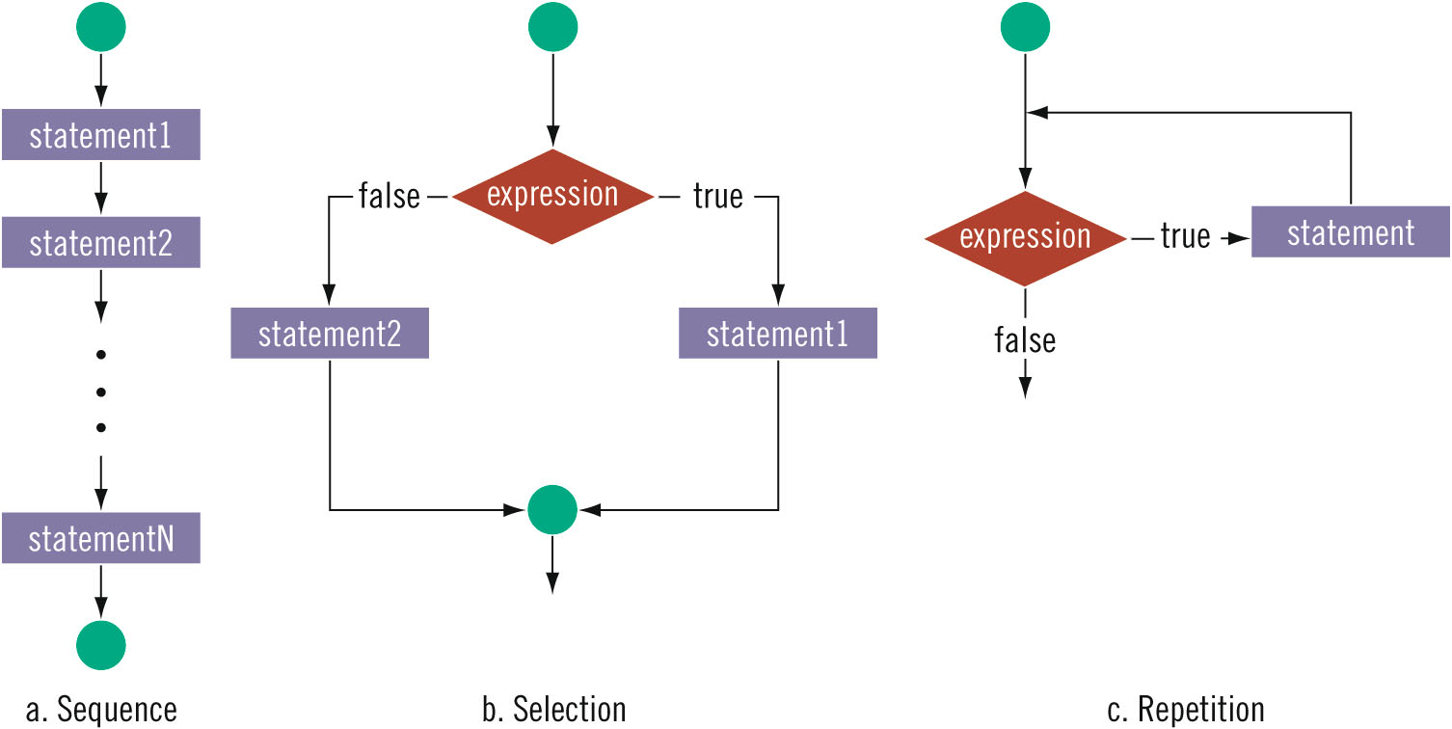
Control Structures (cont’d.)
C++ Programming: From Problem Analysis to Program Design, Seventh Edition

Slide 7
Selection: if and if...else
Execution of selection or repetition requires execution of a logical expression:
  Evaluates to true or false
  “8 is greater than 3”
C++ Programming: From Problem Analysis to Program Design, Seventh Edition

Slide 8
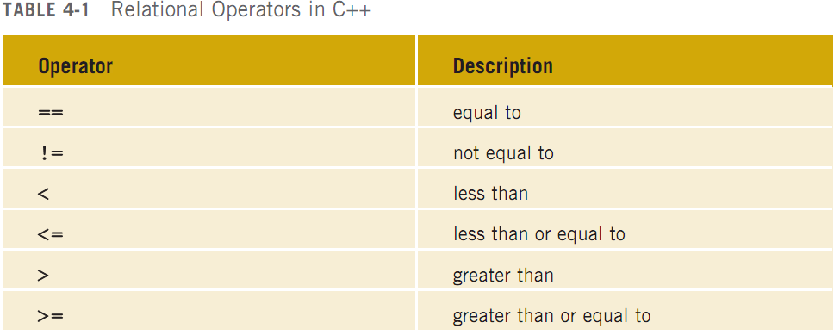
Relational Operators (cont’d.)
C++ Programming: From Problem Analysis to Program Design, Seventh Edition

Slide 9
Relational Operators and Simple Data Types
Conditional statements: only executed if certain conditions are met
Condition: represented by a logical (Boolean) expression that evaluates to a logical (Boolean) value of true or false
Relational operators:
  Allow comparisons
  Require two operands (binary)
  Evaluate to true or false
C++ Programming: From Problem Analysis to Program Design, Seventh Edition

Slide 10
Relational Operators and Simple Data Types (cont’d.)
Relational operators can be used with all three simple data types:
  8 < 15 evaluates to true
  6 != 6 evaluates to false
  2.5 > 5.8 evaluates to false
  5.9 <= 7.5 evaluates to true
C++ Programming: From Problem Analysis to Program Design, Seventh Edition

Slide 11
Comparing Characters
Expression of char values with relational operators
  Result depends on machine’s collating sequence
  ASCII character set
Logical (Boolean) expressions
  Expressions such as 4 < 6 and 'R' > 'T’
  Returns an integer value of 1 if the logical expression evaluates to true
  Returns an integer value of 0 otherwise
C++ Programming: From Problem Analysis to Program Design, Seventh Edition

Slide 12

One-Way Selection
One-way selection syntax:
Statement is executed if the value of the expression is true
Statement is bypassed if the value is false; program goes to the next statement
Expression is called a decision maker
C++ Programming: From Problem Analysis to Program Design, Seventh Edition

Slide 13
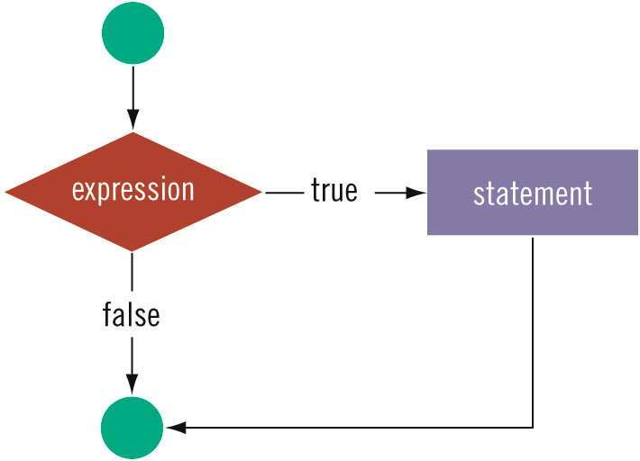
One-Way Selection (cont’d.)
C++ Programming: From Problem Analysis to Program Design, Seventh Edition

Slide 14
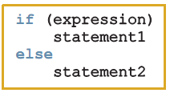
Two-Way Selection
Two-way selection syntax:
If expression is true, statement1 is executed; otherwise, statement2 is executed
  statement1 and statement2 are any C++ statements
C++ Programming: From Problem Analysis to Program Design, Seventh Edition

Slide 15
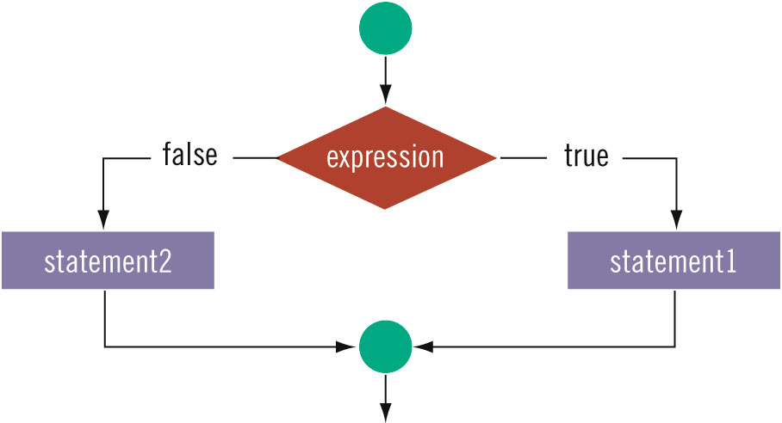
Two-Way Selection (cont’d.)
C++ Programming: From Problem Analysis to Program Design, Seventh Edition

Slide 16
The int Data Type and Logical (Boolean) Expressions
Earlier versions of C++ did not provide built-in data types that had Boolean values
Logical expressions evaluate to either 1 or 0
  Logical expression value was stored in a variable of the data type int
Can use the int data type to manipulate logical (Boolean) expressions
C++ Programming: From Problem Analysis to Program Design, Seventh Edition

Slide 17
bool Data Type and Logical (Boolean) Expressions
The data type bool has logical (Boolean) values true and false
bool, true, and false are reserved words
The identifier true has the value 1
The identifier false has the value 0
C++ Programming: From Problem Analysis to Program Design, Seventh Edition

Slide 18
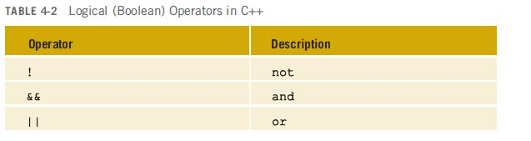
Logical (Boolean) Operators and Logical Expressions
Logical (Boolean) operators: enable you to combine logical expressions
C++ Programming: From Problem Analysis to Program Design, Seventh Edition

Slide 19
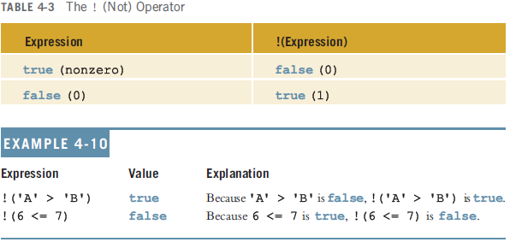
Logical (Boolean) Operators and Logical Expressions (cont’d.)
C++ Programming: From Problem Analysis to Program Design, Seventh Edition

Slide 20
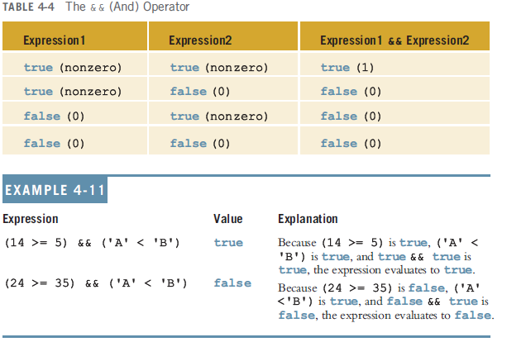
Logical (Boolean) Operators and Logical Expressions (cont’d.)
C++ Programming: From Problem Analysis to Program Design, Seventh Edition

Slide 21
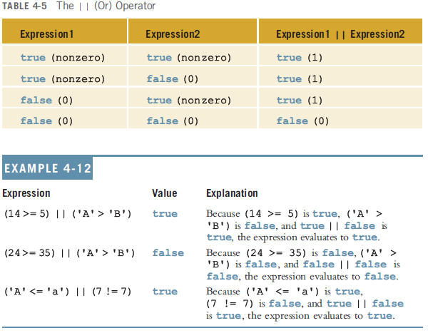
Logical (Boolean) Operators and Logical Expressions (cont’d.)
C++ Programming: From Problem Analysis to Program Design, Seventh Edition

Slide 22
Order of Precedence
Relational and logical operators are evaluated from left to right
  The associativity is left to right
Parentheses can override precedence
C++ Programming: From Problem Analysis to Program Design, Seventh Edition

Slide 23
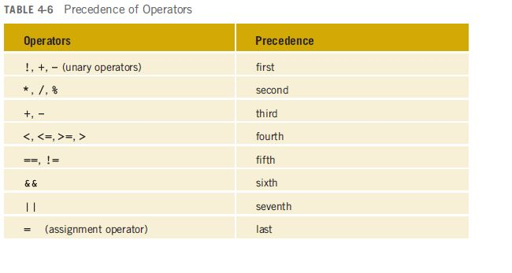
Order of Precedence (cont’d.)
C++ Programming: From Problem Analysis to Program Design, Seventh Edition

Slide 24
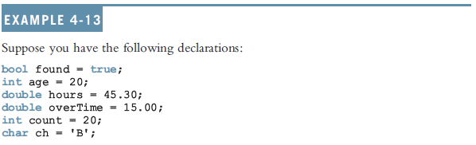
Order of Precedence (cont’d.)
C++ Programming: From Problem Analysis to Program Design, Seventh Edition

Slide 25
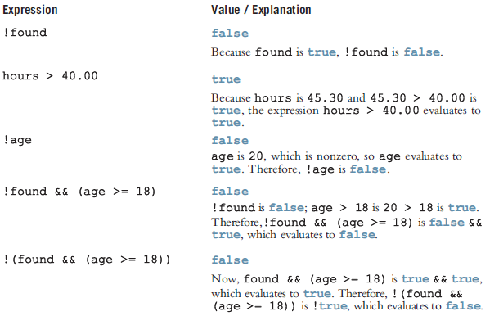
Order of Precedence (cont’d.)
C++ Programming: From Problem Analysis to Program Design, Seventh Edition

Slide 26
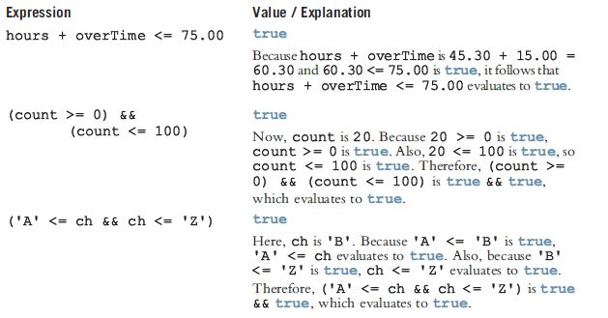
Order of Precedence (cont’d.)
C++ Programming: From Problem Analysis to Program Design, Seventh Edition

Slide 27
Relational Operators and the string Type
Relational operators can be applied to strings
  Strings are compared character by character, starting with the first character
  Comparison continues until either a mismatch is found or all characters are found equal
  If two strings of different lengths are compared and the comparison is equal to the last character of the shorter string
    The shorter string is less than the larger string
C++ Programming: From Problem Analysis to Program Design, Seventh Edition

Slide 28
Relational Operators and the string Type (cont’d.)
Suppose we have the following declarations:
  string str1 = "Hello";
  string str2 = "Hi";
  string str3 = "Air";
  string str4 = "Bill";
  string str4 = "Big";
C++ Programming: From Problem Analysis to Program Design, Seventh Edition

Slide 29
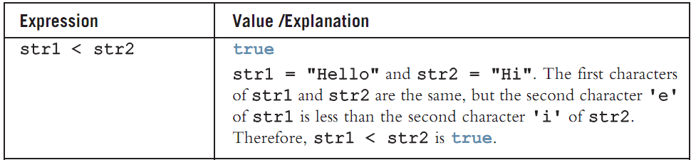
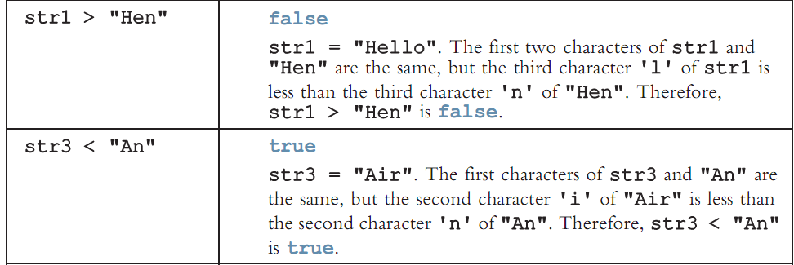
Relational Operators and the string Type (cont’d.)
C++ Programming: From Problem Analysis to Program Design, Seventh Edition

Slide 30
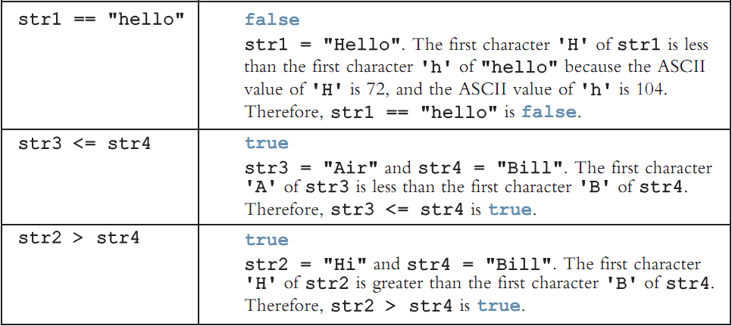
Relational Operators and the string Type (cont’d.)
C++ Programming: From Problem Analysis to Program Design, Seventh Edition

Slide 31
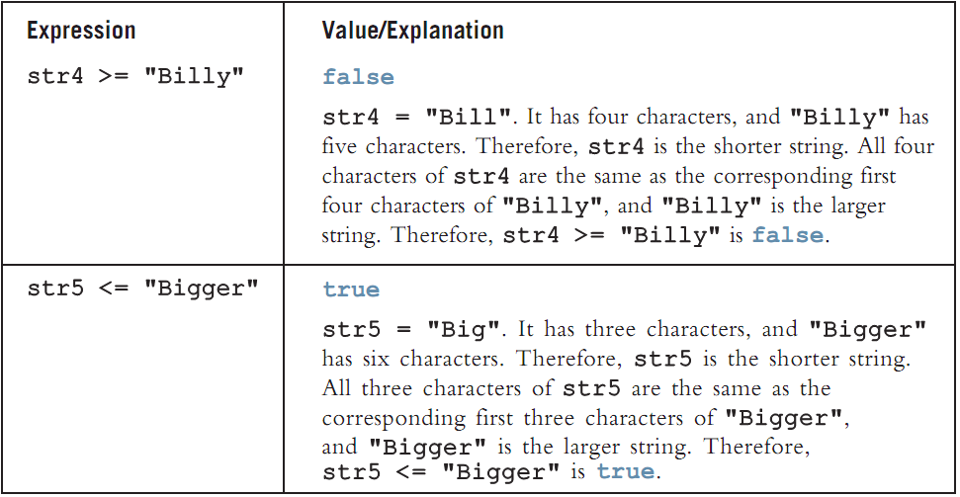
Relational Operators and the string Type (cont’d.)
C++ Programming: From Problem Analysis to Program Design, Seventh Edition

Slide 32
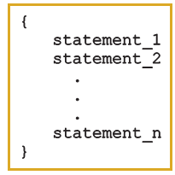
Compound (Block of) Statements
Compound statement (block of statements):
A compound statement functions like a single statement
C++ Programming: From Problem Analysis to Program Design, Seventh Edition

Slide 33
Compound (Block of) Statements (cont’d.)
if (age > 18)
{
cout << "Eligible to vote." << endl;
cout << "No longer a minor." << endl;
}
else
{
cout << "Not eligible to vote." << endl;
cout << "Still a minor." << endl;
}
C++ Programming: From Problem Analysis to Program Design, Seventh Edition

Slide 34
Multiple Selections: Nested if
Nesting: one control statement is located within another
An else is associated with the most recent if that has not been paired with an else
C++ Programming: From Problem Analysis to Program Design, Seventh Edition

Slide 35
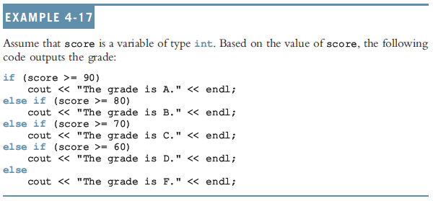
Multiple Selections: Nested if (cont’d.)
C++ Programming: From Problem Analysis to Program Design, Seventh Edition

Slide 36
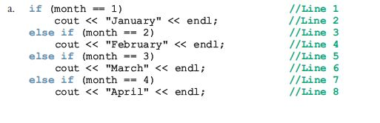

Comparing if…else Statements with a Series of if Statements
C++ Programming: From Problem Analysis to Program Design, Seventh Edition

Slide 37
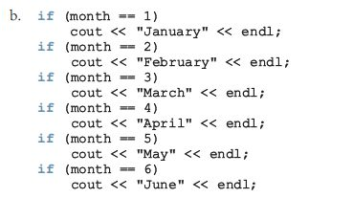
Comparing if…else Statements with if Statements (cont’d.)
C++ Programming: From Problem Analysis to Program Design, Seventh Edition

Slide 38
Short-Circuit Evaluation
Short-circuit evaluation: evaluation of a logical expression stops as soon as the value of the expression is known
Example:
(age >= 21) || ( x == 5) //Line 1
(grade == 'A') && (x >= 7) //Line 2
C++ Programming: From Problem Analysis to Program Design, Seventh Edition

Slide 39
Comparing Floating-Point Numbers for Equality: A Precaution
Comparison of floating-point numbers for equality may not behave as you would expect
  Example:
    1.0 == 3.0/7.0 + 2.0/7.0 + 2.0/7.0 evaluates to false
    Why? 3.0/7.0 + 2.0/7.0 + 2.0/7.0 = 0.99999999999999989
Solution: use a tolerance value
  Example: if fabs(x – y) < 0.000001
C++ Programming: From Problem Analysis to Program Design, Seventh Edition

Slide 40
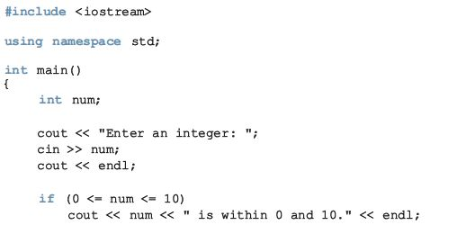
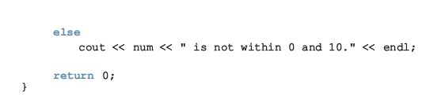
Associativity of Relational Operators: A Precaution
C++ Programming: From Problem Analysis to Program Design, Seventh Edition

Slide 41
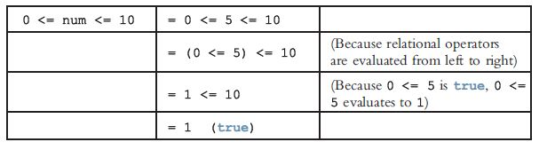
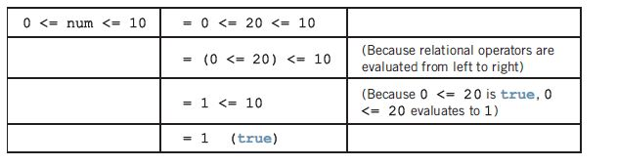
Associativity of Relational Operators: A Precaution (cont’d.)
num = 5
num = 20
C++ Programming: From Problem Analysis to Program Design, Seventh Edition

Slide 42
Avoiding Bugs by Avoiding Partially Understood Concepts and Techniques
Must use concepts and techniques correctly
  Otherwise solution will be either incorrect or deficient
If you do not understand a concept or technique completely
  Don’t use it
  Save yourself an enormous amount of debugging time
C++ Programming: From Problem Analysis to Program Design, Seventh Edition

Slide 43
Input Failure and the if Statement
If input stream enters a fail state
  All subsequent input statements associated with that stream are ignored
  Program continues to execute
  May produce erroneous results
Can use if statements to check status of input stream
If stream enters the fail state, include instructions that stop program execution
C++ Programming: From Problem Analysis to Program Design, Seventh Edition

Slide 44
Confusion Between the Equality (==) and Assignment (=) Operators
C++ allows you to use any expression that can be evaluated to either true or false as an expression in the if statement:
  if (x = 5)
  cout << "The value is five." << endl;
The appearance of = in place of == resembles a silent killer
  It is not a syntax error
  It is a logical error
C++ Programming: From Problem Analysis to Program Design, Seventh Edition

Slide 45
Conditional Operator (?:)
Conditional operator (?:)
  Ternary operator: takes 3 arguments
Syntax for the conditional operator:
expression1 ? expression2 : expression3
If expression1 is true, the result of the conditional expression is expression2
  Otherwise, the result is expression3
Example: max = (a >= b) ? a : b;
C++ Programming: From Problem Analysis to Program Design, Seventh Edition

Slide 46
Program Style and Form (Revisited): Indentation
A properly indented program:
  Helps you spot and fix errors quickly
  Shows the natural grouping of statements
Insert a blank line between statements that are naturally separate
Two commonly used styles for placing braces
  On a line by themselves
  Or left brace is placed after the expression, and the right brace is on a line by itself
C++ Programming: From Problem Analysis to Program Design, Seventh Edition

Slide 47
Using Pseudocode to Develop, Test, and Debug a Program
Pseudocode, or just pseudo
  Informal mixture of C++ and ordinary language
  Helps you quickly develop the correct structure of the program and avoid making common errors
Use a wide range of values in a walk-through to evaluate the program
C++ Programming: From Problem Analysis to Program Design, Seventh Edition

Slide 48
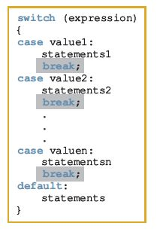
switch Structures
switch structure: alternate
to if-else
switch (integral) expression
is evaluated first
Value of the expression determines
which corresponding action is taken
Expression is sometimes
called the selector
C++ Programming: From Problem Analysis to Program Design, Seventh Edition

Slide 49
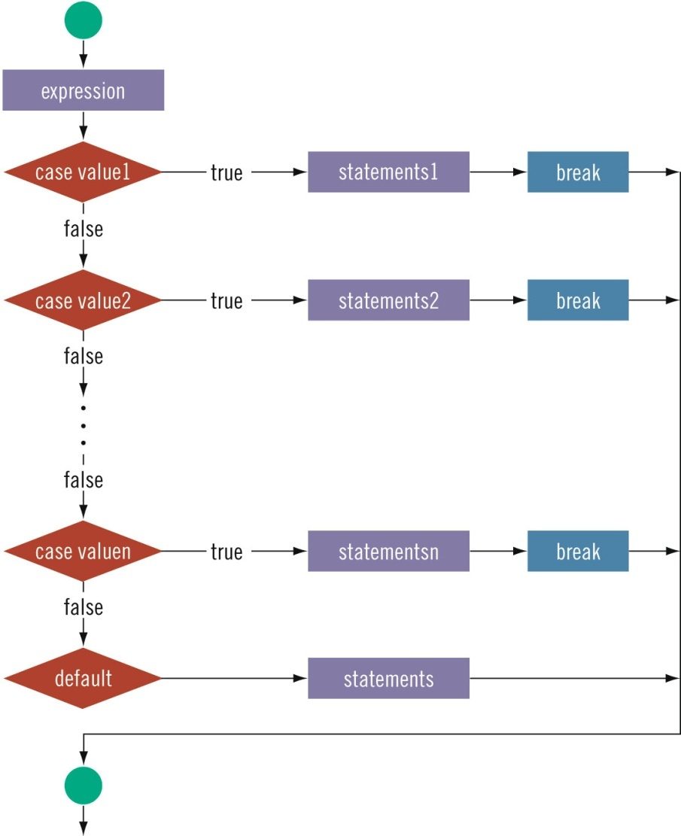

switch Structures (cont’d.)
C++ Programming: From Problem Analysis to Program Design, Seventh Edition

Slide 50
switch Structures (cont’d.)
One or more statements may follow a case label
Braces are not needed to turn multiple statements into a single compound statement
When a case value is matched, all statements after it execute until a break is encountered
The break statement may or may not appear after each statement
switch, case, break, and default are reserved words
C++ Programming: From Problem Analysis to Program Design, Seventh Edition

Slide 51
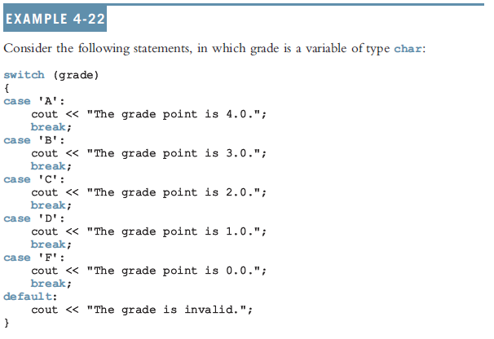
switch Structures (cont’d.)
C++ Programming: From Problem Analysis to Program Design, Seventh Edition

Slide 52
Avoiding Bugs: Revisited
To output results correctly
  Consider whether the switch structure must include a break statement after each cout statement
C++ Programming: From Problem Analysis to Program Design, Seventh Edition

Slide 53
Terminating a Program with the assert Function
Certain types of errors are very difficult to catch
  Example: division by zero
assert function: useful in stopping program execution when certain elusive errors occur
C++ Programming: From Problem Analysis to Program Design, Seventh Edition

Slide 54

The assert Function
Syntax:
  expression is any logical expression
If expression evaluates to true, the next statement executes
If expression evaluates to false, the program terminates and indicates where in the program the error occurred
To use assert, include cassert header file
C++ Programming: From Problem Analysis to Program Design, Seventh Edition

Slide 55
The assert Function (cont’d.)
assert is useful for enforcing programming constraints during program development
After developing and testing a program, remove or disable assert statements
The preprocessor directive #define NDEBUG must be placed before the directive #include <cassert> to disable the assert statement
C++ Programming: From Problem Analysis to Program Design, Seventh Edition

Slide 56
Summary
Control structures alter normal control flow
Most common control structures are selection and repetition
Relational operators: ==, <, <=, >, >=, !=
Logical expressions evaluate to 1 (true) or 0 (false)
Logical operators: ! (not), && (and), || (or)
C++ Programming: From Problem Analysis to Program Design, Seventh Edition

Slide 57
Summary (cont’d.)
Two selection structures: one-way selection and two-way selection
The expression in an if or if...else structure is usually a logical expression
No stand-alone else statement in C++
  Every else has a related if
A sequence of statements enclosed between braces, { and }, is called a compound statement or block of statements
C++ Programming: From Problem Analysis to Program Design, Seventh Edition

Slide 58
Summary (cont’d.)
Using assignment in place of the equality operator creates a semantic error
switch structure handles multiway selection
break statement ends switch statement
Use assert to terminate a program if certain conditions are not met
C++ Programming: From Problem Analysis to Program Design, Seventh Edition

