Slide 1
Chapter 7:
User-Defined Simple Data Types, Namespaces, and the string Type

Slide 2
Objectives
In this chapter, you will:
  Learn how to create and manipulate your own simple data type - called the enumeration type
  Explore how the assignment statement, and arithmetic and relational operators work with enum types
  Learn how to use for loops with enum types
  Learn how to input data into an enum type
C++ Programming: From Problem Analysis to Program Design, Seventh Edition

Slide 3
Objectives (cont’d.)
  Learn how to output data stored in an enum type
  Explore how to write functions to process enum types
  Learn how to declare variables when defining the enumeration type
  Become familiar with anonymous types
  Become familiar with the typedef statement
C++ Programming: From Problem Analysis to Program Design, Seventh Edition

Slide 4
Objectives (cont’d.)
  Learn about the namespace mechanism
  Explore the string data type, and learn how to use string functions to manipulate strings
C++ Programming: From Problem Analysis to Program Design, Seventh Edition

Slide 5
Enumeration Type
Data type: a set of values with a set of operations on them
Enumeration type: a simple data type created by the programmer
To define an enumeration type, you need:
  A name for the data type
  A set of values for the data type
  A set of operations on the values
C++ Programming: From Problem Analysis to Program Design, Seventh Edition

Slide 6

Enumeration Type (cont’d.)
You can specify the name and the values, but not the operations
Syntax:
  value1, value2, … are identifiers called enumerators
  List specifies the ordering:
    value1 < value2 < value3 <...
C++ Programming: From Problem Analysis to Program Design, Seventh Edition

Slide 7
Enumeration Type (cont’d.)
The enumeration type is an ordered set of values
  Default value assigned to enumerators starts at 0
A value used in one enumeration type cannot be used by another in same block
Same rules apply to enumeration types declared outside of any blocks
C++ Programming: From Problem Analysis to Program Design, Seventh Edition

Slide 8
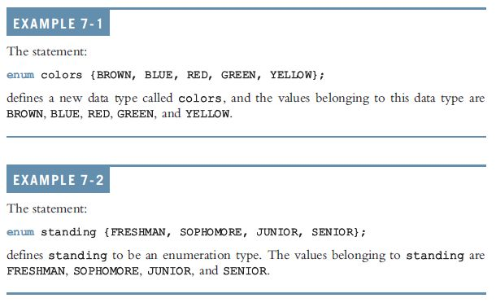
Enumeration Type (cont’d.)
C++ Programming: From Problem Analysis to Program Design, Seventh Edition

Slide 9
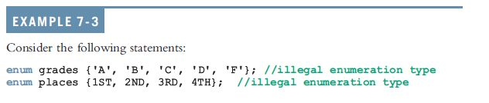
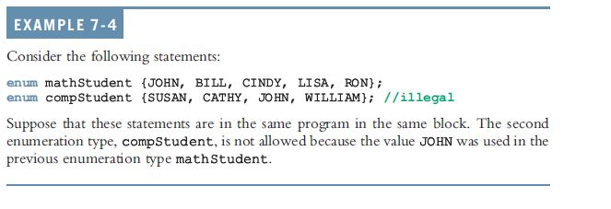
Enumeration Type (cont’d.)
C++ Programming: From Problem Analysis to Program Design, Seventh Edition

Slide 10

Declaring Variables
Syntax:
Example:
  Can declare variables such as:
C++ Programming: From Problem Analysis to Program Design, Seventh Edition

Slide 11
Assignment
Values can be stored in enumeration data types:
popularSport = FOOTBALL;
  Stores FOOTBALL into popularSport
C++ Programming: From Problem Analysis to Program Design, Seventh Edition

Slide 12

Operations on Enumeration Types
No arithmetic operations are allowed on enumeration types
++ and -- are illegal, too:
Solution: use a static cast
C++ Programming: From Problem Analysis to Program Design, Seventh Edition

Slide 13

Relational Operators
An enumeration type is an ordered set of values:
An enumeration type is an integral data type and can be used in loops:
C++ Programming: From Problem Analysis to Program Design, Seventh Edition

Slide 14
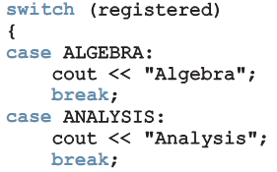
Input /Output of Enumeration Types
An enumeration type cannot be input/output (directly)
  Can input and output indirectly
C++ Programming: From Problem Analysis to Program Design, Seventh Edition

Slide 15
Functions and Enumeration Types
Enumeration types can be passed as parameters to functions either by value or by reference
A function can return a value of the enumeration type
C++ Programming: From Problem Analysis to Program Design, Seventh Edition

Slide 16
Declaring Variables When Defining the Enumeration Type
Can declare variables of an enumeration type when you define an enumeration type:
C++ Programming: From Problem Analysis to Program Design, Seventh Edition

Slide 17
Anonymous Data Types
Anonymous type: values are directly specified in the declaration, with no type name
Example:
C++ Programming: From Problem Analysis to Program Design, Seventh Edition

Slide 18
Anonymous Data Types (cont’d.)
Drawbacks:
  Cannot pass/return an anonymous type to/from a function
  Values used in one type can be used in another, but are treated differently:
Best practices: to avoid confusion, define an enumeration type first, then declare variables
C++ Programming: From Problem Analysis to Program Design, Seventh Edition

Slide 19

typedef Statement
typedef statement: used to create synonyms or aliases to a data type
Syntax:
typedef does not create any new data types
  Only creates an alias to an existing data type
C++ Programming: From Problem Analysis to Program Design, Seventh Edition

Slide 20
Namespaces
ANSI/ISO standard C++ was officially approved in July 1998
Most recent compilers are compatible with ANSI/ISO standard C++
For the most part, standard C++ and ANSI/ISO standard C++ are the same
  However, ANSI/ISO Standard C++ has some features not available in Standard C++
C++ Programming: From Problem Analysis to Program Design, Seventh Edition

Slide 21
Namespaces (cont’d.)
Global identifiers in a header file used in a program become global in the program
  Syntax error occurs if a program’s identifier has same name as a global identifier in the header file
Same problem can occur with third-party libraries
  Common solution: third-party vendors begin their global identifiers with _ (underscore)
    Do not begin identifiers in your program with _
C++ Programming: From Problem Analysis to Program Design, Seventh Edition

Slide 22
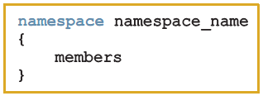
Namespaces (cont’d.)
ANSI/ISO Standard C++ attempts to solve this problem with the namespace mechanism
Syntax:
  Where members consist of variable declarations, named constants, functions, or another namespace
C++ Programming: From Problem Analysis to Program Design, Seventh Edition

Slide 23
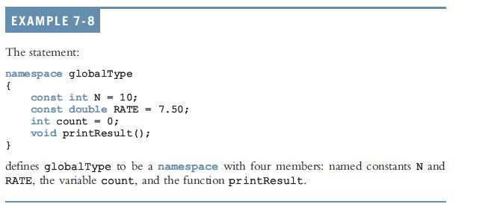
Namespaces (cont’d.)
C++ Programming: From Problem Analysis to Program Design, Seventh Edition

Slide 24



Namespaces (cont’d.)
A namespace member has scope local to the namespace
A namespace member can be accessed outside the namespace:
C++ Programming: From Problem Analysis to Program Design, Seventh Edition

Slide 25
Namespaces (cont’d.)
Examples:
globalType::RATE
using namespace globalType::printResult();
using globalType::RATE;
After the using statement, it is not necessary to put the namespace_name:: before the namespace member
  Unless a namespace member and a global identifier or a block identifier have the same name
C++ Programming: From Problem Analysis to Program Design, Seventh Edition

Slide 26
string Type
To use data type string, a program must include the header file string
A string is a sequence of 0 or more characters
  The first character is in position 0
  The second character is in position 1, etc.
Binary operator + performs the string concatenation operation
Array subscript operator [] allows access to an individual character in a string
C++ Programming: From Problem Analysis to Program Design, Seventh Edition

Slide 27
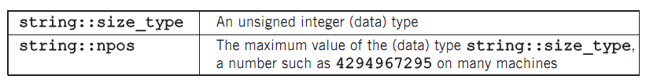
Additional string Operations
C++ Programming: From Problem Analysis to Program Design, Seventh Edition

Slide 28
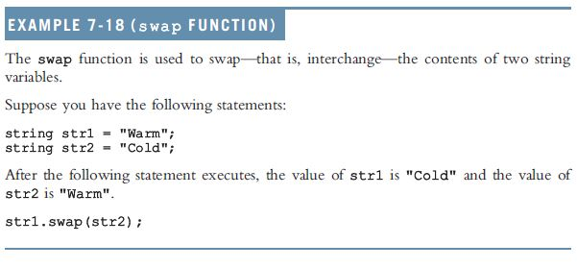
Example 7-18: swap Function
C++ Programming: From Problem Analysis to Program Design, Seventh Edition

Slide 29
Summary
Enumeration type: set of ordered values
  Reserved word enum creates an enumeration type
No arithmetic operations are allowed on the enumeration type
Relational operators can be used with enum values
Enumeration type values cannot be input or output directly
Enumeration types can be passed as parameters to functions by value or by reference
C++ Programming: From Problem Analysis to Program Design, Seventh Edition

Slide 30
Summary (cont’d.)
Anonymous type: a variable’s values are specified without any type name
Reserved word typedef creates synonyms or aliases to previously defined data types
The namespace mechanism is a feature of ANSI/ISO Standard C++
A namespace member is usually a named constant, variable, function, or another namespace
Scope of a namespace member is local to namespace
C++ Programming: From Problem Analysis to Program Design, Seventh Edition

Slide 31
Summary (cont’d.)
using statement simplifies access to namespace members
A string is a sequence of 0 or more characters
Strings in C++ are enclosed in ""
First character of a string is in position 0
In C++, [] is the array subscript operator
C++ Programming: From Problem Analysis to Program Design, Seventh Edition

