Slide 1
Chapter 9:
Records (structs)

Slide 2
Objectives
In this chapter, you will:
  Learn about records (structs)
  Examine various operations on a struct
  Manipulate data using a struct
  Learn about the relationship between a struct and functions
  Examine the difference between arrays and structs
C++ Programming: From Problem Analysis to Program Design, Seventh Edition

Slide 3
Objectives (cont’d.)
  Discover how arrays are used in a struct
  Learn how to create an array of struct items
  Learn how to create structs within structs
C++ Programming: From Problem Analysis to Program Design, Seventh Edition

Slide 4
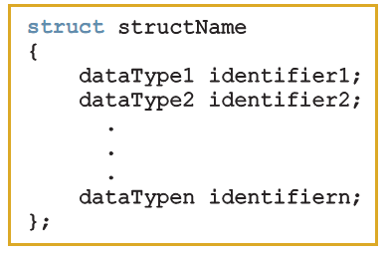
Records (structs)
struct: collection of a fixed number of components (members), accessed by name
  Members may be of different types
Syntax:
C++ Programming: From Problem Analysis to Program Design, Seventh Edition

Slide 5
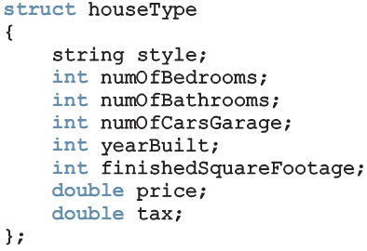

Records (structs) (cont’d.)
A struct is a definition, not a declaration
  Must declare a variable of that type to use it
C++ Programming: From Problem Analysis to Program Design, Seventh Edition

Slide 6
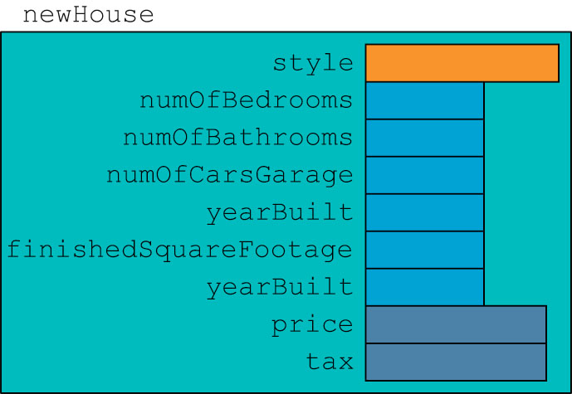
Records (structs) (cont’d.)
C++ Programming: From Problem Analysis to Program Design, Seventh Edition

Slide 7

Accessing struct Members
Syntax to access a struct member:
The dot (.) is called the member access operator
C++ Programming: From Problem Analysis to Program Design, Seventh Edition

Slide 8
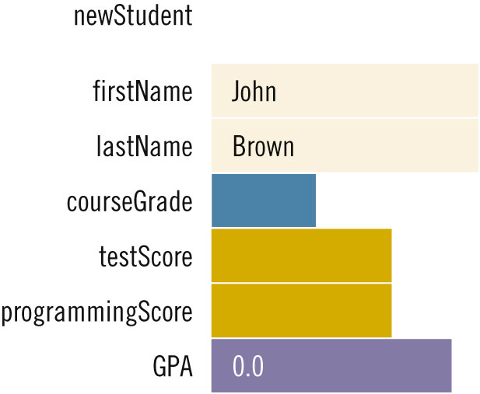
Accessing struct Members (cont’d.)
To initialize the members of newStudent:
  newStudent.GPA = 0.0;
  newStudent.firstName = "John";
  newStudent.lastName = "Brown";
C++ Programming: From Problem Analysis to Program Design, Seventh Edition

Slide 9
Assignment
Value of one struct variable can be assigned to another struct variable of the same type using an assignment statement
The statement:
student = newStudent;
copies the contents of newStudent into student
C++ Programming: From Problem Analysis to Program Design, Seventh Edition

Slide 10
Assignment (cont’d.)
The assignment statement:
student = newStudent;
is equivalent to the following statements:
student.firstName = newStudent.firstName;
student.lastName = newStudent.lastName;
student.courseGrade = newStudent.courseGrade;
student.testScore = newStudent.testScore;
student.programmingScore = newStudent.programmingScore;
student.GPA = newStudent.GPA;
C++ Programming: From Problem Analysis to Program Design, Seventh Edition

Slide 11
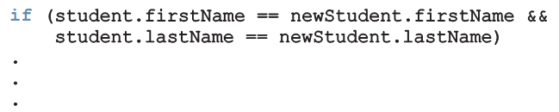
Comparison (Relational Operators)
Compare struct variables member-wise
  No aggregate relational operations allowed
To compare the values of student and newStudent:
C++ Programming: From Problem Analysis to Program Design, Seventh Edition

Slide 12
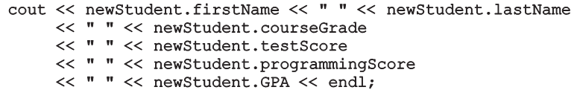
Input/Output
No aggregate input/output operations on a struct variable
Data in a struct variable must be read or written one member at a time
Example: output newStudent contents
C++ Programming: From Problem Analysis to Program Design, Seventh Edition

Slide 13
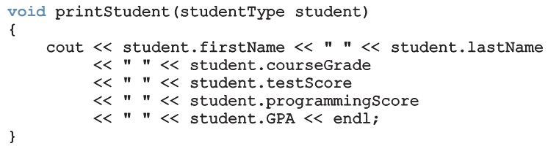
struct Variables and Functions
A struct variable can be passed as a parameter by value or by reference
A function can return a value of type struct
C++ Programming: From Problem Analysis to Program Design, Seventh Edition

Slide 14
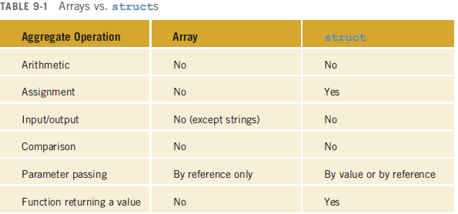
Arrays versus structs
C++ Programming: From Problem Analysis to Program Design, Seventh Edition

Slide 15
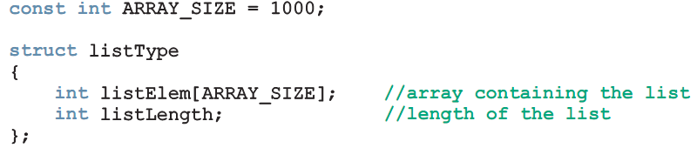
Arrays in structs
Two items are associated with a list:
  Values (elements)
  Length of the list
Define a struct containing both items:
C++ Programming: From Problem Analysis to Program Design, Seventh Edition

Slide 16
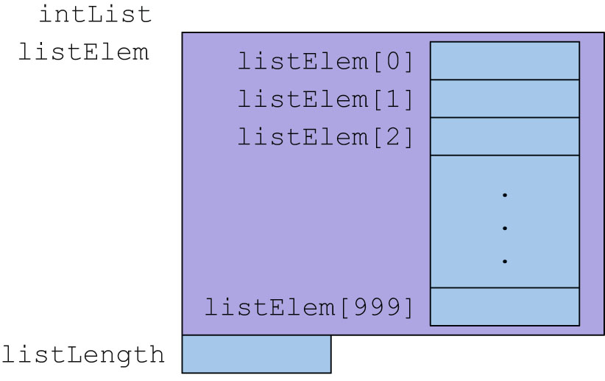
Arrays in structs (cont’d.)
C++ Programming: From Problem Analysis to Program Design, Seventh Edition

Slide 17
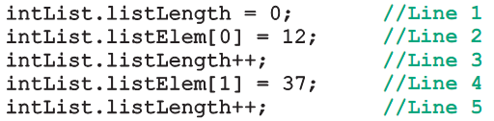

Arrays in structs (cont’d.)
C++ Programming: From Problem Analysis to Program Design, Seventh Edition

Slide 18
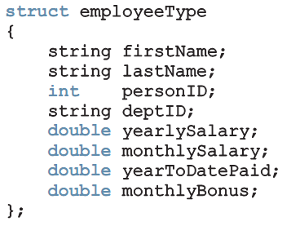
structs in Arrays
Example:
C++ Programming: From Problem Analysis to Program Design, Seventh Edition

Slide 19
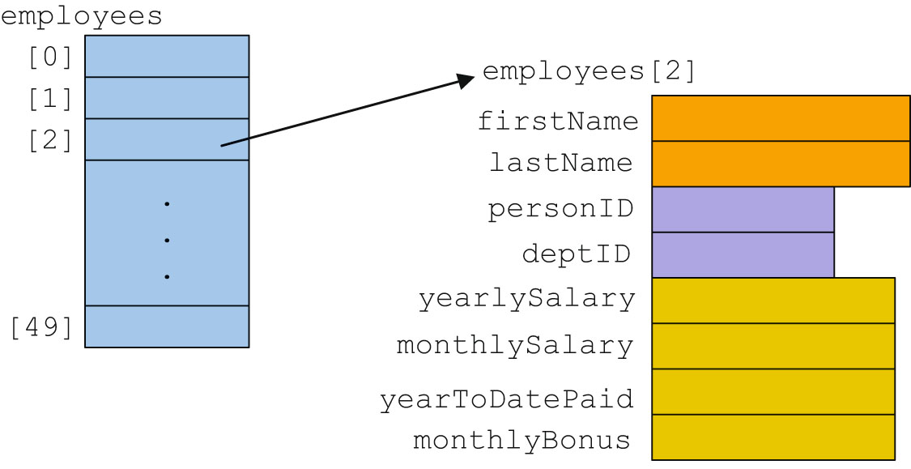
structs in Arrays (cont’d.)
C++ Programming: From Problem Analysis to Program Design, Seventh Edition

Slide 20
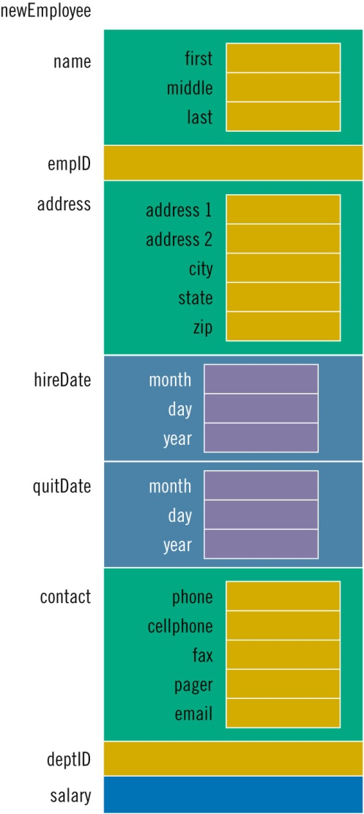

structs within a struct
C++ Programming: From Problem Analysis to Program Design, Seventh Edition

Slide 21
Summary
struct: collection of a fixed number of components
Components can be of different types
  Called members
  Accessed by name
struct is a reserved word
No memory is allocated for a struct
  Memory when variables are declared
C++ Programming: From Problem Analysis to Program Design, Seventh Edition

Slide 22
Summary (cont’d.)
Dot (.) operator: member access operator
  Used to access members of a struct
The only built-in operations on a struct are the assignment and member access
Neither arithmetic nor relational operations are allowed on structs
A struct can be passed by value or reference
A function can return a value of type struct
structs can be members of other structs
C++ Programming: From Problem Analysis to Program Design, Seventh Edition

