Slide 1
Chapter 16:
Searching, Sorting, and the vector Type

Slide 2
Objectives
In this chapter, you will:
  Learn about list processing and how to search a list using sequential search
  Explore how to sort an array using the bubble sort and insertion sort algorithms
  Learn how to implement the binary search algorithm
  Become familiar with the vector type
C++ Programming: From Problem Analysis to Program Design, Seventh Edition

Slide 3
List Processing
List: a collection of values of the same type
Array is a convenient place to store a list
Basic list operations:
  Search the list for a given item
  Sort the list
  Insert an item in the list
  Delete an item from the list
  Print the list
C++ Programming: From Problem Analysis to Program Design, Seventh Edition

Slide 4
Searching
Sequential search algorithm:
  Not very efficient for large lists
  On average, number of key comparisons is equal to half the size of the list
  Does not assume that the list is sorted
If the list is sorted, the search algorithm can be improved
C++ Programming: From Problem Analysis to Program Design, Seventh Edition

Slide 5
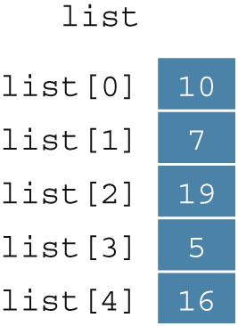
Bubble Sort
list[0]...list[n - 1]
  List of n elements, indexed 0 to n – 1
  Example: a list of five elements (Figure 16-1)
C++ Programming: From Problem Analysis to Program Design, Seventh Edition

Slide 6
Bubble Sort (cont’d.)
Series of n - 1 iterations
  Successive elements list[index] and list[index + 1] of list are compared
  If list[index] > list[index + 1]
    Swap list[index] and list[index + 1]
  Smaller elements move toward the top (beginning of the list)
  Larger elements move toward the bottom (end of the list)
C++ Programming: From Problem Analysis to Program Design, Seventh Edition

Slide 7
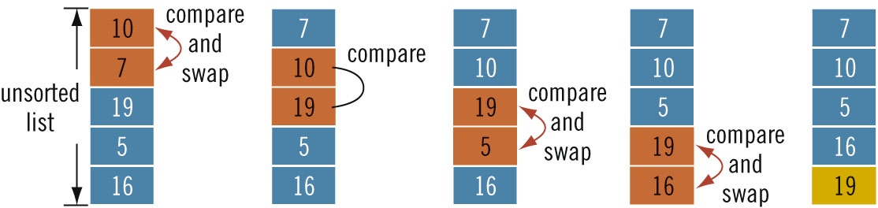
Bubble Sort (cont’d.)
C++ Programming: From Problem Analysis to Program Design, Seventh Edition

Slide 8
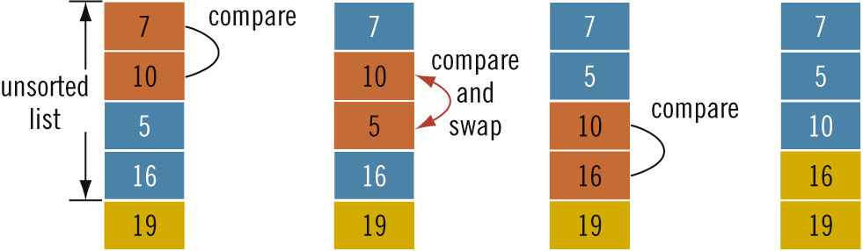
Bubble Sort (cont’d.)
C++ Programming: From Problem Analysis to Program Design, Seventh Edition

Slide 9
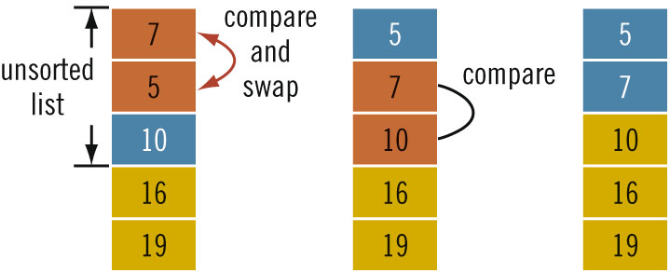
Bubble Sort (cont’d.)
C++ Programming: From Problem Analysis to Program Design, Seventh Edition

Slide 10
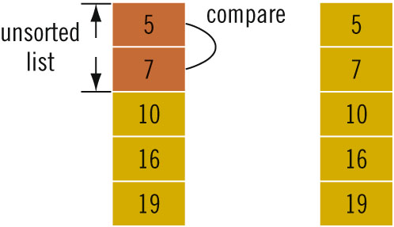
Bubble Sort (cont’d.)
C++ Programming: From Problem Analysis to Program Design, Seventh Edition

Slide 11
Bubble Sort (cont’d.)
List of length n
  Exactly n(n - 1) / 2 key comparisons
  On average n(n - 1) / 4 item assignments
If n = 1000
  500,000 key comparisons and 250,000 item assignments
Can improve performance if we stop the sort when no swapping occurs in an iteration
C++ Programming: From Problem Analysis to Program Design, Seventh Edition

Slide 12
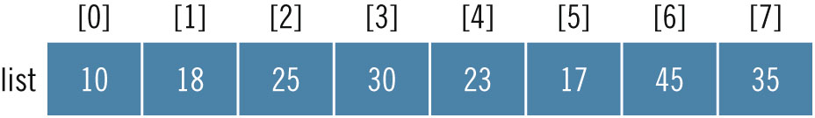
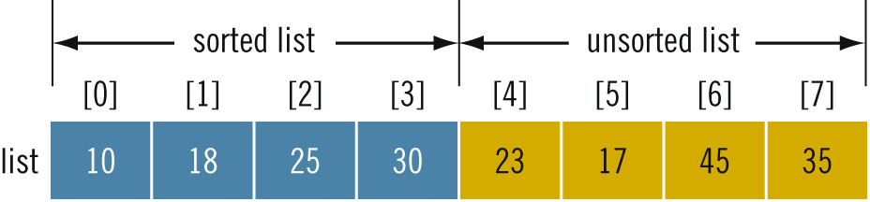

Insertion Sort
Sorts the list by moving each element to its proper place
C++ Programming: From Problem Analysis to Program Design, Seventh Edition

Slide 13
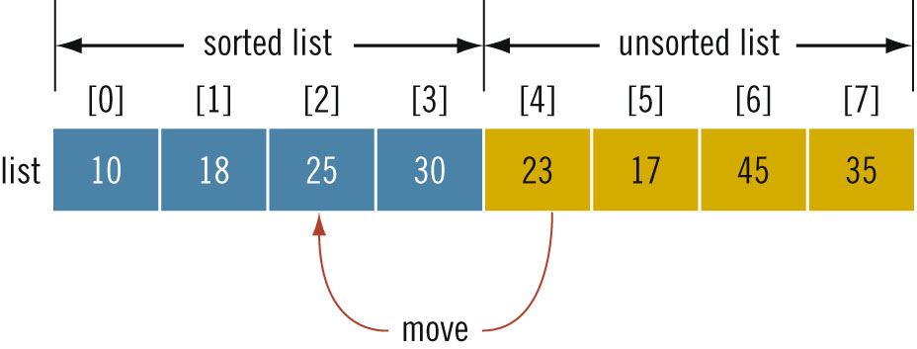

Insertion Sort (cont’d.)
Consider the element list[4]
  First element of unsorted list
  list[4] < list[3]
    Move list[4] to proper location at list[2]
C++ Programming: From Problem Analysis to Program Design, Seventh Edition

Slide 14
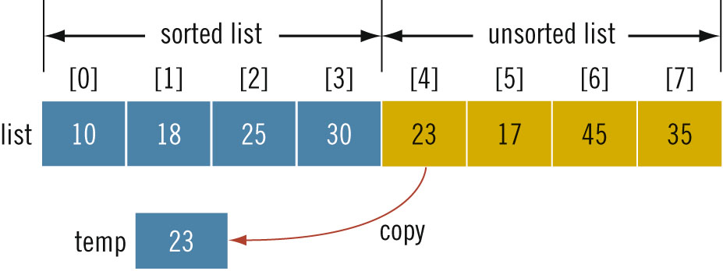

Insertion Sort (cont’d.)
C++ Programming: From Problem Analysis to Program Design, Seventh Edition

Slide 15
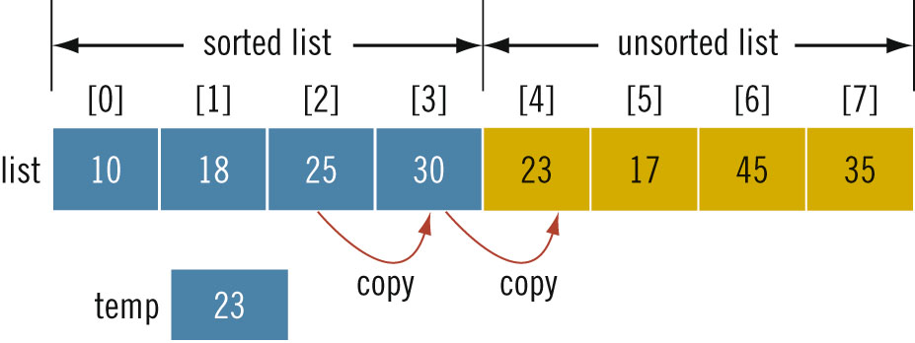
Insertion Sort (cont’d.)
C++ Programming: From Problem Analysis to Program Design, Seventh Edition

Slide 16
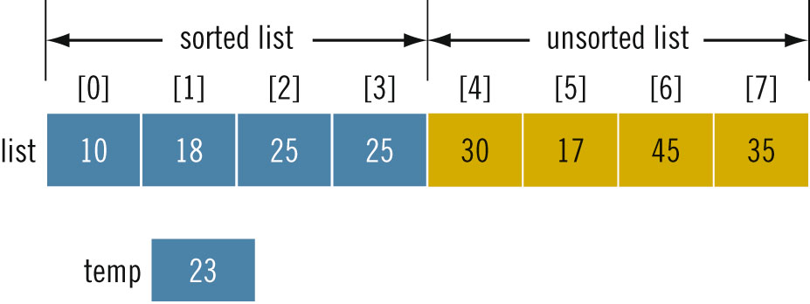
Insertion Sort (cont’d.)
C++ Programming: From Problem Analysis to Program Design, Seventh Edition

Slide 17
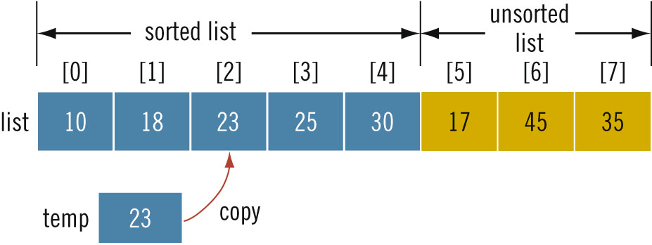
Insertion Sort (cont’d.)
C++ Programming: From Problem Analysis to Program Design, Seventh Edition

Slide 18
Insertion Sort (cont’d.)
During the sorting phase, the array is divided into two sublists: sorted and unsorted
  Sorted sublist elements are sorted
  Elements in the unsorted sublist are to be moved into their proper places in the sorted sublist, one at a time
C++ Programming: From Problem Analysis to Program Design, Seventh Edition

Slide 19
Insertion Sort (cont’d.)
List of length n
  About (n² + 3n – 4) / 4 key comparisons
  About n(n – 1) / 4 item assignments
If n = 1000
  250,000 key comparisons
  250,000 item assignments
C++ Programming: From Problem Analysis to Program Design, Seventh Edition

Slide 20
Binary Search
Much faster than a sequential search
List must be sorted
“Divide and conquer”
Compare search item with middle element
  If less than middle: search only upper half of list
  If more than middle: search only lower half of list
C++ Programming: From Problem Analysis to Program Design, Seventh Edition

Slide 21
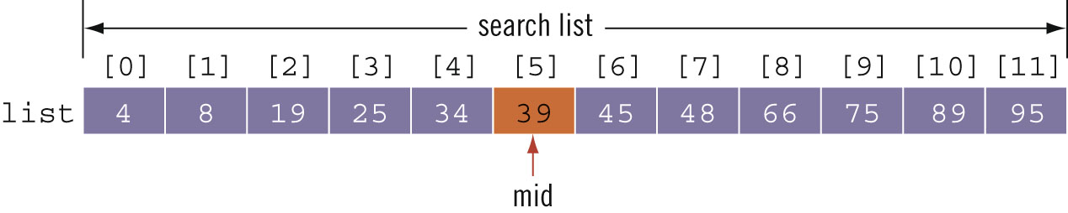
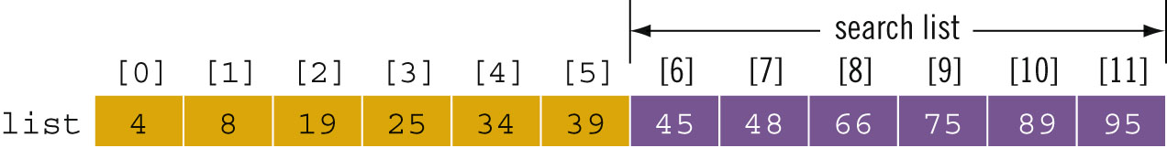
Binary Search (cont’d.)
C++ Programming: From Problem Analysis to Program Design, Seventh Edition

Slide 22
Performance of Binary Search
If L is a sorted list of size 1024
  Every iteration of the while loop cuts the size of the search list by half
  At most, 11 iterations to determine whether x is in L
  Binary search will make 22 comparisons at most
If L has1,048,576 elements
  Binary search makes 42 item comparisons at most
C++ Programming: From Problem Analysis to Program Design, Seventh Edition

Slide 23
Performance of Binary Search (cont’d.)
For a sorted list of length n:
  Maximum number comparisons is 2log₂n + 2
C++ Programming: From Problem Analysis to Program Design, Seventh Edition

Slide 24
vector type (class)
Only a fixed number of elements can be stored in an array
Inserting and removing elements causes shifting of remaining elements
vector type implements a list
  vector container
  vector
  vector object
  object
C++ Programming: From Problem Analysis to Program Design, Seventh Edition

Slide 25
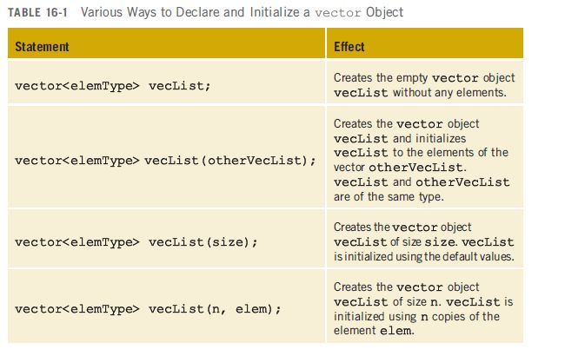
vector type (class) (cont’d.)
C++ Programming: From Problem Analysis to Program Design, Seventh Edition

Slide 26
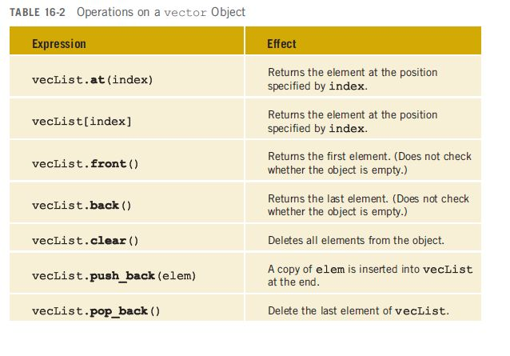
vector type (class) (cont’d.)
C++ Programming: From Problem Analysis to Program Design, Seventh Edition

Slide 27
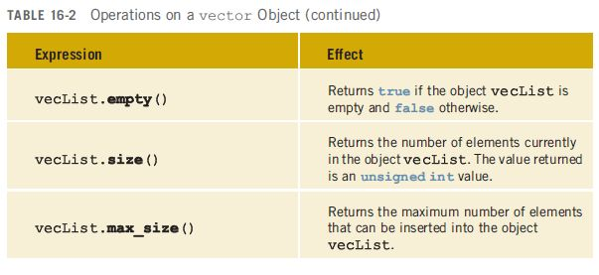
vector type (class) (cont’d.)
C++ Programming: From Problem Analysis to Program Design, Seventh Edition

Slide 28
Vectors and Range-Based for loops
Can use range-based for loop in C++11 Standard to process vector elements
    for (auto p : list) //for all p in list
    cout << p << " ";
    cout << endl;
Can initialize a vector object
  vector<int> intList = {13, 75, 28, 35};
  Not supported by all C++11 compilers
C++ Programming: From Problem Analysis to Program Design, Seventh Edition

Slide 29
Summary
List
  Set of elements of the same type
Sequential search
  Searches each element until item is found
Sorting algorithms
  Bubble sort
  Insertion sort
C++ Programming: From Problem Analysis to Program Design, Seventh Edition

Slide 30
Summary (cont’d.)
Binary search
  Much faster than sequential search
  Requires that the list is sorted
vector type
  Implements a list
  Can increase/decrease in size during program execution
  Must specify the type of object the vector stores
C++ Programming: From Problem Analysis to Program Design, Seventh Edition

