Slide 1
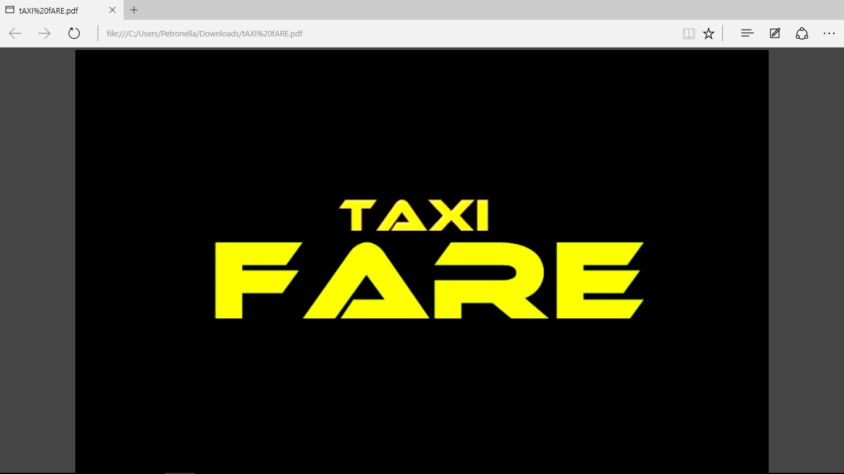
TM
A Registered Trademark of Grey Hugh’s Technologies Pty (Ltd)
©Grey Hugh’s Technologies Pty (Ltd) 2018

Slide 2
Revolutionizing Taxi Fare Payments in South Africa.
Digital Payments via QR Code & USSD for the Minibus Taxi Industry

Slide 3
The South African Taxi Industry Today.
Moves over 15 million commuters daily, vital to national transport, (According to Transaction Capital.2015)
Still heavily reliant on cash: manual fare collection causes delays, theft risks, and data gaps
Lack of reliable trip and revenue data hinders planning and growth

Slide 4
Why Digital Payments Are Urgent.
Post-pandemic commuter expectations: faster boarding, safer travel, cashless convenience
Manual cash handling leads to operational inefficiencies and security risks
Digital payments unlock data for smarter fleet management and regulatory compliance

Slide 5
Introducing Our Digital Payment Platform.
Enables taxi fare payments via QR codes or USSD numbers—accessible on any phone
No smartphone? No problem: USSD ensures inclusion for all commuters
Simple, secure, and fast transactions directly integrated into taxi operations

Slide 6
How It Works: Payment Flow Overview
Commuter scans QR code or dials USSD number at taxi entry
Selects fare amount, confirms payment via mobile money, bank card, or wallet
Instant confirmation to driver and commuter; transaction recorded digitally
Enables real-time tracking of trips and revenue (upload your flow diagram here)

Slide 7
Benefits for Commuters.
No need to carry cash or exact change—reduces theft and loss
Faster boarding, shorter queues, and smoother rides
Access to digital receipts and travel history for transparency

Slide 8
Benefits for Taxi Operators and Associations.
Daily digital payouts and transparent revenue tracking
Reduced cash handling risks and improved safety for drivers
Data-driven insights for fleet management and route optimization
Supports compliance with new transport regulations and integration with SANRAL systems

Slide 9
Economic and Social Impact.
Financial inclusion: integrates informal taxi economy into formal digital finance
Creates new job opportunities via agent networks for top-ups and support
Enhances commuter trust and satisfaction, boosting ridership and revenue
Aligns with national digital transformation goals led by SANTACO and partners

Slide 10
Proven Momentum and Partnerships.
Supported by SANTACO, MTN, and major fintech players like SAPay and Waxd
Early pilots show reduced cash theft, faster boarding, and better data capture
Government backing through National Land Transport Act compliance initiatives

Slide 11
Join Us in Driving the Future of Taxi Travel.
Embrace cashless payments to modernize South Africa’s taxi industry
Improve safety, efficiency, and financial empowerment for millions
Together, let’s build smarter, safer, and more connected transport for all
Contact us to learn more and see the platform in action

