Slide 1

7.2.2019
Flutter Masters
Kevin Ford
e: KevinF@magenic.com
m: 617-259-5192

Slide 2
Class Outline – 2 JUL 2019 (6 PM – 10PM eastern)
Layouts
Row
Column
Stack
Index Stack
GridView
Flow
Table
Wrap
ListView
Expanded

Slide 3
Layouts
Yes, widgets
May make sense to segment page into sections
Functions
Individual widgets
Visual Debugging
package:flutter/rendering.dart
debugPaintSizeEnabled
debugShowMaterialGrid
showPerformanceOverlay

Slide 4
Demo 1

Slide 5
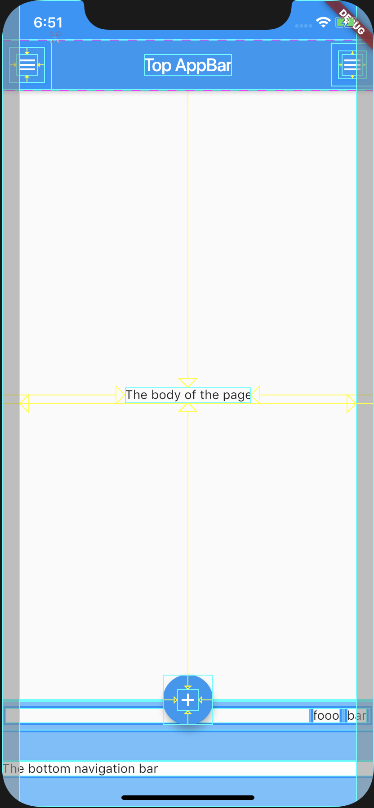
Scaffold
Material Scaffold lays out a ‘standard’ page
appBar
body
bottomNavigationBar
floatingActionButton
persistentFooterButtons
drawer
endDrawer

Slide 6
Demo 2

Slide 7
Rows, Columns, Expanded and Center
Column vs Row
mainAxis
crossAxis
mainAxisSize
mainAxisAlignment
Can nest
Expanded
Flex
Center
Horizontal and Vertical

Slide 8
Demo 3

Slide 9
Stack and IndexStack
Allows children to be overlapped
Children
Positioned
Non-positioned
Sized to contain all non-positioned children
Last item is on ‘top’
IndexedStack only shows one item
Item specified by index property
Sized as if all items are there

Slide 10
Demo 4

Slide 11
GridView and Table
GridView is for scrollable matrix of widgets
GridView.count
crossAxisCount
Table is for fixed length matrix of widgets
Table does automatic sizing unless overridden
defaultColumWidth
Collection of TableRow objects
defaultVerticalAlignment

Slide 12
Demo 5

Slide 13
Flex
A way to apply custom layout rules to a collection of children
Layout rules defined in class that extends from FlowDelegate
Layout done in paintChildren method
Children positioned during paint instead of layout phase
Often used with custom animations to show objects in motion
Animation can be passed to the constructor of delegate to time
Performance of using paint vs layout primary reason to use a flow

Slide 14
Demo 6

Slide 15
ListView
ListView
Scrollable list it items – vertically or horizontally
Single list of items
ListView.builder
ListView.separated
ListView.custom
If not flexible enough use CustomScrollView

Slide 16
Demo 7

Slide 17
Wrap
Wrap contents such as columns and rows
Can be horizontal or vertical depending on child
Use when you don’t want to scroll
Properties to know
direction
spacing
runSpacing

Slide 18
For Next Week Before Class
Read:
Layouts
https://buildflutter.com/flutter-threading-isolates-future-async-and-await/
https://api.flutter.dev/flutter/dart-isolate/Isolate-class.html
https://www.didierboelens.com/2019/01/futures---isolates---event-loop/
https://medium.com/flutter-community/futures-async-await-threading-in-flutter-baeeab1c1fe3
https://flutterappdev.com/2018/12/17/using-streams-in-flutter-flutter-app-development/
https://api.flutter.dev/flutter/scheduler/scheduler-library.html
https://www.youtube.com/watch?v=nQBpOIHE4eE

Slide 19
For Next Week Before Class
Use a future or async await to get a return from a REST API call
Sample APIs can be found here: https://any-api.com/
Have a background task run in a Flutter app
Limitations?
Use streams to publish and subscribe to events in your app

