Slide 1

7.15.2019
Flutter Masters
Kevin Ford
e: KevinF@magenic.com
m: 617-259-5192

Slide 2
Class Outline – 15 Jul 2019 (6PM – 10PM eastern)
State Management
Declarative State
Ephemeral state and app state
State Concepts
setState
Inherited Widgets
Provider and Scoped model

Slide 3
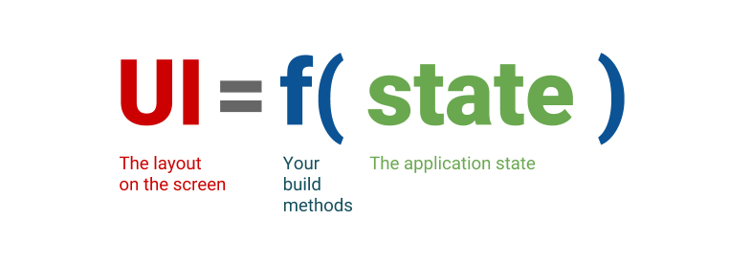
UI objects are always transient
Extremely brief lifecycle of a widget
Only “State” objects “stick around”
Can’t set a property on a widget after it is drawn
Can only “redraw” (setState()/Build) the widget
BUT STATE OBJECTS STICK AROUND
Ephemeral State vs App State

Slide 4
Ephemeral State Concepts
Info
Info
class MyClass extends StatelessWidget
class MyOtherClass extends StatefulWidget
build
class MyState extends State<MyOtherClass>
Drawn widget
build
Drawn widget

Slide 5
Demo 1

Slide 6
When does something become App State?
Yes or no?
When it is passed between pages
When it is saved to a DB
Passed between widgets
No hard and fast rule
Simple solutions
Static variables
Route parameters
Streams

Slide 7
Lifting State up
Keep state above the widgets that use it
ChangeNotifier
class MyModel extends ChangeNotifier {
String _lastName = ’’;
String get lastName => _lastName;
set lastName(String value) {
if (_lastName != value) {
_lastName = value;
this.notifyListeners();
}
}
}
Pass references to sub widgets

Slide 8
Demo 2

Slide 9
Inherited Widgets
…
My Model
Inherited Widget
Some Widget
I need a reference to MyModel
Some Other Widget
…
…

Slide 10
Setup Inherited Widget
class PeopleWidget extends InheritedWidget {
final PeopleModel people; PeopleWidget(this.people, Widget child) : super(child: child);
@override
bool updateShouldNotify(InheritedWidget oldWidget) => true;
static PeopleWidget of(BuildContext context) {
return context.inheritFromWidgetOfExactType(PeopleWidget);
} }
Pass reference to model class to InheritedWidge
If you need custom control over when updates are sent
Static of operator to get reference, convivence method
Widget build(BuildContext context) {
var people = PeopleWidget.of(context).people;
…
}
Find the inheritedWidget and get a reference to the people object without knowing where it is in the tree

Slide 11
Demo 3

Slide 12
Provider package
External package
https://pub.dev/packages/provider
Syntactic Sugar around InheritedWidget
In pubspec.yaml
provider: ^3.0.0+1
Imports:
import 'package:provider/provider.dart’;
Like InheritedWidgets
provider must be further up widget tree
Found by type
Can create app wide state

Slide 13
Simple Provider Package Usage
Widget build(BuildContext context) {
return Provider<PeopleModel>(
builder: (context) => PeopleModel(),
child: childWidget
);
Type of class providers handle
This is a factory but can use existing instance
Provider.of<PeopleModel>(context).someMethod();
Widgets further down the tree can look for provider by type
Make sure Provider you are looking for is above, not within, this context!

Slide 14
More Complex Provider Usage
Widget build(BuildContext context) {
return ChangeNotifierProvider<PeopleModel>(
builder: (context) => PeopleModel(),
child: childWidget
);
Refresh children if notified of change, Supplied model must implement ChangeNotifier.
Consumer<PeopleModel>(
builder: (context, people, _) {
return childWidget
);
}
);
Consumer will find ChangeNotifierProvider of correct type up the widget tree
Build method provides the instance of PeopleModel as a parameter!

Slide 15
Demo 4

Slide 16
Scoped Model
Very similar to Provider
Extends InheritedWidget
Handles change events
Much simpler than Provider

Slide 17
Scoped Model Usage
class PersonModel extends Model { … }
Model must inherit from Model object, implements ChangeNotifier
ScopedModel<PeopleModel>(
model: PeopleModel(),
child: someChildWidget
)
Use types ScopedModel class
Constructs instance of model or returns existing one
ScopedModelDescendant< PeopleModel >(
builder: (context, child, people) => childWidget
);
Or
ScopedModel.of< PeopleModel >(context).someMethod();
Somewhere down the line you get reference to PeopleModel
Make sure Provider you are looking for is above, not within, this context!

Slide 18
Demo 5

Slide 19
For Next Week Before Class
Read:
Flutter Performance
https://flutter.dev/docs/testing/best-practices
https://flutter.dev/docs/testing/ui-performance
https://flutter.dev/docs/development/tools/devtools/memory
Flutter Inspector
https://flutter.dev/docs/development/tools/devtools/inspector
Timeline View
https://flutter.dev/docs/development/tools/devtools/timeline
Memory View
https://flutter.dev/docs/development/tools/devtools/memory
Packages
https://flutter.dev/docs/development/packages-and-plugins/using-packages

Slide 20
For Next Week Before Class
Use the inspector to look at the widget tree of a few apps
Use apps at: https://github.com/flutter/flutter/tree/master/examples
Inspect same apps with timeline view
Also try the memory view
Create a sample app using two or more public libraries from the package library.

