Slide 1

7.15.2019
Flutter Masters
Kevin Ford
e: KevinF@magenic.com
m: 617-259-5192

Slide 2
Class Outline – 22 Jul 2019 (6PM – 10PM eastern)
Flutter Inspecter
Timeline View
Memory View
Dart Packages (https://pub.dev)

Slide 3
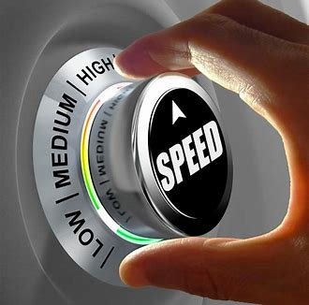
Keeping your app FAAAAAAAST
The build() method gets called … a lot
Avoid expensive work or huge loops
Break up build() methods into smaller widgets
Don’t force everything to be rebuilt, setState() only builds what is below it
Use SlideTransition and TransitionBuilder to avoid unnecessary recursive build calls

Slide 4

Avoid effects
Can call saveLayer()
Allocates an offscreen buffer
May be slower on older GPUs
The Opacity widget is expensive
Clipping is expensive, but not as expensive as opacity
Render grids and lists lazily
Use ListView.builder() for this
The list can be fetched lazily as well
Building and rendering happen on different threads
Keep frames rendering at well below 16ms which will give 60 fps
Saves battery
Keeps device cool

Slide 5
How to test it
Use profile mode
Run on a physical device
A slow physical device
Set to run in profile mode
Edit launch.json to set flutterMode to profile
"flutterMode": "profile"
With running app us Command Palette Dart: Open DevTools
View the Timeline
UI Events – DART code running on the main thread
GPU Events – Doing the drawing

Slide 6
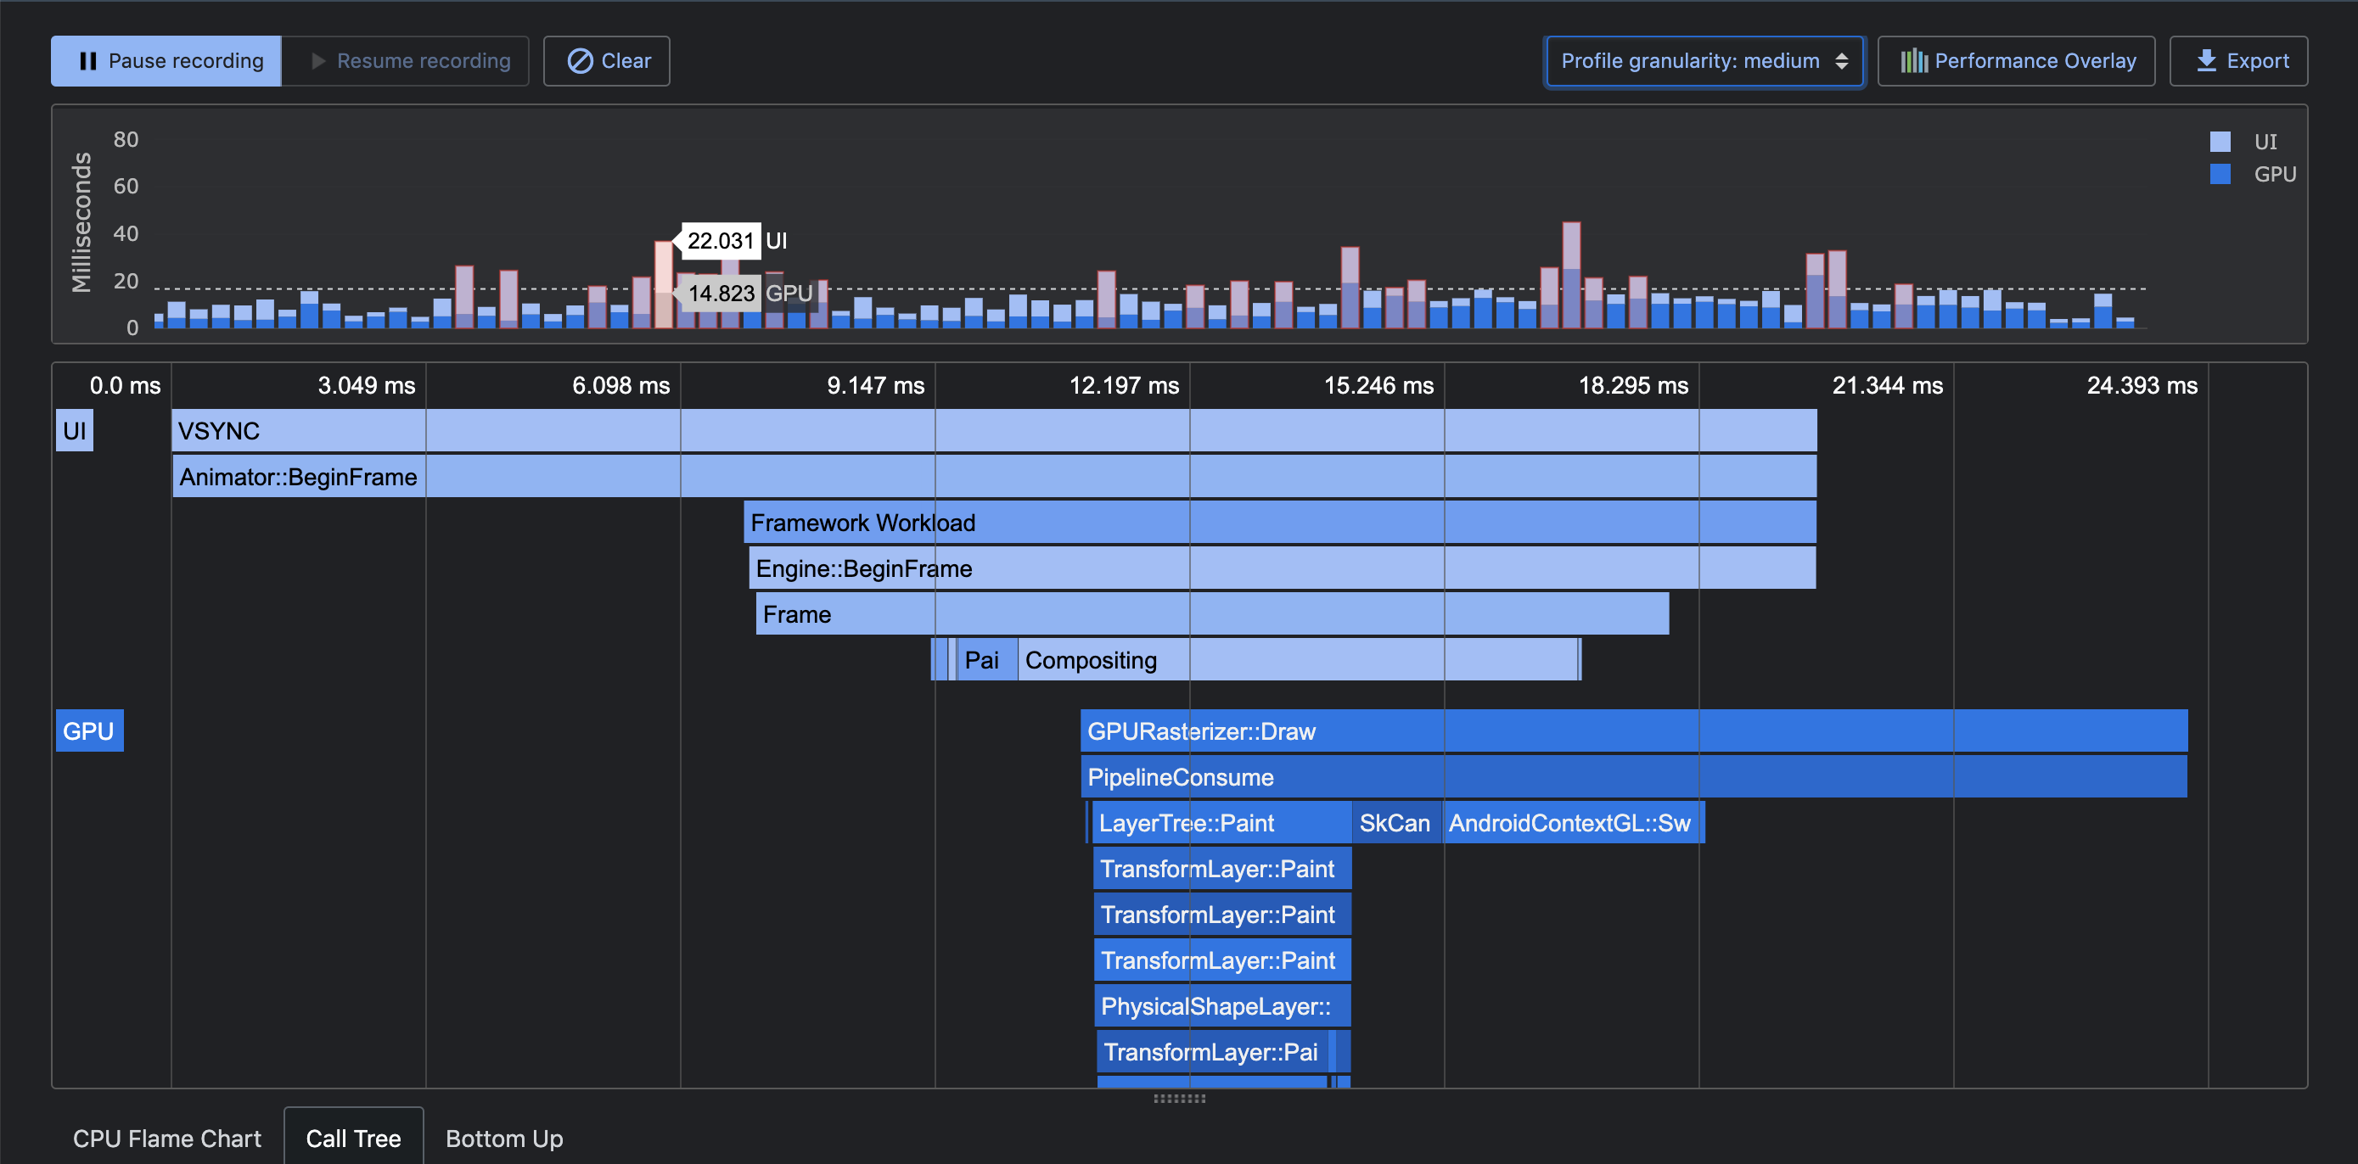

Slide 7
Profiling Gotchas
Be careful of what else is running on the device
Reflector
Heisenberg uncertainty principle
The mere act of profiling changes the results
Be wary of increasing the sample rate
Hot reload doesn’t seem to work

Slide 8
Demo 1

Slide 9
Flutter Inspector
Examining UI of your app
Can’t be in profile mode
Allows inspecting of the widget tree
All pages in back stack are part of the tree

Slide 10
Demo 2

Slide 11
Memory
Shows DART objects
Used for finding memory leaks
Can cause GC (compaction of the heap)
Snapshots save image of objects in memory at a point in time
Use accumulators for memory leaks
Count is total number of current objects in heap

Slide 12
Demo 3

Slide 13

Packages
Similar to Nuget
Find at: https://pub.dev/
Can create your own, for example FMVVM:
https://pub.dev/packages/fmvvm
Add package to pubspec.yaml
fmvvm: ^0.9.6
Multiple packages can have the same dependencies
Can avoid some conflicts by not specifying an exact version
Can specify a range with minimum and maximum
Can point at a git repository
plugin1:
git: url: git://github.com/flutter/plugin1.git

Slide 14
Demo 4

Slide 15
That’s all folks!!!

