Slide 1

Stock Demand Forecasting
Weekly
Presented by : Vishal Sharma

Slide 2
AIM
Forecast weekly stock demand
Analysis historical data
Gather and clean data

Slide 3
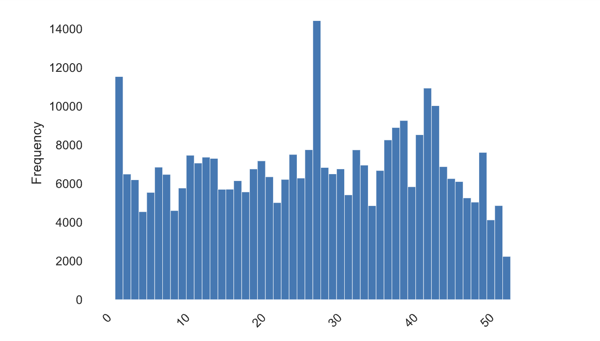
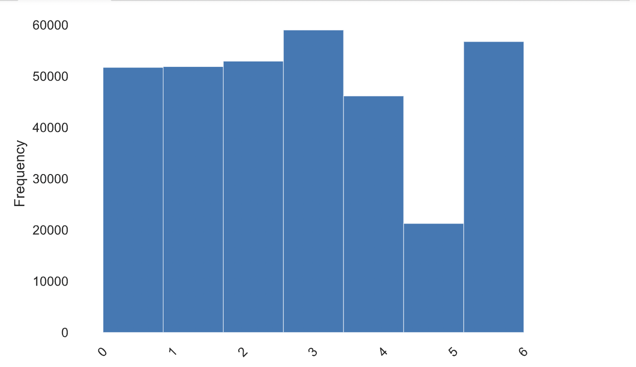
Weekday Trends
Weekly Trends

Slide 4
Solution
Approach to clean historical data
Check daily stock demand and do EDA on it
Invoice date play important role for feature Engineering
Extract date, day, weekday, weekend and months help to forecast data
Using Catboost Regressor for forecasting data (maximum features are categorical)
Demand Forecasting
Data Cleaning
EDA
Feature Engineering
Model training
Performance Evaluation

Slide 5
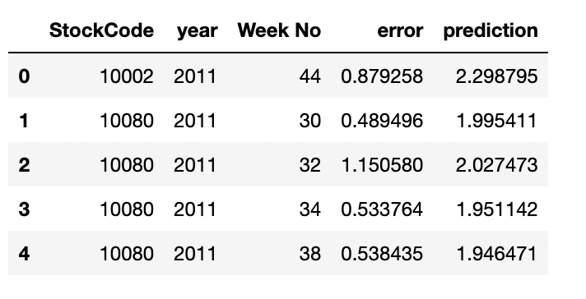
Result
Mean Absolute Percentage Error for time period (11/7/2011 – 12/3/2011 ) weekly : 86.94
Mean Absolute Error : 0.8692

