Slide 1
Defining the Phenotypic Signature of
CFTR Mutation Carriers in the UK Biobank
Yu-Chung Lin (Jerry), Naim Panjwani, Faizan Mohsin, Mitchell Sutton, Jessica Dennis, Johanna M. Rommens, Lei Sun, Lisa J. Strug
Presenter: Yu-Chung Lin (Jerry)
PhD Candidate, Biostatistics
Dalla Lana School of Public Health, University of Toronto
Cystic Fibrosis Centre Seminar
December 5th, 2019

Slide 2
Cystic Fibrosis (CF)
Autosomal recessive genetic disorder caused by 2 mutations in the CF Transmembrane Conductance Regulator (CFTR).
CFTR mutation carriers
1 in 25 among Europeans
Assumed not to exhibit clinical features
Focused on F508del mutation carriers
Excluded individuals carrying other CFTR mutations.
Majority of morbidity due to lung disease but CF involves multiple organ systems
15% of CF individuals born with intestinal obstruction.
Almost everyone shows exocrine pancreatic disease starting in utero.
CFTR variant | Global Frequency¹ in CF
F508del | 69.86%
G542X | 2.54%
G551D | 2.11%
N1303K | 1.57%
R117H | 1.31%
W1282X | 1.22%
¹Ferec and Cutting. Assessing the Disease-Liability of Mutations in CFTR. Cold Spring Harb Perspect Med, 2, a009480, 2012.
Notes:
Here, we’d like to investigate whether those CFTR carriers demonstrate a phenotype. For this study, we define carriers as any individual with one F508del mutation. We excluded individuals carrying other CFTR mutations and those with CF.

Slide 3
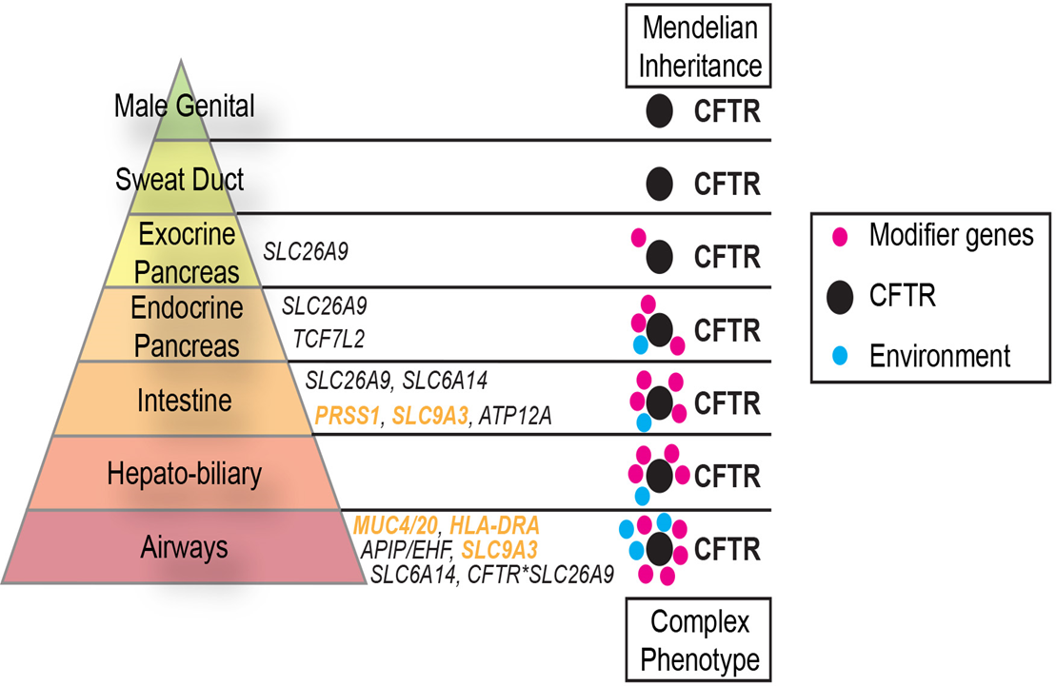

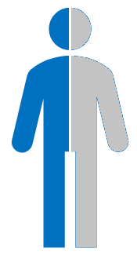
CF Affects Multiple Organs
Does a carrier phenotype exist?
Individual with CF
F508del Carrier
Notes:
-Conceptual model for diseases in CF.
-Having two CFTR mutations, along with environmental exposures/modifier genes, they all contribute to disease severity in each organ.
-Triangle represents organs affected in CF. As we move from top to the bottom, disease severity becomes more complex with greater contributions from modifier genes and environmental exposures.
-For instance, exocrine pancreas (CFTR mutations explains most of the morbidity) in the airways, environmental effect such as exposure to microbes can become much more important.
-Here we ask whether individuals with just one CFTR mutation, in particular the F508del mutation, will exhibit increased morbidity in the organs affected in CF.

Slide 4
Assessing Carrier Phenotype in the UK Biobank
UK Biobank
Cohort study with deep genetic and phenotypic data on over 500,000 individuals.
Participants aged between 40 and 69 at recruitment.
Includes International Classification of Diseases, Tenth Edition (ICD-10).
Phecodes
ICD-10
Better code representation of disease phenotypes²
Classified into 17 phenotype groups
Diagnostic codes classified by the WHO.
Mapped into 1,472 phecodes
Digestive
Endocrine
Musculoskeletal
Respiratory
Number of participants enables us to perform phenome-wide association studies (PheWAS) on each phecode.
²Wu et al. Developing and Evaluating Mappings of ICD-10 and ICD-10-CM Codes to Phecodes. JMIR Medical Informatics (2019)
Notes:
With access to the UKBiobank data, it allows us to investigate the phenotypes of F508del carriers. (Large sample size and high freq of 1 in 25 carriers in European)

Slide 5
Sample Inclusion Criteria from the UK Biobank
Non-CF Individuals with genetic data on F508del mutation
N = 485,232
35,889 related individuals
N = 485,232 – 35,889 = 449,343
73,862 non-Europeans
N = 449,343 – 73,862 = 375,481
113,604 with missing phecodes
N = 375,481 – 113,604 = 261,877
Non-carriers (N=253,175)
F508del Carriers (N=8,702)

Slide 6
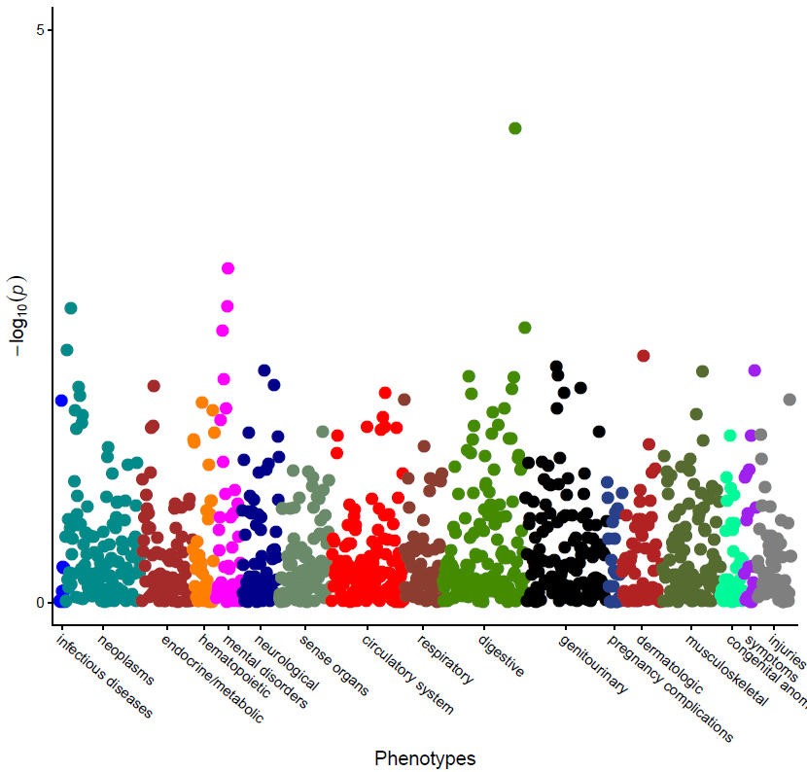
Phenome-wide Association Study of F508del Carriers
All Individuals (N = 261,877)
Obstruction of Bile Duct (n=462 cases)
Obstruction of Bile Duct
Odds Ratio (OR) | 2.09
95% CI (OR) | (1.45, 3.01)
P-Value | 7.3E-5

Slide 7
Phenome-wide Association Study of F508del Carriers
All Individuals (N = 261,877)
Obstruction of Bile Duct (n=462 cases)
Obstruction of Bile Duct
Odds Ratio (OR) | 2.09
95% CI (OR) | (1.45, 3.01)
P-Value | 7.3E-5

Slide 8
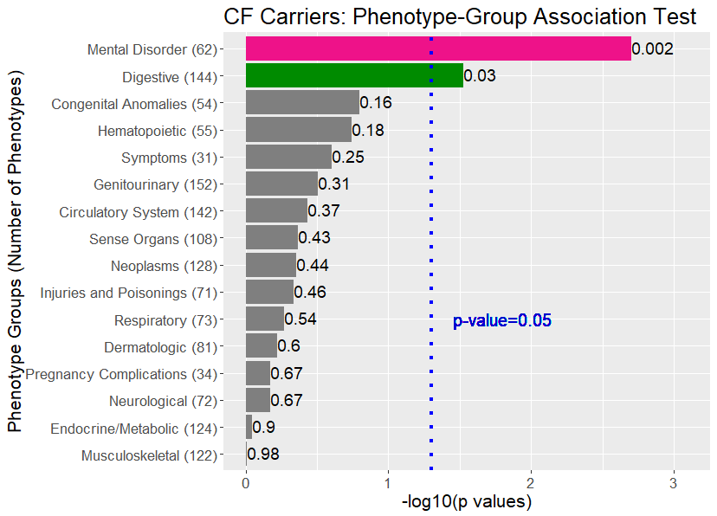
Phenotype-Group Associations Tests
Significant phenotype groups
Mental Disorders
Digestive
Analysis provides evidence for the presence of a signal.
Not how “widespread” the signals are within each phenotype group.

Slide 9







Which Phenotypes Contribute to the Group Associations?
Sampled 500 different subsets containing two-thirds of all participants$, n=261,877$
UK Biobank Participants: Unrelated Europeans with Phecodes (n=261,877)
Resampling data 500 times
$$\frac{2}{3}n$$
$$\frac{2}{3}n$$
$$\frac{2}{3}n$$
$$\frac{2}{3}n$$
$$\frac{2}{3}n$$
$$\frac{2}{3}n$$
Conducted 500 PheWAS
Used saddlepoint approximation to adjust for case-control imbalance and Type I error inflation.
Noted phenotypes with p-value <0.05.
Counted the proportion of iterations a phenotype showed p<0.05.
Notes:
To determine which phenotypes are contributing to the group associations, we sampled 2/3 of the data 500 different times to create 500 different subsets, akin to bootstrapping but without replacements.

Slide 10
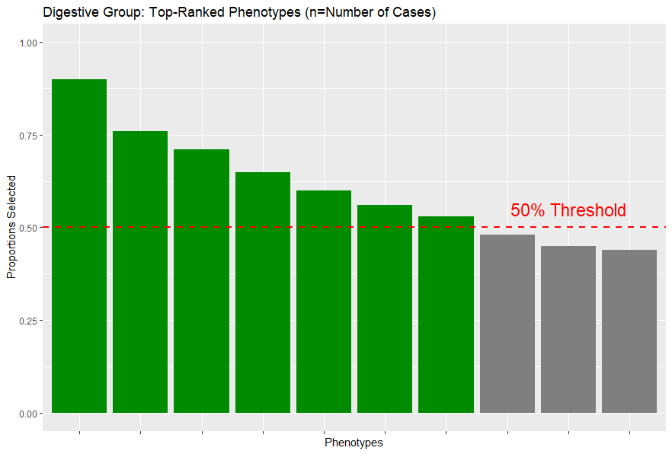
Digestive Phenotypes contributing to the Group Association
Each bar represents a phenotype.
Height of the bar is the proportion of datasets with p < 0.05.
59% of the all digestive phenotypes never had p<0.05.
7 phenotypes had p < 0.05 greater than 50% of the time.
n=462
n=770
Obstruction of Bile Duct
n=421
Diverticulum of Esophagus
Nonspecific Abnormal Findings in Stool Contents
n=81
n=4,661
Cholelithiasis with other cholecystitis
Hemorrhage from Gastrointestinal Ulcer
n=670
n=107
Peritoneal and Intestinal Adhesions
Primary Biliary Cirrhosis
Almost all the top phenotypes reflect obstructions.
Notes:
The figure shows the proportion of times different digestive phenotypes show association at the .05 level across 500 different datasets.
The second bar is the nonspecific abnormal findings in stool contents, with 770 cases. It shows association at the .05 level in over 75% of the datasets.
Almost 60% of the phenotypes were never chosen, but as we can see, 7 phenotypes had p < 0.05 greater than half of the times.
Interestingly, almost all of the top phenotypes reflect obstructions across the CF-affected organs, including bile duct, esophagus, intestine and liver. More importantly, all the top phenotypes showed increased risk for the F508del carriers. The effect sizes are all in the same direction.

Slide 11
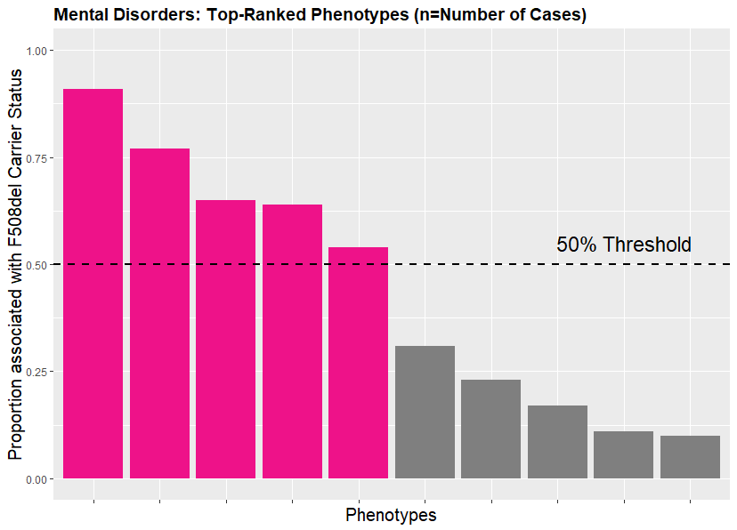
Mental Disorder Phenotypes contributing to the Group Association
65% of the all phenotypes were never selected.
5 phenotypes chosen in greater than 50% of the datasets.
All 5 phenotypes showed increased risk for F508del carriers.
Surprising result.
n=1,128
Major Depressive Disorder
n=29
n=1,110
n=597
Mood Disorders (Non-bipolar/depression)
Swelling, mass or lump in head or neck
n=182
Hallucinations
Aphasia / Speech Disturbance
Notes:
This is the exact same figure but for the mental disorder phenotypes.
This comes as a surprising result for us* as to our knowledge there has been no relationship with mental health phenotypes in CF.

Slide 12
Summary
We observed increased risk of bile duct obstruction in F508del carriers
Risk increases for an individual are small (Obstruction of Bile Duct: 0.2% 0.4%)
The digestive, and surprisingly, the mental disorder phenotypes showed evidence of association as a group
Importantly all associated phenotypes showed increased risk among F508del carriers rather than protective effects.
Several phenotypes showing association in the digestive group are related to obstructions in CF affected organs, which required further investigation.
Modifier genes also impact disease variation in CF. Further investigations underway to assess their impact on carrier phenotypes.
Notes:
Many digestive phenotypes showing association are related to obstructions in CF affected organs. Future work will investigate more rigorously the extent to which this obstructive phenotype impacts F508del carriers.

Slide 13
Predicting Cystic Fibrosis Related Diabetes (CFRD) using Genetic Variants with Small Effects
Yu-Chung Lin (Jerry), Lisa J. Strug
Presenter: Yu-Chung Lin (Jerry)
PhD Candidate, Biostatistics
Dalla Lana School of Public Health, University of Toronto
Cystic Fibrosis Centre Seminar
December 5th, 2019

Slide 14
Recap: CF Modifier Genes Contribute to Disease Severity
Individuals with the same CFTR mutations have varying disease severity across CF-affected organs.
Organs affected: Lung, Intestine, Pancreas, etc.
Modifier genes and clinical/environmental factors contribute to disease severity and co-morbidities across the affected organs.
Previously we showed that exocrine pancreatic damage in utero and early life is a biomarker and causal contributor of Cystic Fibrosis Related Diabetes (CFRD; Soave et al 2015).

Slide 15
Cystic Fibrosis Related Diabetes (CFRD)
Most common comorbidity among individuals with CF.
~20% among adolescents and >40% among CF individuals at age 40.
If untreated results in increased morbidity and mortality
Type II diabetes gene (TCF7L2) and CF modifier of exocrine pancreatic disease, SLC26A9, shown to confer risk from previous GWAS studies.
Time to Event (Censored) outcome
Daily treatment with insulin or oral diabetes medication.
Oral Glucose Tolerance Test (OGTT): 2-hour glucose level > 11.1 mmol/L.
HbA1c is at least 7%.

Slide 16
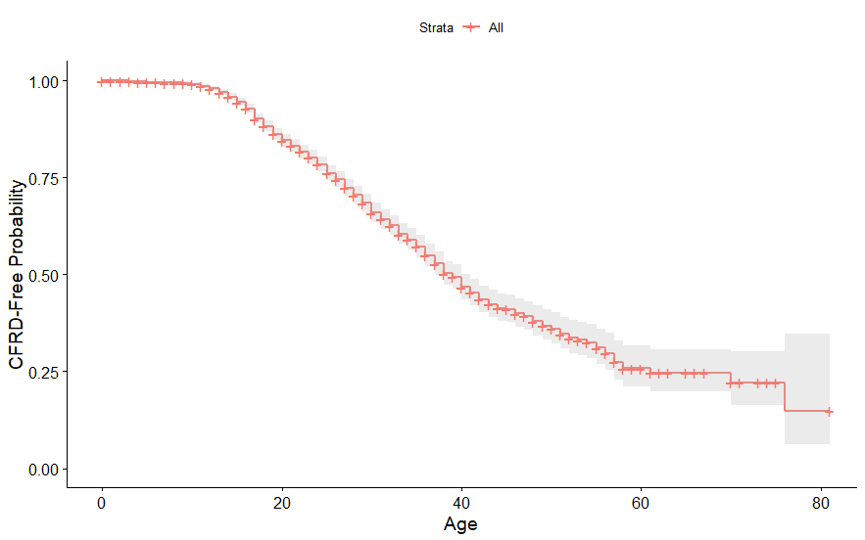
Overarching Goal
To construct a predictive model to evaluate time-dependent CFRD risk based on genetic data and clinical measures early in life.

Slide 17
Canadian Gene Modifier Study (CGMS)
2,206 Individuals.
Include all identified CF modifiers (3,984 SNPs):
Modifiers of lung, intestinal obstruction and exocrine pancreatic disease.
Including all variants annotated to genes that code for proteins residing at the apical plasma membrane alongside CFTR.
SNPs associated with CFRD including Type II diabetes variants.
Clinical Measures early in life:
Sex
Measures of exocrine pancreatic disease:
Intestinal obstruction at birth: Meconium Ileus (MI)
SLC26A9
CFTR mutation severity, etc.

Slide 18
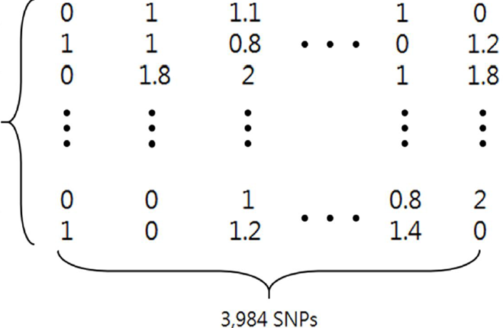
Genotype Data / Clinical Measures
Clinical measures available early in life:
Sex
CFTR mutation severity score (Range: 1 ~ 5)
MI Status
2,206 individuals
3,984 SNPs + Clinical Measures

Slide 19
CFTR Mutation Score^{[1]}
Mutation
Classes
Most Severe
Allelic Score
5
4
3
2
1
I
II
III
IV, V, VI
4
3
2
1
Allele 1
G542X
f
Allele 2
F508del
Function to
combine allelic scores
Individuals with different mutations have varying CF severity.
Range 1 (Least severe) to 5 (Most severe).
Scores are constructed using CFTR mutations from both alleles.
Least Severe
[1] C.Y. Ooi and P.R. Durie. Cystic fibrosis transmembrane conductance regulator gene mutations in pancreatitis (2012). J Cyst Fibros, 11, pp. 355-362

Slide 20
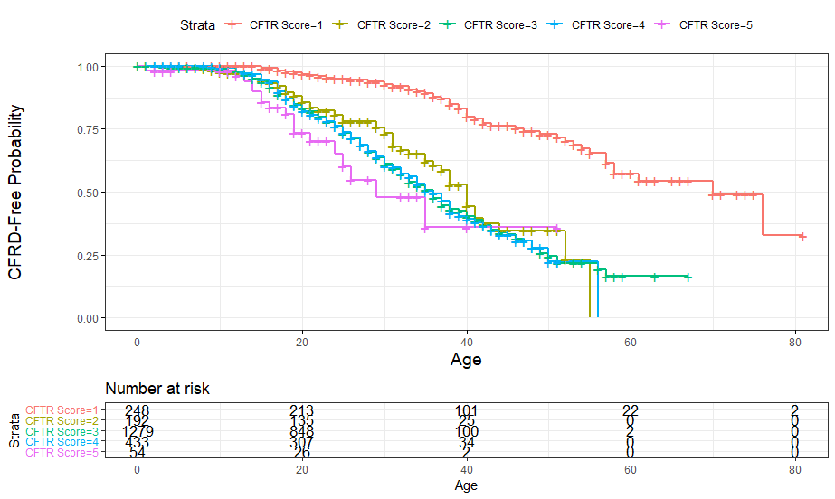
CFRD Event-Free Probabilities

Slide 21
Statistical Modeling – Two Stage Approach
Partitioning CGMS into Training and Validation sets
The age-dependent CFRD risk model was defined in the training set and predictive performance evaluated in the validation set.
Variable Selection
Favours parsimony due to small effects from SNPs and sample size constraint.
Component-wise gradient boosting (CWGB)
Five-fold cross validation (CV) to choose stopping criterion.
Stability Selection
Rank variable importance by the “stability” of each predictor.
Only select predictors that exceed the pre-defined threshold (50%).

Slide 22
Statistical Modeling – Two Stage Approach
Risk Estimation
Cox Proportional Hazard (Cox PH) model using covariates selected by stability selection.
Relax over-penalized effect sizes for the chosen predictors.
Evaluating CFRD risk scores
AUC(t): Time-dependent ROC curves.
CFRD prevalence: Top 10% highest risk v. Bottom 10% lowest risk.
Relevant for applications in clinical settings.
Model evaluation in two independent datasets
French population-based Gene Modifier Study (FGMS, n=1,049)
John Hopkins Twin and Sibling Study (JHU TSS, n=527)

Slide 23
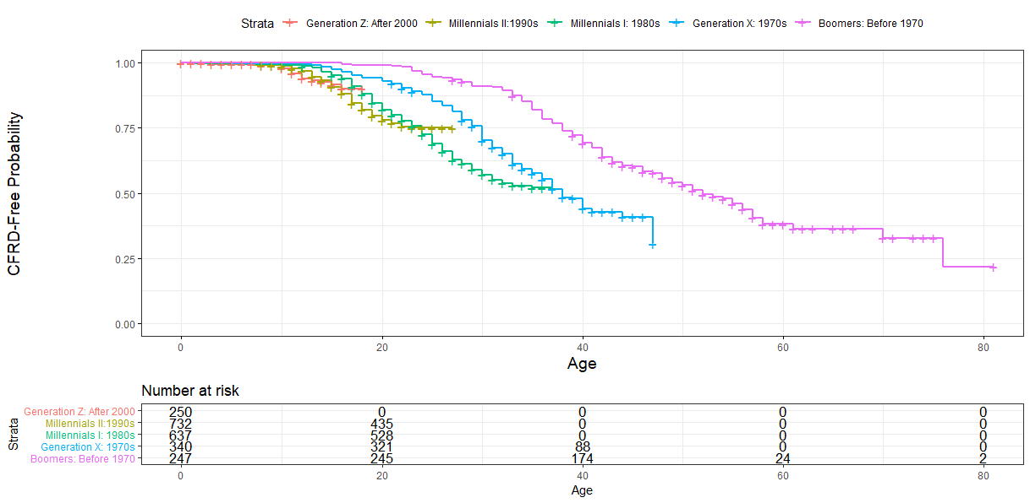
Cohort Effect

Slide 24
Measures of Exocrine Pancreatic Disease Severity
Among the Strongest Predictors
Gene Annotation | Predictor | Hazard Ratio | 95% CI
CFTR | CFTR Mutation Score | 2.97 | (1.98, 4.46)
-- | Sex (Female) | 1.48 | (1.27, 1.74)
PRSS1 | rs1964986 (A) | 1.25 | (1.11, 1.40)
-- | Meconium Ileus (MI) | 1.34 | (1.09, 1.64)
SLC26A9 | rs4077468 (A) | 1.19 | (1.07, 1.34)
NRG1 | rs16879142 (T) | 1.33 | (1.14, 1.54)
SLC5A8 | rs12318809 (G) | 1.36 | (1.17, 1.58)
AKAP7 | rs1729533 (C) | 1.23 | (1.07, 1.42)
TCF7L2 | rs7901695 (C) | 1.15 | (1.02, 1.30)
Measures of exocrine pancreatic disease severity
CFTR mutation severity score
PRSS1, encodes cationic trypsinogen
MI
SLC26A9 variants
Type II diabetes gene, TCF7L2, a contributor reported in earlier studies.
Females exhibit higher CFRD risk.

Slide 25
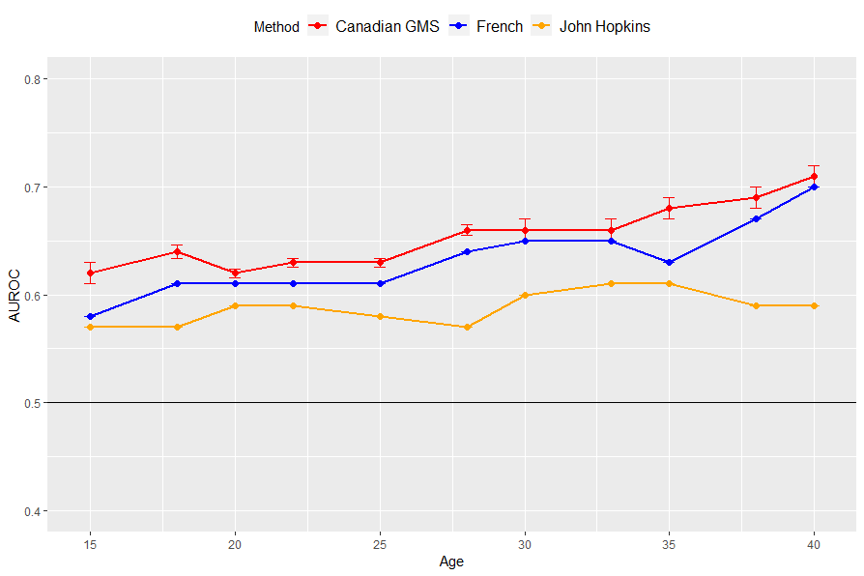
Model Performances (AUC)
Model trained on CGMS was tested on French & JHU cohorts.
For CGMS, internal validation with 500 5-fold CV was used to estimate AUC and its 95% confidence intervals.
Agreement with French cohort but poor performance in JHU TSS.

Slide 26
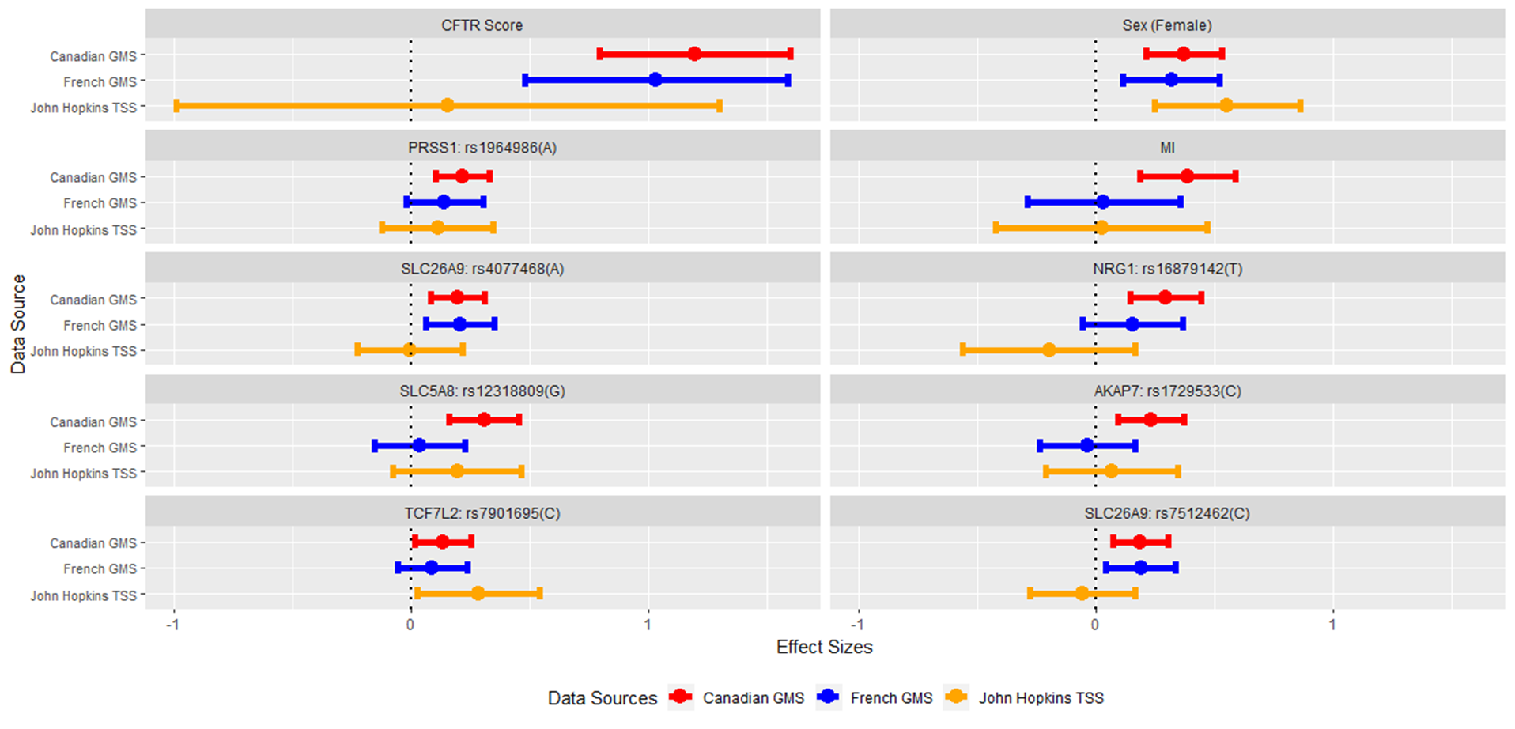
Effect Sizes Often Disagree in the John Hopkins Study

Slide 27
CFRD Prevalence (Top 10% / Bottom 10%)
Data Sources/Age | 18 | 25 | 35
Canadian GMS | 22.7 / 2.6 | 43.7 / 7.2 | 78.9 / 15.4
French GMS | 30.4 / 5.5 | 53.5 / 15.3 | 84.2 / 30.7
JHU TSS | 24.3 / 0.0 | 59.9 / 25.5 | 83.8 / 52.2
Estimated CFRD prevalence comparing the 10% of individuals with the highest risk and the 10% with the lowest risk.
Model is more proficient in stratifying high and low-risk individuals in CGMS and FGMS than in the JHU TSS.
Higher CFRD prevalence in FGMS / JHU TSS compared to CGMS, which requires further investigation.

Slide 28
Concluding Remarks
CFRD risk prediction model using genetic data and clinical measures early in life.
Validated on two independent datasets.
Able to identify CF individuals most susceptible to CFRD.
Frequent monitoring provided to individuals with highest risk.
Adherence to OGTT currently poor.
Measures of exocrine pancreatic disease severity among the most important predictors.
CFTR mutation score, MI
PRSS1, SLC26A9 variants

Slide 29





Acknowledgements
Canadian Gene Modifier Study
Johanna Rommens
Lei Sun
Strug Lab
Lisa Strug
Naim Panjwani
Zeynep Baskurt
Angela Chen
Mohsen Esmaeili
Jiafen Gong
Saba Haroon
Cheng Wang
Fan Wang
Lin Zhang
Yanyan Zhao
Lehang Zhong
John Hopkins Twin & Sibling Study
Gary Cutting Scott Blackman
Sangook Kim
Scott Mastromatteo
Mitchell Sutton
Faizan Mohsin
Gengming He
Katherine Keenan
French Gene Modifier Study
Harriet Corvol

Slide 30
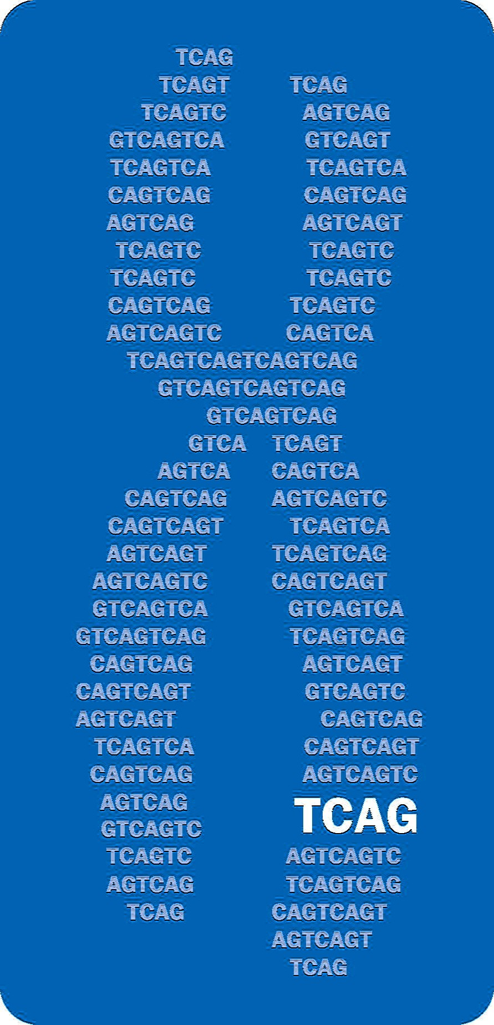



Acknowledgements
Strug Lab
Canadian Gene Modifier Study
Johanna Rommens
Lei Sun
Lisa Strug
Naim Panjwani
Zeynep Baskurt
Angela Chen
Mohsen Esmaeili
Jiafen Gong
Saba Haroon
Cheng Wang
Fan Wang
Lin Zhang
Yanyan Zhao
Lehang Zhong
Sangook Kim
Scott Mastromatteo
Mitchell Sutton
Faizan Mohsin
Vanderbilt University
Jessica Dennis
(Assisted in ICD10-Phecode Conversion)
Gengming He
Katherine Keenan
This research has been conducted using the UK Biobank resource. (Project ID: 40946)

Slide 31
Constructing CFTR Mutation Score from Allele Scores
Allele 2 Score | 1 | 2 | 3 | 4
Allele 1 Score
1 | 1
2 | 1 | 2
3 | 1 | 2 | 3
4 | 1 | 2 | 4 | 5
Constructing CFTR mutation score based on mutation scores from both alleles.
Tends to select the less-severe mutation score in most cases.

Slide 32
Characteristics of Three Independent Datasets
 | Canadian GMS (n=2,206) | French GMS (n=1,049) | John Hopkins TSS (n=527)
Sex (Females) | 1026 (46.5%) | 505 (48.1%) | 256 (48.6%)
Meconium Ileus | 346 (15.7%) | 142 (13.5%) | 90 (17.1%)
CFTR Mutation Score
5 | 54 (2.5%) | 16 (1.5%) | 11 (2.1%)
4 | 433 (19.6%) | 208 (19.8%) | 118 (22.4%)
3 | 1279 (58.0%) | 688 (65.6%) | 332 (63.0%)
2 | 192 (8.7%) | 70 (6.7%) | 52 (9.9%)
1 | 248 (11.2%) | 67 (6.4%) | 14 (2.7%)

