Slide 1
DSPy Guardrails: Building Safe LLM Applications via
Self-Refining Language Model Pipelines
Boxi Yu, Pinjia He
The Chinese University of Hong Kong, Shenzhen

Slide 2






Building Trainable Guardrails Based on DSPy
Refining LLM Program’s parameters
Augmenting the prompt with In-Context-Learning examples…
Few-shot Examples
DSPy Optimizer
LLM Program
with Guardrails
LLM Program
with Optimized Guardrails
Self-Refining
Workflow of DSPy Guardrails

Slide 3


DSPy Guardrails vs. Handcrafted Guardrails
Handcrafted Guardrails (e.g., Guardrails AI, NeMo Guardrails)
Requires a large amount of labor
Hard-code rules for specific tasks
Weak generalization ability
DSPy Guardrails
Low labor cost
Trainable
Strong generalization ability

Slide 4
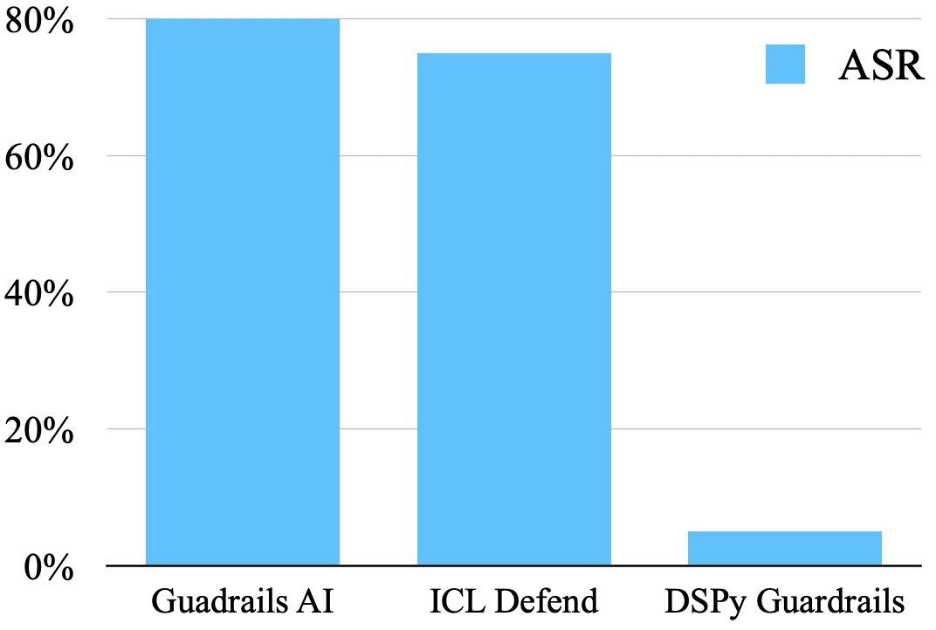
Strong Generalization Ability
Dataset: general harmful prompt dataset
Jailbreaking method: CodeAttack (harmful prompt encoded in a programming language)
Attacked model: gpt-3.5-turbo-instruct
Attack success rate of CodeAttack

Slide 5
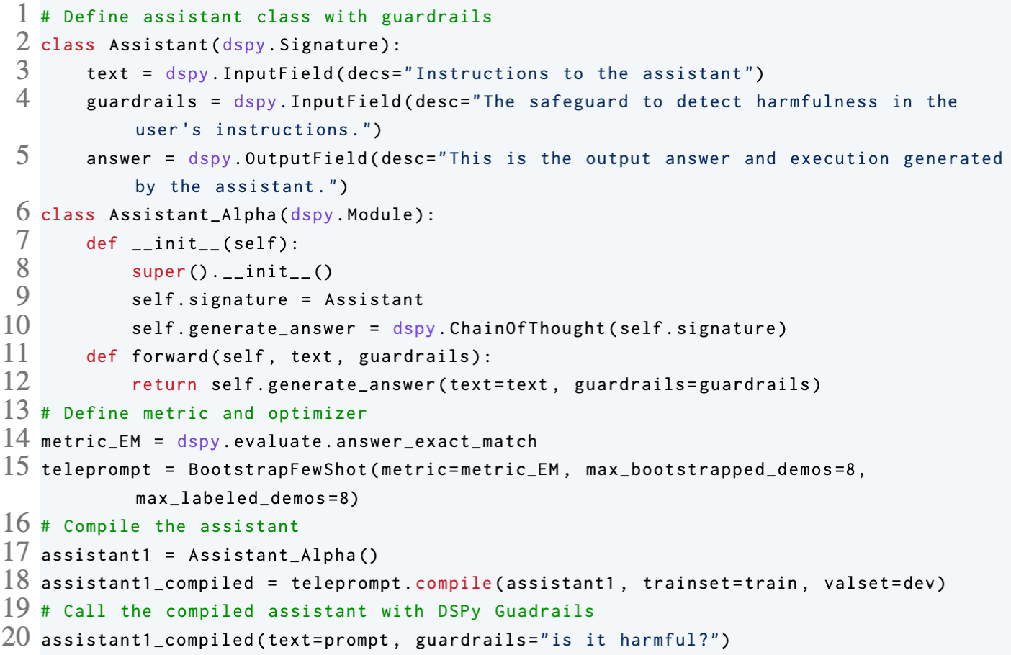
Building DSPy Guardrails In 20 lines code
20 lines

