Slide 1
ANN Methods

Slide 2
Terms
Kinematics: The variables k, QQ, x_b, and t
Kinematic set: a data set containing all relevant information for specific values of the kinematics i.e. k=1, QQ=.3, x_b=.5, t=2.25. A kinematic set corresponds to a a single set of Compton form factors. In the data, this is denoted by the “#Set” column.
Compton form factors: the values which we are trying to obtain
Replicas: The equivalent of monte-carlo sampled experimental data. We take the experimental results and smear them by experimental error to produce many copies or “replicas.”

Slide 3
Project overview
Our goal is to discover the Compton Form Factors or “CFFs” and to predict them for any kinematic set, while properly estimating error.
There are two essential ingredients for finding these CFFs: the TotalUUXS function and the data (pseudo-data at this stage).
We cannot directly measure the CFFs, so they must be discovered indirectly through what information we can observe.
What we can observe directly are the four “kinematics” – k, QQ, x_b, and t and the cross section value “F”
F is a function of the kinematics, the Compton form factors, phi, and a few other variables – F1, F2, and dvcs constant. The TotalUUXS function takes these variables as input and outputs the F.

Slide 4
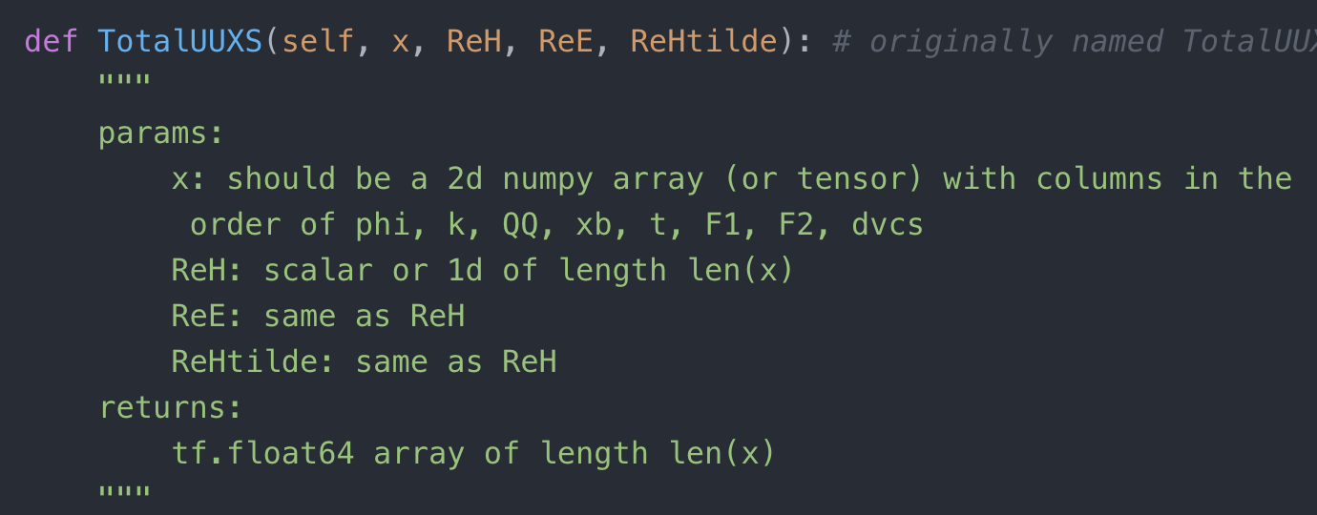
TotalUUXS function
This function can be found here https://github.com/extraction-tools/ANN/blob/master/Nick/Methods/BHDVCStf.py
phi, k, QQ, x_b, t, F1, F2, dvcs const, ReH, ReE, ReHtilde
TotalUUXS function
Fs

Slide 5
Data
The data we use has been generated and is not true, experimental data.
To generate this data, we choose several kinematic sets in a range similar to that for which we have experimental data. F1 and F2 are calculated as functions of t, the dvcs constant is added, and a range of phi is chosen. The CFFs are produced as an arbitrary function of the kinematics. Then, the TotalUUXS function is used to generate F values. The error in F is chosen arbitrarily. In the case of the sample data, it is simply 5% of the F value.
Our objective is to discover the relationship between the kinematics and CFFs

Slide 6
Objective
Our objective is to accurately predict the CFFs as a function of the kinematics, while realistically representing uncertainty.
This can be accomplished two ways – either a local fit or a global fit.
A local fit optimizes the Compton form factors for a specific kinematic set. It cannot, however, tell us the relationship between the kinematics and the Compton form factors. Methods 1 and 2 in these slide are examples of local fits.
A global fit predicts the Compton form factors as a function of the kinematics. Because we cannot observe the Compton form factors, a local fit needs to be performed first, and then a model can be trained on the results of that fit (Method 4). Alternatively, a model can output Compton form factors but compute the loss with F (Method 5).
Everything described here needs to be repeated on multiple replica sets so that uncertainty can be properly estimated.

Slide 7
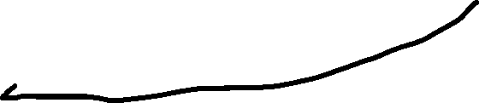
Method 1: Default SciPy Optimizer
Fit three CFFs directly with an optimizer. Everything here is from a single kinematic set. The implementation can be found in a notebook called "Method1.ipynb"
F values
k, QQ, x_b, t, F1, F2, dvcs const, phi
Optimizer
TotalUUXS function
Compton Form Factors

Slide 8
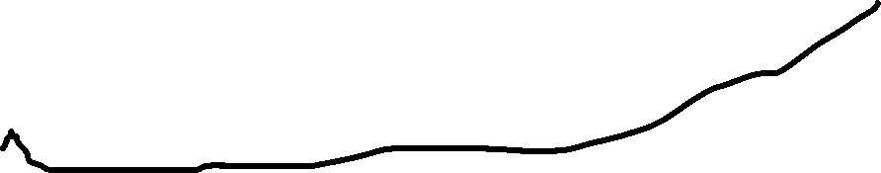
Method 2: ANN Local Fit
Similar to method one, except we use an ANN to produce the compton form factors and optimize its weights. An implementation can be found in the notebook titled "Method2.ipynb"
F values
k, QQ, x_b, t, F1, F2, dvcs const, phi
Optimizer
TotalUUXS function
Kinematics
ANN
Compton Form Factors

Slide 9
Method 3: Prof. Keller's Method
A novel local fitting method. The steps of the process can be found in the powerpoint titled "NewMethod." An implementation can be found in the notebook "Method3.ipynb"
F values (randomly generated using F as mean and errF as std for n sets)
Method 1 (or 2) repeated n times
Randomly generated CFFs using mean and std from previous step
TotalUUXS function
F values
ANN post-training
Kinematics varied slightly within step size
Initial kinematics
ANN
CFF distributions
Optimizer

Slide 10
Method 4: Two-stage Global Fit
Kinematic sets are fitted locally to find CFFs, and then those CFFs are predicted using an ANN with Kinematics as inputs. An implementation can be found in "Method4.ipynb"
F values (randomly generated using F as mean and errF as std for n sets)
Method 1 (or 2) repeated n times
n Optimizers
n sets of CFFs
n sets of CFF estimates
Respective Kinematics
n ANNs
Any Kinematics
CFF estimated distributions
n ANNs post-training

Slide 11
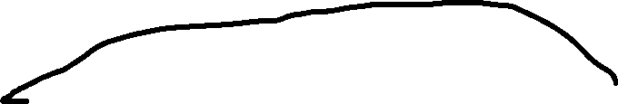
Method 5: Single-stage Global Fit
Global fit on entire pseudo-data set. An implementation can be found in "Method5.ipynb"
F values
Pseudo-data Kinematics
ANN
CFFs
Optimizer
TotalUUXS function
k, QQ, x_b, t, F1, F2, dvcs const, phi
Any Kinematics
ANNs post-training with MC Dropout
CFF estimated distributions

Slide 12
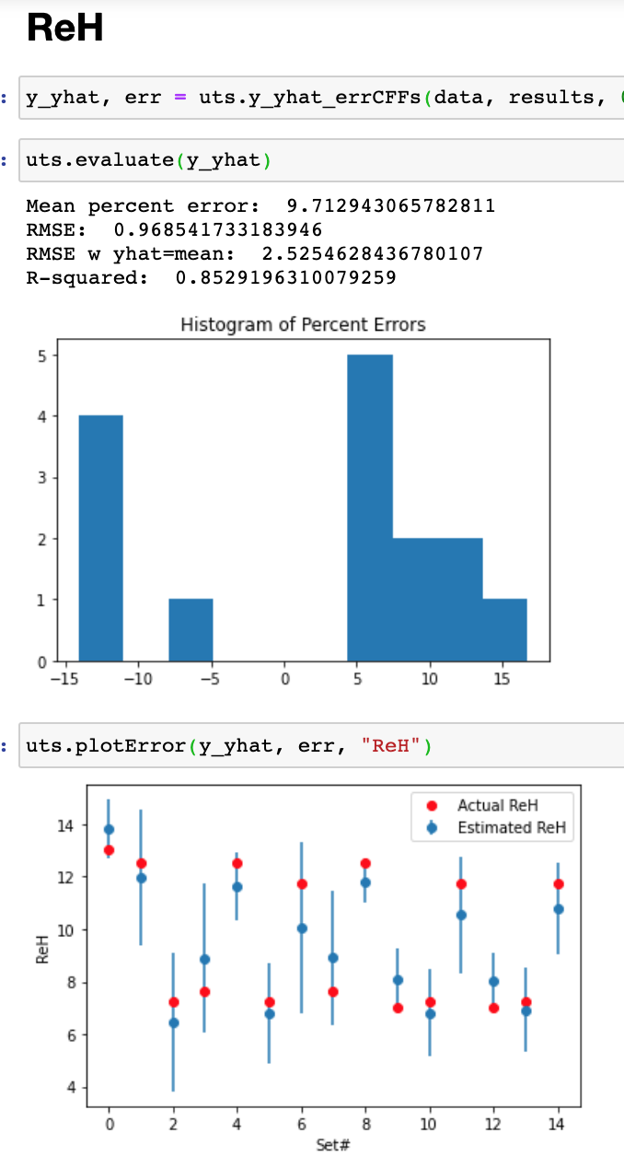
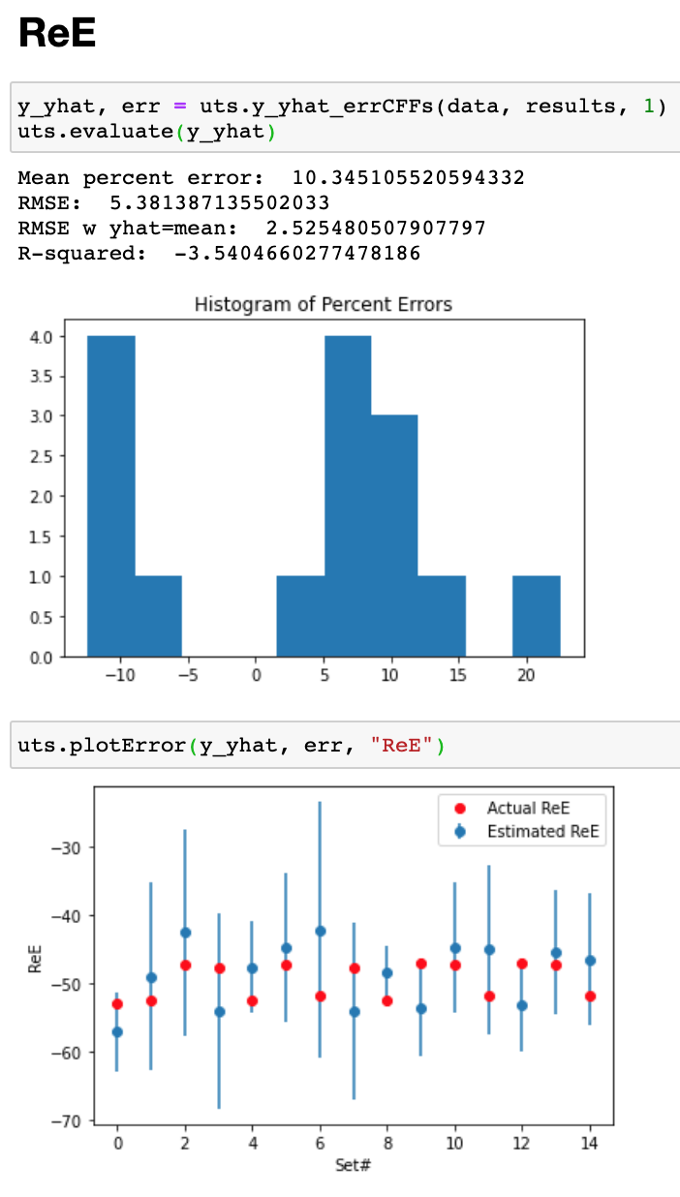
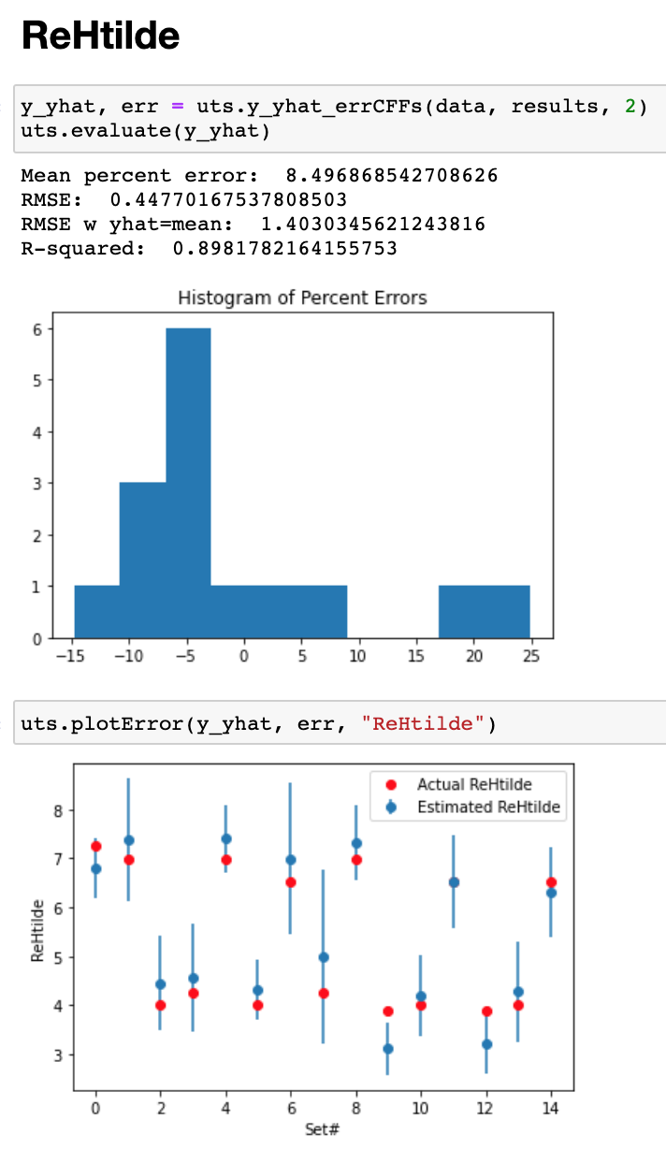

Slide 13
