Slide 1
Fountain
容逸朗
Department of
computer science & technology
Notes:
Hello every one, I am RYL from the department of computer science and technology, today I am going to share you a artwork, "Fountain", first of all, I just want to ask a question, when you hear this name, "Fountain", what is the first image you thought out?

Slide 2
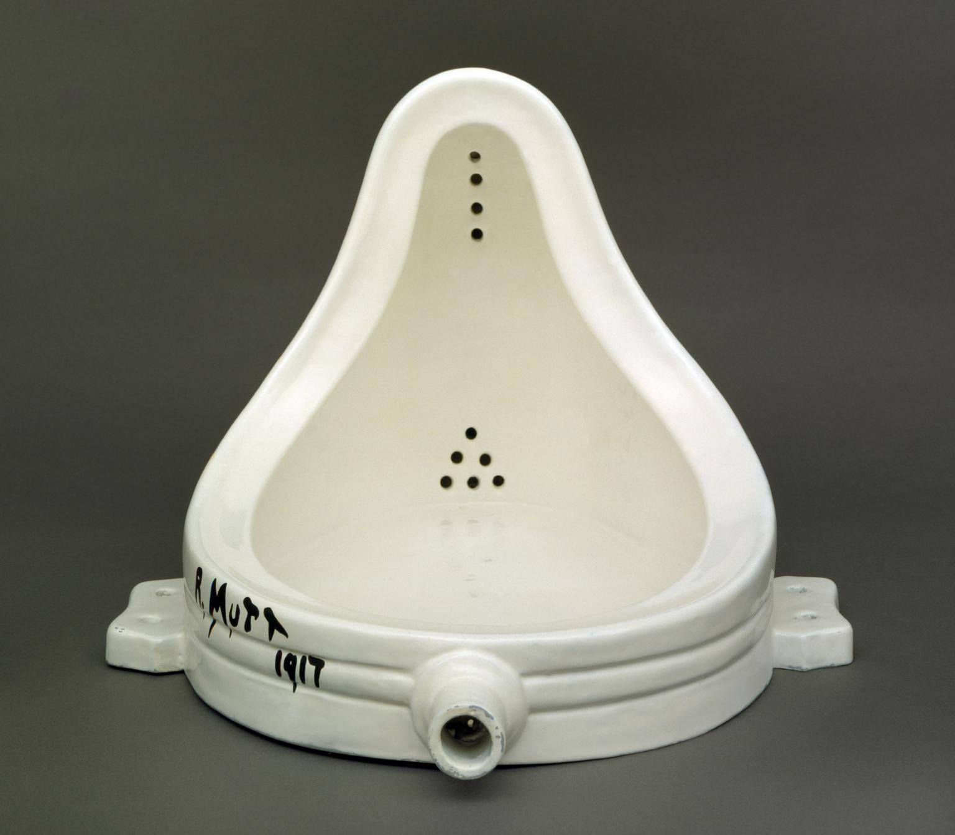
Notes:
Actually, today I am going to share a fountain, look like this, you might think it is just a porcelain urinal you can see in every man's washroom. Something we can see is a urinal with a sign "R.Mutt 1917".

Slide 3
What is Fountain?
a readymade sculpture by Marcel Duchamp in 1917.
a porcelain urinal signed "R. Mutt".
submitted for an exhibition of the Society of Independent Artists.
regarded by art historians and theorists of the avant-garde as a major landmark in 20th-century art.
Notes:
Ok, we can see,
Fountain is a readymade sculpture, and readymade meaning that it is an ordinary, manufactured object that the artist has simply selected and perhaps modified in some way.
And the artist is Marcel Duchamp (someone might noticed that the sign on the urinal is R.Mutt because it is a fake name)
Fountain is a porcelain urinal. There is little else to say about it.
You can also see that this fountain was submitted for an exhibition of the Society of Independent Artists.
(and this exhibition is something that you can pay money to show your work on the exhibition)
From the last sentence, it was regarded by art historians and theorists of the avant-garde as a major landmark in 20th-century art.
(so why this urinal can be a landmark of art, I will talk about it later)

Slide 4
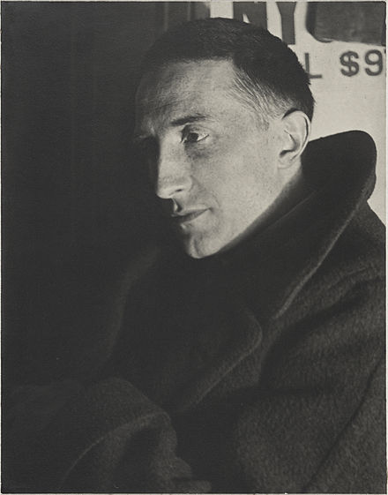
WHO is Duchamp?
a French-American painter, sculptor.
whose work is associated with Cubism, Dada, and conceptual art.
define the revolutionary developments in the plastic arts and the development of conceptual art.
use art to serve the mind.

Slide 5
WhY Fountain Special?
Suspect that art must require superb skills.
Doubt that art must be beautiful.
Doubt that art must be valuable.
No one had done this before.
Notes:
Fountain says, art is no need to be beautiful, as no one will make the connection between urinal and beauty.

Slide 6
Message behind the urinal
The urinal became "about something". It was no longer primarily a useful object – it was primarily a meaningful object.
(Arthur Danto, 1983)
The artworld is, simply put, a milieu in which objects can gain a new power: to express something beyond their ordinary utility.
(Arthur Danto, 1964)
Notes:
Something we should notice that is, if you buy a urinal and send to the gallery, I think no one cares you. This pieces of artwork can be famous and important is also because the time.
From 1910

Slide 7
My opinion
Artwork is no need to be artwork.
The value of this artwork is not only in itself, but in the meaning behind it.
Notes:
"Fountain" is not only conceptual art, it gives us a special and fascinating concept, which makes us think: an artwork that is not an artwork, and a daily object that is not just a daily object.
The point here is not that objects outside the art world cannot contain information—the signs on public toilets also contain information.

Slide 8
Thank you!

