Slide 1
CSE 111 Fall 2026: Project Checkpoint 1
YouTutor
Campus AI Learning Platform
Julian Lee and Richard Chen
October 19, 2026

Slide 2
Project Synopsis and Requirements
AI tutoring for university students
Students use the educational application to choose a course and topic, ask prompts, get AI-generated questions, and complete practice at their own pace.
Required behavior
Course enrollment and topic selection
Personalized tutoring and interactive practice
Preserved AI conversation history
Practice attempts and feedback
Topic progress
2

Slide 3
Main Use Case: Guided Study Session
01
Choose a course and topic
Verify active course enrollment.
02
Ask the AI tutor
Save the student prompt and AI explanation.
03
Complete a crowdsourced practice question
Record the answer, correctness and attempt number.
04
Review progress and practice suggestions
Use recorded topic accuracy to suggest more practice.
3

Slide 4
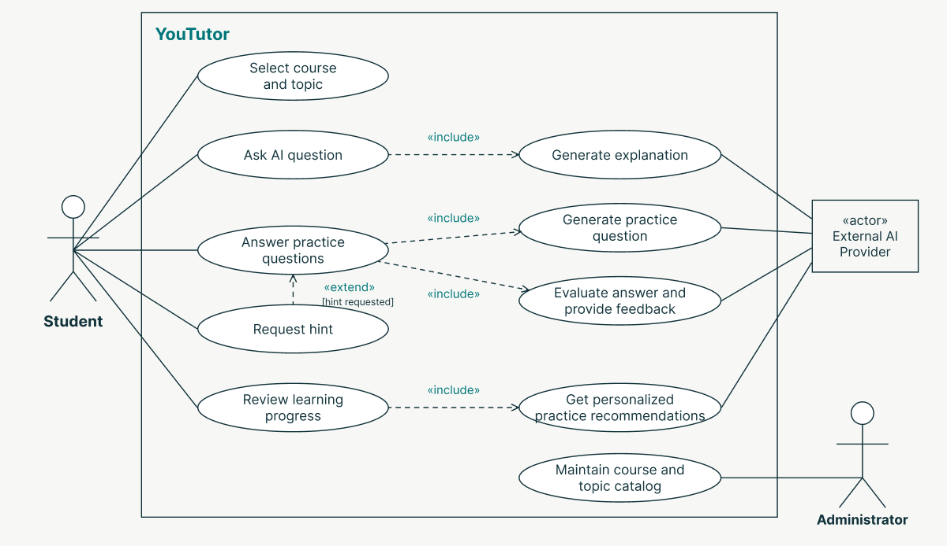
UML Use Case Diagram
4

Slide 5
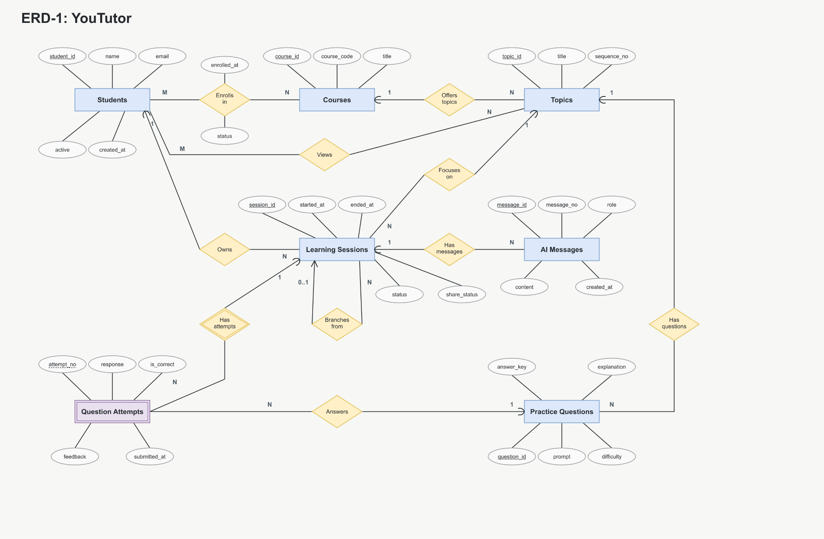
ERD
5

Slide 6
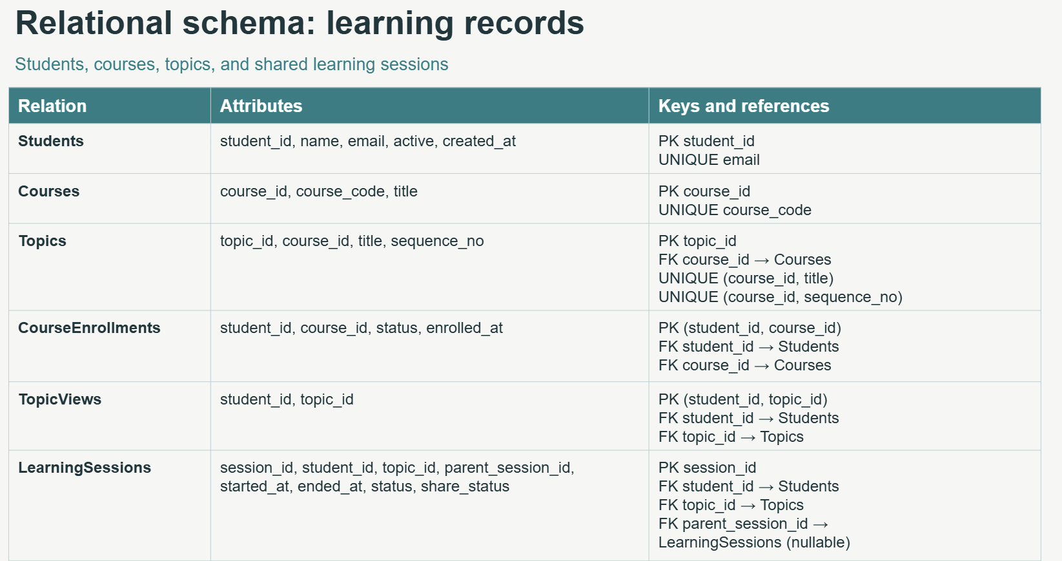

Slide 7
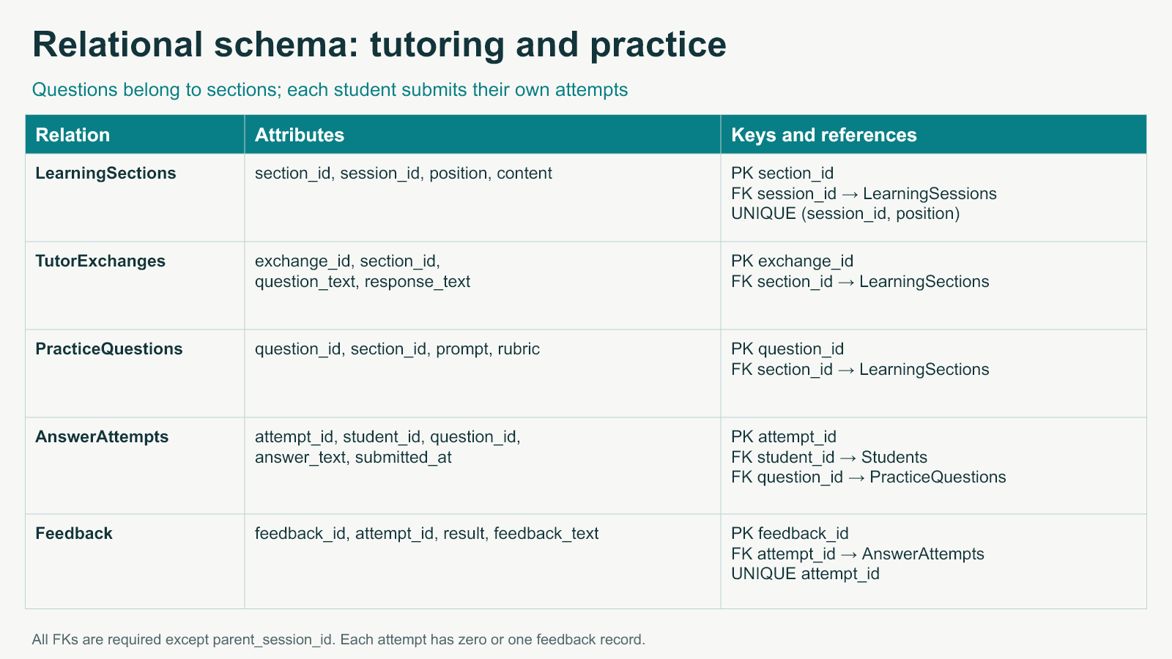

Slide 8
Schema appendix: Students
CREATE TABLE Students (
student_id INTEGER PRIMARY KEY,
name VARCHAR(100) NOT NULL,
email VARCHAR(150) NOT NULL UNIQUE,
active BOOLEAN NOT NULL DEFAULT TRUE,
created_at TIMESTAMP NOT NULL DEFAULT CURRENT_TIMESTAMP
);

Slide 9
Schema appendix: Courses
CREATE TABLE Courses (
course_id INTEGER PRIMARY KEY,
course_code VARCHAR(30) NOT NULL UNIQUE,
title VARCHAR(150) NOT NULL
);

Slide 10
Schema appendix: Topics
CREATE TABLE Topics (
topic_id INTEGER PRIMARY KEY,
course_id INTEGER NOT NULL,
title VARCHAR(150) NOT NULL,
sequence_no INTEGER NOT NULL CHECK (sequence_no > 0),
UNIQUE (course_id, title),
UNIQUE (course_id, sequence_no),
FOREIGN KEY (course_id) REFERENCES Courses(course_id)
ON UPDATE CASCADE ON DELETE RESTRICT
);

Slide 11
Schema appendix: CourseEnrollments
CREATE TABLE CourseEnrollments (
student_id INTEGER NOT NULL,
course_id INTEGER NOT NULL,
status VARCHAR(20) NOT NULL DEFAULT 'active'
CHECK (status IN ('active', 'withdrawn')),
enrolled_at TIMESTAMP NOT NULL DEFAULT CURRENT_TIMESTAMP,
PRIMARY KEY (student_id, course_id),
FOREIGN KEY (student_id) REFERENCES Students(student_id)
ON UPDATE CASCADE ON DELETE CASCADE,
FOREIGN KEY (course_id) REFERENCES Courses(course_id)
ON UPDATE CASCADE ON DELETE CASCADE
);

Slide 12
Schema appendix: TopicViews
CREATE TABLE TopicViews (
student_id INTEGER NOT NULL,
topic_id INTEGER NOT NULL,
PRIMARY KEY (student_id, topic_id),
FOREIGN KEY (student_id) REFERENCES Students(student_id)
ON UPDATE CASCADE ON DELETE CASCADE,
FOREIGN KEY (topic_id) REFERENCES Topics(topic_id)
ON UPDATE CASCADE ON DELETE CASCADE
);

Slide 13
Schema appendix: LearningSessions
CREATE TABLE LearningSessions (
session_id INTEGER PRIMARY KEY,
student_id INTEGER NOT NULL,
topic_id INTEGER NOT NULL,
parent_session_id INTEGER,
started_at TIMESTAMP NOT NULL DEFAULT CURRENT_TIMESTAMP,
ended_at TIMESTAMP,
status VARCHAR(20) NOT NULL DEFAULT 'active'
CHECK (status IN ('active', 'completed')),
share_status VARCHAR(20) NOT NULL DEFAULT 'private'
CHECK (share_status IN ('private', 'shared')),
CHECK (ended_at IS NULL OR ended_at >= started_at),
CHECK (parent_session_id IS NULL OR parent_session_id <> session_id),
FOREIGN KEY (student_id) REFERENCES Students(student_id)
ON UPDATE CASCADE ON DELETE RESTRICT,
FOREIGN KEY (topic_id) REFERENCES Topics(topic_id)
ON UPDATE CASCADE ON DELETE RESTRICT,
FOREIGN KEY (parent_session_id) REFERENCES LearningSessions(session_id)
ON UPDATE CASCADE ON DELETE RESTRICT
);

Slide 14
Schema appendix: AIMessages
CREATE TABLE AIMessages (
message_id INTEGER PRIMARY KEY,
session_id INTEGER NOT NULL,
message_no INTEGER NOT NULL CHECK (message_no > 0),
role VARCHAR(20) NOT NULL
CHECK (role IN ('student', 'assistant')),
content TEXT NOT NULL,
created_at TIMESTAMP NOT NULL DEFAULT CURRENT_TIMESTAMP,
UNIQUE (session_id, message_no),
FOREIGN KEY (session_id) REFERENCES LearningSessions(session_id)
ON UPDATE CASCADE ON DELETE CASCADE
);

Slide 15
Schema appendix: PracticeQuestions
CREATE TABLE PracticeQuestions (
question_id INTEGER PRIMARY KEY,
topic_id INTEGER NOT NULL,
prompt TEXT NOT NULL,
answer_key TEXT NOT NULL,
explanation TEXT NOT NULL,
difficulty INTEGER NOT NULL DEFAULT 2
CHECK (difficulty BETWEEN 1 AND 5),
FOREIGN KEY (topic_id) REFERENCES Topics(topic_id)
ON UPDATE CASCADE ON DELETE RESTRICT
);

Slide 16
Schema appendix: QuestionAttempts
CREATE TABLE QuestionAttempts (
session_id INTEGER NOT NULL,
attempt_no INTEGER NOT NULL CHECK (attempt_no > 0),
question_id INTEGER NOT NULL,
response TEXT NOT NULL,
is_correct BOOLEAN NOT NULL,
feedback TEXT,
submitted_at TIMESTAMP NOT NULL DEFAULT CURRENT_TIMESTAMP,
PRIMARY KEY (session_id, attempt_no),
FOREIGN KEY (session_id) REFERENCES LearningSessions(session_id)
ON UPDATE CASCADE ON DELETE CASCADE,
FOREIGN KEY (question_id) REFERENCES PracticeQuestions(question_id)
ON UPDATE CASCADE ON DELETE RESTRICT
);

