Slide 1


Virtual Healthcare Consultation
& Support System
Dept.of Computer Science and Engineering
Under the guidance of
Mrs.D.Lingavva
Team members:
B.Manjula(B200617)
R.Pavani(B200845)
J.Harini(B200838)

Slide 2
Introduction
Healthcare is one of the most important sectors, but people often face issues such as:
Not getting immediate doctor consultation
Lack of medical awareness
High cost of doctor visits for small symptoms
Delay in diagnosis due to time and distance

Slide 3
Existing system & its drawbacks
Existing System:
Traditional symptom checker apps
Chatbot-based healthcare assistants
Online medical websites
Drawbacks:
Mostly text-only interaction
No support for voice + image + OCR
Cannot analyze prescriptions and lab reports
Poor accessibility for non-technical users
Not integrated end-to-end in one platform

Slide 4
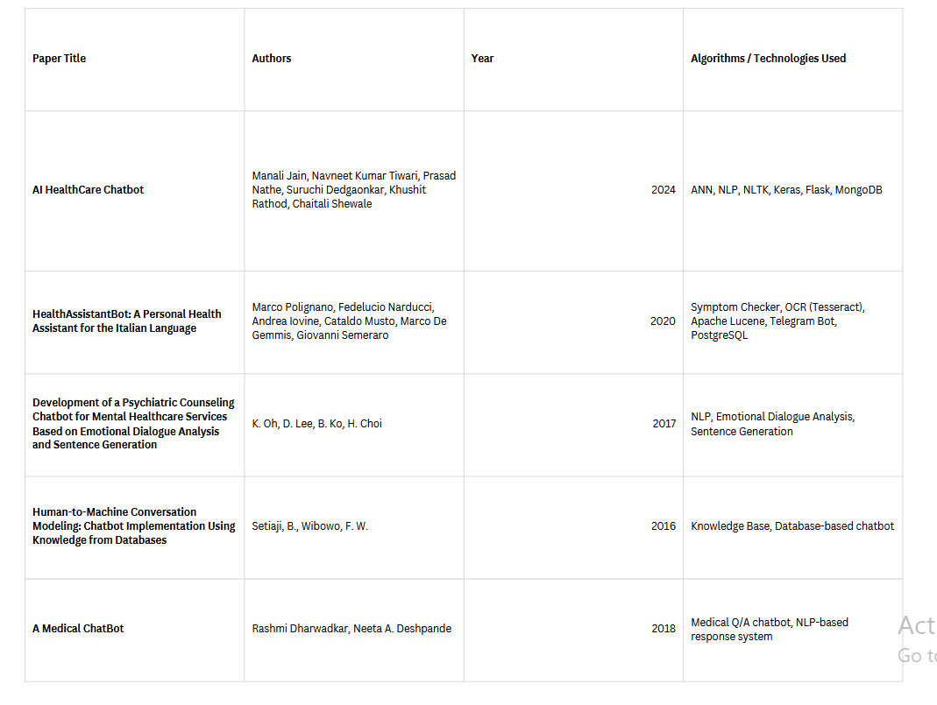
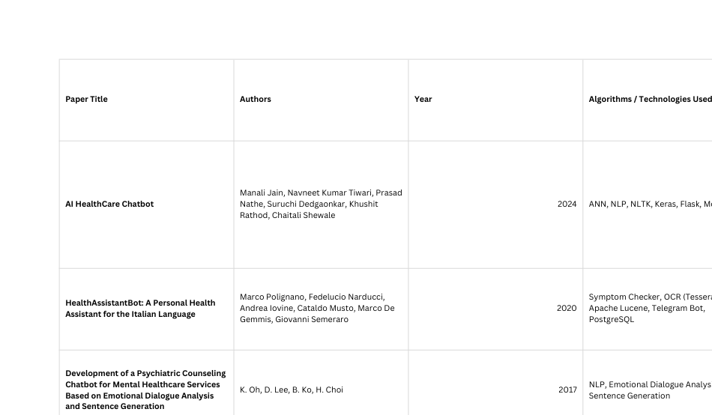
Literature Review
.

Slide 5
Proposed System
Proposed system overview:
Our system provides a complete healthcare assistant with 3 inputs:
Text Input
Voice Input
Image Input
Output:
Disease possibility / health issue type
Precautions
Home remedies
Which doctor to consult, Audio output response

Slide 6
Advantages of Proposed System Over Existing
Multi-input system (text + voice + image)
User-friendly and accessible
Useful for rural and elderly users
Works like real-time consultation support
Prescription/lab report analyzer possible
Generates audio output automatically
Better real-world healthcare support than text-only bots

Slide 7
Technologies used
Gradio is used to build the web interface.
OpenCV + MediaPipe are used for image-based symptom detection.
EasyOCR is used to extract text from prescriptions/lab reports.
Groq Whisper is used for voice-to-text conversion.
Groq LLaMA model is used for generating medical suggestions.
dotenv is used to securely manage the API key.

Slide 8
Software / Hardware Requirements
Software Requirements
Python 3.10+
Gradio
OpenCV
EasyOCR
NumPy
Groq API SDK,dotenv
Hardware Requirements
Minimum 8GB RAM
Intel i3/i5 processor, Internet required for Groq API + gTTS (if used)

Slide 9
Stage 1 – Text-Based Consultation
User enters symptoms using text
Chatbot analyzes symptoms using groq API Generates:
Possible health condition
Precautionary advice
Suggested next steps
Output provided in text format

Slide 10
Stage 2
Voice & image input
User provides symptoms through voice or image
Converts voice input into text and identifies relevant information from uploaded images.
Generates output in text and voice formats
Allows users to download voice output
Includes machine-generated prescription analysis

Slide 11
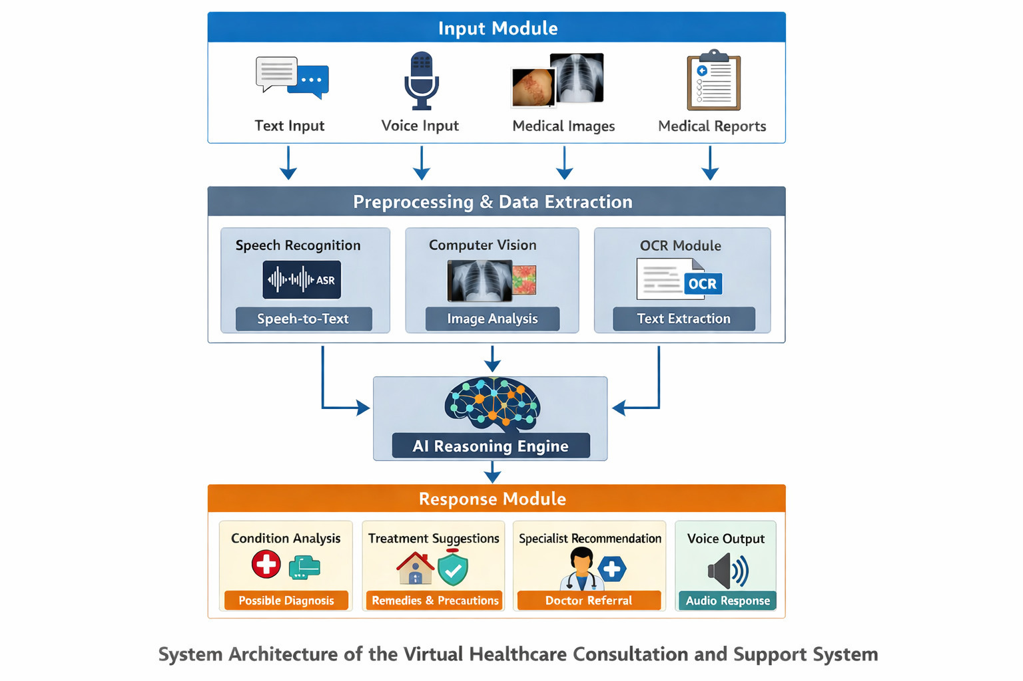
Workflow

Slide 12
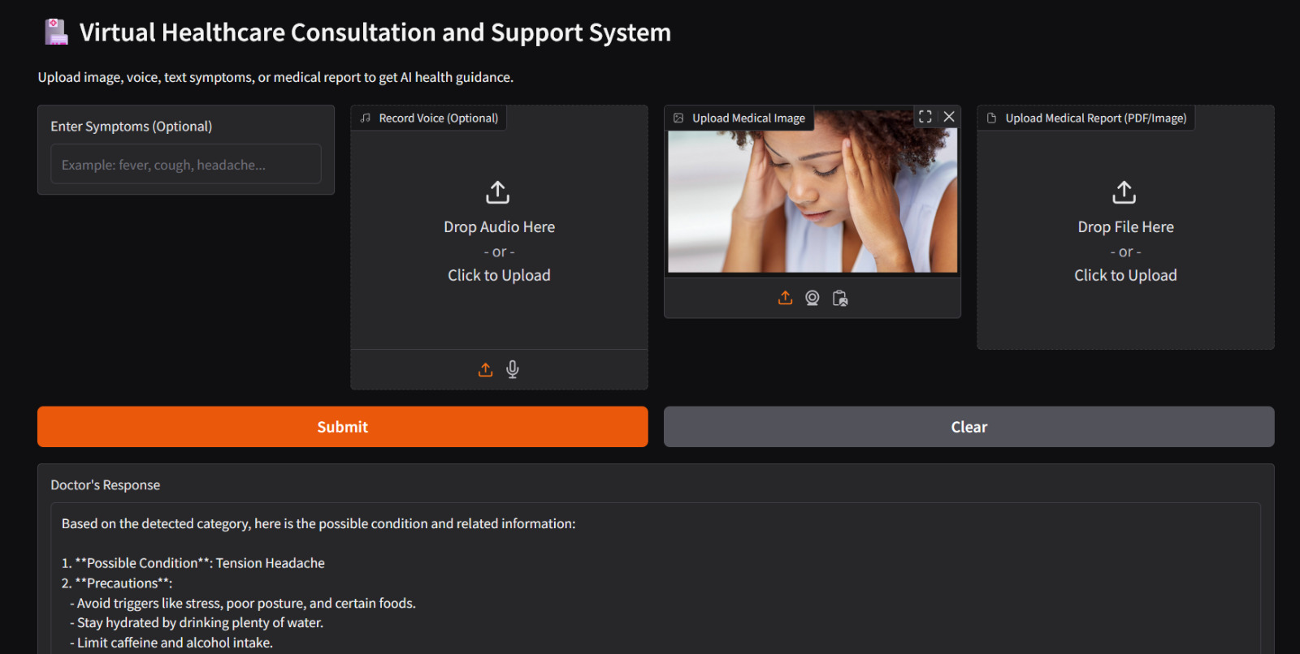
Result

Slide 13
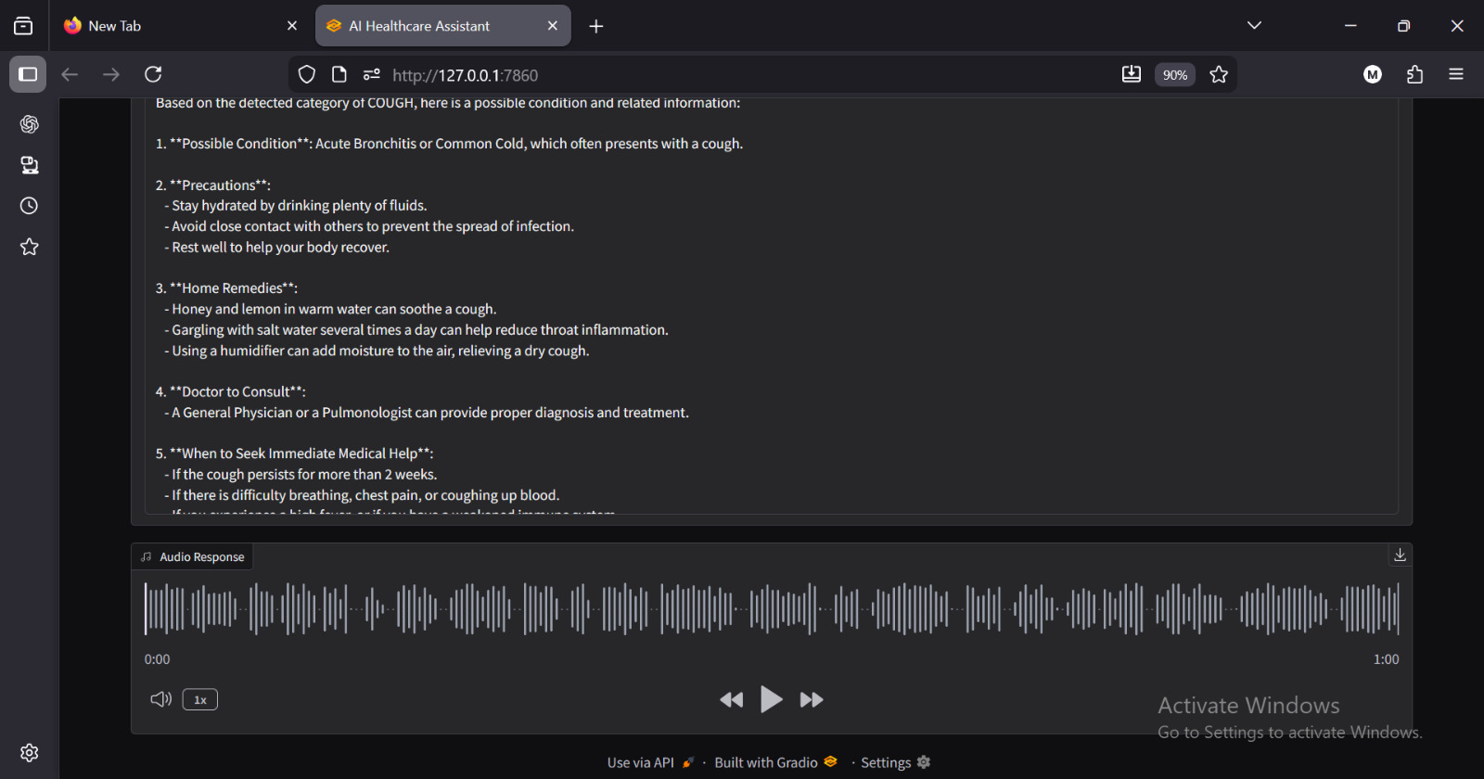
.

Slide 14
Conclusion
An AI-based healthcare chatbot provides preliminary medical guidance through intelligent human–machine interaction. By analyzing user queries using a structured knowledge base, the system delivers quick and reliable health information while supporting healthcare accessibility and encouraging professional consultation for critical cases.

Slide 15
References
Manali Jain et al., AI HealthCare Chatbot,IEEE MIT Art, Design and Technology School of Computing International Conference (MITADTSoCiCon), 2024.
K. Oh et al., Development of a Psychiatric Counseling Chatbot for Mental Healthcare Services,IEEE International Conference on Mobile Data Management, 2017.
B. Setiaji and F. W. Wibowo, Human-to-Machine Conversation Modeling: Chatbot Implementation Using Knowledge from Databases,IEEE International Conference on Intelligent Systems Modelling and Simulation, 2016.

Slide 16
Future Scope
Improve accuracy using advanced AI and machine learning models
Integrate with telemedicine platforms for expert consultation
Enhance data security and privacy for healthcare applications

Slide 17
Thank you

