Slide 1
Weather prediction
Group 5
Boyan Apostolov, pavlin popov, Arthur Jaspar

Slide 2
Phase 1 - proposal
Choose topic
Find main target variable – temperature / temp category
Find dataset
Key Parameters: Temperature, precipitation, humidity, wind speed
Make planning for the week
Notes:
Boyan

Slide 3
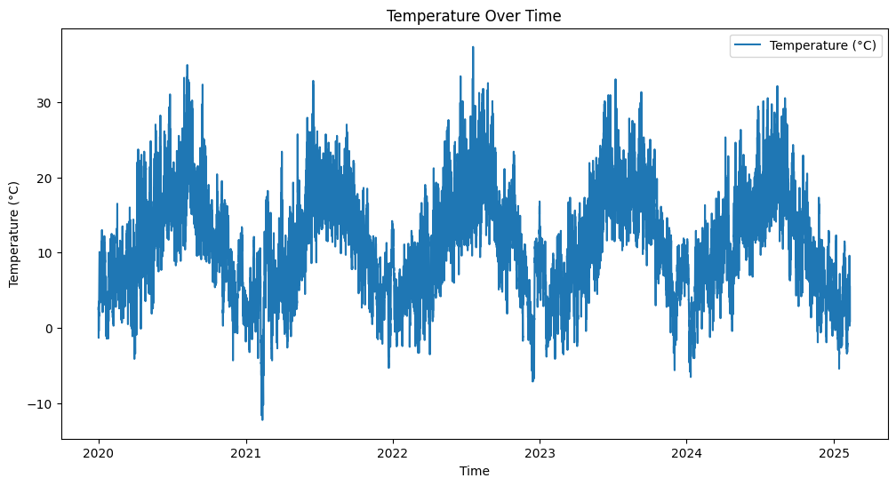
Phase 2 - provisioning
Data loading in notebook
Cleaning the data (Removing duplicates & Filling empty data fields)
Testing out the plots
Summary of graph
seasonal temperature cycle from 2020 to 2025, with peaks in warmer months and dips in colder months. The pattern remains consistent
Notes:
Pavlin

Slide 4
Phase 3 - predictions
Two prediction algorithms
Nearest neighbor
Random Forest Regression
Notes:
Boyan

Slide 5
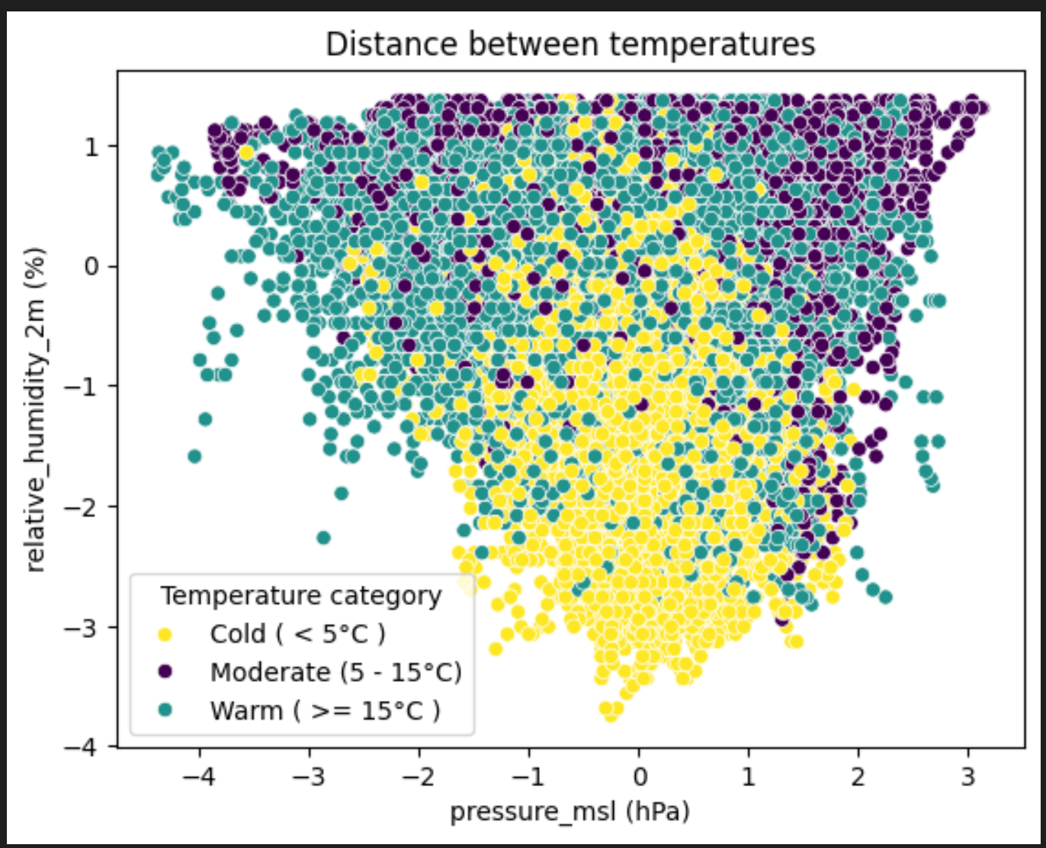
Predictions with nearest neighbor
~ 62% accuracy
Using pressure & humidity as training params
Classification output
Cold ( < 5°C )
Moderate (5 - 15°C)
Warm ( >= 15°C )
Standard deviation of training data
Notes:
Bobby

Slide 6
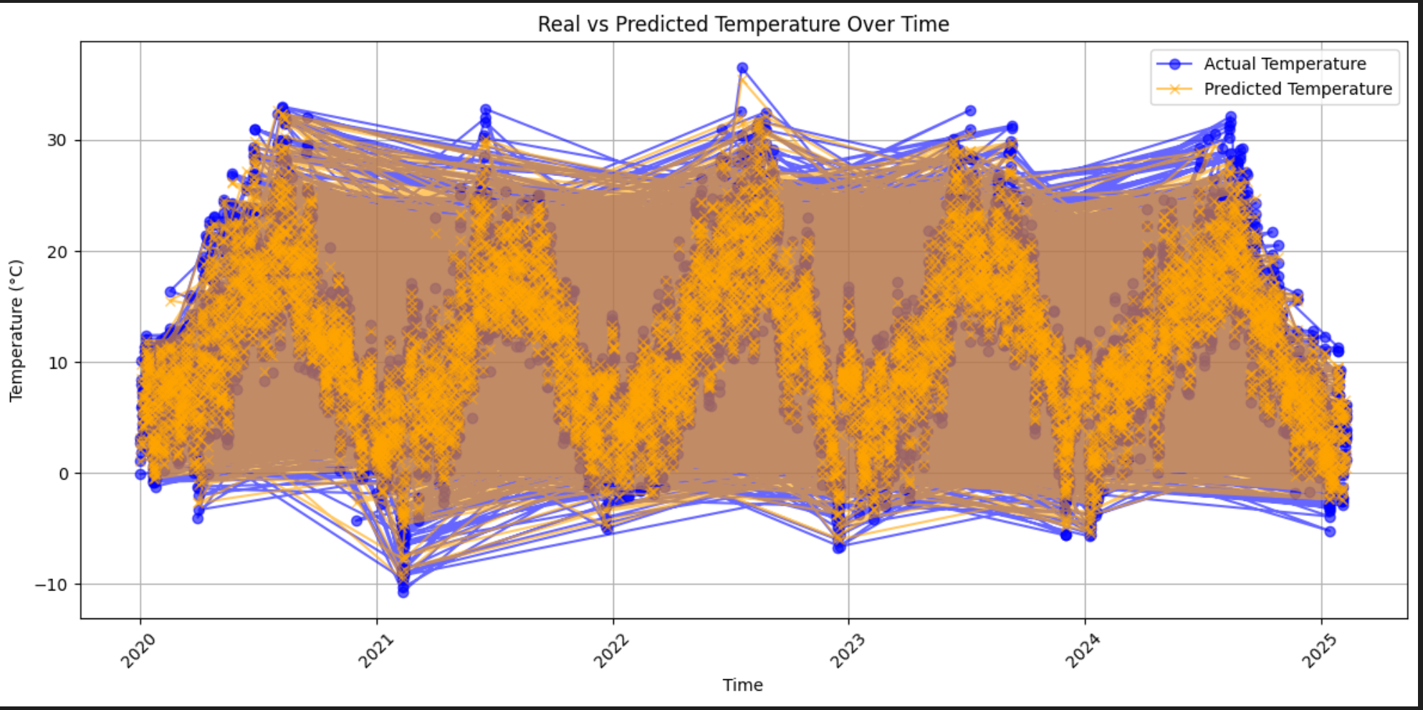
Predictions with random forest regression
~ 99% accuracy
Using all dataset params as training params
Regression output (specific number)
Notes:
Pavlin

Slide 7
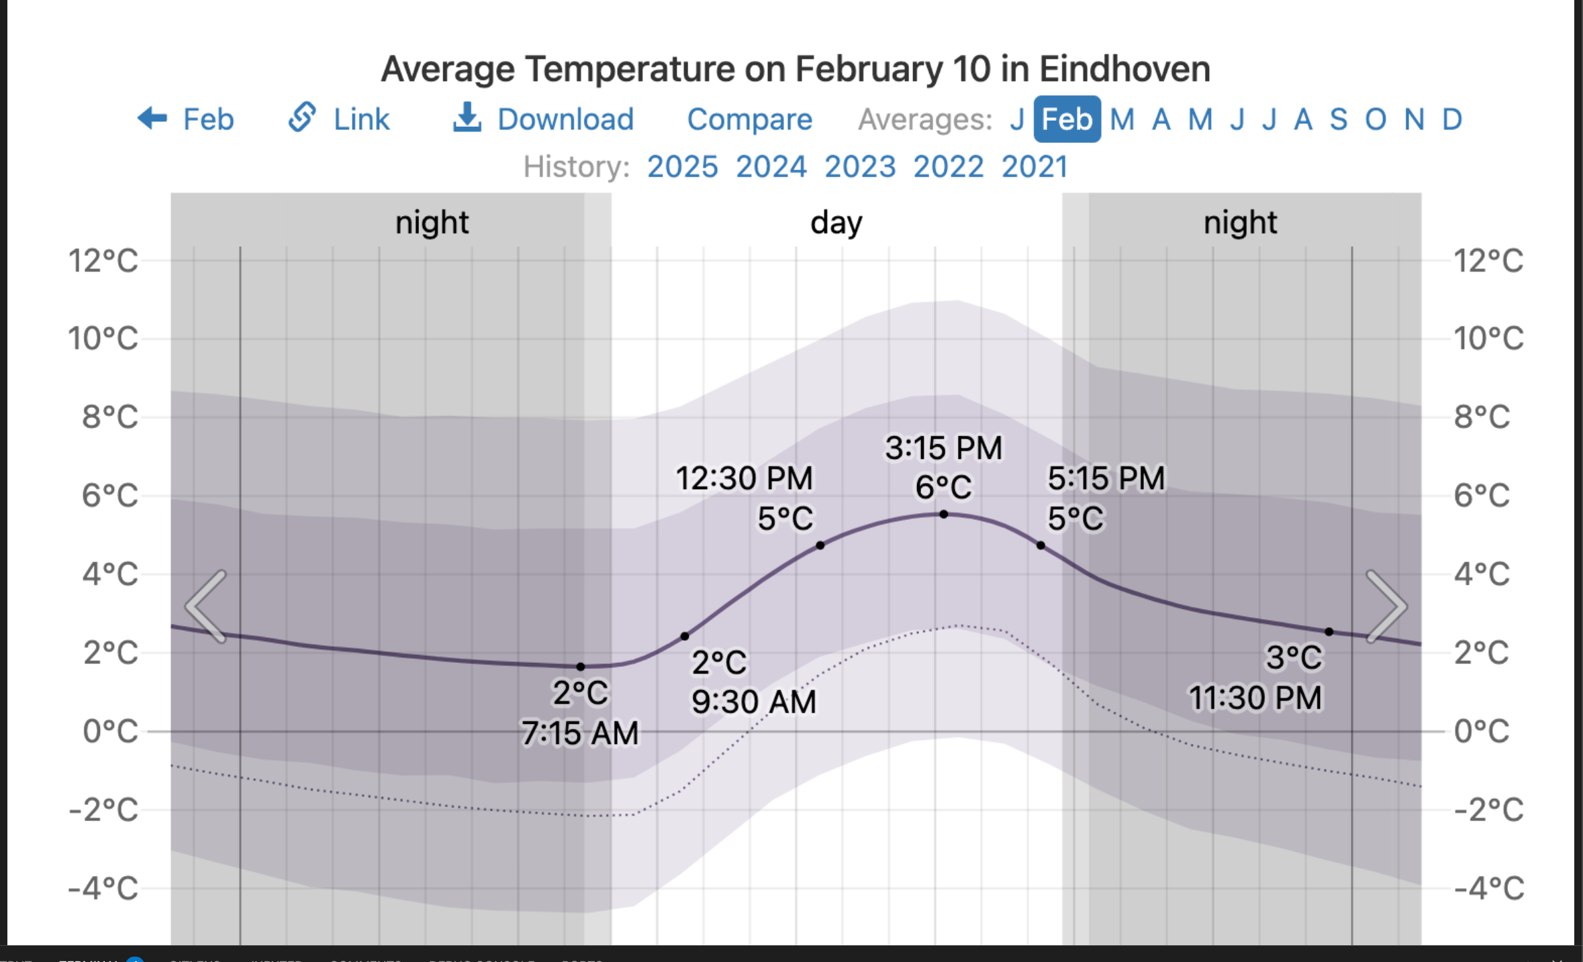
Predictions evaluation
Actual temperature for that day
Predicted temperature for 2025-02-11:
Nearest neighbor: 0 ≤ temperature < 5
Random forest regression: 4.871 °C
Notes:
Boyan

Slide 8
Student evaluation of the week
Boyan
Making plot charts with python
Being able to easily make predictions (without much code)
Nearest neighbor methodology calcification and its problems
Pavlin
Flawless introduction into ML with Python
Many directions to start with ML
Engaging and creative group project
Notes:
Boyan / Pavlin

Slide 9
Thank you

