Slide 1

Guess the word (Hangman clone)
By: Boyan Apostolov, Aleksandar Lalov

Slide 2
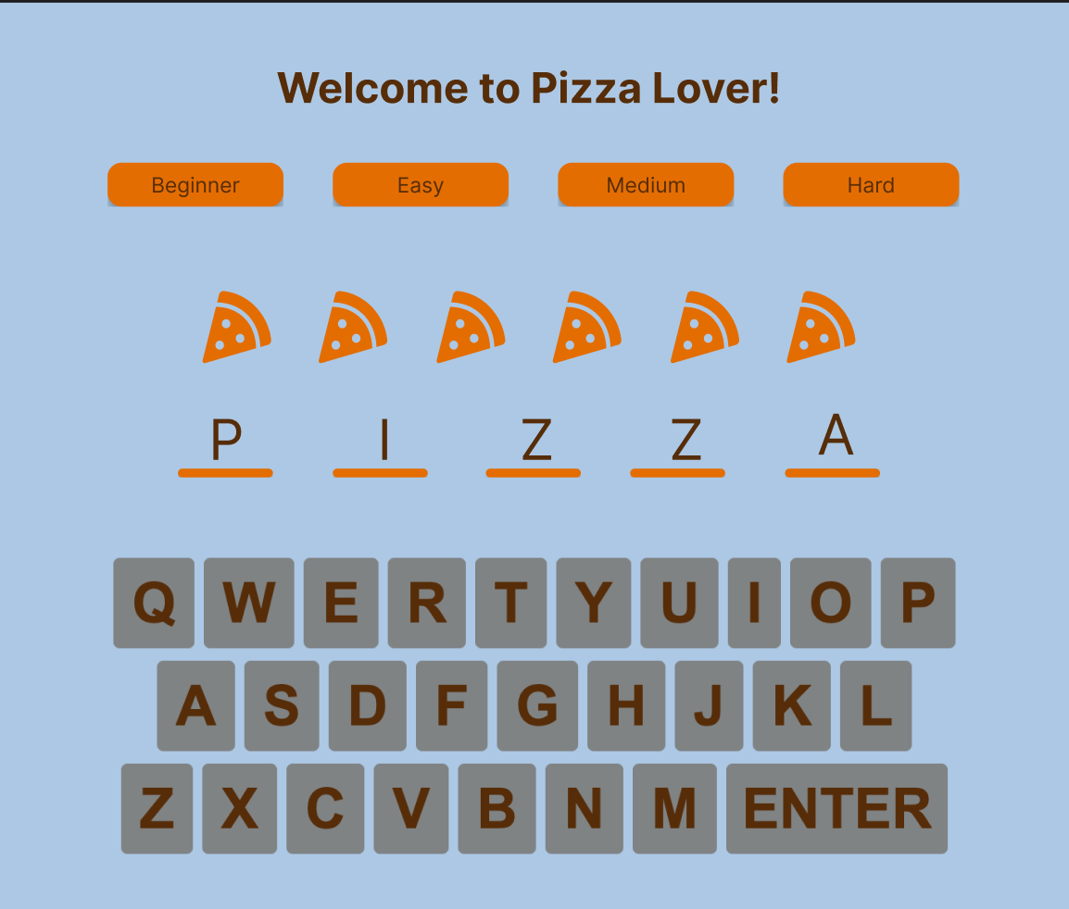
Figma Prototype
https://www.figma.com/community/file/1286279960754647294

Slide 3
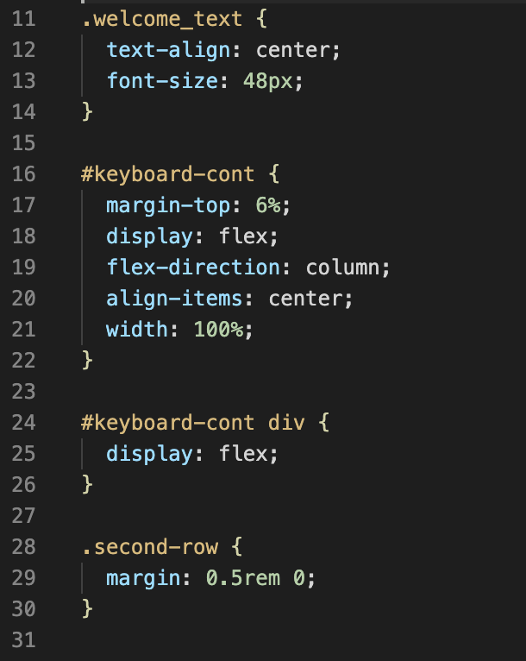
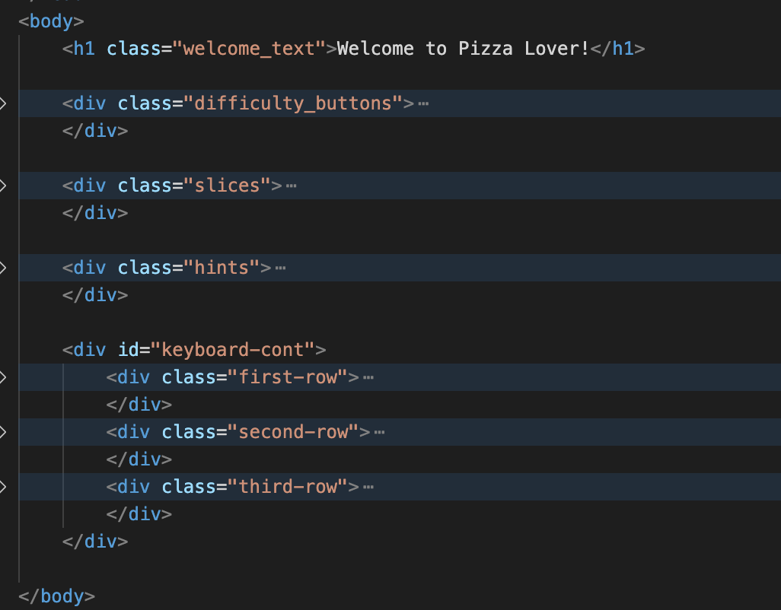
HTML & CSS Structure

Slide 4
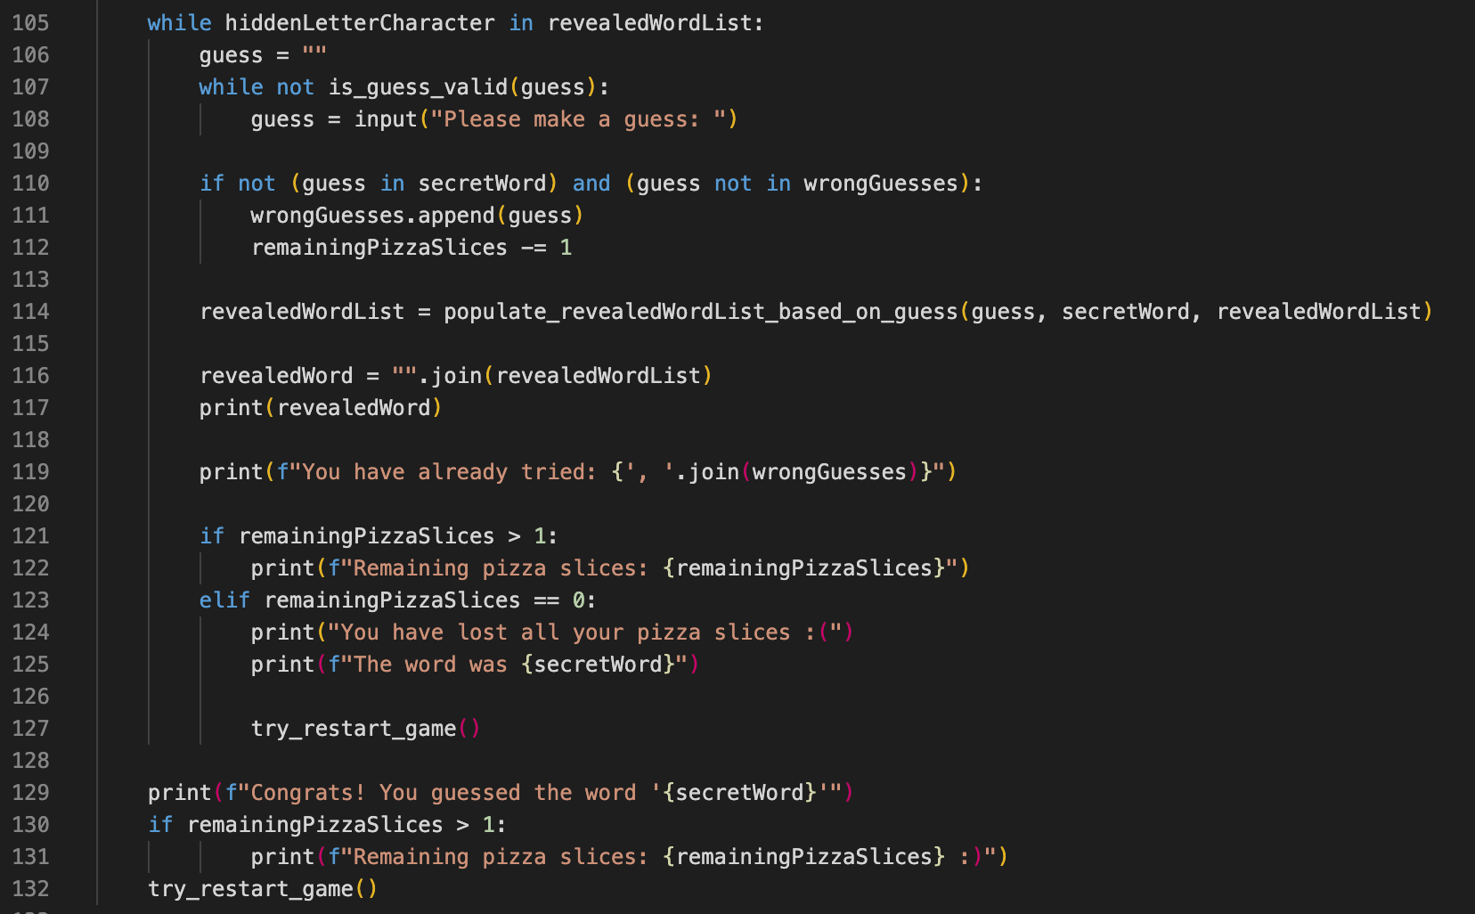
Python code

