Slide 1
Principle and Development of RTK
Presenter：Boyan Zhang

Slide 2
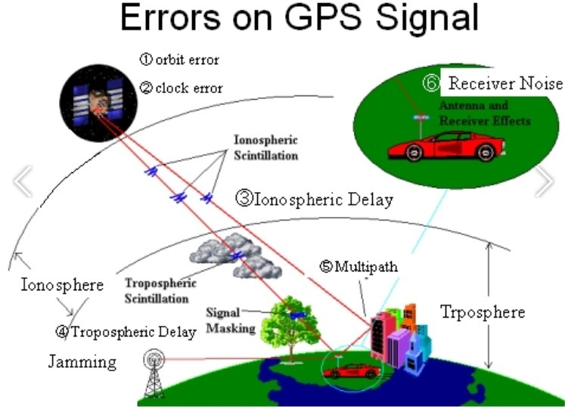
Why do we need RTK?
The disadvantage of GPS
Satellite ephemeris error
Satellite clock error
Ionospheric delay
Tropospheric delay
Multi-path effect
Receiver antenna phase center deviation

Slide 3
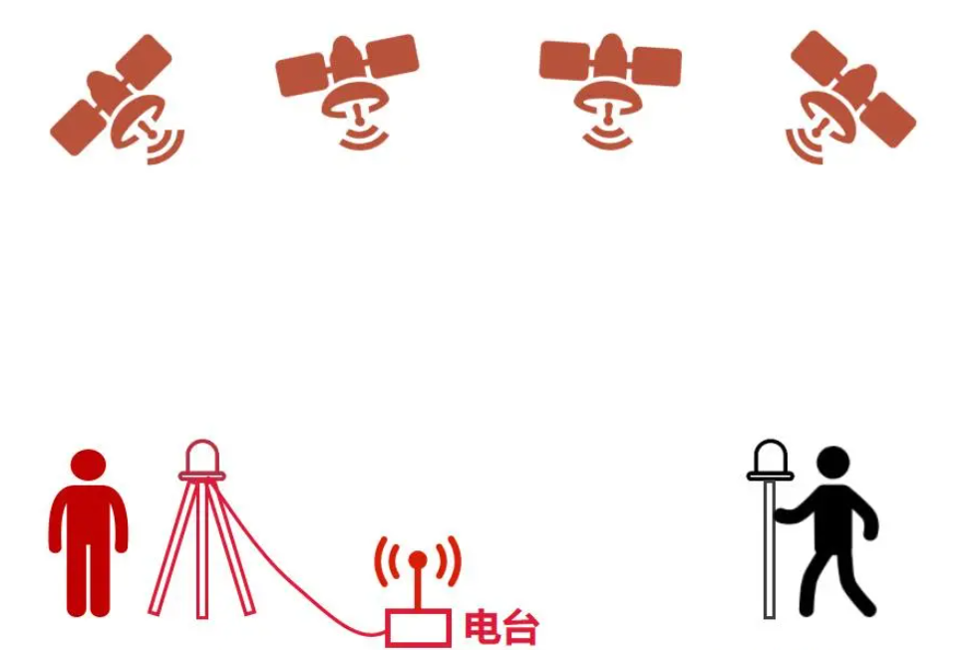

What is RTK?
RTK is a real-time dynamic carrier phase difference technology.
It includes four parts:
satellites
reference station receiver
data chain(radio station)
mobile station receiver

Slide 4
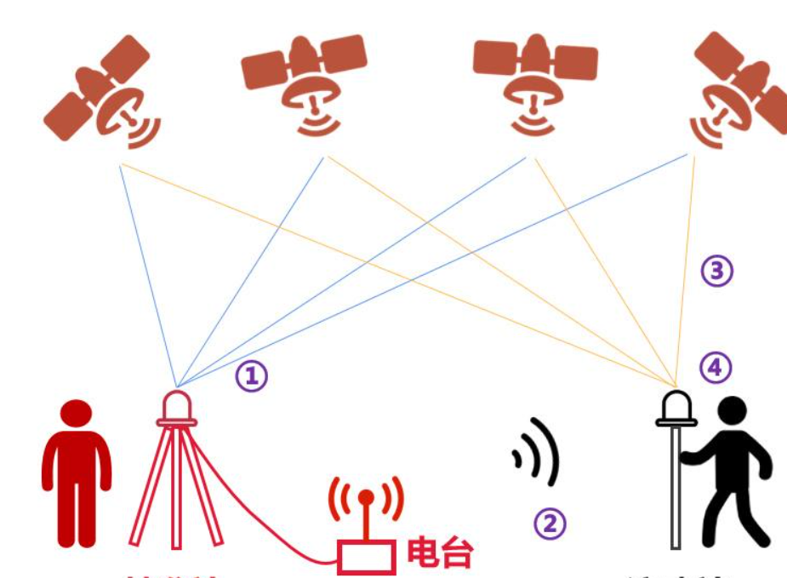
The work process of RTK

Slide 5
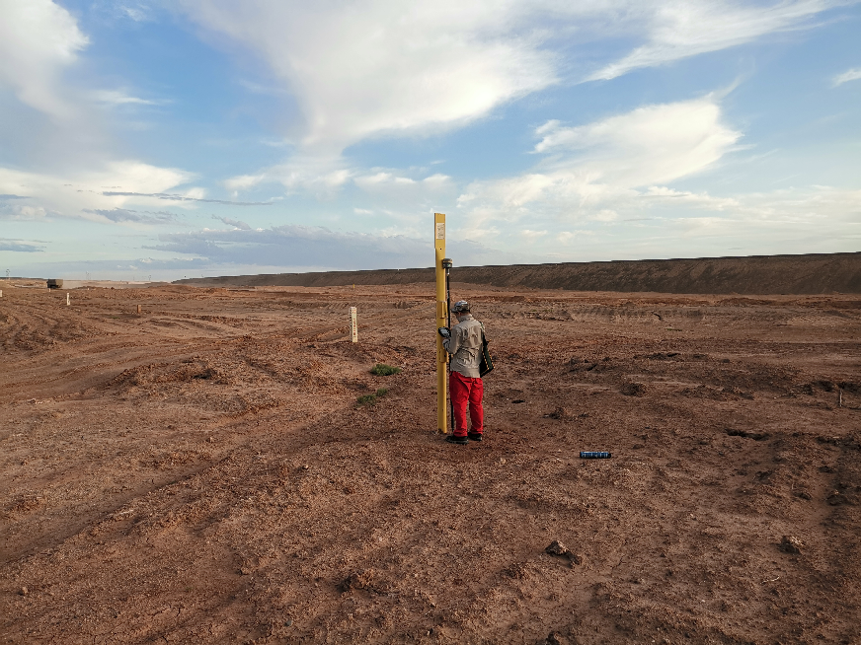
RTK‘s drawbacks
There is a distance limit between the mobile station and the reference station
The terrain and stability of the reference station

Slide 6
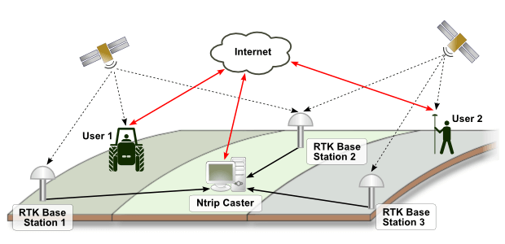
Network RTK
Establish multiple reference stations in an area
The computer receives data from all reference stations
The computer calculates this data and transmits the information to the user

Slide 7

The advantages of network RTK
No need for users to build their own reference stations
Higher accuracy and reliability
Wider distance coverage
The disadvantages of network RTK
The stability of the network has a great impact on the positioning accuracy

Slide 8

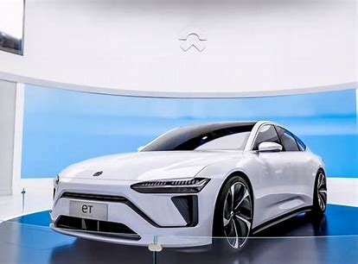
The application of network RTK
WM Motor、 NIO, LEADING IDEAL and other production vehicles are equipped with "high-precision positioning services". 。

Slide 9
Q
A
&

