Slide 1


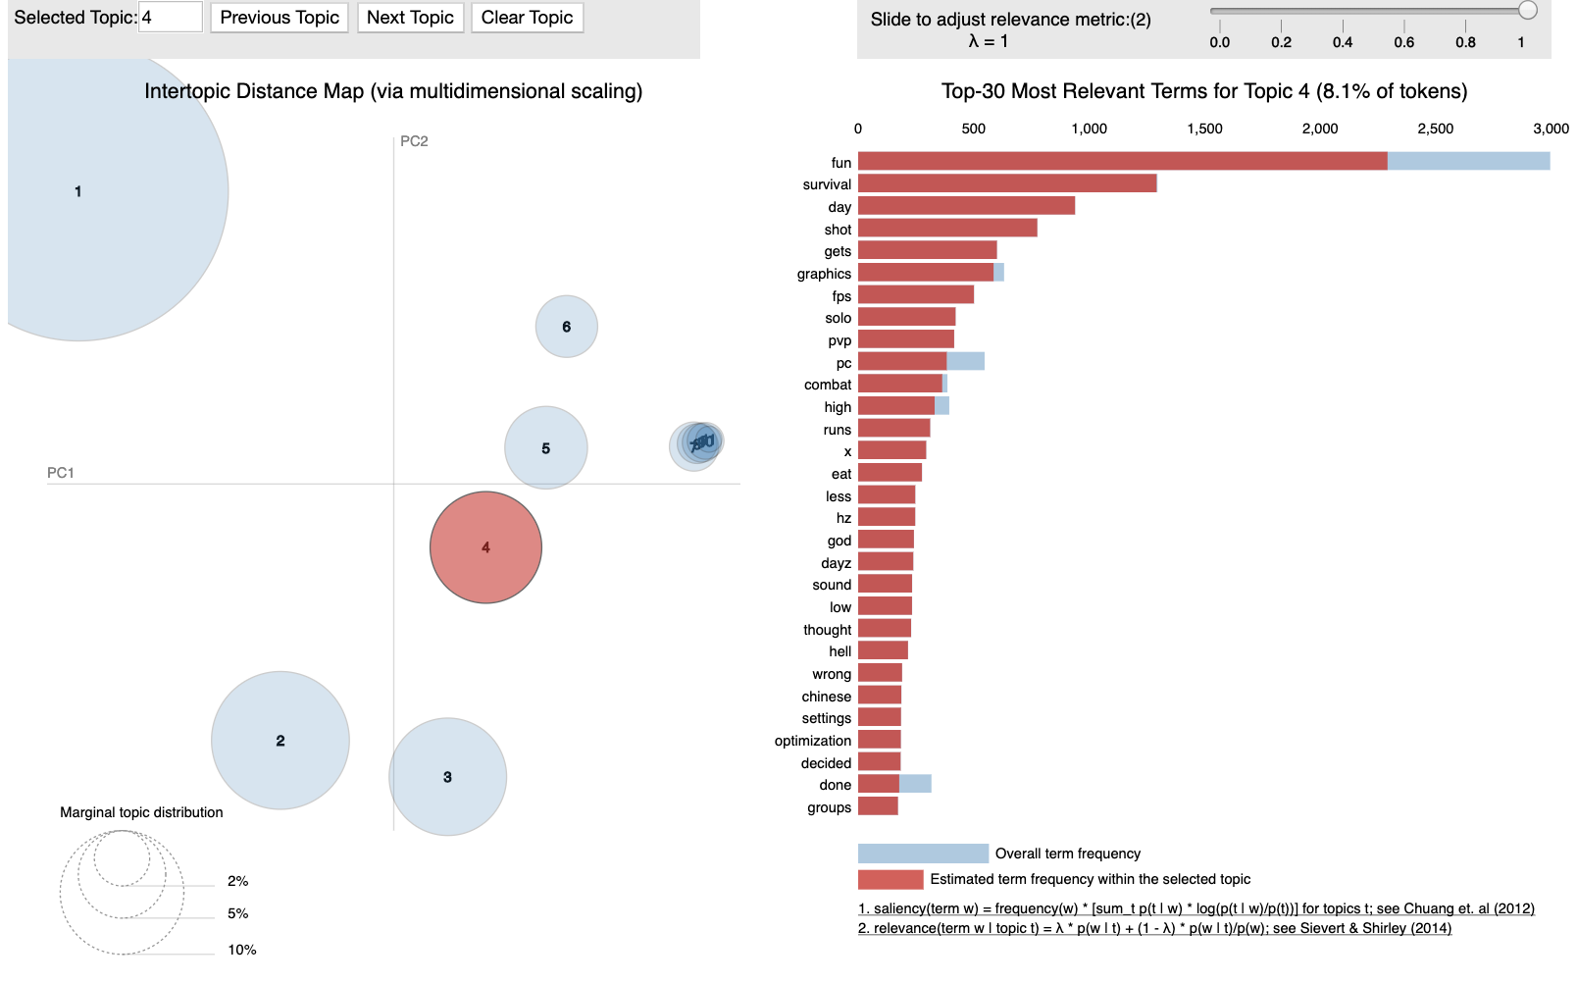
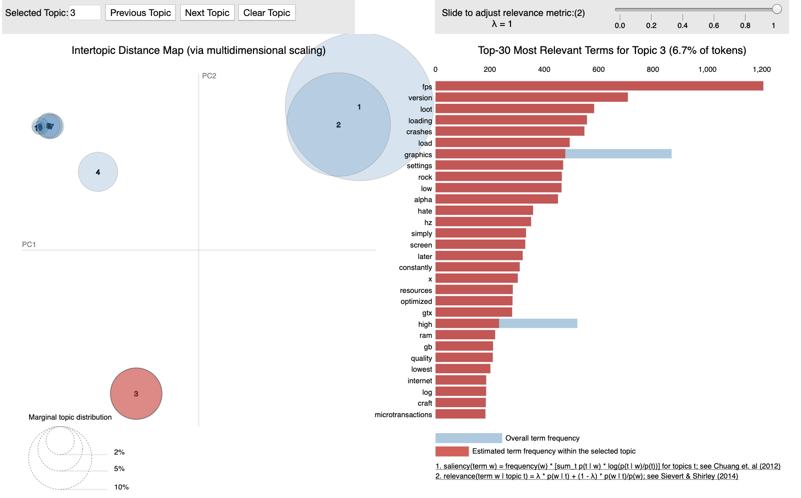
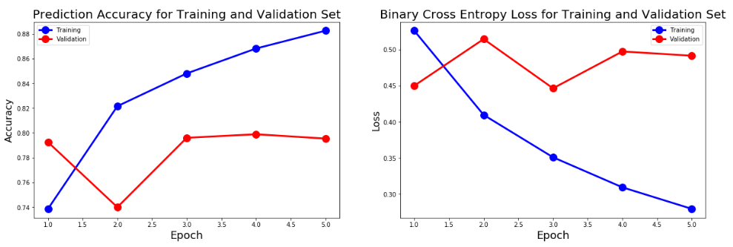
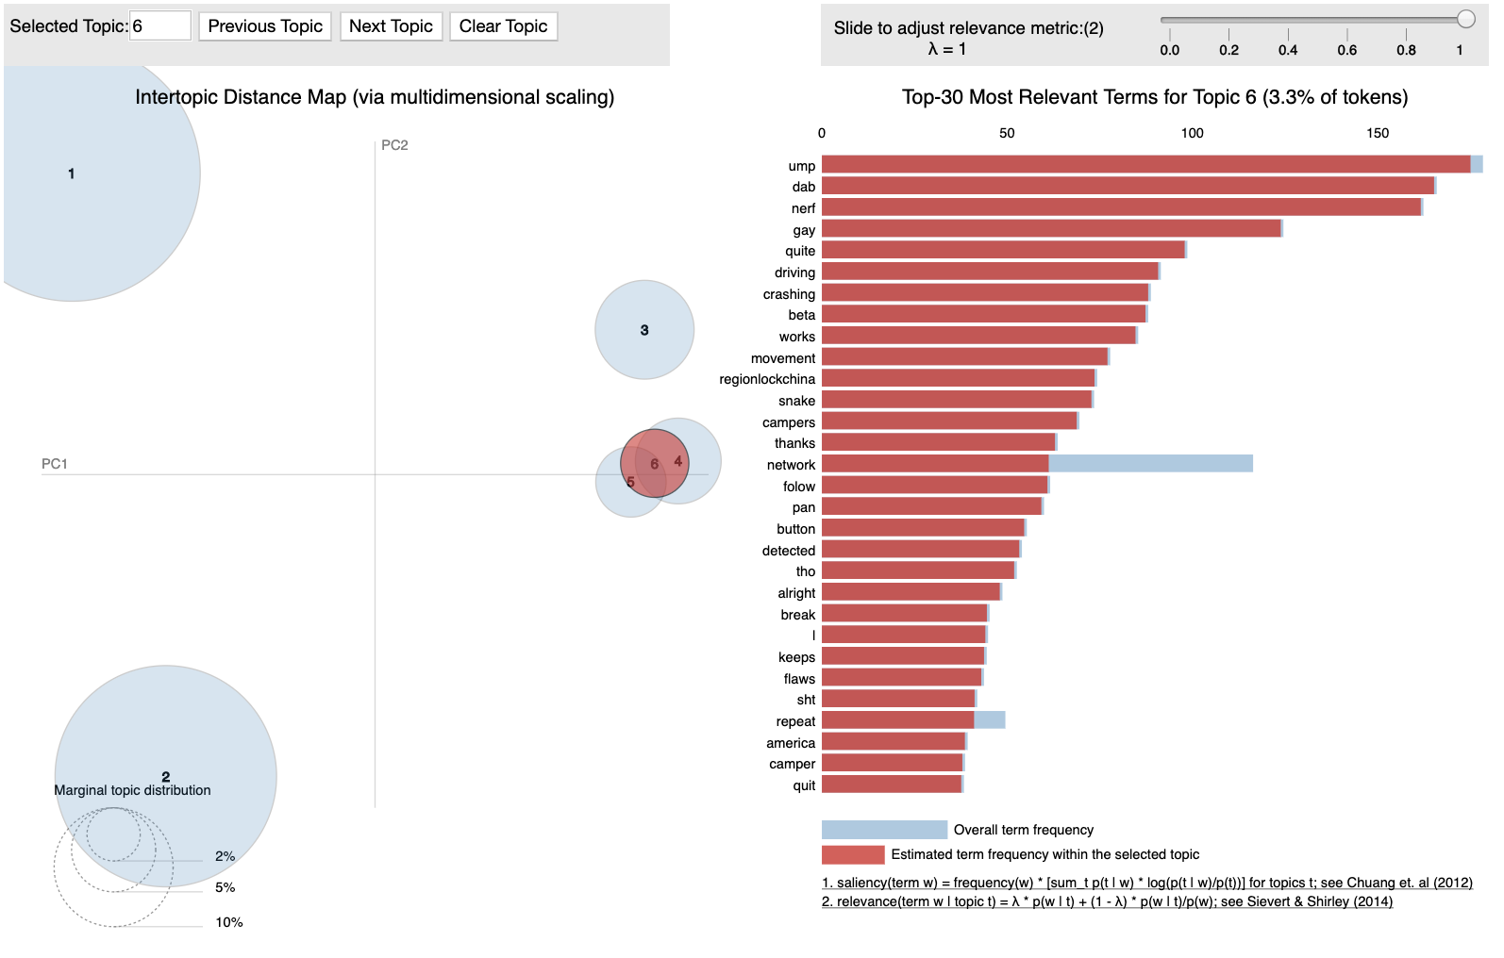
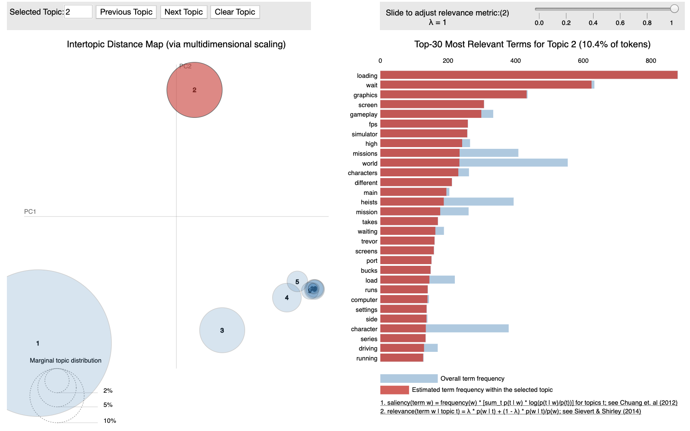
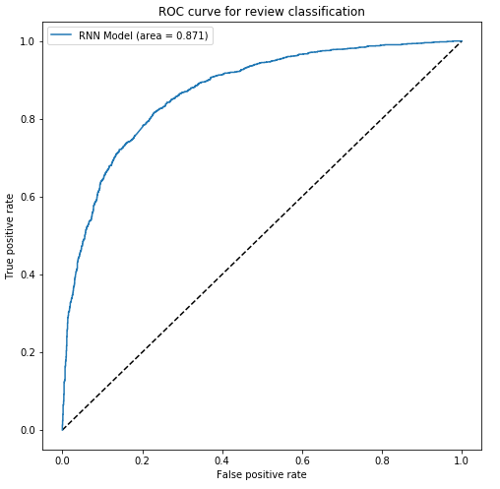
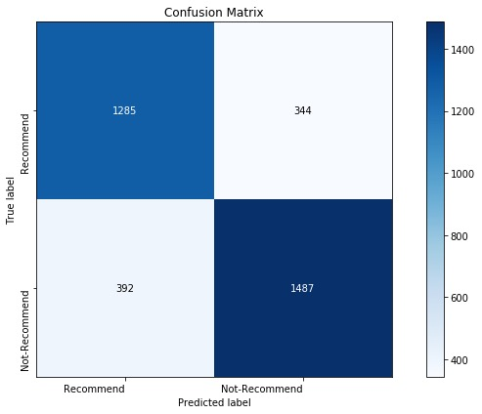
Steam Review Topic Modeling and Classification
Boyang Wei, Mengzhi Zhou, Lechuan Qiu
ANLY 580 Poster Symposium, Georgetown University, Washington, D.C.
Abstract
Results
Gaming industry is one of the very competitive but highly profitable worlds, all developers and publishers are seeking their ways to understand their gamers’ preference, complaints, and satisfaction.
Online gaming community is extremely valuable for developers to use these boards as an opportunity to study their audiences. But as the market grows, the volume of such reviews become huge to capture all the information.
Therefore, the goal of this project is to digest the content that gamers are commenting on platforms by using topic modeling and text classification.
Recommend Review
Not Recommend Review
Text Classification Result
Data
This data contains games review of Steam’s best selling games since February 2019, containing over 400,000 rows with 8 columns: how many people think this comment funny(funny), how many people think this comments helpful(helpful), early access review or not(early_access), recommendation, game review comments(review) and game title(title). In our project, we will mainly focus on column: game review and further data processing with columns: helpful/title/recommendation.
Link: ​https://www.kaggle.com/luthfim/steam-reviews-dataset
.
Fig 1.1 Keywords: Fun, Graphics, Sounds, Optimization, FPS, Combat, etc.
Fig 1.2 Keywords: Crashes Graphics, Loading, Screen, Internet, Optimized, etc.
Fig 2.1 shows there’s a clear overfitting after epoch 2 for the RNN model, as accuracy for validation set converges at around 0.79 and training set still increases. This might due to the fact that our training set is small compared to the RNN structure, which tends to be too flexible for detecting the patterns of recommend and not-recommend reviews.
PUBG Review
GTA V Review
Method
Topic Modeling
The goal of this part is using unsupervised learning method (LDA) to find topics in steam reviews for 4 different data subsets: recommended, not recommended, PlayerUnknown's Battlegrounds and GTA V. Optimal number of topics is measured by the coherence and perplexity score. Since unsupervised learning method only provide clusters of data. Human knowledge is needed to determine the real meaning of each topic by studying the topic key words.
Text Classification
This part focuses on using deep learning model Recurrent Neural Network (RNN) to classify the label of steam reviews (recommend v.s not-recommend). The results are evaluated based on training and validation loss/accuracy for each training epoch. ROC curve and confusion matrix are used for evaluating the overall classification accuracy of the RNN model.
RNN model is customized based on 30,000 most frequent word and projection of 100*1000 for embeddings layer, followed by 0.2 drop-out rate and LSTM layer, and finally connected to dense layer of 1 for binary classification.
Fig 1.3 Keywords: Crashing, Driving, Movement, Network, Flaws, Camper, etc.
Fig 1.4 Keywords: Loading, Graphics, Screen, Simulator, Mission, World, etc.
Fig 2.2/2.3 shows the AUC for classification is around 0.871 and confusion matrix shows the overall accuracy rate is around 0.7902, which is roughly the same as the validation accuracy at epoch 2. The model also is more robust to classify not-recommend reviews compared to recommend reviews.
Note: Cluster distance represents topic differences. Cluster size represents numbers of reviews. And bar chart indicates weights of each keyword in corresponding topics.
Conclusions
References
The topics generated by Topic Modeling ranges from overall games’ properties, specific games’ contents and general hot comments, which correspond to each subset of the review, provide game developers invaluable information on how to improve their games accordingly. The predictive model for game recommendation property could also help classify reviews that occasionally lack of clear labels. Through those NLP tasks, game developers could get better understanding of the gaming community and make timely adjustments accordingly.
José P. Zagal. and Noriko Tomuro., 2013. ​“Cultural Differences in Game Appreciation: A Study of Player Game Reviews”
Mahendra, L. (2019). Steam Reviews Dataset. [online] Kaggle.com. Available at: https://www.kaggle.com/luthfim/steam-reviews-dataset [Accessed 29 Oct. 2019].
“Topic Modeling in Python with Gensim.” Machine Learning Plus, 4 Dec. 2018, https://www.machinelearningplus.com/nlp/topic-modeling-gensim-python/.
“Recurrent Neural Networks (RNN) with Keras: TensorFlow Core.” TensorFlow, https://www.tensorflow.org/guide/keras/rnn.

