Slide 1
Crop yield prediction based on weather using machine learning
Project Guide –
Sri. P. Praveen Yadav
Assistant Professor
CSE Department
Group A5 –
B. Bhoomika 199X1A0508
K. Kishore Kumar Raju 199X1A0561
B. Priyanka 199X1A0507

Slide 2
LIST OF CONTENTS:
Abstract
Brief Introduction
Existing Model
Proposed Model
Implementation
Results Comparison
Conclusion

Slide 3
ABSTRACT:
India is an Agriculture based economy whose most of the GDP comes from farming. The motivation of this project comes from the increasing suicide rates in farmers which may be due to low harvest in crops. Climate and other environmental changes have become a major threat in the agriculture field.
Machine learning is an essential approach for achieving practical and effective solutions for this problem. In this project we aim at predicting yield of the crop from historical available data like weather, soil, rainfall parameters and historic crop yield. In this project, we will make a comparative study of various machine learning algorithms, i.e., K Nearest Neighbours, Random Forest, SVM and Linear Regression, Random Forest Algorithms and predict a best model for crop yield based on the accuracy.

Slide 4
INTRODUCTION:
India is ranked 2nd worldwide in farming. Agriculture and allied sectors like forestry and fisheries accounted for 18.8 percent of the GDP 2022, about 50 percent of the overall workforce . The monetary contribution of agriculture to India‘s GDP is regularly declining. The crop yield of plants relies on different factors like on climatic, geographical, organic, political and financial elements.
For farmers, it is difficult when there is more than one crop to grow especially when the market prices are unknown to them. In recent times, it has become inevitable to use technology to create awareness about cultivation. The seasonal climatic conditions are also being changed against the fundamental assets like soil, water and air which lead to insecurity of food. In a scenario, crop yield rate is falling short of meeting the demand consistently and there is a need for a smart system which can solve the problem of decreasing crop yield.

Slide 5
LITERATURE SURVEY:
1. Title : Predicting yield of the crop using machine learning algorithm
Authors : P.Priya, U.Muthaiah & M.Balamurugan
Publication : International journal of Engineering Sciences and Research Technology (IJESRT), April – 2018
This paper uses R programming with Machine Learning techniques. All the datasets used in the research were sourced from the openly accessible records of the Indian Government. The dataset contains parameters like rainfall, season, and temperature and crop production. The paper concludes that the Results show that we can attain an accurate crop yield prediction using the Random Forest algorithm. The author did a comparative study of decision trees and random forest algorithms. But other algorithms were not considered and the dataset includes very few attributes that would not give accurate predictions

Slide 6
LITERATURE SURVEY:
2. Title : Heuristic Prediction of Crop Yield using Machine Learning Technique
Authors : S. Pavani, Augusta Sophy Beulet P.
Publication : International Journal of Engineering and Advanced Technology (IJEAT), December-2019
In this paper, the data sets of different districts of the Telangana state are collected from Telangana State Development Planning Society. The important factors that determine the crop yield are temperature, humidity, soil moisture and rainfall. The machine learning technique KNN algorithm was used for prediction of crop yield. This paper does not include usage of fertilizers or pesticides as a parameter to the dataset.

Slide 7
EXISTING MODEL:
Other than blogging websites which provide information about the agriculture and agricultural accessories, there is no any particular model for predicting the yield of the crop depending on the historical data.

Slide 8
PROPOSED MODEL:
We have collected temperature, rainfall, crop yield and other datasets from various sources. In this project we have used machine learning algorithms like Decision tree, Random Forest algorithm, Linear Regression, Gradient Boosting to predict crop yield based on factors like temperature, rainfall, and pesticides. Our proposed model for predicting crop yield produces accurate results which will be more helpful for famers in choosing the crops that give best yield.

Slide 9
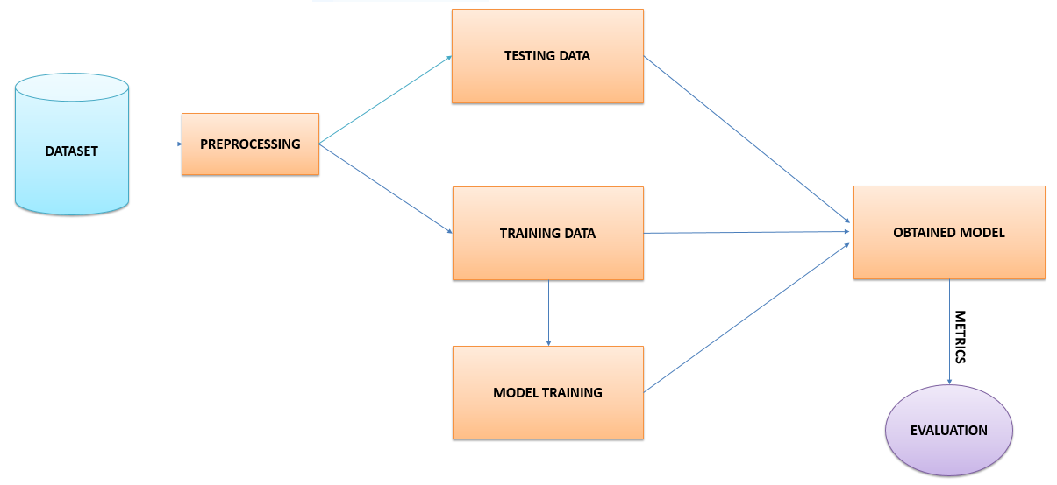
DESIGN AND IMPLEMENTATION:

Slide 10
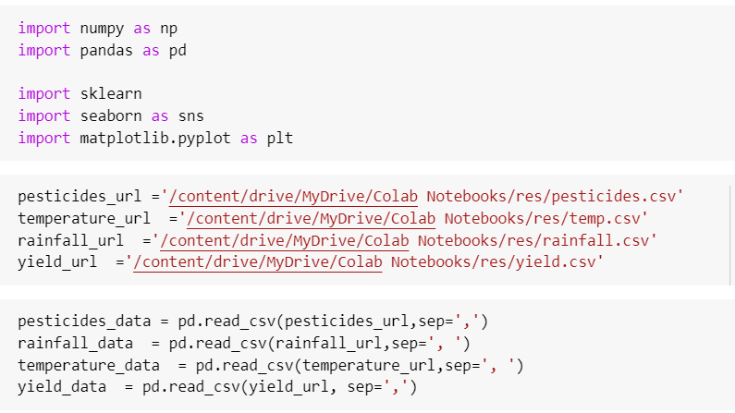
Datasets Loading:

Slide 11
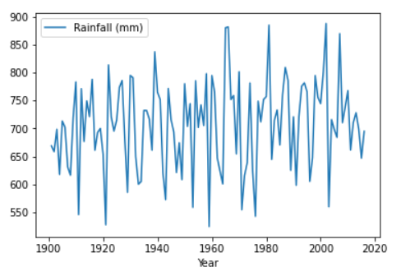
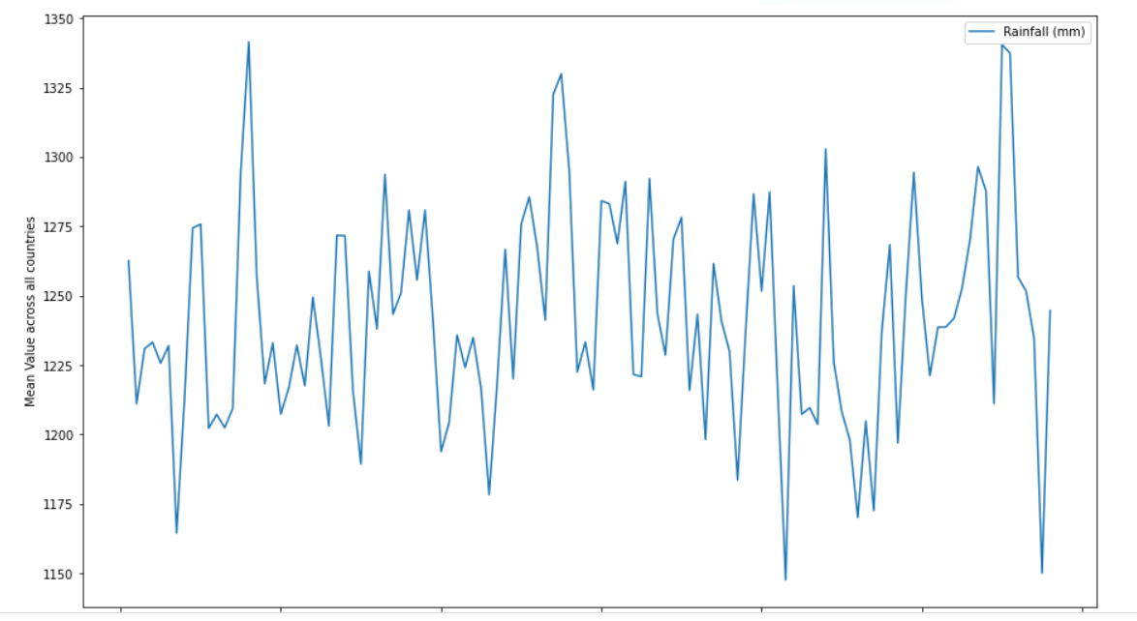
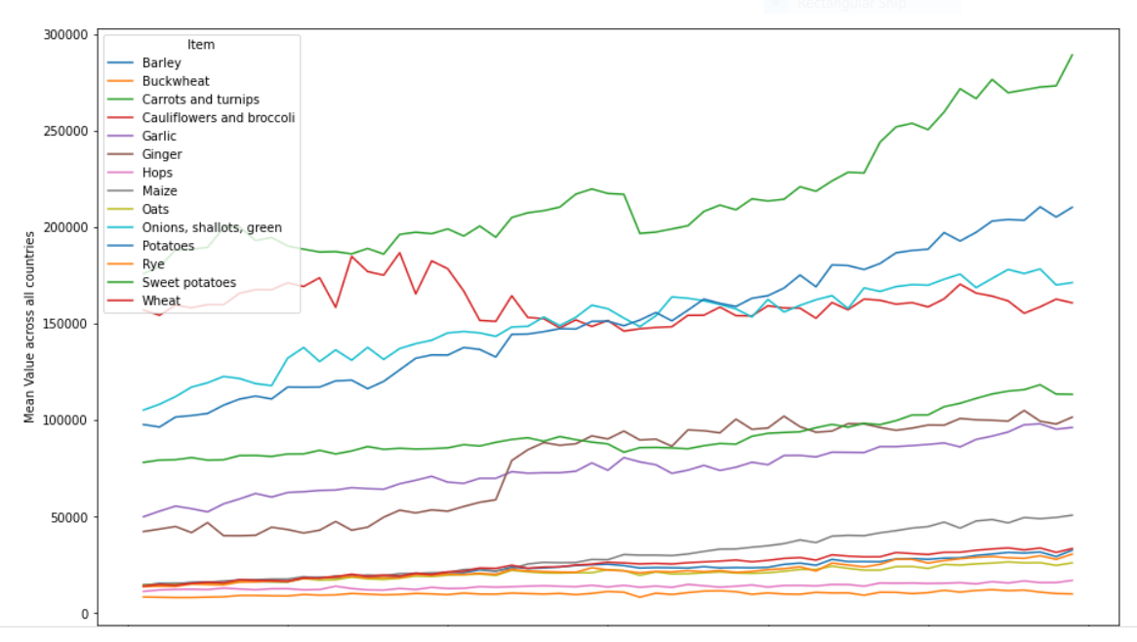
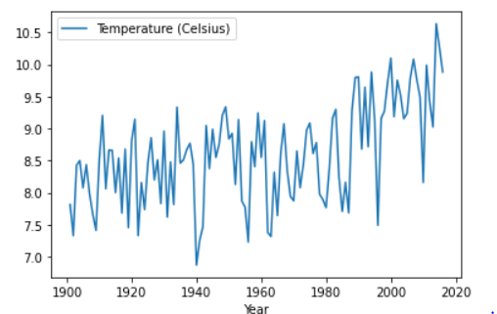
Data Visualization:

Slide 12
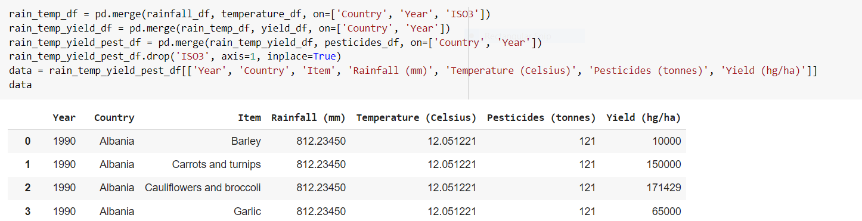
Data merging:

Slide 13
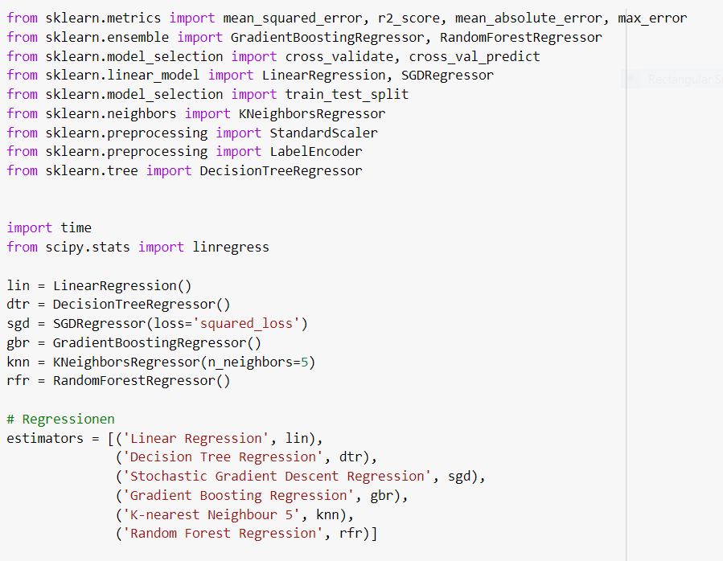
Modelling:

Slide 14
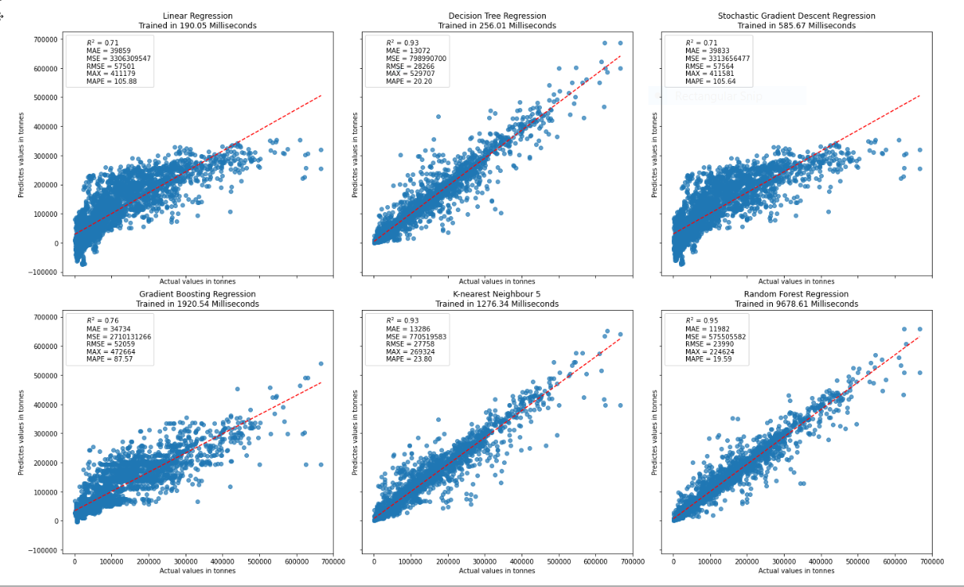
Modelling:

Slide 15
Results Comparison:
Models/ Metrics
R-SQUARE
MAE
MSE
RMSE
MAPE
Linear Regression | Decision Tree Regression | SGD Regression | Gradient boosting | KNN | Random Forest
0.71 | 0.93 | 0.71 | 0.76 | 0.93 | 0.95
39859 | 13072 | 39833 | 34734 | 13286 | 11982
33063 | 79899 | 33136 | 27101 | 77051 | 57550
57501 | 28266 | 57564 | 52059 | 27758 | 23990
105.88 | 20.20 | 105.64 | 87.57 | 23.80 | 19.59

Slide 16
Conclusion:
Proposed Model for Crop Yield Prediction is able to predict the yield for crops. Based on our analysis, Random Forest model produces more accurate results than the other models. Our system accuracy is more than the existing system. Since we are displaying the results in the form of graph with actual and predicted it is easy to compare the previous data. This model will help farmers to grow the crop which will give more yield so that it will be more profitable.

Slide 17
Thank you

