Slide 1
Information security
Boyd Franken & Jeroen Rietveld

Slide 2
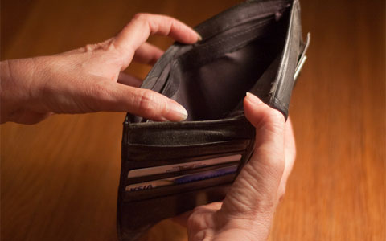
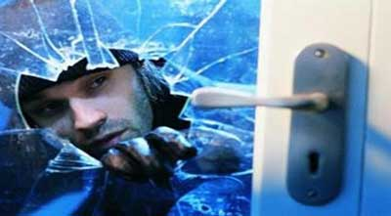
Bluetooth alerter
Bluetooth audio burglar

Slide 3

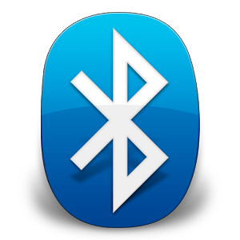


What technologies

Slide 4
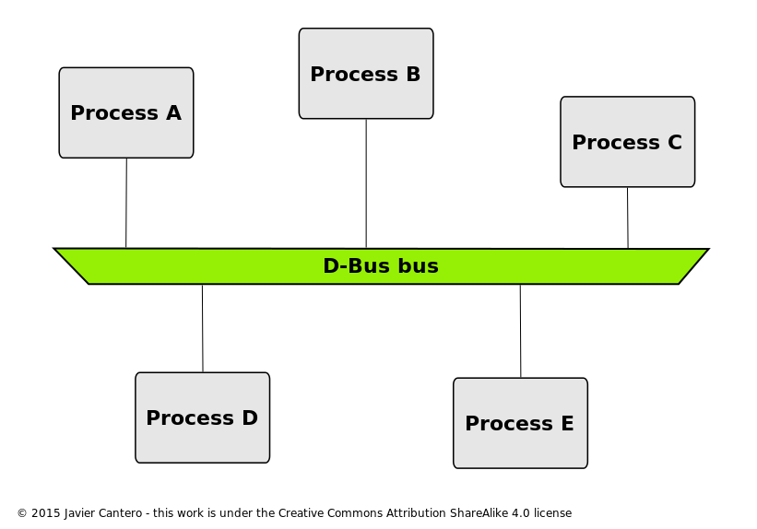

What software

Slide 5
Demo

