Slide 1
Discord Bots
In python

Slide 2
Installing and setup
*Install Python 3.6.4: https://www.python.org/downloads/release/python-364/
1. Download the Windows x86 MSI installer if you run windows
NOTE: Next step dependent on where you installed python at
2. Go to control panel, search for environment variables, click to edit them, click on environment variables. Should
show a list of user variables on top and system variables on bottom. On bottom under system variables
there is one called 'Path’, click on that and edit. Click new and type in 'C:\Python3'. Click new again and
make one called 'C:\Python3\Scripts’.
3. Search command prompt in windows and type in 'python -V' *must be a capital V. If it prints out 'Python 3.6.4' you
did it all correctly.
*Install Visual Studio Code. This is a code editor that is really useful to write python code
https://code.visualstudio.com/download
Create a folder somewhere to keep your python code
File->OpenFolder to that folder in VS Code
Create a new file ending in .py
Press 'control'+'p' to open a search
Type '>terminal' to open the terminal. Google this if it isn't clear
After you write your code, to execute, type 'python FILENAME.py' in the terminal. It should run!

Slide 3
Create the bot & discord Server
Search ‘discord developers’
Go to ‘My Apps’ and create a new app
Click to ‘Create a Bot User’
Go to discord and create a new server

Slide 4
Authorize bot
https://discordapp.com/oauth2/authorize?client_id=CLIENT_ID_GOES_HERE&scope=bot&permissions=0
Add to your new server
Now we have a bot in our new server- but there’s no code behind the bot yet…

Slide 5
Install api wrapper
Search for ‘bot discord.py’ ➔ https://github.com/Rapptz/discord.py

Slide 6
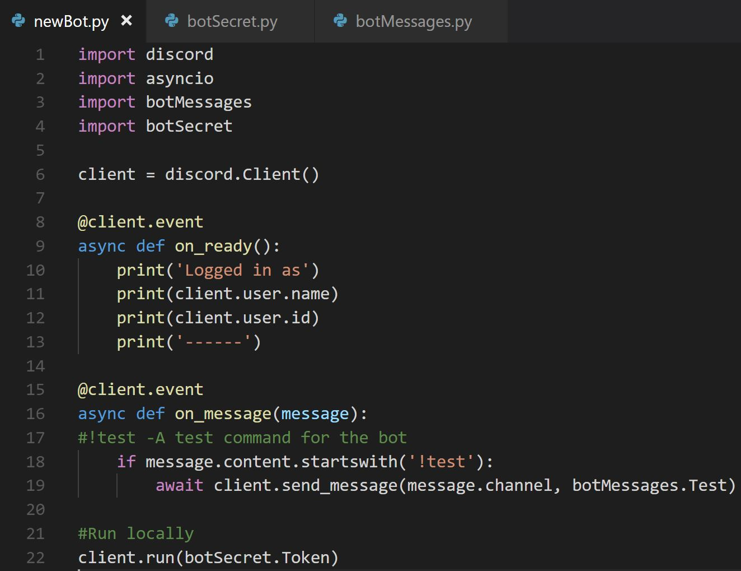
The bot

Slide 7
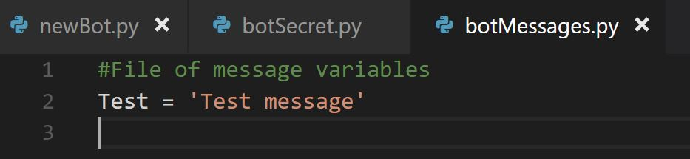
The messages

Slide 8
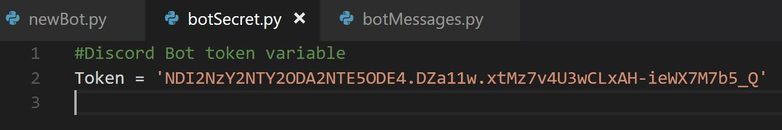
The secret
The reason we keep this in a separate file is so we can upload our code to GitHub and ignore this file. This way our token stays a secret to the world and our bot is not abused.

Slide 9
Demo!!

Slide 10
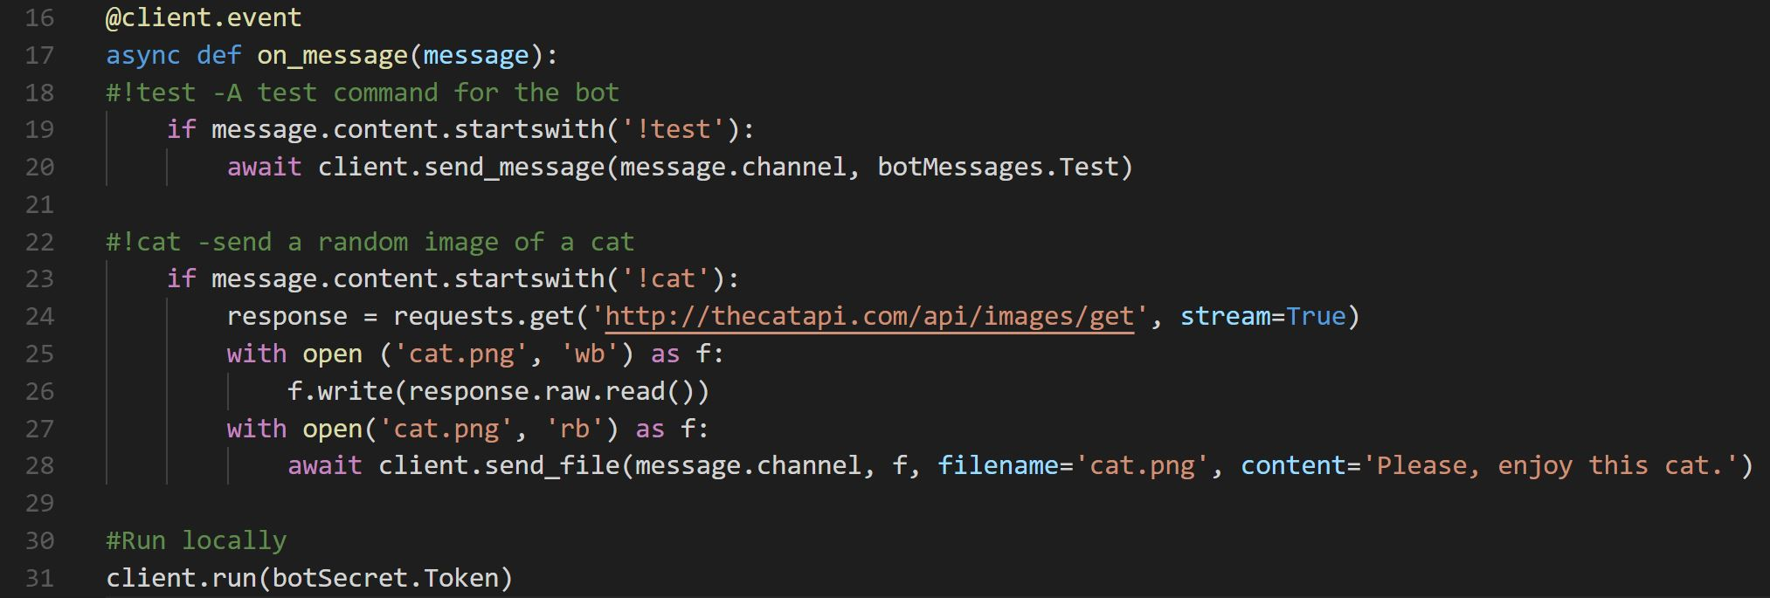
Cats cats cats
Will need to ‘pip install requests’ & import requests in script

Slide 11
Demo!!

Slide 12
Integrate with heroku
Goal is to create a Heroku application that will run the bot 24/7
The bot will not need to be run on our machine
It can be active anytime for the server to use
Need: Procfile, requirements.txt, Bot_Token in Heroku

Slide 13
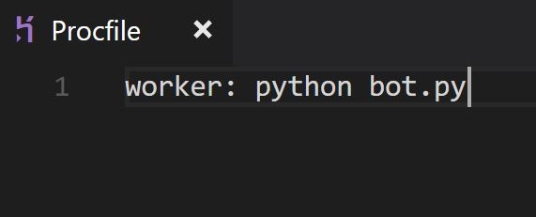
The procfile
Determines what is run by Heroku’s dynos
Different for different languages. For python it will look like:

Slide 14
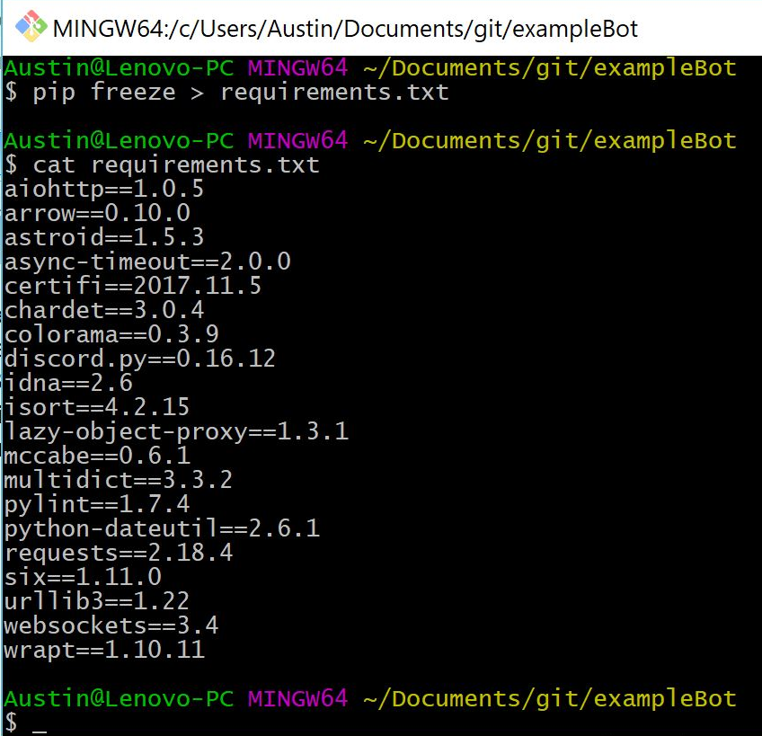
The requirements.txt
Heroku needs to know what you have installed and are importing in your files in order to run them for you.
Go to the folder and run ‘pip freeze > requirements.txt’

Slide 15
Create a Heroku app
Create a Heroku account
Create a new app
Deploy ➔ GitHub ➔ add the bot repository ➔ Connect
On the same page, enable automatic deploys

Slide 16
Set buildpack and manually deploy
In the Heroku app, go to settings ➔ add buildpack ➔ python
Go to deploy ➔ Manual Deploy ➔ Deploy Branch
After this, every time you push your master branch the Heroku app will automatically redeploy your app

Slide 17
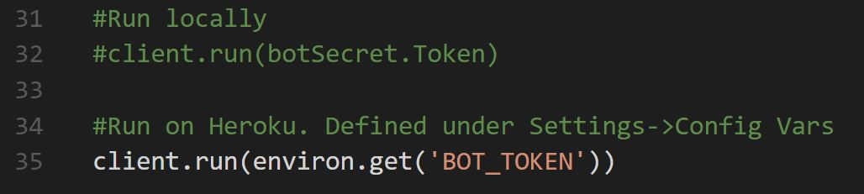
Run worker, edit bot, & demo!
In Heroku app, go to Resources ➔ turn on bot
In Heroku app, got to Settings ➔ add config variable
Add the token from the developers page as ‘BOT_TOKEN’
Change where the client runs from
Don’t forget to add all the needed imports!

Slide 18
All done!
We now have a bot that runs 24/7 on Heroku
It can respond to two types of user inputs
Now try expanding your own fun stuff!
Try to add embedded messages, limit the bot to only one channel in the server, or have the bot send out timed messages

