Slide 1


LIBRARY MANAGEMENT SYSTEM
Team Members:
BRANCH-ECE
SECTION-D
24KB1A04P4 -N.NIKHIL
24KB1A04T5 - P.SRAVAN
24KB1A04D8 - K.SIMHADRI
24KB1A04M7 - M.THULASI KRISHNA

Slide 2
INTRODUCTION
Library management is essential for maintaining book records and ensuring smooth book circulation. Manual systems are slow and prone to errors. A digital Library Management System brings speed, accuracy, and automation.

Slide 3
PREVIOUS LIBRARY SYSTEMS
Manual Entry :
Time-consuming
hard to track
error-prone
Excel-Based Systems:
Limited functionality
lacks automation
Barcode-Based Systems: Requires scanners and external software

Slide 4
Drawbacks of Previous Systems
- Prone to data loss
- Difficult to maintain
- No real-time updates
- Limited search capabilities
- Requires physical presence to manage

Slide 5
Objective
- Build a Library Management System
- Use only C language and Data Structures (Arrays, Linked Lists, Trees)
- Provide functionalities like book issue, return, and record maintenance

Slide 6
System Overview
- Add and store book and student records
- Search and manage books using efficient data structures
- Issue and return books with record updates
- Maintain due dates and fines (simulated)

Slide 7
Technologies and Tools
- Language: C
- Concepts Used: Arrays, Linked Lists, Trees
- Storage: File Handling to save data
- Simulated Data: Text-based book and student information

Slide 8
Working Flow
1. Add Books (Admin adds book records)
2. Register Students (Student info added to database)
3. Issue Books (Book linked to student)
4. Return Books (Update status)
5. View Reports (Issued books, available books, students)

Slide 9
Modules in Project
1. Book Structure Module
Defines the struct Book with fields: id, title, and author
2. Add Book Module
Stores the data in a binary file (library.dat).
3. Display Books Module
Displays them in a formatted table.
4. Search Book Module
Displays book details if found.
5. Delete Book Module
Deletes a book record by ID using a temporary file.
6. Main Menu Module
Provides a menu-driven interface.

Slide 10
Advantages of Our System
- Lightweight and efficient (C-based)
- Easy to maintain and modify
- Uses core data structures for performance
- Offline system, no internet dependency
- Can be extended with real-time features later

Slide 11
Challenges
- File handling complexity increases with data
- No GUI (text-based simulation only)
- Needs manual data entry
- Real-time integration (like SMS alerts) not included

Slide 12
SOURCE CODE
https://onlinegdb.com/Qb-LawJOuO

Slide 13
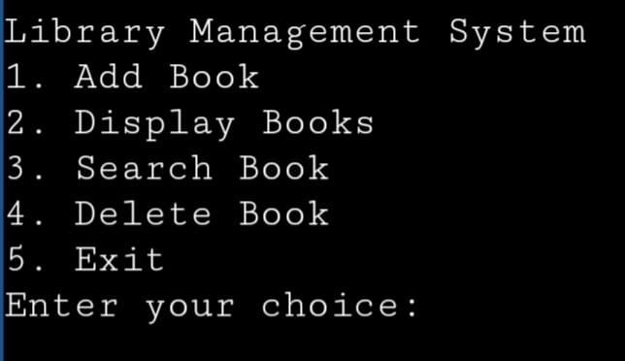
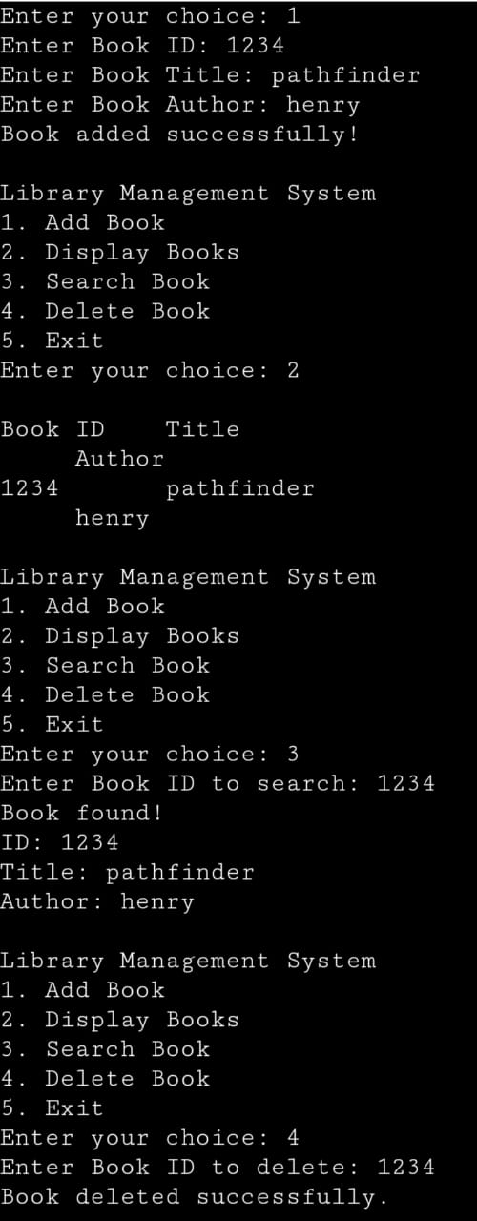
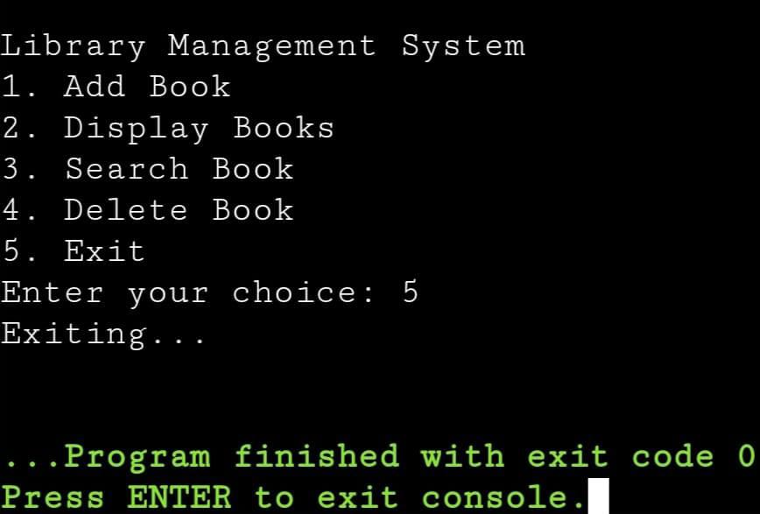
OUTPUT IMAGES

Slide 14
Conclusion
Using C and Data Structures, we have created an efficient Library Management System that reduces errors, increases speed, and simplifies management. This system lays the foundation for future digital library automation.

Slide 15


